Slide 1
RESTAURANT RECOMMENDATION

Slide 2
Contents
Business Problem
Data Description
Methodology
Result
Discussion
Conclusion
Appendix

Slide 3
Business Problem
How can a company should get the perfect location ?
This question can be answered and the target people may be a restaurant owner or a barber shop owner or any one.
Here, I am able to build a recommendation model based on K means clustering to my friend who wanted to start his own restaurant in New York city.

Slide 4
Data Description
The data set is collected from various sources like Kaggle and Wikipedia.
Total no of rows are 650 with 14 column attributes which help in build the model
Columns such as:
Address
Categories
Primary Categories
Latitude, Longitude
Name of Restaurants
Different type of ratings
Votes

Slide 5
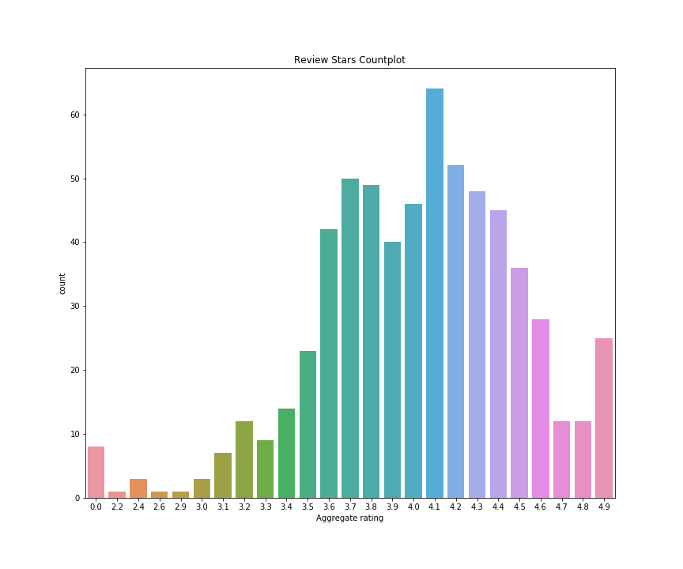
Data Methodology
Exploratory Data Analysis

Slide 6
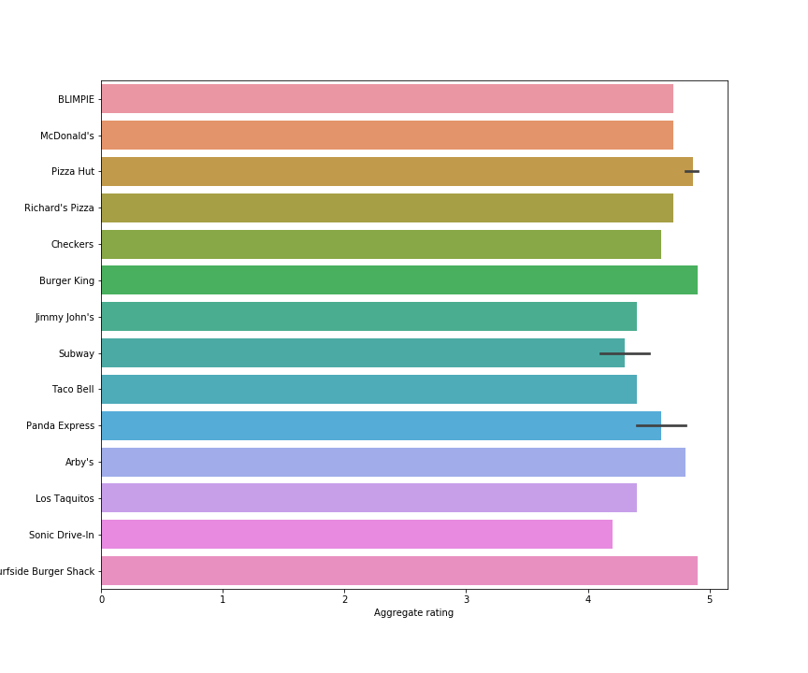

Slide 7
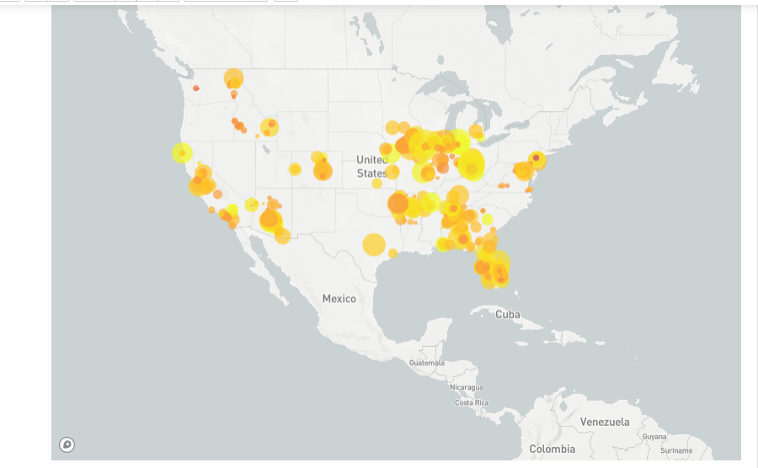

Slide 8
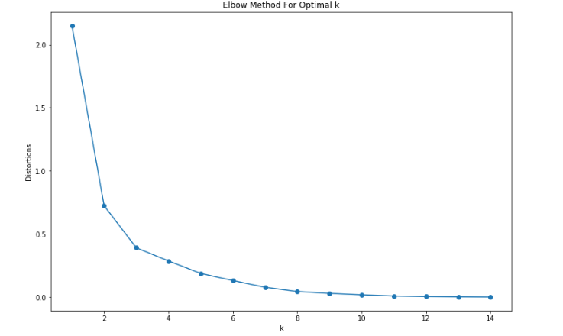
Results
Finding optimal K

Slide 9
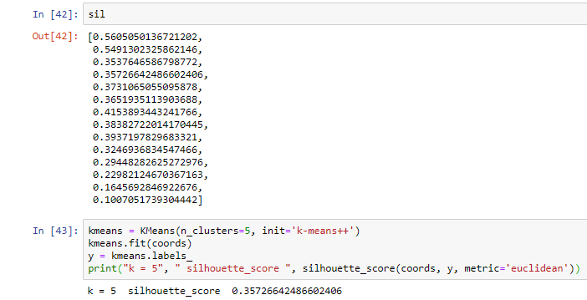
Cont..
Sil Score

Slide 10
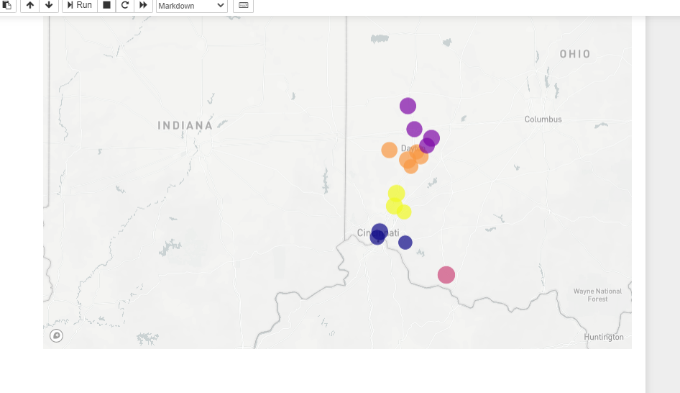
Divide the Las Vegas restaurants in 5 clusters and found that somewhere between Cincinnati and Dayton will be the perfect place

Slide 11
Discussion
I found the location between Cincinnati and Dayton will be a perfect place. We can also do recommendation based on the food preferred by the people who visits those restaurants frequently so that we can launch our own restaurants with those food items

Slide 12
Conclusion
With the of the map we can easily found the perfect location for new restaurants. we can recommend the top-n list for each user along with the restaurant information. To avoid recommending a restaurant that is too far away from the user, we can use a search radius to pre-select all the places that are within this range. These should all be straightforward, so I will just stop here.

Slide 13
Appendix
Wikipedia
Foursquare
Google

