Slide 1

AquaYield: Predicting Crop Irrigation Needs Using Machine Learning
SRN : PES1PG25CA033
Name: Avirup Shyam
Project Domain: Agriculture
Goal: Zero Hunger

Slide 2

AIML
Abstract
Inefficient irrigation wastes water and degrades soil, threatening global food security.
Project addresses SDG 2 (Zero Hunger) using ML.
Dataset: 2,200 records, 7 features — N, P, K, temperature, humidity, pH, rainfall.
Irrigation label engineered using thresholds: low rainfall, high temperature, low humidity = needs irrigation.
Three models trained: Logistic Regression (92.50%),
Random Forest selected as best model — rainfall and humidity are top predictive features.
Model saved and deployed via Streamlit UI with real-time prediction using input sliders.
Helps farmers reduce water waste and protect soil — supports sustainable agriculture.

Slide 3
AIML
Dataset
SourceURL: https://www.kaggle.com/datasets/madhuraatmarambhagat/crop-recommendation-dataset
Dataset Name: Crop Recommendation Dataset
Size / Shape: 2200 rows × 8 columns
Simple description about the dataset: The Crop Recommendation Dataset contains soil nutrient and weather condition data for 22 different crop types. Each record includes Nitrogen (N), Phosphorus (P), Potassium (K), temperature, humidity, soil pH, and rainfall values, along with a crop label. The dataset is fully clean with no missing values and 100 samples per crop type, making it well-balanced for classification tasks.

Slide 4
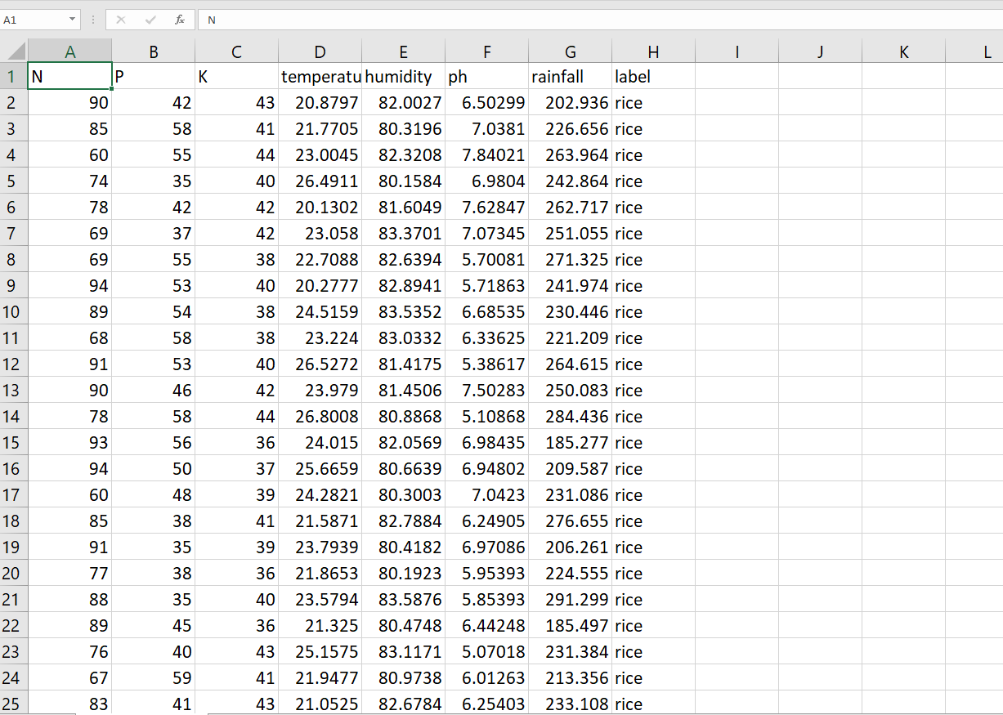
AIML
Dataset Snapshot

Slide 5
AIML
Methodology
Supervised Learning
What are you trying to do: Prediction - predicting whether a crop needs irrigation (1) or not (0)
What is your choice of Algorithms (tentative) : Logistic Regression
UI Tool (tentative): Streamlit
Cloud Platform (tentative): Not Applicable yet (Local Deployment)

Slide 6
THANK YOU

