Slide 1
Machine Fault Diagnosis Agent
CAPSTONE PROJECT
Presented By:
Avirup Biswas(Narula Institute of Technology – CSE department)

Slide 2
OUTLINE
Problem Statement
Proposed System/Solution
System Development Approach (Technology Used)
Result (Output Image)
Conclusion
Future Scope
References

Slide 3
Problem Statement
An AI agent helps detect faults in machines like lathes, mills, or pumps based on vibrations, temperature, or unusual noises. It can answer: "Why is my CNC machine vibrating too much?" or "What could cause overheating in a hydraulic pump?". It suggests basic maintenance actions and safety precautions.

Slide 4
Proposed Solution
The proposed AI agent helps detect faults in machines like lathes, mills, or pumps based on vibrations, temperature, or unusual noises. This system use agentic ai approach to give answers to our prompts. The solution will consist of the following components:
Data Collection:
Sensors on the machinery (like lathes, mills, or pumps) collect real-time data on key indicators such as vibration, temperature, and noise.
Gave a initial prompt or direction to our agentic ai to identify the desired prompt.
Artificial Intelligence Model:
Used IBM’s “Granite-3-3-8b-instruct” model. An AI model to detect patterns and anomalies that are early signs of a potential fault.
Deployment:
Deployed on IBM cloud, can use the public and private endpoint and preview to use the model.
Evaluation:
This project addresses a critical need in industrial maintenance by enabling early fault detection in machinery using AI. Leveraging IBM Granite AI for natural language understanding makes the system user-friendly, while integration with sensor data ensures real-time diagnosis. The use of IBM Cloud Lite ensures scalability and accessibility.

Slide 5
System Approach
The proposed system follows a layered architecture that integrates sensor-based monitoring, intelligent fault analysis, and natural language interaction. It combines real-time machine data with AI-driven reasoning to diagnose faults and provide actionable maintenance suggestions. The entire system is deployed on IBM Cloud Lite using the IBM Granite AI model for seamless, scalable, and intelligent operations.
System requirements:
Used DELL Inspiron with 16GB RAM with 250GB SSD and 1TB HDD.
Used windows 10 Operating System and Microsoft Edge browser.
Library required to build the model:
Used IBM lite services.
Used IBM granite-3-3-8b-instruct model for AI services and watsonx ai runtime.
Used IBM storage services for storage purpose

Slide 6
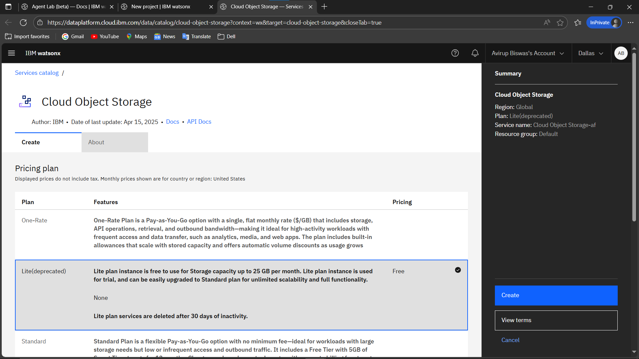
Result

Slide 7
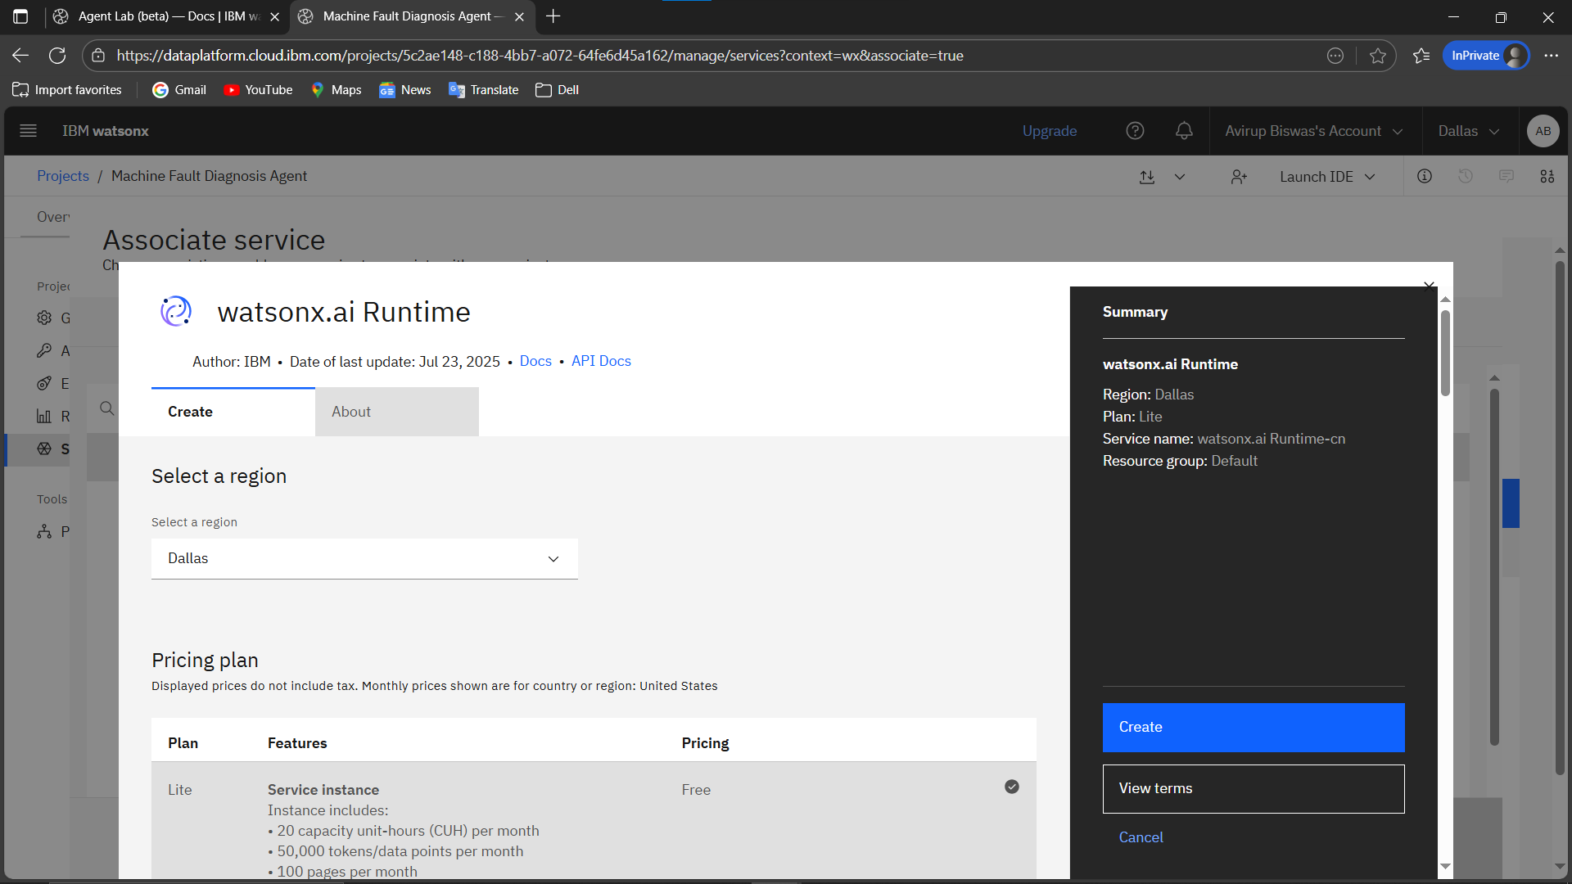
Result

Slide 8
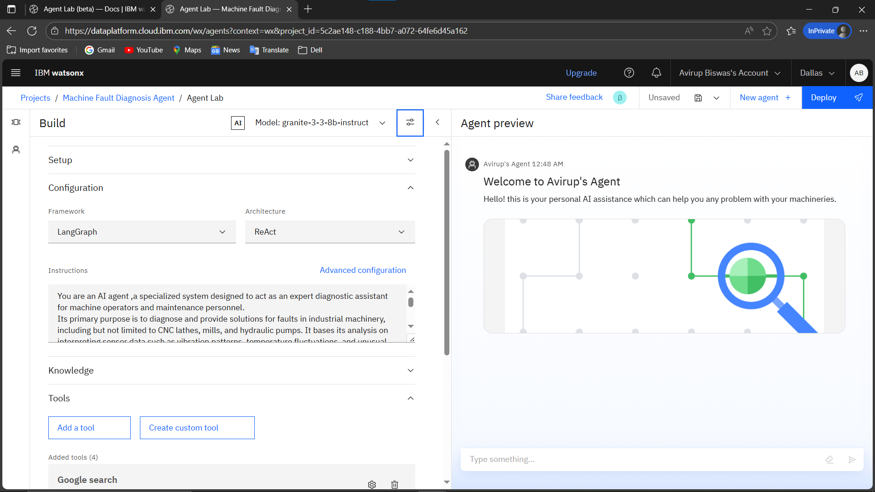
Result

Slide 9
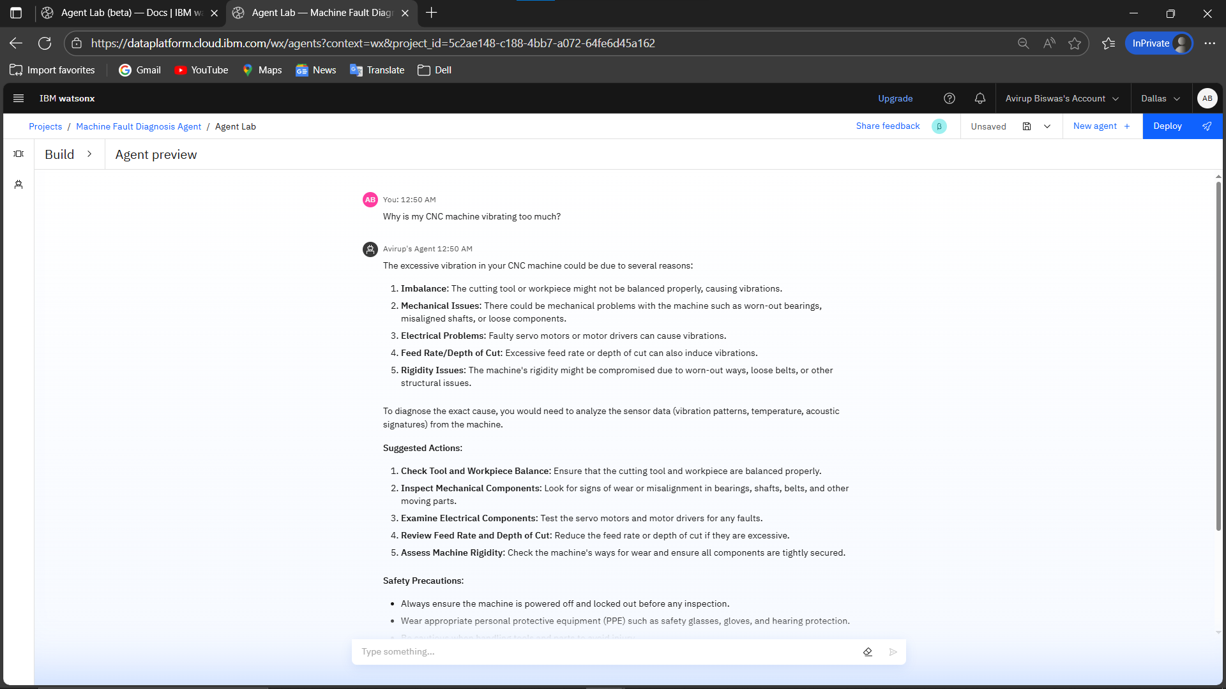
Result

Slide 10
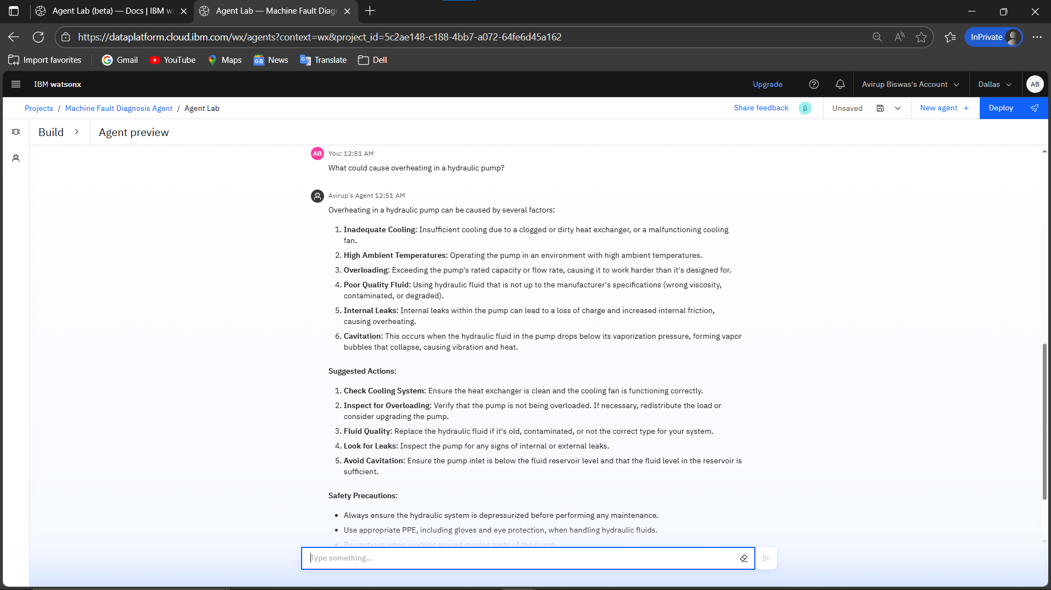
Result

Slide 11
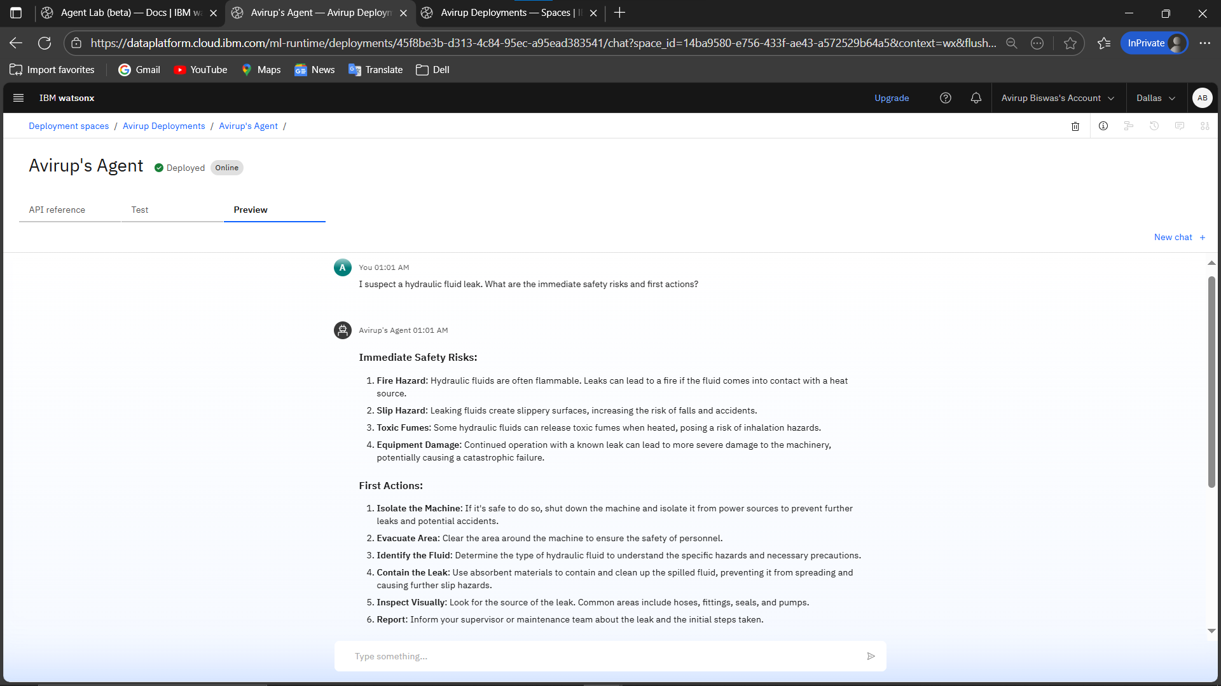
Result

Slide 12
Conclusion
The Machine Fault Diagnosis Agent successfully demonstrates how AI can enhance industrial maintenance by detecting faults in machinery based on real-time sensor data. By integrating the IBM Granite AI model with IBM Cloud Lite services, the system provides intelligent, user-friendly diagnostics through natural language interaction. This not only reduces machine downtime and maintenance costs but also improves operational safety and efficiency. The project highlights the practical potential of combining mechanical engineering knowledge with modern AI technologies.

Slide 13
Future scope
In the future, the Machine Fault Diagnosis Agent can be enhanced by integrating predictive maintenance capabilities using historical data and machine learning, enabling it to forecast issues before they occur. The system can be expanded to support a wider variety of industrial machines and offer a mobile application for on-site access. Features like automated fault reporting, multilingual support, and self-learning from past diagnostics can further improve its usability, efficiency, and adaptability in diverse industrial environments.

Slide 14
References
In this project, IBM's Granite-3-3-8B-Instruct AI model was used to enable intelligent natural language understanding and reasoning for machine fault diagnosis. IBM Cloud services provided the deployment infrastructure, while watsonx.ai facilitated seamless integration of the large language model. The IBM SkillsBuild platform supported learning and practical application of these technologies. All development, testing, and cloud access were carried out using the Microsoft Edge browser.

Slide 15
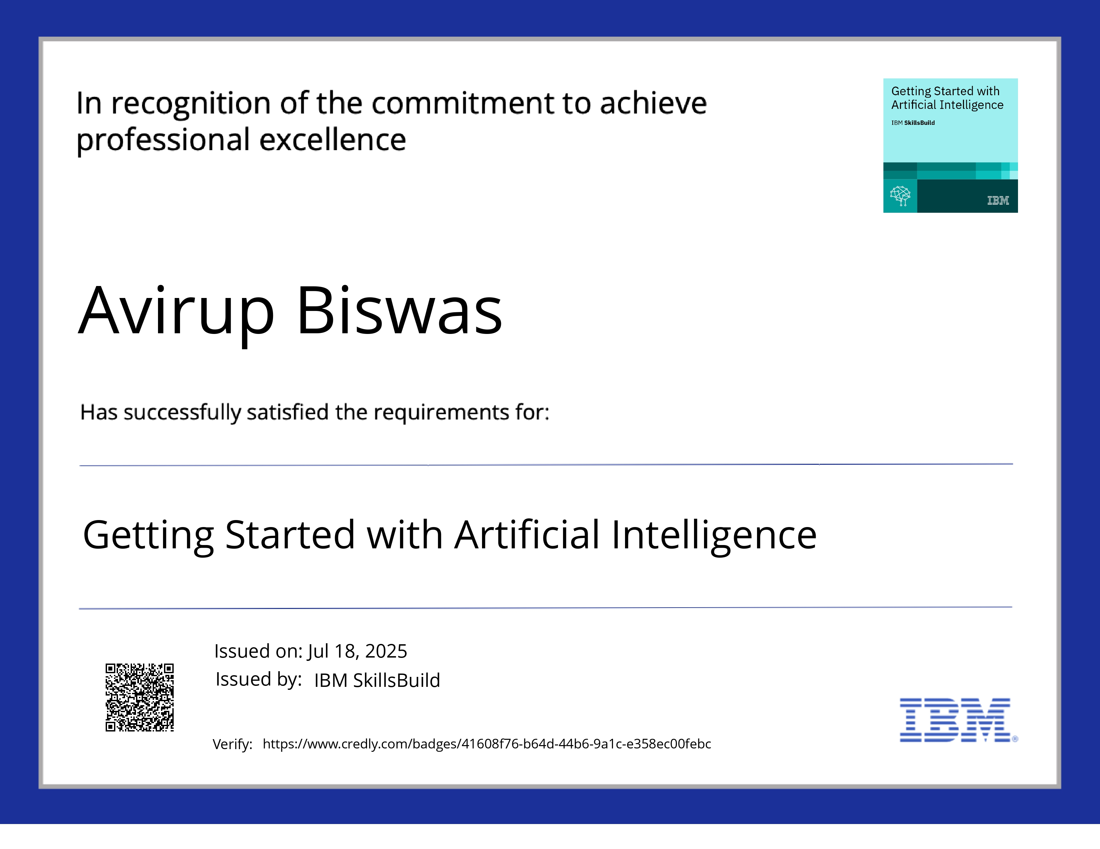
IBM Certifications
Getting started with AI:-

Slide 16
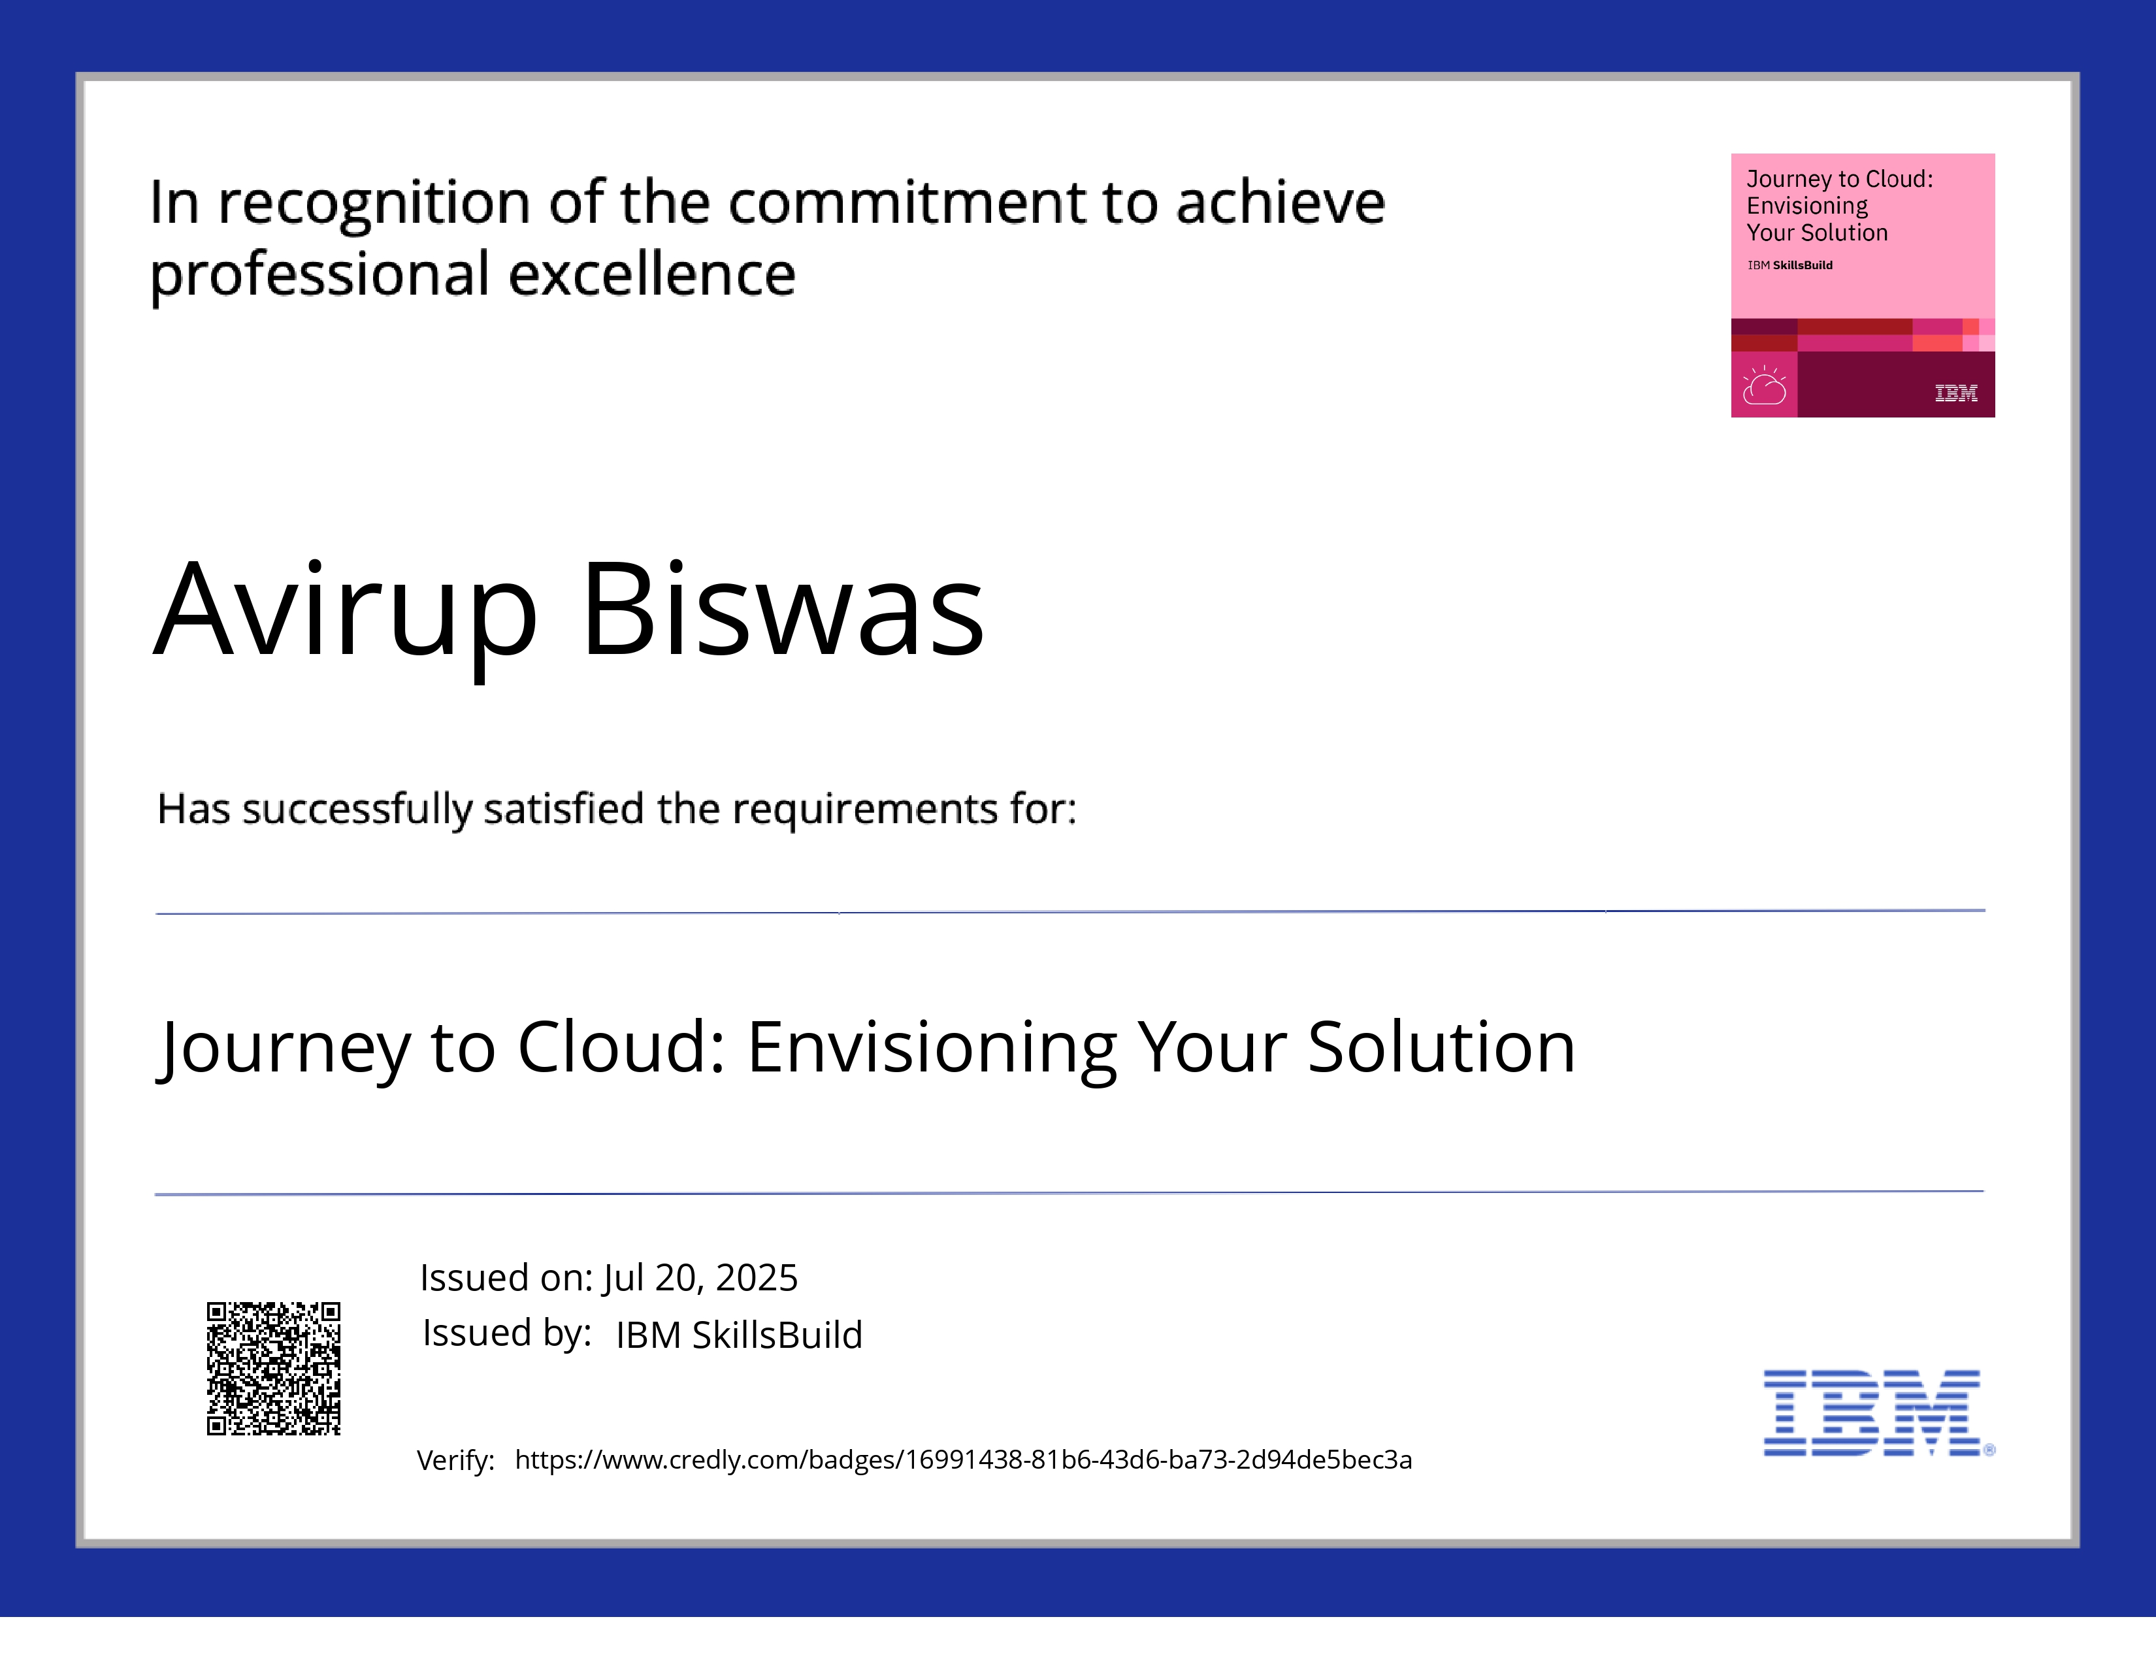
IBM Certifications
Journey to Cloud: Envisioning your Solution:-

Slide 17
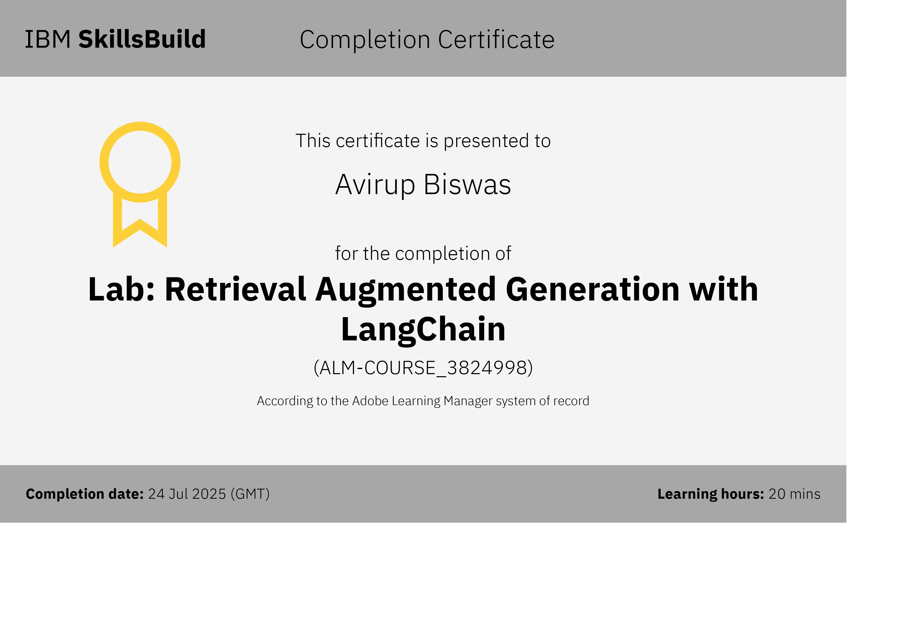
IBM Certifications
Lab: Retrieval Augmented Generation with Lang chain:-

Slide 18
THANK YOU

