Slide 1
Google Play Store App Analysis
Presented by: Avirup Saha
Praxis Business School
Fordham University Spring 2018

Slide 2
Overview
About Lending club & Business Problem
Data Description
Explanatory Data Analysis
Data Preparation & Processing
Models (Using MLlib)
Linear Regression
Decision Tree Regression
Gradient Boost Regression
Summary of results
Usefulness of model
Future work
Notes:
This is the general overview of what we are planning to present today.
First we will give an overview of Lending club and what is the business problem we are trying to solve.
Then we will discuss about the data explanatory analysis that we performed on the data set.
Following this we will briefly discuss the about the data set, how we prepare and set up the data for our machine learning model.
After that we will take a closer look at the machine learning process and how we use the spark MLlib to implement the machine learning algorithms.
And then summary and conclusion

Slide 3
Overview of Business Problem
Primary objective is to explore the dataset and find out various statistical insights in the Android Market. The dataset is collected from Kaggle.com containing around 10,000 records of different Play Store Apps.
.

Slide 4
Data Description
Google Play, also branded as the Google Play Store and formerly Android Market, is a digital distribution service operated and developed by Google. It serves as the official app store for certified devices running on the Android operating system and its derivatives as well as Chrome OS, allowing users to browse and download applications developed with the Android software development kit (SDK) and published through Google. Google Play also serves as a digital media store, offering music, books, movies, and television programs. Applications are available through Google Play either free of charge or at a cost. They can be downloaded directly on an Android device through the proprietary Play Store mobile app or by deploying the application to a device from the Google Play website. Google Play was launched on March 6, 2012, bringing together Android Market, and the Google under one brand, marking a shift in Google's digital distribution strategy. The services included in Google Play are Play Books, Play Games and Google TV. The Google Play store had over 82 billion app downloads in 2019 and reached over 3.5 million apps published in 2020.

Slide 5
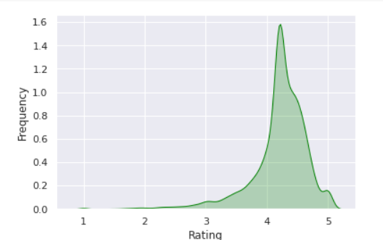
Data Explanatory Analysis
Distribution Plot of loan amount
Distribution Plot of Interest Rate

Slide 6
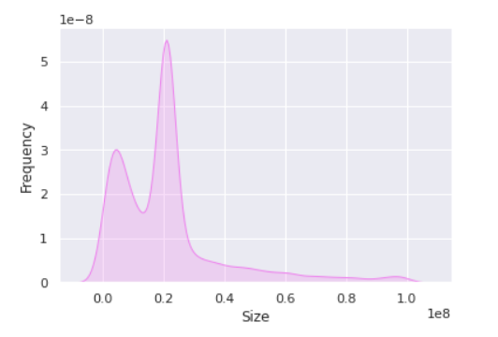
Data Explanatory Analysis
Number of loans over the time
Median interest rate over the time

Slide 7
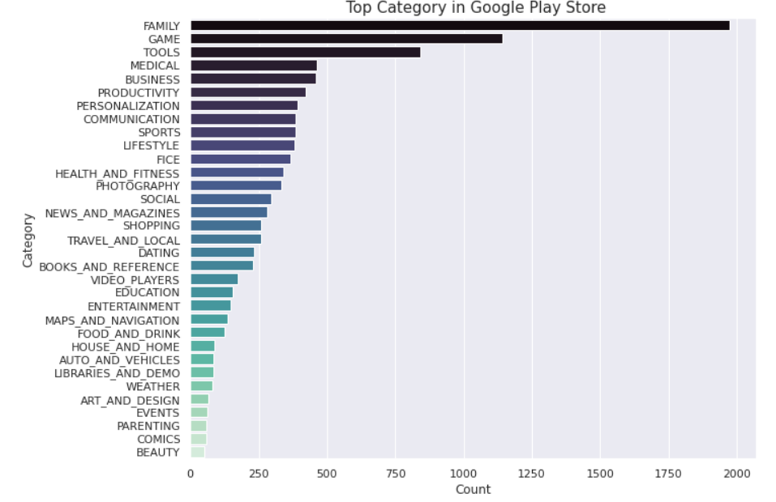
Data Explanatory Analysis
Analyzing Loan amounts over loan status
Figure: Violin plot for loan status

Slide 8
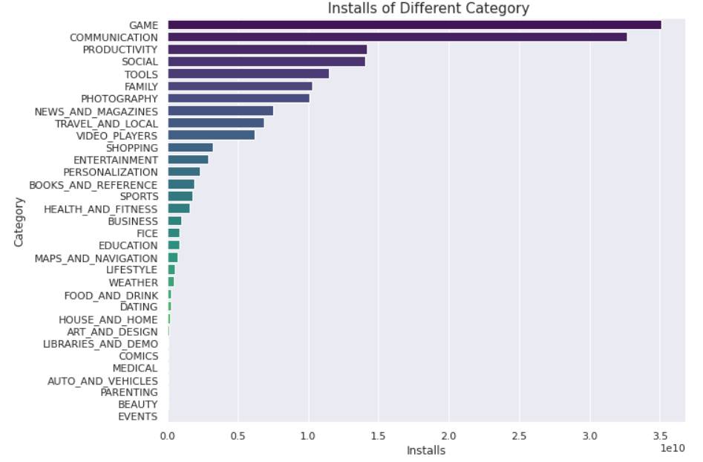
Data Explanatory Analysis
Analyzing loan amount distribution for each grade, factored over sub grade.
Figure 1: Analysis of loan amount for Grade A
Figure 2: Analysis of loan amount for Grade G

Slide 9
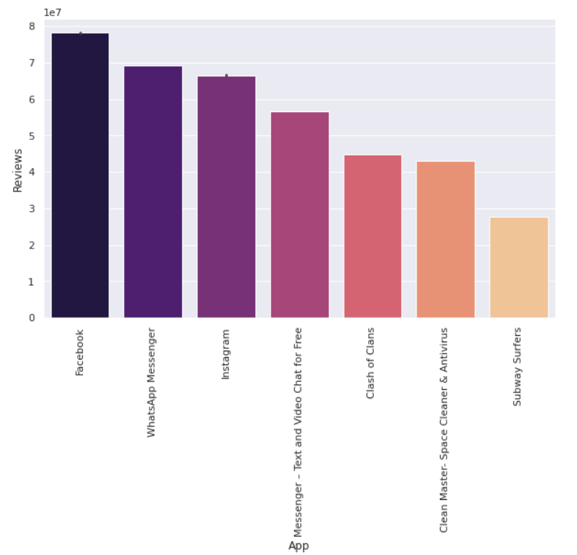
Data Explanatory Analysis
Figure 1: Analysis of interest rate for Grade A
Figure 2: Analysis of interest rate for Grade G

Slide 10
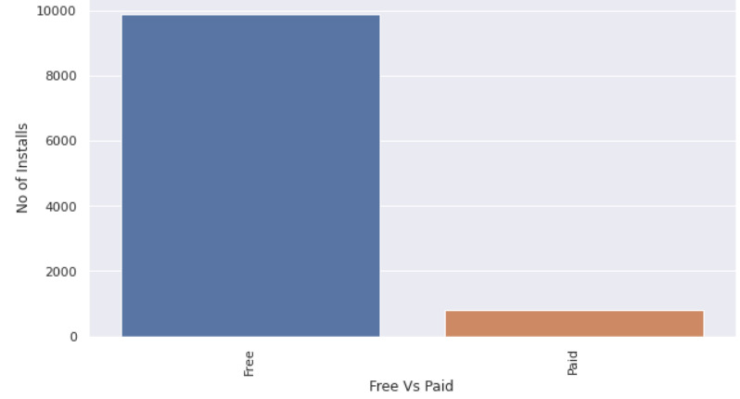
Data Explanatory Analysis
Figure 1: Analysis of interest rate for Grade A
Figure 2: Analysis of interest rate for Grade G

Slide 11
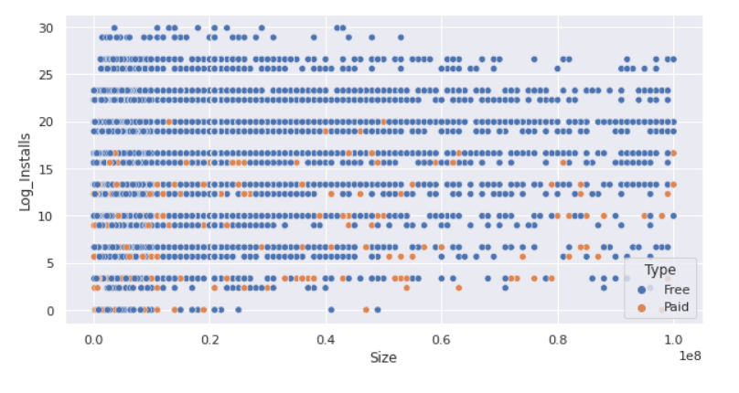
Data Explanatory Analysis
Figure 1: Analysis of interest rate for Grade A
Figure 2: Analysis of interest rate for Grade G

Slide 12
Data Preparation & Processing
We have changed data types for numerical columns
We have have imputed null values for Rating and Installs with average value
We have implemmeted Log Transformation
Notes:
Though the data was good quality, we found out that we have to perform some cleanup activity.
First we removed the records which have more than 50% of missing values.
Then for better interpretation of results we convert some continuous variables into ranges.
We use StringIndexerAPI to convert the ordinal features such as borrowers experience level and VectorAssemblerAPI to convert the rest nominal features. Following which, we binary encoded the variables with binary values.
For our classification model we

Slide 13
Machine Learning Regression
We developed five Regression models to determine and compared their predictive capabilities. We utilized multiple assessment metrices (given below) to determine the most successful model with respect to RMSE score

Slide 14
LinearRegression
Linear regression is a popular method to predict a continuous response.
The main intention behind using this learning algorithm is to handle
the class imbalance. Linear regression is one of the implementation
of linear models, for which spark provides ability to handle the class
imbalance by adding a class weights.

Slide 15
Decession Trees
To extend scope of our model building, we wanted to include a generative machine learning model in our trails.
The intention behind using this regression was to handle the class
imbalance issue by adding the default prior belief (beta distribution
function) and calculate the max posterior probability.
Notes:
Note: - As we notice from the results, this algorithm is not performing well as compared to others. We tried to drill down the root cause for the issue, but the spark provides very abstract level API for the algorithm implementation and doesn’t provide much control on its implementation. As a side work, we try implementing this same model in R and Python, where we first calculated the Maximum Likelihood Estimator based on the distribution of each feature and used combinations of Alpha & Beta values (For beta distribution) for prior. We then calculated the max posterior probability to each observations and achieved 92.6% precision.

Slide 16
Gradient Boosting regression
In contrary to random forest, which tried to minimize the error by reducing the variance, we tested the opposite way by reducing the bias.
Boosting reduces error mainly by reducing bias and also to some extent
variance, by aggregating the output from many models.
GBM is a boosting method, which builds on weak regressionto
improve the already trained ensemble in sequential order.
We used pyspark.ml.regression to implement this algorithm with
optimized hyper parameter. We also tested our model with different step
sizes for gradient descent and tree depth.

Slide 17
Model Tuning and ML Pipeline
Parameter Grid to select the hyper params
ML Pipeline to create stages for feature vectorization and estimators
Cross Validator
Classification Evaluator
Best Hyper parameters for individual classifier algorithm

Slide 18
Model Usefulness
Our model can be useful to provide comprehensive analysis of the
historical data as well as a smart prediction about the investor’s
money to lower their risk.
By developing a nearly perfect prediction model, we would hope to
reduce the number of delinquencies in the investment and helps
genuine borrowers to maintain their credit ratings. This would help
lending club to engage more investors and borrowers in their
platform, hence increasing the revenue growth

Slide 19
Future Work
We currently tried to handle class imbalance issue by providing class
weights, because as of this moment, apache spark’s existing MLlib
framework only allows this technique with only few algorithms.
In future, we would hope to modify the goal of our modelling and try to
predict rating (grade/sub grade) based on their app.
This would extend our learnings to solve a multi-class
problem.
Notes:
SMOTE - Synthetic Minority Over-sampling Technique

