Slide 1
Firewalls

Slide 2
Table of Contents
INTRODUCTION
HOW FIREWALL WORKS
TYPES OF FIREWALLS
MAKING THE FIREWALL FIT
TESTING A FIREWALL CONFIGURATION
CONCLUSION
REFERENCES

Slide 3
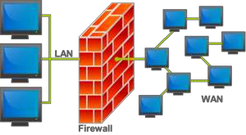
Introduction
Is hardware, software, or a combination of both
used to prevent unauthorized programs or Internet users from accessing a private network and/or a single computer.

Slide 4
Hardware vs. Software Firewalls
Hardware Firewalls
Protect an entire network
Implemented on the router level
Usually more expensive, harder to configure
Software Firewalls
Protect a single computer
Usually less expensive, easier to configure

Slide 5
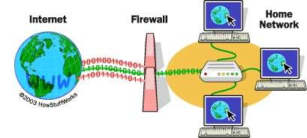
How does a software firewall work?
Inspects each individual “packet” of data as it arrives at either side of the firewall
Determines whether it should be allowed to pass through or if it should be blocked

Slide 6
Firewall Rules
Allow – traffic that flows automatically because it has been deemed
Block – traffic that is blocked because it has been deemed dangerous to your computer
Ask – asks the user whether or not the traffic is allowed to pass through

Slide 7
What Can a Firewall Do?
Focus for security decisions
Stop hackers from accessing your computer
Can enforce security policy
Protects your personal information
Limits your exposure
Blocks “pop up” ads and certain cookies
Can log Internet activity efficiently
Determines which programs can access the Internet

Slide 8
What Can't a Firewall Do?
Can't protect you against malicious insiders
Can't protect you against connections that don't go through it
Can't protect against completely new threats
Can't protect against viruses

Slide 9
Types of Firewalls
Packet Filtering Firewall
Application level Gateway
Circuit level gateway

Slide 10
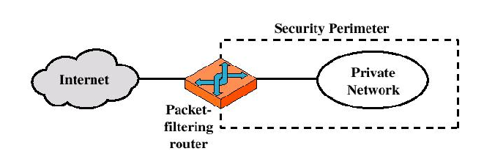
Types of Firewalls
Packet-filtering Router

Slide 11
Types of Firewalls
Packet-filtering Router
Applies a set of rules to each incoming IP packet and then forwards or discards the packet
Filter packets going in both directions
The packet filter is typically set up as a list of rules based on matches to fields in the IP or TCP header
Two default policies (discard or forward)

Slide 12
Types of Firewalls
Advantages:
Simplicity
Transparency to users
High speed
Disadvantages:
Difficulty of setting up packet filter rules
Lack of Authentication

Slide 13
Types of Firewalls
Possible attacks and appropriate countermeasures
IP address spoofing
Source routing attacks
Tiny fragment attacks

Slide 14
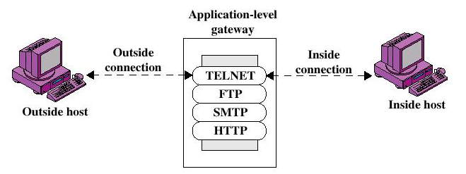
Types of Firewalls
Application-level Gateway

Slide 15
Types of Firewalls
Application-level Gateway
Also called proxy server
Acts as a relay of application-level traffic

Slide 16
Types of Firewalls
Advantages:
Higher security than packet filters
Only need to scrutinize a few allowable applications
Easy to log and audit all incoming traffic
Disadvantages:
Additional processing overhead on each connection (gateway as splice point)

Slide 17
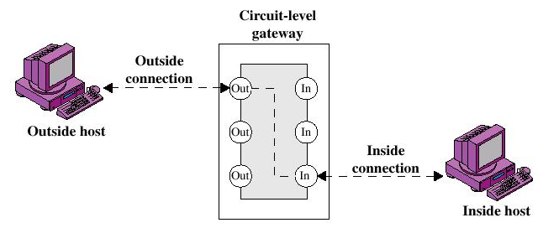
Types of Firewalls
Circuit-level Gateway

Slide 18
Types of Firewalls
Circuit-level Gateway
Stand-alone system or
Specialized function performed by an Application-level Gateway
Sets up two TCP connections
The gateway typically relays TCP segments from one connection to the other without examining the contents

Slide 19
Types of Firewalls
Circuit-level Gateway
The security function consists of determining which connections will be allowed
Typically use is a situation in which the system administrator trusts the internal users
An example is the SOCKS package

Slide 20
Making The Firewall Fit
IP address
Domain names
Protocols
Ports

Slide 21
What It Protects You From
Remote login
SMTP session hijacking
Operating system bugs
Spam
E-mail bombs
Source routing

Slide 22
Security Strategies implemented
Default Deny
Prohibit all communication that is not expressly permitted
Default Permit
Permit all communication that is not explicitly prohibited
Least Privilege
reduces the authorization level at which various actions are performed
Defense in Depth
security approach whereby each system on the network is secured to the greatest possible degree
Choke Point
forces attackers to use a narrow channel to bypass the network

Slide 23
REFRENCES
www.howstuffworks.com
www.securityfocus.com
www.firewall.com

Slide 24
THANKU

