Slide 1
XML
Kaustuv Bhattacharjee

Slide 2
XML: Introduction
XML stands for Extensible Markup Language
A text-based markup language derived from Standard Generalized Markup Language (SGML)
XML tags identify the data and are used to store and organize the data (rather than specifying how to display it like HTML tags)
XML introduces new possibilities by adopting many successful features of HTML.

Slide 3
XML Characteristics
Three important characteristics of XML:
XML is extensible − XML allows to create own self-descriptive tags, or language, that suits the application
XML carries the data, does not present it − XML allows to store the data irrespective of how it will be presented
XML is a public standard − XML was developed by an organization called the World Wide Web Consortium (W3C) and is available as an open standard

Slide 4
XML Usages
XML can work behind the scene to simplify the creation of HTML documents for large web sites.
XML can be used to exchange the information between organizations and systems.
XML can be used for offloading and reloading of databases.
XML can be used to store and arrange the data, which can customize data handling needs.
XML can easily be merged with style sheets to create almost any desired output.
Virtually, any type of data can be expressed as an XML document.

Slide 5
XML-a markup language
XML is a markup language that defines set of rules for encoding documents in a format that is both human-readable and machine-readable.
XML- NOT a programming language:
A programming language consists of grammar rules and its own vocabulary which is used to create computer programs.
XML does not qualify to be a programming language as it does not perform any computation or algorithms.
It is usually stored in a simple text file and is processed by special software that is capable of interpreting XML.
Notes:
What is a markup language: Markup is information added to a document that enhances its meaning in certain ways, in that it identifies the parts and how they relate to each other. More specifically, a markup language is a set of symbols that can be placed in the text of a document to demarcate and label the parts of that document.

Slide 6
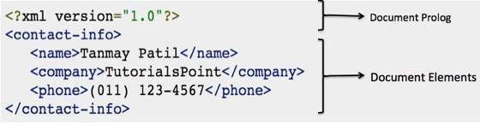
XML- Document
A basic unit of XML information
Composed of elements and other markup
Can contain wide variety of data. For example, database of numbers, numbers representing molecular structure or a mathematical equation.
XML Document example:
A simple XML document showing parts of XML document:

Slide 7
XML Document – contd.
Document Prolog Section:
Comes at the top of the document, before the root element
This section contains the following −
XML declaration
Document type declaration
Document Elements Section
Building blocks of XML
Divided into a hierarchy of sections, each serving a specific purpose
Can be separated into multiple sections
Elements can be containers, with a combination of text and other elements

Slide 8
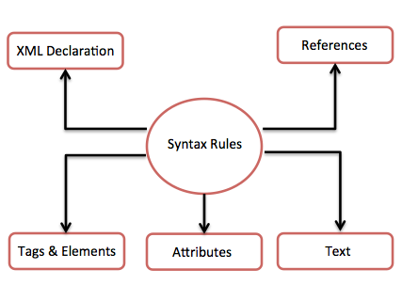
XML-Syntax
The following diagram depicts the syntax rules to write different types of markup and text in an XML document.

Slide 9
XML-Syntax Contd…
XML Declaration
The XML document can optionally have an XML declaration. It is written as follows −
<?xml version = "1.0" encoding = "UTF-8"?>
Where version is the XML version and encoding specifies the character encoding used in the document.
Syntax Rules for XML Declaration
The XML declaration is case sensitive and must begin with "<?xml>" where "xml" is written in lower-case.
If document contains XML declaration, then it strictly needs to be the first statement of the XML document.
The XML declaration strictly needs be the first statement in the XML document.
An HTTP protocol can override the value of encoding that you put in the XML declaration.

Slide 10
XML-Syntax Contd…
Tags and Elements
An XML file is structured by several XML-elements, also called XML-nodes or XML-tags. The names of XML-elements are enclosed in triangular brackets < > as shown below − <element>
Syntax Rules for Tags and Elements
Element Syntax − Each XML-element needs to be closed either with start or with end elements as shown below −<element>....</element>
Nesting of Elements − An XML-element can contain multiple XML-elements as its children, but the children elements must not overlap. i.e., an end tag of an element must have the same name as that of the most recent unmatched start tag.

Slide 11
XML-Syntax Contd…
Syntax Rules for Tags and Elements (continued)
Root Element − An XML document can have only one root element as shown below:
<root>
<x>...</x>
<y>...</y>
</root>
Case Sensitivity − The names of XML-elements are case-sensitive. That means the name of the start and the end elements need to be exactly in the same case.
For example, <contact-info> is different from <Contact-Info>

Slide 12
XML-Syntax Contd…
XML Attributes
An attribute specifies a single property for the element, using a name/value pair. An XML-element can have one or more attributes. For example −
<a href = "http://www.tutorialspoint.com/">Tutorialspoint!</a>
Here href is the attribute name and http://www.tutorialspoint.com/ is attribute value.
Syntax Rules for XML Attributes
Attribute names in XML (unlike HTML) are case sensitive. That is, HREF and href are considered two different XML attributes.
Same attribute cannot have two values in a syntax. The following example shows incorrect syntax because the attribute b is specified twice
<a b = "x" c = "y" b = "z">....</a>
Attribute names are defined without quotation marks, whereas attribute values must always appear in quotation marks. Following example demonstrates incorrect xml syntax as the attribute value is not defined in quotation marks:
<a b = x>....</a>

Slide 13
XML-Syntax Contd…
XML References
References usually allow to add or include additional text or markup in an XML document. References always begin with the symbol "&" which is a reserved character and end with the symbol ";". XML has two types of references −
Entity References − An entity reference contains a name between the start and the end delimiters. For example &amp; where amp is name. The name refers to a predefined string of text and/or markup.
Character References − These contain references, such as &#65;, contains a hash mark (“#”) followed by a number. The number always refers to the Unicode code of a character. In this case, 65 refers to alphabet "A".

Slide 14
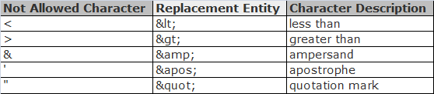
XML-Syntax Contd…
XML Text
The names of XML-elements and XML-attributes are case-sensitive, which means the name of start and end elements need to be written in the same case.
To avoid character encoding problems, all XML files should be saved as Unicode UTF-8 or UTF-16 files.
Whitespace characters like blanks, tabs and line-breaks between XML-elements and between the XML-attributes will be ignored.
Some characters are reserved by the XML syntax itself. Hence, they cannot be used directly. To use them, some replacement-entities are used, which are listed below

Slide 15
XML - Comments
Similar to HTML comments
Added as notes or lines for understanding the purpose of an XML code
Can be used to include related links, information, and terms
visible only in the source code; not in the XML code
May appear anywhere in XML code
Syntax
XML comment has the following syntax −
<!—XML comment-->
A comment starts with <!-- and ends with -->.

Slide 16
XML Comments – contd…
Example:
<?xml version = "1.0" encoding = "UTF-8" ?>
<!--Students grades are uploaded by months-->
<class_list>
<student>
<name>Tanmay</name>
<grade>A</grade>
</student>
</class_list>
XML Comments Rules
Following rules should be followed for XML comments −
Comments cannot appear before XML declaration.
Comments may appear anywhere in a document.
Comments must not appear within attribute values.
Comments cannot be nested inside the other comments.

Slide 17
XML Character Entities
Both, HTML and XML, have some symbols reserved for their use, which cannot be used as content in XML code. To display them, the character entities are used.
For example, < and > signs are used for opening and closing XML tags.
There are few special characters or symbols which are not available to be typed directly from the keyboard.
Types of Character Entities:
There are three types of character entities −
Predefined Character Entities
Numeric Character Entities
Named Character Entities

Slide 18
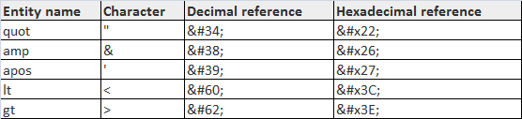
XML Character Entities – Contd...
Predefined Character Entities
Introduced to avoid the ambiguity while using some symbols. List is given below:
Ampersand − &amp;
Single quote − &apos;
Greater than − &gt;
Less than − &lt;
Double quote − &quot;
Numeric Character Entities
Used to refer to a character entity. Numeric reference can either be in decimal or hexadecimal format.
General syntax: &# decimal number or &#x Hexadecimal number
Examples of some pre-defined character entities:
Named Character Entities
Most preferred type of character entity where each entity is identified with a name.
Notes:
Named Character Entities: Example:
'Aacute' represents capital character A` with acute accent.
'ugrave' represents the small u` with grave accent.

Slide 19
XML Encoding
Process of converting unicode characters into their equivalent binary representation.
When the XML processor reads an XML document, it encodes the document depending on the type of encoding.
Hence, we need to specify the type of encoding in the XML declaration.
Encoding Types
There are mainly two types of encoding −
UTF-8
UTF-16
UTF stands for UCS Transformation Format, and UCS itself means Universal Character Set.
The number 8 or 16 refers to the number of bits used to represent a character.
They are either 8(one byte) or 16(two bytes).
For the documents without encoding information, UTF-8 is set by default.
Syntax:
<?xml version = "1.0" encoding = "UTF-16" standalone = "no" ?> or
<?xml version = "1.0" encoding = "UTF-8" standalone = "no" ?>
The XML files encoded with UTF-8 tend to be smaller in size than those encoded with UTF-16 format.

Slide 20
XML Validation
A process by which an XML document is validated
An XML document is said to be valid if
its contents match with the elements, attributes and associated document type declaration(DTD)
if the document complies with the constraints expressed in it
Validation is dealt in two ways by the XML parser. They are −
Well-formed XML document
Valid XML document

Slide 21
XML Validation contd…
Well-formed XML Document
An XML document is said to be well-formed if it adheres to the following rules −
Non DTD XML files must use the predefined character entities for amp(&), apos(single quote), gt(>), lt(<), quot(double quote).
It must follow the ordering of the tag. i.e., the inner tag must be closed before closing the outer tag.
Each of its opening tags must have a closing tag or it must be a self ending tag.(<title>....</title> or <title/>).
It must have only one attribute in a start tag, which needs to be quoted.
amp(&), apos(single quote), gt(>), lt(<), quot(double quote)entities other than these must be declared.

Slide 22
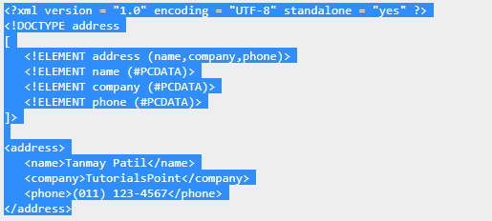
XML Validation contd…
Well-formed XML Document - Example
The above example is said to be well-formed as −
It defines the type of document. Here, the document type is element type.
It includes a root element named as address.
Each of the child elements among name, company and phone is enclosed in its self explanatory tag.
Order of the tags is maintained.

Slide 23
XML Validation contd…
Valid XML Document
If an XML document is well-formed and has an associated Document Type Declaration (DTD), then it is said to be a valid XML document.
Document Type Declaration (DTD)
A way to describe XML language precisely
DTDs check vocabulary and validity of the structure of XML documents against grammatical rules of appropriate XML language
An XML DTD can be either specified inside the document, or it can be kept in a separate document and then liked separately

Slide 24
XML DTD
Syntax:
<!DOCTYPE element DTD identifier
[
declaration1
declaration2
........
]>
In the above syntax:
The DTD starts with <!DOCTYPE delimiter.
An element tells the parser to parse the document from the specified root element.
DTD identifier is an identifier for the document type definition, which may be the path to a file on the system or URL to a file on the internet. If the DTD is pointing to external path, it is called External Subset.
The square brackets [ ] enclose an optional list of entity declarations called Internal Subset.
Types - Two types:
Internal (elements are declared within the XML files)
External (DTD elements are declared outside the XML file)

Slide 25
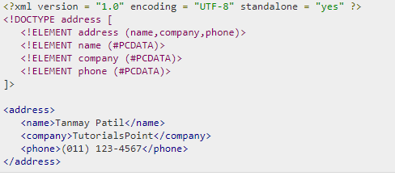
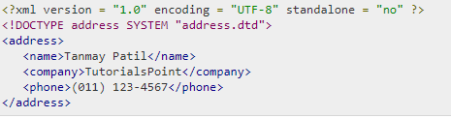
XML DTD contd…
Internal DTD Example:
External DTD Example:
Notes:
Internal DTD: To an internal DTD, standalone attribute in XML declaration must be set to yes. This means, the declaration works independent of an external source.
External DTD: They are accessed by specifying the system attributes which may be either the legal .dtd file or a valid URL. To refer it as external DTD, standalone attribute in the XML declaration must be set as no. This means, declaration includes information from the external source.

Slide 26
XML Schema
An XML Schema describes the structure of an XML document.
The XML Schema language is also referred to as XML Schema Definition (XSD).
Purpose:
The purpose of an XML Schema is to define the legal building blocks of an XML document:
the elements and attributes that can appear in a document
the number of (and order of) child elements
data types for elements and attributes
default and fixed values for elements and attributes
Why Learn XML Schema?
In the XML world, hundreds of standardized XML formats are in daily use.
Many of these XML standards are defined by XML Schemas.
XML Schema is an XML-based (and more powerful) alternative to DTD.

Slide 27
XML Schema Contd…
XML Schemas Support Data Types:
One of the greatest strength of XML Schemas is the support for data types.
It is easier to describe allowable document content
It is easier to validate the correctness of data
It is easier to define data facets (restrictions on data)
It is easier to define data patterns (data formats)
It is easier to convert data between different data types
Some benefits of using XML schema
XML Schemas use XML Syntax (need not learn a new language)
Secure Data Communication

Slide 28
XML Schema Contd…
Example of XML Schema Definition (XSD):
<?xml version="1.0"?> <xs:schema xmlns:xs="http://www.w3.org/2001/XMLSchema"> <xs:element name="note"> <xs:complexType> <xs:sequence> <xs:element name="to" type="xs:string"/> <xs:element name="from" type="xs:string"/> <xs:element name="heading" type="xs:string"/> <xs:element name="body" type="xs:string"/> </xs:sequence> </xs:complexType> </xs:element> </xs:schema>

Slide 29
XML Tree
Tree structure helps to describe an XML document easily.
Contains root (parent) elements, child elements and so on
Helps to know all succeeding branches and sub-branches starting from the root.
XML parsing starts at the root, then moves down the first branch to an element, take the first branch from there, and so on to the leaf nodes.

Slide 30
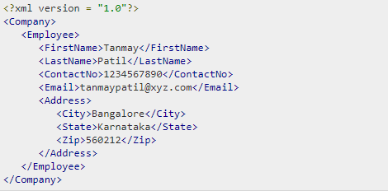
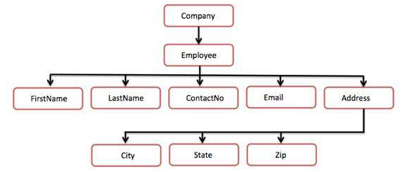
XML Tree - Example
XML Tree Example:
Following tree structure represents the above XML document −

Slide 31
XML Viewing
XML document can be viewed using a simple text editor or any browser.
Most of the major browsers supports XML.
XML files can be opened in the browser by just double-clicking the XML document (if it is a local file) or by typing the URL path in the address bar (if the file is located on the server)
XML files are saved with a ".xml“ extension.
Text Editors
Any simple text editor such as Notepad, TextPad, or TextEdit can be used to create or view an XML document.
Firefox Browser/Chrome Browser
XML code can be opened in Chrome by double-clicking the file.
The XML code displays coding with color, which makes the code readable.
It shows plus(+) or minus (-) sign at the left side in the XML element.
Errors in XML Document
If XML code has some tags missing, then a message is displayed in the browser.

Slide 32
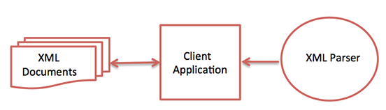
XML Parsers
A software library or a package that provides interface for client applications to work with XML documents
Checks for proper format of the XML document and may also validate the XML documents.
Modern day browsers have built-in XML parsers.
The goal of a parser is to transform XML into a readable code.
Following diagram shows how XML parser interacts with XML document −
Some commonly used parsers −
MSXML (Microsoft Core XML Services) − Standard set of XML tools from Microsoft that includes a parser.
System.Xml.XmlDocument − Part of .NET library, containing different classes related to working with XML.
Java built-in parser − The Java library has its own parser.
Saxon − Saxon offers tools for parsing, transforming, and querying XML.
Xerces − Xerces is implemented in Java, developed by open source Apache Software Foundation.

Slide 33
XHTML
XHTML stands for EXtensible HyperText Markup Language.
XHTML is introduced to combine the strengths of HTML and XML.
XHTML is almost identical to HTML but it is stricter than HTML.
XHTML is HTML defined as an XML application, HTML redesigned as XML.
XHTML doesn't facilitate to make badly formed code to be XHTML compatible.
It is supported by all major browsers.
XHTML is stricter than HTML in syntax and case sensitivity.
XHTML documents are well-formed and parsed using standard XML parsers, unlike HTML, which requires a lenient HTML-specific parser.

Slide 34
XHTML contd…
Why use XHTML:
XHTML was developed to make HTML more extensible and increase interoperability with other data formats.
There are two main reasons behind the creation of XHTML:
It creates a stricter standard for making web pages, reducing incompatibilities between browsers. So it is compatible for all major browsers.
It creates a standard that can be used on a variety of different devices without changes.

Slide 35
Thank You

