Slide 1


HOTEL
RECOMMENDATION SYSTEM

Slide 2

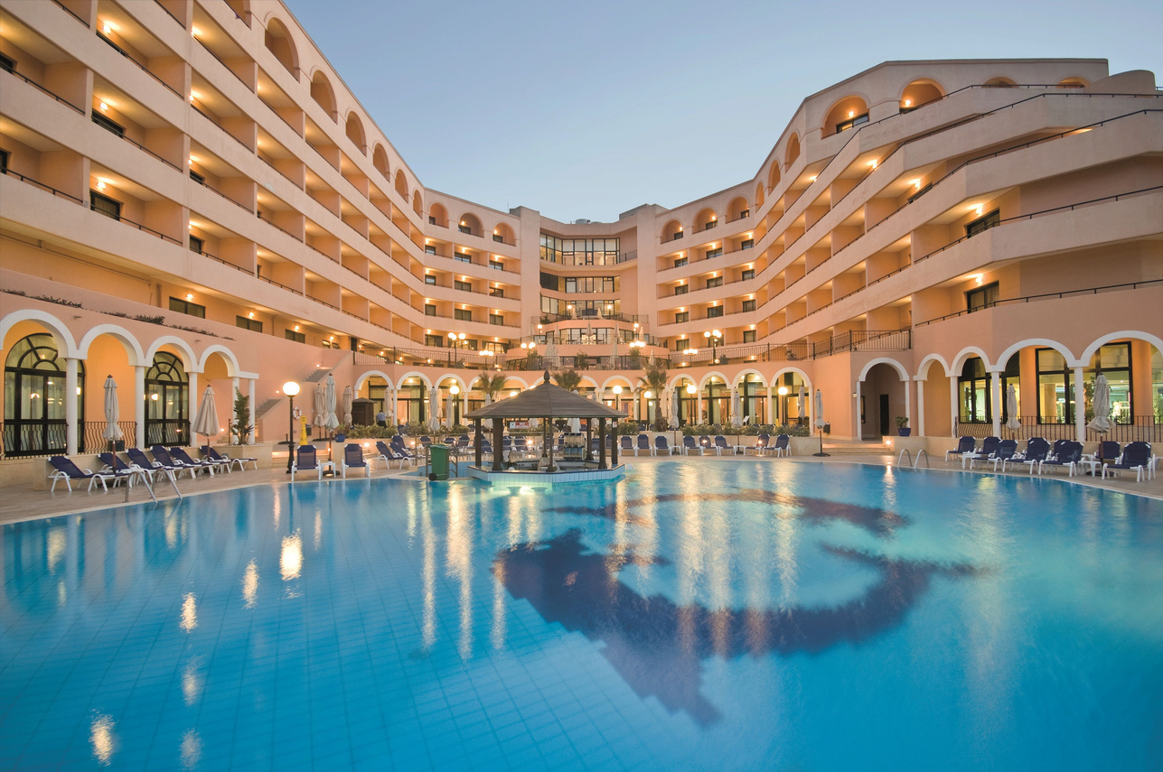
INTRODUCTION
Mission
The proliferation of online travel platforms has led to an overwhelming number of hotel options. This project aims to develop a hotel recommendation system that leverages customer feedback to provide personalized and accurate recommendations.
By analyzing customer reviews and preferences, the system will assist travelers in selecting hotels that align with their specific needs and tastes, enhancing overall travel experiences.

Slide 3

PROBLEM STATEMENT
Lack of personalized recommendations based on user history and behavior.
Overwhelming number of hotel options on online platforms.
Inefficient use of customer feedback for improving recommendations.
Existing recommendation systems often provide generic suggestions.
Lack of personalized recommendations based on user history and behavior.
Difficulty in finding hotels that match individual preferences.
Lack of personalized recommendations based on user history and behavior.

Slide 4
PROPOSED SOLUTION
The proposed solution uses Filtering and Sorting systems.
Comprehensive Data collection is done on hotels, including amenities, pricing, location, and customer reviews to extract meaningful insights and provide tailored recommendations.
Libraries used : Numpy, Pandas, Pickle
FILTERING
SORTING
Filtering is done based on:
Tag-based filtering from descriptive query
Country-based
Star rating based (3 star, 4 star, etc.
Sorting is based on :
Hotel Rating based
Customer Review Sorting
Price Based Sorting

Slide 5
ALGORITHMS USED
In the hotel recommendation system, the filtering function accepts the dataframe, country, description, price and other parameters in order to filter out the suitable hotels that best fit the criteria required by the user.
Some Libraries that have been used are:
Pandas
Tf-Idf Vectorizer and cosine from scikit learn

Slide 6
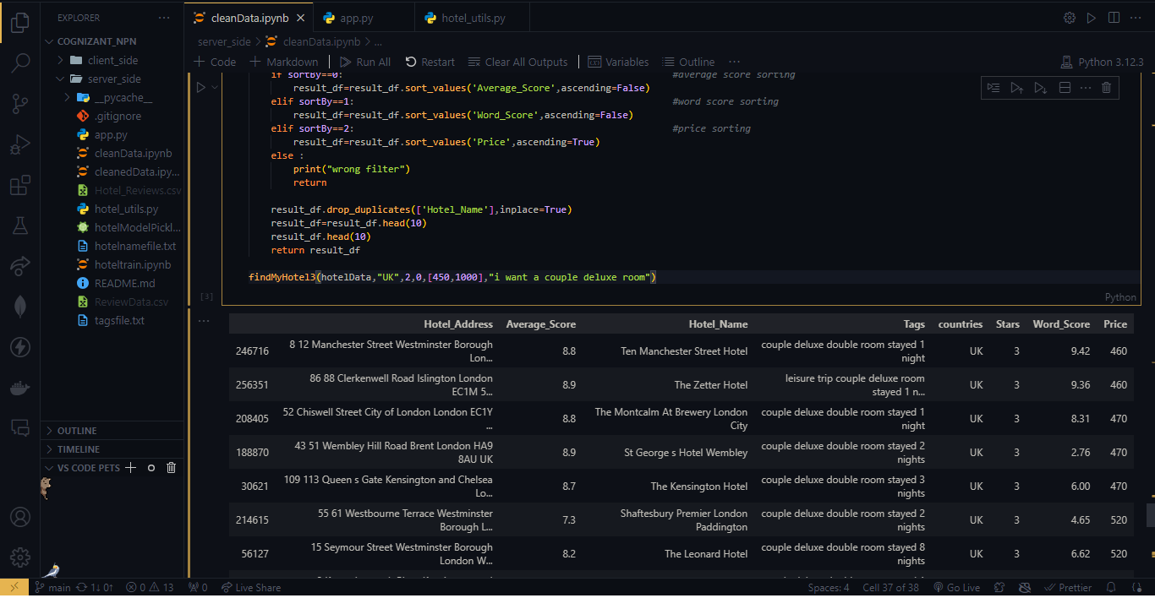



Code Snippets
Sample output of the searching function

Slide 7
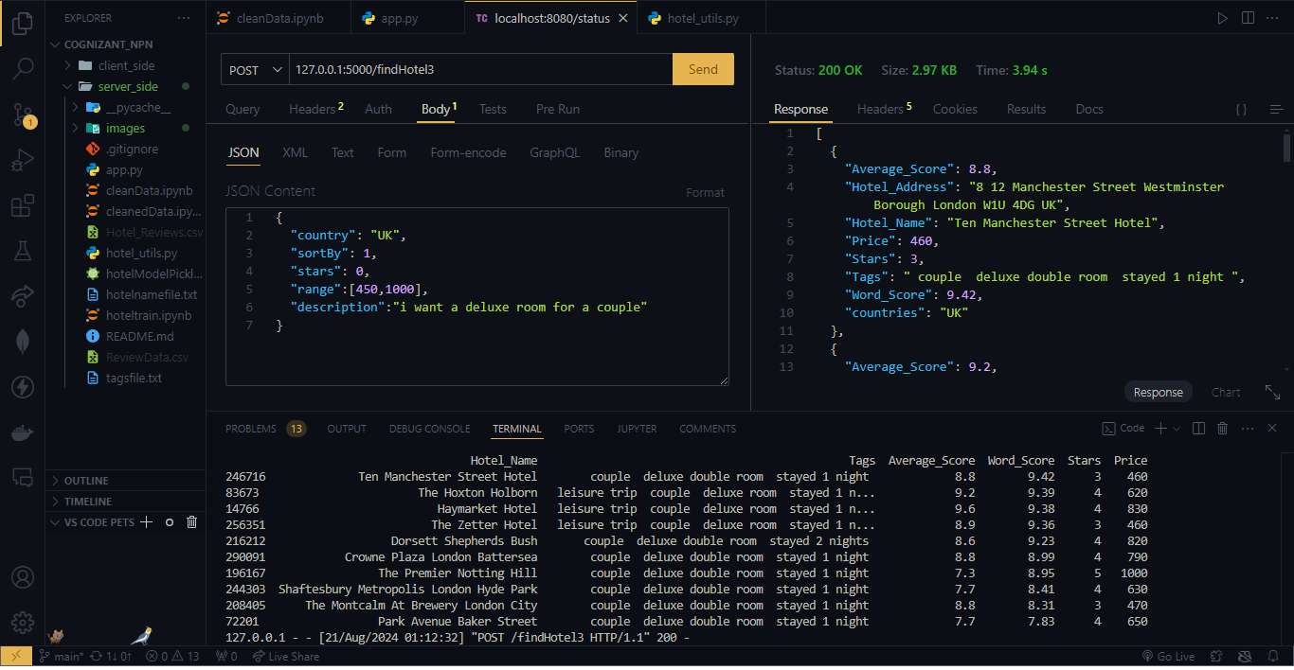
Code Snippets
Request and Response from the back-end server

Slide 8
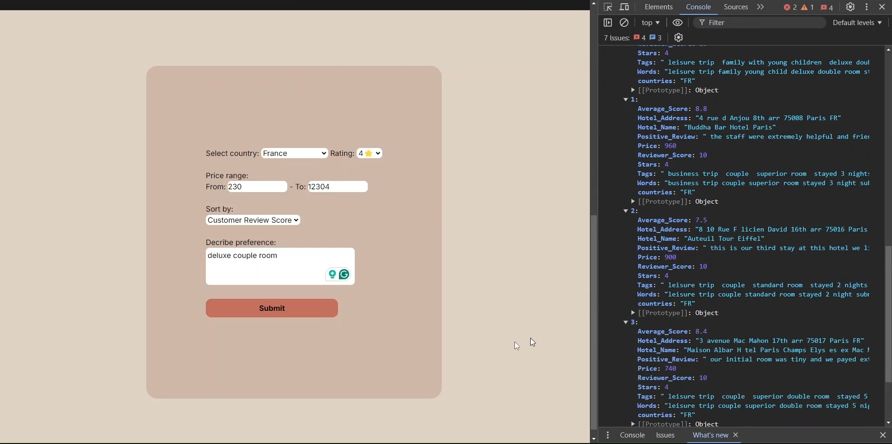
Frontend

