Slide 2
Server
Control
Module
CV
Module
Connect
Module
Image Stream
Bot 1
Connect
Module
Camera
Module
Command
Image Stream
Connect
Module
Control
Module
Command
Bot 2
Camera
Module

Slide 3
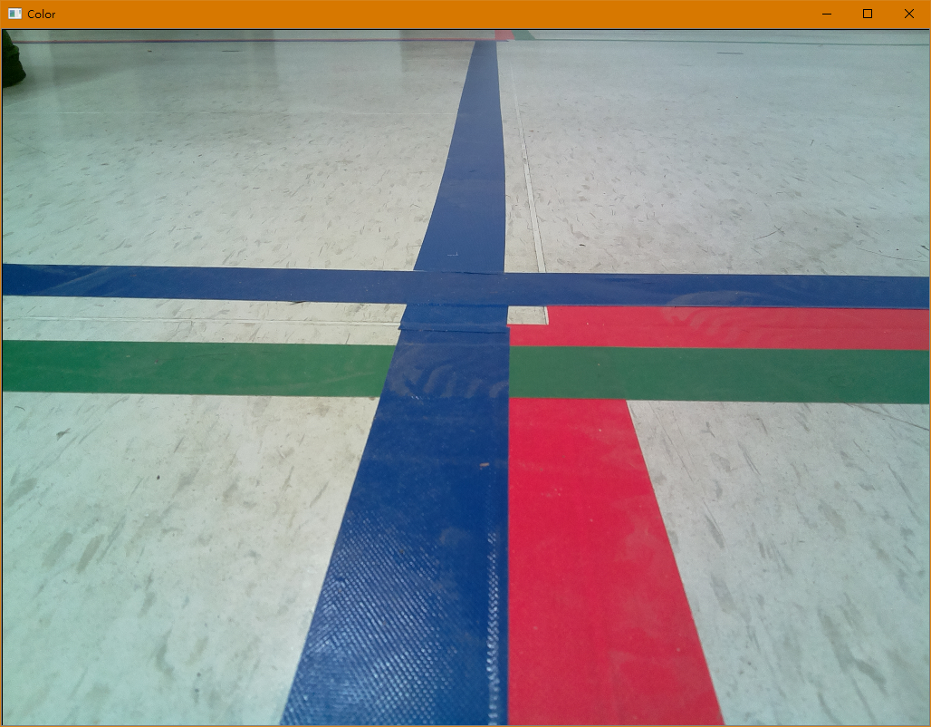
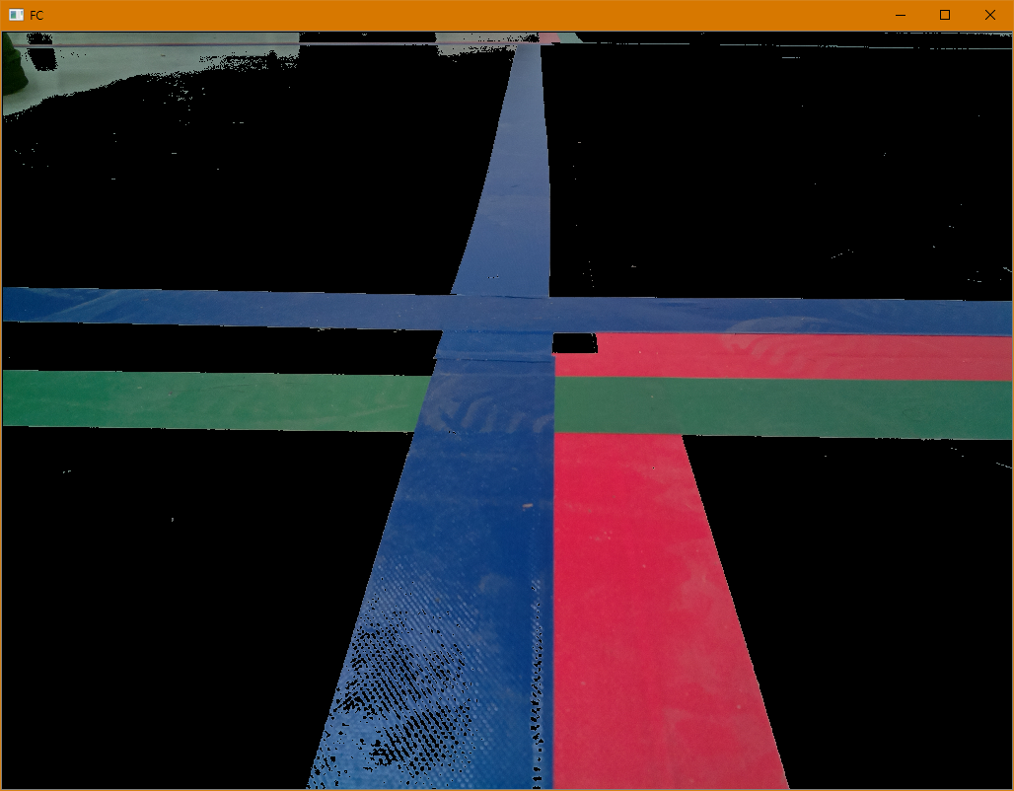

Slide 4
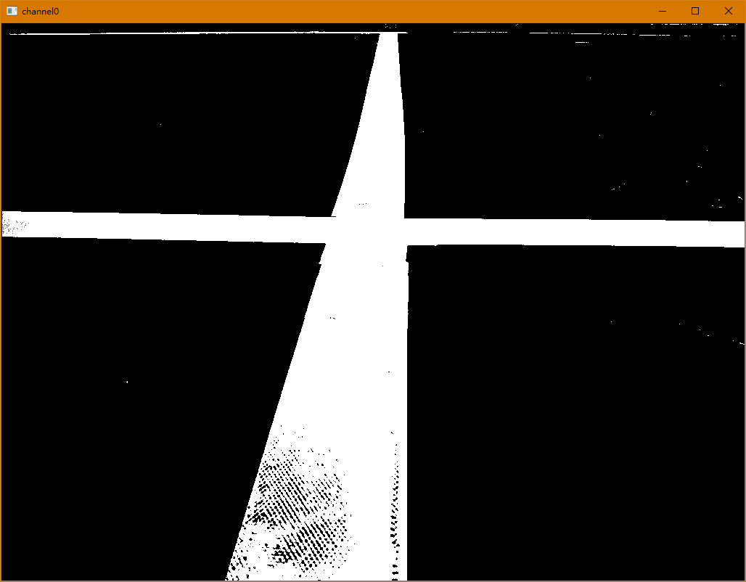
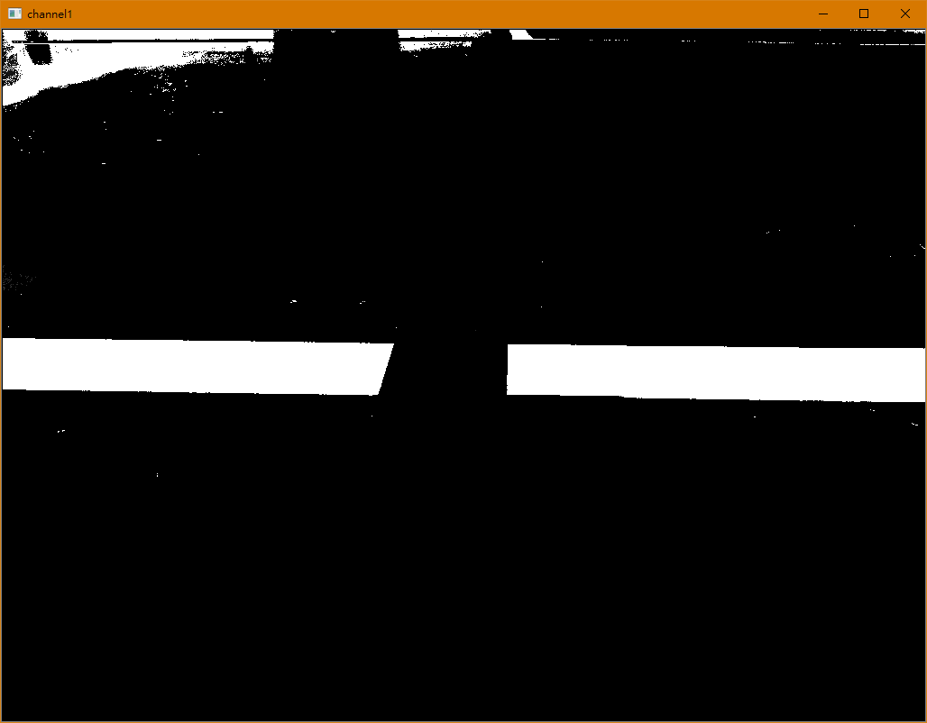
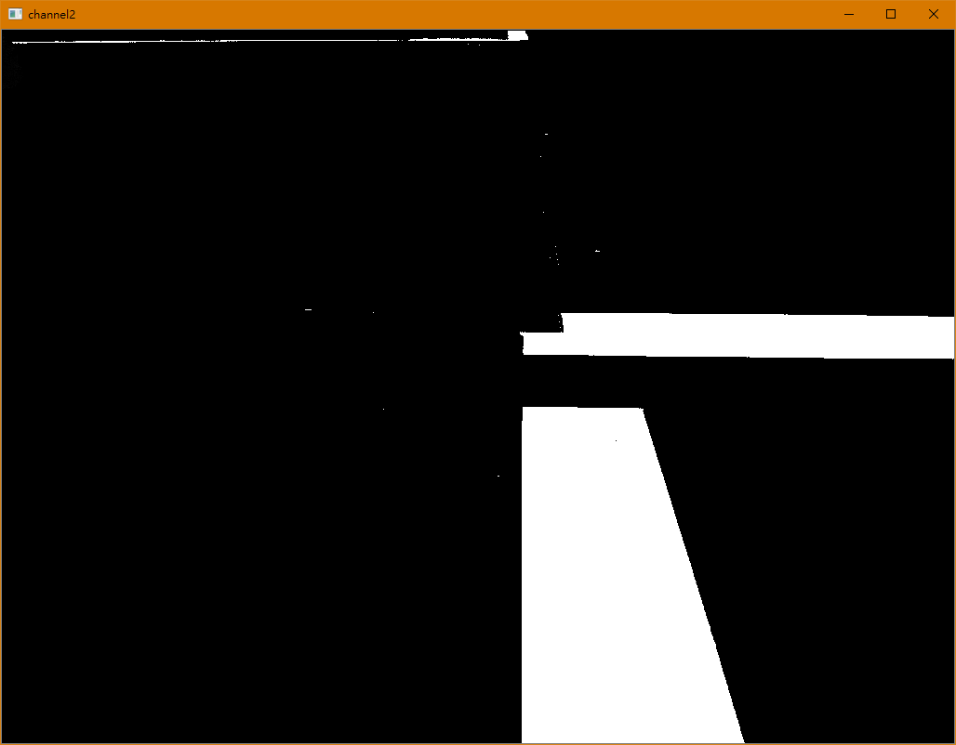
B
G
R

