Slide 1

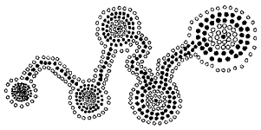

Slide 2

I am Patrick Prosser
I am a senior lecturer at Glasgow
I teach algorithms & data structures in java
I am a member of
  the algorithms group
  the apes (distributed, not disbanded)
I am a Glaswegian
This is all that I am allowed to tell you

Slide 3

CI9(4)
Hybrid Algorithms for the Constraint Satisfaction Problem
Patrick Prosser
Still using that old greasy stuff?
Who cares?
So?

Slide 4


Slide 5

What’s he going to cover!
Stop wasting time
get on with it!
How to do it (the idiot’s guide)
(good old fashioned) chronological backtracking BT
Forward checking FC
FC with CBJ
Conflict directed backjumping CBJ

Slide 6
What do we want from the algorithm?
  Minimise consistency checks
  minimise nodes visited
  fast (woooooosh!)
  pretty

Slide 7
Preamble
v[i] is a variable
d[i] is a set of values for variable v[i]
x is a value in d[i] ( and y in d[j])
c[i,j] is a binary relation/constraint such as
  >, <, =, nextto, f(x,y), nil (no constraint)
check(i,j) tests if v[i]=x is compatible with v[j]=y
cd[i] is the current domain of v[i]
  i.e. the working domain of v[i]

Slide 8
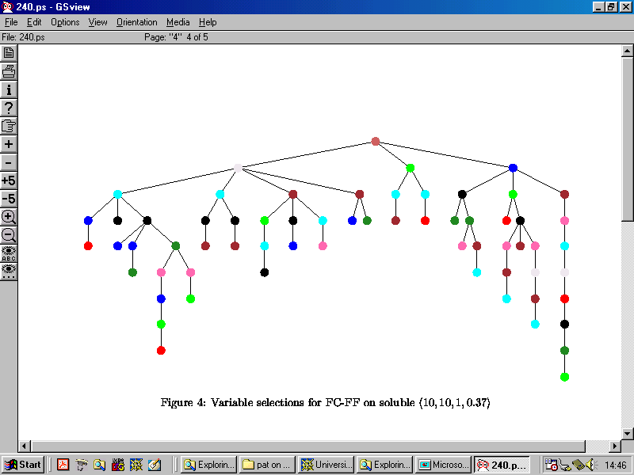
It’s all just depth first search, right?

Slide 9
BT
bt-label
  iterate over x in cd[i] until an x is
  found that is compatible with all
  past variables i.e. check(h,i) true for all
  0 < h < i
  On route to finding this compatible value
  if any incompatible value x is found
  remove it from cd[i]
  return (i+1,true) or (i,false)

Slide 10
BT
bt-unlabel
  bt-label(i) returned (i,false) or
  bt-unlabel(i) returned (i,false)
  the variable to backtrack to is h = i-1
  i.e. the previous variable
  remove the value v[h] from cd[h]
  reset cd[i]
  return (h,true) or (h,false)

Slide 11

BT Thrashes!
past variable v[h]
past
conflict with v[h]
current variable v[i]
future
future variable v[j]

Slide 12

CBJ (reduce thrashing)
1
2
3
conflict set
4
{2,0}
5
6
{4,1,0}

Slide 13
CBJ (reduce thrashing)
1
2
3
4
{2,1,0}
5
6
Jump back to deepest past variable
in confSet (call it h) and then
combine confSet[i] with confSet[h]
History:
  Konkrat and V Beek,
  Gent and Underwood

Slide 14
CBJ implementation
Implementation
  confSet[0..n][0..n] is a boolean
  confSet[i][h] = true if v[i] in conflict with v[h]
  on backjumping do logical OR
  … and then clear out confset[i]
For DVO
  h is the depth in the search tree of the
variable v[i] conflicts with!

Slide 15
What is forward checking?
OZ
Show me!

Slide 16

Check Forwards
instantiate v[i] = x
for all variables v[j]
  where v[j] is adjacent to v[i] &
  v[j] is in the future of v[i]
remove all values from cd[j] inconsistent with v[i]=x
with respect to constraint c[i][j]
do this every time we instantate a variable
  a lot of work!
  does it pay off?
    Can you bear the suspense?

Slide 17
Forward Checking
1
2
3
NOTE: arrows go forward!
4
5
6
7
8
9

Slide 18
Forward Checking, a marking scheme
associate with each variable v[i]
  future[i][j] = true
    if v[i] = x removes values from cd[j]
  past[j][y] = i
    if v[i] = x removes value y from cd[j]
  cd[i][x] = true
    if x is currently in current domain of i
checkForwards(i,j) does as follows
  for y in (1 .. m)
    if cd[j][y] and not(check(i,x,j,y))
      cd[j][y] = false
      past[j][y] = i
      future[i][j] = true

Slide 19
Forward checking by marking
Marking scheme uses static space!
Makes it easy to retract/backtrack
It’s neat
But it still thrashes :(

Slide 20
1
2
3
4
5
Forward Checking Can Thrash
6
7
8
9

Slide 21
Check Forwards, Jump Back!
1
2
3
There are no values in cd[6] compatible with v[9]
  get more values into cd[9] (undo v[1]?) OR
  get more values into cd[6] (undo v[4])
… and if that doesn’t work?
  undo v[3] so cd[4] gets value compatible with
  cd[6] that is then compatible with cd[9]
4
5
6
All the information is already there
7
8
9

Slide 22
Check forwards, jump back!
assume v[i] = x causes dwo on v[j]
  v[i] is now in conflict with all variables forward checking against v[j]
  h = past[j][y] means that v[h] removes y from cd[j]
  therefore confSet[i][h] = true
  do this for all y!
assume no more values to try in cd[i], must backjump to v[h] where
  h is the deepest variable that is in confSet[i] or in past[i]
  confSet[h] is united with confSet[i] and past[i]

Slide 23
What is a dvo heuristic? (you kind of skipped that)
Does it make any difference
Show me!
OZ

Slide 24
So?
Paper rejected from IJCAI91 (written in 1990)
I was a Lisp programmer at the time (it shows)
I think the experiments were very good (so there!)
Nice study of influence of topological parameter on search cost.
In conclusion I forgot to say CBJ was new … why?
I like BMJ, it is cool (I was smart for 1 day)
I think CBJ is pretty (natural, discovered, not invented)
I like FC-CBJ (I can understand it)
I identify work to be done (researchers love that (why?))
… and I make errors re-dvo’s (researchers love that (why?))
I put my results in perspective (trash them :)
I got encouragement (Nadel) and help (Ole and Peter)
I got a whole load of background (Rina)
But it hurt … why did it take 3 years to get somebody to read it?

Slide 25


