Slide 1

Hackathon
ALPHA_GEEKS
Avish dhirawat
Gaurav Vaishnav
Astha khandelwal
Chirag misra
TOURISM

Slide 2

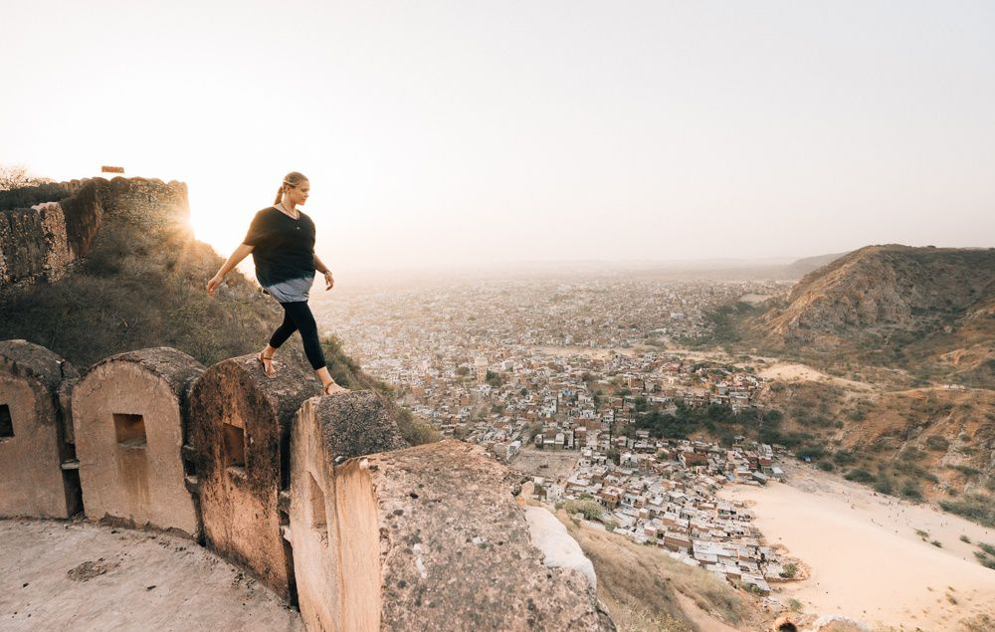
NOVATURIENT
The feeling that pushes you to travel and explore

Slide 3
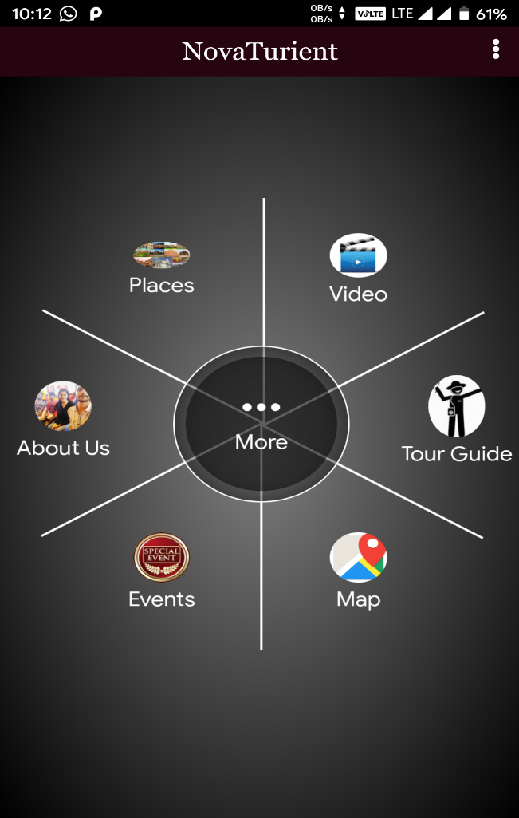
Novaturient
OPTIONS COVERED BY THE APPLICATION-
Login/signup
Filters
Tour guide
Place Recognition
Event Page
Best Places to Go
Under-RATED PLACEs

Slide 4
Problem Statement
Tourism generates an important chunk of the revenue in Rajasthan. So, keeping in mind design a hack that could solve the issue of multilinguality problem that arises while interacting with local people. As well as, develop a utility app that can come in handy to these foreigners while traversing the nook and corners of the state.

Slide 5
Objectives
to create an efficient tour management system.
Will help to tourists to find the best locations to visit as per their interests.
To provide the user friendly interface which will link the user with their nearby places.
To increase popularity of some under-rated places in Rajasthan.
Introducing cultural events with their happening places so as the tourists can feel the vibrant culture of our heritage.

Slide 6
Solution
Through this application we want to gain attention of the tourists to Explore more.
->for this purpose we have developed an application named “novaturient” which displays all the famous Tourist places near by user and also the Underrated Places where tourists can Entertain themselves.
->Added some of the Not Well-Known but Best to Hangout/Chill locations.
-> To Develop culture to some places which are not yet Cultured by Increasing recommendation to a particular place.
-> Recognition of Place where the image taken using Machine Learning and OPENCV.
-> Recommending the Current and Upcoming Event on basis of Personal Interest.
-> And Much more addition Features.

Slide 7
Categories based on company
->The Tags of places:
Friends
Family
Couple

Slide 8
Based on Popularity
Rated
Underrated

Slide 9
Recognition using Machine learning
We are using deep learning part of Machine learning for the purpose of recognition of places using algorithm CNN(Convolutional Neural Network) also known as Feed Forward Artificial Intelligence.

Slide 10
Special Features
Of the people, By the people, For the people.
Promoting the culture of the heritage.
Exploring the hidden places.
Foreign exchange earning from tourism will increase.

Slide 11
Technology Stack
Android Development Tool
Machine Learning using Python
MySQL

Slide 12
Thank You

