Slide 1
SmartQueue
Final Project
Presentation
Queue Management System
19th, February 2026
CSCI 6234 | Object-Oriented Analysis & Design
Spring 2026 | Group 06
Yashika LNU
Avish Kaushik

Slide 2
Agenda
Project Vision
Requirements
Use Case Diagram
Activity Diagram
Analysis Model
Domain Model
Sequence (Robustness) Diagrams
Collaboration Diagram
Design Model
Component Diagram
State Diagram
Conclusion
SmartQueue QMS | CSCI 6234 Spring 2026 | Group 06

Slide 3
Project Vision
The Problem
The Solution
Long physical queues cause customer frustration, staff inefficiency, and service bottlenecks.
No real-time visibility into waiting times or appointment scheduling leads to poor service quality.
SmartQueue is a digital Queue Management System (QMS) enabling customers to book appointments and join virtual queues remotely — eliminating physical lines and streamlining service delivery.
Key Features
Virtual Queue
Appointment Booking
Real-Time Updates
Role-Based Access
Join service queues without physical presence
Schedule appointments with date/time selection
Live queue position and status notifications
Customer, Staff, and Admin portals
SmartQueue QMS | CSCI 6234 Spring 2026 | Group 06

Slide 4
System Actors & Use Cases
Customer
Staff
Admin
Register / Login
Call Next Customer
Manage Services
Book Appointment
Complete Service
Manage Staff Accounts
Cancel Appointment
Join Virtual Queue
View Queue Position
Leave Queue
SmartQueue QMS | CSCI 6234 Spring 2026 | Group 06

Slide 5
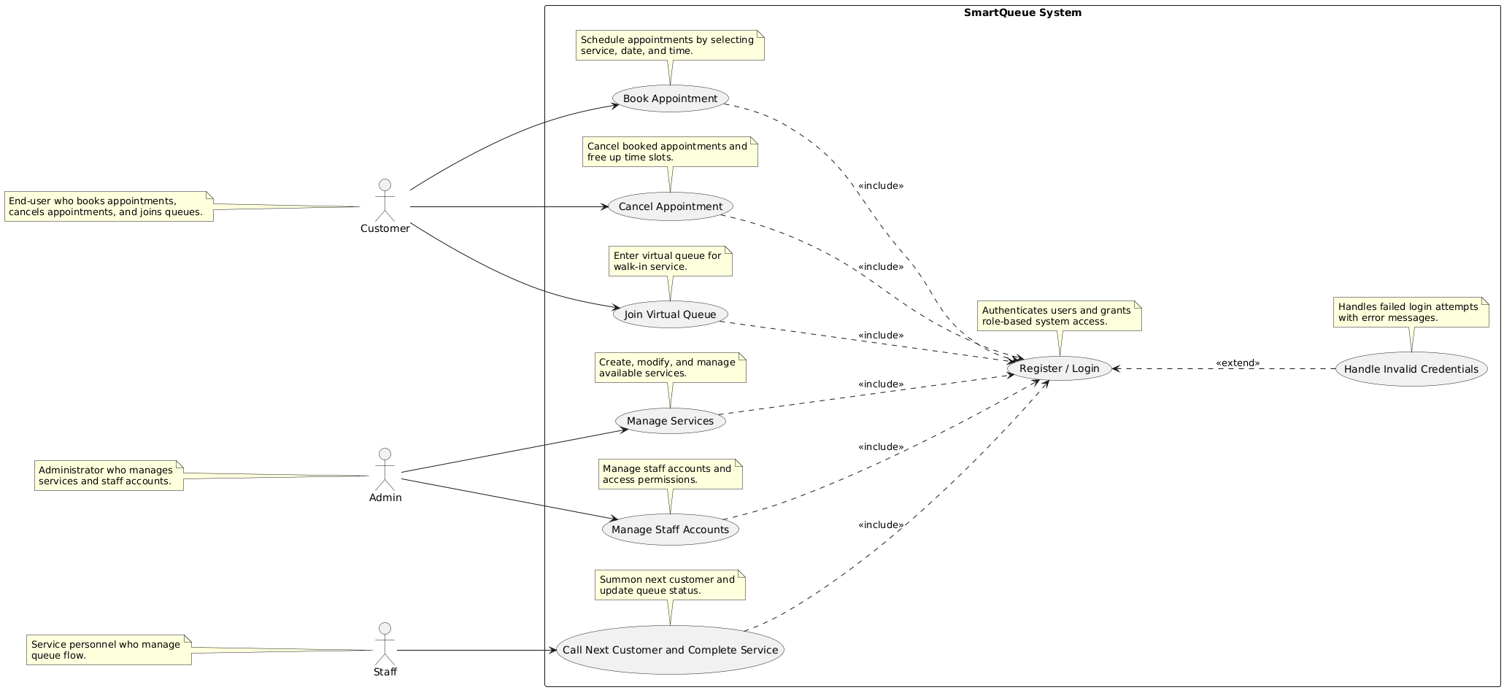
Requirements — Use Case Diagram
SmartQueue supports three actor types: Customer, Staff, and Admin. All use cases include the Register/Login use case.
SmartQueue QMS | CSCI 6234 Spring 2026 | Group 06

Slide 6
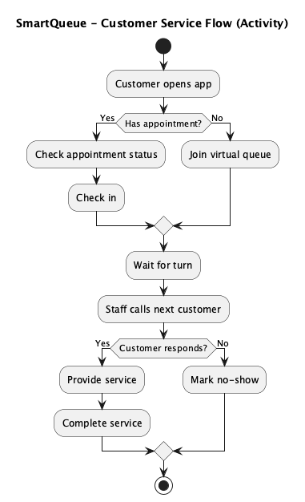
Requirements — Activity Diagram
SmartQueue Customer Service Flow
Customer opens app → Has appointment? → Check-in or Join Queue → Wait → Staff calls → Customer responds? → Service Complete or No-Show
SmartQueue QMS | CSCI 6234 Spring 2026 | Group 06

Slide 7
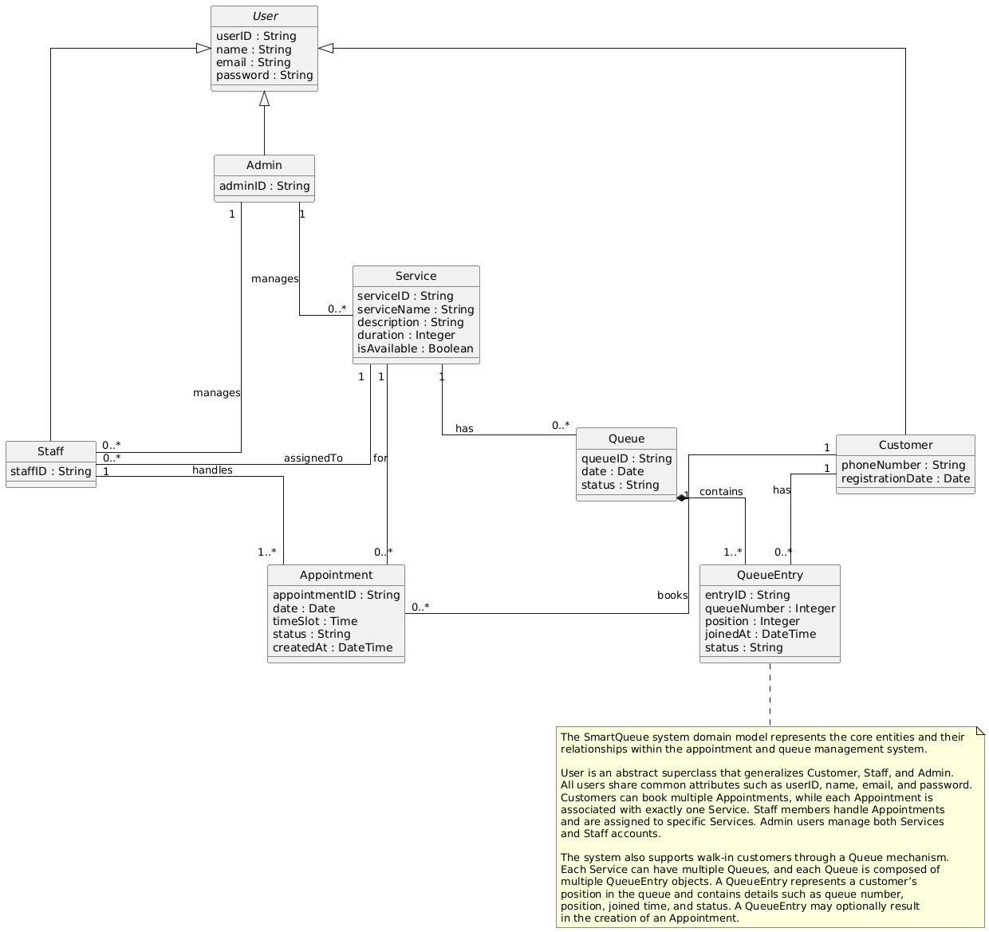
Analysis — Domain Model
Core entities: User (Customer / Staff / Admin), Service, Appointment, Queue, QueueEntry. Customer books Appointments; Service has a Queue; Queue contains QueueEntries.
SmartQueue QMS | CSCI 6234 Spring 2026 | Group 06

Slide 8
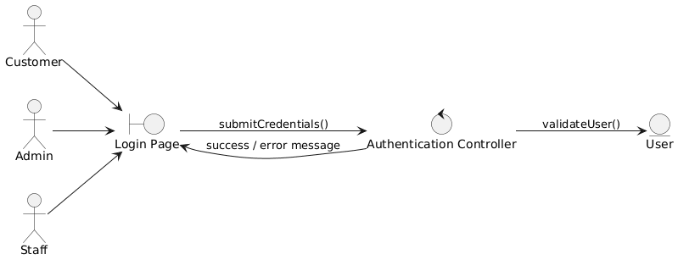
Analysis — Robustness Diagram: Register / Login
Robustness / Sequence Diagram (Actor → Boundary → Control → Entity)
Actor → Login Page → Authentication Controller → User Entity. Credentials validated; success or error returned.
SmartQueue QMS | CSCI 6234 Spring 2026 | Group 06

Slide 9
Analysis — Robustness Diagram: Handle Invalid Credentials
When credentials fail validation, the controller returns an error message rendered on the Login Page.
SmartQueue QMS | CSCI 6234 Spring 2026 | Group 06

Slide 10
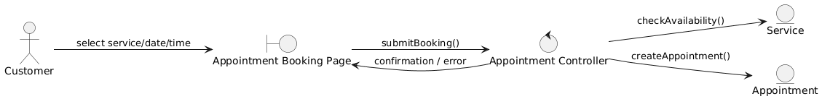
Analysis — Robustness Diagram: Book Appointment
Customer selects Service, Date, and Time Slot. Controller checks availability; creates Appointment entity on success.
SmartQueue QMS | CSCI 6234 Spring 2026 | Group 06

Slide 11
Analysis — Robustness Diagram: Cancel Appointment
Customer selects an existing appointment. Controller updates Appointment status to CANCELLED.
SmartQueue QMS | CSCI 6234 Spring 2026 | Group 06

Slide 12
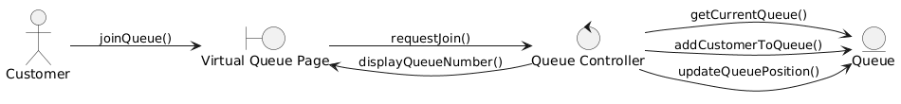
Analysis — Robustness Diagram: Join Virtual Queue
Customer requests to join a service queue. Controller adds QueueEntry and returns the assigned queue position.
SmartQueue QMS | CSCI 6234 Spring 2026 | Group 06

Slide 13
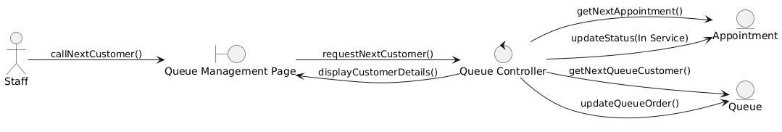
Analysis — Robustness Diagram: Call Customer & Complete Service
Staff calls next customer from the Queue Management page. Controller retrieves next appointment/queue entry and updates statuses.
SmartQueue QMS | CSCI 6234 Spring 2026 | Group 06

Slide 14
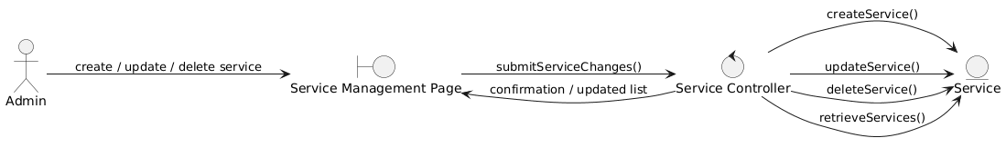
Analysis — Robustness Diagram: Manage Service
Admin performs CRUD operations on Services via Service Controller. Changes persisted to the Service entity.
SmartQueue QMS | CSCI 6234 Spring 2026 | Group 06

Slide 15
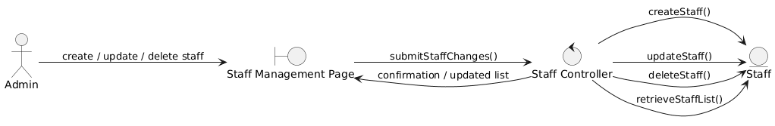
Analysis — Robustness Diagram: Manage Staff Account
Admin performs CRUD operations on Staff accounts via Staff Controller. Changes persisted to the Staff entity.
SmartQueue QMS | CSCI 6234 Spring 2026 | Group 06

Slide 16
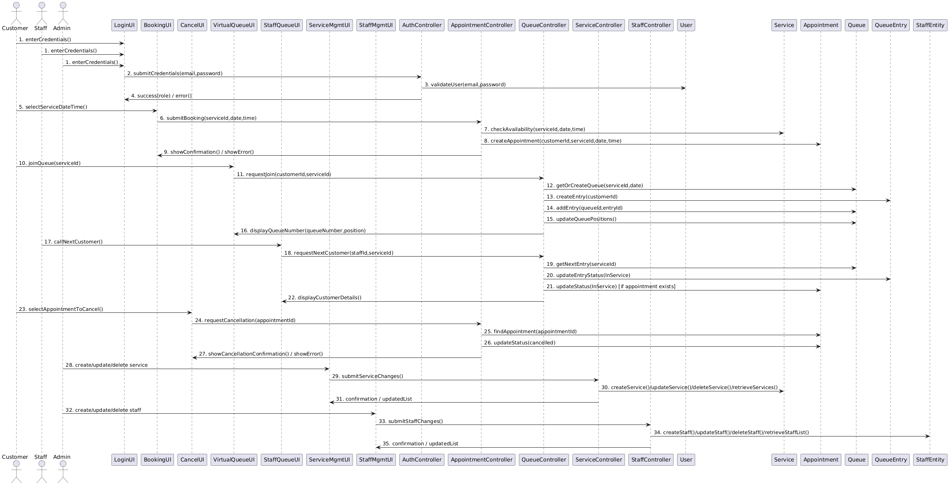
Analysis — Collaboration Diagram: Full Project
Communication Diagram showing object interactions
Full Collaboration Diagram for the project
SmartQueue QMS | CSCI 6234 Spring 2026 | Group 06

Slide 17
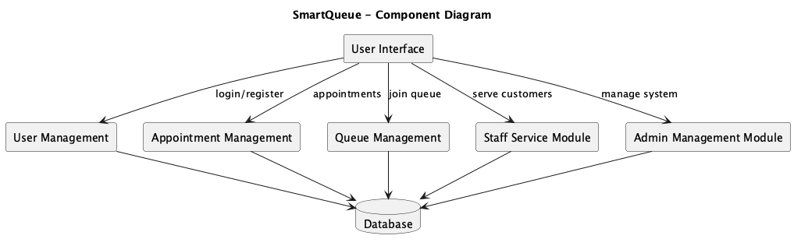
Design — Component Diagram
High-level system component architecture
UI → User Management, Appointment Management, Queue Management, Staff Service Module, Admin Management Module → Database.
SmartQueue QMS | CSCI 6234 Spring 2026 | Group 06

Slide 18
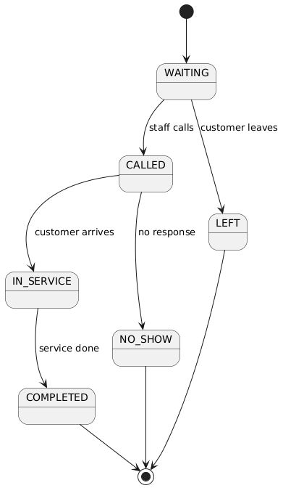
Design — State Diagram: QueueEntry Lifecycle
State machine for QueueEntry object
States: WAITING → CALLED → IN_SERVICE → COMPLETED. Alternative transitions: WAITING→LEFT, WAITING/CALLED→NO_SHOW.
SmartQueue QMS | CSCI 6234 Spring 2026 | Group 06

Slide 19
Architecture Summary
Layered Architecture: UI → Controllers → Services → Database
OO Patterns Applied
Inheritance: User → Customer / Staff / Admin
Composition: Queue ◆── QueueEntry
MVC-style separation: Boundary / Control / Entity
Design Artifacts Produced
Use Case, Activity, Domain Model
8 Sequence (Robustness) Diagrams
Collaboration, Class, Component, State Diagrams
All diagrams authored in PlantUML and version-controlled via Git
SmartQueue QMS | CSCI 6234 Spring 2026 | Group 06

Slide 20
Conclusion
OO Analysis
Impact
OO Design
Comprehensive domain and robustness modeling using UML
Eliminates physical queues, improves service efficiency
Class, Component, State & Collaboration diagrams
Thank You | SmartQueue QMS | CSCI 6234 Spring 2026 | Group 06

