Slide 1
SmartQueue
Final Project Presentation
Queue Management System
16th, April 2026
CSCI 6234 | Object-Oriented Analysis & Design
Spring 2026 | Group 06
Yashika LNU
Avish Kaushik

Slide 2
Agenda
Project Vision
Requirements
Use Case Diagram
Analysis Model
Activity Diagram
Domain Model
Robustness Diagrams
Collaboration Diagram
Design Model
Class Diagram
Sequence Diagram
User Interface Design Prototype
Conclusion
SmartQueue QMS | CSCI 6234 Spring 2026 | Group 06

Slide 3
Project Vision
The Problem
The Solution
Long physical queues cause customer frustration, staff inefficiency, and service bottlenecks. No real-time visibility into waiting times or appointment scheduling leads to poor service quality.
SmartQueue is a digital Queue Management System (QMS) enabling customers to book appointments and join virtual queues remotely — eliminating physical lines and streamlining service delivery.
Key Features
Virtual Queue
Appointment Booking
Real-Time Updates
Role-Based Access
Join service queues without physical presence
Schedule appointments with date/time selection
Live queue position and status notifications
Customer, Staff, and Admin portals
SmartQueue QMS | CSCI 6234 Spring 2026 | Group 06

Slide 4
System Actors & Use Cases
Customer
Staff
Admin
Register / Login
Call Next Customer
Manage Services
Book Appointment
Complete Service
Manage Staff Accounts
Cancel Appointment
Join Virtual Queue
SmartQueue QMS | CSCI 6234 Spring 2026 | Group 06

Slide 5
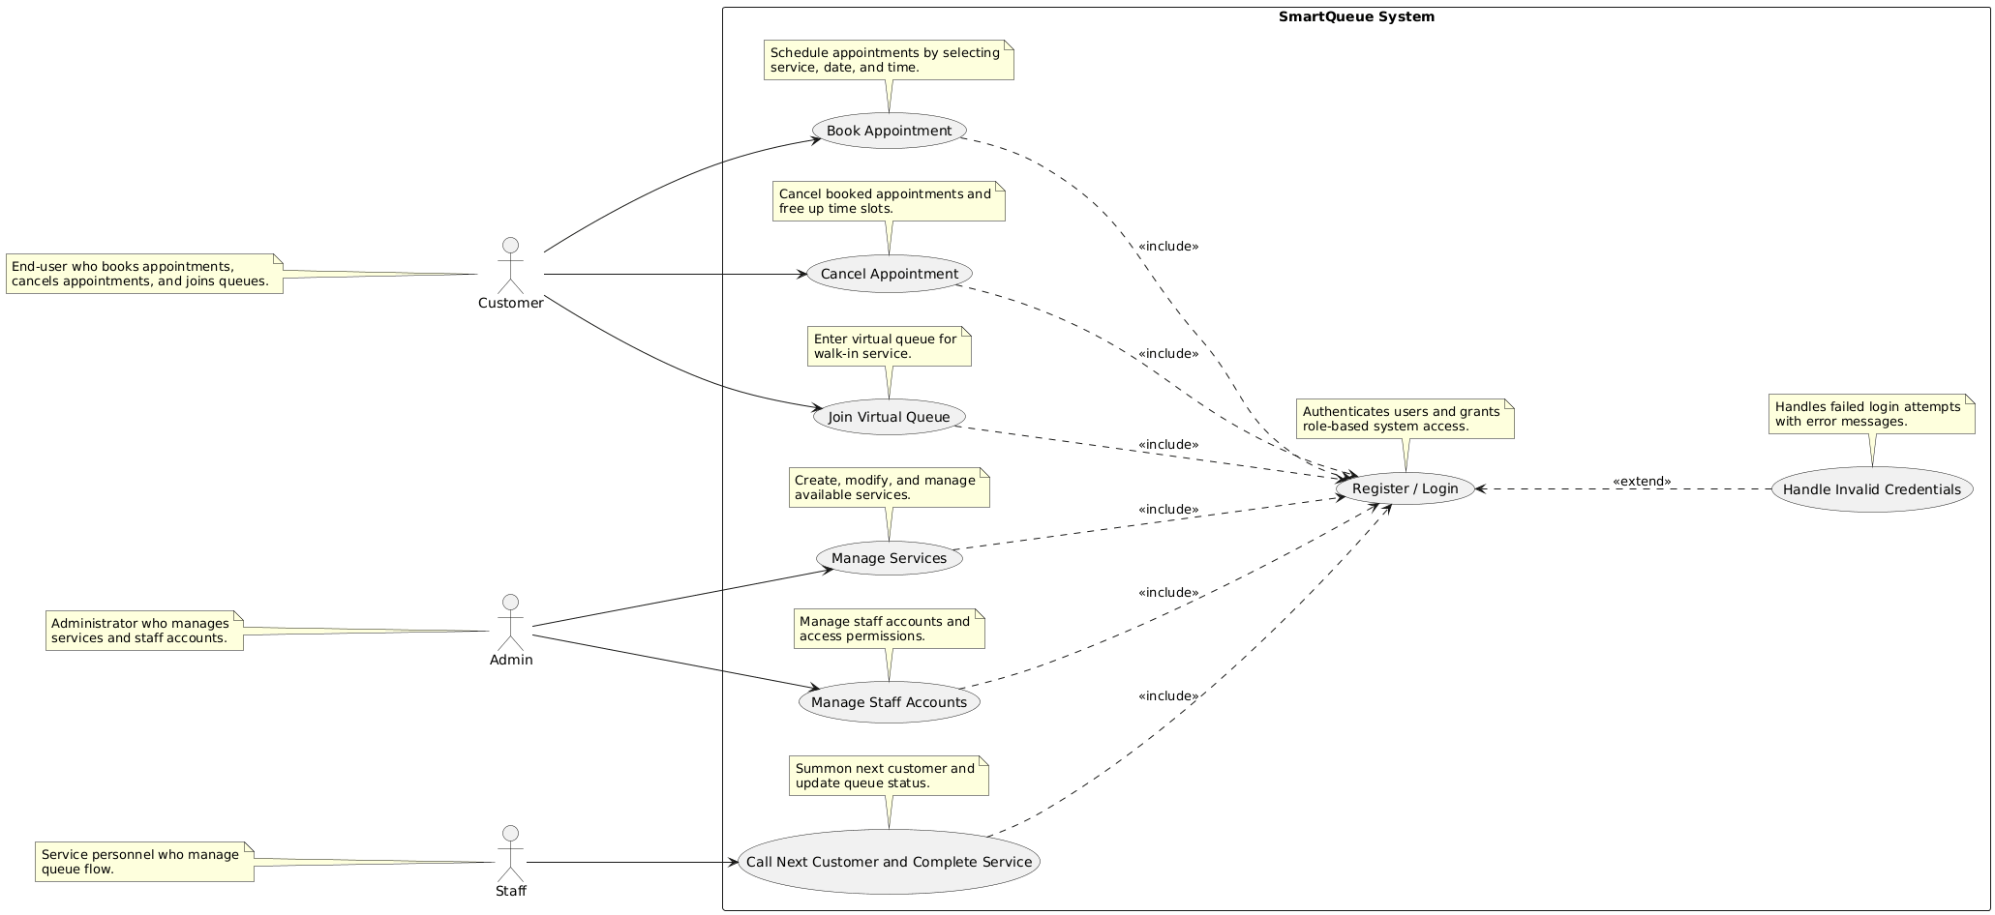
Requirements — Use Case Diagram
SmartQueue supports three actor types: Customer, Staff, and Admin. All use cases include the Register/Login use case.
SmartQueue QMS | CSCI 6234 Spring 2026 | Group 06

Slide 6
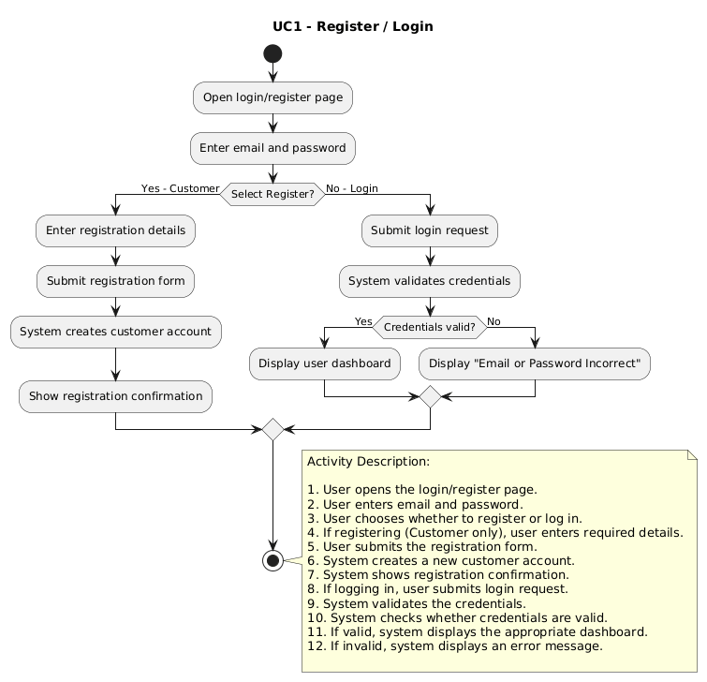
Analysis — Activity Diagram
Use Case 1 – Register/Login
User opens the login/register page.
User enters email and password.
User chooses whether to register or log in.
If registering (Customer only), user enters required details.
User submits the registration form.
System creates a new customer account.
System shows registration confirmation.
If logging in, user submits login request.
System validates the credentials.
System checks whether credentials are valid.
If valid, system displays the appropriate dashboard.
If invalid, system displays an error message.
SmartQueue QMS | CSCI 6234 Spring 2026 | Group 06

Slide 7
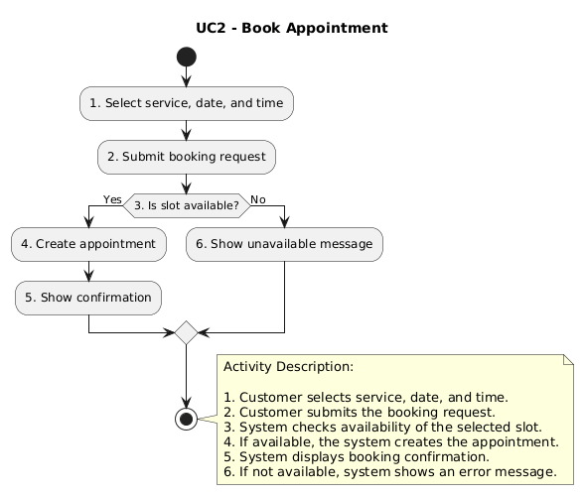
Analysis — Activity Diagram
Use Case 2 - Book Appointment
Customer selects service, date, and time.
Customer submits the booking request.
System checks availability of the selected slot.
If available, the system creates the appointment.
System displays booking confirmation.
If not available, system shows an error message.
SmartQueue QMS | CSCI 6234 Spring 2026 | Group 06

Slide 8
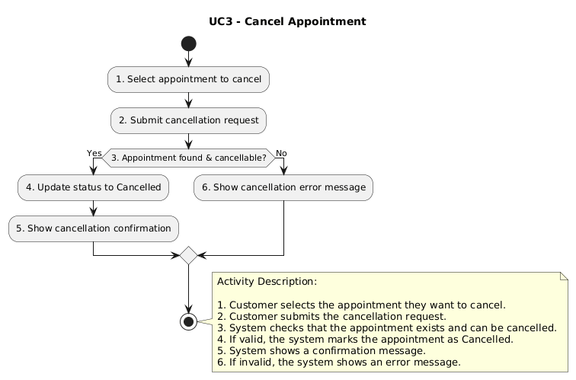
Analysis — Activity Diagram
Use Case 3 - Cancel Appointment
Customer selects the appointment they want to cancel.
Customer submits the cancellation request.
System checks that the appointment exists and can be cancelled
If valid, the system marks the appointment as Cancelled.
System shows a confirmation message.
If not available, system shows an error message.
SmartQueue QMS | CSCI 6234 Spring 2026 | Group 06

Slide 9
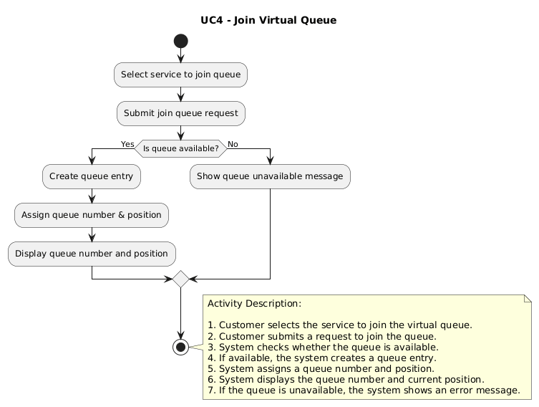
Analysis — Activity Diagram
Use Case 4 - Join Virtual Queue
Customer selects the service to join the virtual queue.
Customer submits a request to join the queue.
System checks whether the queue is available.
If available, the system creates a queue entry.
System assigns a queue number and position.
System displays the queue number and current position.
If the queue is unavailable, the system shows an error message.
SmartQueue QMS | CSCI 6234 Spring 2026 | Group 06

Slide 10
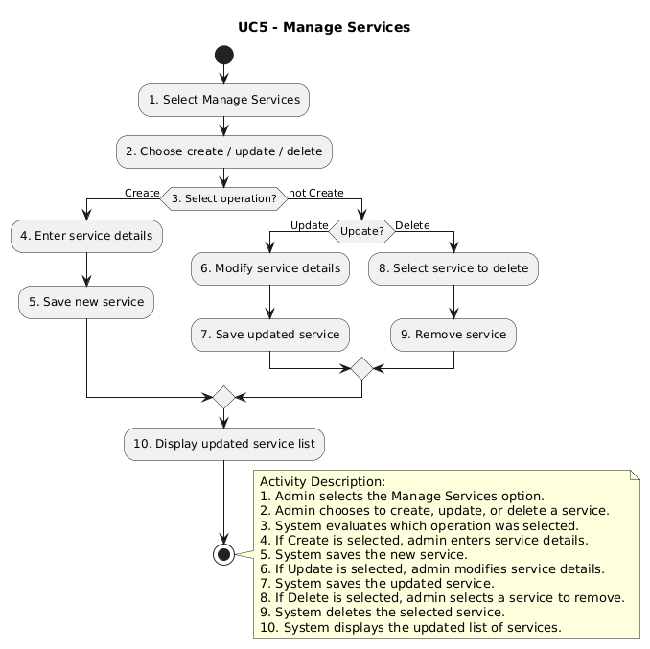
Analysis — Activity Diagram
Use Case 5 - Manage Service
Admin selects the Manage Services option.
Admin chooses to create, update, or delete a service.
System evaluates which operation was selected.
If Create is selected, admin enters service details.
If Update is selected, admin modifies service details.
System saves the updated service
If Delete is selected, admin selects a service to remove.
System deletes the selected service
System displays the updated list of services.
SmartQueue QMS | CSCI 6234 Spring 2026 | Group 06

Slide 11
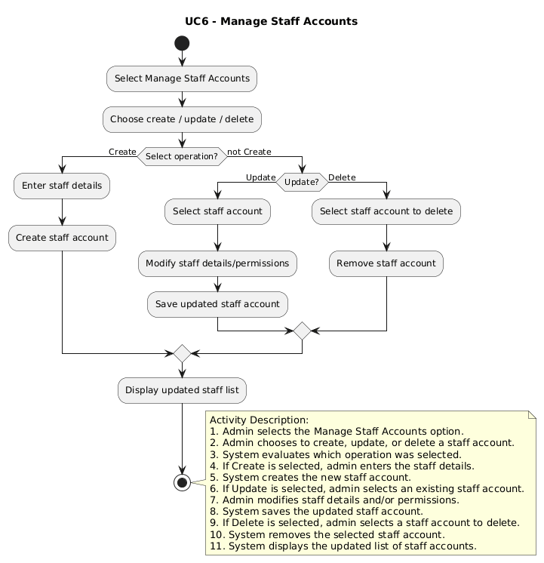
Analysis — Activity Diagram
Use Case 6 - Manage Staff Account
Admin selects the Manage Staff Accounts option.
Admin chooses to create, update, or delete a staff account.
System evaluates which operation was selected.
If Create is selected, admin enters the staff details.
System creates the new staff account.
If Update is selected, admin selects an existing staff account.
Admin modifies staff details and/or permissions.
System saves the updated staff account.
If Delete is selected, admin selects a staff account to delete.
System removes the selected staff account.
System displays the updated list of staff accounts.
SmartQueue QMS | CSCI 6234 Spring 2026 | Group 06

Slide 12
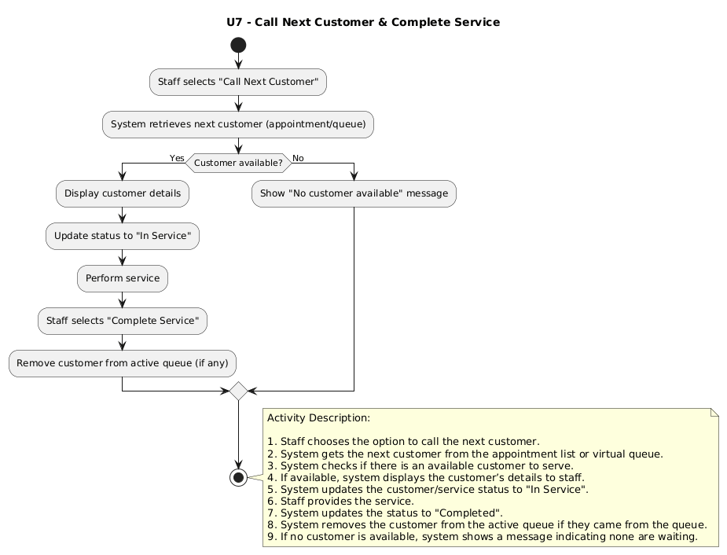
Analysis — Activity Diagram
Use Case 7 - Call Customer and Complete Service
Staff chooses the option to call the next customer.
System gets the next customer from the appointment list or virtual queue.
System checks if there is an available customer to serve.
If available, system displays the customer’s details to staff.
System updates the customer/service status to "In Service".
Staff provides the service.
System updates the status to "Completed".
System removes the customer from the active queue if they came from the queue.
If no customer is available, system shows a message indicating none are waiting.
SmartQueue QMS | CSCI 6234 Spring 2026 | Group 06

Slide 13
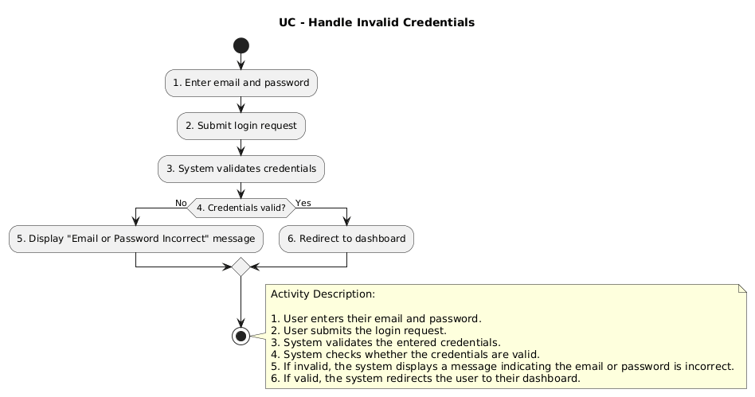
Analysis — Activity Diagram
Use Case 8 - Handle Invalid Credentials
User enters their email and password.
User submits the login request.
System validates the entered credentials.
System checks whether the credentials are valid.
If invalid, the system displays a message indicating
the email or password is incorrect.
If valid, the system redirects the user to their dashboard.
SmartQueue QMS | CSCI 6234 Spring 2026 | Group 06

Slide 14
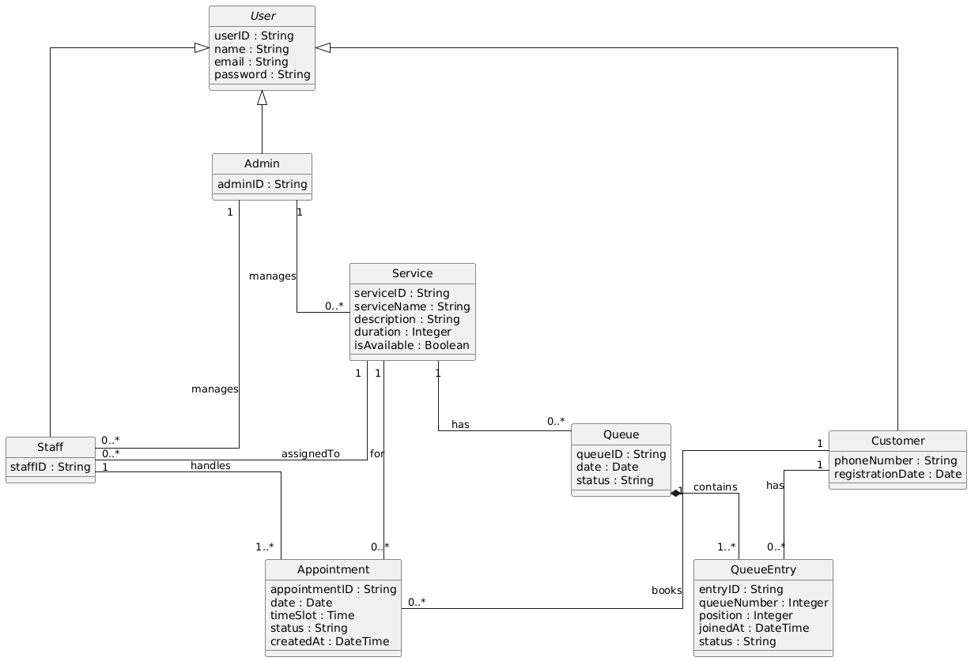
Analysis — Domain Model
Core entities: User (Customer / Staff / Admin), Service, Appointment, Queue, QueueEntry. Customer books Appointments; Service has a Queue; Queue contains QueueEntries.
SmartQueue QMS | CSCI 6234 Spring 2026 | Group 06

Slide 15
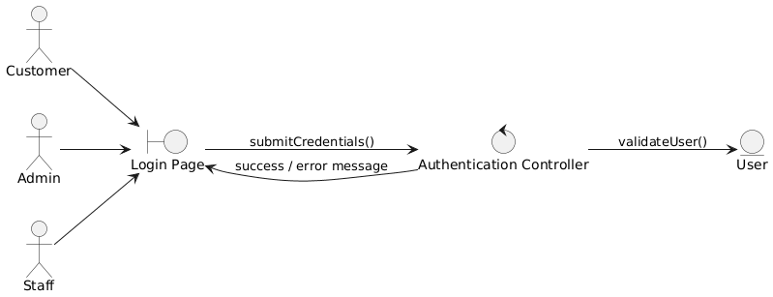
Analysis — Robustness Diagram
Robustness / Sequence Diagram (Actor → Boundary → Control → Entity)
Use Case 1 – Register/Login
Actor → Login Page → Authentication Controller → User Entity. Credentials validated; success or error returned.
SmartQueue QMS | CSCI 6234 Spring 2026 | Group 06

Slide 16
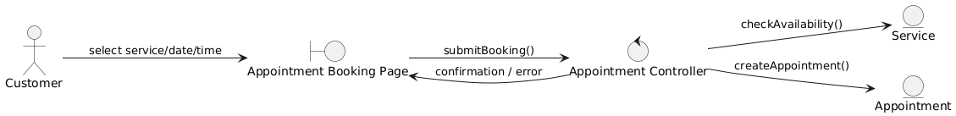
Analysis — Robustness Diagram
Use Case 2 – Book Appointment
Customer selects Service, Date, and Time Slot. Controller checks availability; creates Appointment entity on success.
SmartQueue QMS | CSCI 6234 Spring 2026 | Group 06

Slide 17
Analysis — Robustness Diagram
Use Case 3 – Cancel Appointment
Customer selects an existing appointment. Controller updates Appointment status to CANCELLED.
SmartQueue QMS | CSCI 6234 Spring 2026 | Group 06

Slide 18
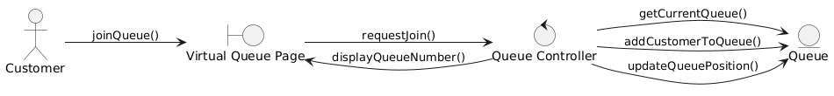
Analysis — Robustness Diagram
Use Case 4 – Join Virtual Queue
Customer requests to join a service queue. Controller adds QueueEntry and returns the assigned queue position.
SmartQueue QMS | CSCI 6234 Spring 2026 | Group 06

Slide 19
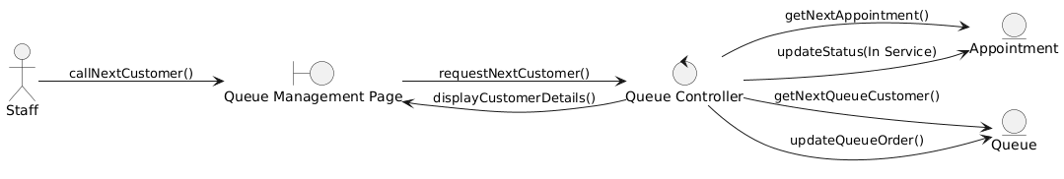
Analysis — Robustness Diagram
Use Case 5 – Call Customer and Complete Service
Staff calls next customer from the Queue Management page. Controller retrieves next appointment/queue entry and updates statuses.
SmartQueue QMS | CSCI 6234 Spring 2026 | Group 06

Slide 20
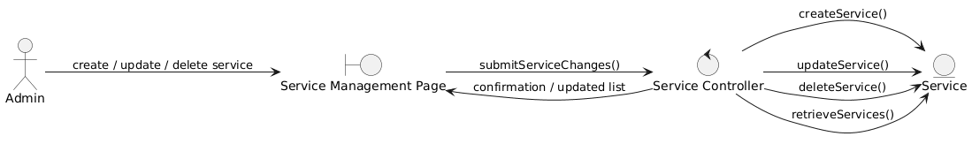
Analysis — Robustness Diagram
Use Case 6 – Manage Service
Admin performs CRUD operations on Services via Service Controller. Changes persisted to the Service entity.
SmartQueue QMS | CSCI 6234 Spring 2026 | Group 06

Slide 21
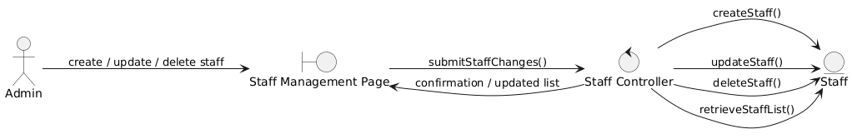
Analysis — Robustness Diagram
Use Case 7 – Manage Staff Account
Admin performs CRUD operations on Staff accounts via Staff Controller. Changes persisted to the Staff entity.
SmartQueue QMS | CSCI 6234 Spring 2026 | Group 06

Slide 22
Analysis — Robustness Diagram
Use Case 8 – Handle Invalid Credentials
When credentials fail validation, the controller returns an error message rendered on the Login Page.
SmartQueue QMS | CSCI 6234 Spring 2026 | Group 06

Slide 23
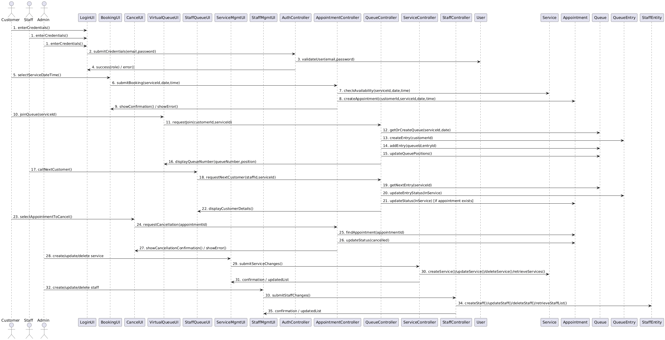
Analysis — Collaboration Diagram: Full Project
Communication Diagram showing object interactions
Full Collaboration Diagram for the project
SmartQueue QMS | CSCI 6234 Spring 2026 | Group 06

Slide 24
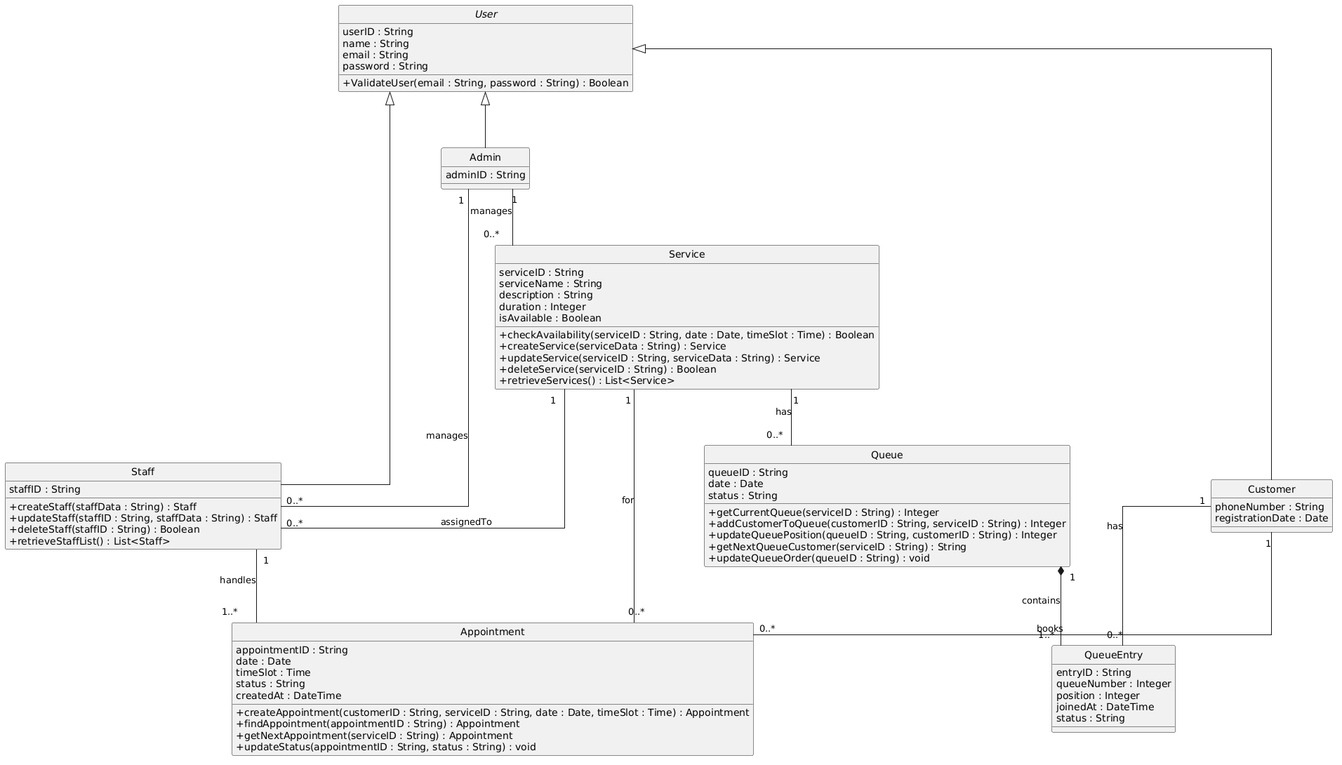
Design — Class Diagram
High-level system component architecture
UI → User Management, Appointment Management, Queue Management, Staff Service Module, Admin Management Module → Database.
SmartQueue QMS | CSCI 6234 Spring 2026 | Group 06

Slide 25
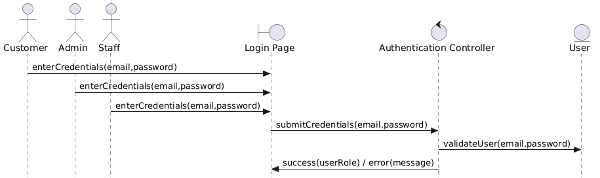
Design — Sequence Diagram
Sequence Diagram (Actor → Boundary → Control → Entity)
Use Case 1 – Register/Login
Actor → Login Page → Authentication Controller → User Entity. Credentials validated; success or error returned.
SmartQueue QMS | CSCI 6234 Spring 2026 | Group 06

Slide 26
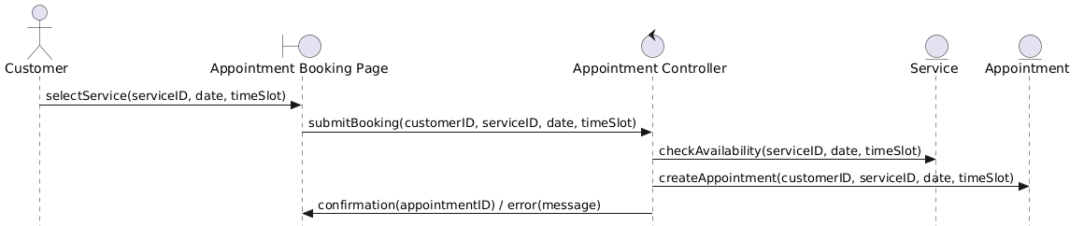
Design — Sequence Diagram
Use Case 2 – Book Appointment
Customer selects Service, Date, and Time Slot. Controller checks availability; creates Appointment entity on success.
SmartQueue QMS | CSCI 6234 Spring 2026 | Group 06

Slide 27
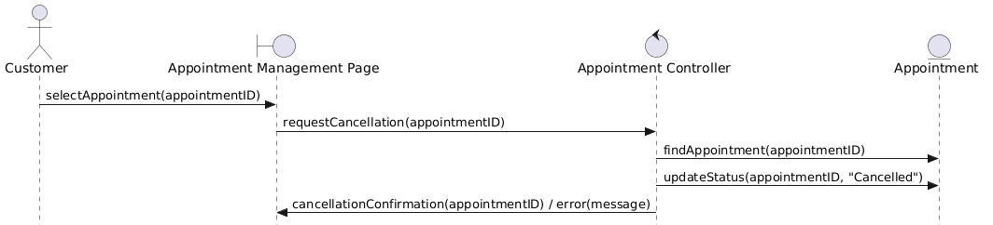
Design — Sequence Diagram
Use Case 3 – Cancel Appointment
Customer selects an existing appointment. Controller updates Appointment status to CANCELLED.
SmartQueue QMS | CSCI 6234 Spring 2026 | Group 06

Slide 28
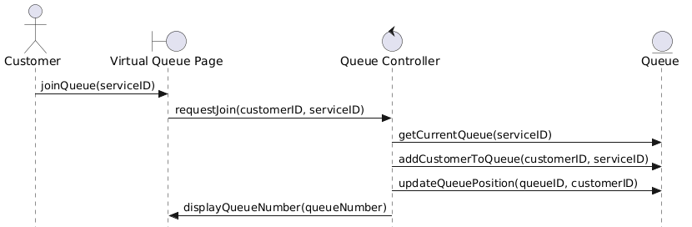
Design — Sequence Diagram
Use Case 4 – Join Virtual Queue
Customer requests to join a service queue. Controller adds QueueEntry and returns the assigned queue position.
SmartQueue QMS | CSCI 6234 Spring 2026 | Group 06

Slide 29
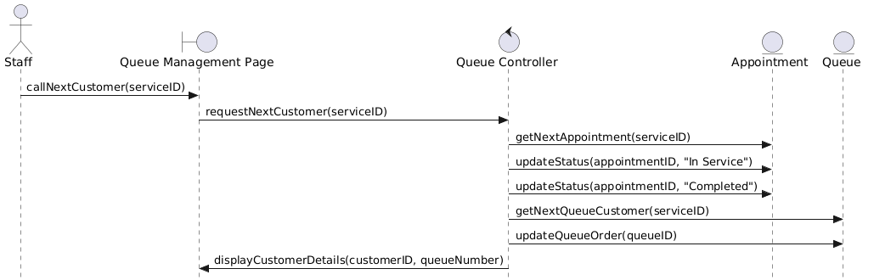
Design — Sequence Diagram
Use Case 5 – Call Customer and Complete Service
Staff calls next customer from the Queue Management page. Controller retrieves next appointment/queue entry and updates statuses.
SmartQueue QMS | CSCI 6234 Spring 2026 | Group 06

Slide 30
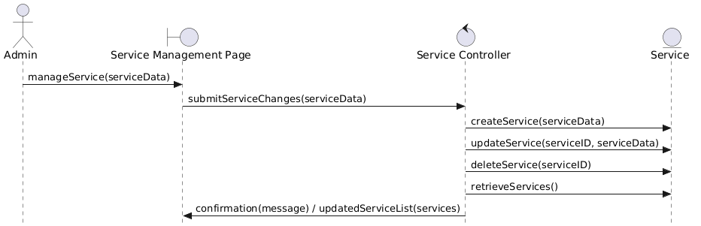
Design — Sequence Diagram
Use Case 6 – Manage Service
Admin performs CRUD operations on Services via Service Controller. Changes persisted to the Service entity.
SmartQueue QMS | CSCI 6234 Spring 2026 | Group 06

Slide 31
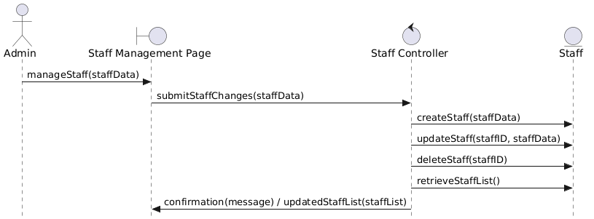
Design — Sequence Diagram
Use Case 7 – Manage Staff Account
Admin performs CRUD operations on Staff accounts via Staff Controller. Changes persisted to the Staff entity.
SmartQueue QMS | CSCI 6234 Spring 2026 | Group 06

Slide 32
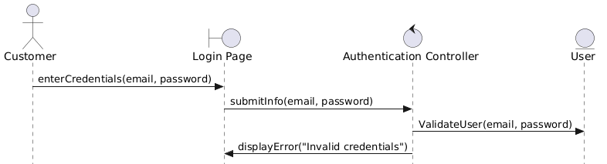
Design — Sequence Diagram
Use Case 8 – Handle Invalid Credentials
When credentials fail validation, the controller returns an error message rendered on the Login Page.
SmartQueue QMS | CSCI 6234 Spring 2026 | Group 06

Slide 33
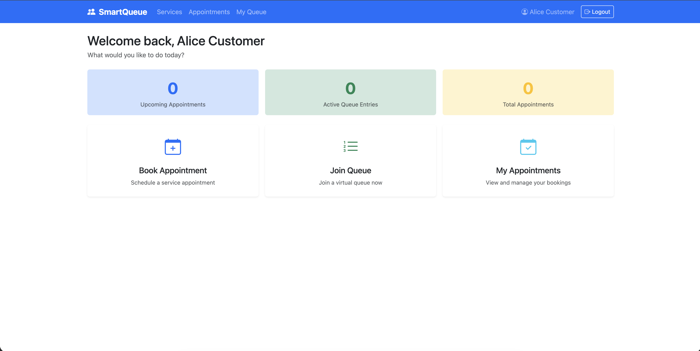
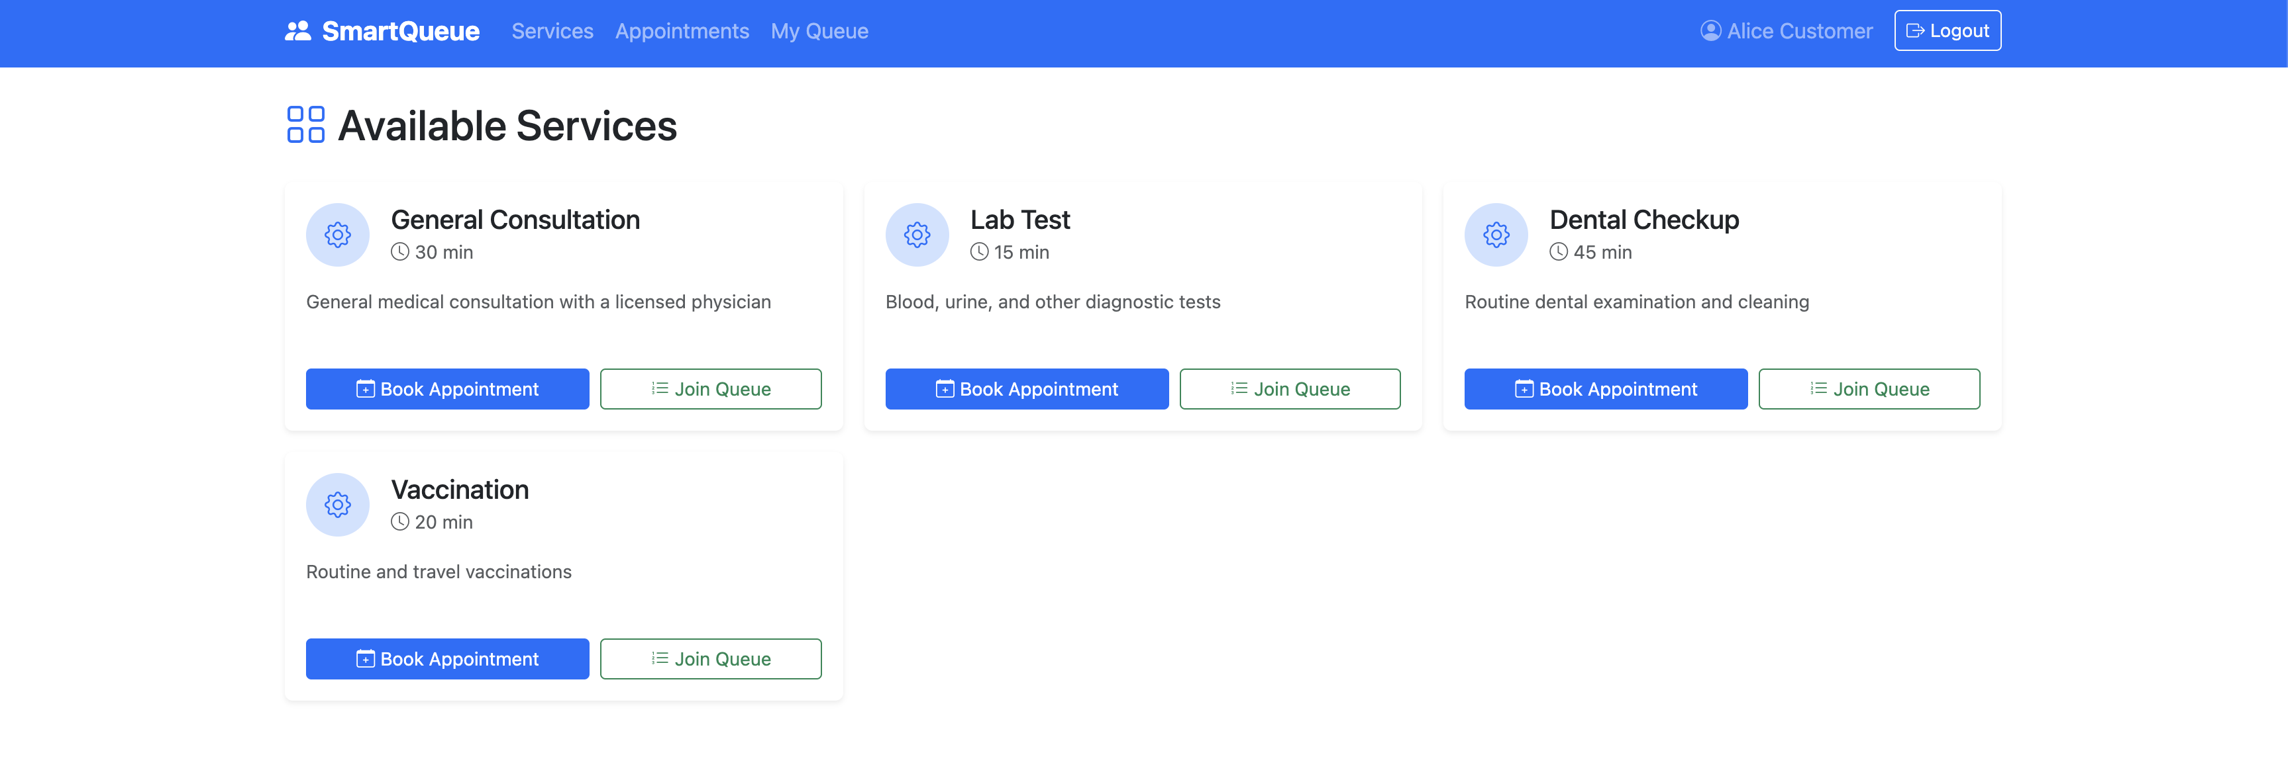
User Interface Design
User’s/Customer’s landing page
List of all the available services
SmartQueue QMS | CSCI 6234 Spring 2026 | Group 06

Slide 34
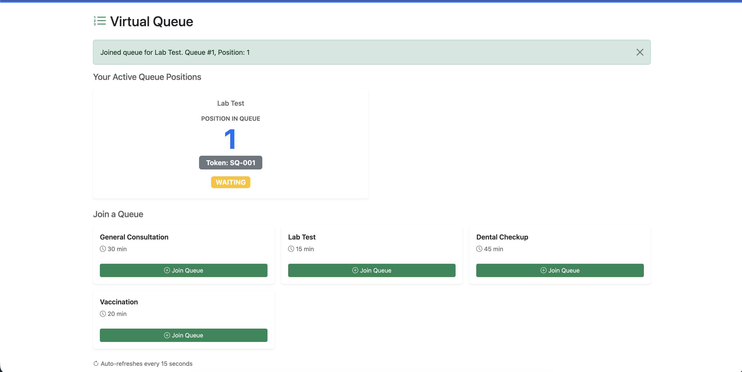
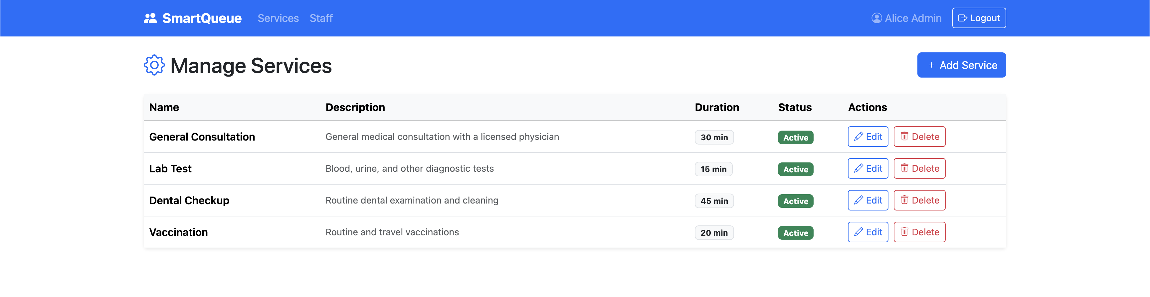
User Interface Design
Join Virtual Queue Interface for Users
Manage Services for admin
SmartQueue QMS | CSCI 6234 Spring 2026 | Group 06

Slide 35
Architecture Summary
Layered Architecture: UI → Controllers → Services → Database
OO Patterns Applied
Inheritance: User → Customer / Staff / Admin
Composition: Queue ◆── QueueEntry
MVC-style separation: Boundary / Control / Entity
Design Artifacts Produced
Use Case, Activity, Domain Model
8 Sequence (Robustness) Diagrams
Collaboration, Class, Component, State Diagrams
All diagrams authored in PlantUML and version-controlled via Git
Hosted Application - https://smartqueue-sandy.vercel.app/
SmartQueue QMS | CSCI 6234 Spring 2026 | Group 06

Slide 36
SmartQueue
Thank you!

