Slide 1
Intrusion Detection System
By- Vandan Pandya(2100996)
Avisha Singh(2088371)
Aditya Shah(2088748)
Satya Anusha Atluri(2139399)

Slide 2
Introduction
Cyber attacks nowadays are difficult to detect, therefore we need a system that can learn the nature of attacks itself and take actions.
Objective of the project is to train a system using Algorithms such as logistic regression, Naïve bayes, Decision Tree, Random forest, Gradient boosting using dimensionality reduction techniques (feature selection, PCA) to detect attacks.
Dataset used is CICIDS2017 and 13 types of attacks were executed.
Evaluation metrics used are Recall, Precision and Accuracy.

Slide 3

Literature Review
Shone et al. [7] proposed a network intrusion detection system based on a Non-Symmetric Deep Auto-Encoder technique. The final classifier is a random forest, which is made up of two NDAEs stacked on top of each other.
Tang et al. [8] introduced a software-defined network (SDN) intrusion detection system (IDS) (SDN). The IDS model was deployed on the SDN controller. It has several layers of buried information in its neurons
[9] described a network-based intrusion detection system. on automatic decoders They used principal component analysis (PCA) to reduce dimensionality and save just the most significant characteristics before sending the data to an auto encoder with a support vector machine (SVM) as a classifier. Abusitta and colleagues.

Slide 4
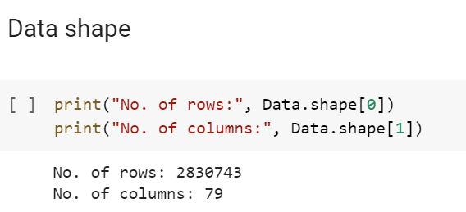
Data Description
CICIDS2017 dataset was used to implement and evaluate our proposed model as it contains all necessary criteria for reliable network intrusion detection
The dataset contains data captured over 5 days starting on Monday through Friday.
With each day containing
specific type of attack
except for Monday, which
captured data containing
normal traffic flow.
The attacks include DoS, DDoS, Brute Force, XSS, SQL Injection, Infiltration, Portscan, and Botnet.

Slide 5
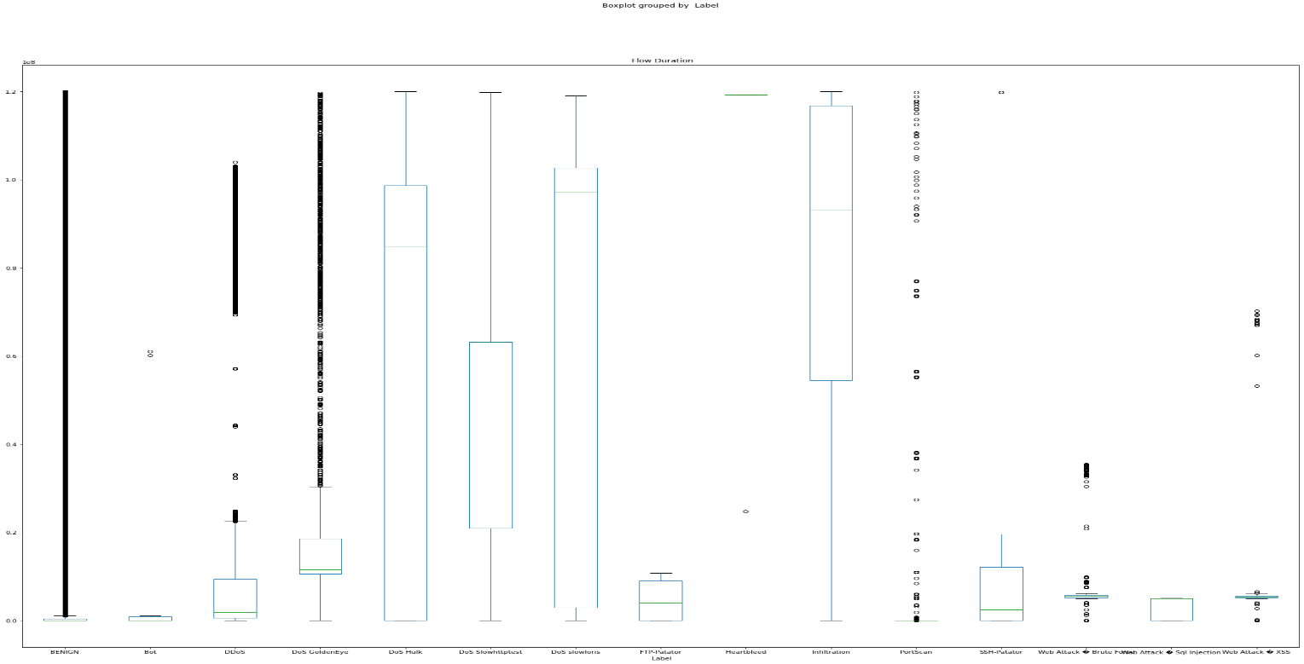
Exploratory Data Analysis
The dataset for our data is of the shape 2830743x79.
The feature “Flow bytes” has 1358 missing values in the dataset which are missing completely at random.
1358 missing values were replaced with the median of the values so that the data does not get skewed.
There are 13 different types of attacks and 1 benign flow.
Class benign has a lot of outliers for all of the features, DDOS, DOS goldeneye, DOS hulk, DOS slow http request, and DOS slow loris have values scattered over a long range

Slide 6
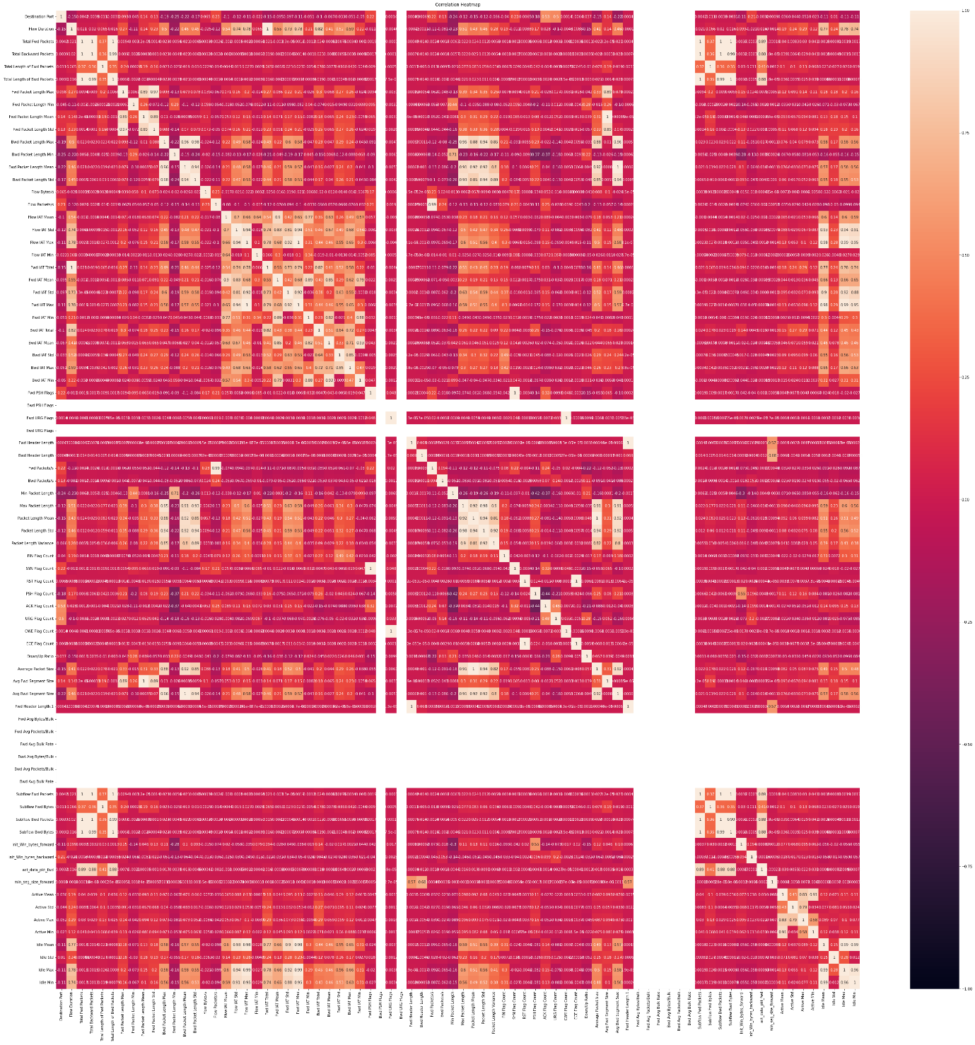
The features Max packet length and packet length std have a high correlation of 0.98.
Fwd Packets and flow packets are highly correlated with a correlation of 0.99.
Avg bwd segment size and bwd packet length mean are highly correlate with a high correlation coefficient of 0.96.

Slide 7
Data Preprocessing
Data Pre-processing is a process which is used to transform the raw dataset into a clean data set.
In data preprocessing step, we first separate the dependent and the independent features.
Next, we replace all the infinity values with 0 in our dataset.
We then use MinMaxScaler to normalize our dataset to values between 0 and 1.
In the next step, we use label encoder to label encode the dependent features.

Slide 8
Dimensionality Reduction
Feature Selection using Random Forest Classifier:
Finding the feature importance with the help of the Random Forest Classifier fall under the category of Embedded methods.
At each node, the dataset is split into 2 buckets by the tree with each having observations that are similar to one another and differ from those in the other bucket.
The top 20 features from the feature importance were considered for training the model.

Slide 9
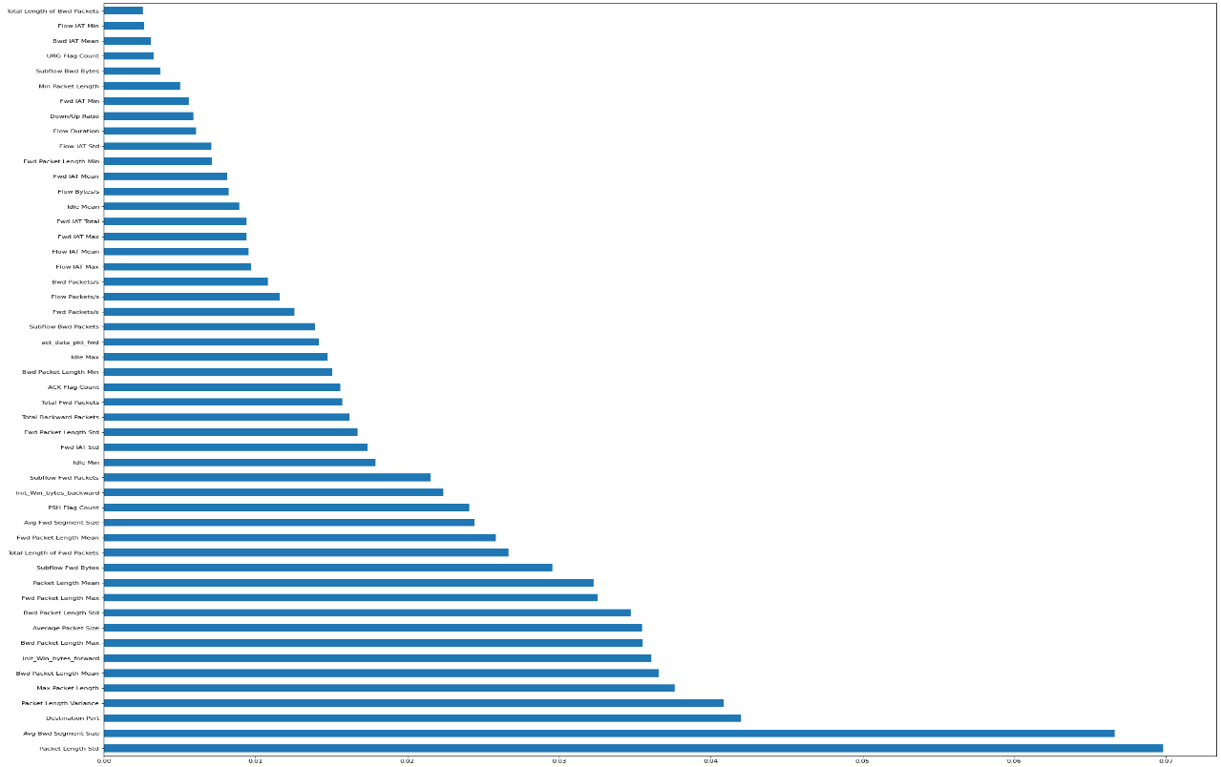
Results
The results of the feature importance using Random Forest is shown in the figures 21 and 22:
Figure 21- Feature Importances computed Using Random Forest Classifier

Slide 10
Principal Component Analysis
Principal Component Analysis reduces the number of features in the dataset but it maintains most of the vital information of the dataset.
Moreover, by making use of PCA, the issue of overfitting can be significantly reduced as it removes the features with a very high correlation
The explained variance is the amount of variance in terms of percentage which is attributed to each of the selected components.
With the explained variance of nearly 98-99%, we have 15 principal components that can be used for model training.

Slide 11
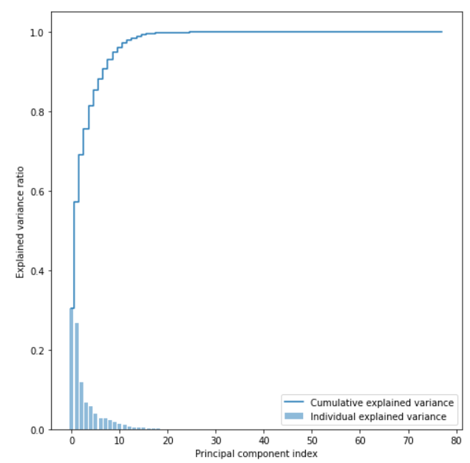
Figure 22- Principal Component Analysis results using explained variance

Slide 12
Model Training
The dataset with 2830743 rows and 79 features was split with 80% of the data used for training and the rest 20% for testing.
The following two methods for reducing the dimensionality for training the model are used since, too many features can lead to overfitting –
-Feature Selection through Random Forest
-Principal Component Analysis through explained variance
Supervised machine learning models were used because they measure its accuracy through loss function and it keeps on adjusting until the error has been sufficiently minimized.
Six different supervised ML models were used-
-Logistic Regression
-Naïve Bayes
-Decision Tree
-Random Forest
-Gradient Boosting

Slide 13


Methodologies
Logistic Regression
Logistic regression is one of the simpler and easier models to train, in the process of classification.
But a limitation of Logistic Regression is that it could be very efficient only when the dataset has features that are linearly separable.
Linearly separable data are very rare to find in real-world scenarios.
The train and test classification report using the 20 features extracted from Random Forest Classifier is shown below:
Figure 3- Train Classification Report Figure 4- Test Classification Report

Slide 14


Naïve Bayes
The core of the Naïve Bayes Classifier is based on the Bayes Theorem. It assumes independence among predictors.
In a number of real-world scenarios, the Naïve Bayes model can be applied without accepting Bayesian probability or making use of any of the Bayesian methods.
Naive Bayes is an uncomplicated process for building classifiers: models assigning class labels to problem instances that are depicted as vectors of values of features, where the class labels are drawn from some finite set.
The train and test classification report using the 20 features extracted from Random Forest Classifier is shown below.
Figure 7- Train Classification Report Figure 8- Test Classification Report

Slide 15

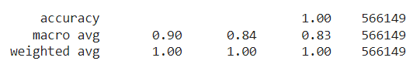
Decision Tree
The decision tree model works by transforming the data into a tree representation.
One main difficulty in working with the Decision tree model is that even a small change in the data will result in a rather huge change in the optimal decision tree.
It is also not so efficient in predicting continuous values.
The train and test classification report using the 20 features extracted from Random Forest Classifier is shown below:
Figure 11- Train Classification Report Figure 12- Test Classification Report

Slide 16
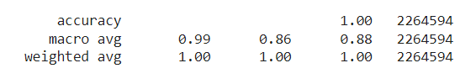

Random Forest
The Random Forest model uses the Decision tree model for its prediction.
One of the main cons of this method is that it is time-consuming and much harder than other models.
The computational resources required are also much greater.
The train and test classification report using the 20 features extracted from Random Forest Classifier is shown below:
Figure 15- Train Classification Report Figure 16- Test Classification Report

Slide 17


Gradient Boosting
Another model considered was the gradient boosting model.
This model is known to be one of the most powerful techniques in ML for predictive models.
It is known to be helpful in reducing variance and bias in a machine learning model.
The main advantages of this model are that they are more accurate in comparison with other models, and this model can train faster, especially on larger datasets.
The train and test classification report using the 20 features extracted from Random Forest Classifier is shown below:
Figure 19- Train Classification Report Figure 20- Test Classification Report

Slide 18
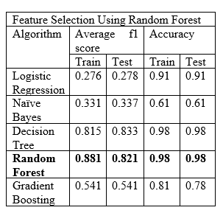
Results

Slide 19
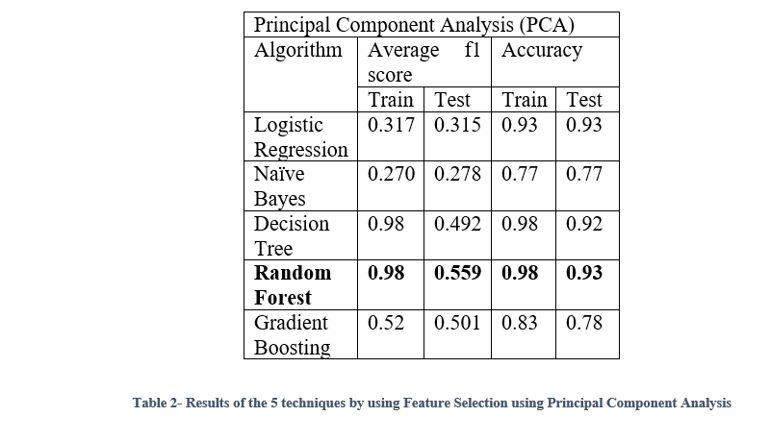

Slide 20
Conclusion
From the results in Table 1 and Table 2, we can conclude that Random forest outperforms all other algorithms with both dimensionality reduction techniques.
However, feature selection using random forest works better compared to Principal component analysis on Train and Test data. Random Forest has an average f1 score of 0.881 and 0.821 on the train test respectively, and accuracy of 0.98 and 0.98 on the train test respectively.
These results depict that to perform detection of attacks, we can leverage random forests.

Slide 21
References
Adel Abusitta, Martine Bellaiche, Michel Dagenais, and Talal Halabi, "A deep learning method for proactive multi-cloud cooperative intrusion detection system," Future Generation Computer Systems, Volume 98, Pages 308-318, ISSN 0167-739X, 2019.
Dimensionality Reduction for Network Anomalies Detection: A Deep Learning Approach, Dawoud A., Shahristani S., Raun C. (2019). Xhafa F., Enokido T., Barolli L., Takizawa M., Takizawa M., Takizawa M., Takizawa M., Takizawa M., Takizawa M., Takiza (eds) Web, AI, and Network Applications are all examples of web-based applications. WAINA 2019 will be held this year.Volume 927 of Advances in Intelligent Systems and Computing. Springer
T. A. Tang, L. Mhamdi, D. McLernon, S. A. R. Zaidi, and M. Ghogho, "Deep learning technique for Network Intrusion Detection in Software Defined Networking," in 2016 International Conference on Wireless Networks and Mobile Communications (WINCOM), Fez, pp. 258-263.

Slide 22
Thank you slide

