Slide 1

INTENSITY AND POLARIZATION MODULATION BASED PHOTONIC TRANSCEIVER DESIGN
This project is submitted in partial fulfilment of the requirements for the degree of
Master of Technology
Submitted By
ARNAV MUKHOPADHYAY
Roll: 97/RPM/161 001
Regs.: 133-1121-0041-13
Specialization – Nanoelectronics & Photonics
Under the Guidance of
Professor Abhirup Das Barman
INSTITUTE OF RADIOPHYSICS AND ELECTRONICS, UNIVERSITY OF CALCUTTA
Sisir Mitra Bhavan, 92 APC Roy Road, Kolkata – 700009, West Bengal India

Slide 2
OBJECTIVE
Highlight limitations of Electronics based transceiver and discuss the requirements for the Photonics based design
Design Photonic based Up and Down Converter using MZM and Study its Linearity
Design Photonic transceiver based on Polarization Modulator. Study its Linearity
Comparative analysis BTB and down conversion data network utilizing Photonic based transceiver

Slide 3
FEATURES OF MICROWAVE PHOTONICS
Can generate high quality signals required for applications like Interferometric Radar, High Precision and Sensitive applications
Generated frequency can span from microwave to millimeter wave
Simultaneous coherent waveform can be generated
Nonlinearity can be used for implementing complex data processing algorithm
Frequency translation (up and down conversion) can be implemented

Slide 4
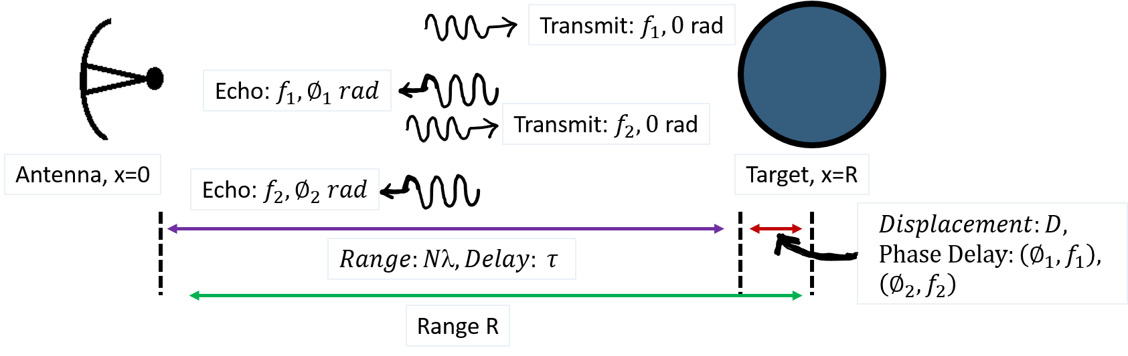
INTERFEROMETRY BASED RADAR
$Phase Delay : ∅_{1}= \frac{2π f_{1}}{c}×2 \left(Nλ+D \right)=\frac{2πf_{1}}{c}×2$D, for f₁; $∅_{2}= \frac{2πf_{2}}{c}×2$D for f₂
$$Differential Phase \left(measured by Interference\right): ∆∅= \frac{2π ∆f}{c}×2D, ∆f= f_{2} − f_{1}$$
$$Unambiguous Diplacement \left(∆∅=2π\right): D_{max}= \frac{c}{2 ∆f}=\frac{150 mm}{∆f (GHz)}, ∆f= f_{2} − f_{1}$$
Atmospheric attenuation is frequency dependent
Received signal SNR must be high (Use Step-Frequency CW Radar)
Transmitted frequencies must be of high quality (Coherent and Low Phase Noise) (Use Microwave Photonics)

Slide 5
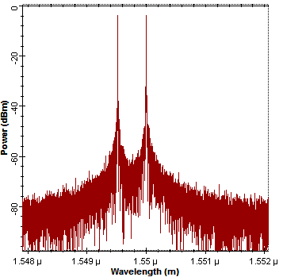
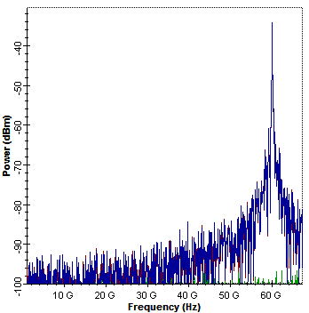
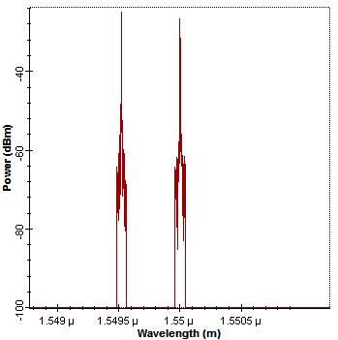
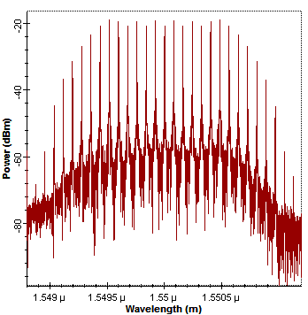
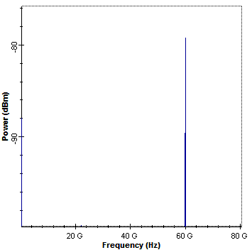
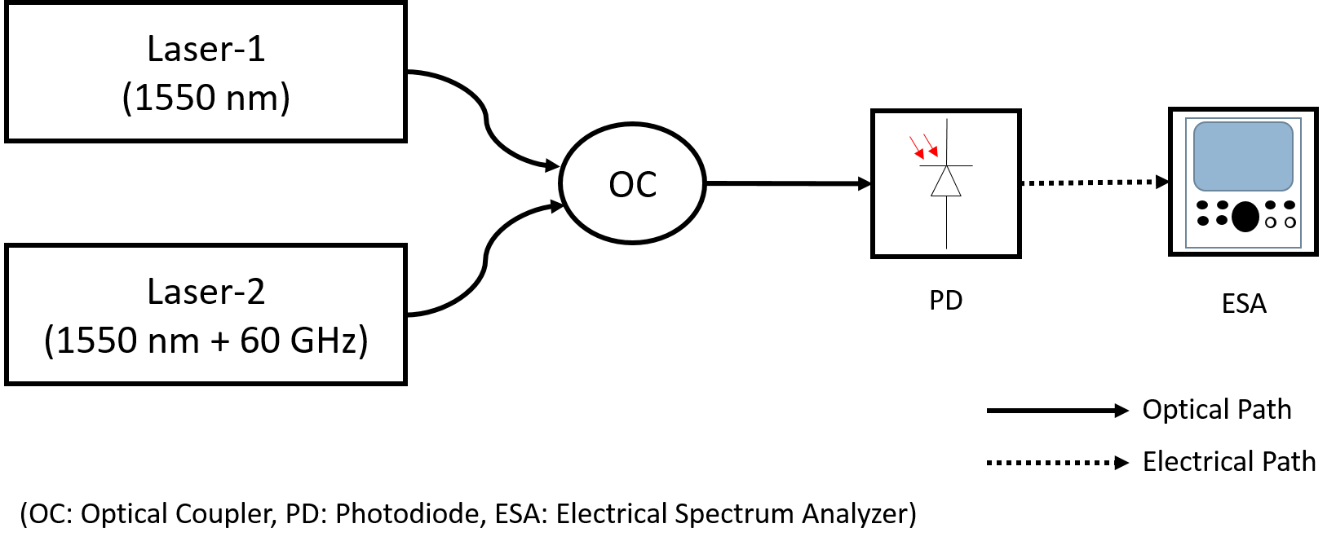
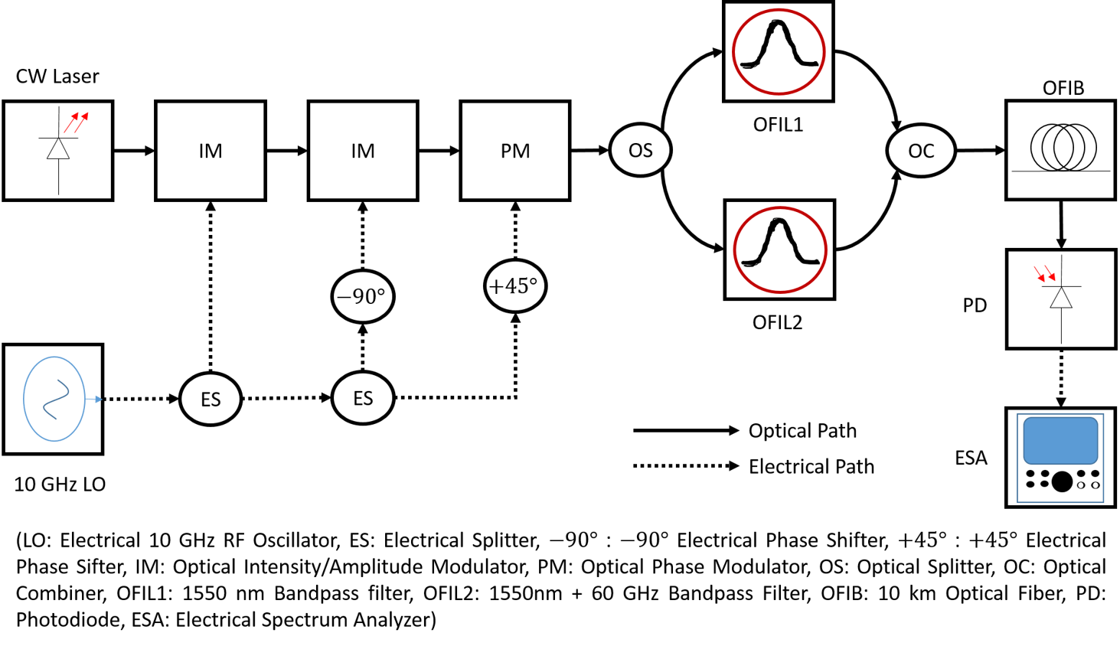
MICROWAVE PHOTONICS FREQUENCY GENERATION
Optical Heterodyning:
Optical Comb generation:
Independent Laser Sources leads to Phase Noise
Highly Coherent and low phase noise of generated microwave

Slide 6
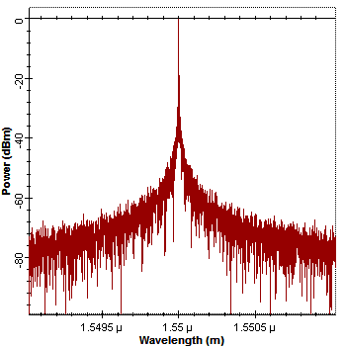
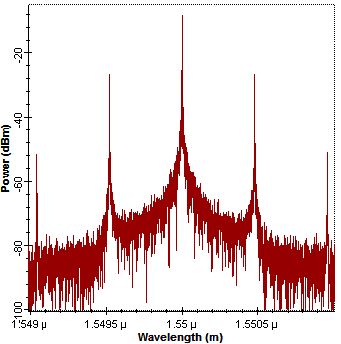
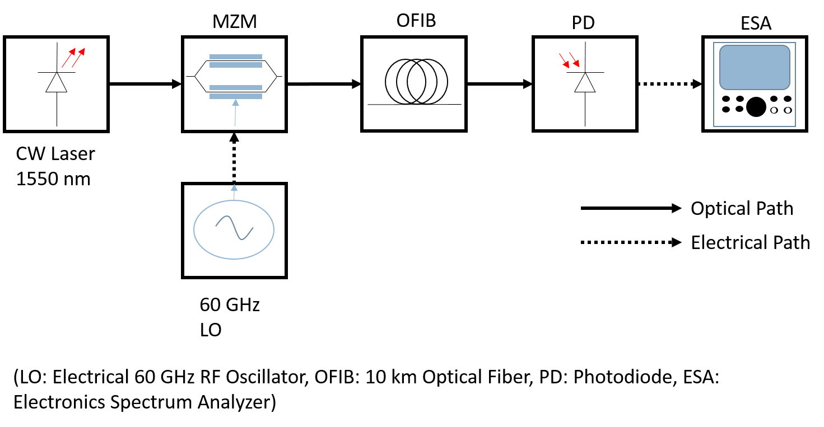
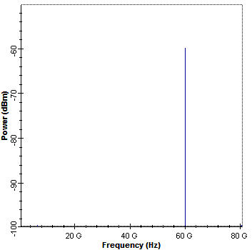
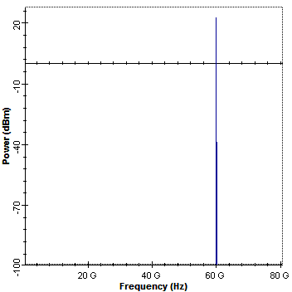
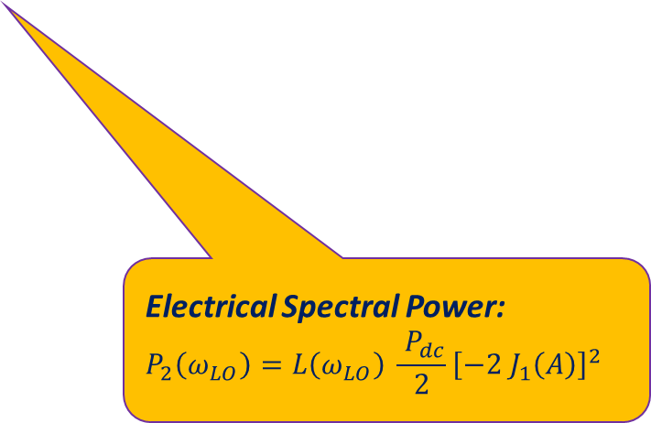
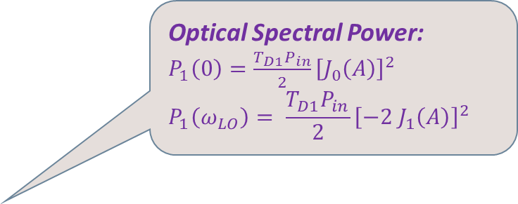

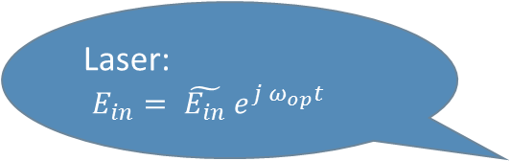
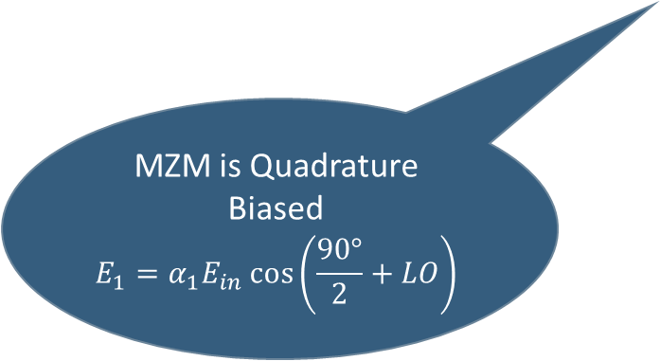
MICROWAVE PHOTONICS FREQUENCY GENERATION
External (MZM) Modulation:
60 GHz
Optical Spectral Power:
$P_{1}\left(0\right)=\frac{T_{D1}P_{in}}{2}{\left[J_{0}\left(A\right)\right]}^{2}$
$$P_{1}\left(ω_{LO}\right)= \frac{T_{D1}P_{in}}{2}{\left[−2 J_{1}\left(A\right)\right]}^{2}$$
Laser:
$E_{in}= \tilde{E_{in}} e^{j ω_{op}t}$
60 GHz
MZM is Quadrature Biased
$$E_{1}=α_{1}E_{in}\cos\left(\frac{90°}{2}+LO\right)$$
60 GHz
$$V_{LO}= \tilde{V_{LO}}\cos{ω_{LO}t}$$
Electrical Spectral Power:
$$P_{2}\left(ω_{LO}\right)=L\left(ω_{LO}\right) \frac{ P_{dc}}{2}{\left[−2 J_{1}\left(A\right)\right]}^{2}$$

Slide 7
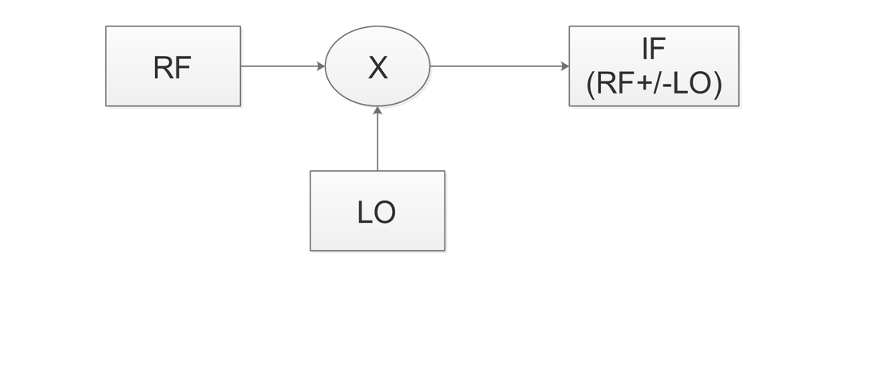
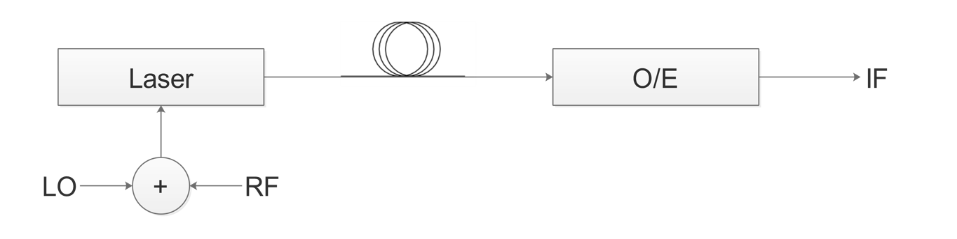
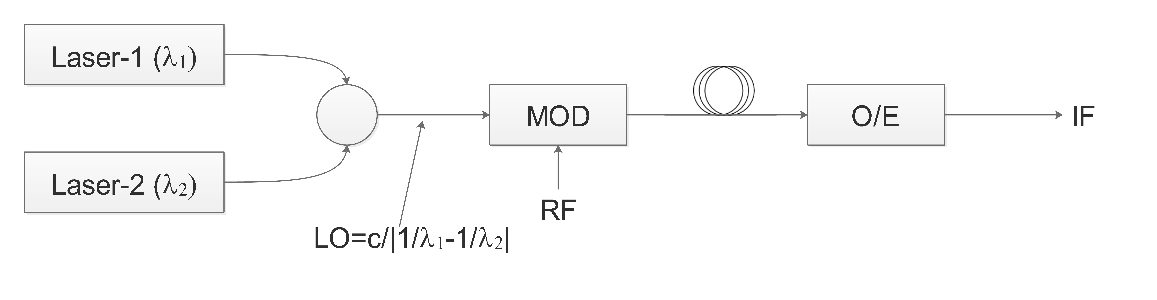
TRANSCEIVER
OBJECTIVE:
A schematic that can be used to do UP AND DOWN-CONVERSION, without a lot of design changes.
Much lower phase noise than electrical counterpart
RF and LO Isolation
Scalability
RF Mixer (Basis for Photonic Transceiver)
Direct Modulation (Pros.: Simple, Low Cost)
(Cons.: Limited Bandwidth, Chirping)
Ext. Mod. with Multiple Laser (Pros.: mmWave LO capable)
(Cons.: High Phase Noise)

Slide 8
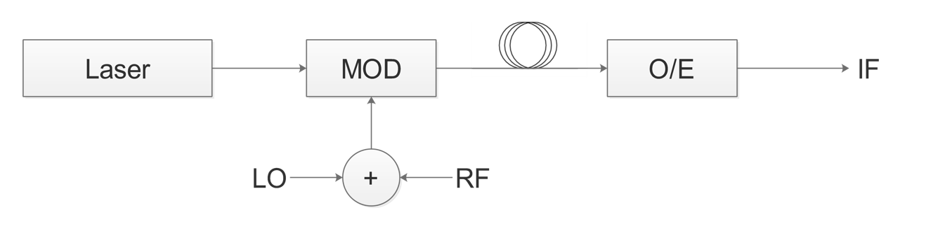
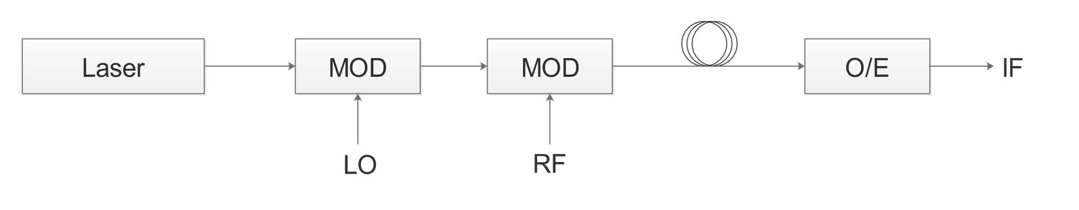
TRANSCEIVER
OBJECTIVE:
A schematic that can be used to do UP AND DOWN-CONVERSION, without a lot of design changes.
Much lower phase noise than electrical counterpart
RF and LO Isolation
Scalability
Ext. Mod. With Single Mod. (Pros.: High Bandwidth and Speed)
(Cons.: Limited LO-RF Isolation)
Ext. Mod. With Cascaded Mod. (Pros.: High Bandwidth, Speed, Isolation; Any LO stage useable)

Slide 9
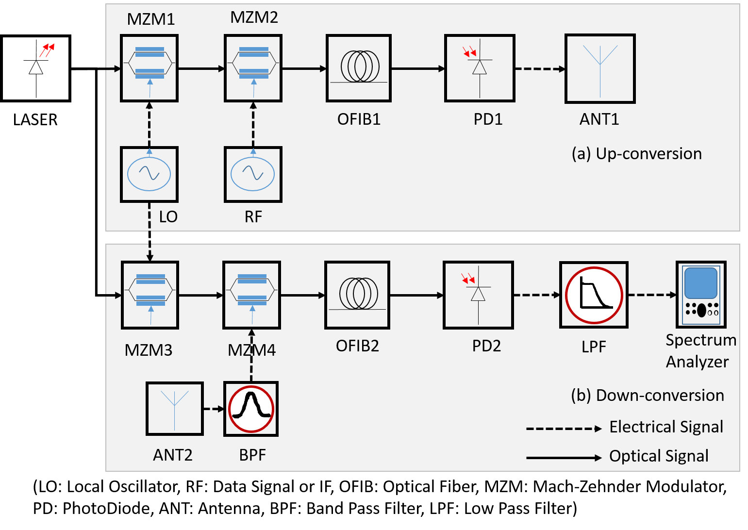
MZM based Up and Down-Conversion
Schematic

Slide 10
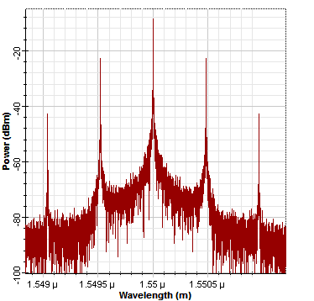
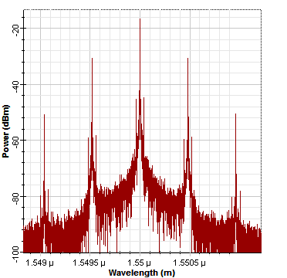
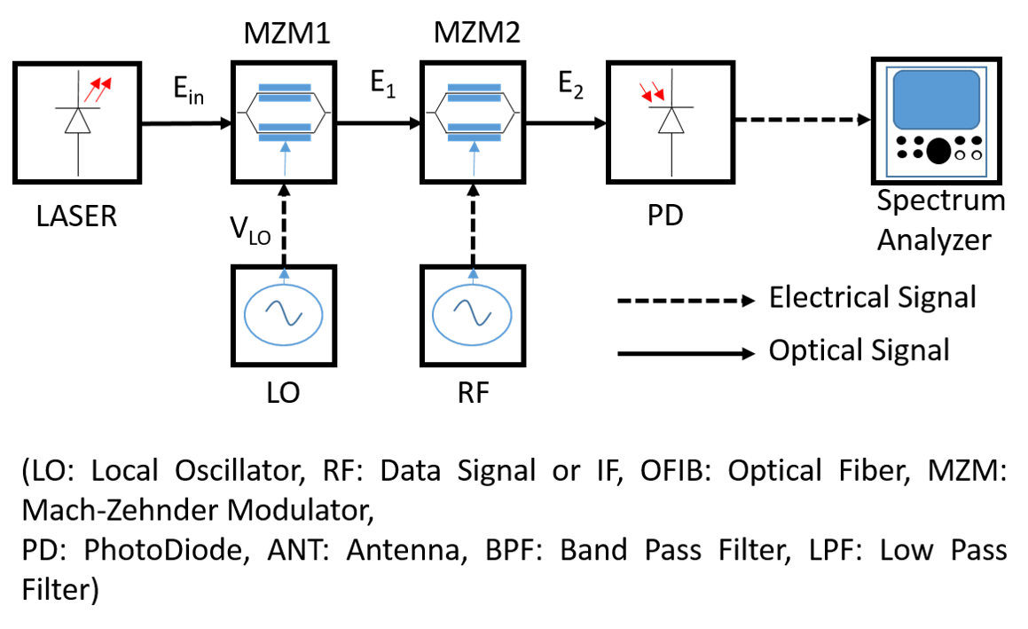
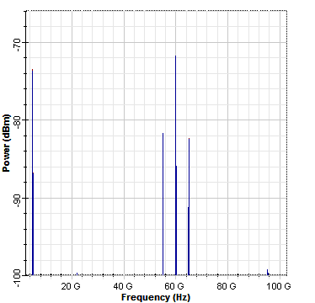
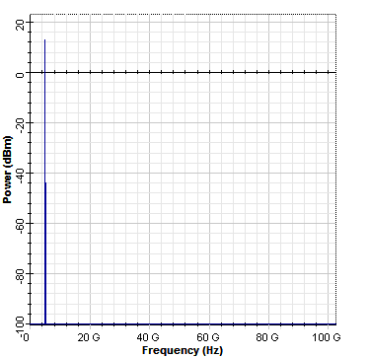
MZM based Up-Conversion
60 GHz
60 GHz
5 GHz
5 GHz
60 GHz
55 GHz
65 GHz
5 GHz

Slide 11
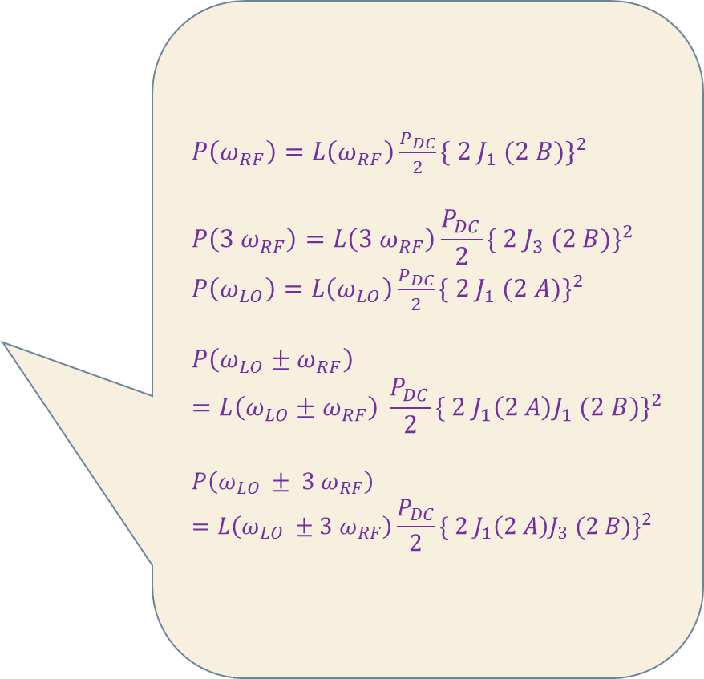


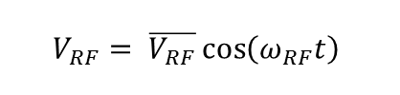
MZM based Up-Conversion
$P_{2}\left(0\right)=\frac{T_{D}P_{in}}{2}{\left[J_{0}\left(A\right)J_{0}\left(B\right)\right]}^{2}$
$$P_{2}\left(ω_{RF}\right)= \frac{T_{D}P_{in}}{2}{\left[−2 J_{0}\left(A\right)J_{1}\left(B\right)\right]}^{2}$$
$$P_{2}\left(2 ω_{RF}\right)= \frac{T_{D}P_{in}}{2}{\left[−2 J_{0}\left(A\right)J_{2}\left(B\right)\right]}^{2}$$
$P\left(ω_{RF}\right)=L\left(ω_{RF}\right)\frac{P_{DC}}{2}{\{ 2 J_{1} (2 B)\}}^{2}$
$$P\left(3 ω_{RF}\right)=L\left({3 ω}_{RF}\right)\frac{P_{DC}}{2}{\{ 2 J_{3} (2 B)\}}^{2}$$
$P\left(ω_{LO}\right)=L\left(ω_{LO}\right)\frac{P_{DC}}{2}{\{ 2 J_{1} (2 A)\}}^{2}$
$$P\left(ω_{LO}±ω_{RF}\right)=L\left(ω_{LO}±ω_{RF}\right) \frac{P_{DC}}{2}{\{ 2 J_{1}\left(2 A\right)J_{1} (2 B)\}}^{2}$$
$$P\left(ω_{LO} ± {3 ω}_{RF}\right)=L\left(ω_{LO} ±{3 ω}_{RF}\right)\frac{P_{DC}}{2}{\{ 2 J_{1}\left(2 A\right)J_{3} (2 B)\}}^{2}$$
$P_{2}\left(ω_{LO}\right)= \frac{T_{D}P_{in}}{2}{\left[−2 J_{1}\left(A\right)J_{0}\left(B\right)\right]}^{2}$
$P_{2}\left(ω_{LO}± ω_{RF}\right)= \frac{T_{D}P_{in}}{2}{\left[2 J_{1}\left(A\right)J_{1}\left(B\right)\right]}^{2}$
$P_{2}\left(ω_{LO}± 2 ω_{RF}\right)= \frac{T_{D}P_{in}}{2}{\left[2 J_{1}\left(A\right)J_{2}\left(B\right)\right]}^{2}$
$$V_{RF}= \overline{V_{RF}}\cos\left(ω_{RF}t\right)$$

Slide 12
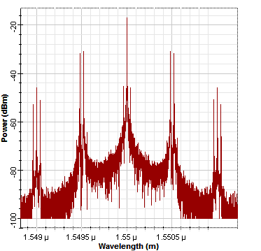
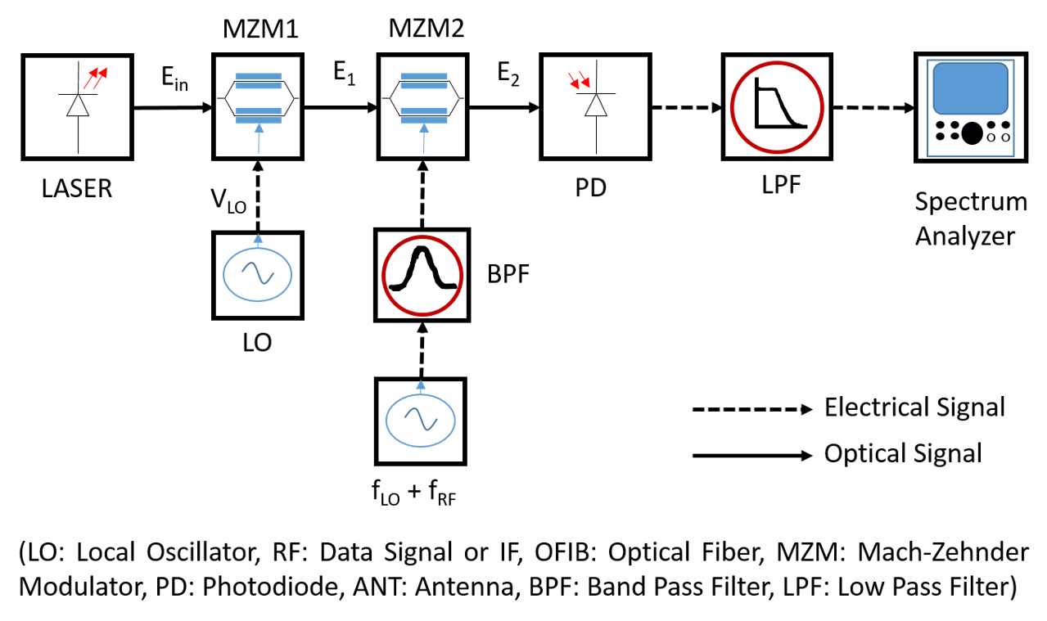
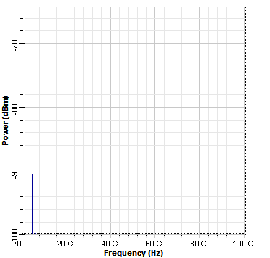
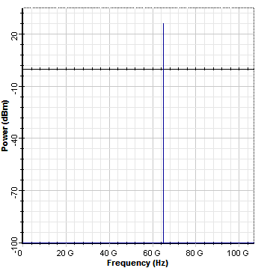
MZM based Down-Conversion
60 GHz
65 GHz
65 GHz
5 GHz

Slide 13
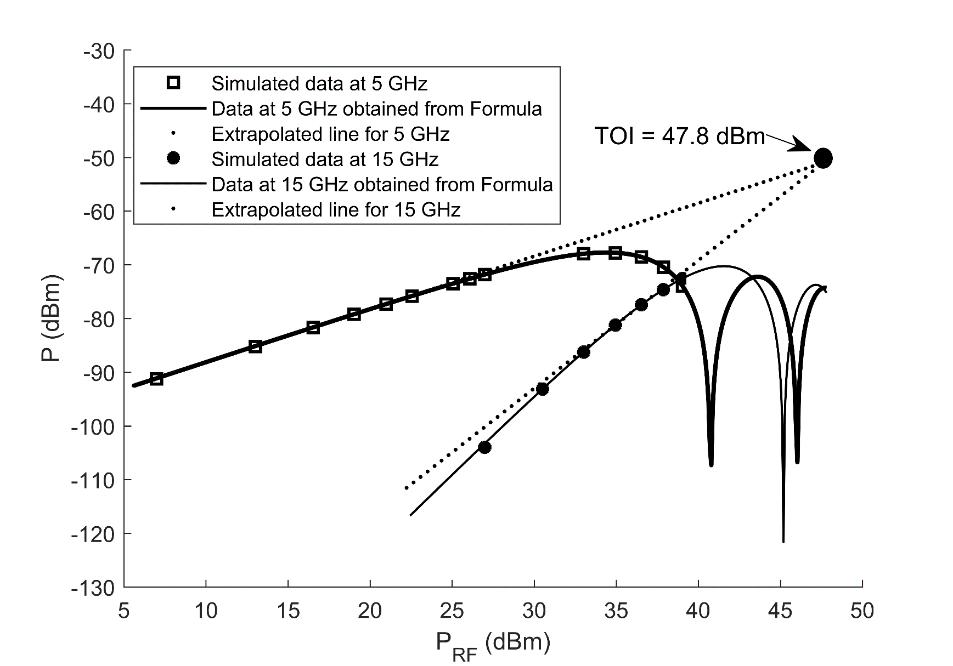
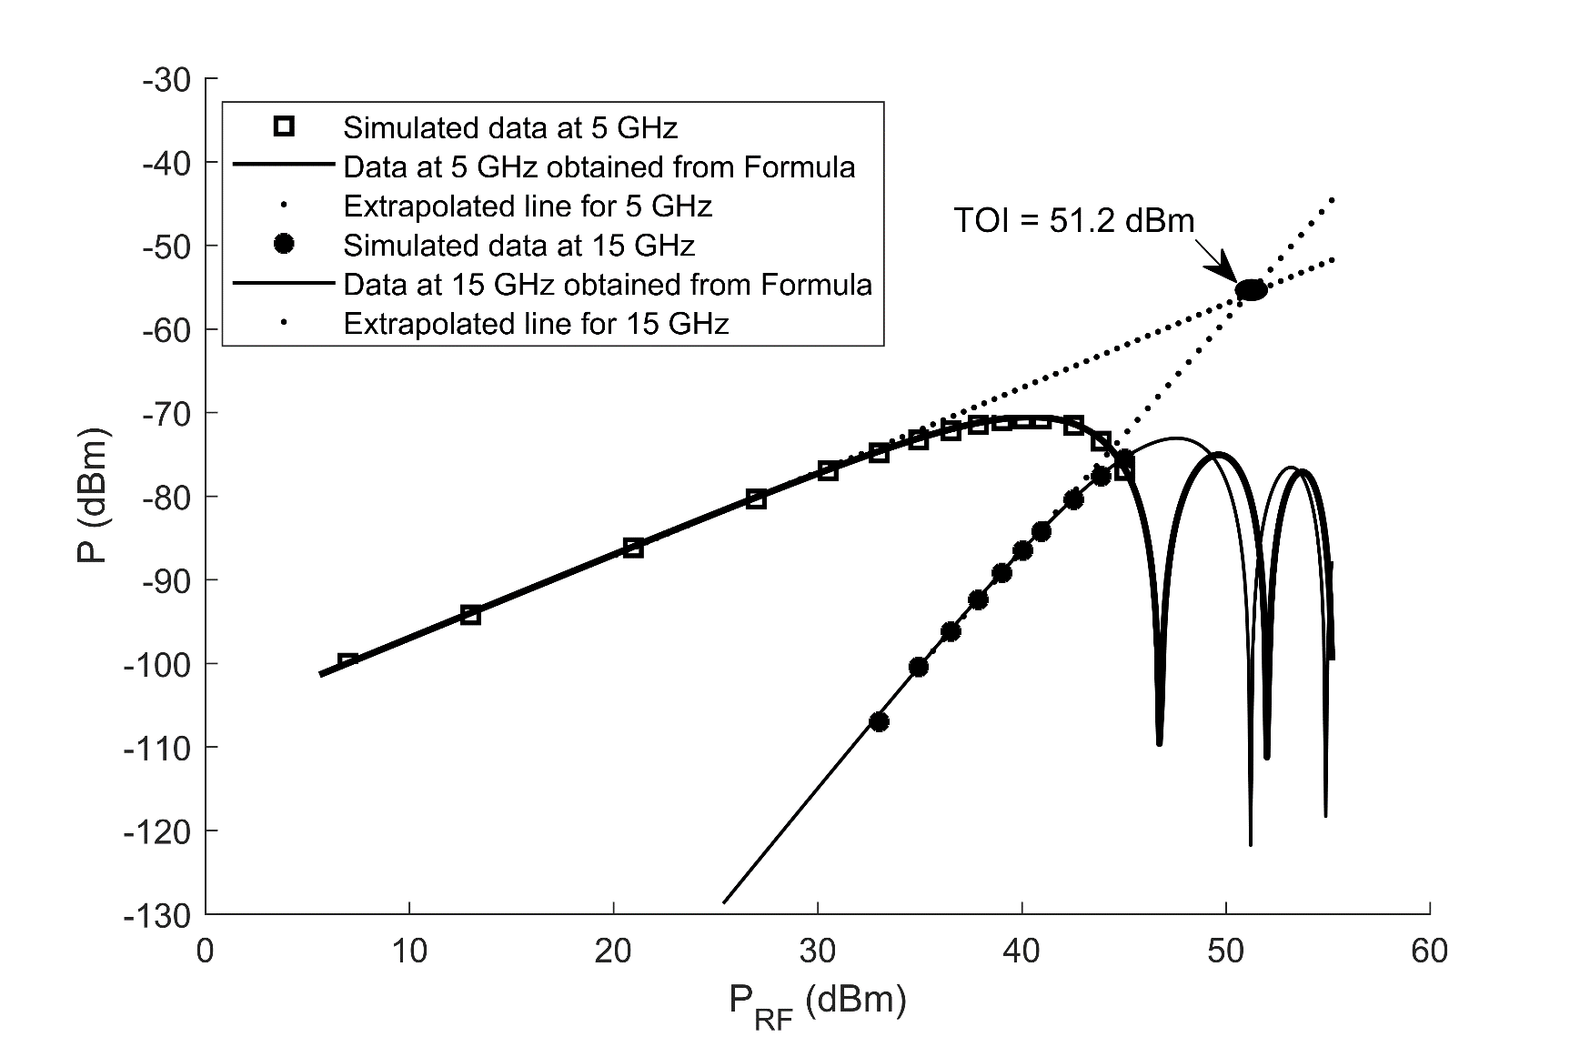


Linearity Performance of MZM based Transceiver
OBJECTIVE:
Assess the Linearity region of the transceiver and find the Input Third Order Intercept (TOI).
Obtain maximum linear RF power can be applied which is marked by TOI
MZM $V_{π}=4 V$
MZM $V_{π}=8 V$
OFF
CONCLUSION: Higher the Half-wave voltage of MZM, the higher is the value of TOI, the better is the transceiver.

Slide 14
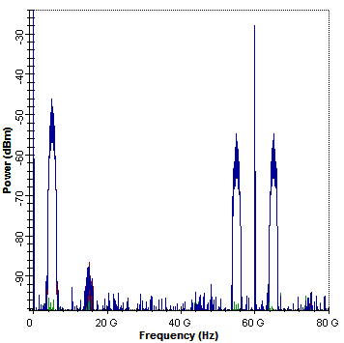
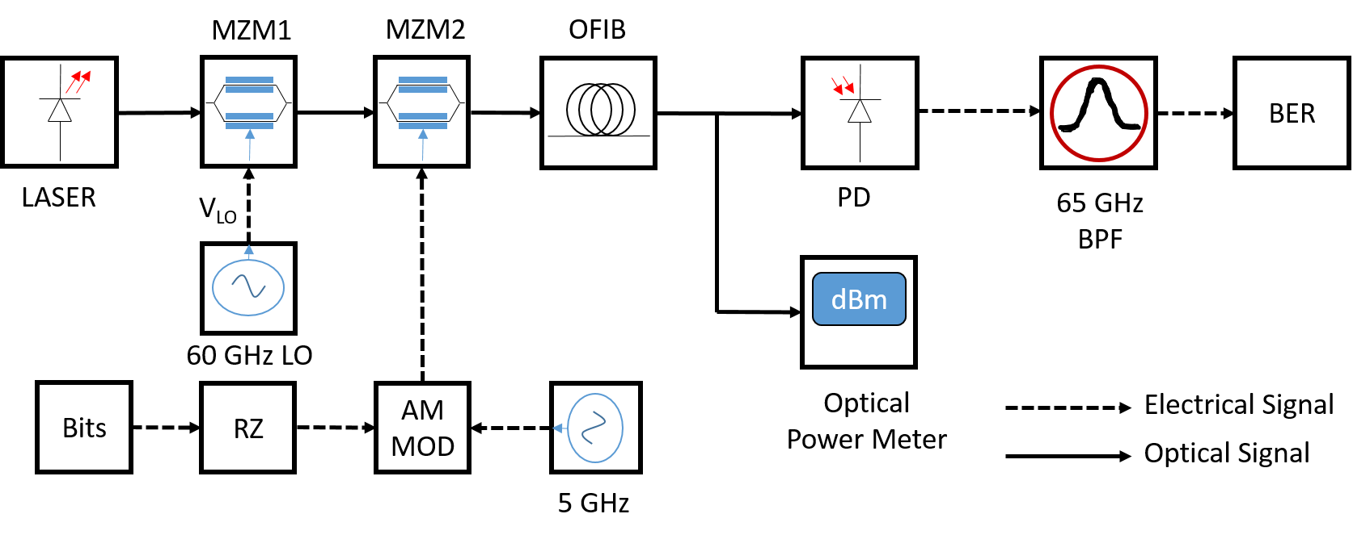
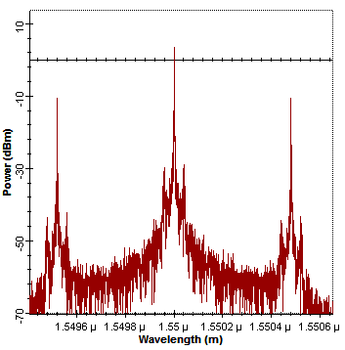
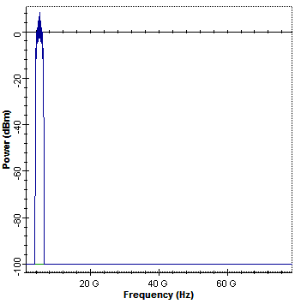
Back-To-Back (BTB) Network using MZM based Transceiver

Slide 15
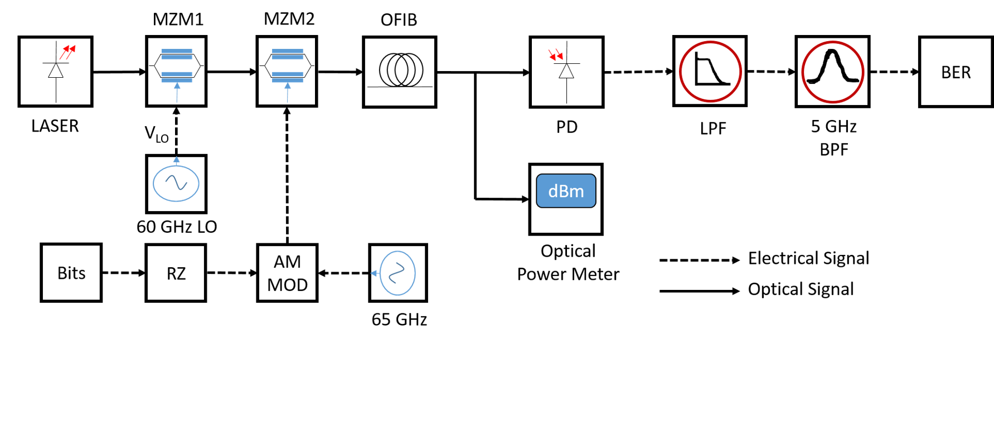
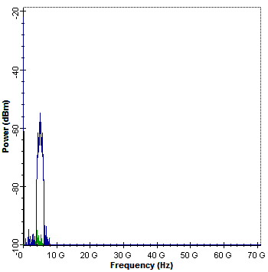
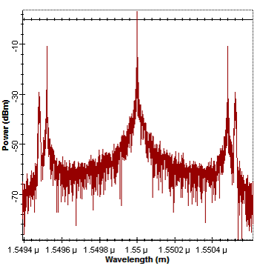
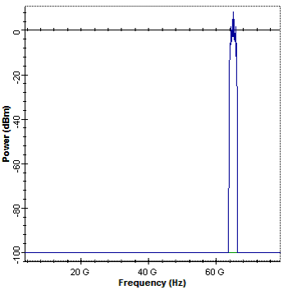
MZM Down-conversion Data Network

Slide 16
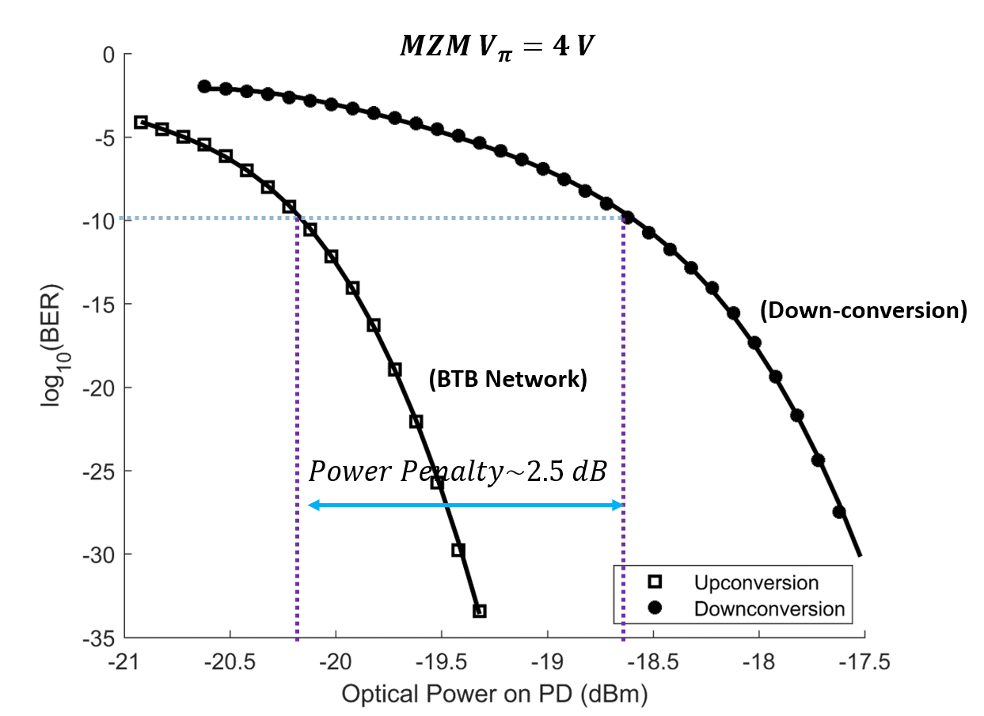
BER measurement for MZM based Transceiver
OBJECTIVE:
Comparative analysis of BER for BTB and Data Down-conversion network designed using MZM.
Provides a comparative analysis of the quality of the transceiver.
CONCLUSION: Power penalty is about 2.5 to 3 dB, which is good for practical situation.

Slide 17
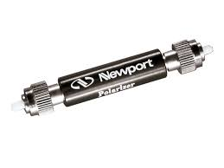
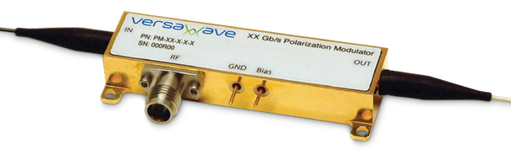



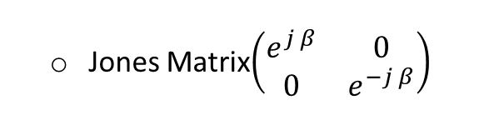
FEATURES OF POLM BASED TRANSCEIVER
OBJECTIVE:
Eliminate bias deviation problem of MZM
Take advantage of Polarization state of Light
Laser
$$Linear Horz. Polarizer$$
POLM
Jones Matrix $\left(\begin{matrix}1 & 0 \\ 0 & 0\end{matrix}\right)$
Jones Matrix$\left(\begin{matrix}e^{j β} & 0 \\ 0 & e^{−j β}\end{matrix}\right)$
Assumed H-Polarized
Jones Vector $\left(\begin{matrix}1 \\ 0\end{matrix}\right)$

Slide 18



POLARIZATION CONTROLLER (PC)
Introduced by Lefevre in 1980
Popular PC which is commercially manufactured and made available
Can be used to change state of light between all states of polarization
Jones matrix: $J\left(α, θ, β\right)=QWP\left(β\right).HWP\left(θ\right).QWP\left(α\right)$
Rotation Matrix: Half-wave plate fixed at $90°$. The Jones matrix is: $J\left(θ\right)=\left[\begin{matrix}\cos{2θ} & \sin{2θ} \\ −\sin{2θ} & \cos{2θ}\end{matrix}\right]$
Circular Rotation: Quarter wave plates are respectively rotated at $90°$ and $−90°$. The Jones matrix is: $J\left(θ\right)= \left(\begin{matrix}\cos{θ} & i\sin{θ} \\ i\sin{θ} & \cos{θ}\end{matrix}\right)$

Slide 19





POLM based Up-Conversion

Slide 20




POLM based Down-Conversion

Slide 21








Jones matrix of POLM based Transceiver
Input:$E_{1}= \frac{α_{1}E_{in}}{\sqrt{2}}\left[\cos{(A\cos\left(ω_{LO}t+ θ_{LO}\right) )}−\sin{(A\cos\left(ω_{LO}t+ θ_{LO}\right) )}\right]$
$$J_{1}=\frac{1}{\sqrt{2}}\left(\begin{matrix}1 & 1 \\ −1 & 1\end{matrix}\right)$$
$$J_{3}= \frac{1}{\sqrt{2}}\left(\begin{matrix}1 & i \\ i & 1\end{matrix}\right)$$
$$J_{4}=\left(\begin{matrix}1 & 0 \\ 0 & 0\end{matrix}\right)$$
$$E_{5}= J.E_{1}$$
$$J_{2}=\left(\begin{matrix}e^{j β} & 0 \\ 0 & e^{− j β}\end{matrix}\right)$$
$$E_{6}=αE_{1} \\ (cos[B\cos{{ (ω}_{RF}t}+ θ_{RF})]−sin[B\cos{{ (ω}_{RF}t}+ θ_{RF})])$$

Slide 22


Spectral Power in POLM based Transceiver
$P_{op}\left(optical carrier\right)= \frac{T_{D}P_{in}}{2}{\{ J_{0}\left(A\right)J_{0} (B) \}}^{2}$
$P_{op}\left(ω_{RF}\right)= \frac{T_{D}P_{in}}{2}{\{ 2 J_{0}\left(A\right)J_{1} (B) \}}^{2}$
$P_{op}\left(ω_{LO}\right)= \frac{T_{D}P_{in}}{2}{\{ 2 J_{1}\left(A\right)J_{0} (B) \}}^{2}$
$$P_{op}\left(ω_{LO}± ω_{RF}\right)= \frac{T_{D}P_{in}}{2}{\{ 2 J_{1}\left(A\right)J_{1} (B) \}}^{2}$$
$P\left(ω_{RF}\right)=L\left(ω_{RF}\right)\frac{P_{DC}}{2}{\{ 2 J_{1 }\left(2B\right)\}}^{2}$
$P\left(ω_{LO}\right)=L\left(ω_{LO}\right)\frac{P_{DC}}{2}{\{ 2 J_{1 }\left(2A\right)\}}^{2}$
$$P\left(ω_{LO} ± ω_{RF}\right)=L\left(ω_{LO} ± ω_{RF}\right)\frac{P_{DC}}{2}{\{ 2 J_{1 }\left(2A\right)J_{1 }\left(2B\right)\}}^{2}$$

Slide 23

Linearity Performance of POLM based Transceiver
OBJECTIVE:
Assess the Linearity region of the transceiver and find the Input Third Order Intercept (TOI).
Obtain maximum linear RF power can be applied which is marked by TOI
OFF
4V PolM
CONCLUSION: TOI is lower than 4V MZM

Slide 24



BER measurement for POLM based Transceiver
OBJECTIVE:
Comparative analysis of BER for BTB and Data Down-conversion network designed.
Provides a comparative analysis of the quality of the transceiver.
CONCLUSION: Power penalty is about 2 to 2.5 dB, which is better than MZM based Transceiver.

Slide 25
Conclusions
Quadrature biased MZM is found to be stable for Frequency generation, Photonic based up and down conversion
A high TOI of 47.8 dBm (4 V MZM) and 51.2 dBm (8 V MZM) makes it suitable for use in Interferometry based Radar.
Maximum power penalty from BER comparison, is 3 dB for MZM based transceiver.
Polarization based transceiver is also designed to overcome Bias Drift problem of MZM.
Polarization Modulator based Transceiver exhibit a 38.25 dBm TOI, can improve detection precision of interferometry based Radar
Maximum power penalty estimated from BER plot, is 2.5 dB.

Slide 26
References
[1] M. Skolnik, “Introduction to Radar Systems”, MGH Publishers, India (2014).
[2] C. Nguyen, S. Kim, “Theory, Analysis and Design of Interferometric Sensors”, Springer (2012).
[3] S. Pinna, S. Melo, F. Laghezza, F. Scotti, E. Lazzeri, M. Scaffadi, P. Gelfi, A. Bogoni, “Photonics based radar for sub-mm displacement sensing”, IEEE Journal of Selected Topics in Quantum Mechanics (2016).
[4] J. Yao, “Microwave Photonics”, Vol. 27 (3), Journal of Lightwave Technology (2009).
[5] R. Yu, V. R. Supradeepa, C. M. Long, D. E. Leaird, A. M. Weiner, “Generation of very flat optical frequency combs from continuous-wave lasers using cascaded intensity and phase modulators driven by tailored radio frequency waveforms”, Optics Letters, Vol 35 (19) (2010).
[6] Vincent J. Urick Jr., Jason D. McKinney, Keith J. Williams, “Fundamentals of Microwave Photonics”, Wiley Publishers (2015).
[7] Takahiro Numai, “Fundamentals of Semiconductor Lasers”, Second Edition, Springer (2015).
[8] G. K. Gopalakrishnan, “Microwave-Optical Mixing in LiNbO₃ Modulators”, IEEE Transactions on Microwave Theory and Techniques (1993), Vol. 41 (12), Page 2383 – 2391.
[9] C. Li, Y. Wang, W. Wang, Z. Xu, B. Zhao, H. Wang, D. Tang, “Widely Tunable Optoelectronic Oscillator Using a Dispersion-Induced Single Bandpass MPF”, IEEE Photonics Technology Letters (2017), Vol. 30(1), Page 7 – 10.
[10] G. Tong, T. Jin, H. Chi, X. Zhu, T. Lai, X. Wu, “A Novel Optoelectronic Oscillator Based on Brillouin-Induced Slow Light Effect”, IEEE Photonics Technology Letters(2017), Vol. 29(16), Page 1375 – 2017.

Slide 27
References
[11] E. Sackinger, “Broadband Circuits for Optical Fiber Communications”, Wiley Publishers (2005).
[12] H. Nagata, K. Kiuchi, and S. Kazumasa, “Studies of thermal drift as a source of output instabilities in Ti: LiNbO3 optical modulators,” Journal of Lightwave Technology, vol. 75, no. 9, pp. 4762–4764 (1994).
[13] E. Wooten, K. Kissa, A. Yi-Yan, E. Murphy, D. Lafaw, P. Hallemeier, D. Maack, D. Attanasio, D. Fritz, G. McBrien, and D. Bossi, “A review of lithium niobate modulators for fiber-optic communications systems,” IEEE Journal of Selected Topics Quantum Electron., vol. 6, no. 1, pp. 69–82 (2000).
[14] Yejun Fu, Xiupu Zhang, Bouchaib Hraimel, Taijun Liu, Dongya Shen, “Mach-Zehnder”, IEEE Microwave Magazine, 1527-3342/13 (Nov-Dec 2013).
[15] E. Wooten, K. Kissa, A. Yi-Yan, E. Murphy, D. Lafaw, P. Hallemeier, D. Maack, D. Attanasio, D. Fritz, G. McBrien, and D. Bossi, “A review of lithium niobate modulators for fiber-optic communications systems,” IEEE Journal of Selected Topics Quantum Electron., vol. 6, no. 1, pp. 69–82 (2000).
[16] M. Salvestrini, G. Guilbert, and S. Gille, “Analysis and control of the dc drift in LiNbO3-based Mach-Zehnder modulators,” Journal of Lightwave Technology, vol. 29, no. 10, pp. 1522–1534 (2011).
[17] H.C. Lefevre, “Single-Mode Fibre Fractional Wave Devices and Polarization Controllers”, Electronics Letters, Vol. 16, No. 20 (1980).
[18] R. Ulrich, A. Simon, “Polarization optics of twisted single mode fibers', Applied Optics, Vol.18, pp. 2241-2251 (1979).
[19] E. Colitt, “Polarized light in Fiber Optics”, The PolaWave Group (2003).

Slide 28
THANK YOU

