Slide 1
CSE 212 : OBJECT ORIENTED PROGRAMMING PROJECT : STUDENT MANAGEMENT SYSTEM
Prepared By :
Gourob Das Gupta(02107043)
Muhammad Sajedul Alam Tanim(02107067)
Avishek Majumder(02107060)
Department Of Computer Science & Engineering, Port City International University.

Slide 2
CONTENTS
Problem Statement. Activity Diagram.
Problem Objective. User Interface(UI).
Preliminary Solution. Cost Analysis.
Project Scopes : Disadvantage.
*Functions/Functional Requirement. Advantage.
*Features/Non-Functional Requirement. Conclusion.
System Architecture. Thank you page.
Project Stakeholders. Q/A.
*Administrator.
*Students.

Slide 3
PROBLEM STATEMENT
The Organizations has to handle records for many number of students and maintenance was difficult. Though it has used an information system , it was totally manual. hence there is a need to upgrade the system with a computer based information system.

Slide 4
OBJECTIVE OF STUDENT MANAGEMENT SYSTEM
The main objective of the student management system is to manage the details of profiles, courses, logins, exams, fees. It manages all the information about profiles, students, fees. The project is totally built at administrative end and thus only the administrator is guaranteed the access. The purpose of the project is to build an application program to reduce the manual work for managing the profiles, courses, students, logins. It tracks all the details about the logins, exams , fees.

Slide 5
PRELIMINARY SOLUTION
The problem can be solved by replacing the current manual system with a computerized and automated database management system application.
The system will store the data in a database and process the information quickly and efficiently.
It will automate the whole student management process.
It would be easily accessible and remove the hassle of administrators and students at the same time.

Slide 6
PROJECT SCOPES
Functions/Functional Requirements :
1.Creation Of New Record : This function creates a record for a new student.
2.Deletion Of Record : This function is used to delete the existing record of any student.
3.Updation In Record : This function updates the information in a record of any student.
4.Display Of Data In Record : This function displays the record of the student.

Slide 7
PROJECT SCOPES (CONTINUED)
Features/Non-Functional Requirements :
1.Administrator will be using email address.
2.Only authorized users can access the system with username and password.
3.Easy tracking of records and updation can be done.
4.The system is very interactive.

Slide 8
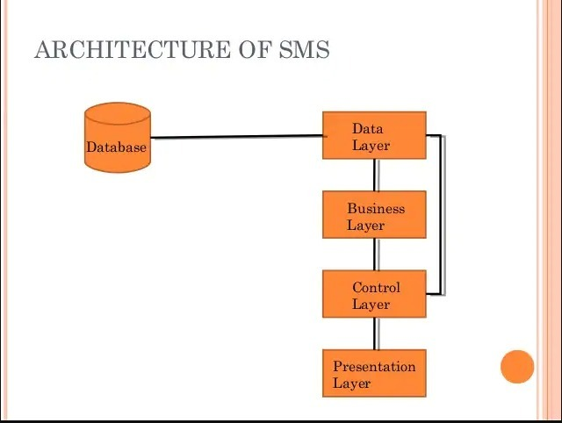
SYSTEM ARCHITECTURE

Slide 9
PROJECT STAKEHOLDERS
Administrator.
Students.

Slide 10
STAKEHOLDER: ADMINISTRATOR
Administrator activity the system includes :-
Provide student information.
Efficient control over student data.
Monitor student performance.
Supervise multiple branches.

Slide 11
STAKEHOLDER:STUDENT
Student activity the system includes :
1) Access to personal Information.
2) Add or update information.
3) Describe himself or herself.
4) Enter Age or Blood group.

Slide 12
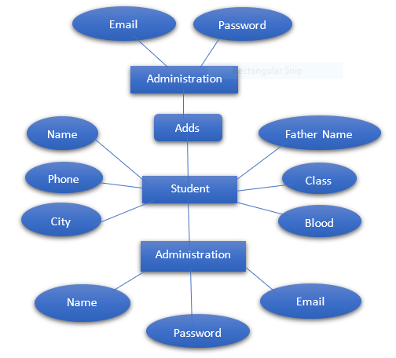
ACTIVITY DIAGRAM

Slide 13
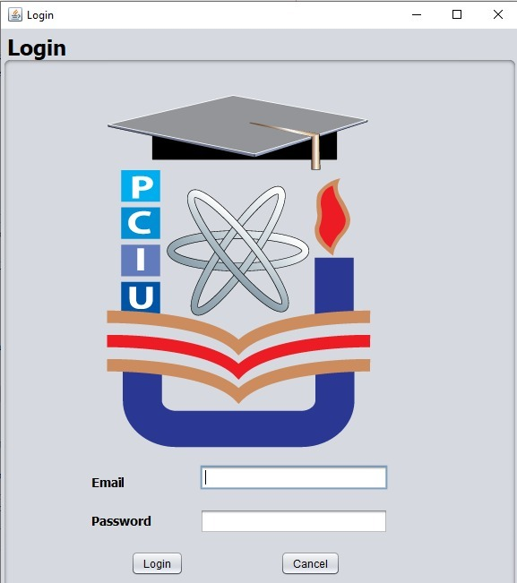
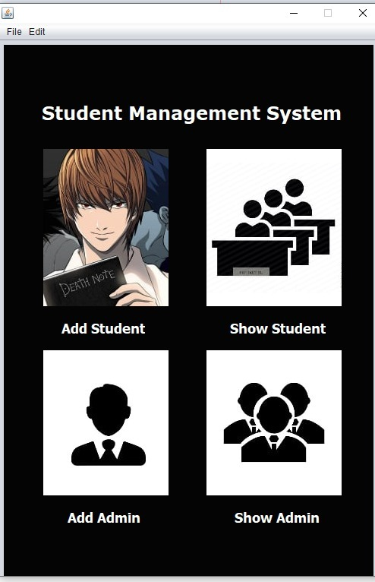
USER INTERFACE(UI): ONE

Slide 14
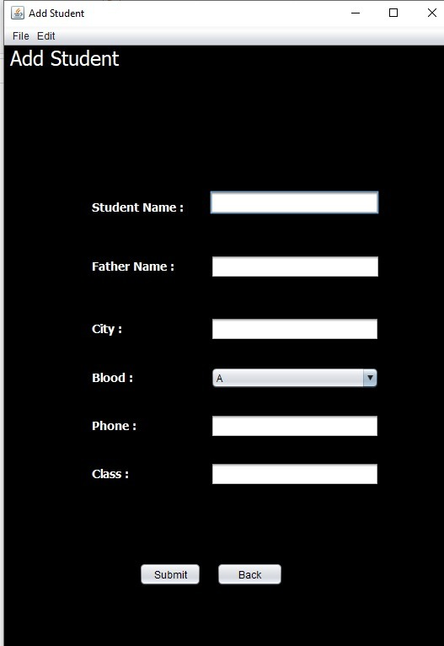
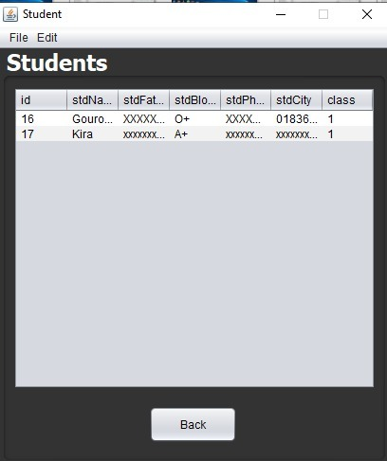
USER INTERFACE(UI):- TWO

Slide 15
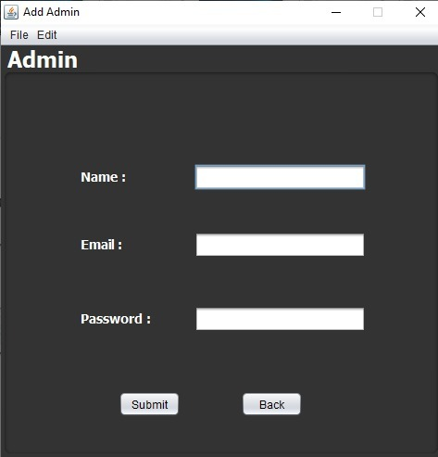
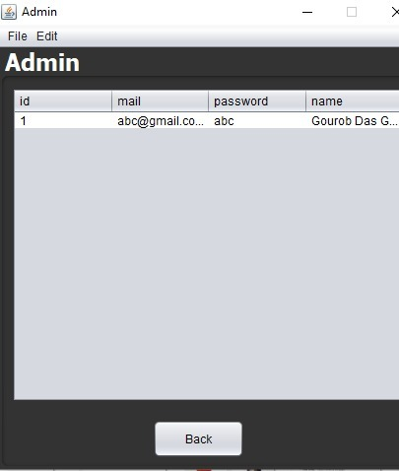
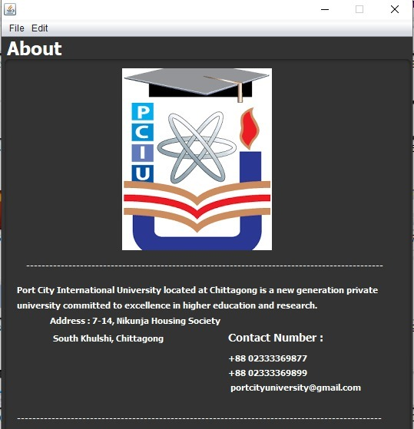
USER INTERFACE(UI):- THREE

Slide 16
COST ANALYSIS
Serial No | Item | Amount (BDT)
1 | Application Software Development | 60,000
2 | Work Station | 100,000
3 | Web Server | 50,000
4 | Database Server | 50,000
5 | Initial Data Entry | 40,000
Total |  | 300,000

Slide 17
DISADVANTAGE
The drawbacks in Student Management System software can be counted on fingers; with mostly only benefits, these systems have a few countable downsides. Often, applications face minor technical glitches and these systems are no exception but, ratification is immediate. Only, people who are accustomed to regular use of smartphones or computers can operate this software. Extensive modules and features make it difficult for a user to utilize the application. With huge flow in traffic the application is prone to performance issues. Few companies market their products at extravagant price, which are not affordable by growing organizations. Absence of proper internet-network makes it difficult for a user to access information, which is a significant disadvantage. The risk of data mishandling might be bothersome; but all these drawbacks can be evaded by choosing proper, cost-efficient and best software that best benefits an organization.

Slide 18
ADVANTAGE
The advantages of Student Management System software cannot be explained but could be summarized. The world has seen a tremendous growth in technology in past few decades than in centuries; with necessity in clouding and data management, many organizations have opened their gates to simplify procedures by reducing human effort. With SMS software much of paper work could be circumvented. Mishandling of data is biggest concerns in many organizations hence; to bypass misuses Management System applications are designed under regulate guidelines and directives. Collaborative coordination between faculty and students could be attained and, announcements can be published with a single click in bulk via these simple programs. Few applications give parents access to candidate’s academic performances and behaviors.SMS software makes library management flexible and orderly.

Slide 19
CONCLUSION
Helpful to perform paperless work and manage all date
Provides easy, accurate, ambiguous and faster data access.
Overall, efficiency has improved and work process simplified. Although all the objectives have been met, the system still has room for improvement . The system is robust and flexible enough for future upgrade using advanced technology and devices.

Slide 20
THANK YOU

Slide 21
Q&A
ANY QUESTION?

