Slide 1

TM3221 – DATA SCIENCE FOR BPM · GROUP ASSIGNMENT
Customer Churn Prediction and Analysis Using Machine Learning
A data-driven approach for customer retention
[Group name]
Department of Management of Technology · Faculty of Business · University of Moratuwa
Notes:
PRESENTER A (about 1 minute)
Good morning. Our project asks a practical business question: which telecom customers are likely to leave, and why? We analysed 7,043 customers of a telecom provider, cleaned a deliberately messy dataset, tested which factors are associated with churn, and built machine learning models to predict it. We will finish with recommendations the company could act on.

Slide 2
Why churn matters and what we set out to answer
1
Clean
RESEARCH QUESTION
Audit and repair a messy dataset without leaking test data
Which customer characteristics and service-related factors are most strongly associated with churn – and how effectively can machine learning predict it?
2
Explore
Find patterns linking demographics, services and billing to churn
3
Model
Compare logistic regression, decision tree and random forest
Churn = a customer leaving the company. Keeping customers is usually cheaper than winning new ones, so knowing who is at risk lets retention budgets go where they matter.
4
Act
Interpret the drivers and turn them into retention actions
TM3221 · Customer Churn Prediction · Presenter A
2
Notes:
PRESENTER A (about 1.5 minutes)
Read the research question. Explain that churn is costly because a lost customer stops paying and must be replaced. Walk through the four objectives: clean, explore, model, act. Stress one principle that runs through the whole project: the data are observational, so we talk about associations and predictions, not causes.

Slide 3
The dataset: 7,043 telecom customers, 1 in 4 churned
IBM Telco Customer Churn sample data (Kaggle) – the assignment file contained injected errors
7,073
21
26.5%
raw rows → 7,043 customers after removing 30 duplicates
columns: demographics, account, services and the target
churned (1,869 customers): imbalanced classes
Demographics
Account & billing
gender, senior citizen, partner, dependents
tenure, contract, payment method, paperless billing, monthly & total charges
Services
Target
phone, multiple lines, internet type, six internet add-ons
Churn = Yes / No (left within the last month)
TM3221 · Customer Churn Prediction · Presenter A
3
Notes:
PRESENTER A (about 1.5 minutes)
The file had 7,073 rows and 21 columns. After removing 30 exact duplicates we have 7,043 customers. 26.5% churned. Point out why that matters: a model that always says 'no churn' is already 73.5% accurate but useless, so we cannot judge models by accuracy alone. Hand over to Presenter B for data cleaning.

Slide 4
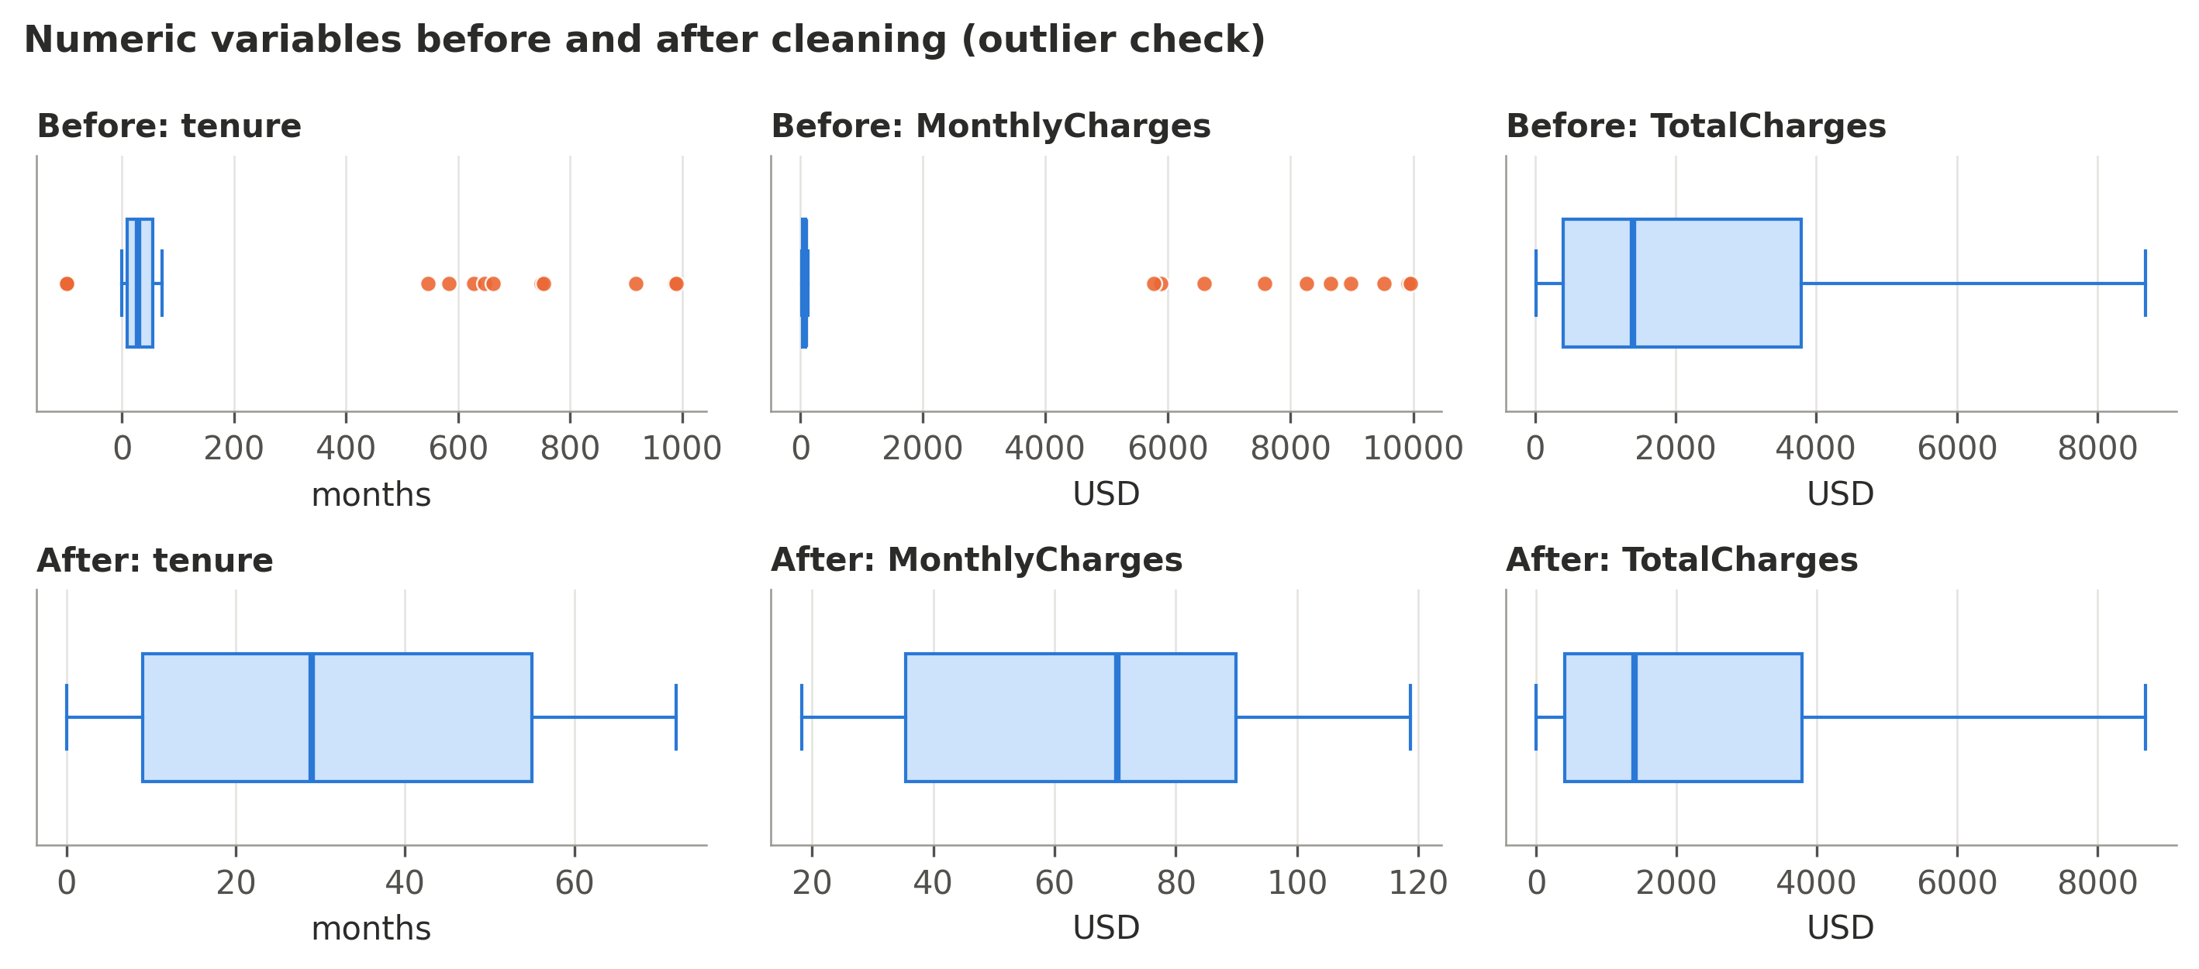
Data cleaning: repair, don't delete
Problems were documented first; every rule works row by row, so nothing leaks from the test set
30 exact duplicate rows removed
Hidden missing values: 11 blanks and 12 'INVALID_VAL' in TotalCharges – invisible to isnull()
Impossible values: tenure of −99 or 988 months; monthly bills up to 9,960 USD
Repaired with TotalCharges ≈ tenure × MonthlyCharges: 2% error vs 74% for median filling
Outliers: 0 remain after repair – real extremes kept, no winsorising
Before: errors stretch the axes. After: plausible ranges and no IQR outliers.
TM3221 · Customer Churn Prediction · Presenter B
4
Notes:
PRESENTER B (about 2 minutes)
We never edited the raw file. We first loaded every value as text, which exposed problems that a normal isnull() check misses. Explain the key trick: total charges is roughly months times the monthly bill, so if one of the three values is broken we can rebuild it from the other two – far more accurate than filling in an average. Outliers: we used the IQR rule and boxplots; the extreme values were impossible errors, not real customers. After repair there are no outliers, so we deleted nothing. Leakage: these rules only use the customer's own row; anything that learns from data (median, scaling, encoding) happens later inside a Pipeline on training data only.

Slide 5
Who churns? Contract, internet, payment and tenure
Churn rate (%) by group · overall churn rate 26.5%
Highest risk: month-to-month (42.7%), fiber optic (41.9%), electronic check (45.3%) and the first year (47.5%). Gender shows no difference (26.9% vs 26.2%).
TM3221 · Customer Churn Prediction · Presenter B
5
Notes:
PRESENTER B (about 2 minutes)
Churn rate = churners divided by customers in the group. Month-to-month customers churn at 42.7% against 2.8% on two-year contracts. Fiber customers churn at more than twice the DSL rate. Electronic-check payers churn far more than those on automatic payment. Churn is concentrated in the first year. These are associations: fiber customers also pay more, so we cannot say fiber itself causes churn.

Slide 6
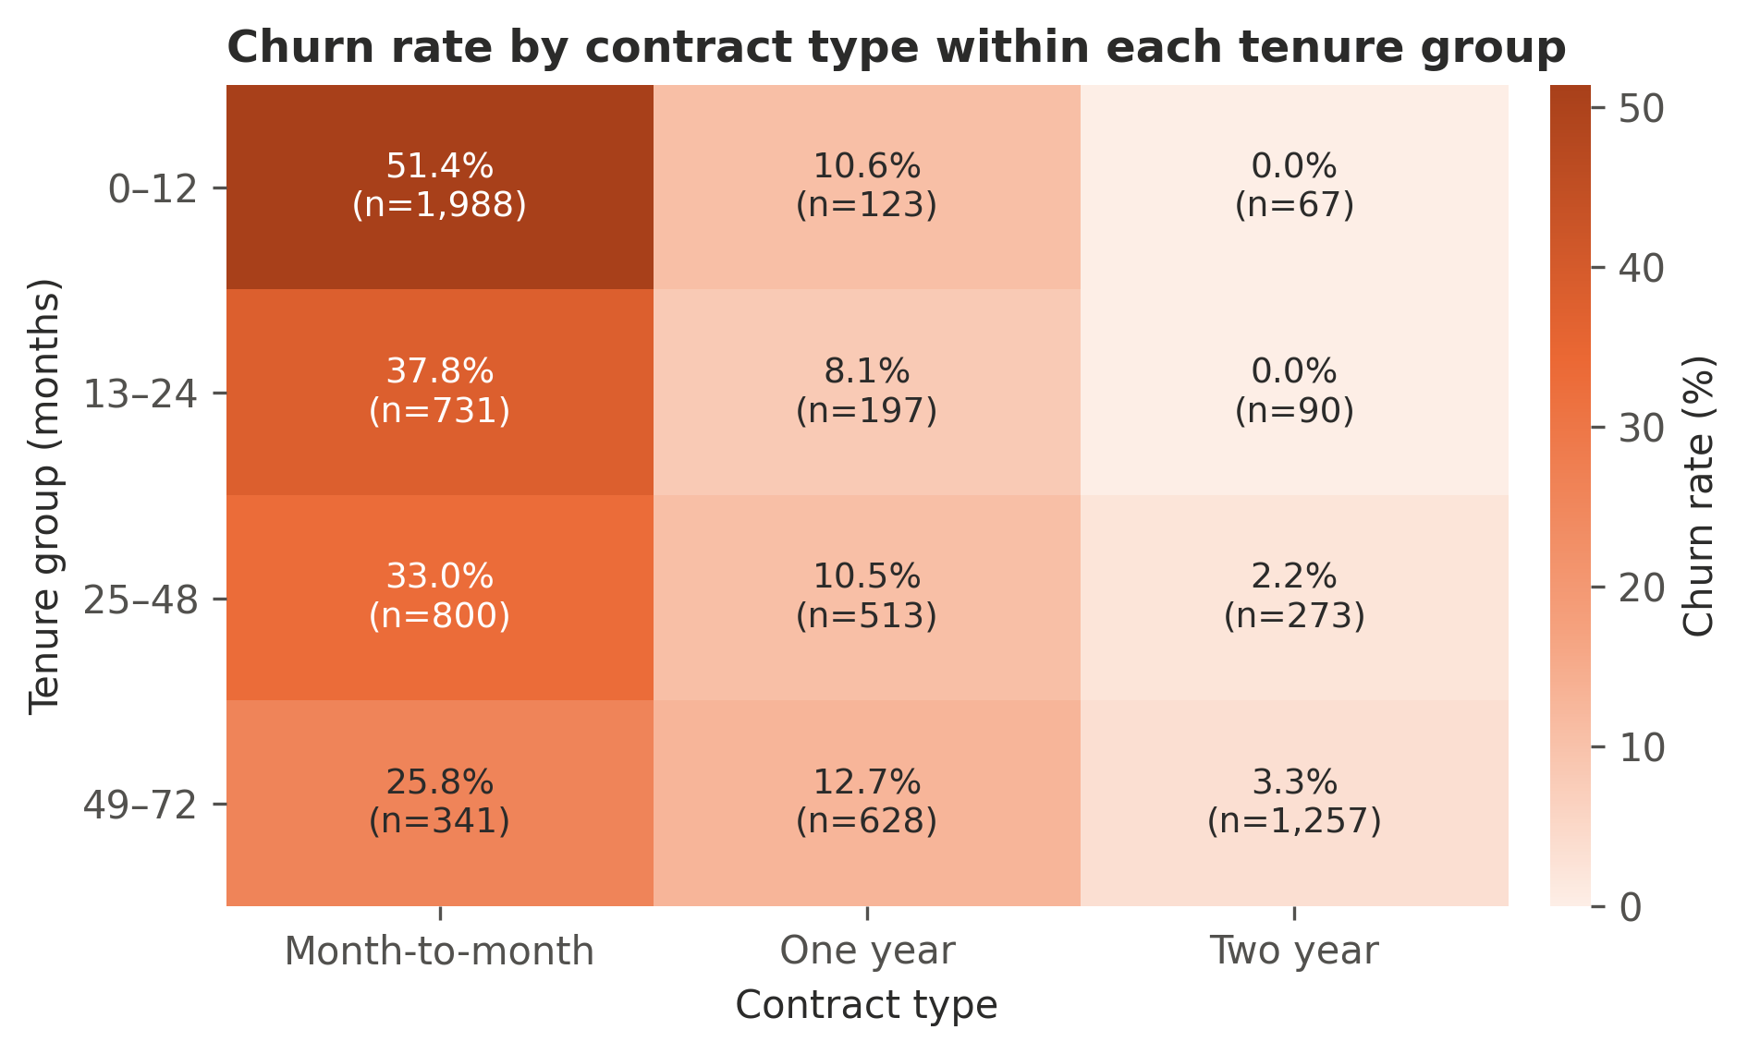
Patterns that need careful reading
Contract matters at every tenure level · protective add-ons matter, streaming does not
Contract beyond tenure
Even after 4+ years, month-to-month churn is 25.8% vs 3.3% on two-year contracts.
Security & support add-ons
Internet customers: 14.6% churn with online security vs 41.8% without; tech support 15.2% vs 41.6%.
Price is tangled with service
Bills over 90 USD are 97% fiber customers – the 'price effect' is mostly a service-type effect.
TM3221 · Customer Churn Prediction · Presenter B
6
Notes:
PRESENTER B (about 1.5 minutes)
The heatmap answers a fair question: month-to-month customers are newer, so is contract just a tenure effect? No – within every tenure group month-to-month churn is far higher. Second, among internet customers, online security and tech support go with much lower churn, while streaming add-ons barely matter. Third, monthly charges: the bands mostly reflect which service a customer has. Hand over to Presenter C.

Slide 7
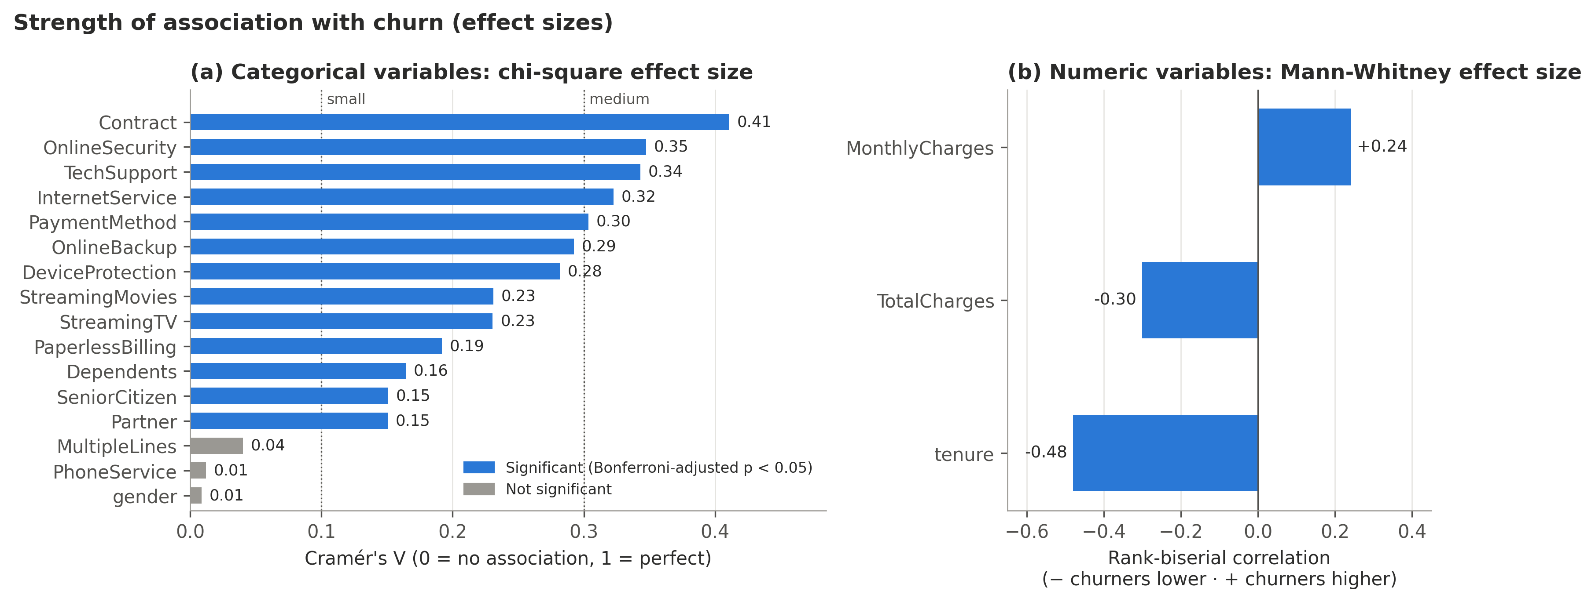
Significant is not the same as important
Chi-square (categorical) and Mann-Whitney U (numeric) tests · Bonferroni-corrected · effect sizes
13 of 16
categorical variables linked to churn (not gender, phone or multiple lines)
V = 0.41
contract: largest effect (medium); tenure r = -0.48
VIF ≈ 836
MonthlyCharges is set by the services: dropped from the logistic model
TM3221 · Customer Churn Prediction · Presenter C
7
Notes:
PRESENTER C (about 2 minutes)
With 7,000 customers almost everything is 'significant', so we also measured effect size: Cramér's V for categories and the rank-biserial correlation for numbers. Contract has the biggest effect; demographics are significant but small; gender has none. We used Mann-Whitney instead of a t-test because tenure and charges are not normally distributed, and Bonferroni because we ran 19 tests. Multicollinearity: the monthly bill is almost exactly the sum of the service prices (VIF about 836), so we removed MonthlyCharges and TotalCharges from the logistic regression. Note: scaling does not reduce VIF – a mistake in last year's example report.

Slide 8
Method: a fair, leakage-safe model comparison
Binary classification – predict Churn = Yes / No
1
2
3
4
5
Split
Pipeline
Tune
Select
Test once
Stratified 80/20
5,634 train · 1,409 test
Impute → scale → one-hot,
fitted on training data only
Grid search with
stratified 5-fold CV
Highest CV ROC-AUC;
within 0.01 → simpler model
All models on the same
unseen 1,409 customers
Dummy baseline: always predicts 'no churn' – the floor to beat
Logistic regression: interpretable: odds ratio per feature
Decision tree: readable if/then rules
Random forest: 300 trees – non-linear patterns
Imbalance: class_weight = "balanced" for every model (no SMOTE) · metrics: ROC-AUC, PR-AUC, recall, precision, F1 – not accuracy alone
TM3221 · Customer Churn Prediction · Presenter C
8
Notes:
PRESENTER C (about 2 minutes)
Walk through the five steps. The key idea is that the test set is locked away until the very end. All preprocessing sits inside a scikit-learn Pipeline, so during cross-validation it is re-fitted on each training fold – this prevents data leakage. We fixed the selection rule before seeing test results: best cross-validated ROC-AUC, but if another model is within 0.01 we prefer the more interpretable one. ROC-AUC measures how well the model ranks churners above loyal customers. Hand over to Presenter D.

Slide 9
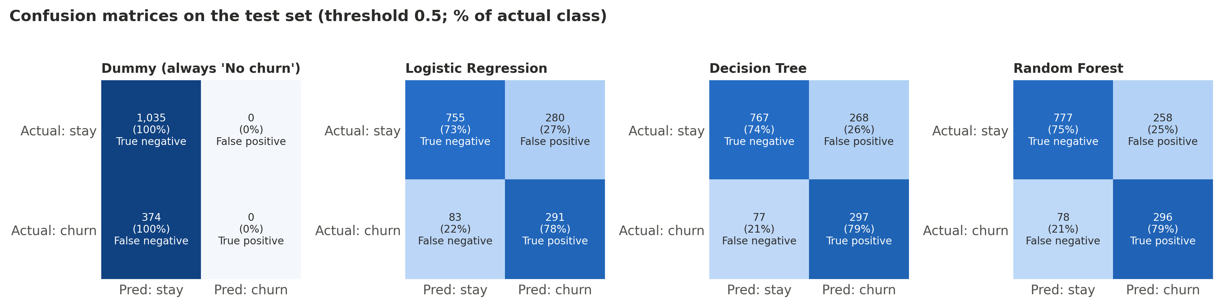
All models beat the baseline; differences are small
Test set of 1,409 customers · threshold 0.5
Model | CV ROC-AUC | Test ROC-AUC | Recall | Precision | F1 | Accuracy
Dummy baseline | 0.500 | 0.500 | 0.00 | 0.00 | 0.00 | 0.73
Logistic Regression ★ | 0.845 | 0.839 | 0.78 | 0.51 | 0.62 | 0.74
Decision Tree | 0.831 | 0.836 | 0.79 | 0.53 | 0.63 | 0.76
Random Forest | 0.849 | 0.845 | 0.79 | 0.53 | 0.64 | 0.76
0.84
test ROC-AUC, logistic regression (95% CI 0.82–0.86)
78%
of churners caught (291 of 374); the dummy catches 0%
★ Selected: within 0.01 of the random forest in CV. On the test set the forest is +0.006 AUC, but the 95% CI (-0.001 to 0.014) includes zero.
TM3221 · Customer Churn Prediction · Presenter D
9
Notes:
PRESENTER D (about 2 minutes)
The baseline is 73.5% accurate but catches no churners – that is why accuracy is misleading. All three models reach a test ROC-AUC of about 0.84 and catch roughly 78–79% of churners. The random forest was slightly better, but within our tolerance in cross-validation, and a bootstrap test shows the difference on the test set is not statistically reliable. So by our pre-set rule we chose logistic regression, which is easier to explain and overfits least. Confusion matrix: 83 churners missed (lost revenue) and 280 loyal customers flagged (unneeded offers) – a trade-off the threshold can adjust.

Slide 10
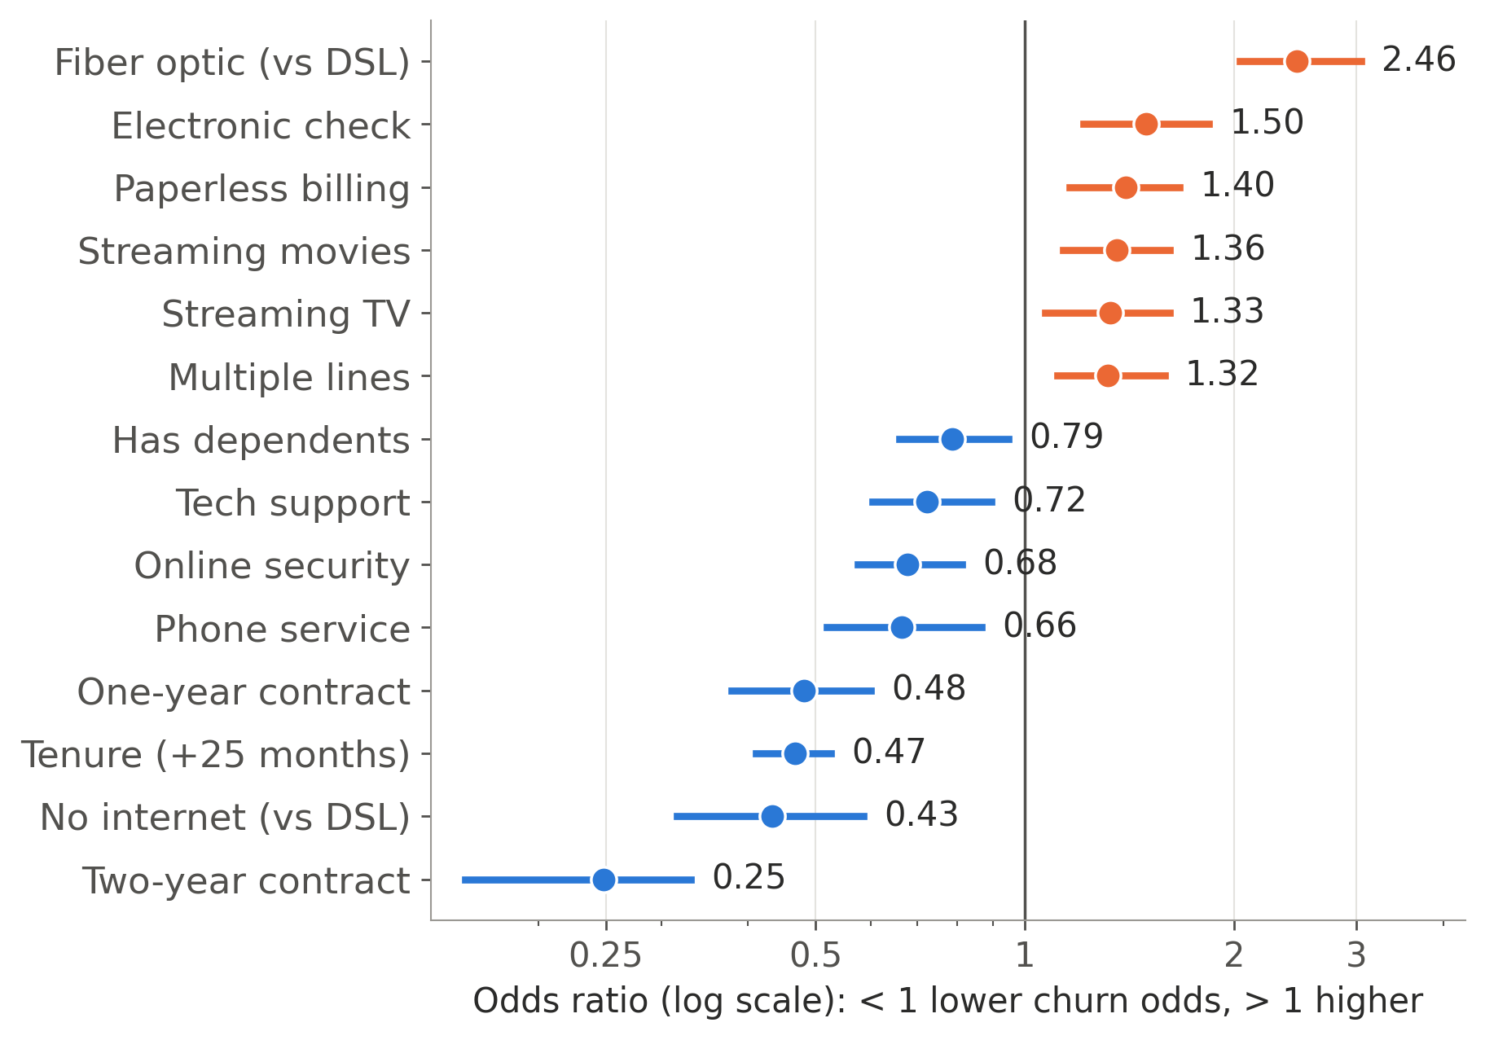
What drives the predictions?
Logistic regression odds ratios (95% bootstrap intervals) – only clear effects shown; full chart in the report
×0.25
odds for a two-year vs month-to-month contract
×0.47
odds for every extra ~25 months of tenure
×2.5
odds for fiber optic vs DSL
×1.5
odds for electronic check vs bank transfer
Same top drivers in permutation importance, decision-tree rules and EDA: contract, tenure, internet type.
TM3221 · Customer Churn Prediction · Presenter D
10
Notes:
PRESENTER D (about 2 minutes)
An odds ratio below 1 means lower churn odds, above 1 higher. Holding everything else constant: two-year contracts have about a quarter of the odds of month-to-month; every extra two years of tenure roughly halves the odds; fiber optic has about 2.5 times the odds of DSL; electronic check about 1.5 times. Grey items, including gender and senior citizen, have no clear effect once other factors are included. Permutation importance and a simple decision tree agree: the riskiest group is month-to-month fiber customers in their first 13 months, with 71% churn.

Slide 11
Business value: target the riskiest customers first
Cumulative gains on the test set – customers contacted in order of predicted risk
50%
of all churners are in the top 20% of risk scores (random targeting: 20%)
75%
actual churn rate in the highest-risk 10% – 2.8× the average
Use the scores to rank customers and size the contact list to the retention budget; the threshold is a business setting.
TM3221 · Customer Churn Prediction · Presenter D
11
Notes:
PRESENTER D (about 1.5 minutes)
This is the most practical result. If the retention team calls the 20% of customers the model ranks as riskiest, they reach 50% of everyone who would churn – random calling would reach only 20%. In the top 10%, three in four customers really churn. Hand over to Presenter E.

Slide 12
Recommendations for customer retention
Each action follows from the evidence – and should be tested
1
Longer contracts
2
First-year onboarding
3
Fix the fiber experience
Offer incentives to move month-to-month customers to 1–2 year plans (OR 0.25).
Welcome calls and early check-ins – churn is 47.5% in year one.
Review fiber pricing, reliability and support; survey leavers (OR 2.5).
4
Automatic payment
5
Security & support bundles
6
Prioritise and test
Nudge electronic-check payers (45.3% churn) to automatic bank or card payment.
Trials of online security and tech support (14.6% vs 41.8% churn).
Score monthly, call the top-risk group first, and A/B-test offers to measure their real effect.
TM3221 · Customer Churn Prediction · Presenter E
12
Notes:
PRESENTER E (about 2 minutes)
Each recommendation comes from a specific finding. Contracts and tenure are the strongest drivers, so the first two actions target month-to-month and new customers. Fiber churn stays high even after controlling for other factors, which points to a service or price issue worth investigating. Automatic payment and security or support add-ons are associated with lower churn. Finally, because our data are observational, the company should test each offer with a randomised trial before rolling it out.

Slide 13
Limitations and responsible use
Limitations
Responsible use
Observational data: associations, not causes
Missing drivers: complaints, service quality, competitor offers – about 1 in 5 churners is hard to predict
Repaired records churned at 31.7% vs 26.4% (not significant)
IBM sample data for one provider – re-validate before real use
Balanced weights inflate probabilities: use scores for ranking
Decision support, not automatic decisions
Never use gender or age to offer worse terms – gender has no predictive value here anyway
Protect customer data and use it only for agreed purposes
Monitor performance monthly and retrain regularly
TM3221 · Customer Churn Prediction · Presenter E
13
Notes:
PRESENTER E (about 1.5 minutes)
Be open about limits: we can predict and describe associations, but not prove causes. The model misses churners who look loyal – probably people leaving for reasons not in the data, like competitor offers. On responsible use: the model should help staff prioritise, not decide alone, and must not disadvantage customers because of gender or age.

Slide 14
Conclusion
1
Drivers
Short contracts, short tenure, fiber optic, electronic check and missing security/support add-ons are most associated with churn; gender is not.
2
Prediction
A leakage-safe logistic regression reaches test ROC-AUC 0.84 and catches 78% of churners – as good as a random forest, and explainable.
3
Action
Ranking customers by risk puts 50% of churners in the top 20% – focus retention budgets there and test offers.
Thank you – questions are welcome
Notes:
PRESENTER E (about 1 minute)
Summarise the three takeaways: what drives churn, how well we can predict it, and how the company can use it. Invite questions. Likely questions and answers are in presentation/speaker_guide.md.

