Slide 1
Part 3: The Medium Access Control Sublayer
More Contents on the Engineering Side of Ethernet

Slide 2
Ethernet Physical Layer standards
10Base5
  10 Mbps, Baseband transmission, 500m cable length
10Base2
  10 Mbps, Baseband transmission, ~200m cable length
10Base-T
  10 Mbps, Baseband transmission, UTP cable
100Base-TX
  100 Mbps, Baseband transmission, UTP cable

Slide 3
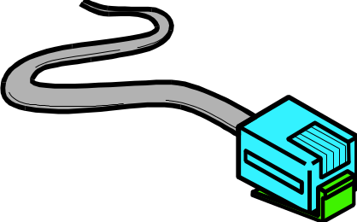

Ethernet 10Base-T & 100Base-TX
Wiring
  Unshielded Twisted Pair (UTP)
  Category 5 wiring is best
    Cat 3 and Cat 4 in some older installations
  Bundle of eight wires (only uses four)
  Terminates in RJ-45 connector

Slide 4
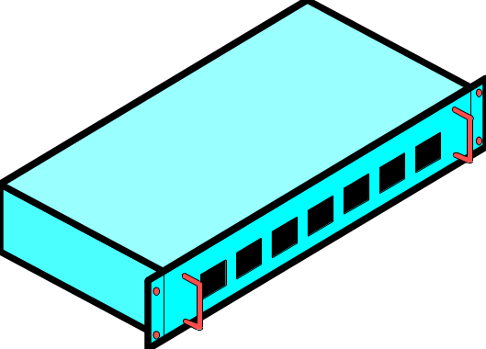

10Base-T & 100Base-TX hubs
UTP-based networks use hubs to interconnect NICs
  each UTP cable runs directly from a NIC to a hub

Slide 5
10Base-T & 100Base-TX hubs
Hubs have many ports, each of which has one incoming network cable
Hubs are usually located in computer rooms, or network distribution cupboards
  a patch panel (or patch bay) is used to connect between hubs and the wall sockets throughout a building

Slide 6
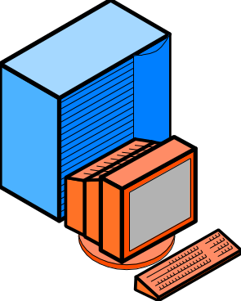
10Base-T & 100Base-TX wiring
Wiring
  100 meters maximum distance hub-to-station
  Can use multiple hubs (max 4) to increase the distance between any two stations
200 m
100 m
100 m

Slide 7
10Base-T to 100Base-TX
Upgrading from 10Base-T to 100Base-TX
  Need new hub
    May have some 10 Mbps ports to handle 10Base-T NICs
    May have autosensing 10/100 ports that handle either
  Need new NICs
    Only for stations that need more speed
  No need to rewire
    This would be expensive

Slide 8
Multiple Hubs in 10Base-T
Farthest stations in 10Base-T can be five segments (500 metres apart)
  100 metres per segment
  Separated by four hubs
100m
100m
10Base-T hubs
100m
500m, 4 hubs
100m
100m

Slide 9
Multiple Hubs in 100Base-TX
Limit of Two Hubs in 100Base-TX
  Must be within a few metres of each other
  Maximum span ~200 metres
  Shorter distance span than 10Base-T
2 Co-located
Hubs
100m
100Base-TX
Hubs
100m

Slide 10
Latency and Congestion with hubs
Ethernet is a shared media LAN
  Only one station can transmit at a time
  Even in multi-hub LANs
  Others must wait
  This causes delay
All Other
Stations
Must Wait
One Station Sends

Slide 11
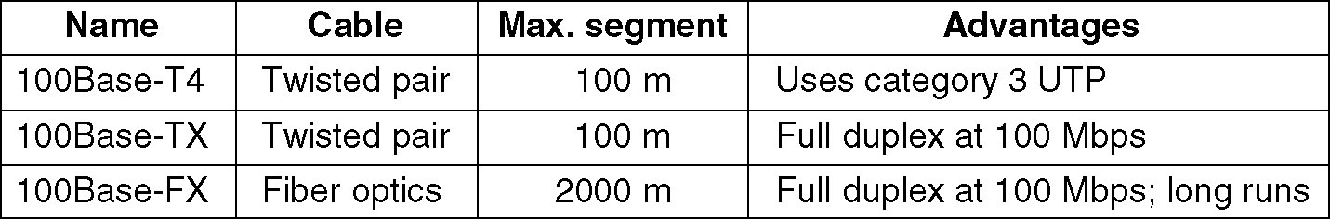
Fast Ethernet
The original fast Ethernet cabling.

Slide 12
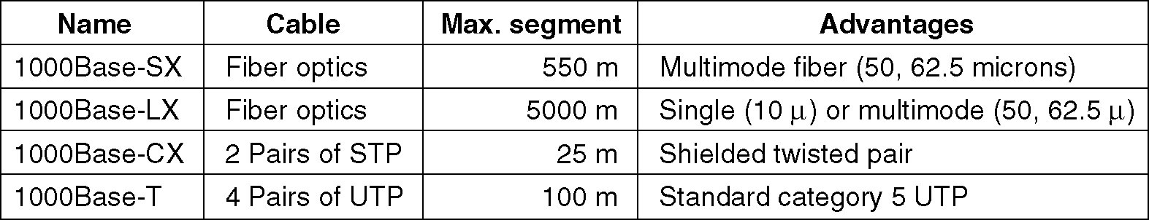
Gigabit Ethernet
Gigabit Ethernet cabling.

Slide 13
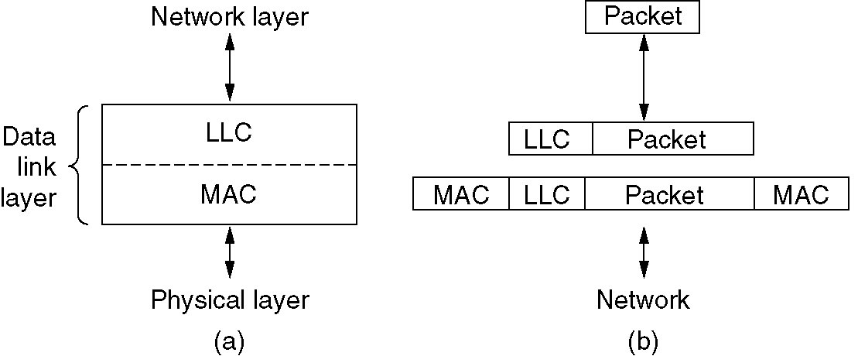
IEEE 802.2: Logical Link Control
(a) Position of LLC. (b) Protocol formats.

Slide 14
Repeaters
  Regenerate the signal
  Provide more flexibility in network design
  Extend the distance over which a signal may travel down a cable

Slide 15
Ethernet Repeaters and Hubs
  Connect together one or more Ethernet cable segments of any media type
  If an Ethernet segment were allowed to exceed the maximum length or the maximum number of attached systems to the segment, the signal quality would deteriorate.

Slide 16
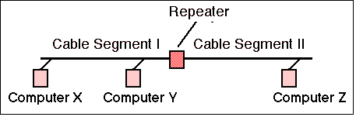
Ethernet Repeaters and Hubs
Used between a pair of segments
Provide signal amplification and regeneration to restore a good signal level before sending it from one cable segment to another

Slide 17
Ethernet Bridge
  Join two LAN segments (A,B), constructing a larger LAN
  Filter traffic passing between the two LANs and may enforce a security policy separating different work groups located on each of the LANs.

Slide 18
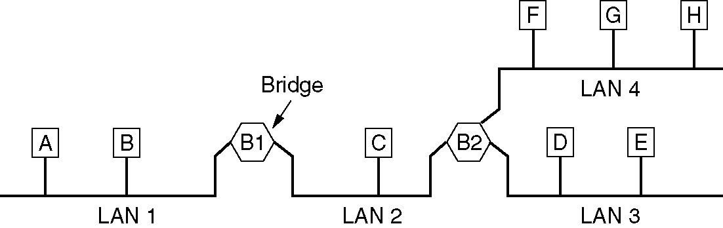
Local Internetworking
A configuration with four LANs and two bridges.

Slide 19
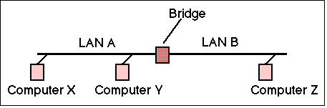
Ethernet Bridges
Simplest and most frequently used → Transparent Bridge (meaning that the nodes using a bridge are unaware of its presence).
Bridge could forward all frames, but then it would behave rather like a repeater
Bridges are smarter than repeaters!

Slide 20
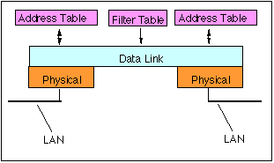
Ethernet Bridges
A bridge stores the hardware addresses observed from frames received by each interface and uses this information to learn which frames need to be forwarded by the bridge.

Slide 21
Ethernet Switch → Modern LANs
  Fundamentally similar to a bridge
  Supports a larger number of connected LAN segments
  Richer management capability.
  Logically partition the traffic to travel only over the network segments on the path between the source and the destination (reduces the wastage of bandwidth)

Slide 22
Ethernet Switch → Benefits
  Improved security
    users are less able to tap-in into other user's data
  Better management
    control who receives what information (i.e. Virtual LANs)
    limit the impact of network problems
  Full duplex
    rather than half duplex required for shared access

Slide 23
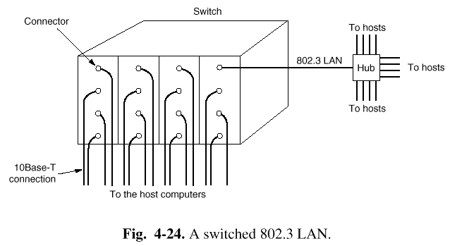
Switched LAN
Hub and Switched LAN
  hub simulates a single shared medium
  switch simulates a bridged LAN with one computer per segment

Slide 24
Ethernet Switches
Highly Scalable
10Base-T switches
  Competitive with 100Base-TX hubs in both cost and throughput
  Increasingly used to desktops
100Base-TX switches
  Higher performance (and price)
Gigabit Ethernet switches
  Very expensive

Slide 25
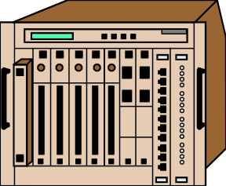
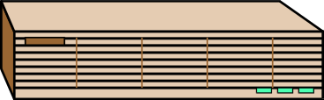

Ethernet Switches
No limit on number of Ethernet switches between farthest stations
  So no distance
  limit on size of
  switched networks

Slide 26
Ethernet Switches
Ethernet Switches must be Arranged in a Hierarchy (or daisy chain)
  Only one possible path between any two stations, switches
1
Path=4,5,2,1,3
2
3
4
5
6

Slide 27
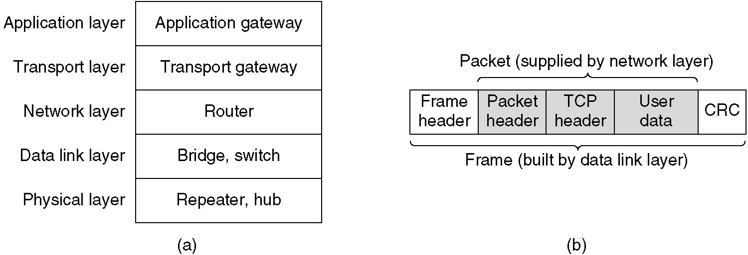
Repeaters, Hubs, Bridges, Switches, Routers and Gateways
(a) Which device is in which layer.
(b) Frames, packets, and headers.

Slide 28
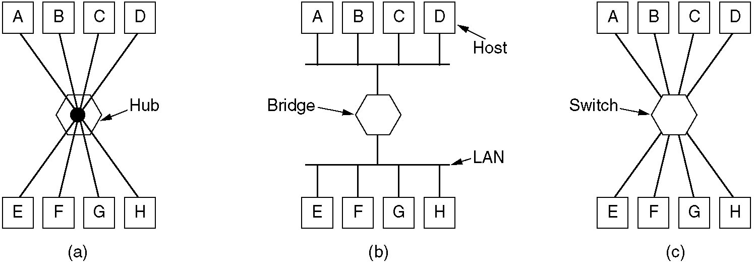
Repeaters, Hubs, Bridges, Switches, Routers and Gateways
(a) A hub. (b) A bridge. (c) a switch.

Slide 29
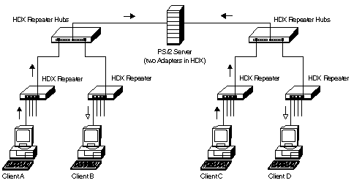

Repeater HUBs

Slide 30
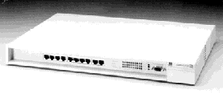
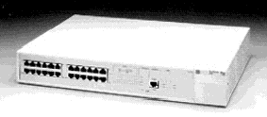
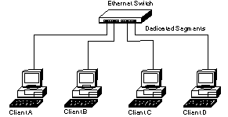
Switches

Slide 31
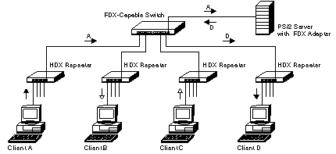
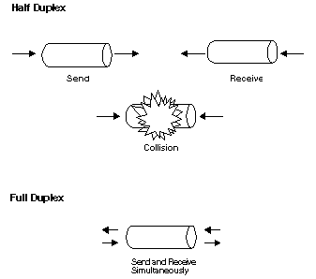
Switches
Repeater HUBs

Slide 32
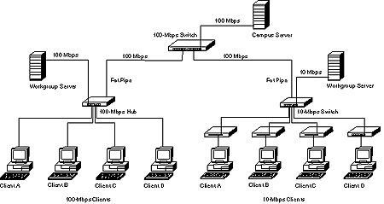

Slide 33
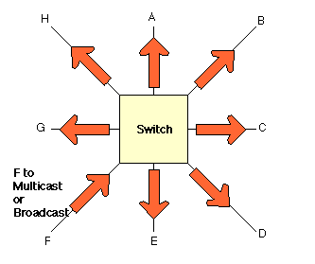
Ethernet Switches and Multicast Traffic
Multicast Traffic from F is delivered to all output interfaces (ports) which asks for it

Slide 34
Switches Versus Routers
Switches
Fast
Inexpensive
No benefits of alternative routing
No hierarchical addressing
Routers
Slow
Expensive
Benefits of alternative routing
Hierarchical addressing
“Switch where you can; route where you must”

