Slide 1
StudAura
Watch. Capture. Track. Revise.
A YouTube-based learning workspace, shipped with a complete DevSecOps pipeline
Docker · GitHub Actions · Trivy · GHCR · Terraform · EKS · Helm · ArgoCD · Prometheus · Grafana
Live app: stud-aura.vercel.app
Avishkar Chavan · DevOps final capstone
Notes:
Introduce StudAura and say the project has two halves: the product, and the delivery chain around it.

Slide 2
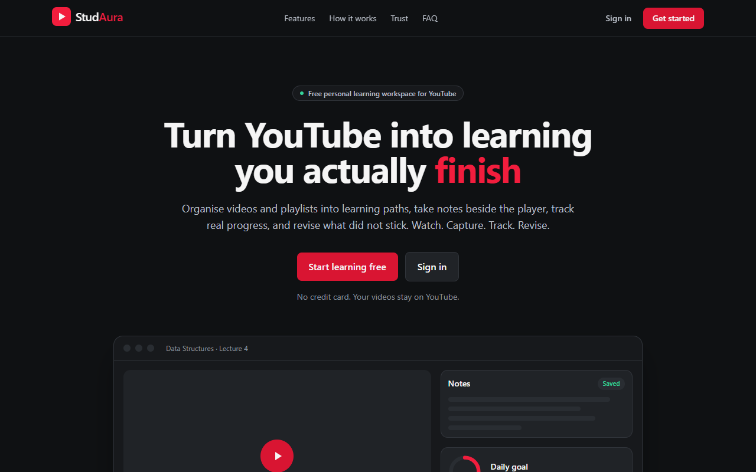
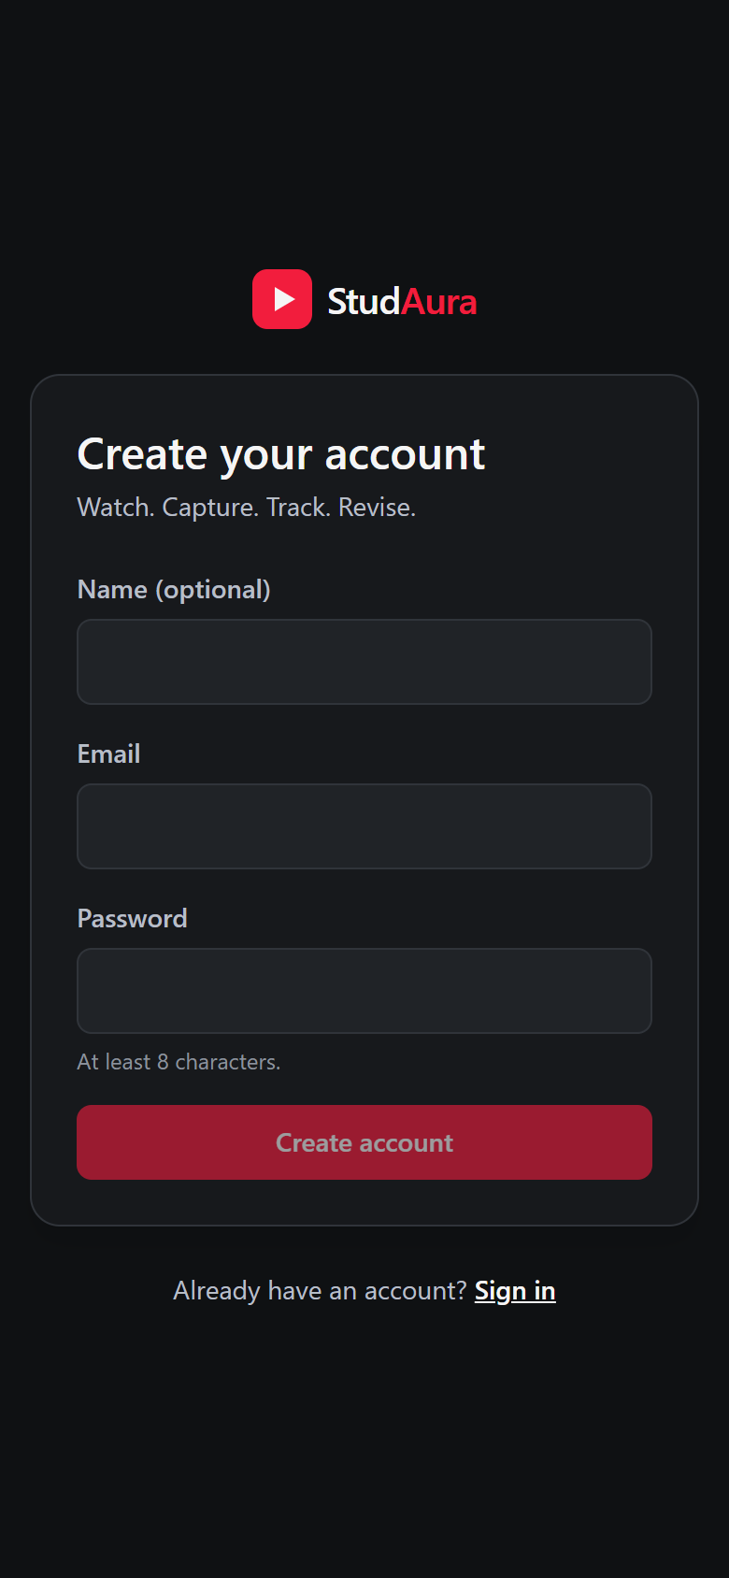
What StudAura does
Learning paths
Player
Import videos or whole playlists; failures are reported per item.
Embedded YouTube player that resumes where you stopped.
Notes
Goals + revision
Landing page at stud-aura.vercel.app
Rich text with autosave, retry and conflict detection.
Daily goal from real playback; a revision queue.
The same app through the EKS load balancer, on a phone-sized screen
Notes:
Show the sign-in page. Mention it is a real app: Supabase auth, FastAPI backend, React frontend, responsive on a phone.

Slide 3
Tech stack
Frontend
Backend
Delivery
React 18
Vite + TypeScript
Tailwind CSS v4
TanStack Query
TipTap editor
Vitest + Playwright
FastAPI
SQLAlchemy 2 (async)
Alembic migrations
JWT via Supabase JWKS
PostgreSQL
prometheus-fastapi-
instrumentator
Docker (multi-stage)
GitHub Actions
Trivy, GHCR
Terraform, AWS EKS
Helm, ArgoCD
Prometheus, Grafana
Notes:
Supabase gives auth and Postgres; everything else is ours.

Slide 4
Architecture
Frontend x2
nginx + React SPA
Browser
AWS load balancer
ingress-nginx
/ goes to the frontend, /api goes to the backend
Backend x2
FastAPI
Supabase Postgres
Auth + data
Prometheus
scrapes /metrics
Grafana
dashboard + alerts
Notes:
Trace one request: browser, load balancer, ingress, then frontend or backend; backend talks to Supabase Postgres. Prometheus scrapes the backend; Grafana reads Prometheus.

Slide 5
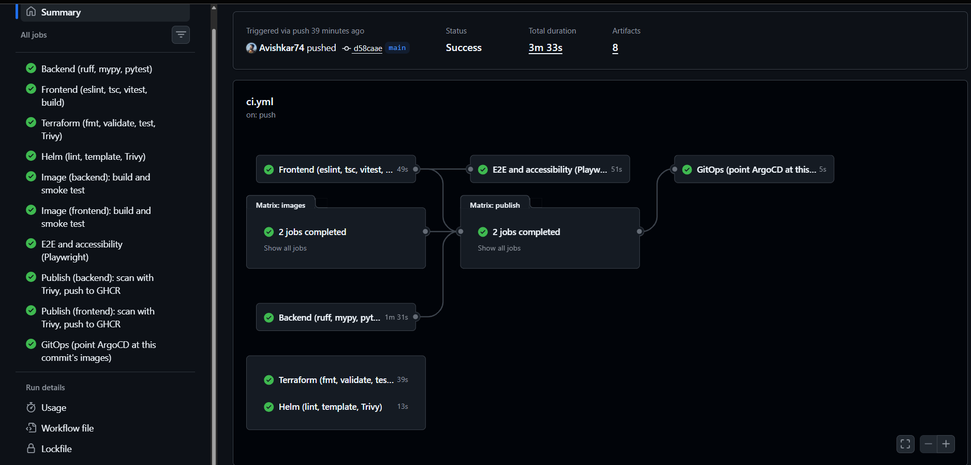
CI/CD pipeline
Pull request
lint, tests, build
Images
build, non-root
Publish
Trivy, then GHCR
GitOps
deploy branch
ArgoCD
syncs cluster
Runs on every pull request and every push to main
pytest on a real PostgreSQL service; a skipped test fails the build
Images tagged with the commit SHA only, never latest
Playwright + axe accessibility checks on main
Green run on main: all jobs passed
Notes:
Show the green run. Every PR runs all gates. Only main publishes. Tags are always the commit SHA.

Slide 6
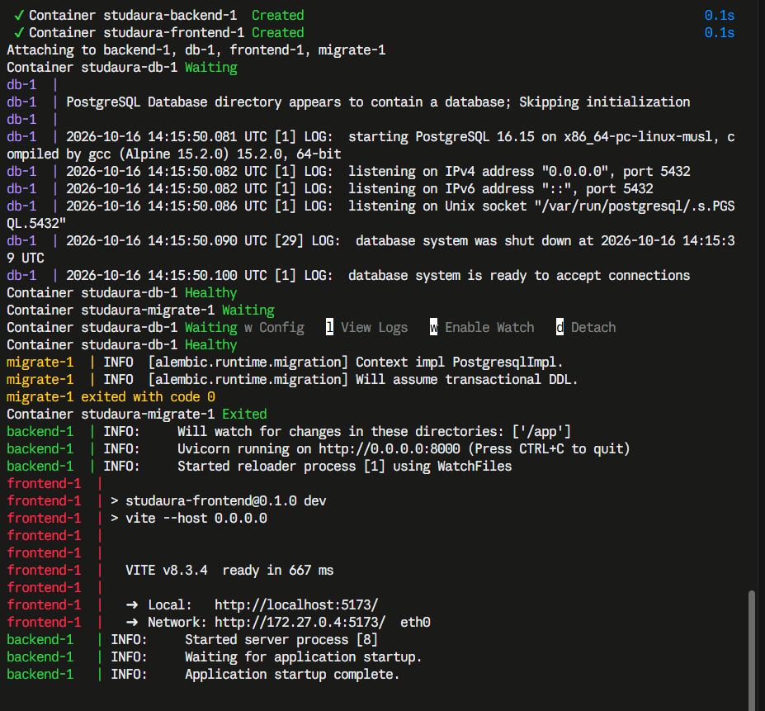
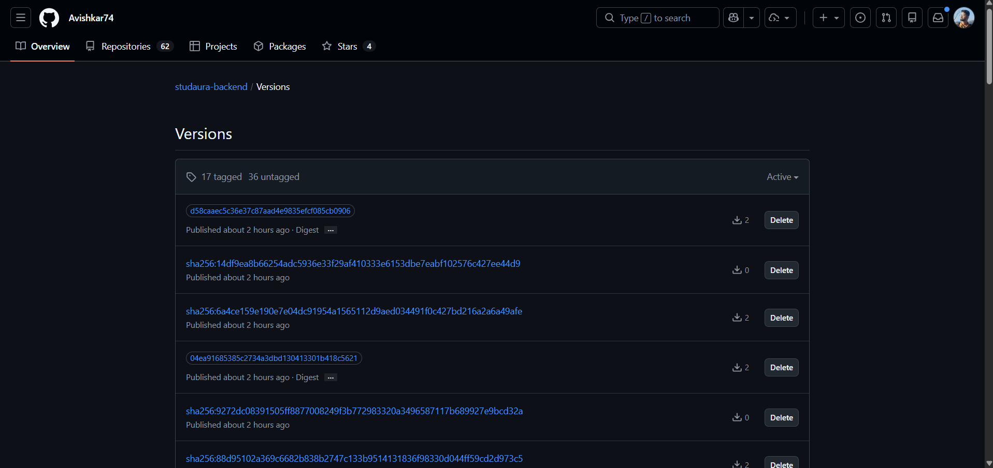
Containers and registry
GHCR: studaura-backend, commit-SHA tags
docker compose up --build
Multi-stage Dockerfiles, both images run as non-root
Tags are commit SHAs; no latest tag is published
Notes:
Show docker compose up, then the GHCR page with SHA tags.

Slide 7
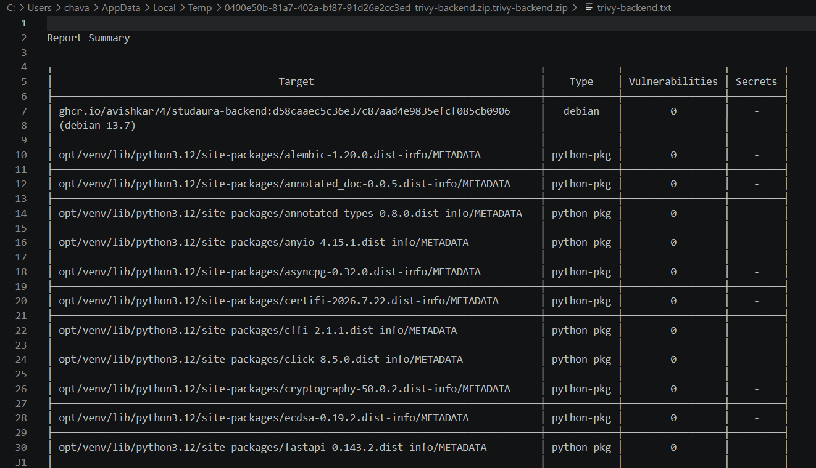
DevSecOps with Trivy
Both images are scanned before they are pushed
A fixable HIGH or CRITICAL blocks the publish
Terraform and rendered Helm manifests are scanned on every PR
Non-root, read-only filesystem, dropped capabilities
No secrets in Git; actions pinned to commit SHAs
Backend image: 0 vulnerabilities
The first run of the HIGH gate caught two Starlette CVEs; upgrading cleared them.
Notes:
Explain what Trivy scanned and what a clean result means.

Slide 8
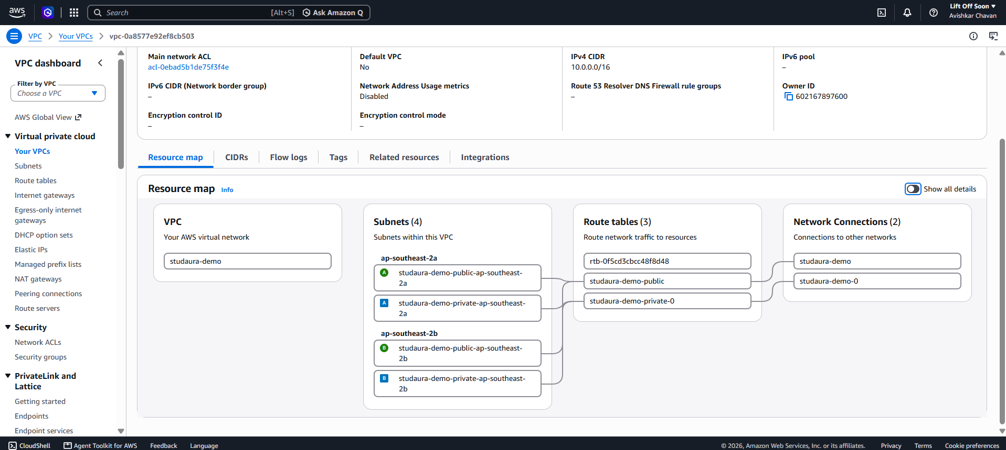
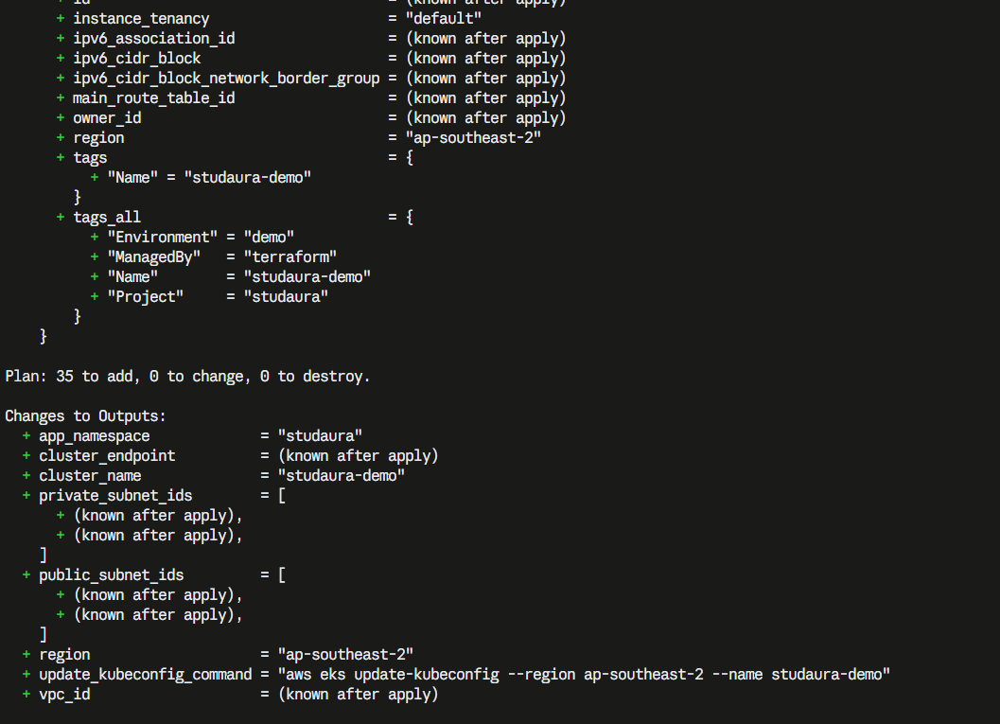
Terraform: VPC and EKS as code
VPC with 2 public and 2 private subnets in 2 zones
Internet gateway and a NAT gateway for the nodes
EKS cluster and a managed node group
IAM roles, KMS key, add-ons
terraform.tfvars.example, no credentials in Git
Plan tests run in CI
AWS console: VPC resource map, Sydney
35
resources in one plan
Notes:
Show terraform plan, then the AWS console VPC resource map.

Slide 9
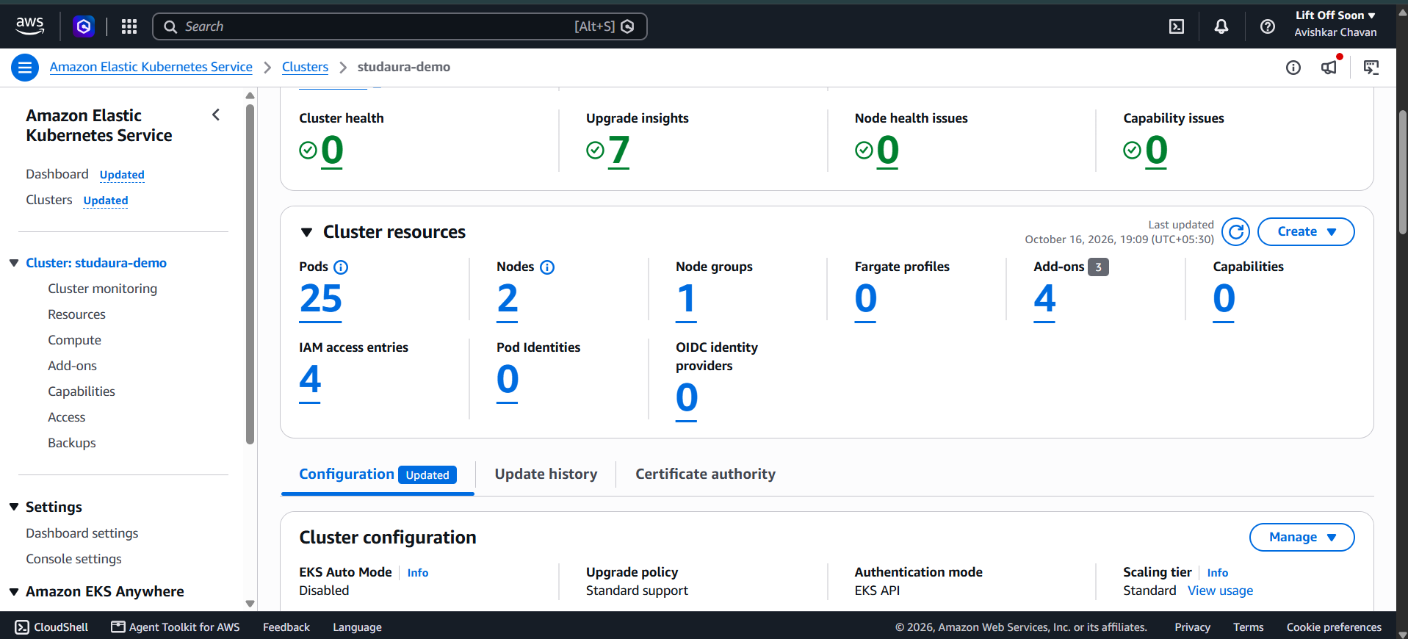
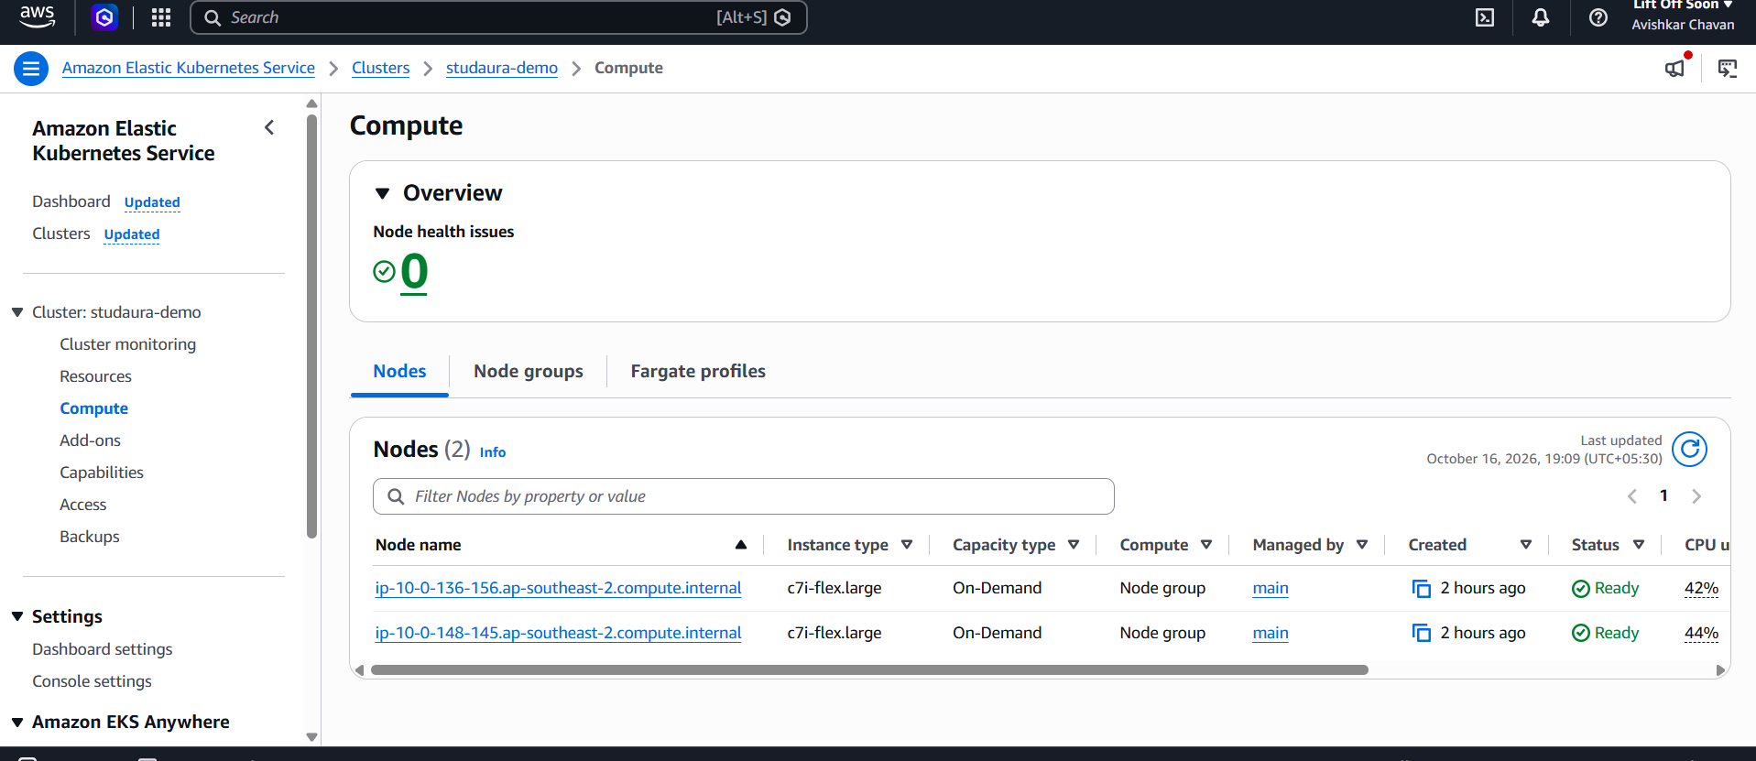
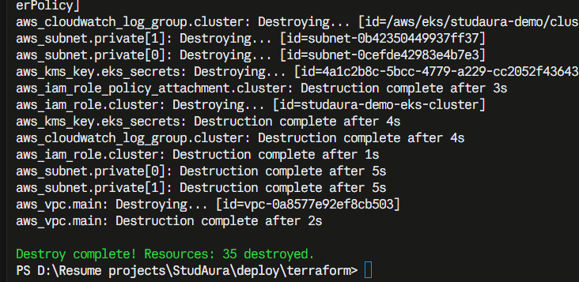
Terraform: applied and destroyed
Node group: 2 x c7i-flex.large, Ready
EKS cluster studaura-demo, Active
init, plan and apply all run from the CLI
Destroyed once the evidence was captured, so nothing keeps billing
terraform destroy: 35 destroyed
Notes:
Show the cluster and node group in the console, then the destroy output.

Slide 10
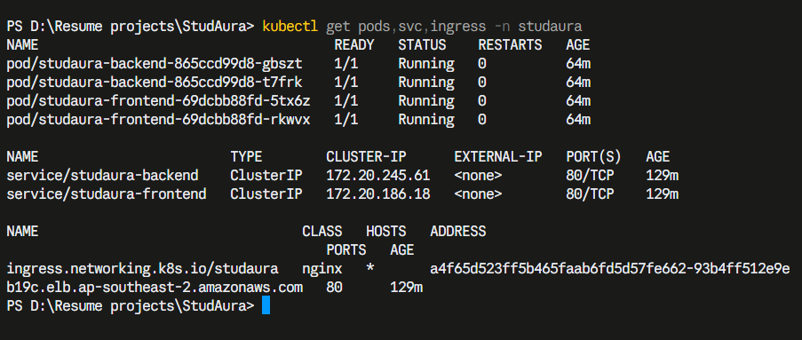
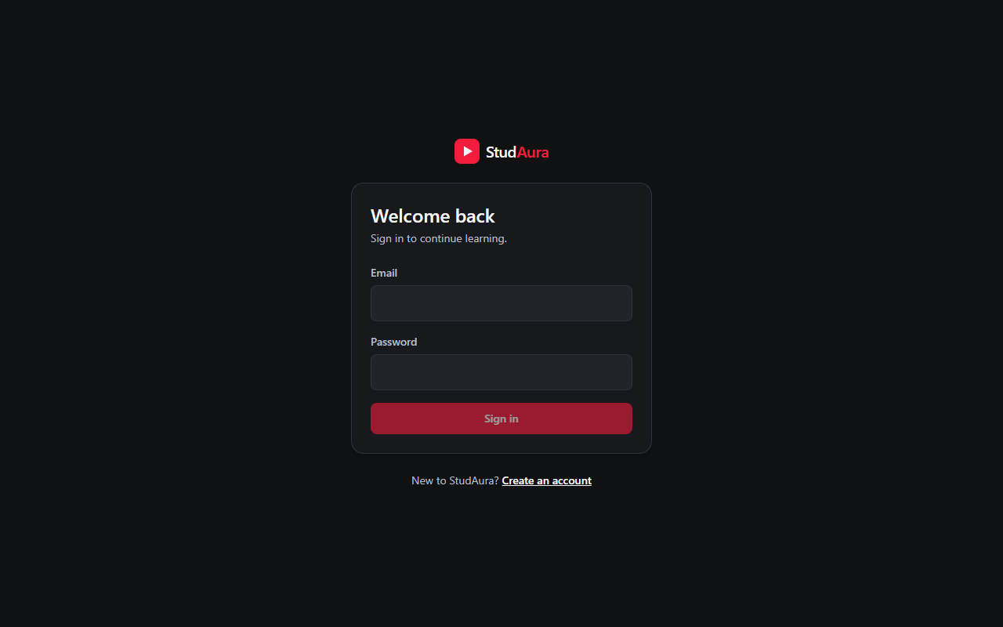
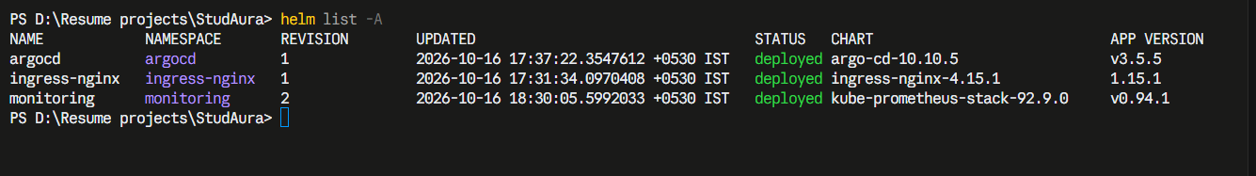
Kubernetes and Helm
2 backend + 2 frontend pods, autoscaling 2 to 4
ClusterIP Services; one Ingress
/ goes to the frontend, /api to the backend
Migration runs as a hook Job
kubectl get pods,svc,ingress -n studaura
helm list -A
The app through the Ingress
Notes:
Show kubectl get pods, svc, ingress and helm list; then the app through the load balancer.

Slide 11
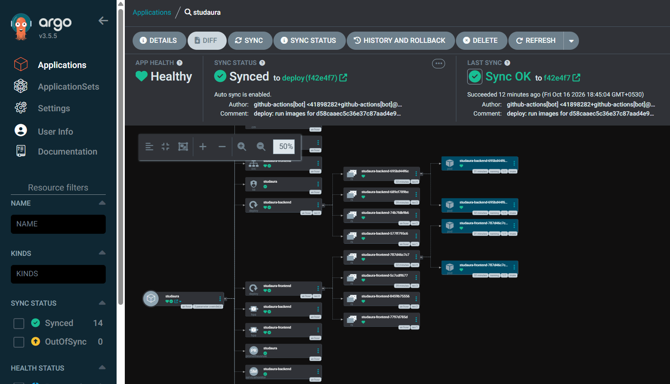
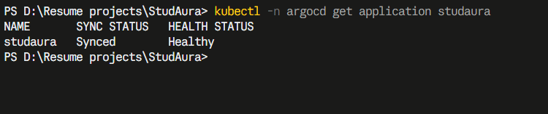
GitOps with ArgoCD
main
merge
CI publish
images in GHCR
deploy branch
image.yaml: SHA
ArgoCD
sync + self-heal
The cluster pulls its state from Git
CI holds no cluster credentials
Self-heal reverts manual drift
kubectl get application
ArgoCD: Healthy, Synced to the deploy branch
Notes:
Merge to main, CI moves the deploy branch, ArgoCD applies it. Main is never pushed to by automation.

Slide 12
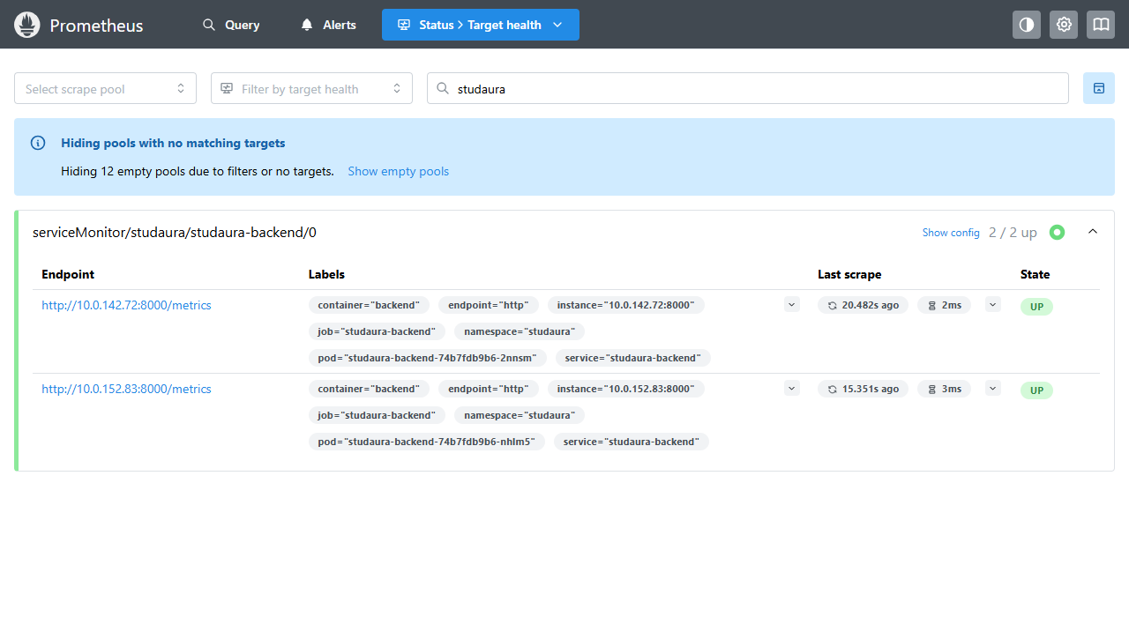
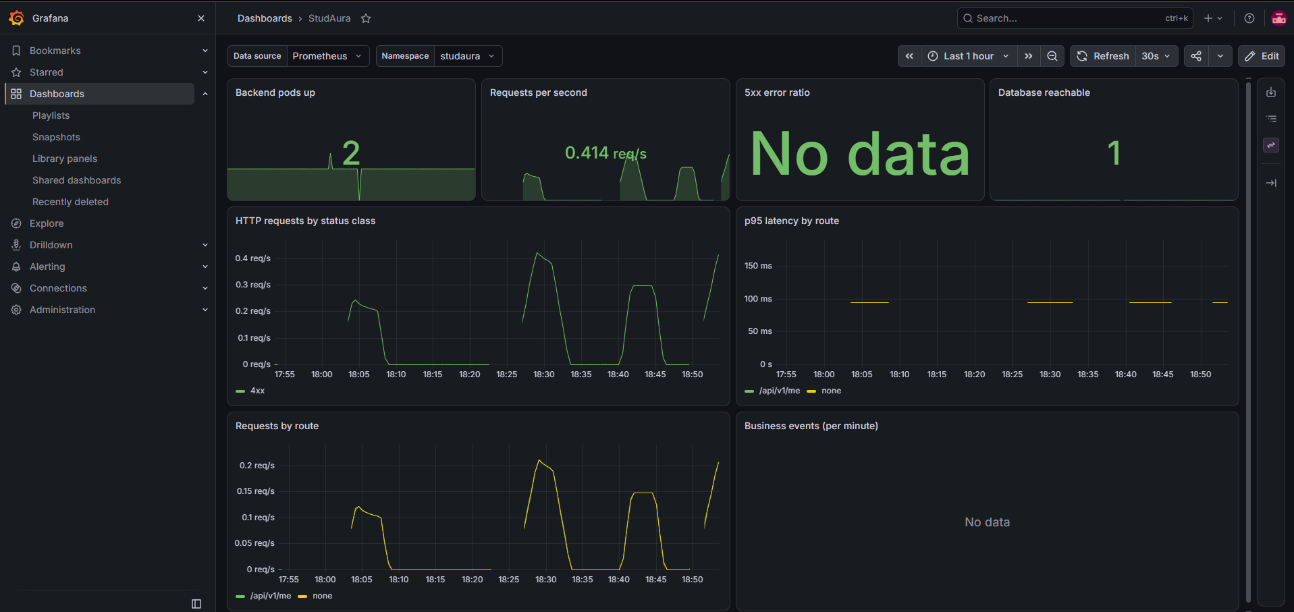
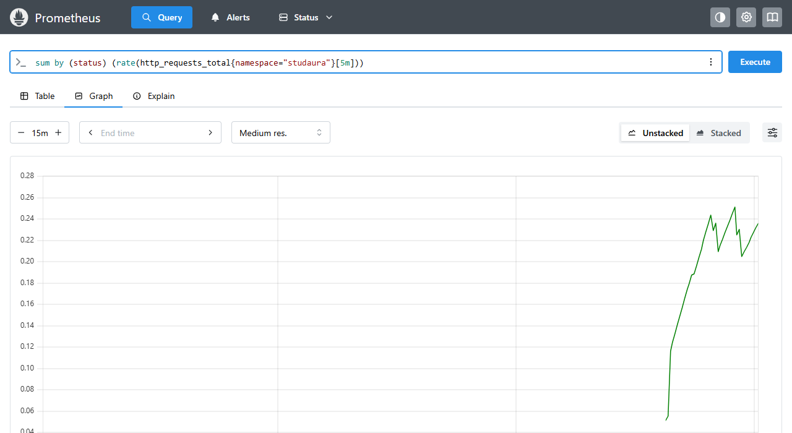
Observability
Grafana dashboard StudAura
Prometheus: both backend pods UP
Live request rate by status class
ServiceMonitor scrapes /metrics
Alerts: backend down, 5xx, database
Dashboard provisioned from Git
Notes:
Show /metrics, the Prometheus targets page, then the Grafana dashboard with traffic running.

Slide 13
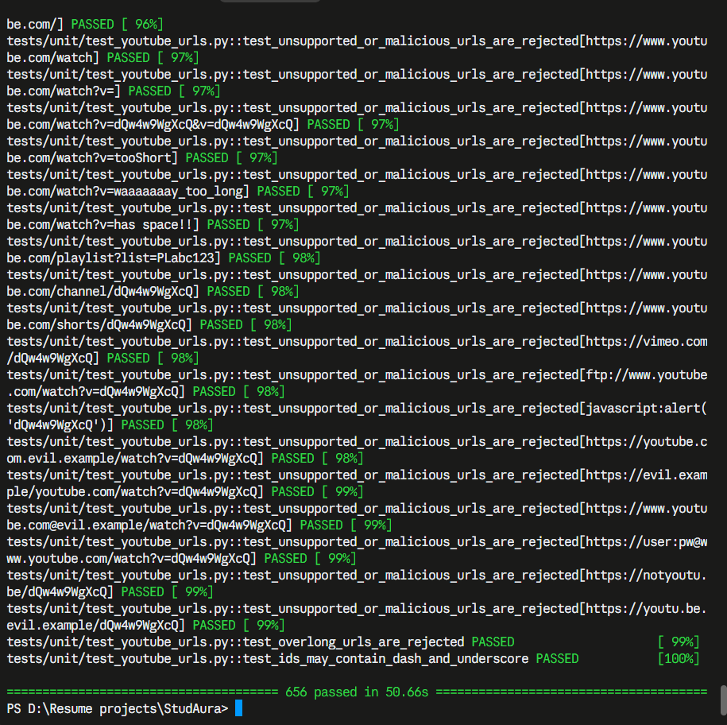
Quality gates
674
425
30+
backend tests, real PostgreSQL
frontend unit tests
pull requests merged
pytest -v on the evidence run: 656 passed; 674 now
Backend tests use a throwaway database and a fake YouTube adapter
Playwright runs on desktop and phone sizes, with axe WCAG 2 A/AA scans
Both images scan clean: zero fixable HIGH or CRITICAL findings
Notes:
Numbers are from the real CI runs and the local pytest run.

Slide 14
Key learnings and limits
What I learned
Known limits
Small, reviewed pull requests keep CI green.
A pipeline is only trustworthy if every gate can fail.
GitOps removes cluster credentials from CI.
Cloud account policies shape the architecture as much as the code.
HTTP only: no domain or certificate yet.
Database in Mumbai, cluster in Sydney: about 260 ms per query.
Prometheus data is not persisted.
The cluster is destroyed once the evidence is captured, to avoid cost.
Notes:
Be honest about the limits; graders respect it.

