Slide 1
StudAura
Watch. Capture. Track. Revise.
A YouTube-based learning workspace, shipped with a complete DevSecOps pipeline
Note: the app walkthrough comes first - skip to slide 13 for the DevOps part.
Docker · GitHub Actions · Trivy · GHCR · Terraform · EKS · Helm · ArgoCD · Prometheus · Grafana
Avishkar Chavan · DevOps final capstone
Notes:
Introduce StudAura and say the project has two halves: the product, and the delivery chain around it.

Slide 2
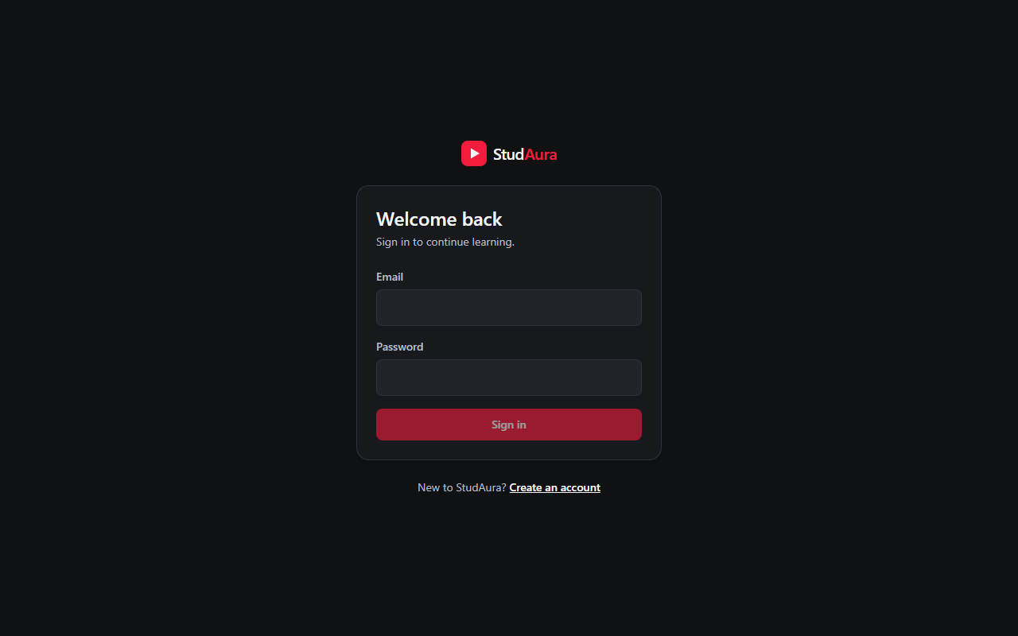
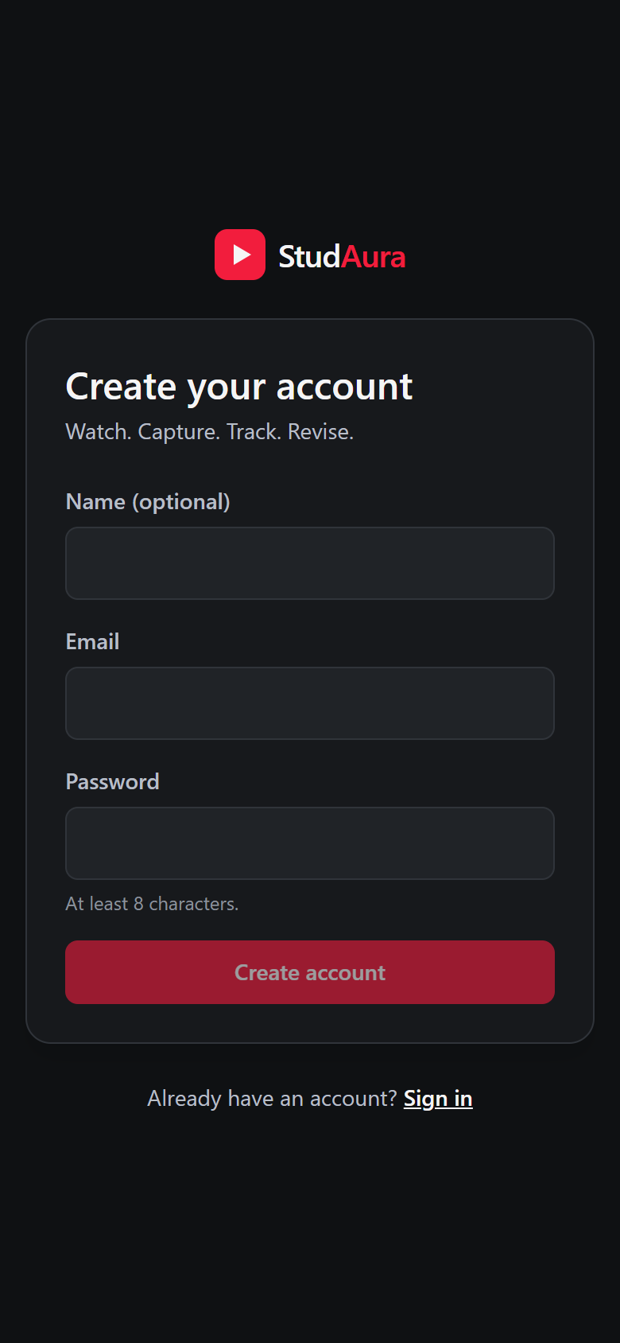
What StudAura does
Learning paths
Player
Import videos or whole playlists; failures are reported per item.
Embedded YouTube player that resumes where you stopped.
Notes
Goals + revision
Docker Compose, localhost:3000
Rich text with autosave, retry and conflict detection.
Daily goal from real playback; a revision queue.
The same app through the EKS load balancer, on a phone-sized screen
Notes:
Show the sign-in page. Mention it is a real app: Supabase auth, FastAPI backend, React frontend, responsive on a phone.

Slide 3
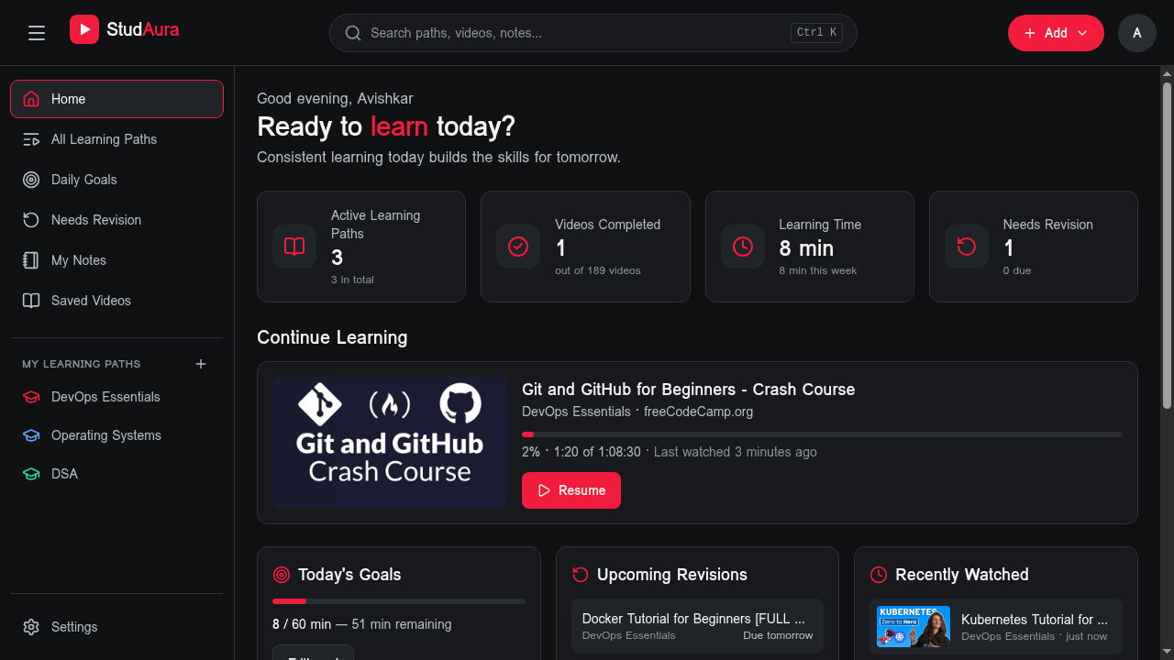
Home dashboard
Progress at a glance: stats, today's goal, one-click resume

Slide 4
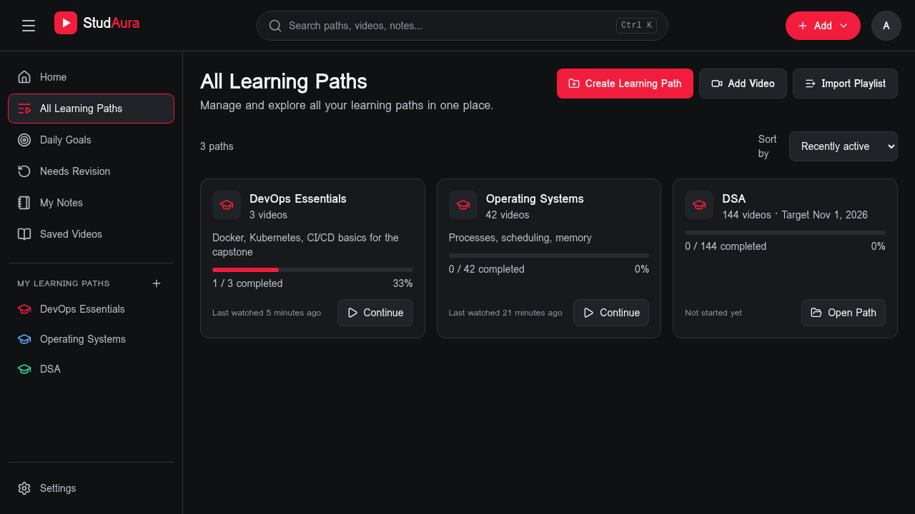
Learning paths
Videos and playlists grouped into paths, with completion tracked

Slide 5
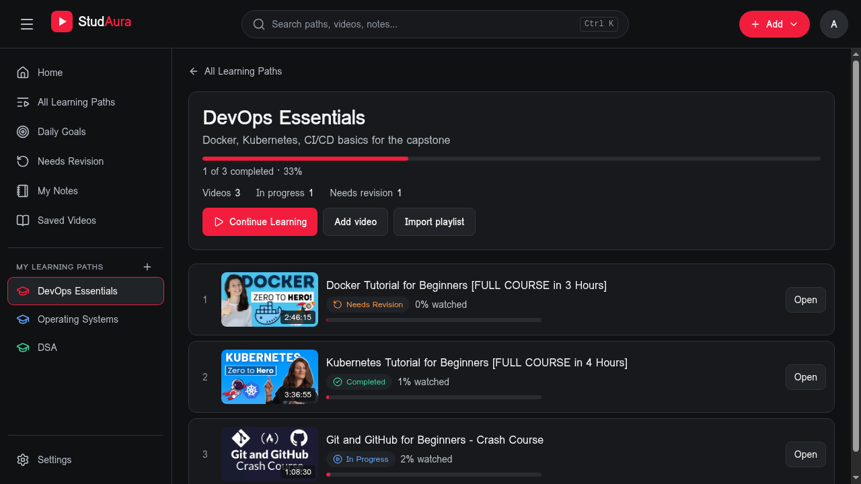
Inside a learning path
Each video shows its status and watch progress

Slide 6
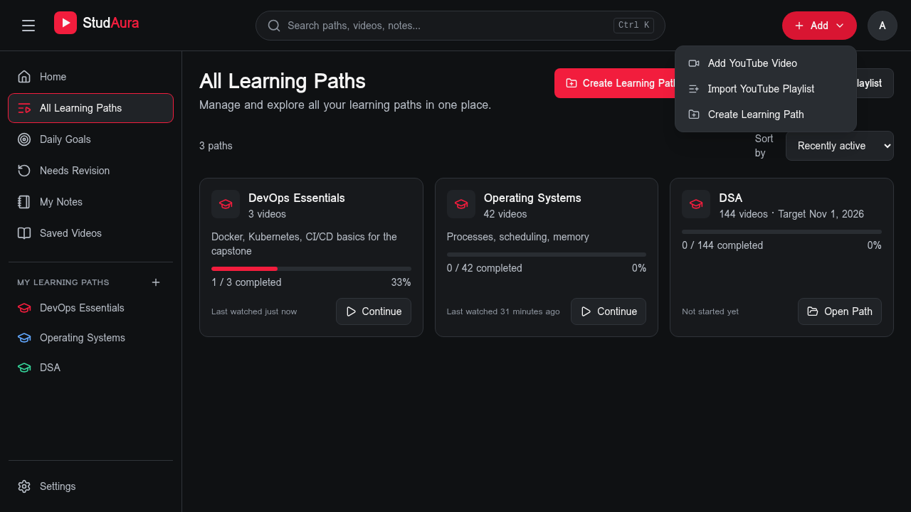
Adding content
Import one YouTube video or a whole playlist

Slide 7
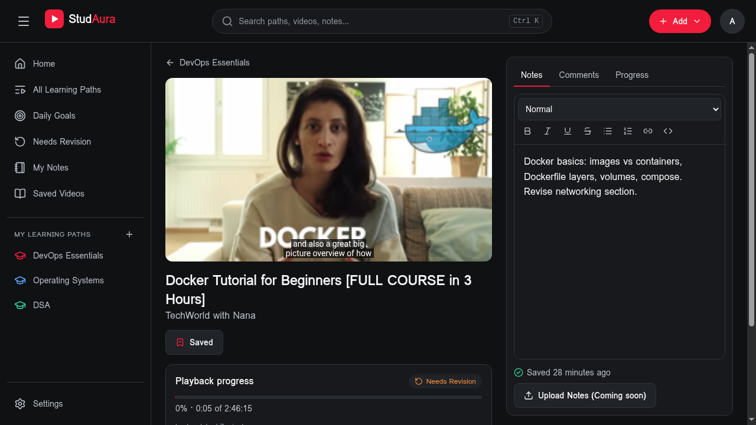
Watch and take notes
The player and notes editor sit side by side; notes autosave

Slide 8
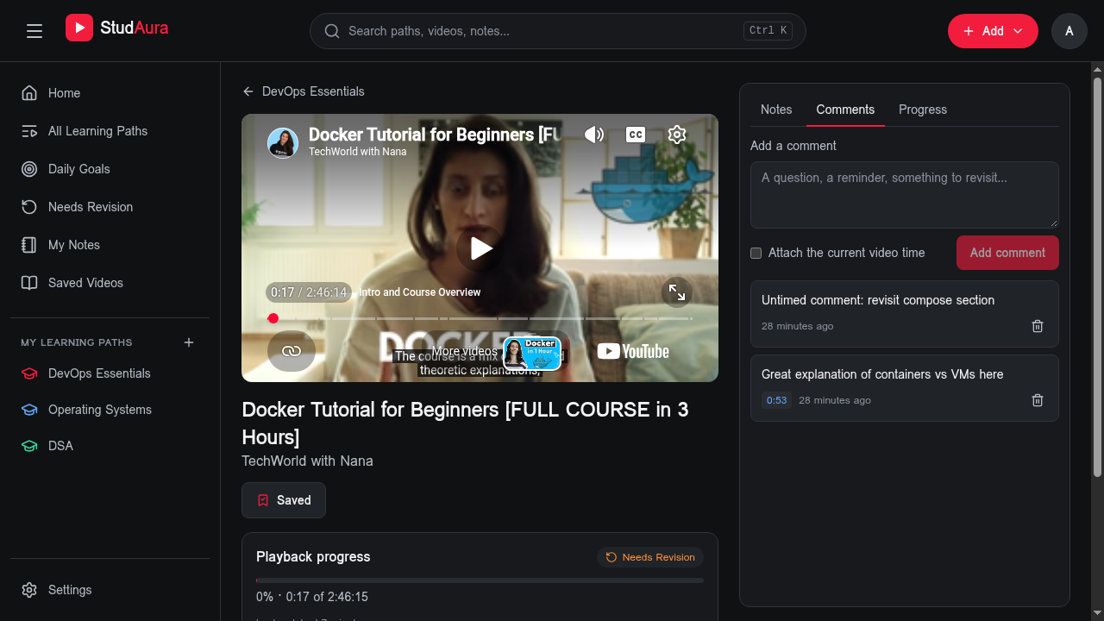
Timestamped comments
Comments can point to an exact moment in the video

Slide 9
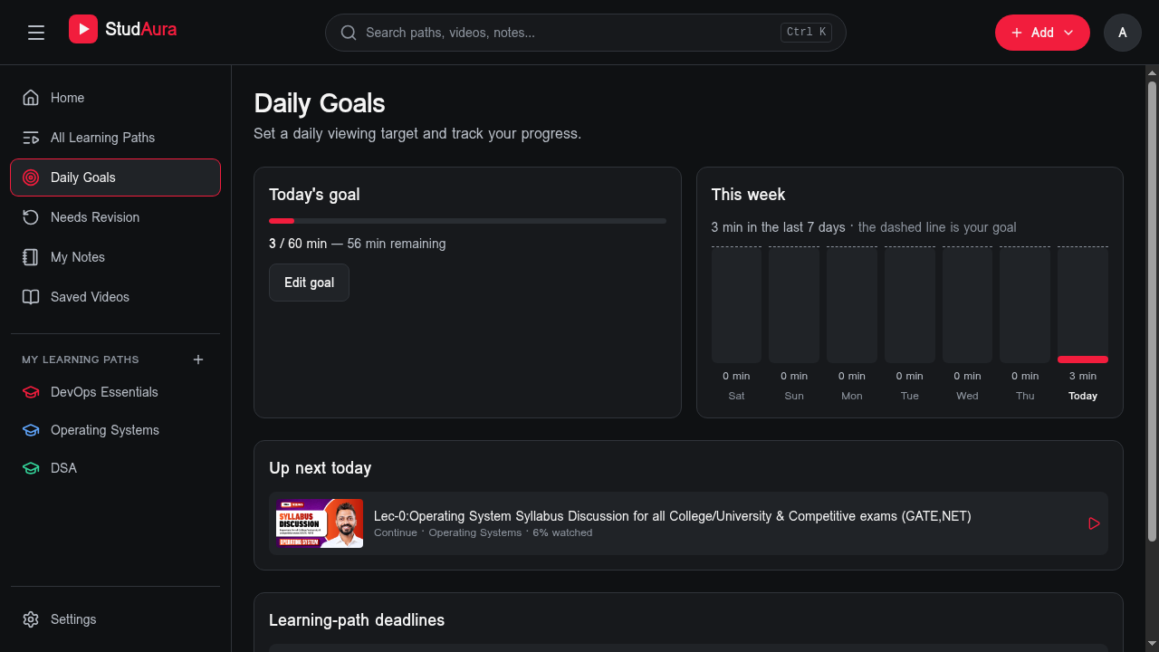
Daily goals
Goals count real playback time, with the week shown as a chart

Slide 10
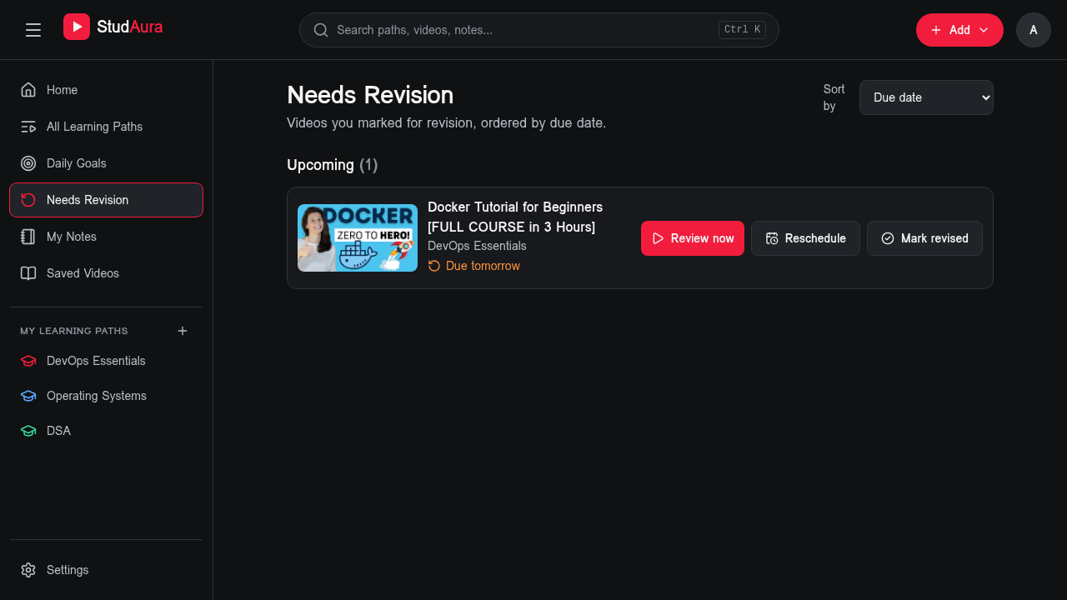
Revision queue
Flag a video for revision and review it by its due date

Slide 11
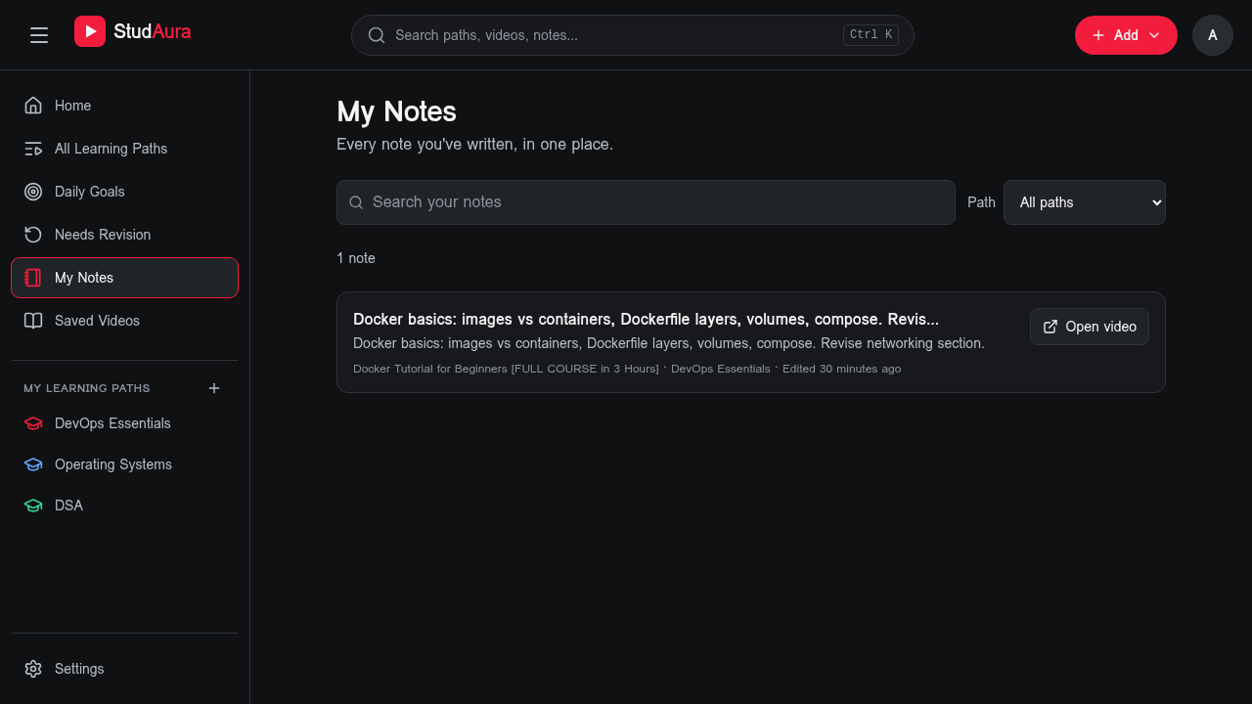
My notes
Every note in one searchable library

Slide 12
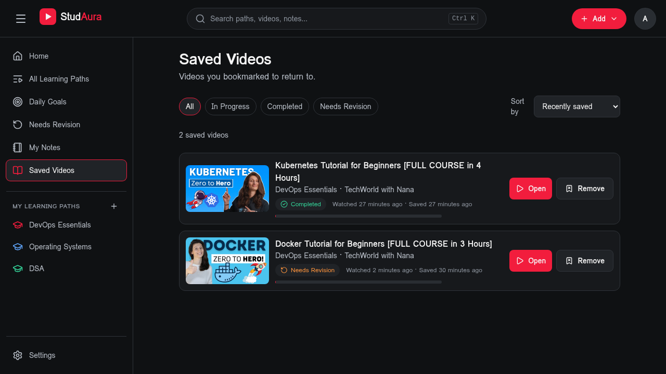
Saved videos
Bookmarked videos with status filters

Slide 13
Tech stack
Frontend
Backend
Delivery
React 18
Vite + TypeScript
Tailwind CSS v4
TanStack Query
TipTap editor
Vitest + Playwright
FastAPI
SQLAlchemy 2 (async)
Alembic migrations
JWT via Supabase JWKS
PostgreSQL
prometheus-fastapi-
instrumentator
Docker (multi-stage)
GitHub Actions
Trivy, GHCR
Terraform, AWS EKS
Helm, ArgoCD
Prometheus, Grafana
Notes:
Supabase gives auth and Postgres; everything else is ours.

Slide 14
Architecture
Frontend x2
nginx + React SPA
Browser
AWS load balancer
ingress-nginx
/ goes to the frontend, /api goes to the backend
Backend x2
FastAPI
Supabase Postgres
Auth + data
Prometheus
scrapes /metrics
Grafana
dashboard + alerts
Notes:
Trace one request: browser, load balancer, ingress, then frontend or backend; backend talks to Supabase Postgres. Prometheus scrapes the backend; Grafana reads Prometheus.

Slide 15
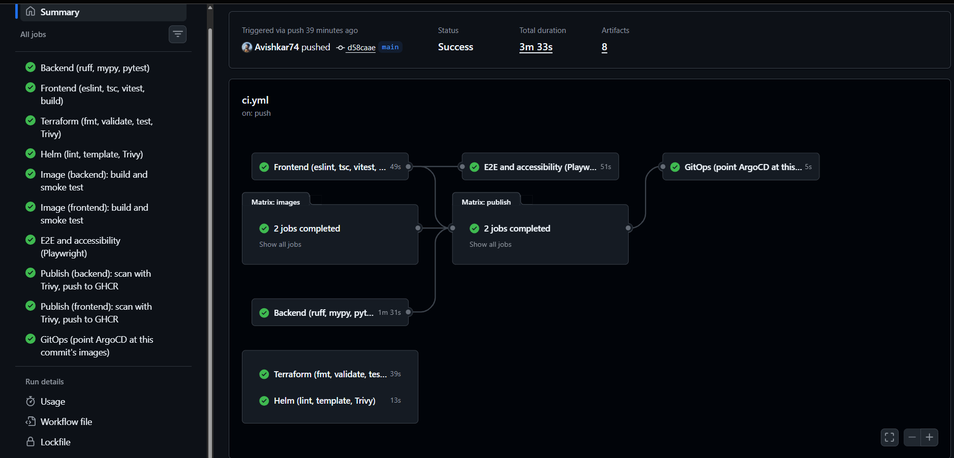
CI/CD pipeline
Pull request
lint, tests, build
Images
build, non-root
Publish
Trivy, then GHCR
GitOps
deploy branch
ArgoCD
syncs cluster
Runs on every pull request and every push to main
pytest on a real PostgreSQL service; a skipped test fails the build
Images tagged with the commit SHA only, never latest
Playwright + axe accessibility checks on main
Green run on main: all jobs passed
Notes:
Show the green run. Every PR runs all gates. Only main publishes. Tags are always the commit SHA.

Slide 16
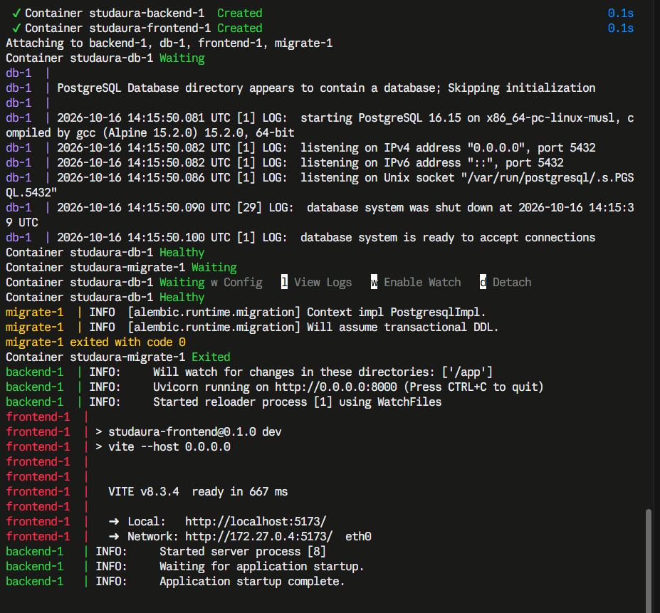
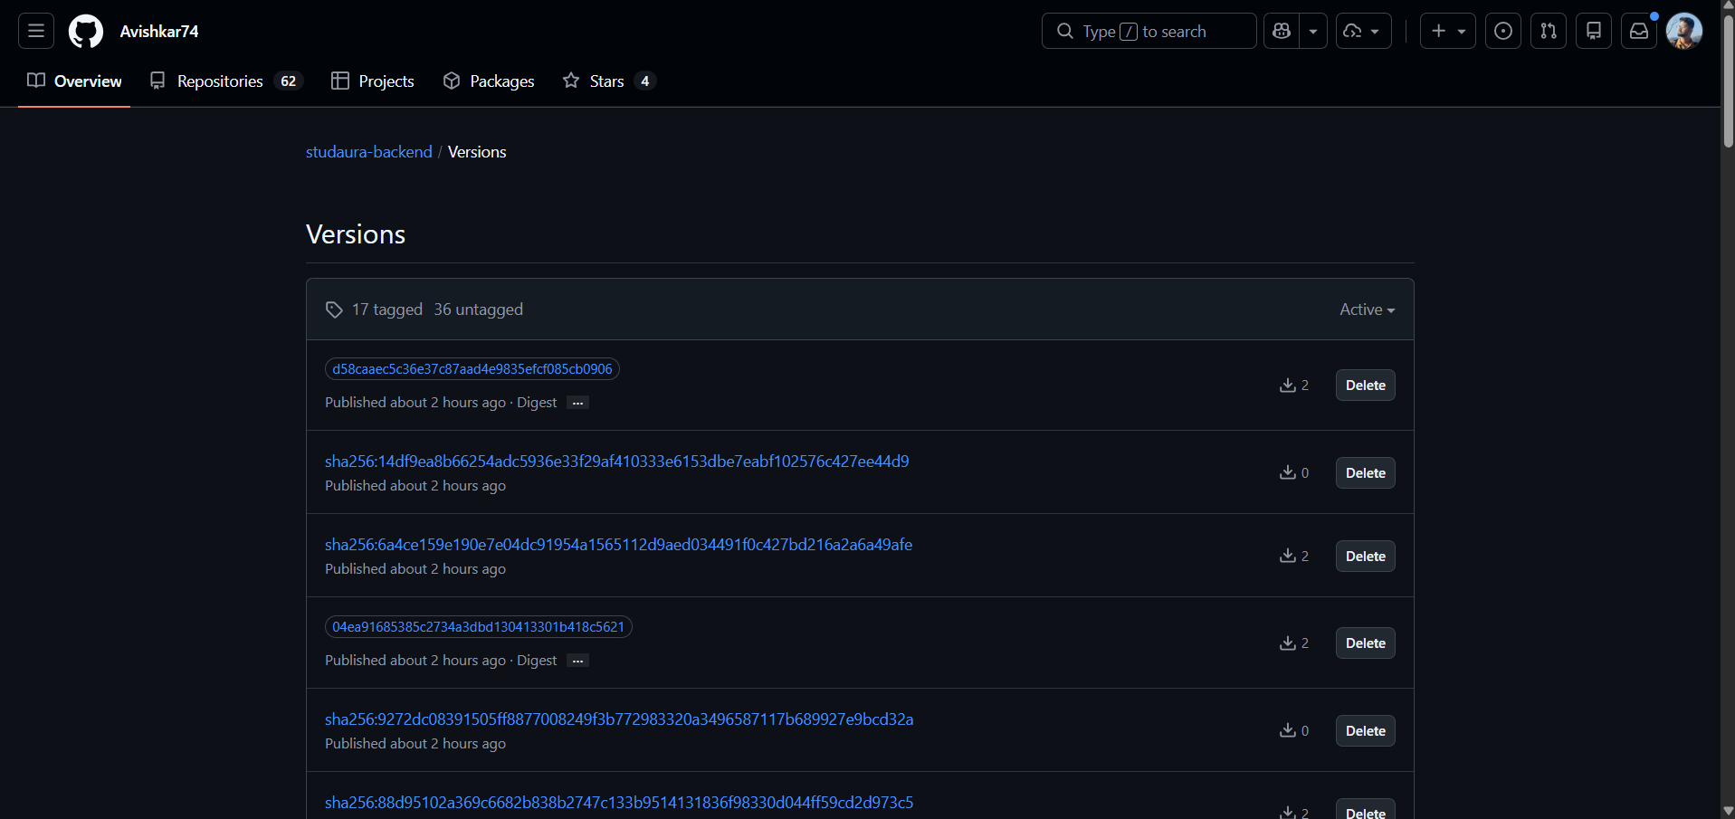
Containers and registry
GHCR: studaura-backend, commit-SHA tags
docker compose up --build
Multi-stage Dockerfiles, both images run as non-root
Tags are commit SHAs; no latest tag is published
Notes:
Show docker compose up, then the GHCR page with SHA tags.

Slide 17
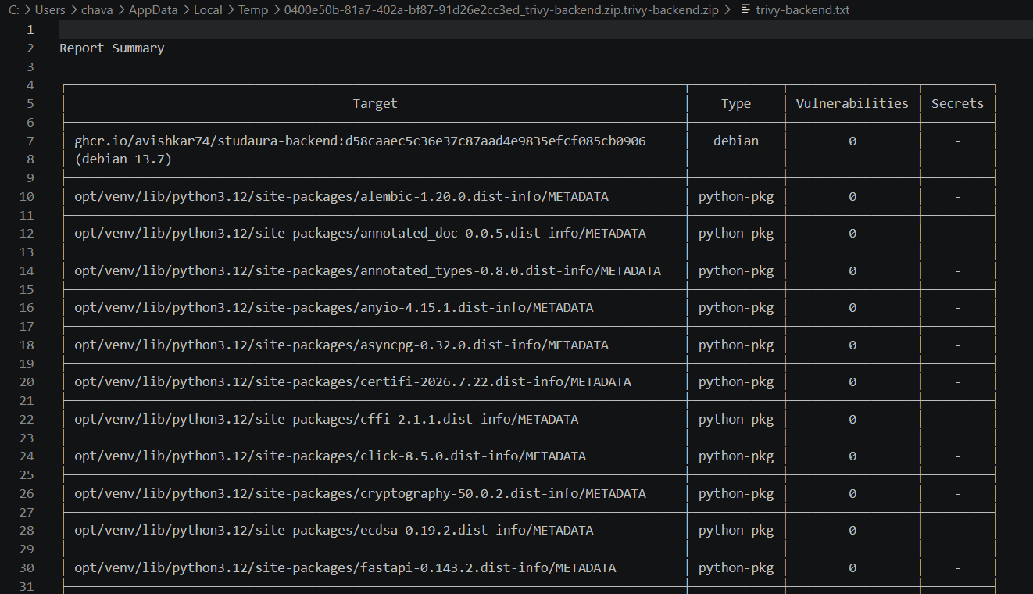
DevSecOps with Trivy
Both images are scanned before they are pushed
A fixable HIGH or CRITICAL blocks the publish
Terraform and rendered Helm manifests are scanned on every PR
Non-root, read-only filesystem, dropped capabilities
No secrets in Git; actions pinned to commit SHAs
Backend image: 0 vulnerabilities
The first run of the HIGH gate caught two Starlette CVEs; upgrading cleared them.
Notes:
Explain what Trivy scanned and what a clean result means.

Slide 18
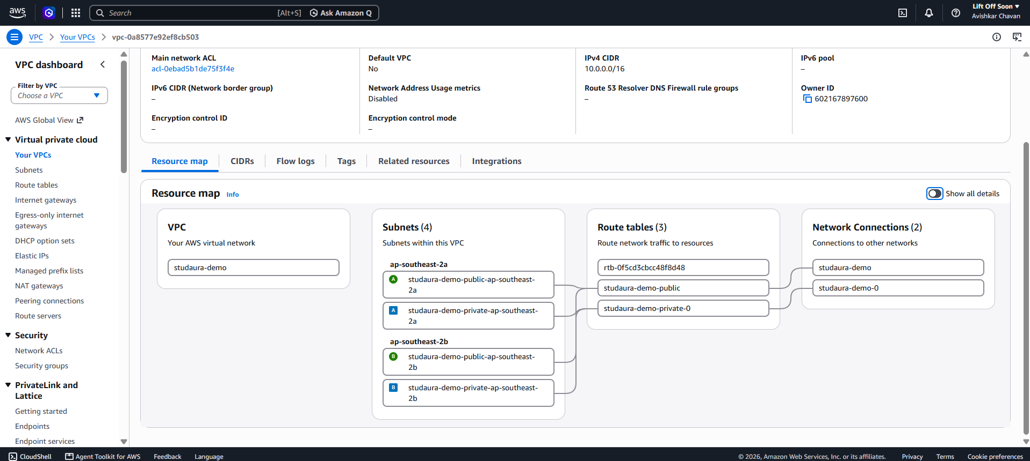
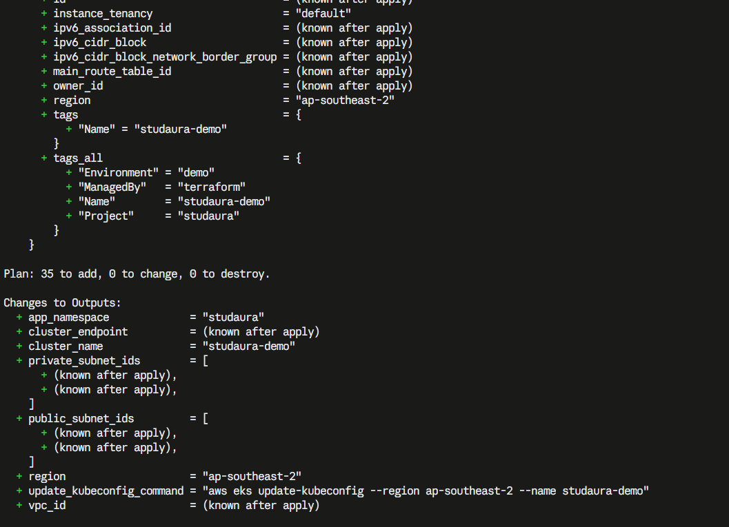
Terraform: VPC and EKS as code
VPC with 2 public and 2 private subnets in 2 zones
Internet gateway and a NAT gateway for the nodes
EKS cluster and a managed node group
IAM roles, KMS key, add-ons
terraform.tfvars.example, no credentials in Git
Plan tests run in CI
AWS console: VPC resource map, Sydney
35
resources in one plan
Notes:
Show terraform plan, then the AWS console VPC resource map.

Slide 19
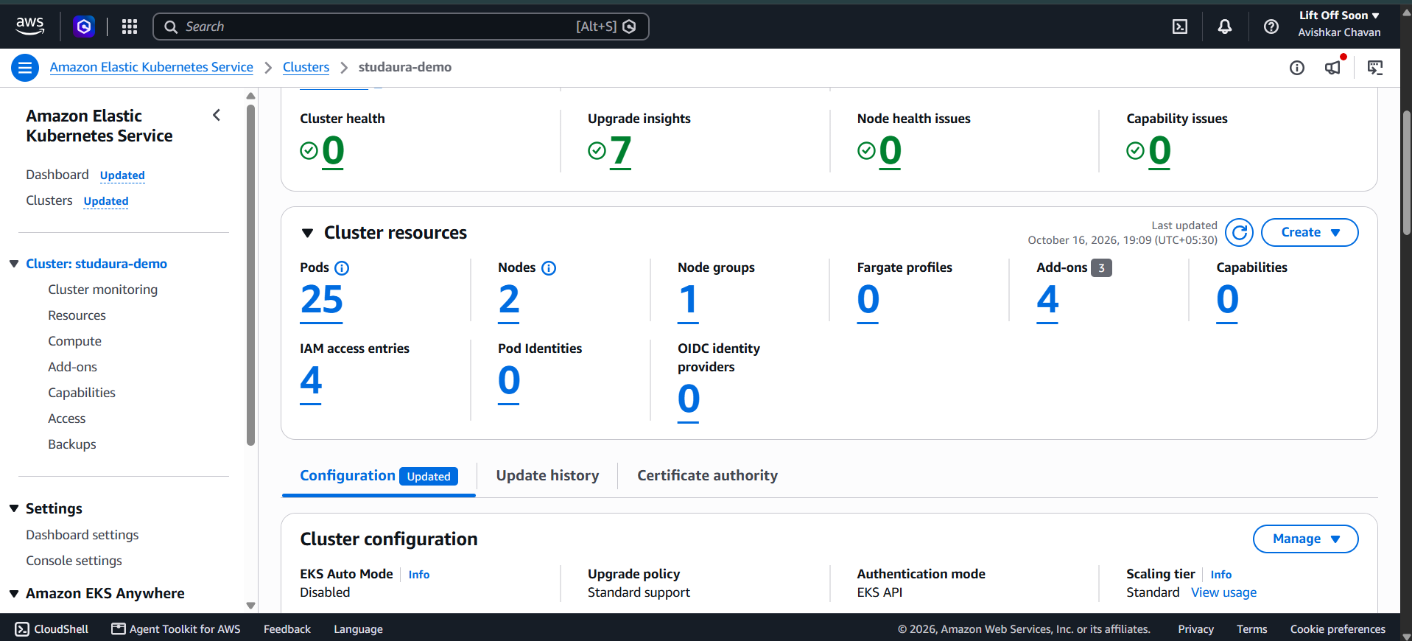
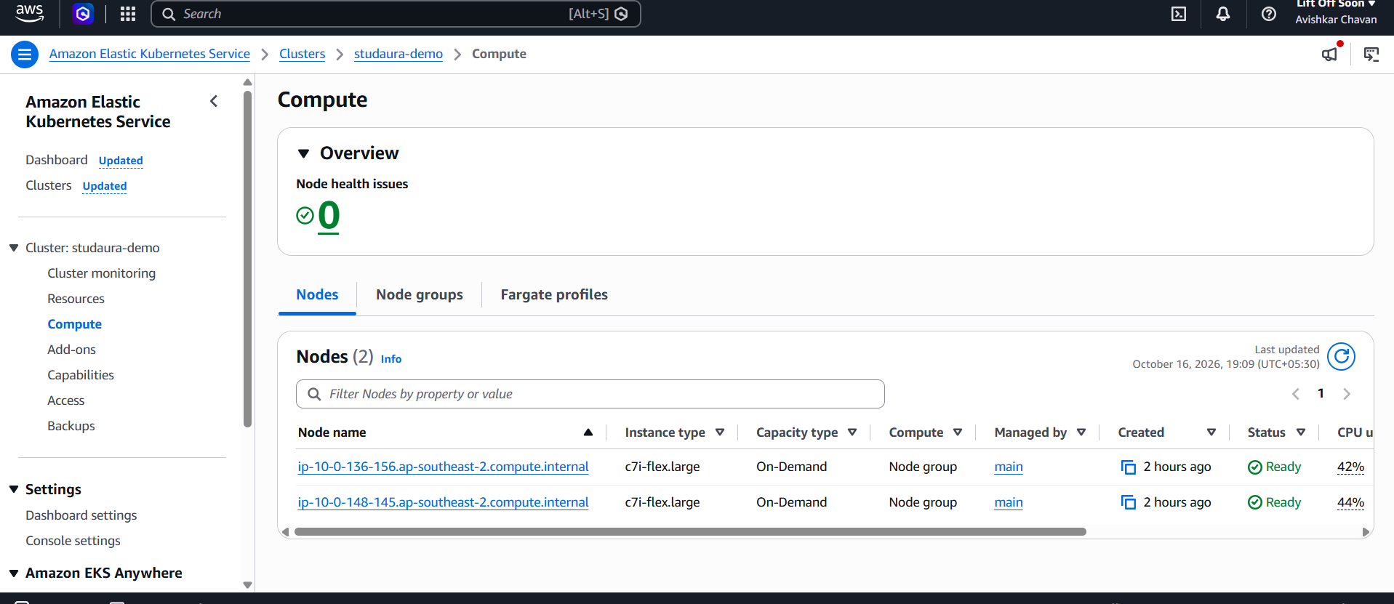
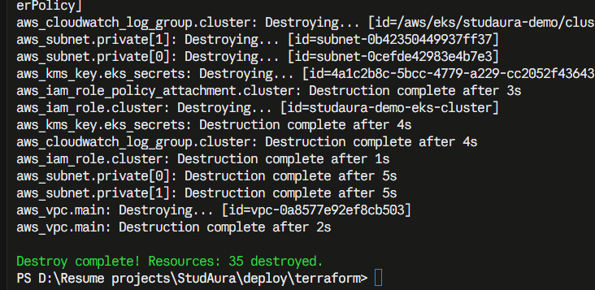
Terraform: applied and destroyed
Node group: 2 x c7i-flex.large, Ready
EKS cluster studaura-demo, Active
init, plan and apply all run from the CLI
Destroyed once the evidence was captured, so nothing keeps billing
terraform destroy: 35 destroyed
Notes:
Show the cluster and node group in the console, then the destroy output.

Slide 20
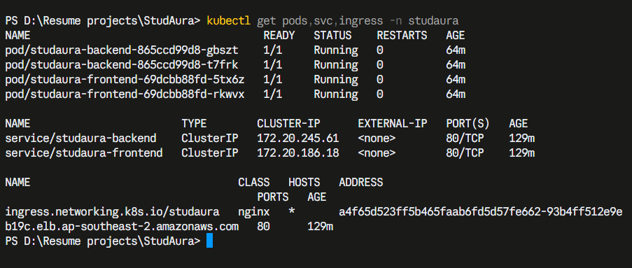
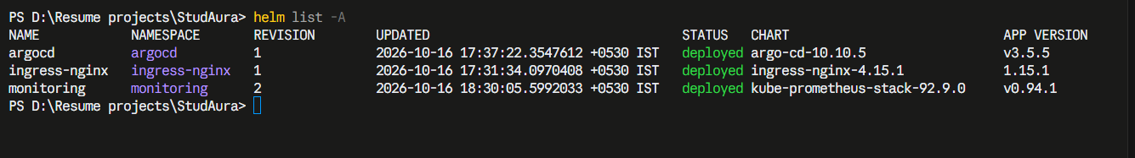
Kubernetes and Helm
2 backend + 2 frontend pods, autoscaling 2 to 4
ClusterIP Services; one Ingress
/ goes to the frontend, /api to the backend
Migration runs as a hook Job
kubectl get pods,svc,ingress -n studaura
helm list -A
The app through the Ingress
Notes:
Show kubectl get pods, svc, ingress and helm list; then the app through the load balancer.

Slide 21
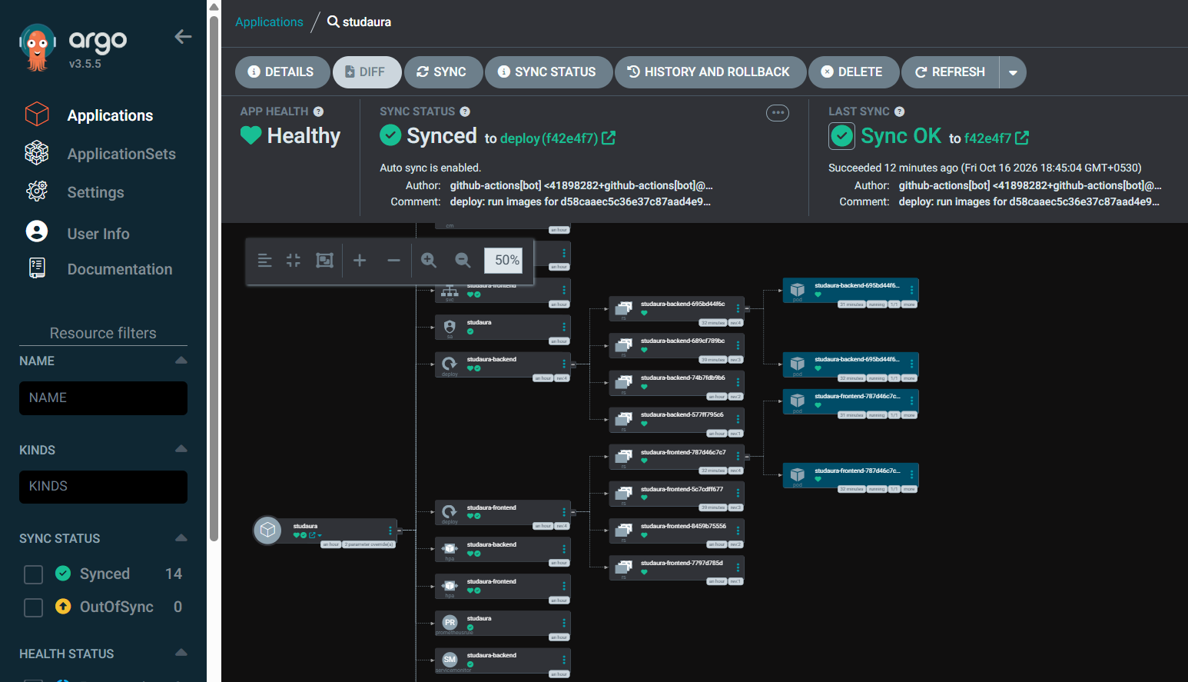
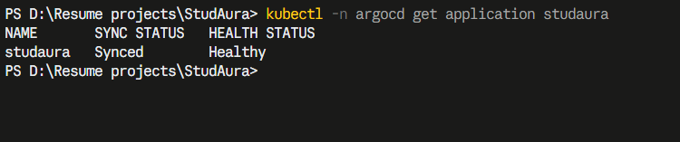
GitOps with ArgoCD
main
merge
CI publish
images in GHCR
deploy branch
image.yaml: SHA
ArgoCD
sync + self-heal
The cluster pulls its state from Git
CI holds no cluster credentials
Self-heal reverts manual drift
kubectl get application
ArgoCD: Healthy, Synced to the deploy branch
Notes:
Merge to main, CI moves the deploy branch, ArgoCD applies it. Main is never pushed to by automation.

Slide 22
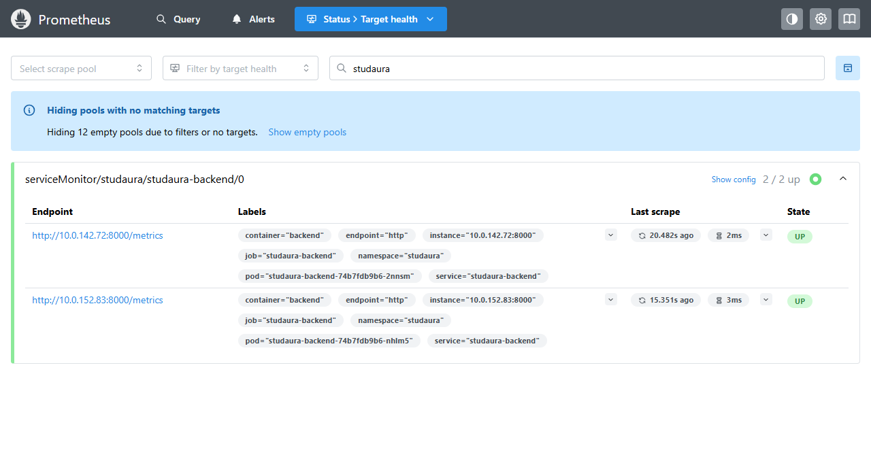
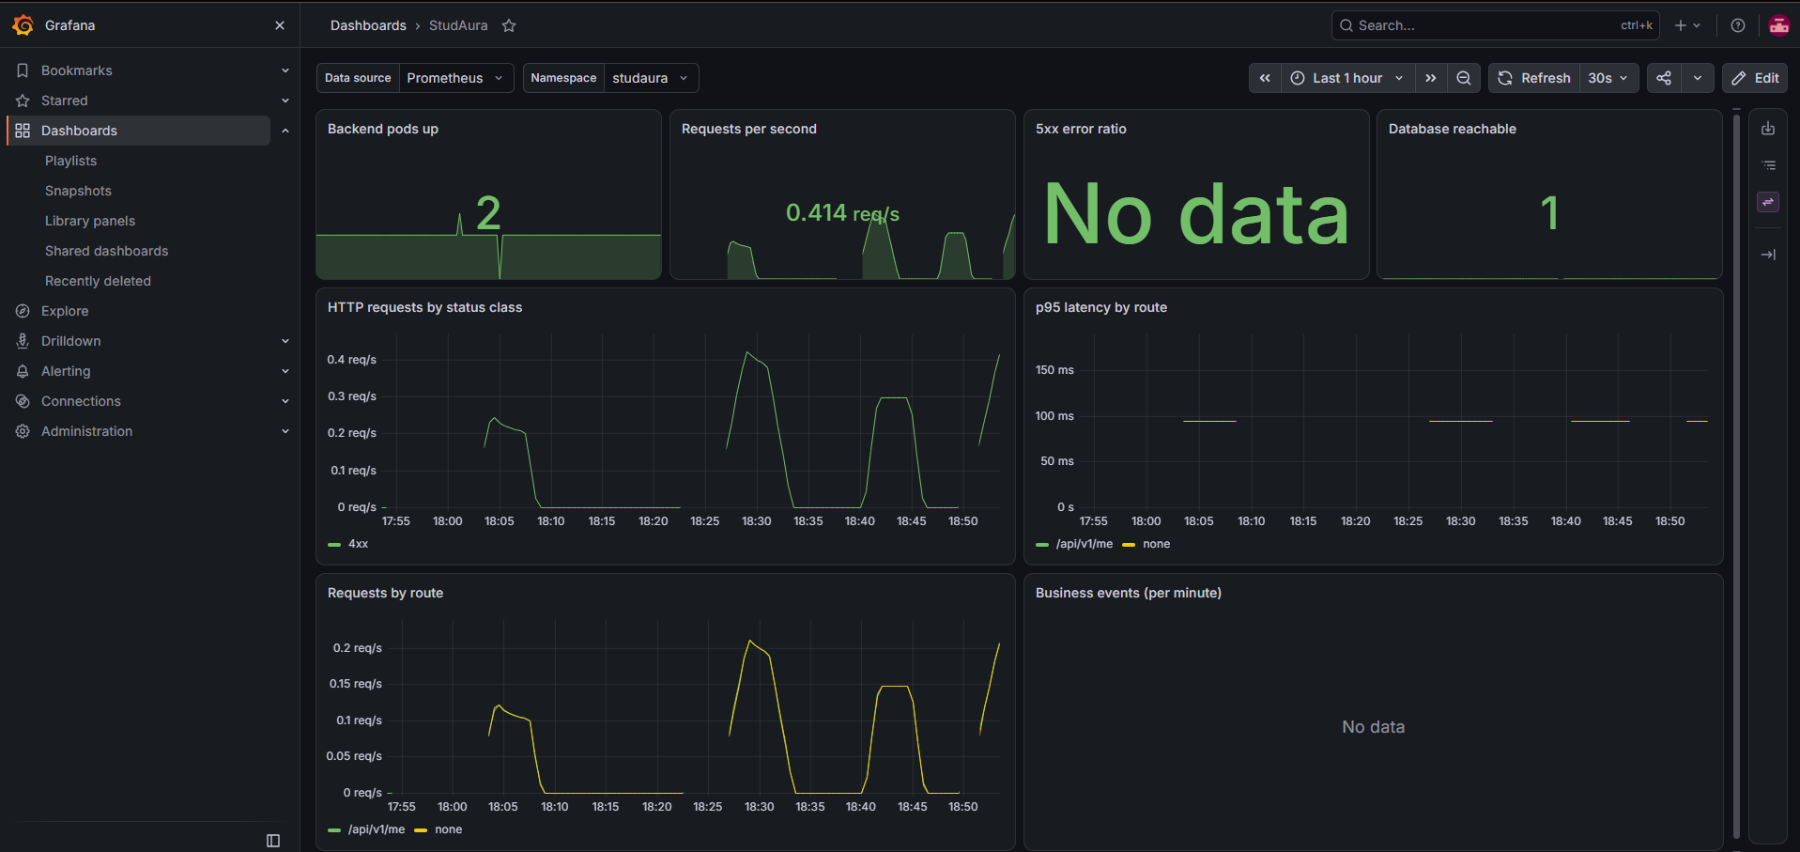
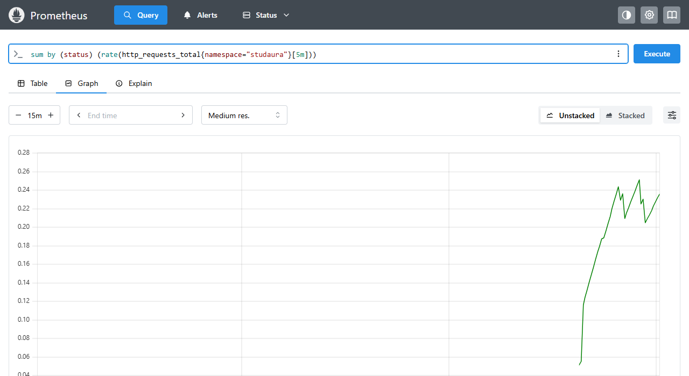
Observability
Grafana dashboard StudAura
Prometheus: both backend pods UP
Live request rate by status class
ServiceMonitor scrapes /metrics
Alerts: backend down, 5xx, database
Dashboard provisioned from Git
Notes:
Show /metrics, the Prometheus targets page, then the Grafana dashboard with traffic running.

Slide 23
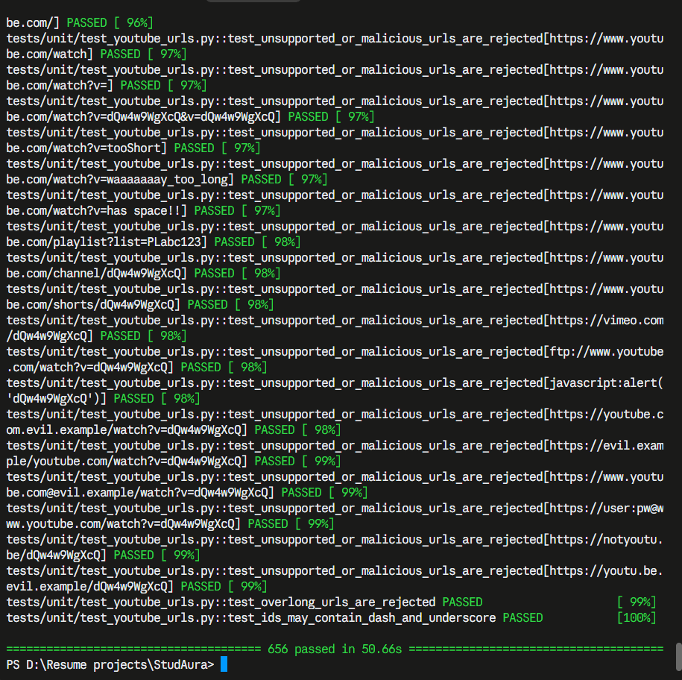
Quality gates
674
425
37
backend tests, real PostgreSQL
frontend unit tests
pull requests merged
pytest -v: 674 passed (656 in the captured run)
Backend tests use a throwaway database and a fake YouTube adapter
Playwright runs on desktop and phone sizes, with axe WCAG 2 A/AA scans
Both images scan clean: zero fixable HIGH or CRITICAL findings
Notes:
Numbers are from the real CI runs and the local pytest run.

Slide 24
Key learnings and limits
What I learned
Known limits
Small, reviewed pull requests keep CI green.
A pipeline is only trustworthy if every gate can fail.
GitOps removes cluster credentials from CI.
Cloud account policies shape the architecture as much as the code.
HTTP only: no domain or certificate yet.
Database in Mumbai, cluster in Sydney: about 260 ms per query.
Prometheus data is not persisted.
The cluster is destroyed once the evidence is captured, to avoid cost.
Notes:
Be honest about the limits; graders respect it.

