Slide 1




HUMAN FACE RECOGNITION – COMPUTER VISION
TEAM NAME: ERROR 404
MEMBERS:
Aditya Singh
Akash Arya
Aryan Mehta
Kanav Avasthi
Avi Tayal

Slide 2
PROBLEM STATEMENT
Human Face Recognition by using Computer Vison (Deep Learning)
In this project, team task is to identify the human face real time from a CCTV (For this project
we will provide you Video Clip) camera with the help of computer Vision. If CCTV camera
frame (image from the Video) contains multiple faces, then developed model must have
capability to recognize all the faces in frame.
Data Storage
After recognition of faces developed, Software will return the face identity (For Example: Employee Code) and Date and time of recognition in a csv file.

Slide 3
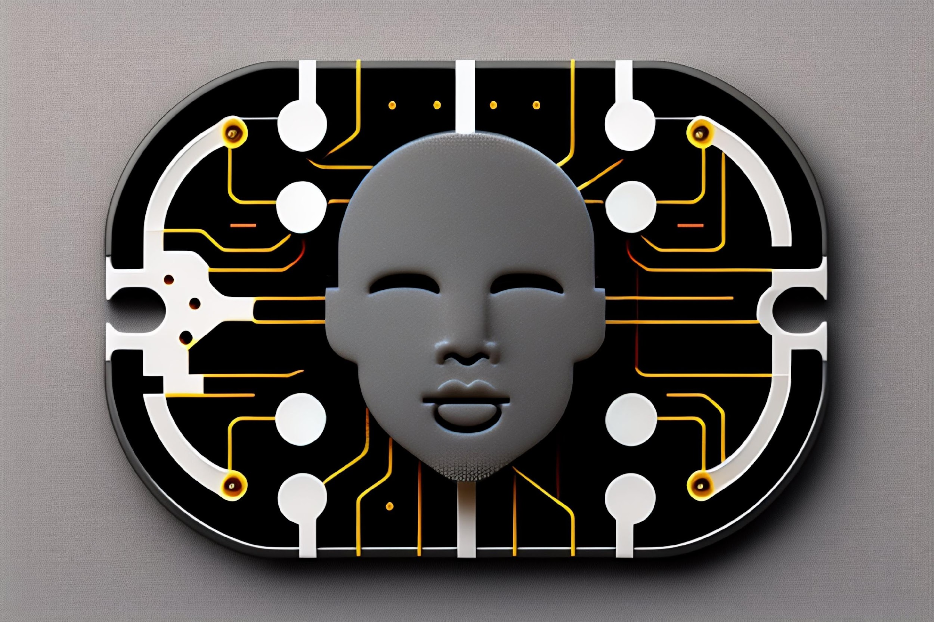
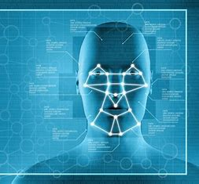
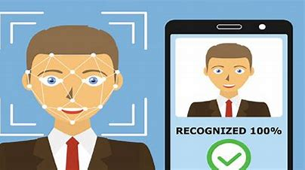
INTRODUCTION!
Face detection technology has received a lot of attention recently and has been used in a variety of industries, including security, surveillance, and marketing.
Employee face detection has become a viable technique for increasing security, productivity, and efficiency in the workplace.
Advanced computer vision techniques can precisely identify and track employee faces in real-time, giving important details about their conduct, attendance, and engagement.

Slide 4
OUR PROPOSED MODEL
We propose an open source model which uses pre-trained modules that will boost our accuracy even with a small dataset.
face_recognition: A Python package called the face_recognition library gives programmers the ability to identify and work with faces.
We use face encoding and detection parameters of face_recognition module to locate the coordinates of detected faces in a frame and draw a rectangle around it.
We use a distance hyperparameter of 0.515 to compare detected face to the faces in the dataset.
If the distance hyperparameter is detected at less than 0.515, we declare it as unknown.
All known faces are stored in a list with the earliest detection time stamp in a video.

Slide 5
WHY SHOULD YOU CHOOSE OUR MODEL?
The face recognition model built using these libraries can accurately recognize faces in images or videos, making it useful for security, surveillance, and other applications where identity verification is important.
Our model uses open source modules that require a smaller volume of dataset to provide accurate recognition results.
The model can be easily integrated with other software applications and systems, making it compatible with a wide range of devices and platforms.
The model can be trained on large datasets and can handle a large number of faces, making it suitable for use in applications that require processing large amounts of data.

Slide 6
LIMITATIONS OF OUR MODEL
Our model relies on the current set of images and if it is not regularly updated for new employees or for latest images of the employees, it could provide false results.
A faster processing unit is required for our model, so that it could provide faster results or else the model becomes useless.
These are the limitations for our model, if these problems are dealt with, it would be a better, faster and more efficient model for your organization.

Slide 7
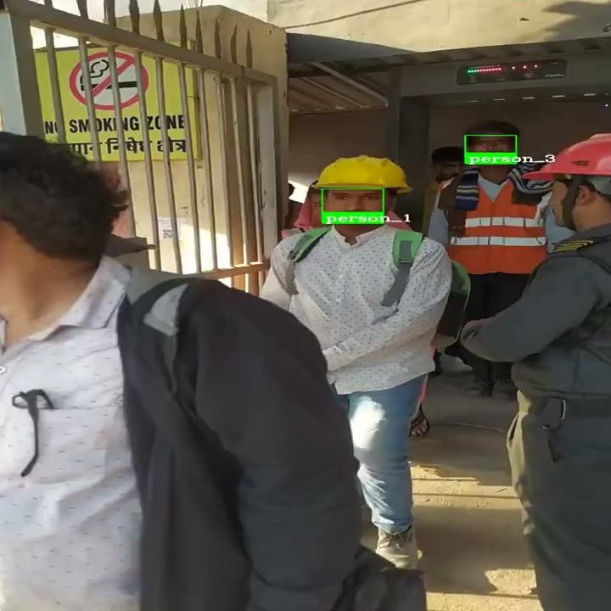
DEMONSTRATION OF OUR MODEL

Slide 8
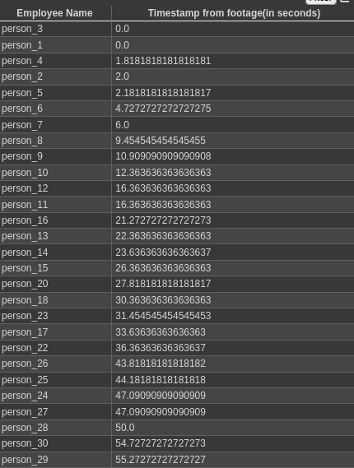
DATA STORAGE IN OUR MODEL
Faces are detected and stored in a list based on the earliest frame of appearance, the time of occurrence is detected from there.
The employees in the video are registered in a list which is converted into a .csv file along with the timestamp of their appearance.
This data is provided to the user in a web based platform.

Slide 9
REFERENCES
OpenCV: OpenCV-Python Tutorials
GeeksForGeeks: GeeksforGeeks | A computer science portal for geeks
face-recognition · PyPI
Stack Overflow - Where Developers Learn, Share, & Build Careers

