Slide 1
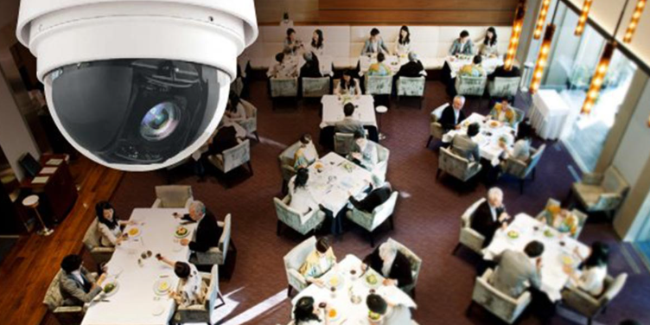
Food Consumption Level Classification
Leveraging Synthetic Data and GenAI for Restaurant Operations Optimization
Presenters:
Shlomi Ben Shitrit 314711250
Yarden Aviad (Gottreich) 213211477 Avital skop 212052823

Slide 2
Motivating Use Case (The "Why")
Operational Efficiency: Restaurants struggle to monitor table status in real-time. Having an automatic algorithm that can monitor the food consumption - knowing exactly when a plate is empty allows for faster clearing and better customer service.
Enhanced Guest Experience: Proactive service - refilling or clearing at the perfect moment- without intruding on the customers.
The Hardware Challenge: Utilizing existing infrastructure (standard overhead security cameras) rather than requiring specialized, expensive sensors.
The Data Gap: No public, labelled datasets exist for "stages of eating" in a restaurant setting, creating a barrier for traditional AI development.

Slide 3
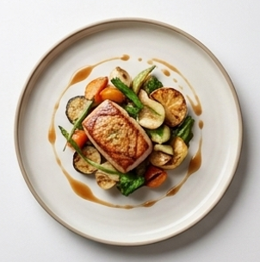
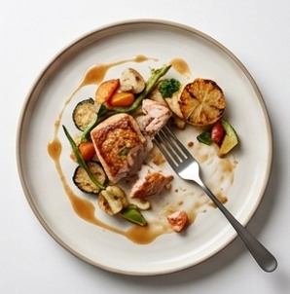

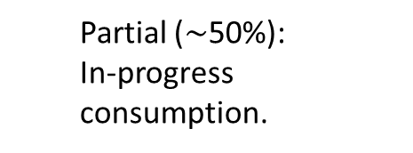
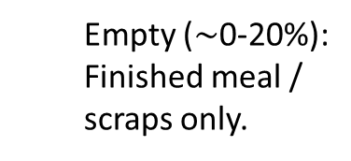
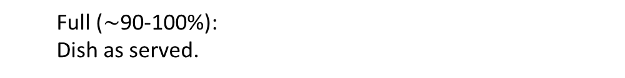
Project task description (The "What")
Primary Objective: Develop a robust classifier to identify the "fullness" of a plate from a top-down perspective.
Core Methodology:
Synthetic Data Generation: Utilizing Diffusion model to create a controlled and diverse dataset of plates fullness of plates and food types.
Automated Labeling: Generating labels based on the prompts used for image creation (Full/Partial/Empty).
Environmental Adaptability: Teaching the model to work correctly even with different lighting, various types of food, or when things like cutlery and napkins cover parts of the plate.
Classification Categories:
Empty ($\sim$0-20%):
Finished meal /
scraps only.
Full ($\sim$90-100%):
Dish as served.
Partial ($\sim$50%):
In-progress consumption.

Slide 4
Models and Methods
Pipeline
Generate synthetic multi-table scenes
Training & Evaluation
Train multiple models on synthetic data
Compare performance across models
Evaluate robustness to noise and occlusions.
Apply controlled cropping to isolate table regions
Extract plate regions within each table
Models and Fine-tuning:
Train CNN and ViT on synthetic data
Evaluate CLIP as a pre-trained model
Classify food consumption level per plate

Slide 5
Data Specification and Generation
Problem
Limited availability of suitable labeled data
Existing datasets do not match the required scenario (top-view restaurant tables with food consumption labels)
Variability (Data Augmentation)
Different food types
Lighting conditions
Camera angles Noise and blur
Partial plate occlusions
Data Generation
Generate synthetic images using generative models
Use prompt-based generation to control scene properties
Labeling
Labels are inferred from the generation setup and prompts
Dataset Design
Classes: for example - Full / Partial / Empty
split : Train / Validation / Test

Slide 6
Metrics and KPIs
Performance Evaluation
Accuracy Overall percentage of correct predictions
Precision / Recall Important when classification errors have different impacts
Confusion Matrix Analyzes errors between classes
(e.g., confusion between Partial and Full)
Optional Extended Evaluation
Robustness Performance under noise, occlusions, and varying conditions
Generalization Train on synthetic data, test on different distributions
Domain Gap Analysis Evaluate transfer from synthetic to real-world images

Slide 7
Future directions
Temporal Analysis
Incorporate
time dimension
Compare table states
across time
Enable decisions
(e.g., call waiter, clear table)
Siamese Network Approach
Input: two images (reference “full” state
+ current state)
The model extracts feature embeddings from each image
A comparison layer measures the difference between the two representations
Motivation
Captures changes over time
Enables understanding of consumption progression (e.g., from full → half)

