Slide 1
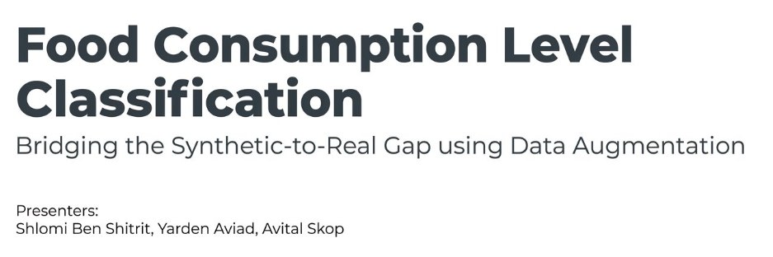

Slide 2
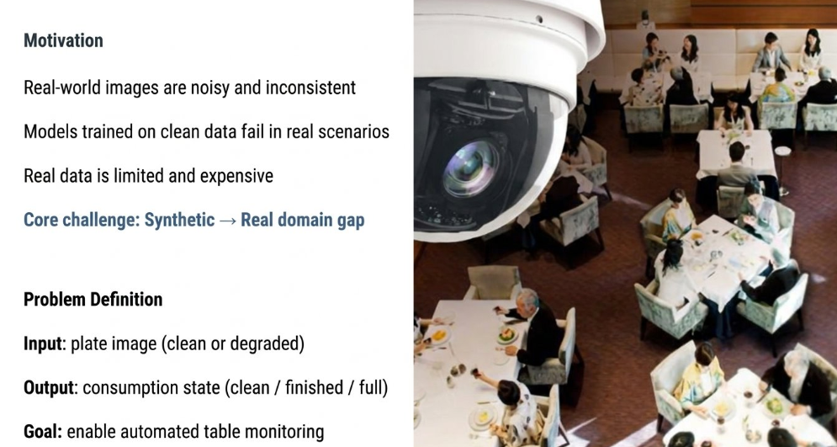
Notes:
מוטיבציה - ירדן

Slide 3
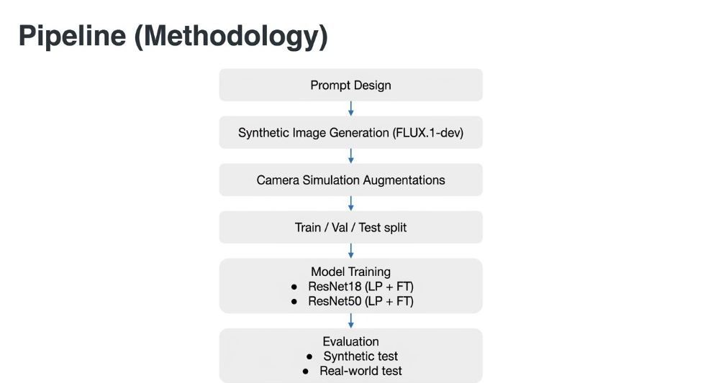
Notes:
- ירדןPipline ((איך המודל עובד בראשי פרקים

Slide 4
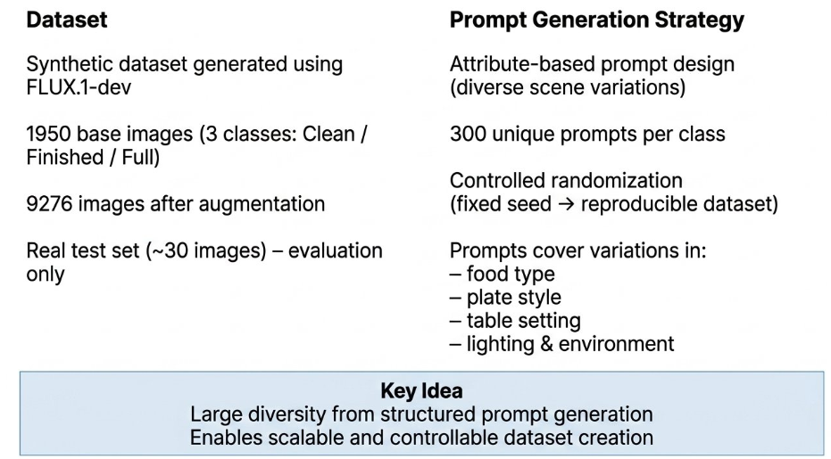
45
Notes:
יצירת הדאתא - שלומי

Slide 5
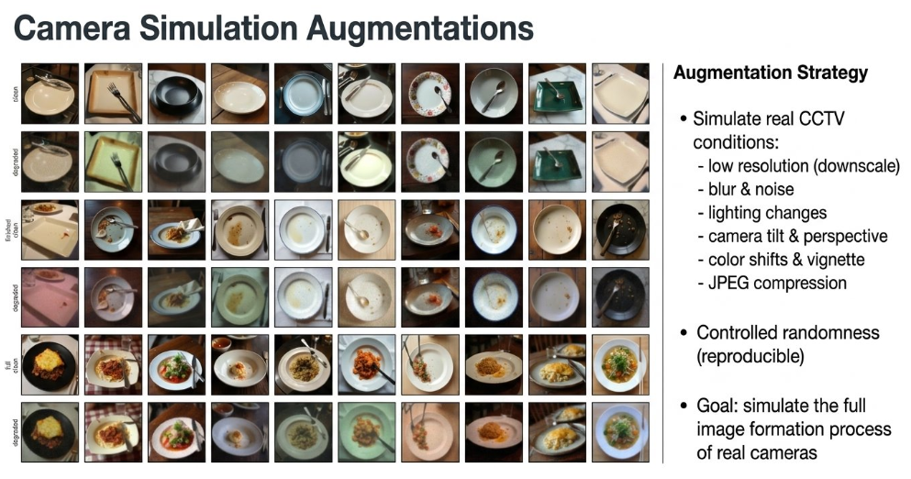
Notes:
אוגמנטציות - שלומי

Slide 6
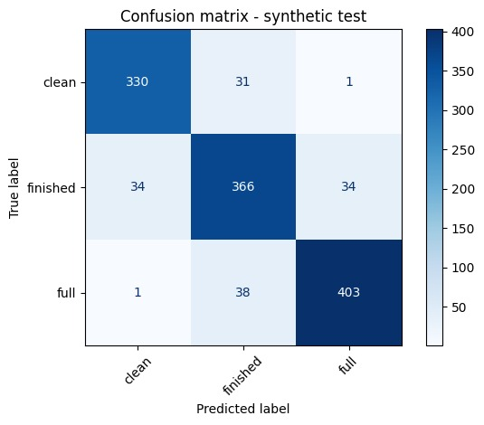
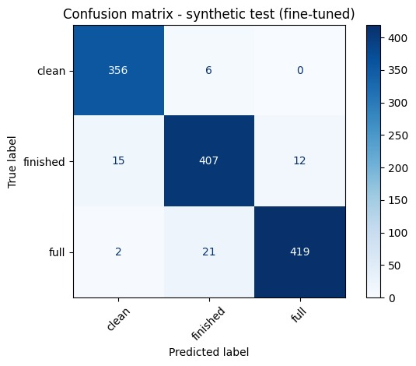
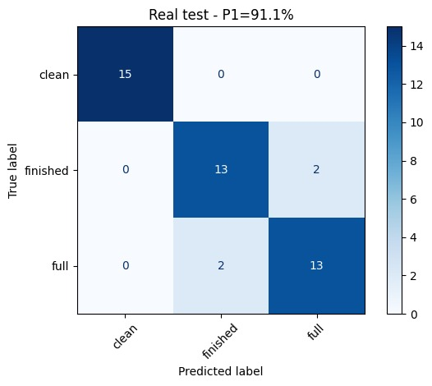
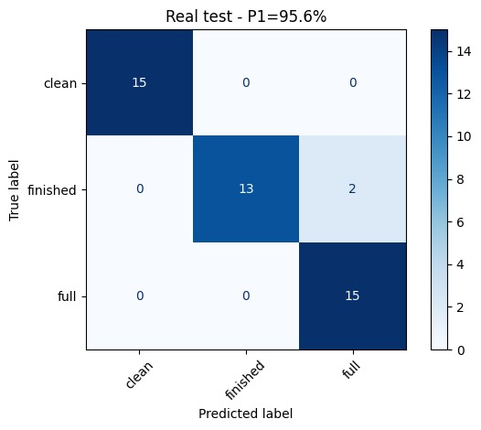
Results – ResNet18
Synthetic Data Test
Real Data Test
Linear-Probe
Fine-Tuned
Linear-Probe
Fine-Tuned
Notes:
תוצאות המודלים - אביטל

Slide 7
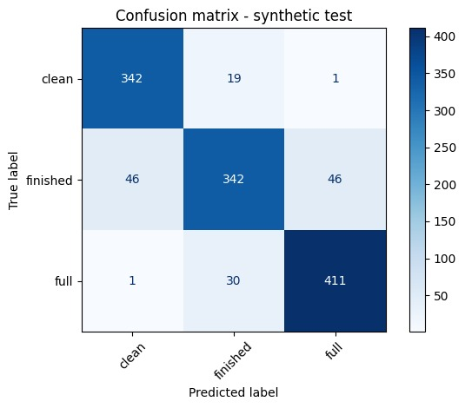

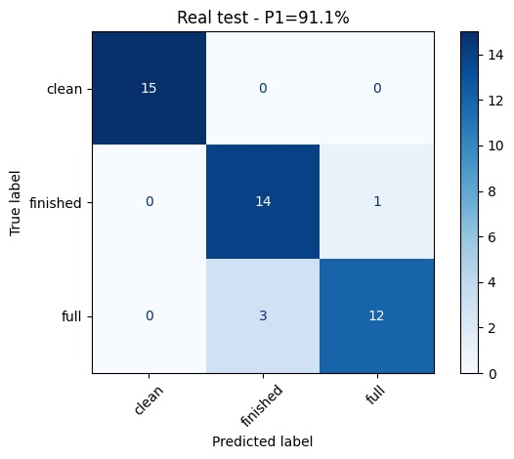
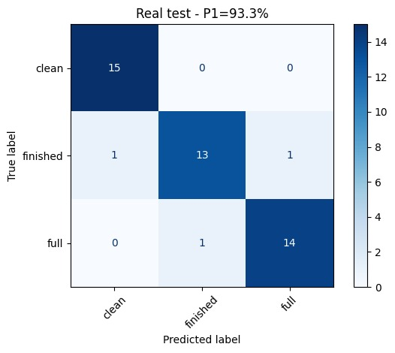
Results – ResNet50
Synthetic Data Test
Real Data Test
Linear-Probe
Fine-Tuned
Linear-Probe
Fine-Tuned
Notes:
תוצאות המודלים - אביטל

Slide 8
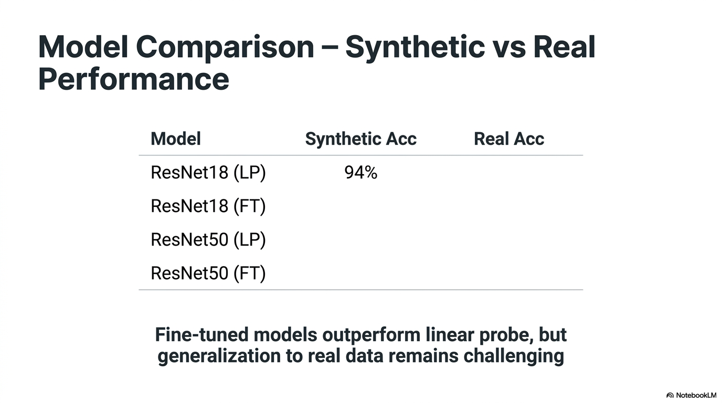
88.9%
91.1%
95.6%
95.6%
88.4%
91.1%
94.7%
93.3%
Partial fine-tuning (layer4 only) was used to prevent overfitting.
Due to its larger capacity, ResNet50 adapts more strongly to synthetic data, which may slightly reduce generalization compared to ResNet18.
Notes:
השוואת תוצאות - אביטל

Slide 9
Key Insights
• Clear synthetic → real domain gap
• Augmentations improve generalization
• Fine-tuning significantly outperforms linear probe
Limitations
• Very small real-world dataset (~45 images)
• Synthetic data does not fully capture real variability
Future Work
System-level:
• Plate state tracking over time
• Waiter decision support system
• Multi-table scene understanding
ML:
• Improve augmentation realism
• Combine models
• Explore self-supervised models (e.g., DINO)
Notes:
מסקנות וחשיבה לעתיד - ירדן

Slide 10

Thank you for listening!!

