Slide 1
Bugs amount optimizer using Information gain and Diagnoser
Amir Avitan Stav Sapir

Slide 2
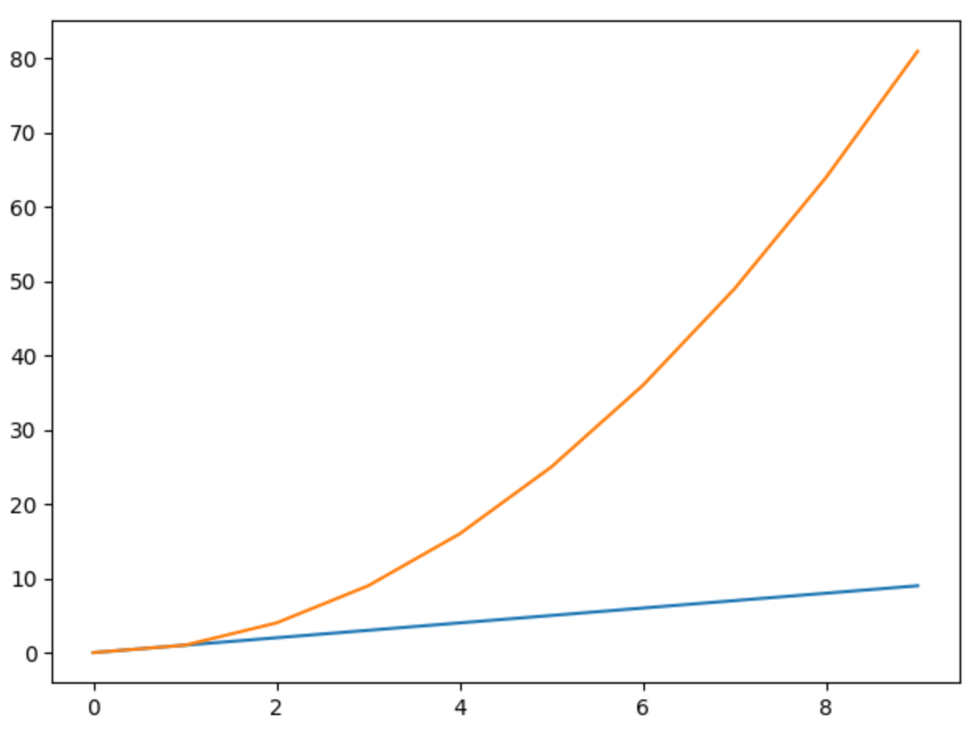
Project target
To find a sub-set of constant size that will give the most bugs
In the sub set

Slide 3
Used algorithms
Diagnostic algorithm that simulates the the test for a given state and updates the fail probability for each component in the given test
Optimizer algorithm that is based on Information gain logic to find the subset with the most
Information gain

Slide 4
Implementation details

Slide 5
First results

Slide 6
Next steps
Compare to base line
Finish report

Slide 7

Questions?

