Slide 1
Firefly Training

Slide 2
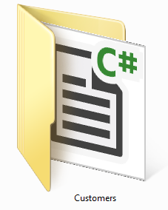
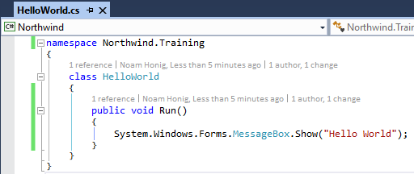
The C# (csharp) Language
C# is case sensitive
Every execution statement ends with a ;
The code is organized in classes
Classes have members (Methods, fields, properties, events etc…)
Classes are organized in namespaces (like folders)

Slide 3
Access Modifiers
Access modifiers are keywords used to specify the declared accessibility of a member or a type. It determines which code can use this class or method. There are four access modifiers:
private – only visible to code within class and inner classes
protected – also visible to code within class that inherit from this class
Internal – visible to any code within my assembly (dll/exe)
public – visible to any code
Defaults:
Classes are “internal”
Members (methods, fields etc…) and inner classes are “private”

Slide 4
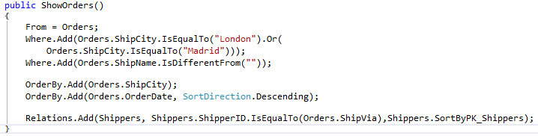
Calling a controller
Calls the constructor and creates an instance

Slide 5

Controller life cycle
When the Execute() method is called the controller runs and performs the following events:
OnLoad
OnStart
Load data and for each row:
OnEnterRow
OnLeaveRow
OnSavingRow – if the row was changed
Save changes to the database
OnEnd
OnUnLoad

Slide 6
Migrated Data Types

Slide 7
Number
Similar to: int, decimal, float, double etc….
Can be null as opposed to int, decimal etc….
Can hold any int or decimal value
When divided by Zero – returns Zero
Usage:
Number n = 1;
Number n2 = -1.5;

Slide 8
Text
Similar to - string
Can be null
When performing comparison it ignores spaces.
For string: “a “== “a” return false
For Text: “a “==“a” return true
Usage:
Text a = “.NET”;

Slide 9
Bool
Similar to - bool
Can be null as opposed to bool
Usage:
Bool a = true;
Bool b = null;

Slide 10
Date
Resembles - DateTime
Resolution - days
Can be null as opposed to DateTime
Can have Empty (Zero) date – as opposed to DateTime
Usage:
Date d = Date.Now
Date bd = new Date(1976,6,16)
If (d==Date.Empty)

Slide 11
Time
Remotely Resembles - TimeSpan
Resolution: Seconds
Can be null
Usage:
Time t = Time.Now;
Time t1 = new Time(8,35,25);
Time t2 = Time.StartOfDay;

Slide 12
TypedColumnBase<dataType>
A column with the same specifc type
TypedColumnBase<Date> => DateColumn
TypedColumnBase<Time> => TimeColumn
TypedColumnBase<Number> => NumberColumn
TypedColumnBase<Text> => TextColumn
TypedColumnBase<Bool> => BoolColumn
….

Slide 13
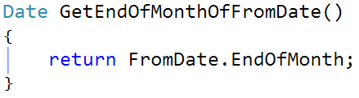
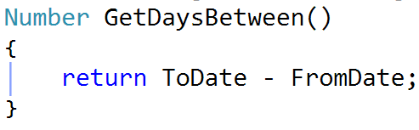
Func<dataType>
A method that returns the same specifc type
Func<Date> => a method that returns Date
Func<Number> => a method that returns Number
Func<Time> => a method that returns Time
Func<Text> => a method that returns Text
Func<Bool> => a method that returns Bool
….
CSharp 6 style:
CSharp 6 style:

Slide 14
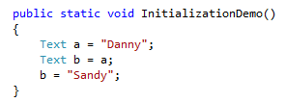
Initialization Demo - Text
Danny
a
Sandy
b

Slide 15
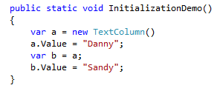
Initialization Demo - Column
Danny
Column
a
Value
Sandy
b

Slide 16
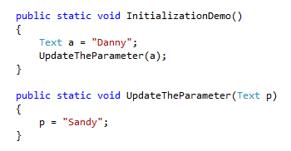
Initialization Demo – Text parameter
Danny
a
Danny
Sandy
p

Slide 17
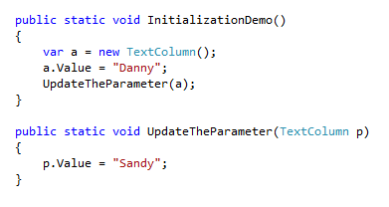
Initialization Demo - Column parameter
Danny
Column
a
Value
Sandy
P

