Slide 1
Firefly Training

Slide 2
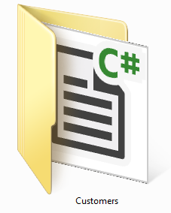
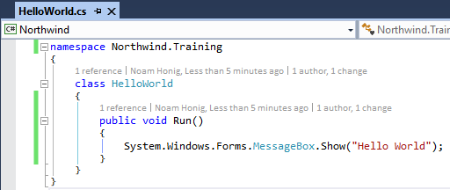
The C# (csharp) Language
C# is case sensitive
Every execution statement ends with a ;
The code is organized in classes
Classes have members (Methods, fields, properties, events etc…)
Classes are organized in namespaces (like folders)

Slide 3
Access Modifiers
Access modifiers are keywords used to specify the declared accessibility of a member or a type. It determines which code can use this class or method. There are four access modifiers:
private – only visible to code within class and inner classes
protected – also visible to code within class that inherit from this class
Internal – visible to any code within my assembly (dll/exe)
public – visible to any code
Defaults:
Classes are “internal”
Members (methods, fields etc…) and inner classes are “private”

Slide 4
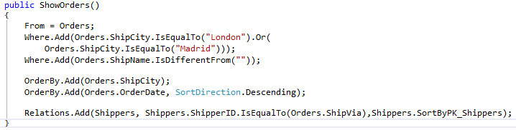
Calling a controller
Calls the constructor and creates an instance

Slide 5

Controller life cycle
When the Execute() method is called the controller runs and performs the following events:
OnLoad
OnStart
Load data and for each row:
OnEnterRow
OnLeaveRow
OnSavingRow – if the row was changed
Save changes to the database
OnEnd
OnUnLoad

Slide 6
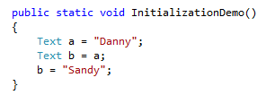
Initialization Demo - Text
Danny
a
Sandy
b

Slide 7
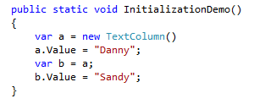
Initialization Demo - Column
Danny
Column
a
Value
Sandy
b

Slide 8
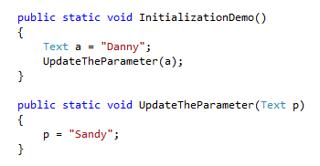
Initialization Demo – Text parameter
Danny
a
Danny
Sandy
p

Slide 9
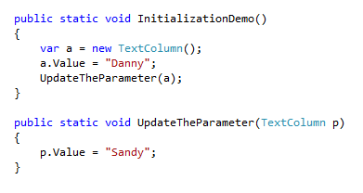
Initialization Demo - Column parameter
Danny
Column
a
Value
Sandy
P

