Slide 1
Branches And Releases
Branch for Urgent Bug
master
Branch for Feature A
Branch for Feature B
V1
Feature A, Step 1
Feature B, Step 1
Feature A, Step 2
Urgent Production Bug S1
Can’t release as there is unfinished work
Urgent Production Bug Done
V1.1
Feature A, Step 3
Feature B Done
V1.2
Feature A Step 4
Feature A Done
Release V2
1

Slide 2
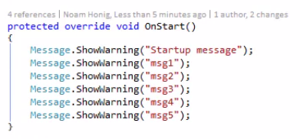
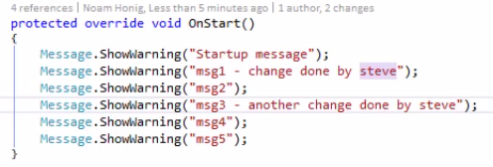
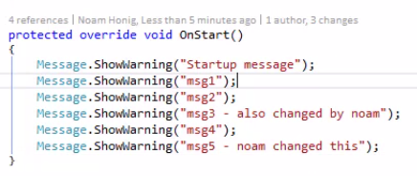
Demo Merge and Conflict
Original code
Feature B
Feature A

Slide 3
Feature B was committed to Master
Feature B

Slide 4
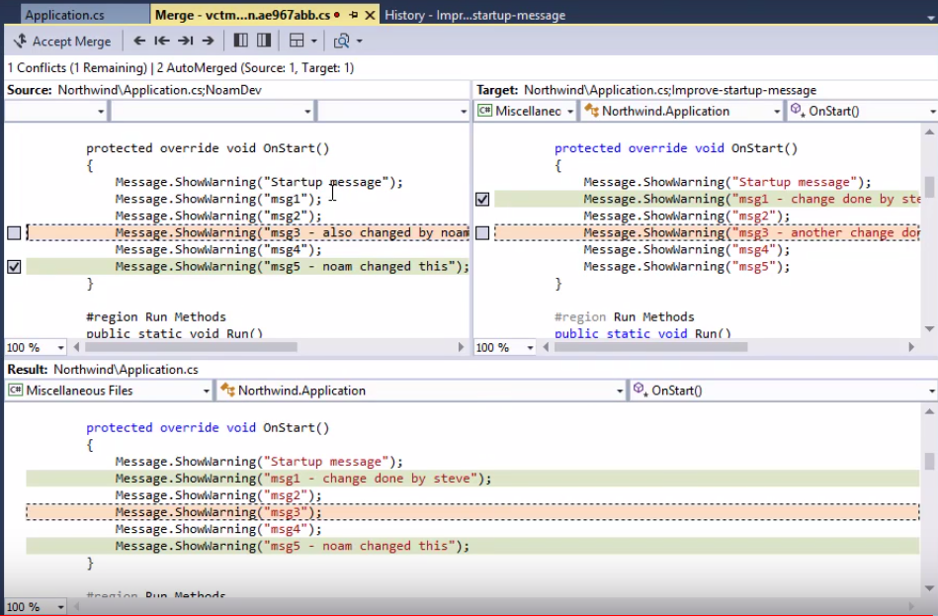
Merging featre A to Master with B
Changes from A and B Conflict
Change from A accepted
Change from B accepted

