Slide 1

Open-vocabulary Keyword-spotting with Adaptive Instance Normalization
A. Navon A. Shamsian N. Glazer G. Hetz J. Keshet
aiOla Research
Notes:
Hi, I’m Aviv, and will present Open vocabulary keyword spotting with adaptive instance normalization.
This is a joint work with Aviv Navon, Neta Glazer, Gil Hetz, and Yossi Keshet from aiOla research.

Slide 2
Background
Keyword spotting (KWS):
Goal: Identify specific keywords within an audio utterance.
Keywords are predefined.
Notes:
In keyword spotting, we are interested in identifying the presence of predefined keywords in given utterance.

Slide 3
Background
Keyword spotting (KWS):
Goal: Identify specific keywords within an audio utterance.
Keywords are predefined.
Open-vocabulary KWS:
Goal: Detect arbitrary keywords at inference.
Motivation:
Personalization, user-defined keywords.
No need for additional training to incorporate novel keywords.
Low resource languages, specialized domains and jargon.
Notes:
On the other hand, in open vocabulary keyword spotting, we wish to train a model to identify arbitrary keywords at inference time.
This approach has multiple advantages: it allows the personalization of keyword spotting models, and increase accessibility to low resource languages, as well as specialized domains.

Slide 4
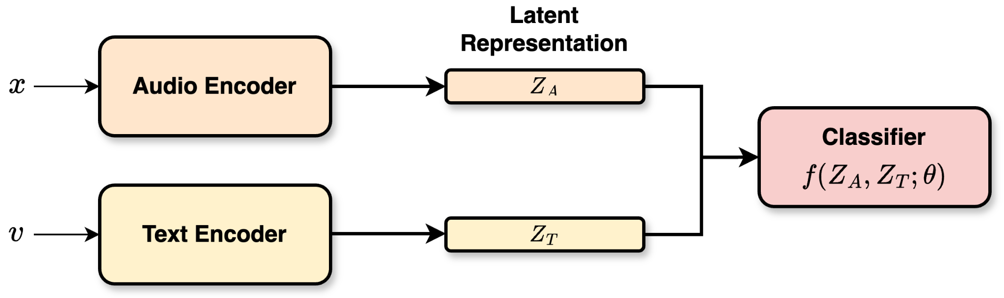
Overview
Previous Works - General Approach
Embed textual and auditory input into a joint space.
Detect keywords based on audio-text similarity.
Notes:
Previous methods for open vocabulary keyword spotting, mostly follow the same general approach. First, encode the audio and text data into a joint latent representation space. Then, use a classifier to predict the probability for a given keyword.

Slide 5
Overview
Previous Works - General Approach
Key Limitation
Using two encoders for representing heterogeneous modalities in a joint space may cause significant misalignment between audio and text embeddings.
Notes:
A key limitation of these approaches is that projecting the heterogeneous modalities into a joint space may cause significant missmatch between audio and text embeddings.

Slide 6
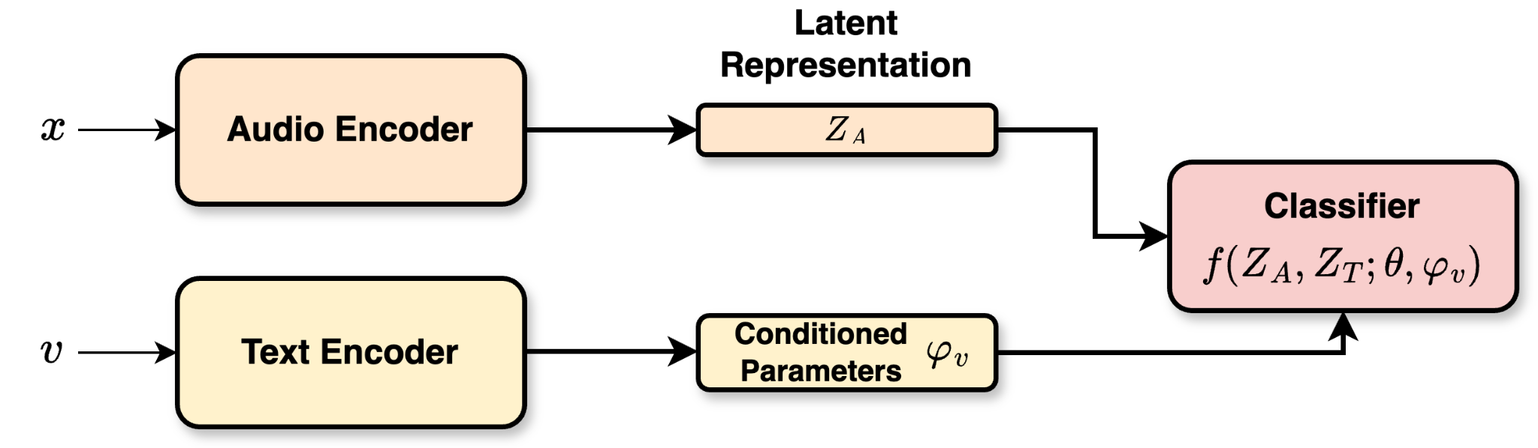
Overview
Previous Works - General Approach
Key Limitation
Using two encoders for representing heterogeneous modalities in a joint space may cause significant misalignment between audio and text embeddings.
We address this limitation by adaptively condition parameters on query keywords.
Notes:
To address this issue, we take a different path to the open-vocabulary problem: Instead of embedding the textual and acoustic information into a joint latent space, we use the text encoder to map the input keyword into a set of normalization parameters. These parameters are then used to process the audio signal representation.

Slide 7
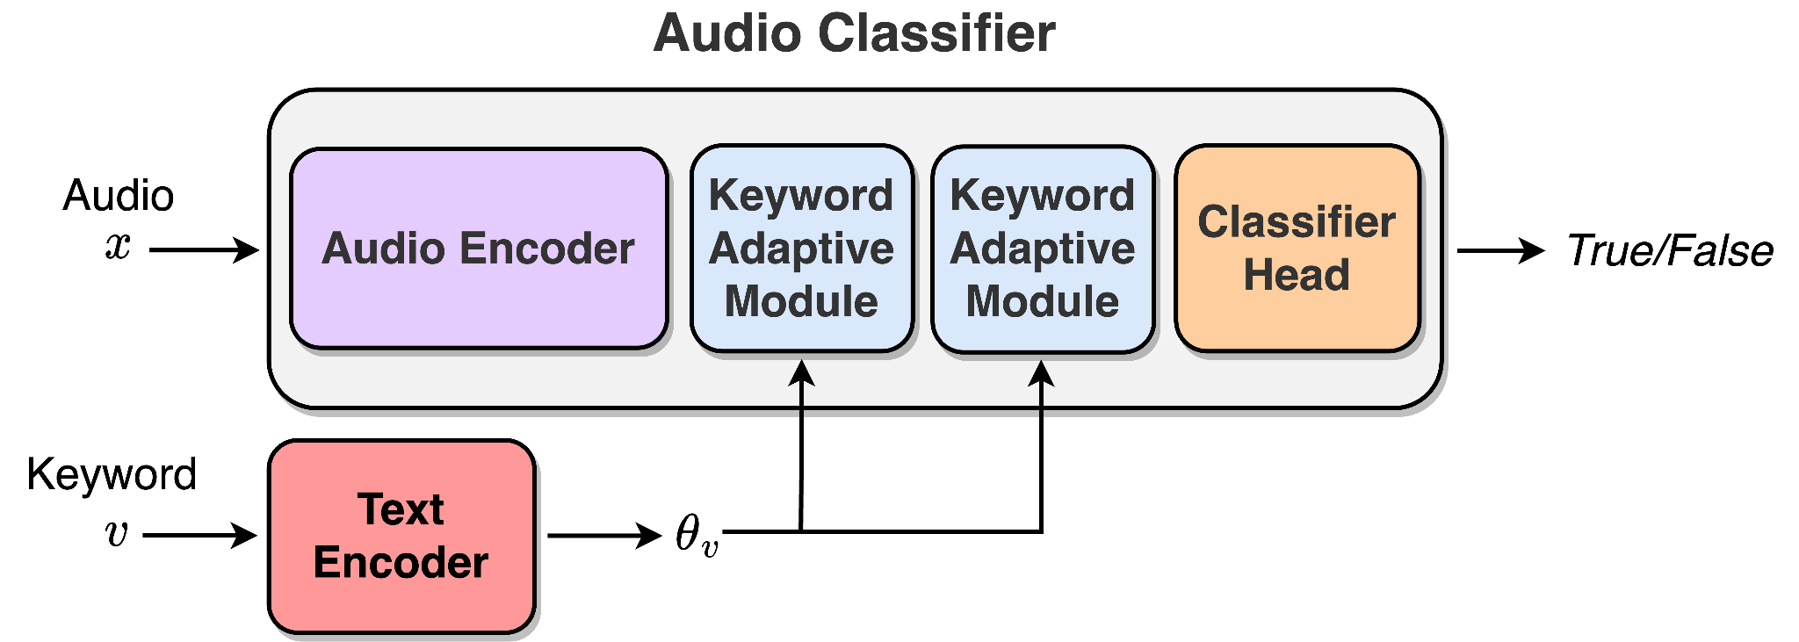
The AdaKWS Model
The audio is processed using the classifier which is conditioned on the keyword through the keyword-adaptive modules.
Notes:
In our method, which we term AdaKWS, the audio representation is processed using a classifier which is conditioned on the input keyword through keyword-adaptive normalization layers.

Slide 8
The AdaKWS Model
The audio is processed using the classifier which is conditioned on the keyword through the keyword-adaptive modules.
❄️
The Audio Encoder is a pre-trained Whisper encoder.
Robust Speech Recognition via Large-Scale Weak Supervision, Radford et al., 2022.
Notes:
We use a pre-trained Whisper encoder for encoding the audio signal. This audio encoder is kept frozen during training.

Slide 9
The AdaKWS Model
The audio is processed using the classifier which is conditioned on the keyword through the keyword-adaptive modules.
❄️
The Text Encoder outputs a set of keyword-conditioned normalization parameters.
Notes:
As the text encoder we employ a character-based LSTM encoder which maps an input keyword into a set of normalization parameters.

Slide 10
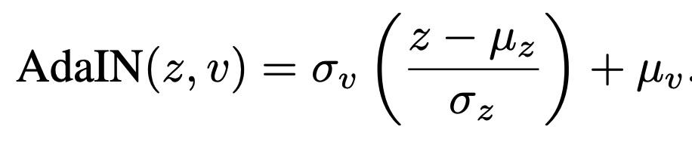
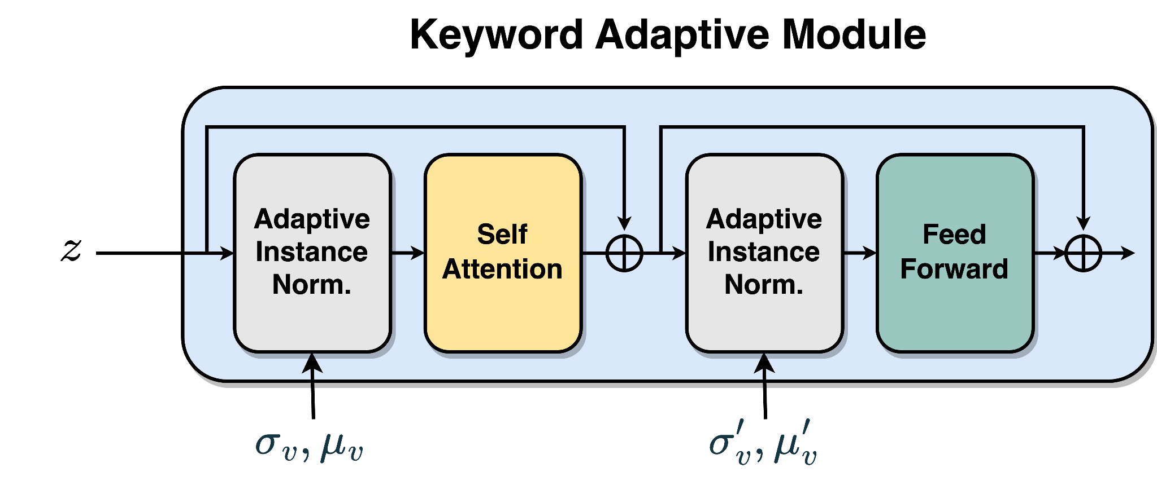
Keyword Adaptive Module
Each module is a standard transformer encoder block in which we swap the Layer Normalization layers with Adaptive Instance Normalization layers (AdaIN). An AdaIn is a normalization layer of the form:
z is the audio representation and
v is the target keyword
Notes:
The keyword adaptive module is a standard transformer encoder in which we swap the Layer Normalization modules with an Adaptive Instance Normalization (AdaIN) layers, where the adaptive parameters are keyword-conditioned, produced by the text encoder. Here, sigma V and Mu V denote the adaptive parameters.

Slide 11
Online Keyword Sampling
Training examples are pairs of speech utterances and keywords.
Notes:
To train our model, we require positive and negative pairs of speech utterances and keywords.

Slide 12
Online Keyword Sampling - Positive
Training examples are pairs of speech utterances and keywords.
Positive Examples
Random keyword phrase from the speech transcription.
Notes:
The positive examples are obtained by randomly sampling keyword phrases from the corresponding transcript.

Slide 13
Online Keyword Sampling - Positive
Training examples are pairs of speech utterances and keywords.
Consider the utterance:
“Open vocabulary keyword spotting with adaptive instance normalization”
Positive Examples
Random keyword phrase from the speech transcription.
Notes:
Consider the following transcript example: “Open vocabulary keyword spotting with adaptive instance normalization”

Slide 14
Online Keyword Sampling - Positive
Training examples are pairs of speech utterances and keywords.
Consider the utterance:
“Open vocabulary keyword spotting with adaptive instance normalization”
Positive Examples
Random keyword phrase from the speech transcription:
keyword
Notes:
An example for a positive keyword phrases would be the word “keyword”

Slide 15
Online Keyword Sampling - Positive
Training examples are pairs of speech utterances and keywords.
Consider the utterance:
“Open vocabulary keyword spotting with adaptive instance normalization”
Positive Examples
Random keyword phrase from the speech transcription:
instance normalization
Notes:
And the phrase “instance normalization”

Slide 16
Online Keyword Sampling - Negative
“Open vocabulary keyword spotting with adaptive instance normalization”
Random Negative
Random keyword phrase from different speech utterances in the batch:
animals, drink, neighborhood
Notes:
For generating negative keywords we consider several sampling approaches. The first, is sampling random keyword from different examples in the training batch.
This naive approach is likely to produce keywords which are acoustically far from the words in the input audio. We empirically found that this approach is not effective for training a keyword spotting model that can accurately differentiate acoustically similar words.

Slide 17
Online Keyword Sampling - Negative
“Open vocabulary keyword spotting with adaptive instance normalization”
Nearest Keyword
Represent each keyword with last layer’s embedding representation.
Querying for the keyword with the smallest cosine distance within training batch:
instance → distance, keyword → backward
Notes:
Therefore, we propose new methods for generating hard negative samples. For the first approach, we use the text encoder’s embedding representation. We then obtain a negative keyword with the smallest cosine distance with respect to the positive keyword. In this example, we obtain the word “distance” as a negative example for the positive anchor “instance”.

Slide 18
Online Keyword Sampling - Negative
“Open vocabulary keyword spotting with adaptive instance normalization”
Keyword Concatenation
Concatenating a positive keyword with a random negative keyword:
spotting → spotting animals, animals spotting
Notes:
Next, we consider keyword concatenation. In this approach, we generate negative samples by concatenating positive and negative keywords. For instance, by concatenating the negative keyword “animals” to the positive keyword “spotting”, we obtain the negative term “spotting animals”.

Slide 19
Online Keyword Sampling - Negative
“Open vocabulary keyword spotting with adaptive instance normalization”
Character Swapping
Alter a positive keyword by substituting one or more characters.
Character can be chosen randomly, or according to an a priori mapping of acoustically similar characters (“s”→“z”,“p”→“b”, etc.).
spotting → zbotting, adaptive → adantive
Notes:
In the final approach, we alter a positive keyword by substituting one or more of its characters. The characters can be chosen randomly, or according to some a priori mapping between acoustically similar characters, like “p” and “b”. Here, we alter the positive keyword “spotting” to obtain the negative keyword “zbotting”. :)

Slide 20
Experimental Setup
Datasets:
VoxPopuli dataset - multilingual corpus with transcribed utterances from 16 languages.
Keyword spotting benchmark: LibriPhrase easy (LE) and hard (LH).
Zero-shot evaluation: Fleurs and multilingual-LibriSpeech.
Several model sizes: AdaKWS-Tiny, AdaKWS-Base, AdaKWS-Small.
Diverse and challenging evaluation sets, with random, concat and swap negatives.
ASR-based and KWS baselines.
Notes:
We move to discuss the experimental results. We use multiple multilingual datasets including, VoxPopuli, multilingual LibriSpeech and Fleurs, and the keyword spotting benchmark LibriPhrase.
For the audio encoder we evaluate three Whisper encoder size configurations, tiny, base and small.
To construct our evaluation set, we first sample positive keywords. Then, we sample random, concat, and swap negatives as described before, with equal probability. This results in a diverse and challenging open-vocabulary keyword spotting benchmark.
We compare our approach with ASR-based and keyword spotting baselines.

Slide 21
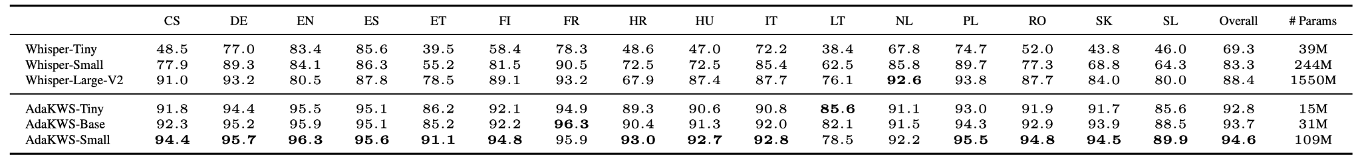
Multilingual KWS - Voxpopuli
F1 results for the VoxPopuli test dataset:
Notes:
We start by evaluating our approach on the multilingual VoxPopuli dataset, a common benchmark with 16 transcribed languages.
Our method, AdaKWS, outperforms the Whisper baselines by a notable margin, over 6% with respect to the best performing baseline. Moreover, it outperforms the baselines in 15 out of the 16 languages, with around 10 times fewer parameters.

Slide 22
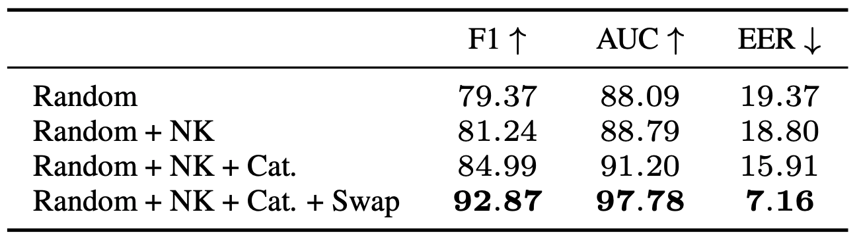
Effect of Negative Sampling Methods
Results for the AdaKWS-tiny model, trained using different negative sampling approaches, on the VoxPopuli test dataset:
Notes:
Next, we perform an ablation study on the effectiveness of the proposed negative sampling approaches. We can see that the character swapping approach largely contributes to the success of our model. We hypothesize that this is due to the fact that this approach produces the negative keywords which are acoustically most similar to the positive keywords.

Slide 23
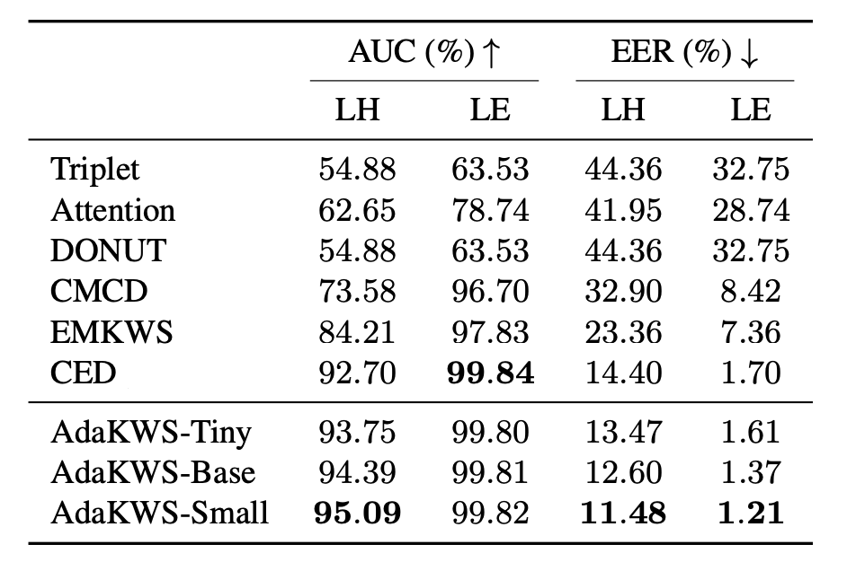
KWS Benchmark - LibriPhrase
Results for the LibriPhrase easy (LE) and LibriPhrase hard (LH) test dataset:
Notes:
Next, we compare AdaKWS to state-of-the-art methods for keyword spotting on the LibriPhrase hard and Libriphrase easy datasets.
The LibriPhrase hard is a commonly used benchmark with hard negative samples, selected based on Levenshtein distance.
We see that AdaKWS significantly outperforms the current state-of-the-art methods on this challenging benchmark.

Slide 24
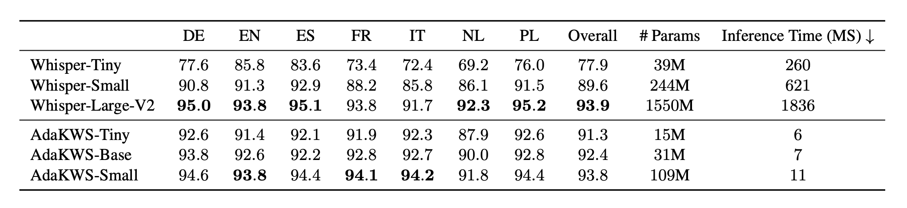
Zero-shot Performance - Multilingual LibriSpeech
F1 results for the Multilingual LibriSpeech test dataset:
Notes:
We now evaluate the generalization capabilities of our method under zero shot setups. Here, we evaluate the AdaKWS models trained using the VoxPopuli dataset on the multilingual LibriSpeech data.
Notably, the AdaKWS-Small model achieves on-par performance with around two orders of magnitude faster inference time, with respect to the Whisper large-v2 baseline.

Slide 25
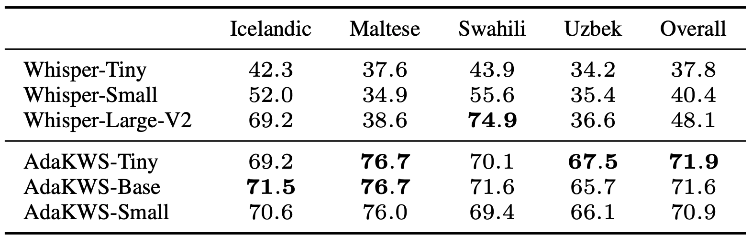
Generalization to Novel Languages - Fleurs
Zero-shot performance for low resource, novel languages: F1 results for four languages from the Fleurs test dataset:
Notes:
Finally, we evaluate AdaKWS on novel languages, not observed during training. Our approach significantly outperform the Whisper baselines. Specifically, our approach achieves 23% improvement in average F1 compared to Whisper large-v2.

Slide 26
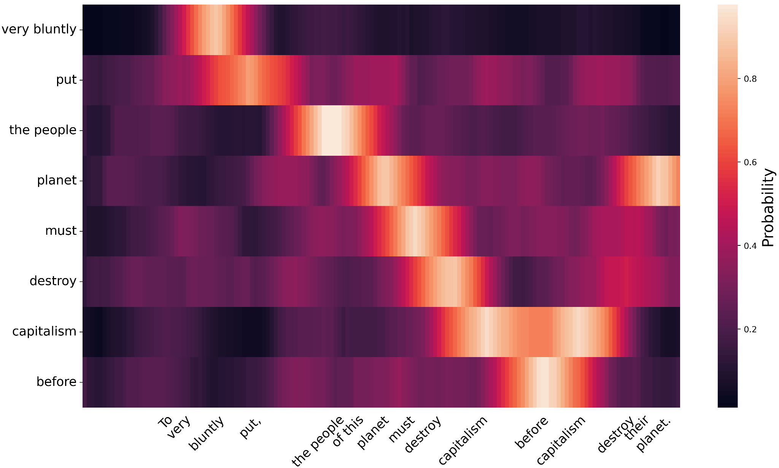
Visualization of AdaKWS Prediction
Notes:
Here, we illustrate the predicted probability of a queried keyword (y-axis) across different time windows. Note that higher probability scores are aligned with the temporal occurrence of the word within the utterance (x-axis).

Slide 27
Conclusion
We present AdaKWS, a novel open-vocabulary KWS model.
We present a new keyword-adaptive normalization layers.
We propose several online negative sampling techniques and evaluate their effectiveness.
We evaluate AdaKWS on a diverse set of multilingual benchmarks, as well as generalization to novel datasets and languages.
Notes:
To summarize, we present AdaKWS, a novel open-vocabulary KWS model.
Our model utilizes keyword adaptive normalization layers to obtain keyword specific classifiers.
We propose several online negative sampling techniques and evaluate their effectiveness.
We evaluate AdaKWS on a diverse set of multilingual benchmarks, as well as generalization to novel datasets and languages, and show that AdaKWS outperforms ASR and keyword spotting baselines.

Slide 28
Thank you
for listening!

