Slide 1

Shay Yaakov

Slide 2


Slide 3
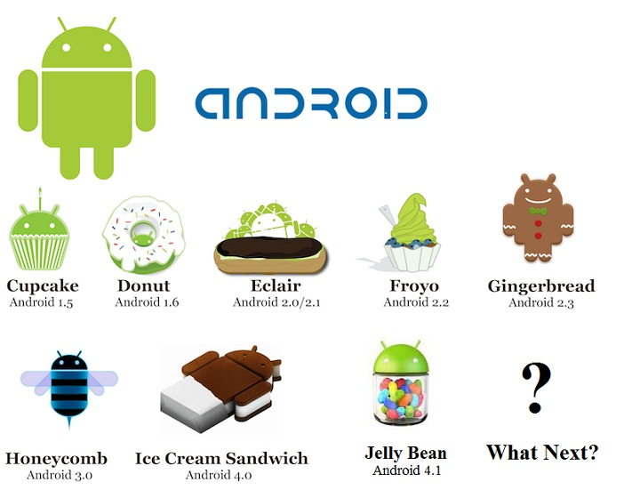

Slide 4
Application Components
Activity
  Single screen with user interface.
Service
  No visual UI, run in background for an indefinite period of time.
  Similar to daemon.
Broadcast Receiver
  Does nothing but receive and react to broadcast announcements (E.g. Timezone changed, battery low, …)
Content Provider
  Makes a specific set of the application's data available to other applications. (E.g. Wrapper for data in file system or DB)

Slide 5
Activities and Lifecycle
The Android system controls the lifecycle of your application
  - It can stop it at any time (e.g. incoming call)
Each Activity has a predefined lifecycle methods, the important ones are:
  onSaveInstanceState() - called after the activity is stopped. Used to save data so that the activity can restore its states if re-started
  onPause() - always called if the activity ends, can be used to release resource or save data
  onResume() - called if the activity is re-started, can be used to initialize fields

Slide 6
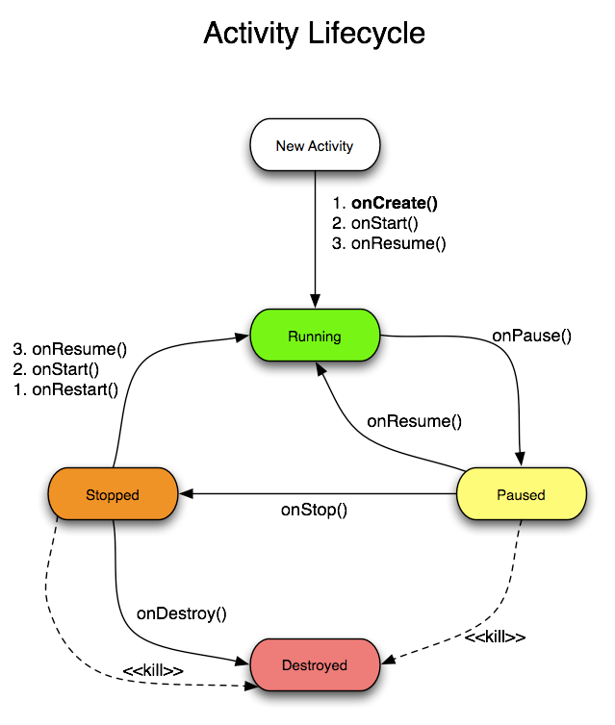

Slide 7
Views and layout manager
Views are user interface widgets
  Button, EditText, TextView...
The base class for all views is the android.view.View class
Attributes configure a view appearance and behavior
  layout_width, layout_height ...
A layout manager is responsible for arranging other views
Layout managers can be nested to create complex layouts
  LinearLayout, RelativeLayout ...

Slide 8
AndroidManifest.xml
Each Android project includes a manifest file, AndroidManifest.xml, stored in the root of its project hierarchy.
The manifest defines the structure and metadata of your application, its components, and its requirements.

Slide 9
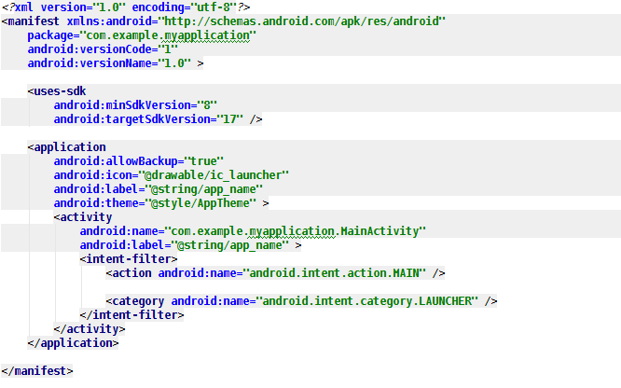
AndroidManifest.xml

Slide 10
Intents
request for an action to be performed (usually on a set of data)
Support interaction between any application components available on an Android device
  start a new Activity
  broadcast messages (broadcast intents)

Slide 11

Explicit Intents
Explicit Intent names the component which should be called by the Android system, using the Java class as identifier.
  Used to open new activities in the same app.

Slide 12
Implicit Intents
Implicit intent specifies the action to perform and optionally an URI for the action.
Implicit Intent is managed by Android Intent resolution, which maps the intent to a Service, Activity or Broadcasts Receiver
This resolution is done by matching intent with intentFilters of every app.
If more than one app can handle the action, the user will have to choose.

Slide 13
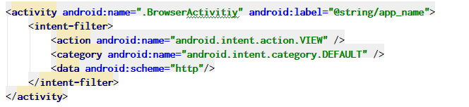
Intent Filters
An IntentFilter specifies the types of Intent that an activity, service, or broadcast receiver can respond to.
IntentFilters are declared in the Android Manifest.

Slide 14
CODE

Slide 15
3rd party Libraries
ActionBarSherlock
http://actionbarsherlock.com/

Slide 16
3rd party Libraries
NineOldAndroids
http://nineoldandroids.com/

Slide 17
3rd party Libraries
RoboGuice
https://github.com/roboguice/roboguice/wiki

Slide 18
3rd party Libraries
AndroidAnnotations
http://androidannotations.org/

Slide 19
3rd party Libraries
Square OpenSource
http://square.github.io/

Slide 20
3rd party Libraries
Volley
http://www.youtube.com/watch?v=yhv8l9F44qo
http://java.dzone.com/articles/android-%E2%80%93-volley-library

