Slide 1
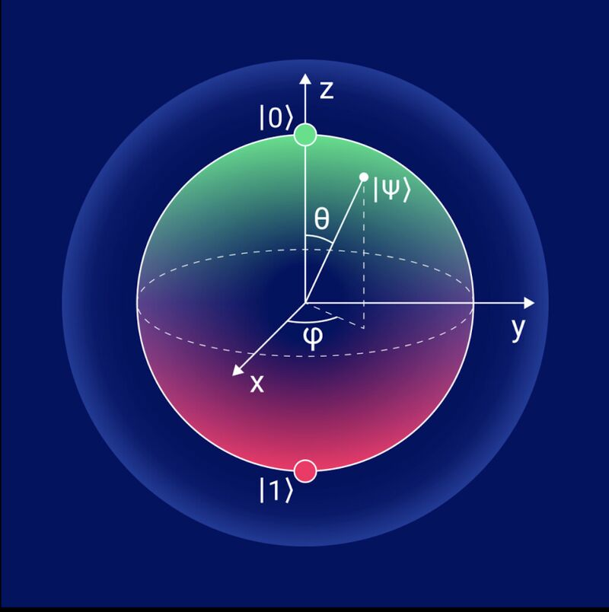
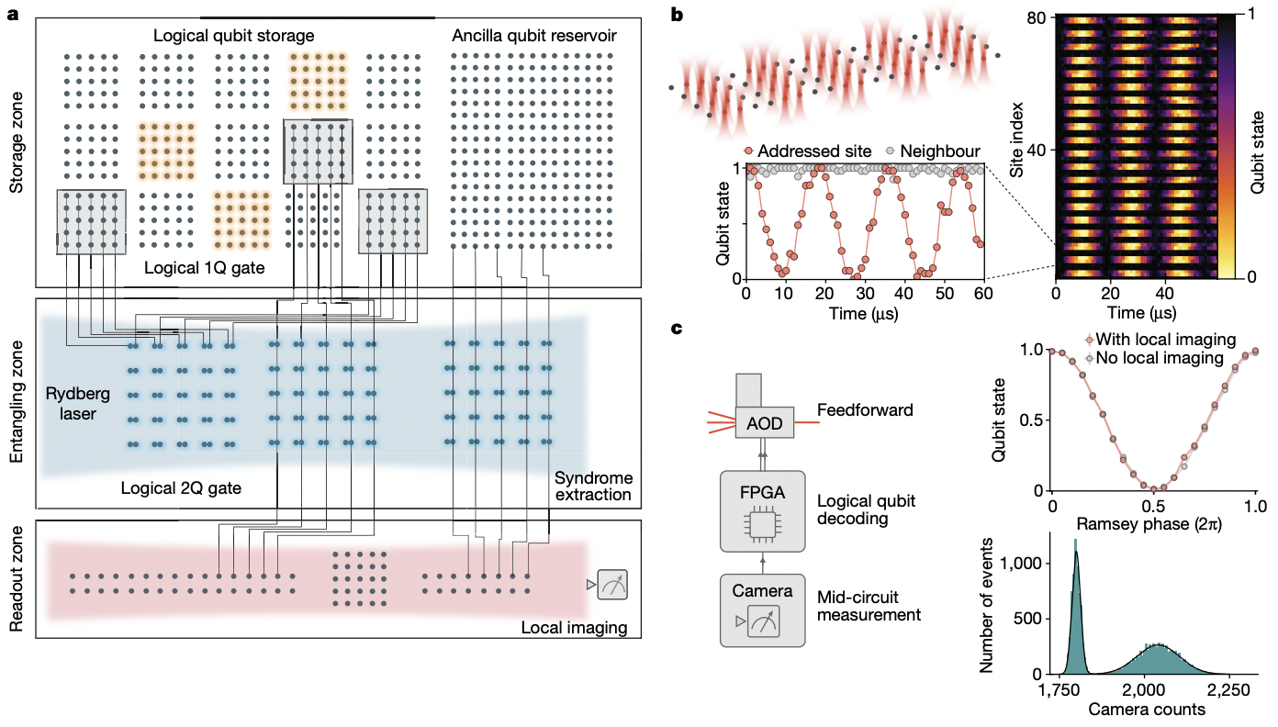
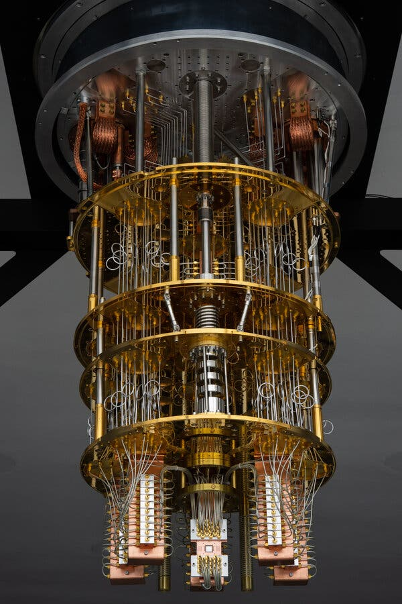
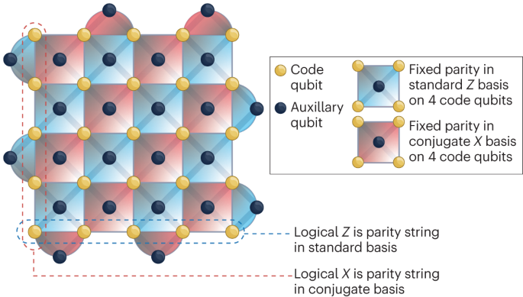
Overview of Quantum Computing
James Bartusek
Columbia
Crafting the Cryptoeconomy
October 30, 2026

Slide 2
What is a Quantum Computer?
Any computer stores information in some physical system, and manipulates it according to some physical process
A quantum computer takes advantage of uniquely quantum-mechanical phenomena to store and process information:
Superposition
Interference
Entanglement

Slide 3
Superposition
An ordinary bit of information is either 0 or 1
A quantum bit (qubit) can exist in both possibilities simultaneously, only collapsing to 0 or 1 upon observation (measurement)

Slide 4
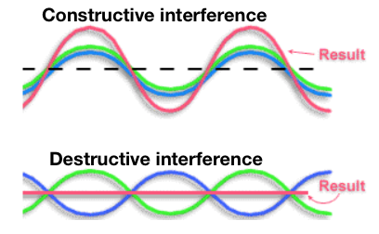
Interference
Waves can reinforce each other, or cancel out, depending on their relative phase
Quantum algorithms take advantage of the wave-like nature of particles to make useful answers more likely

Slide 5
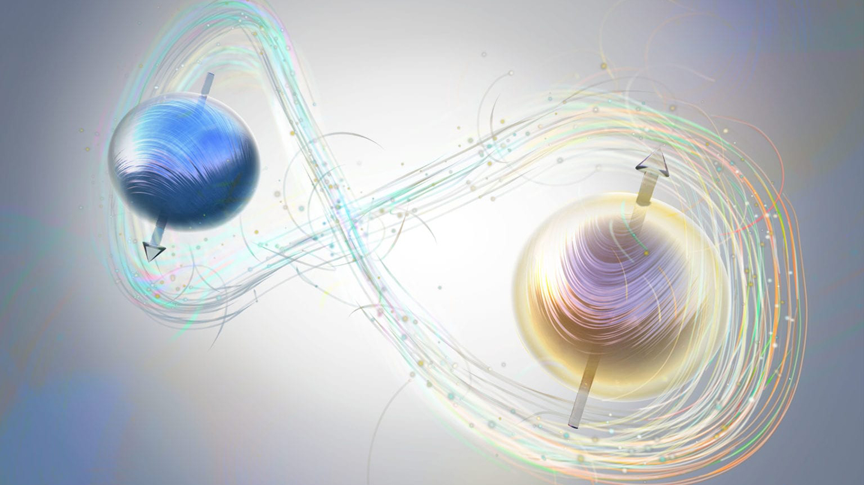
Entanglement
The behavior of quantum particles, even those far apart, can be linked
In such cases, the state of a joint system cannot be described by concatenating the state of each individual system

Slide 6
Why do we care?
Some computational problems are known to have an extremely efficient quantum “shortcut”
93427 x 64019 = 5981103113
5981103113 = ? x ?
Multiplication is easy…but reversing it can be much, much harder, even for (classical) computers
In 1994, Peter Shor showed that quantum computers can factor integers efficiently by taking advantage of superposition and interference

Slide 7
BUT…not all problems admit a dramatic quantum shortcut
Consider searching for a “needle in a haystack”:
Which input produces this exact SHA-256 output?
f4707bd7…b273318e
Guess | SHA-256 output | Result
0000 | 9af15b33…606529a0 | No match
0001 | 888b19a4…f5e56d32 | No match
0002 | 4fac6dbe…258c35b4 | No match
… | …
5837 | f4707bd7…b273318e | Match
Learning that each previous guess was not a match does not help the computer choose its next guess
There does not seem to be any mathematical “structure” in SHA-256 that the quantum computer can take advantage of to dramatically shortcut its search

Slide 8
Common misconception: A quantum computer can set up a superposition over all possible inputs, and then simply identify and output the correct one
Reality: extracting the correct answer from this giant superposition requires carefully engineering a pattern of constructive and destructive interference. There is formal evidence that this cannot be performed efficiently for every search problem.

Slide 9



Quantum computing and cryptography
The two most widely implemented approaches to public-key cryptography, RSA and Diffie-Hellman, are quantum-broken
There are two main cryptographic paradigms:
Private-key cryptography
Public-key cryptography
An attack generally requires the eavesdropper to solve some unstructured search problem
An attack generally requires the eavesdropper to solve some structured search problem
private conversation
agree on private key
(generally quantum-safe, though key sizes may need to double)

Slide 10
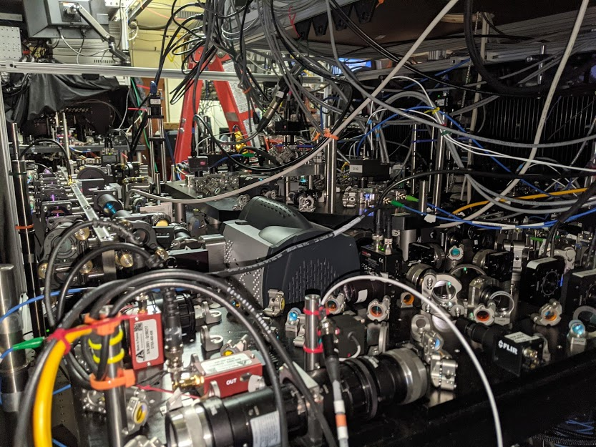
So where are all the quantum breaks in practice?
Quantum computers exist
But quantum information is extremely fragile
Stray interactions with the environment can completely spoil an in-progress quantum computation
Bottom line: quantum computers today cannot control enough qubits for enough time with sufficient noise-resilience to run Shor’s algorithm on cryptographic-scale inputs

Slide 11
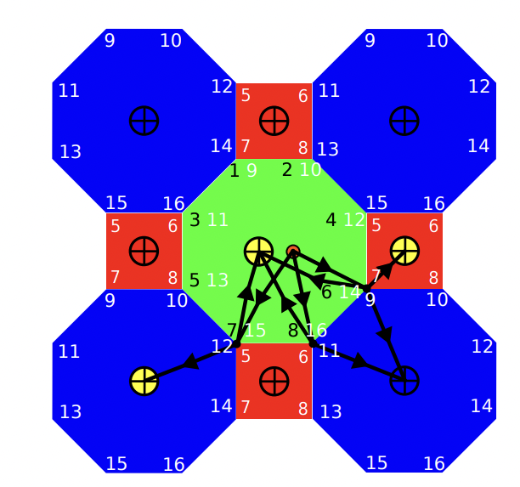
Quantum error-correction
We have known since the late ‘90s that, in theory, quantum computers can recover from environmental noise
The idea is called quantum error-correction: spread the information we care about redundantly across several noise-prone qubits, and use this redundant encoding to detect and then correct errors as the computation proceeds

Slide 12
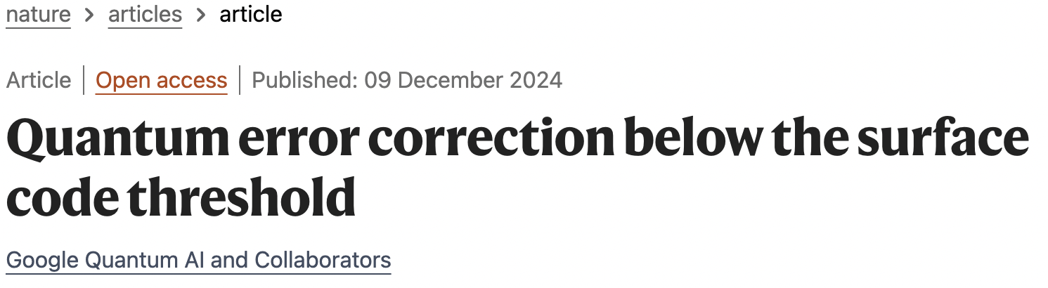
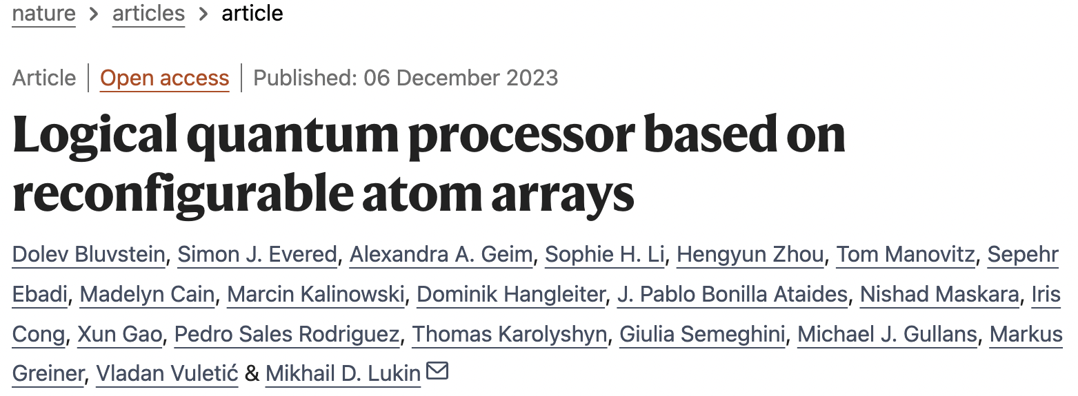
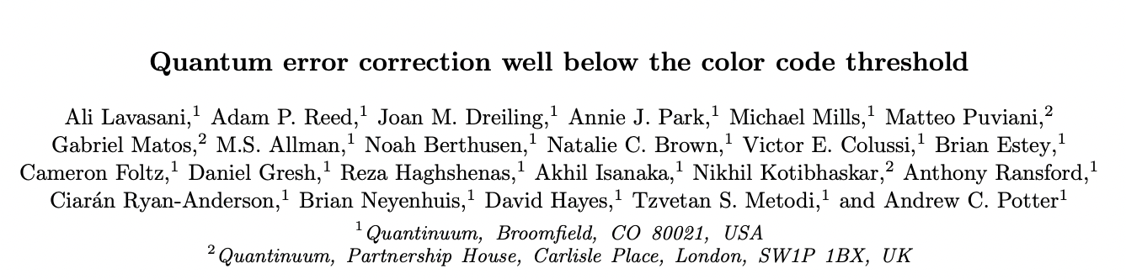
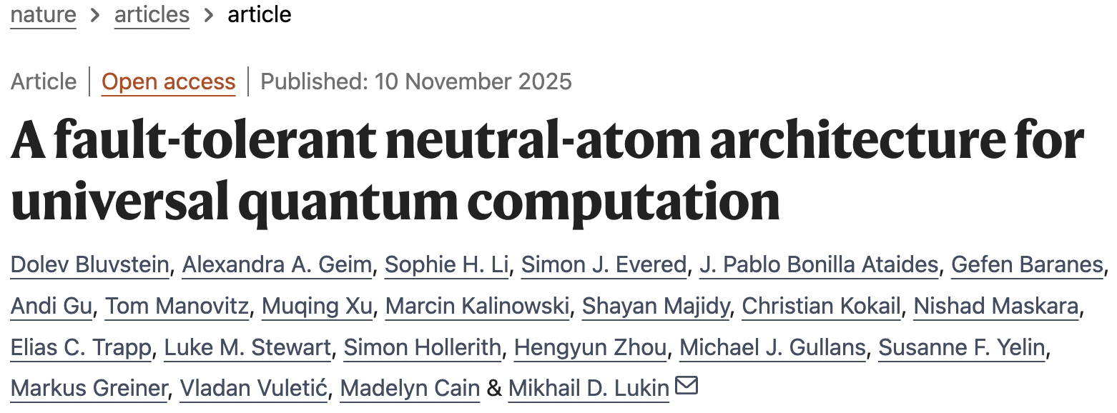
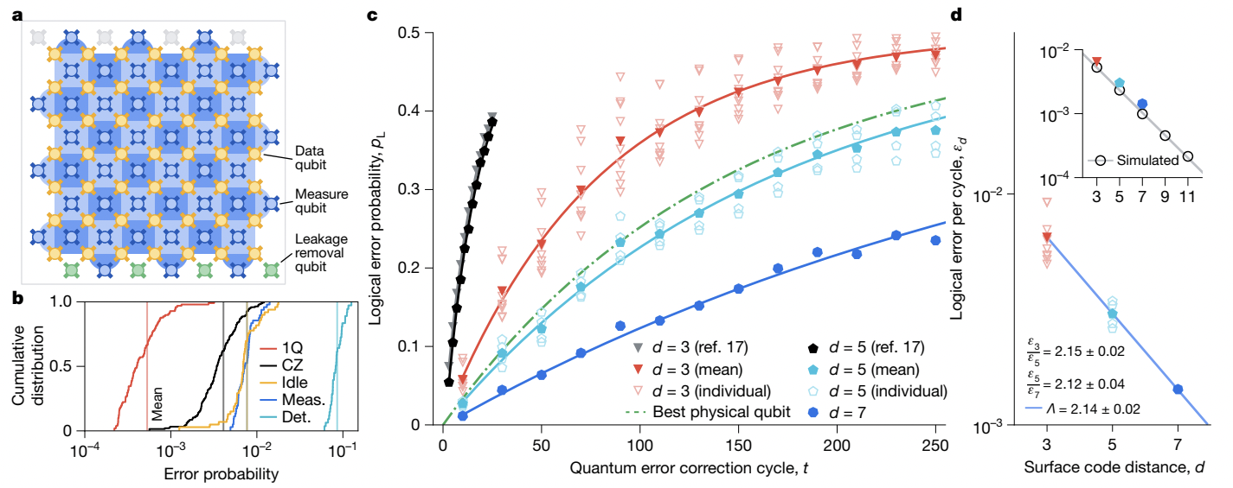
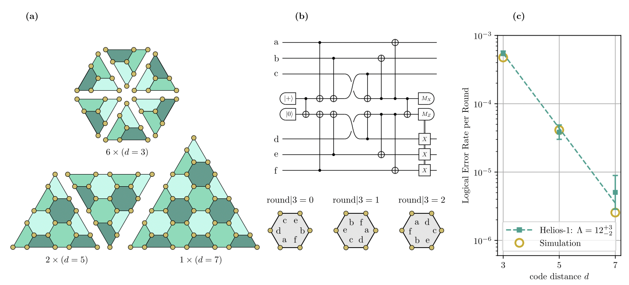
Recent progress
Implementing quantum error-correction is an enormous engineering challenge
But this goal has seen rapid progress over the past couple of years, on a variety of quantum computing platforms

Slide 13
So when does the threat to cryptography become practical?
It is difficult to say exactly. But NIST recommends starting the quantum transition now
An (in-progress) success story: Quantum-resistant standards for public-key cryptography
  Late ‘90s / early ‘00s: Researchers identified lattices as an alternative foundation for public-key cryptography. Based on our current understanding, quantum computer do not vastly outperform classical computers at solving lattice-based computational problems
  2016: NIST publishes a call for post-quantum algorithms
  2017-2023: Years of public testing, review, and revision
  2024: The first three standards are chosen:
    Key agreement: ML-KEM
    Digital signatures: ML-DSA and SLH-DSA
  Today:
    Migration: ML-KEM already incorporated into TLS and many secure messaging protocols
    More foundations, more testing…

Slide 14
An aside: Flipping the script?
In the cryptocurrency space, we are mostly concerned with the advent of quantum computing technologies
Quantum computers are a powerful technology – can we use them constructively?
More generally, research at the intersection of quantum information and cryptography is split into two branches
“Post-quantum cryptography”
“Quantum cryptography”
Honest parties with quantum computation and potentially quantum communication
Goal: New functionalities
Classical honest parties
Goal: Protection against quantum attackers

Slide 15
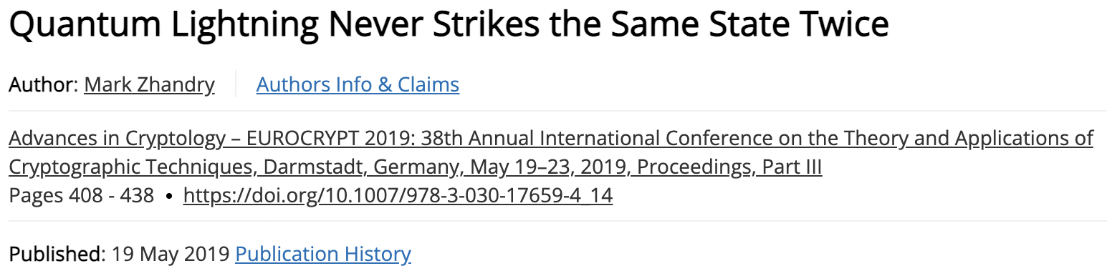
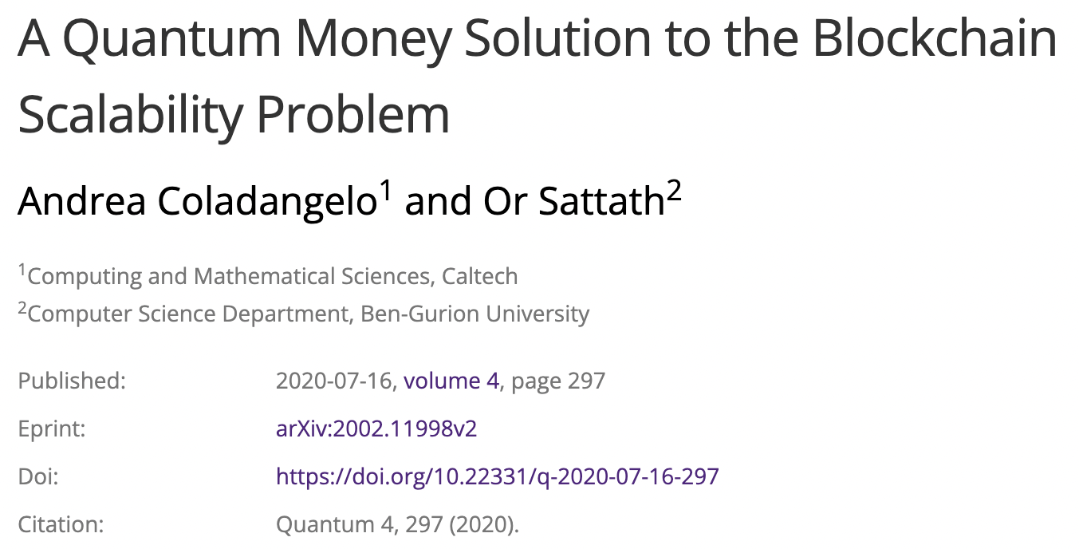
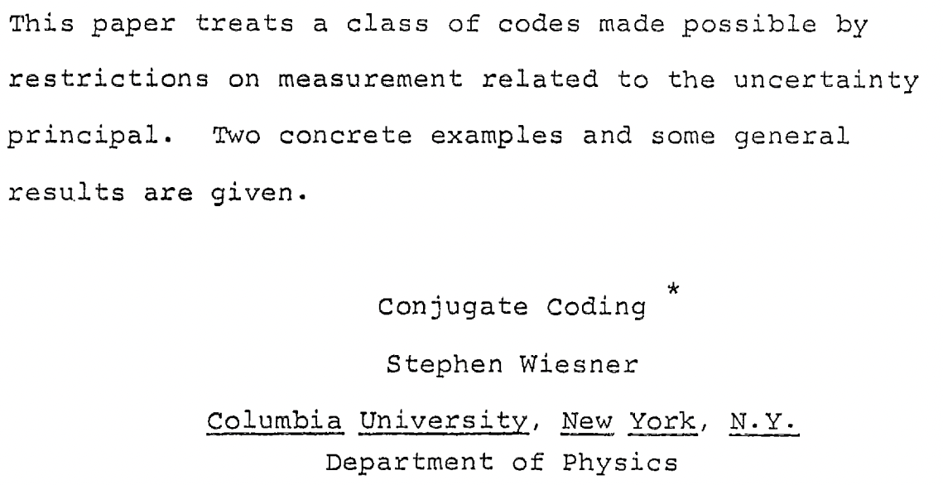
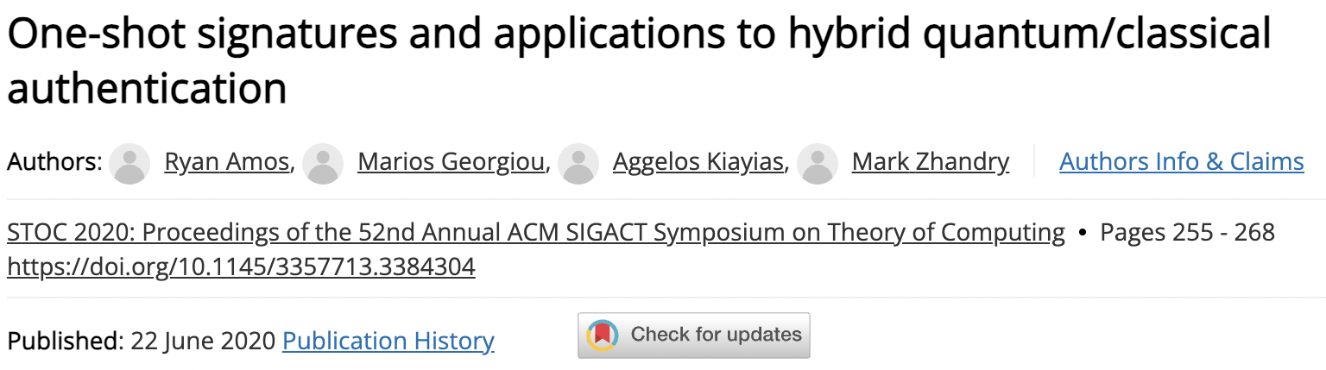
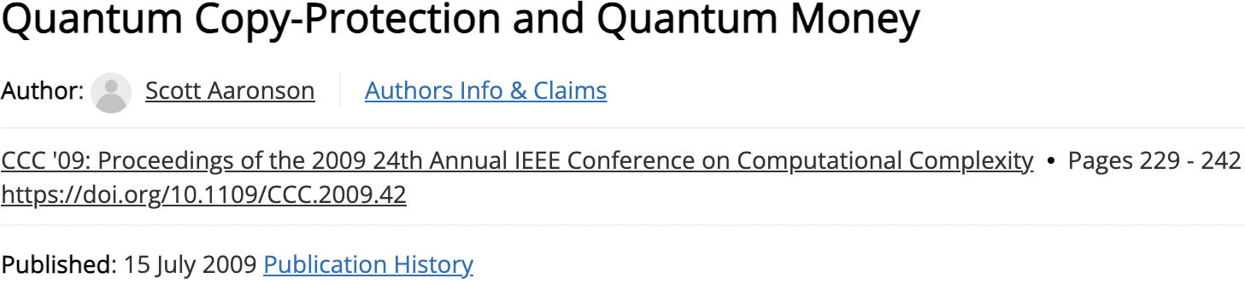
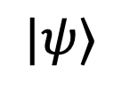
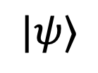
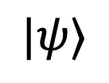
Quantum no-cloning
A central tenant of quantum information states that it is impossible, in general, to copy an unknown quantum state:
$$|ψ⟩$$
$$|ψ⟩$$
$$|ψ⟩$$
Idea: encode money into unclonable quantum states to prevent double-spending.
This mechanism could be used as an alternative to the blockchain one day.

