Slide 1
Prescription Based Prediction
Project Presentation
Aviv Yaish and Chaim Hoch

Slide 2
Introduction
The U.S. Centers for Medicare and Medicaid Services (CMS) publicly released in 2015 a dataset of prescriptions made under Medicare Part D in 2013.
This dataset includes the number of drugs given for each provider and anonymized information about each provider (doctor).
It is very interesting to explore what can be learned from this data.

Slide 3
Dataset
The dataset is a pairing between a list of prescribed drugs and anonymized data on the provider. It has 239,930 records.
The list of drugs includes drugs prescribed more than 10 times in that year and the number of prescriptions per drug. These drugs include brand names and generics names alike.
For each provider, the dataset includes information such as the gender of the provider, specialty, region, years practicing, location type.

Slide 4
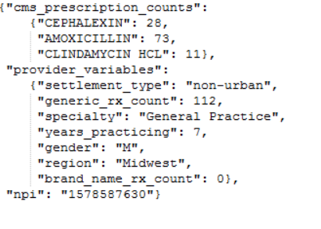

Slide 5
Goals
Predicting provider features by their prescription:
Gender
Region
Specialty

Slide 6
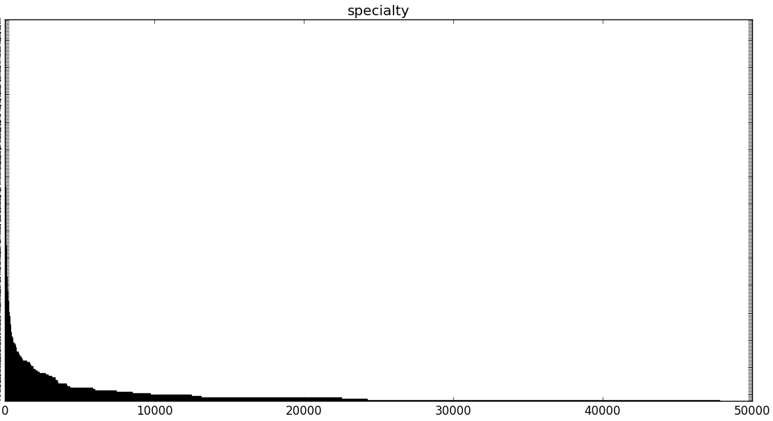
Statistics
The specialty field is characterized by a ‘long-tail’, so we only look at providers who are in a ‘popular enough’ specialty.

Slide 7
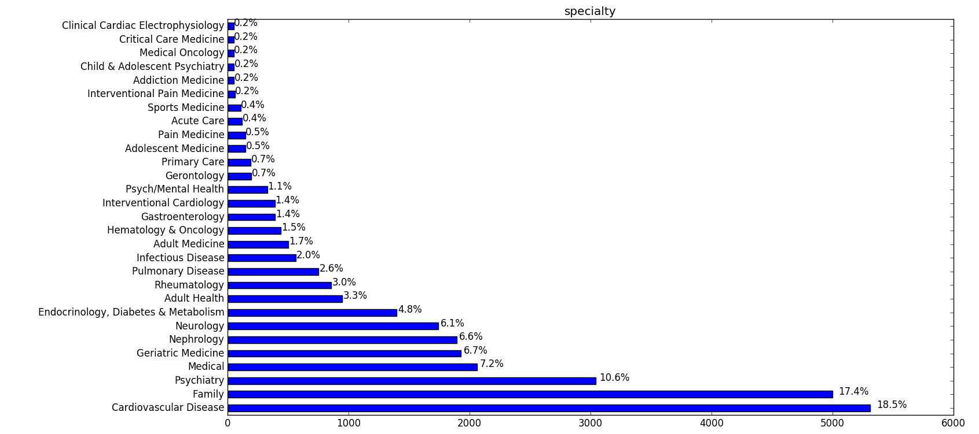

Slide 8
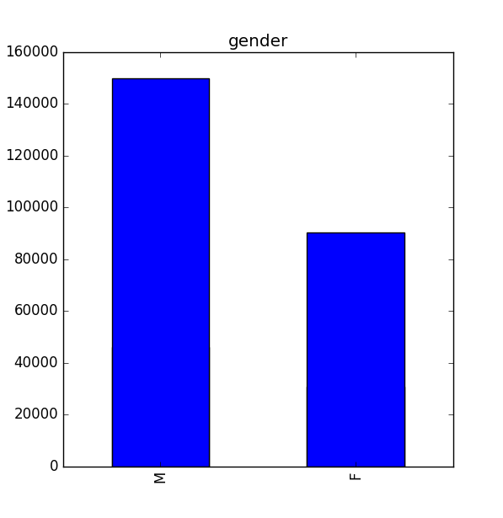
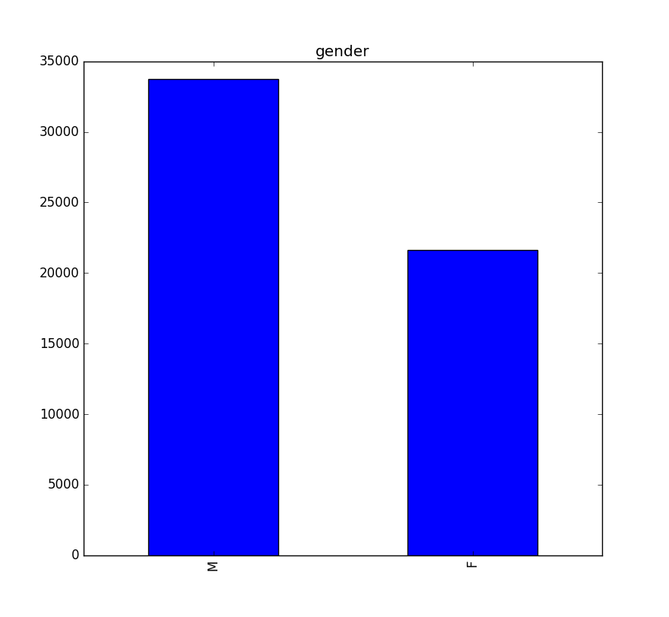
This removal still retains other statistical properties, such as gender and region distribution:

Slide 9
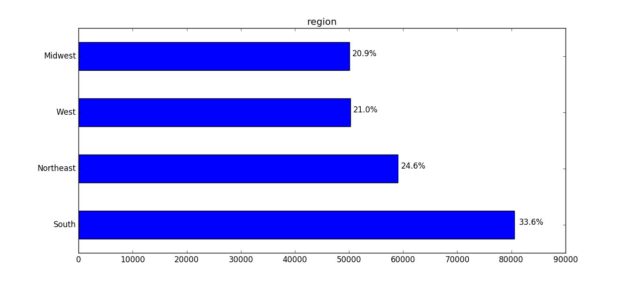
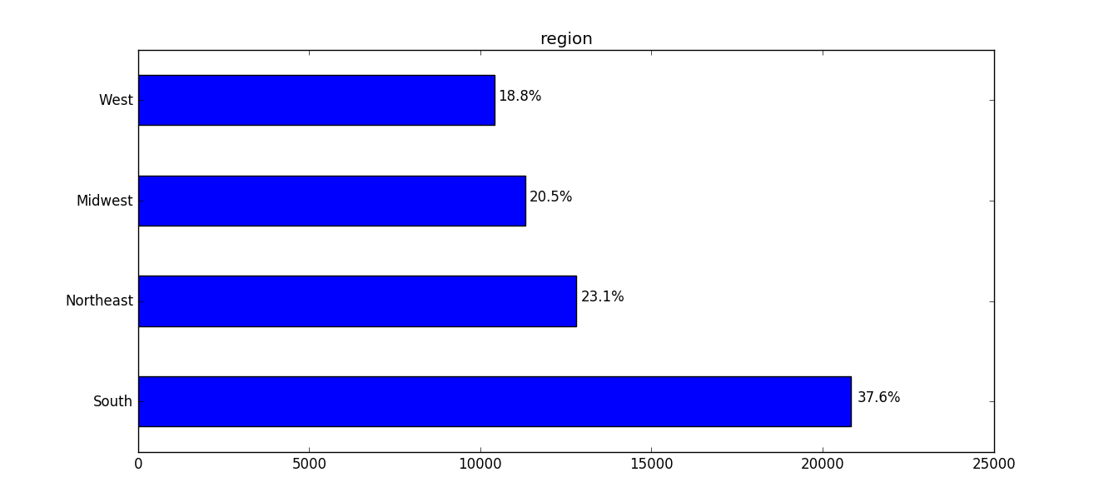
Before:
After:

Slide 10
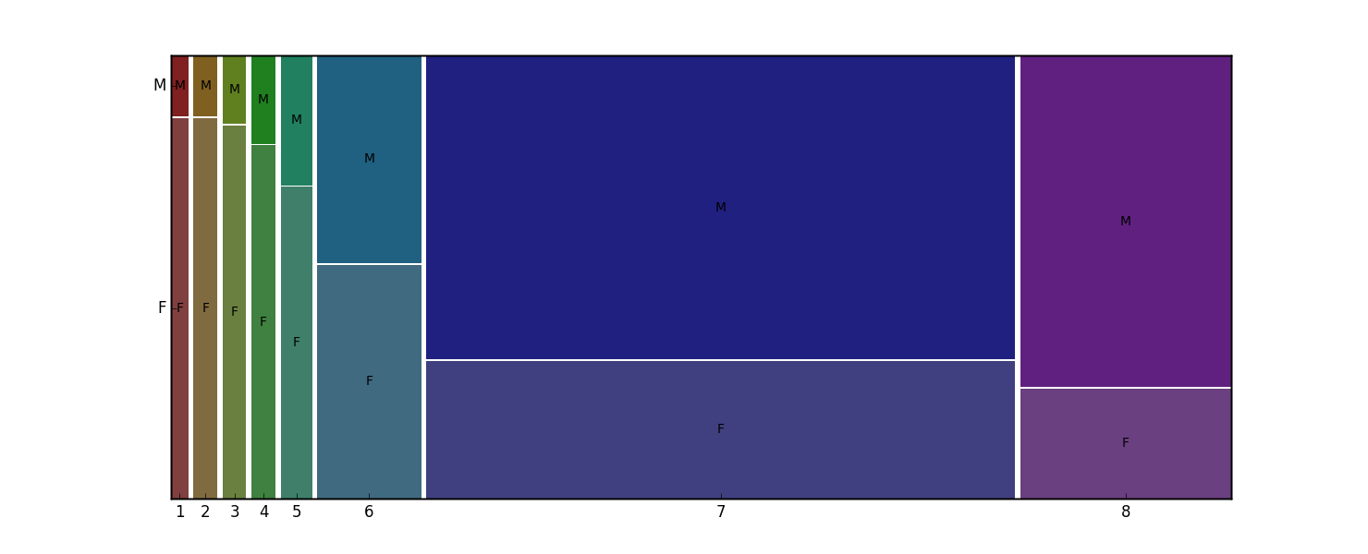
Years practicing by gender

Slide 11
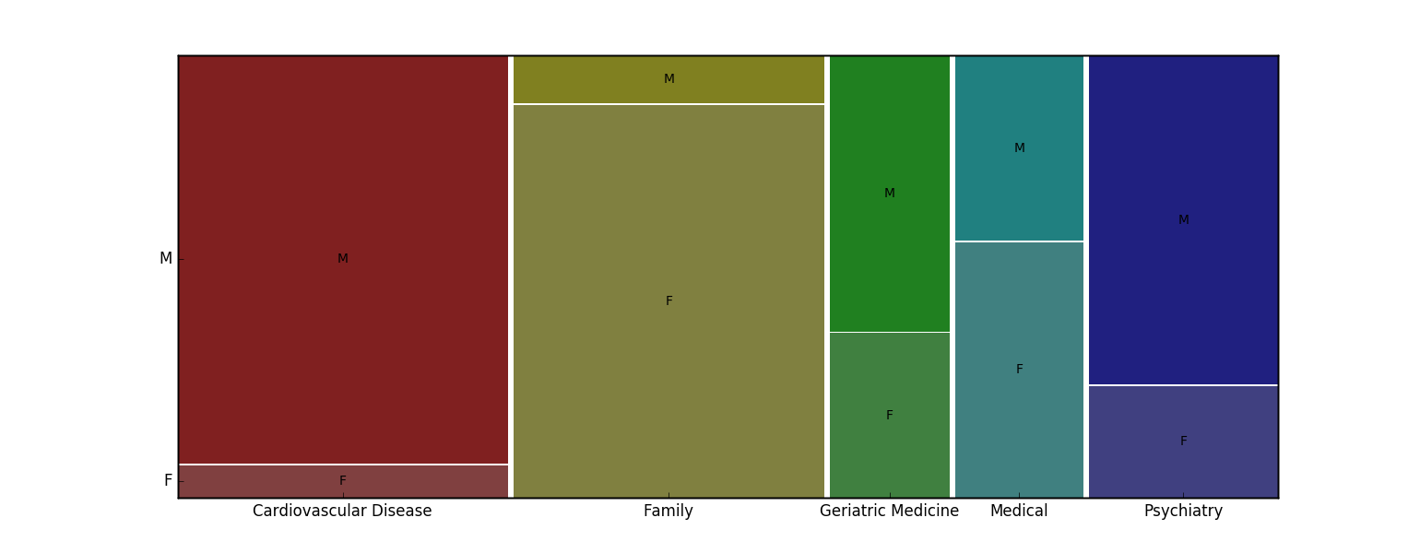
Top Specialties by gender

Slide 12
Prediction - introduction
For each feature of the provider, we trained Logisitic Regression and Random Forests models to predict it based on the prescriptions.
We used 75% of the data to train and 25% to test.

Slide 13
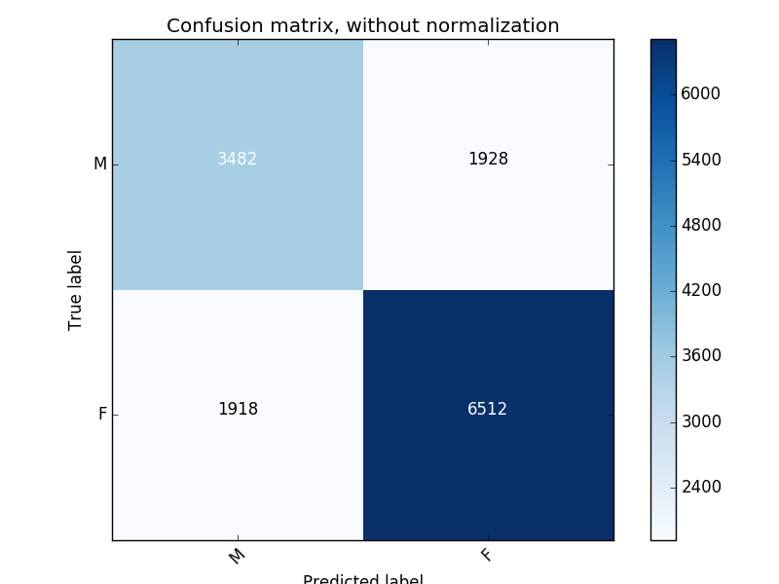
Results - GENDER
Random Forest: 72% Accuracy
‘Dummy’ Model: 50%

Slide 14
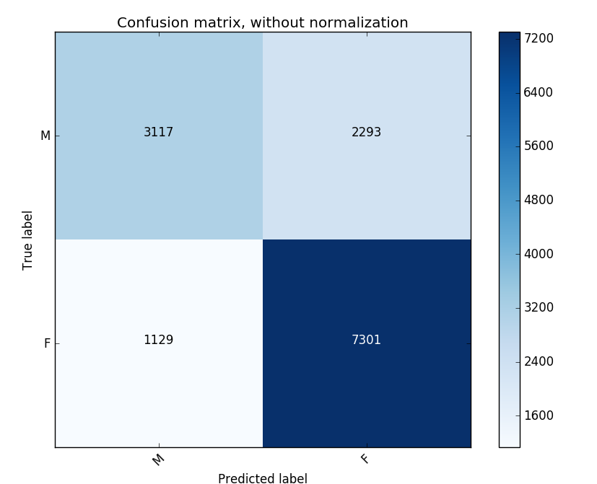
Results - GENDER
Random Forest (with Bagging):
75% Accuracy
‘Dummy’ Model: 50%

Slide 15
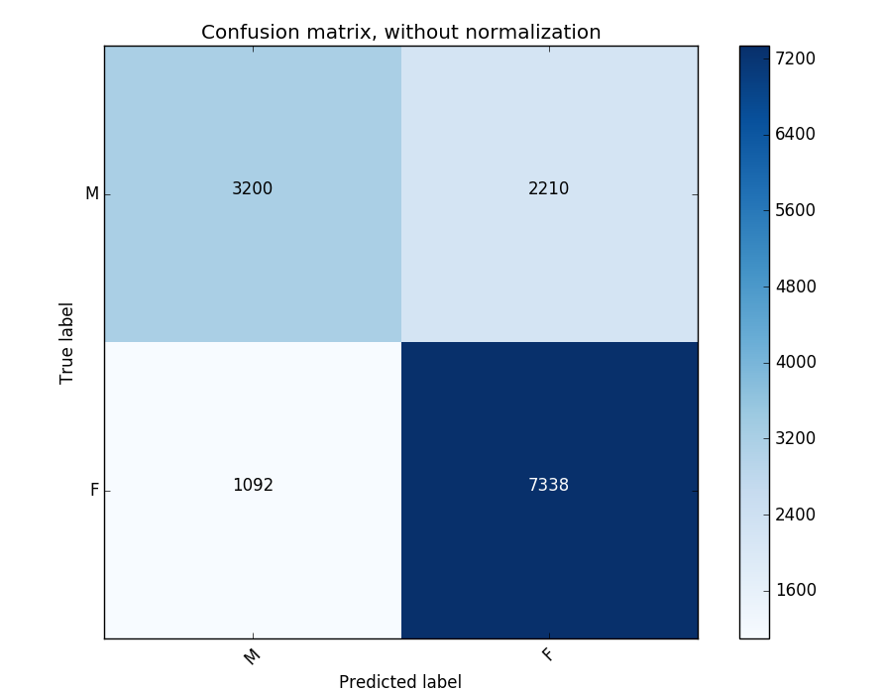
Results - Gender
Logistic Regression: 76% Accuracy
‘Dummy’ Model: 50%

Slide 16
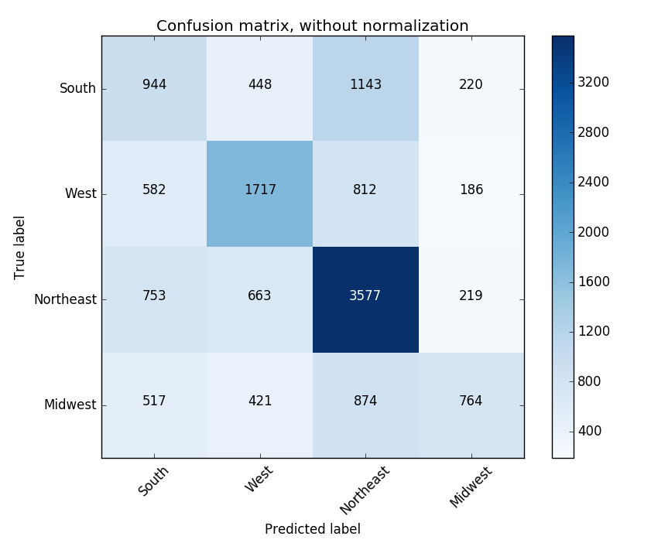
Results - REGION
Random Forest: 50%
‘Dummy’ Model: 25%

Slide 17
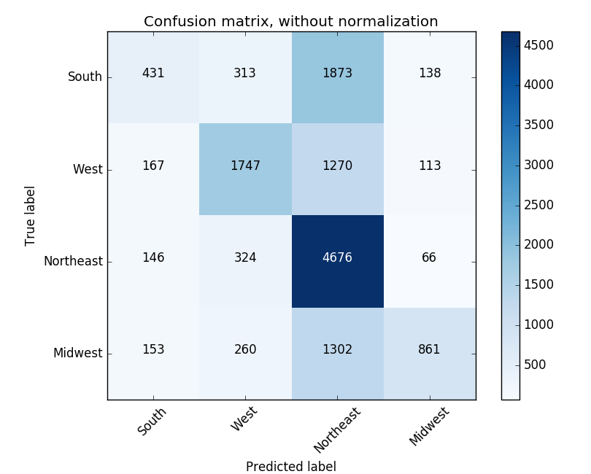
Results - REGION
Random Forest (with Bagging): 55%
‘Dummy’ Model: 25%

Slide 18
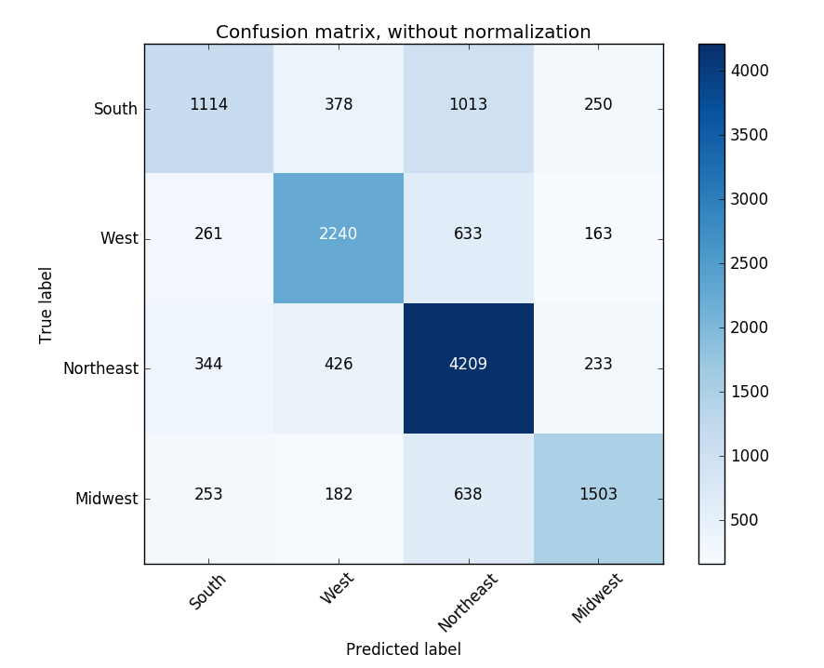
Results - Region
Logistic Regression: 66%
‘Dummy’ Model: 25%

Slide 19
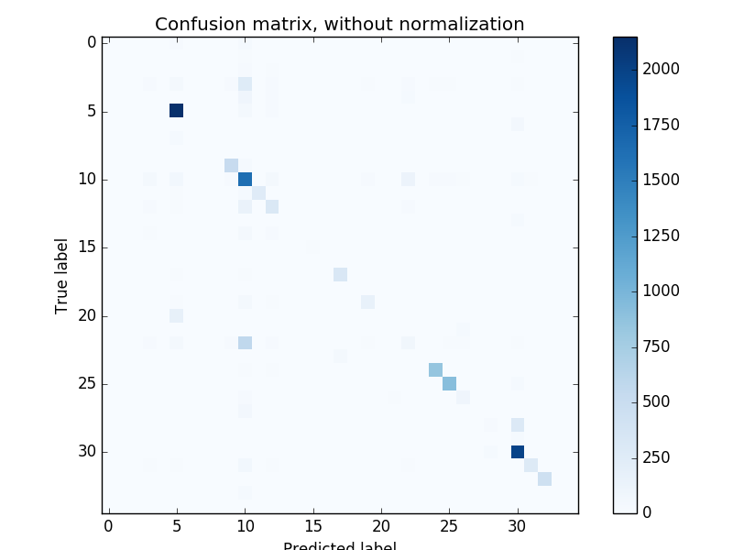
Results - Specialty
Random Forest: 72%
‘Dummy’ Model: 2.8%

Slide 20
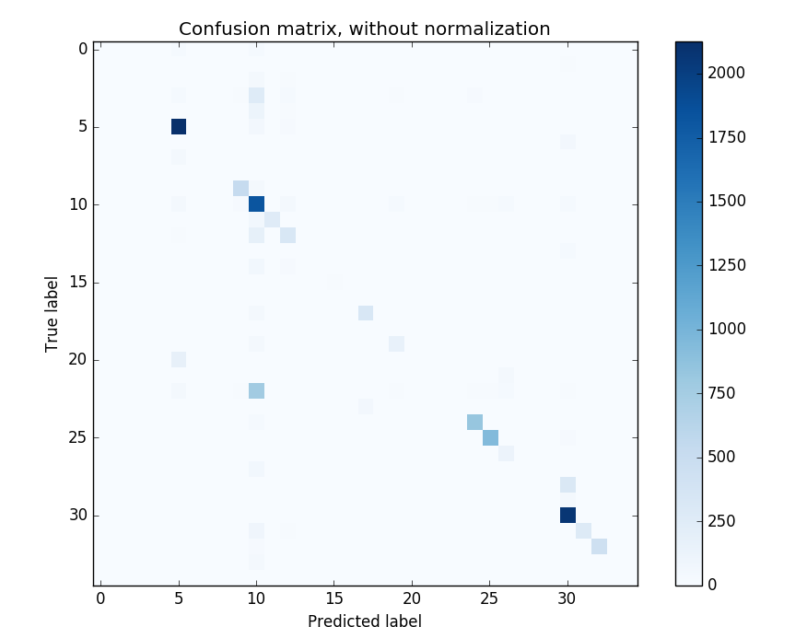
Results - Specialty
Random Forest (with Bagging): 74%
‘Dummy’ Model: 2.8%

Slide 21
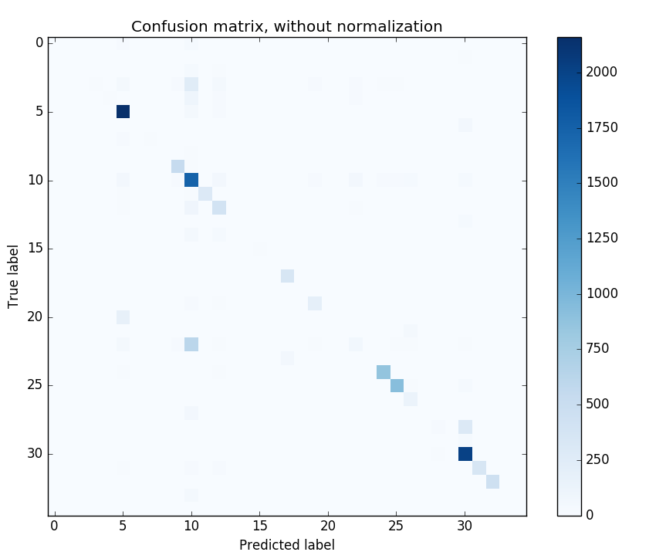
Results - Specialty
Logistic Regression: 76%
‘Dummy’ Model: 2.8%

Slide 22
RESULTS IN TABLE
 | Gender | Region | Specialty
Random Forests | 72% | 50% | 72%
Random Forests (bagging) | 75% | 55% | 74%
Random Forests (boosting) | 75% | 57% | 73%
Logistic Regression | 76% | 66% | 76%
Dummy | 50% | 25% | 2.8%

Slide 23
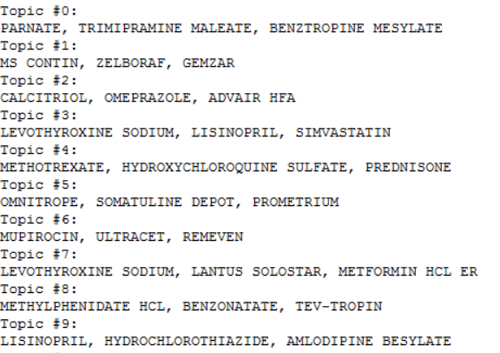
Latent Dirichlet Allocation
We used LDA to find ‘topics’ in the drugs prescriptions. In our settings, topics are specialties – each specialty is likely to have typical drugs.

Slide 24
from Topics to Specialties
Most Probable Topic (Counts) | Next Probable (Counts) | Drugs
Cardiovascular Disease, 7876 | Interventional Cardiology, 678 Family, 183 | MISOPROSTOL FOLIC ACID CILOSTAZOL
Family, 6261 | Medical, 2440 Adult Health, 805 | CALCITRIOL OMEPRAZOLE ADVAIR HFA
Geriatric Medicine, 1320 | Family, 474 Adult Health, 281 | NICARDIPINE HCL CARDENE SR AMERGE
Psychiatry, 8196 | Psych/Mental Health, 1203 Child & Adolescent Psychiatry, 236 | SUBOXONE BUPRENORPHINE-NALOXONE BUPRENORPHINE HCL

Slide 25
summary
In most of the cases we checked, application of machine learning to predict various features of the providers from the medications they prescribed worked quite well.
In particular, specialty prediction is accurate. This can be explained by:
Uniqueness of certain medication to certain specialties
Gender discrepancies in the various specialties

Slide 26
Questions?

