Slide 1
Artificial Neural Networks – Project 2 FIGURES
Ora Friedman TZ 328768163, Aviva Heller TZ 015972045

Slide 2
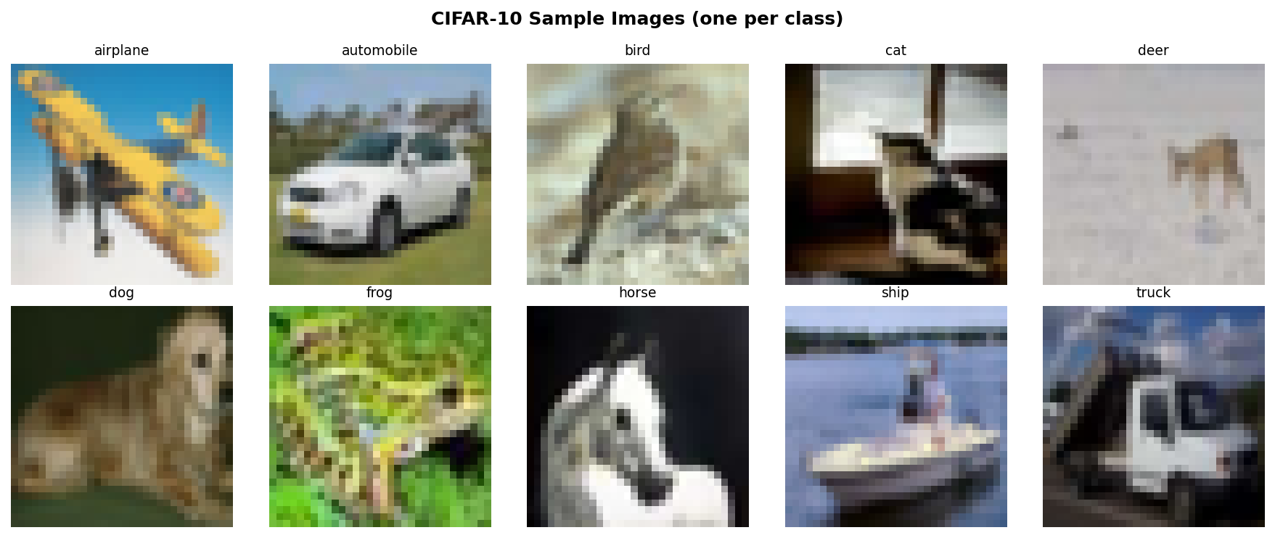
Figure A1: Sample images from CIFAR-10 (one per class).

Slide 3
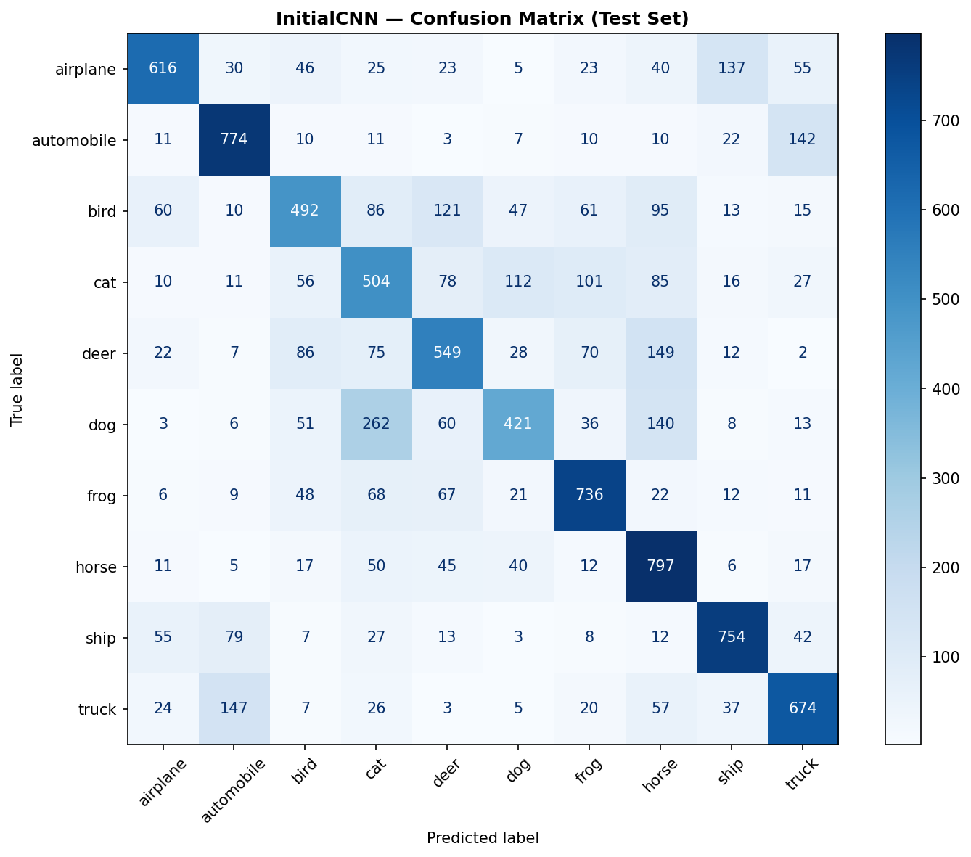
Figure A2: Confusion matrices for InitialCNN and ImprovedCNN on the CIFAR-10 test set.

Slide 4
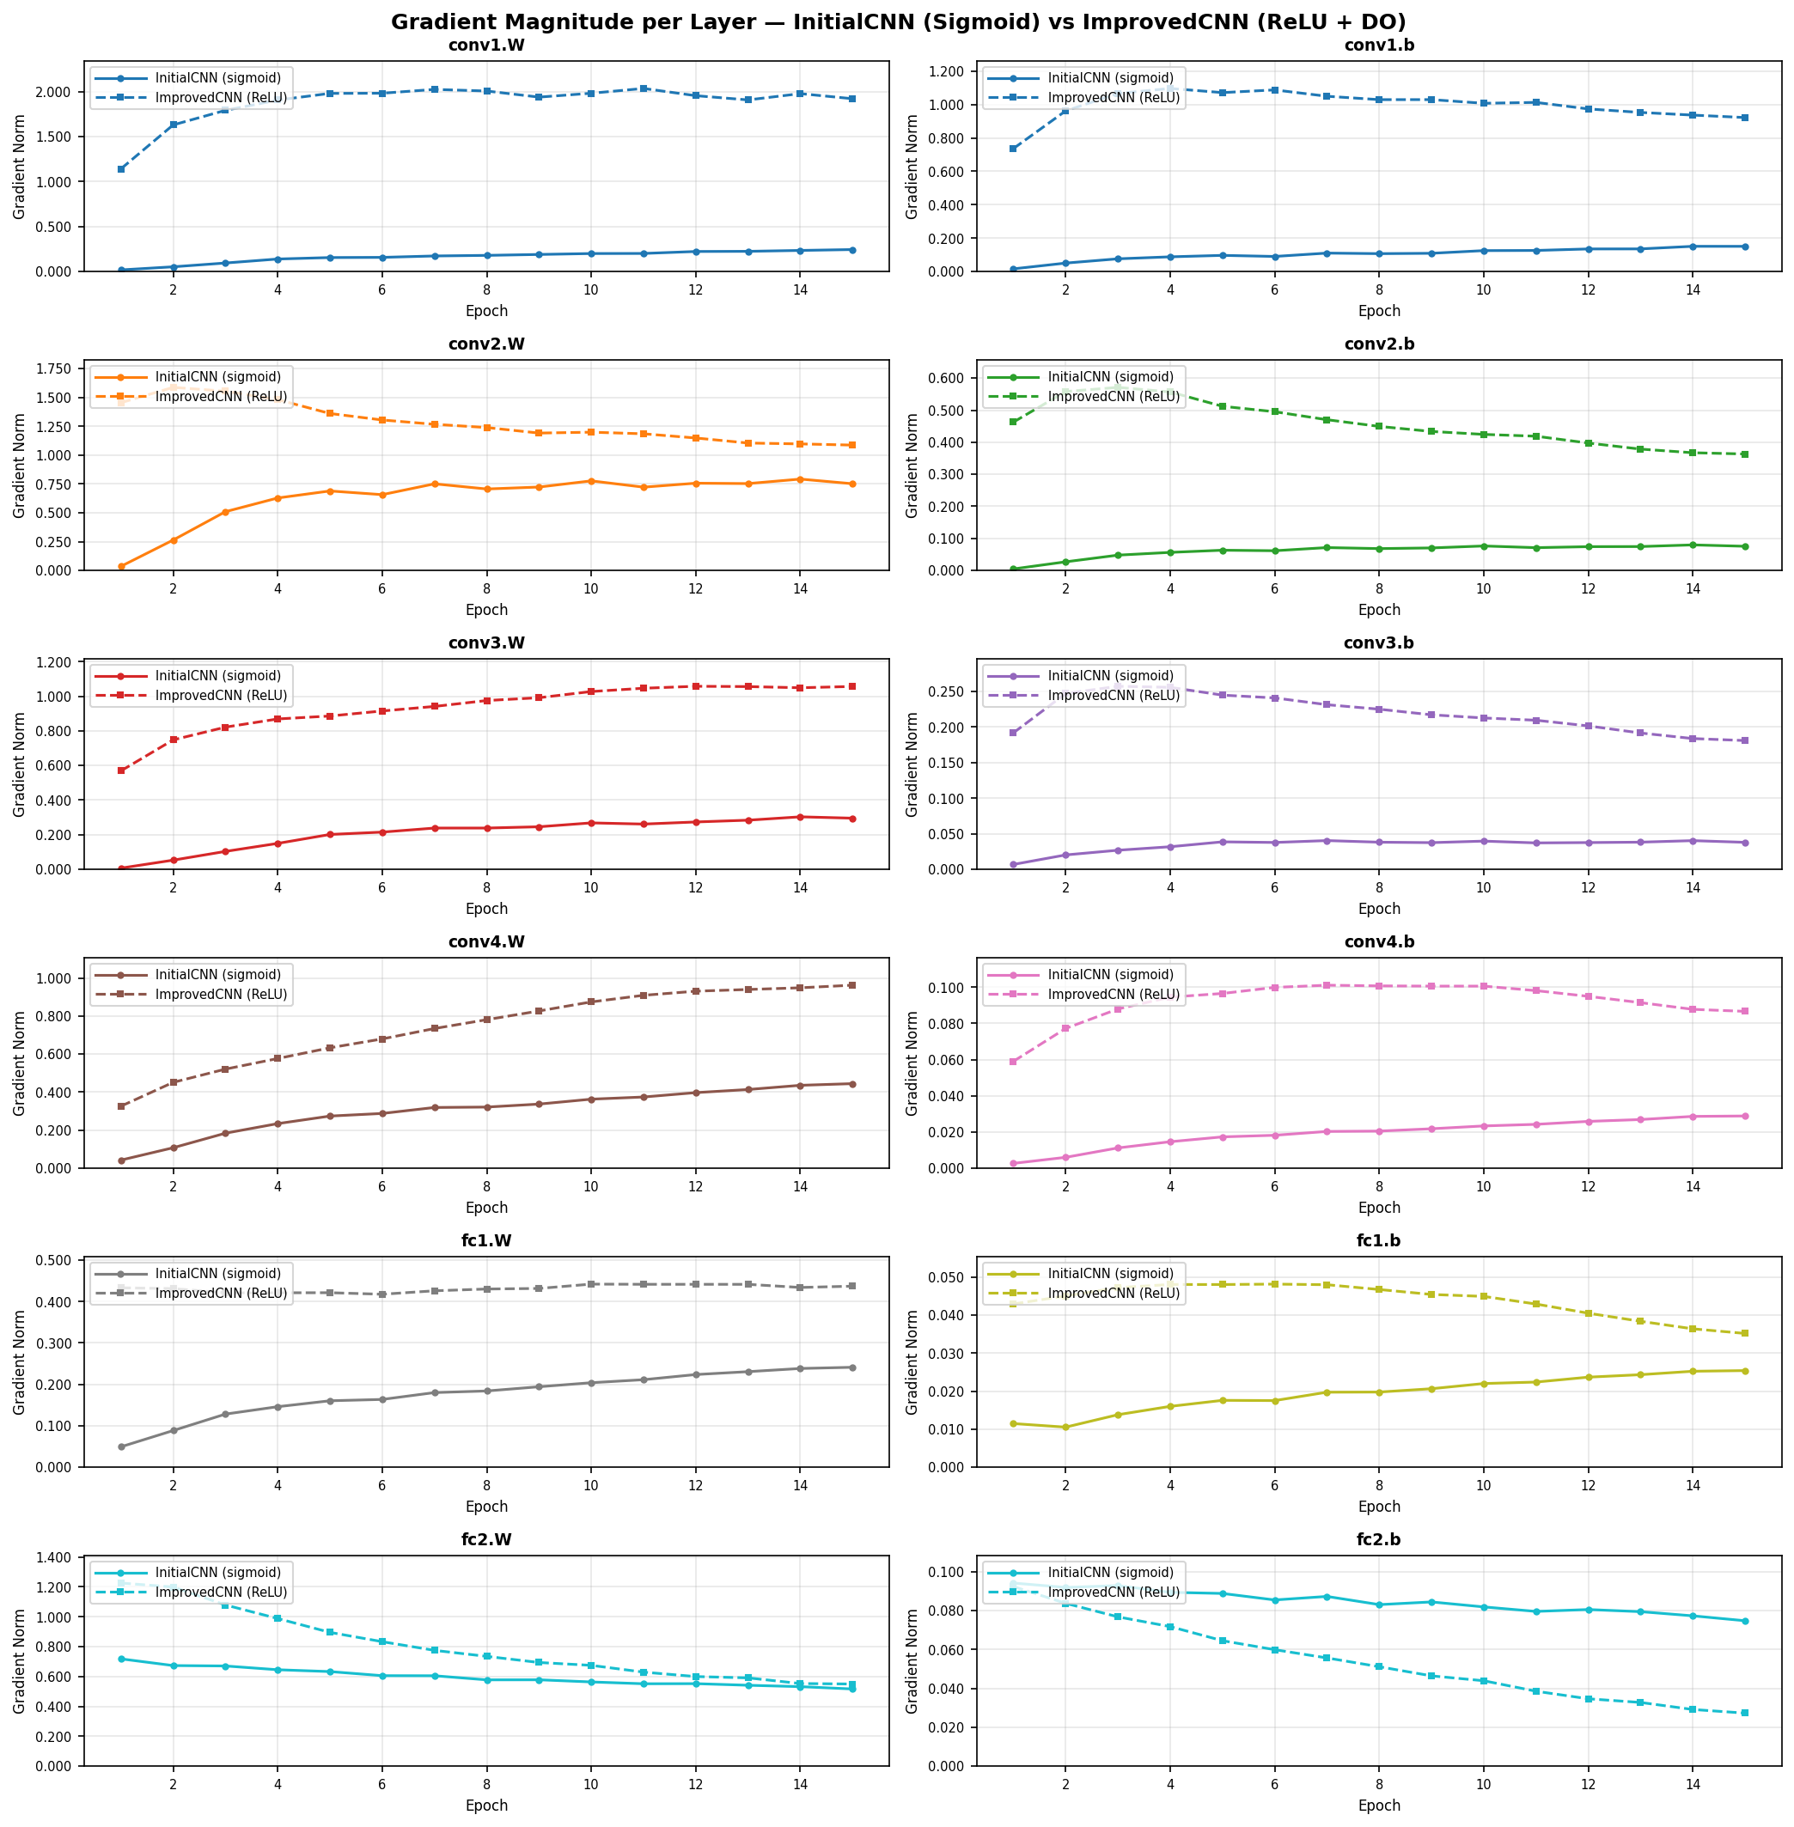
Figure A3. Gradient magnitude per layer across 15 epochs — InitialCNN with Sigmoid vs ImprovedCNN with ReLU and Dropout.

Slide 5
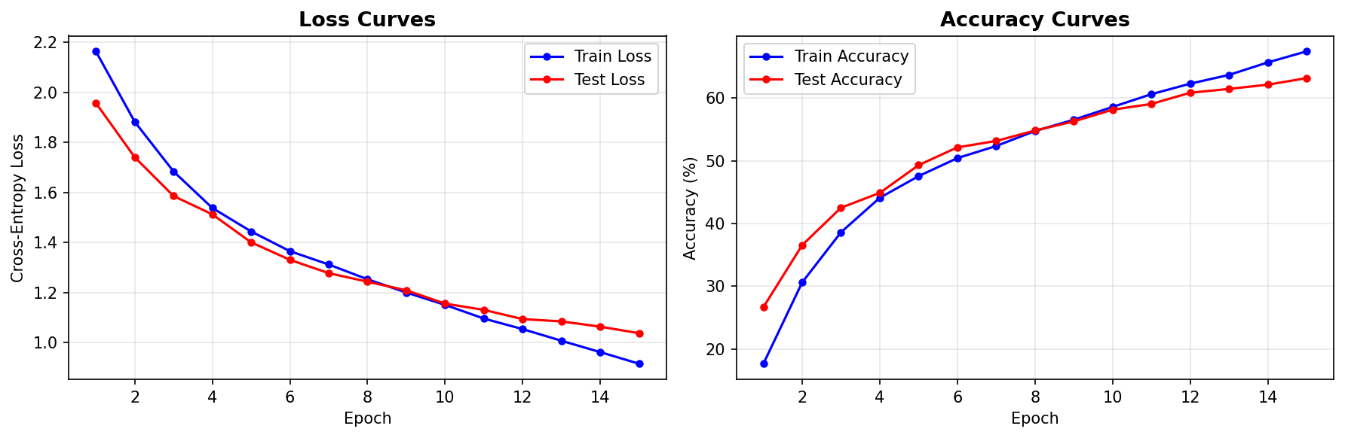
Figure 1. (A) The learning curves plotting loss and accuracy for each epoch across 15 epoch training run for InitialCNN. Both metrics are tracked separately for training set (blue) and test set (red).

Slide 6
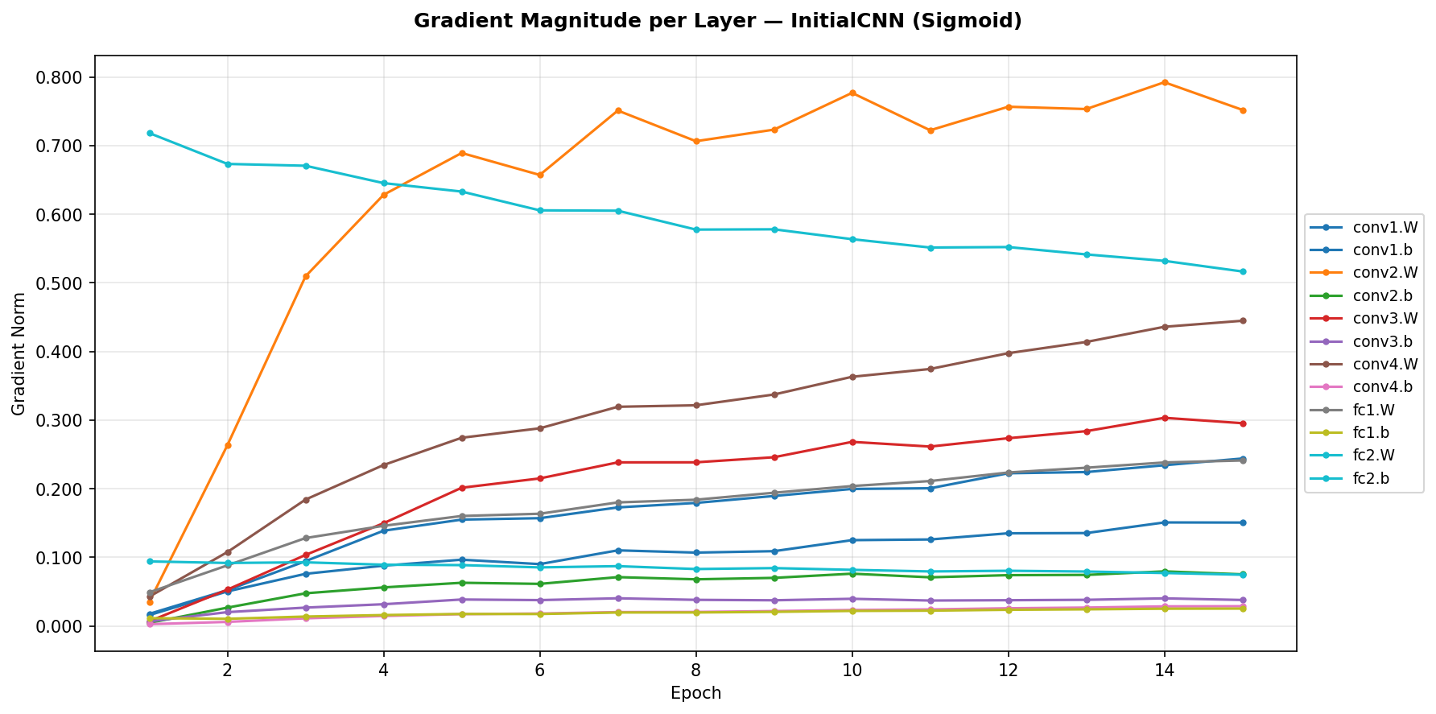
Figure 1. (B) Average gradient norm per parameter across epochs 1–15 for InitialCNN.

Slide 7
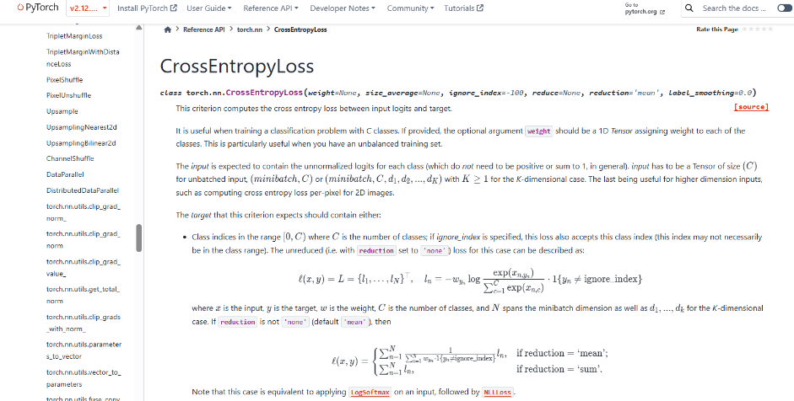
Figure A4. Official PyTorch documentation for CrossEntropyLoss, indicating that the loss function internally applies LogSoftmax before NLLLoss.

Slide 8
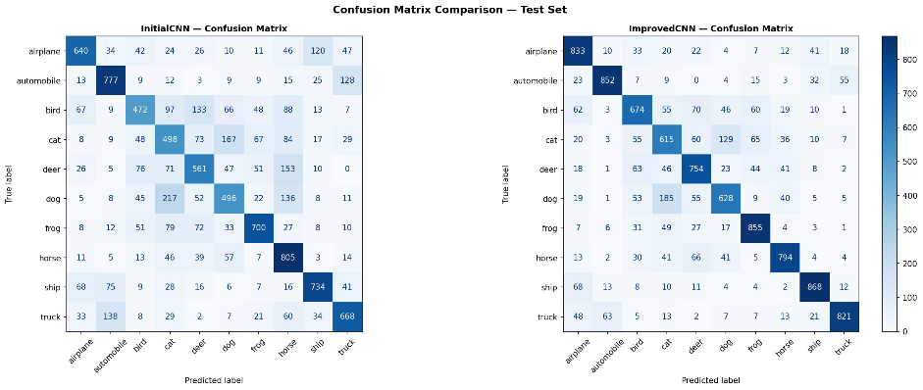
Figure A2: Confusion matrices for InitialCNN and ImprovedCNN on the CIFAR-10 test set.

Slide 9
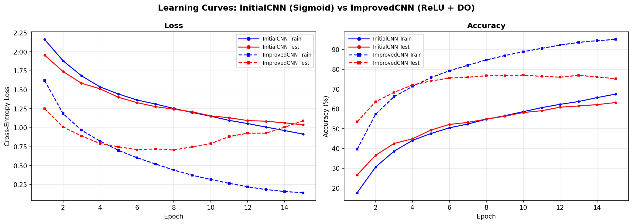
Figure 2: (B) Learning curves plotting loss and accuracy for each epoch across a 15-epoch training run for new CNN (solid) and MLP (dashed). Both metrics are tracked separately for training set (blue) and test set (red).

Slide 10
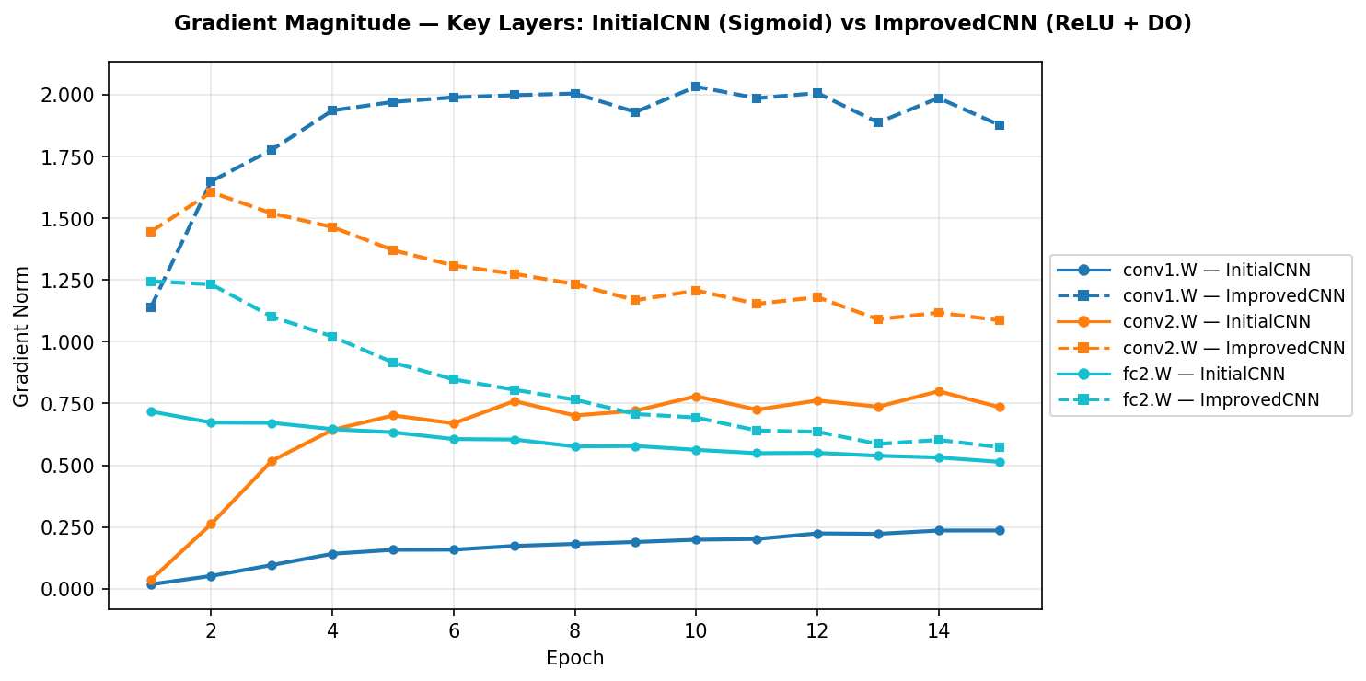
Figure 2. (B) Average gradient norm for key parameter across epochs 1–15 for InitialCNN (solid) and ImprovedCNN (dashed).

Slide 11
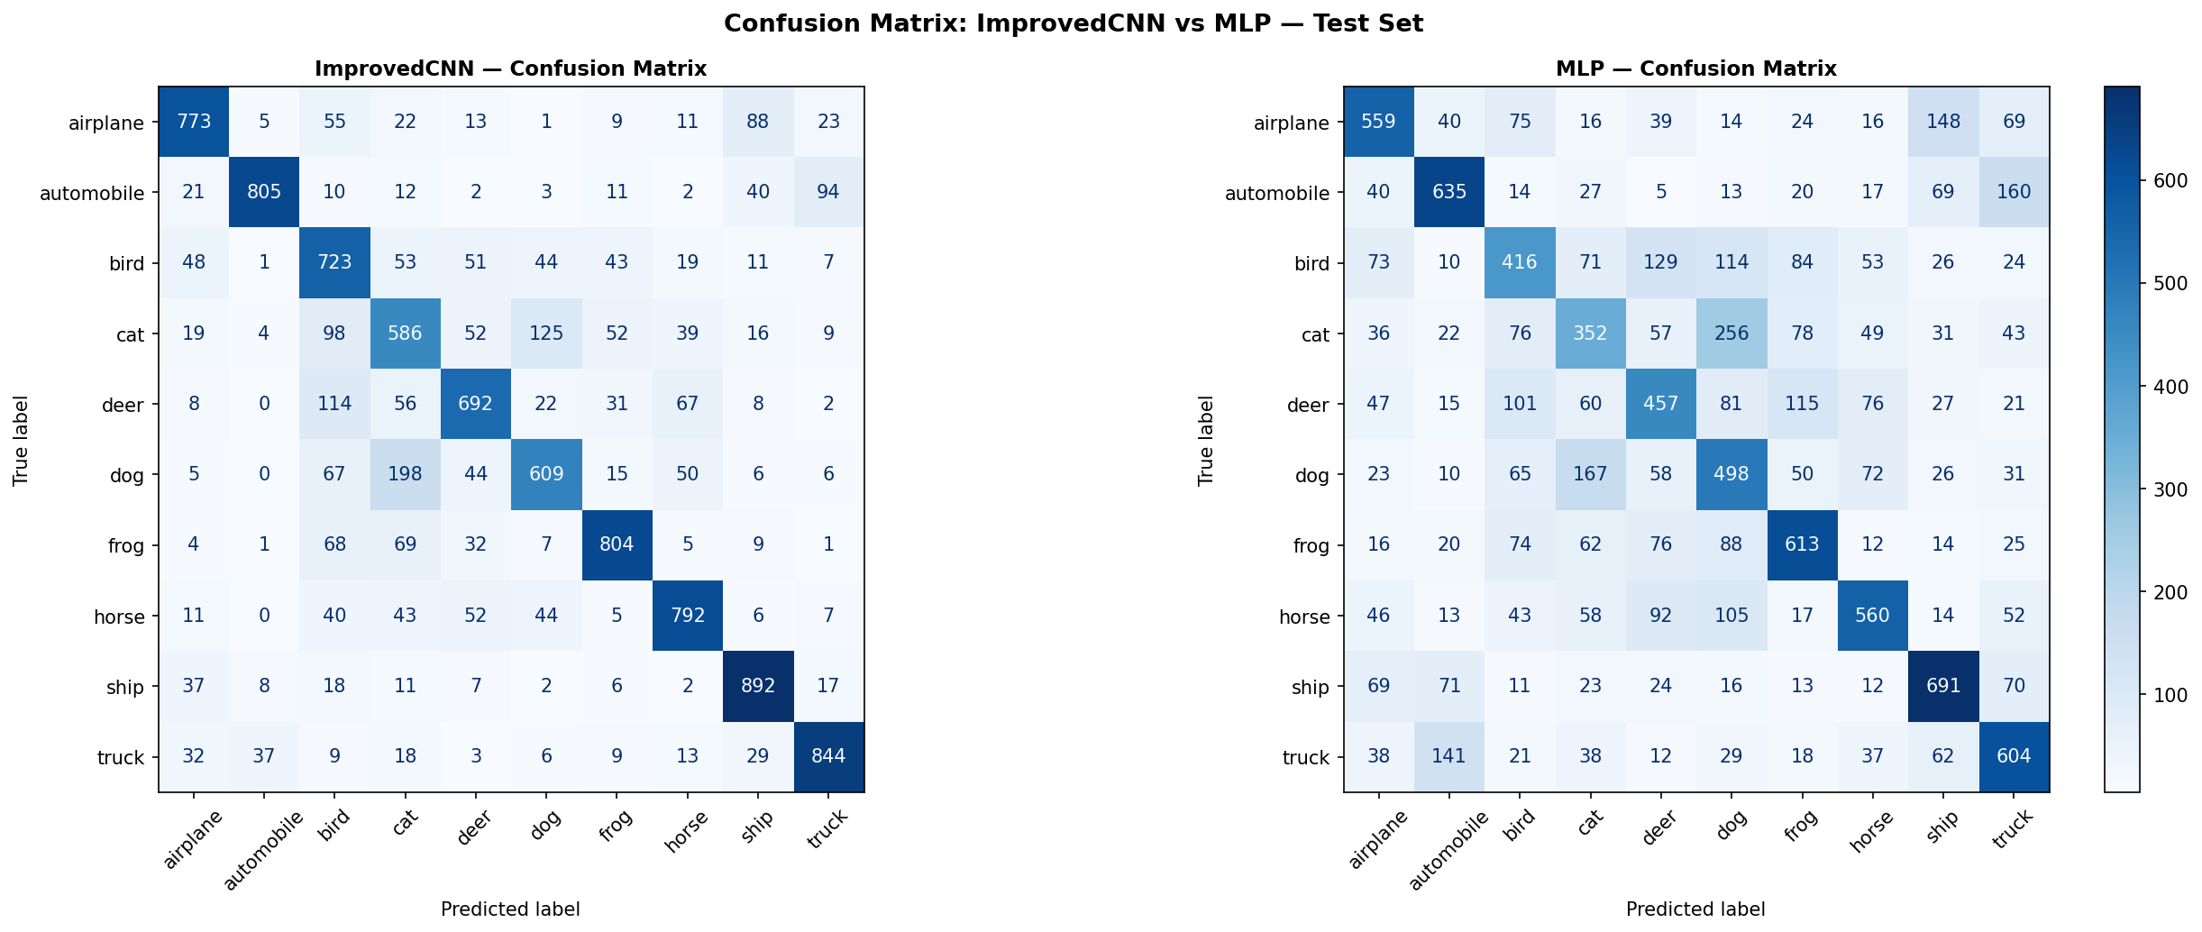
Figure 3: (A) Confusion matrices for ImprovedCNN and MLP.

Slide 12
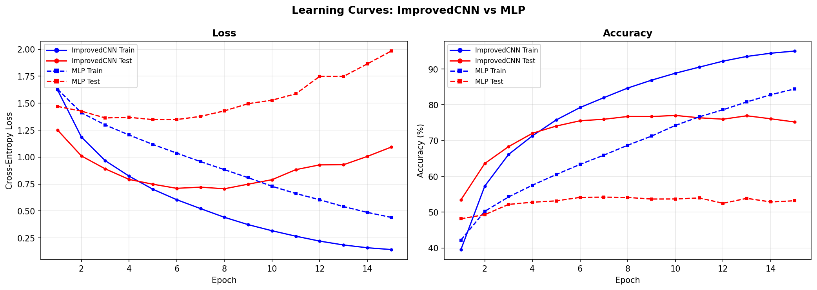
Figure 3 (B) Learning curves plotting loss and accuracy for each epoch across a 15-epoch training run for new CNN (solid) and MLP (dashed). Both metrics are tracked separately for training set (blue) and test set (red).

Slide 13
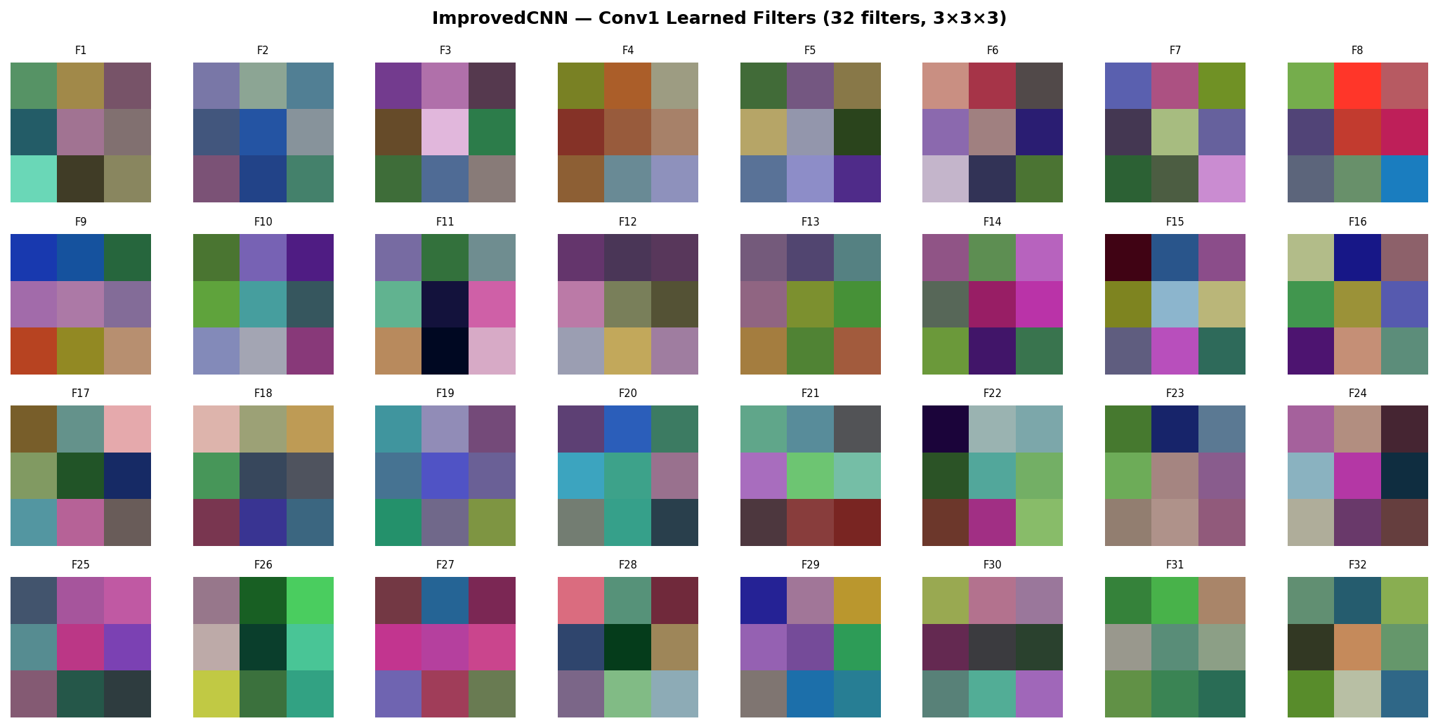
Figure 4: (A) Learned conv1 filters for ImprovedCNN (64 filters, 3×3×3).

Slide 14
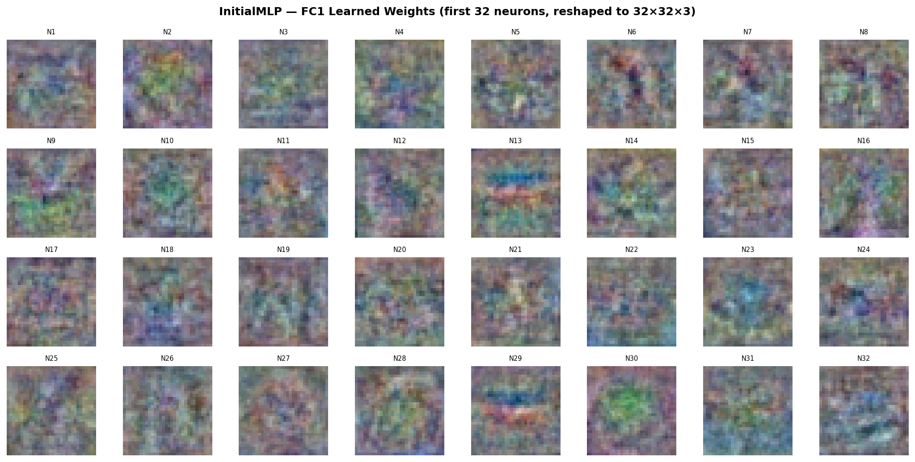
Figure 4: (B) FC1 learned weights for InitialMLP (first 32 neurons, reshaped to 32×32×3).

Slide 15
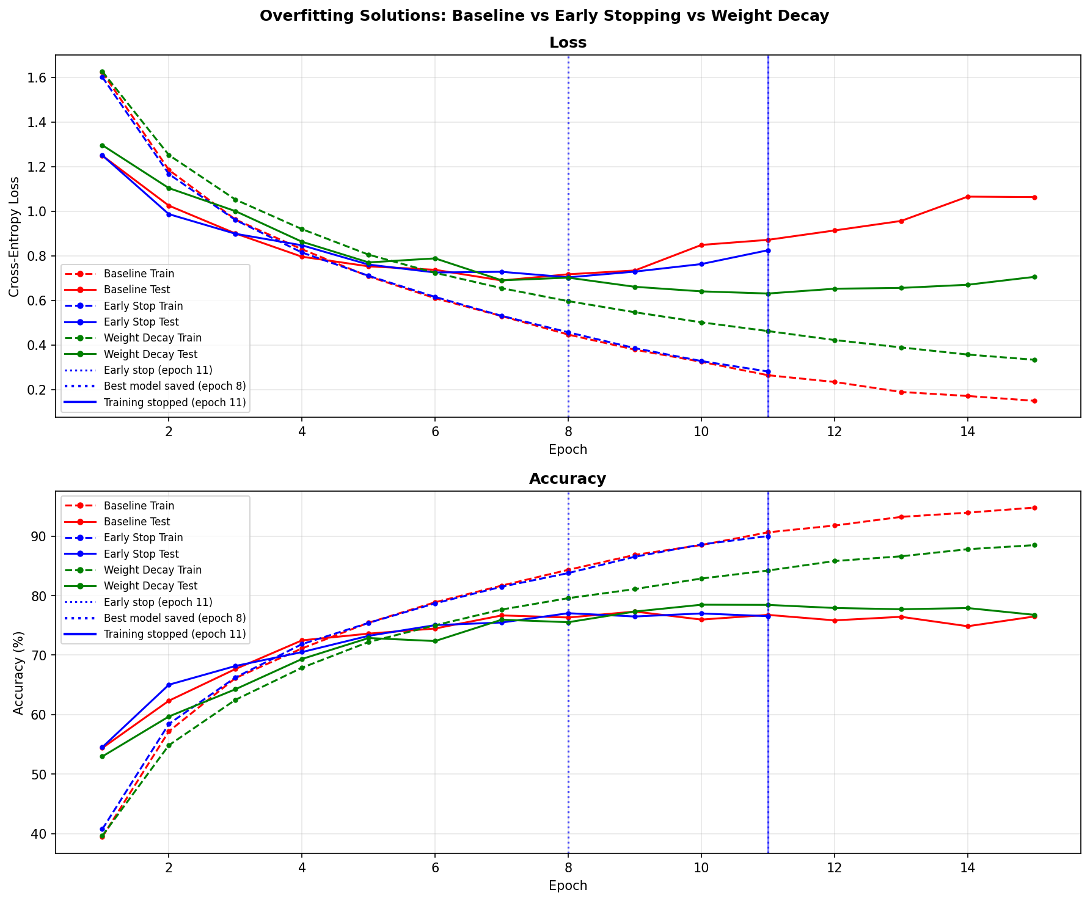
Figure 5: (A) Loss curves and (B) accuracy curves across 15 epochs for the baseline ImprovedCNN (red), early stopping (blue), and weight decay (green). Both metrics are tracked separately for training set (dashed) and test set (solid). Vertical markers indicate best model saved (epoch 8, dotted) and training stopped (epoch 11, solid).

Slide 16
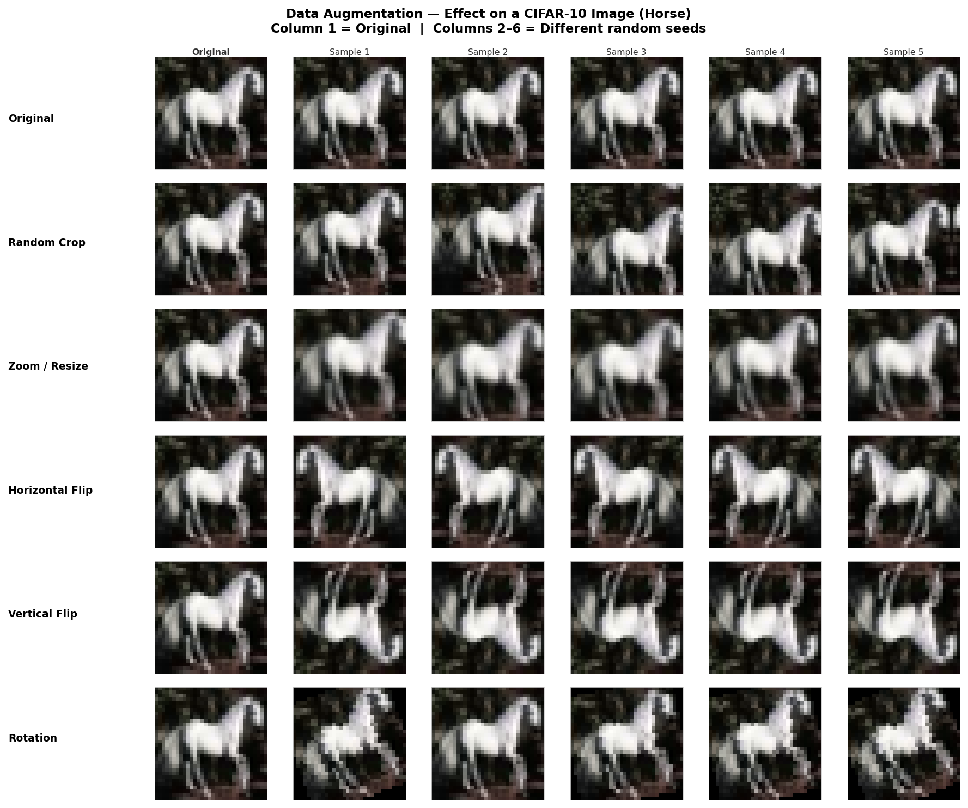
Figure A5. Effect of each augmentation on a sample CIFAR-10 image (horse). Each row shows one of the three applied transformations with five different random seeds. Column 1 is the unmodified original.

Slide 17
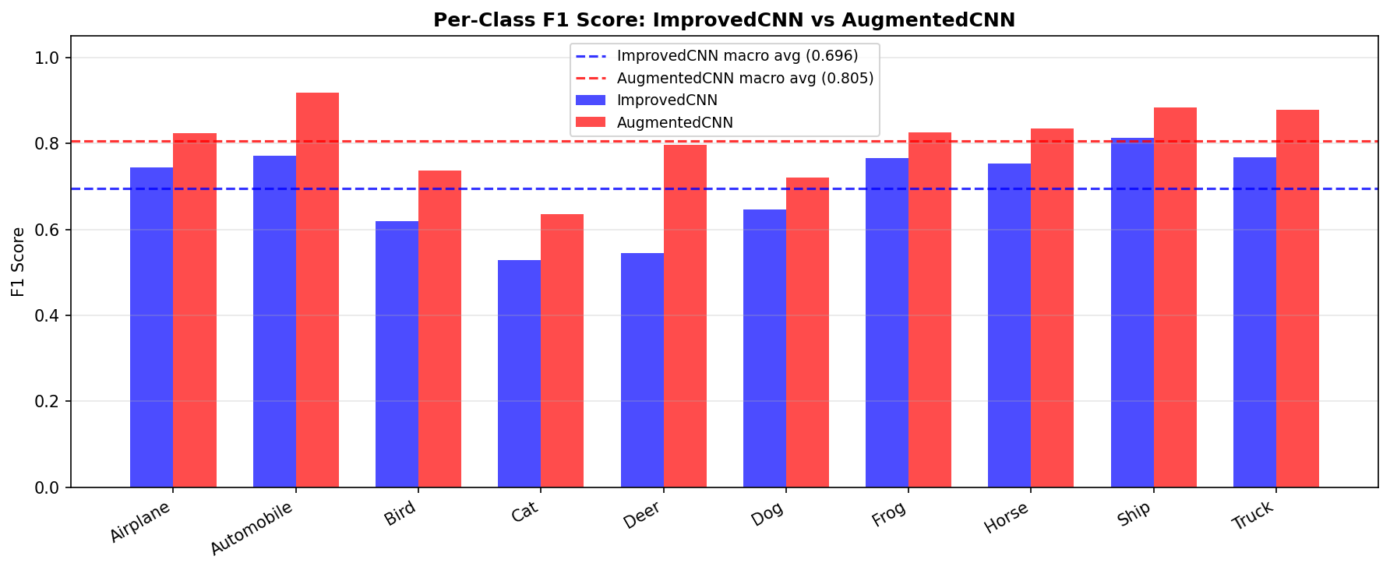
Figure 6. (A) Per-class F1 score for ImprovedCNN (blue bars) and AugmentedCNN (red bars). Dashed lines show macro F1 averages for each model.

Slide 18
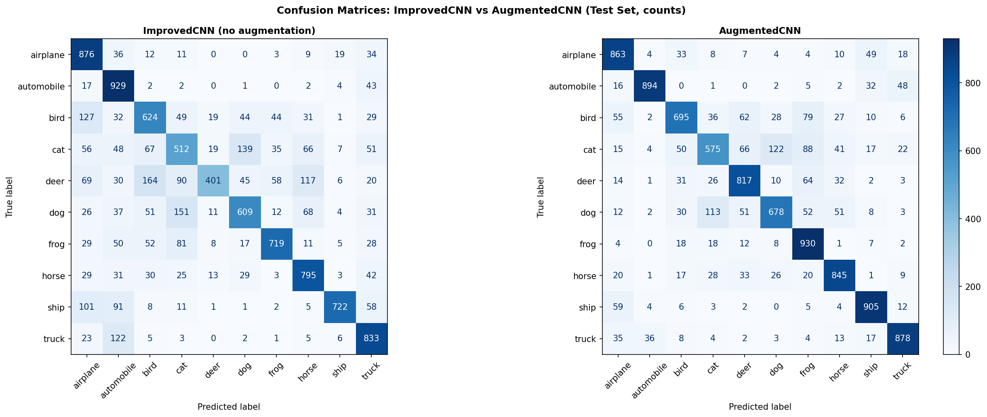
Figure 6. (B) Confusion matrices for AugmentedCNN. Values show raw counts out of 1,000 test samples per class.

Slide 19
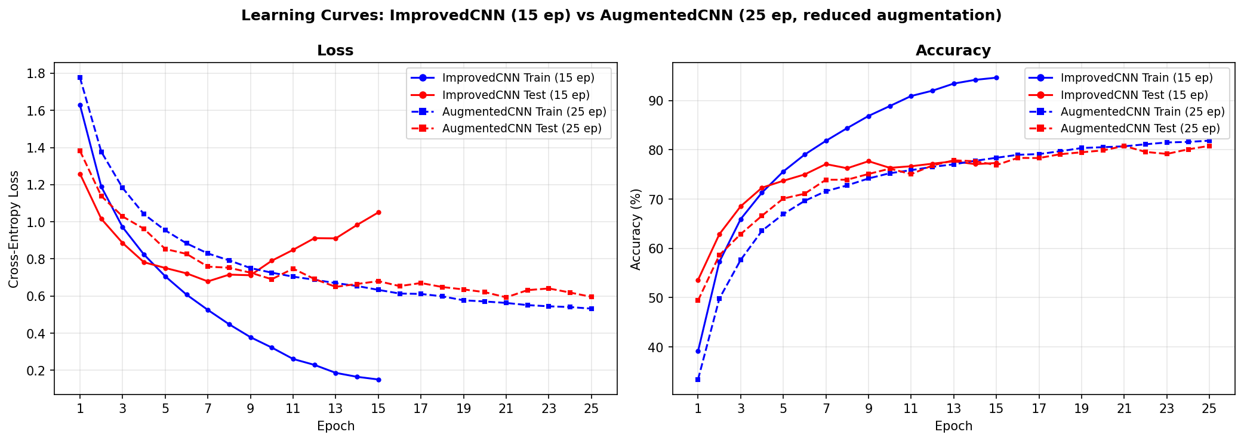
Figure 6. (C) Loss and accuracy learning curves for ImprovedCNN (solid lines, 15 epochs) and AugmentedCNN (dashed lines, 25 epochs). Blue = train, red = test.

Slide 20
Figure 7. Architecture of the PatchMLP_CNN hybrid network.

Slide 21
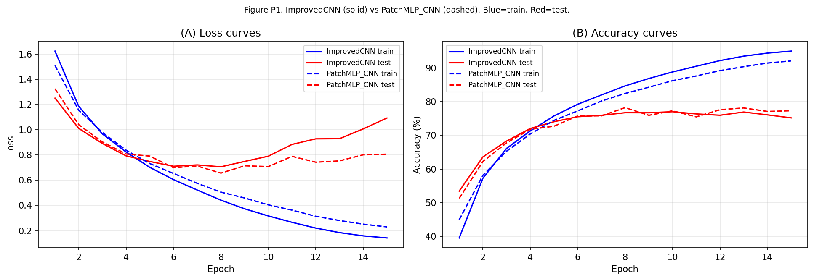
Figure 8. (A) Loss and accuracy learning curves of ImprovedCNN and PatchMLP_CNN.

Slide 22
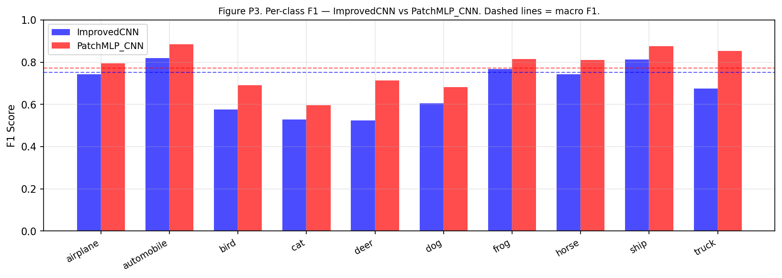
Figure 8. (B) Per-class F1 - ImprovedCNN (blue) vs PatchMLP_CNN.

Slide 23
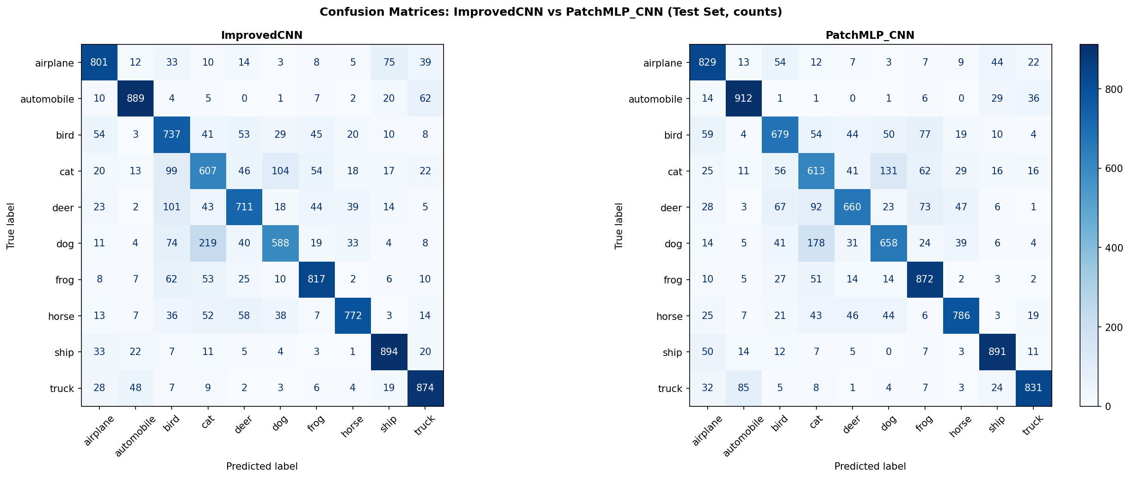
Figure A6. Confusion matrices — ImprovedCNN (left) vs PatchMLP_CNN (right).

