Slide 1













FLIGHT FARE
PREDICTION
By Aviya Singh

Slide 2
INTRODUCTION
Flight Price Predictor is a web application that uses machine learning to forecast airfare prices for domestic flights in India. Built with Flask and scikit-learn, this tool allows travelers to make more informed booking decisions by predicting ticket prices based on various flight parameters.

Slide 3
TECHNOLOGIES USED
Machine Learning
Data Visualization
Backend
scikit-learn
pandas
numpy
Matplotlib
Seaborn
Flask (Python)
Gunicorn (for deployment)
Frontend
HTML5
CSS3
JavaScript
Bootstrap 5

Slide 4

Feature | Description
Airline | The airline company
Date of Journey | Date of the flight
Source & Destination | Departure and arrival cities
Route | Flight route information
Departure & Arrival time | Time of departure and arrival
Duration | Total flight duration
Total Stops | Number of stops between source and destination
Additional Info | Additional information about the flight
Price | Target variable (fare in INR)
DATASET
The model is trained on the Flight Price Dataset from Kaggle, which includes features like:

Slide 5
MACHINE LEARNING
MODEL AND COMPARISON
Model | R² Score | RMSE | MAE
Linear Regression | 0.62 | 3792.56 | 2998.33
Support Vector Regression | 0.64 | 3703.22 | 2588.24
Random Forest | 0.81 | 2738.43 | 1684.87
Decision Tree | 0.74 | 3163.12 | 2154.37

Slide 6


MODEL TRAINING PROCESS
Data Cleaning
Model Persistence
Feature Engineering
Hyperparameter Tuning
Categorical Encoding
Model Selection

Slide 7


API ENDPOINTS
Endpoint | Method | Description
/ | GET | Home page with prediction form
/predict | POST | Returns fare prediction based on input parameters
/statistics | GET | Shows model performance statistics

Slide 8
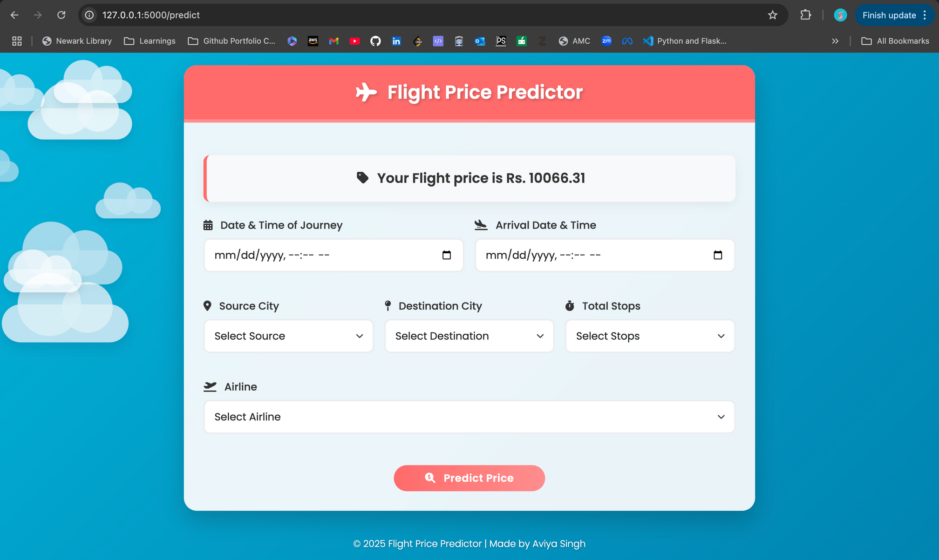
FLIGHT PRICE PREDICTOR

Slide 9
PROBLEMS AND CHALLENGES
Data Challenges
Model Limitations
Availability of data
Temporal constraints
Feature coverage
Prediction lag
New routes

Slide 10
REFERENCES
Korkmaz, Huseyin. (2024). Prediction of Airline Ticket Price Using Machine Learning Method. Journal of Transportation and Logistics. 9. 1-14. 10.26650/JTL.2024.1486696.
M. Tuli, L. Singh, S. Tripathi and N. Malik, "Prediction of Flight Fares Using Machine Learning," 2023 13th International Conference on Cloud Computing, Data Science & Engineering (Confluence), Noida, India, 2023, pp. 13-18, doi: 10.1109/Confluence56041.2023.10048801.
Gupta, Shikha & Gupta, Nishi & Publication Hub, Tjcse. (2024). Flight Fare Prediction Using Machine Learning.

Slide 11
THANK YOU
https://github.com/Aviya-Singh/Flight-Prediction

