Slide 1

Political Generative Art
Case Study:
Dynamics of the Israeli-Palestinian Separation Barrier
Avner Peled

Slide 2
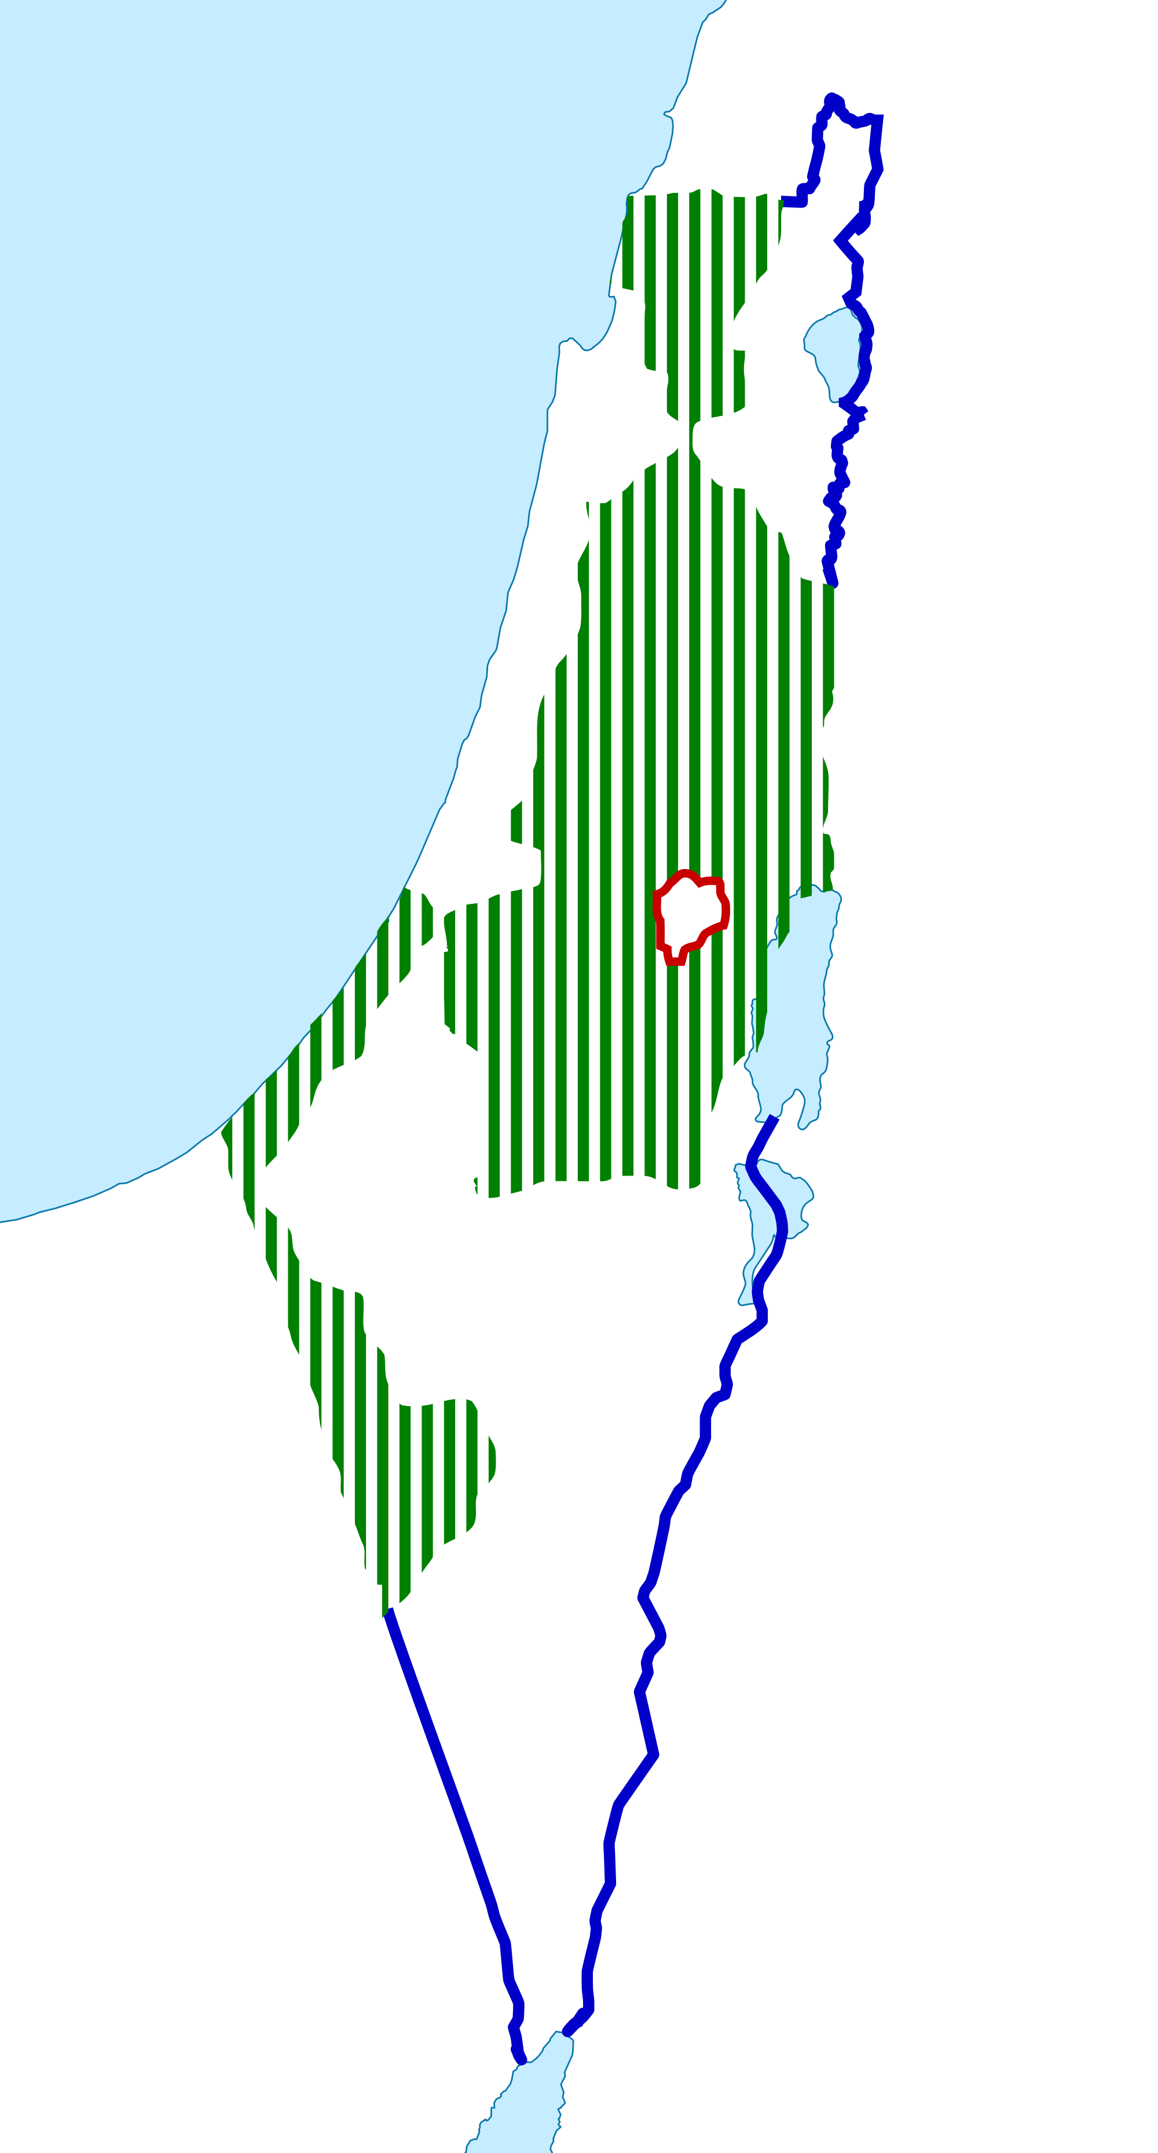
Some History

Slide 3
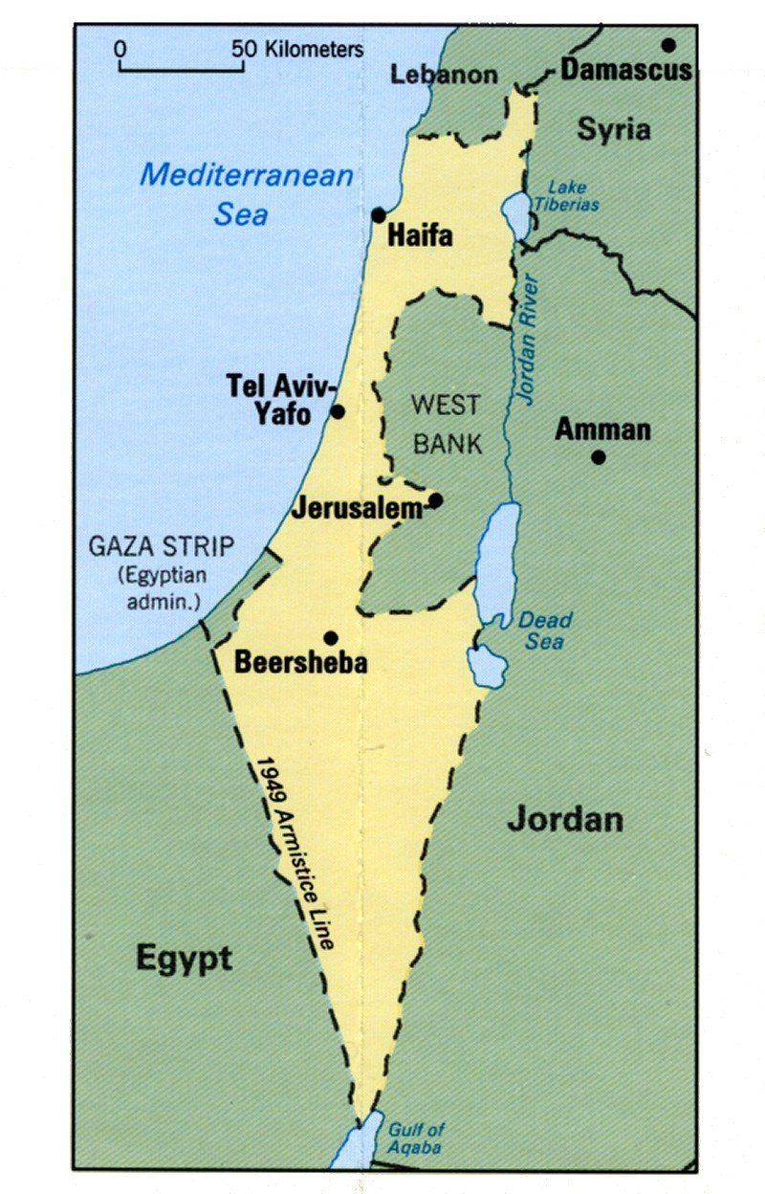
1949

Slide 4
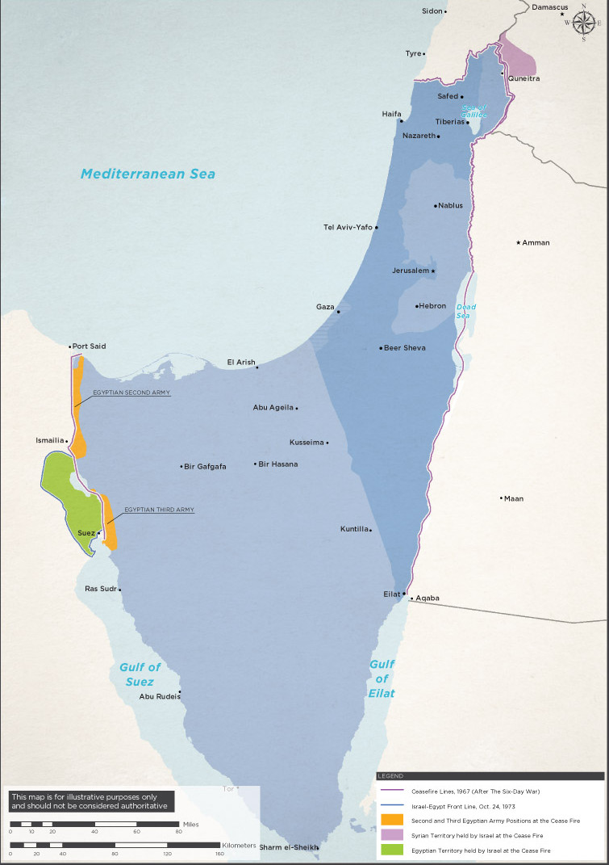
1968
=

Slide 5
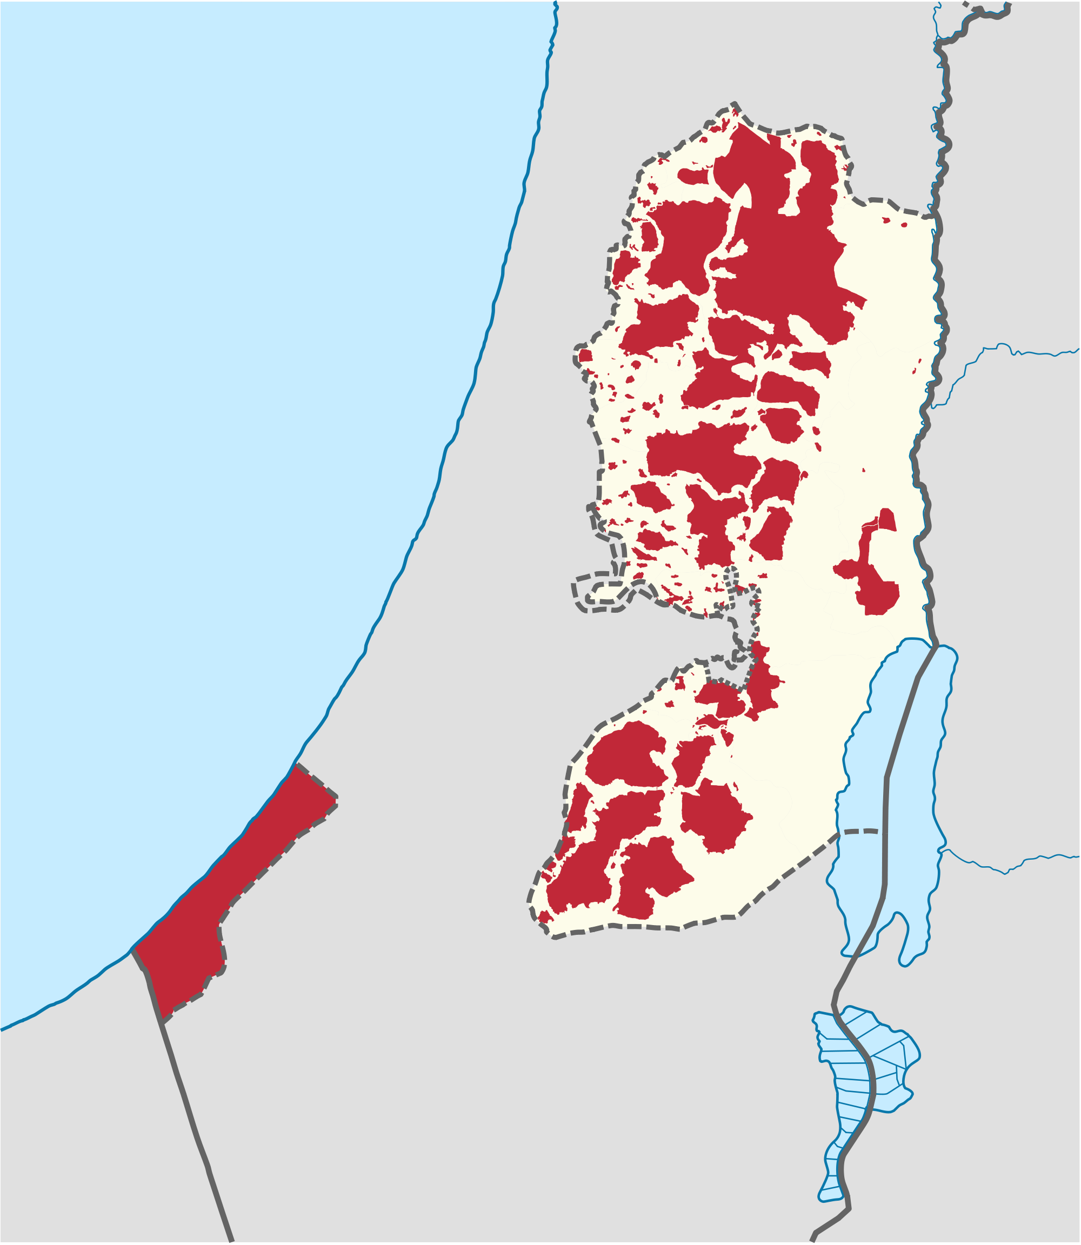
1995

Slide 6
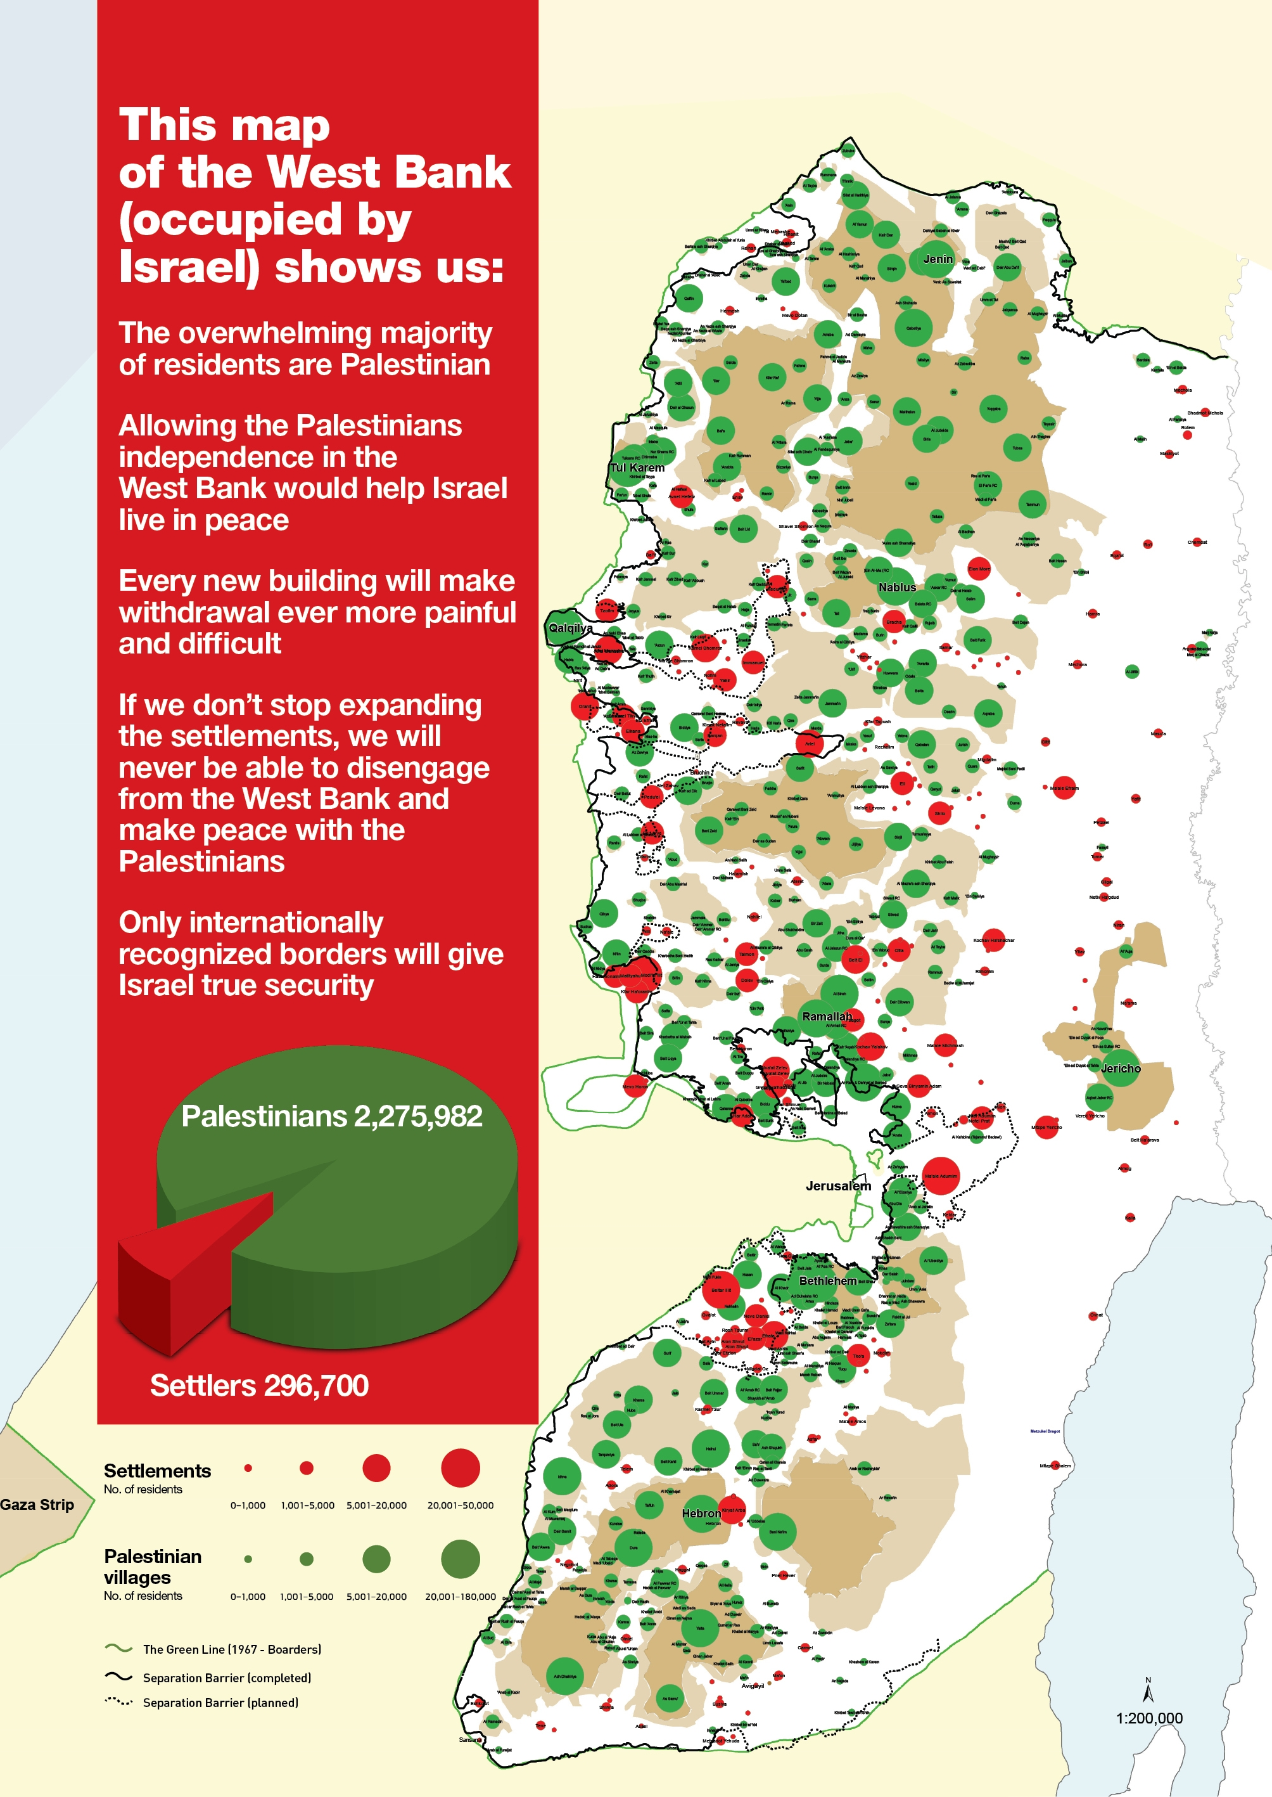
2011

Slide 7
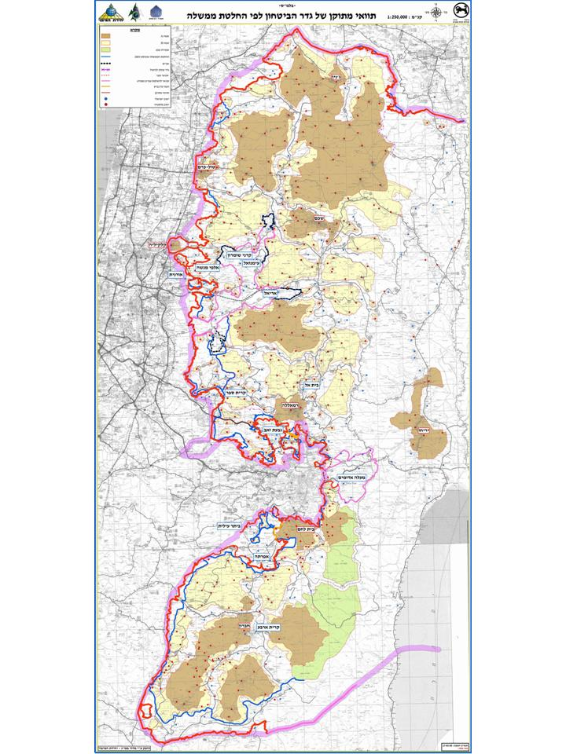
The Wall

Slide 8
Security or Greed?

Slide 9
Agent Based
Modeling

Slide 10

Palestinian
Pv_{i,j}(t)=(1−exp[−k(1−π)(ψ)(1−λ)])
_{π - Level of Freedom : = 1−}∑ settler neighbors ,barrier neighbors
neighbors
Ψ – Anger
λ – Blockage

Slide 11

Settler
Vs – Violent rate
Es – Expansion rate

Slide 12

Wall
r = 1+Gr
Palestinian relocation

Slide 13
Demo

Slide 14
Results

Slide 15
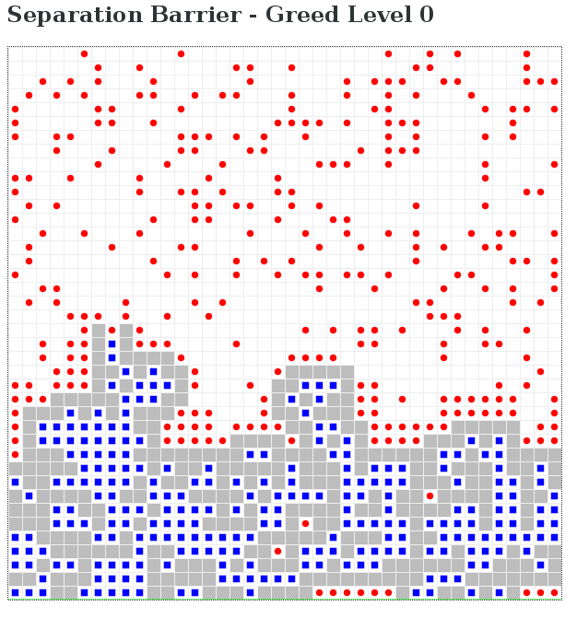
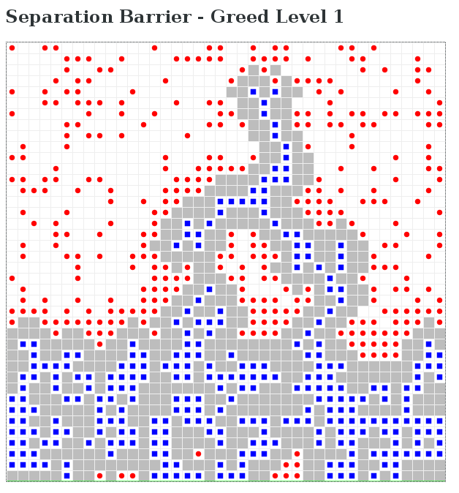
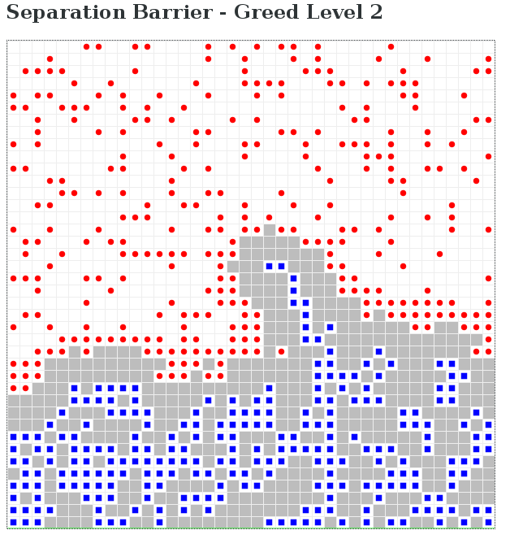
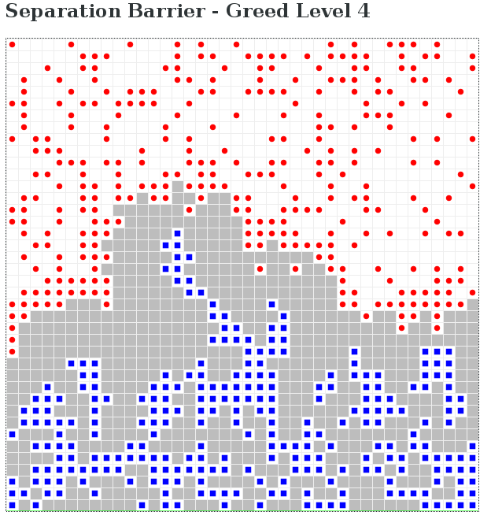
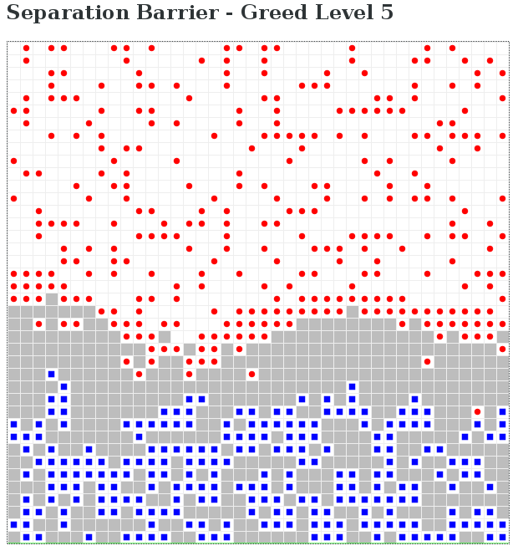
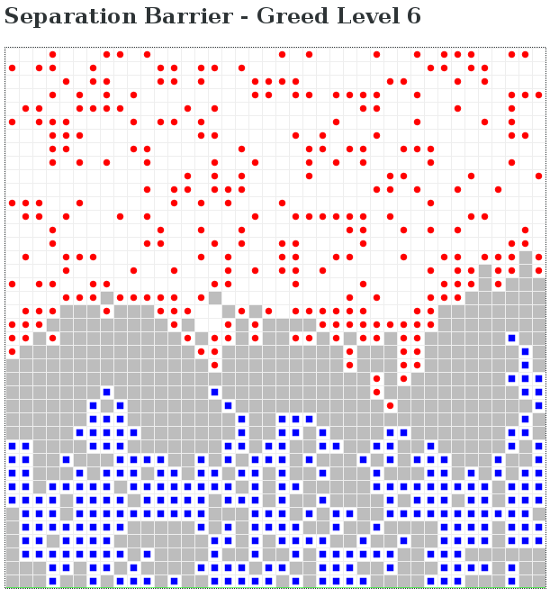

Slide 16
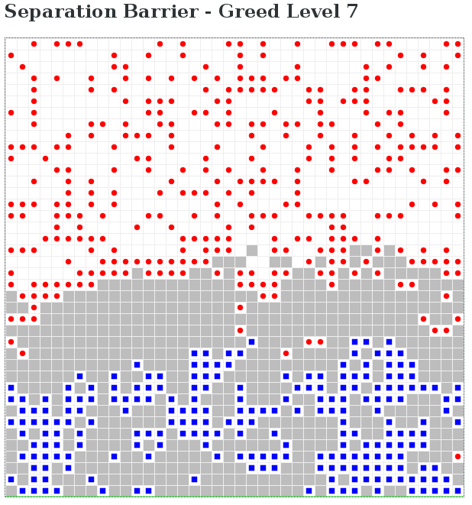
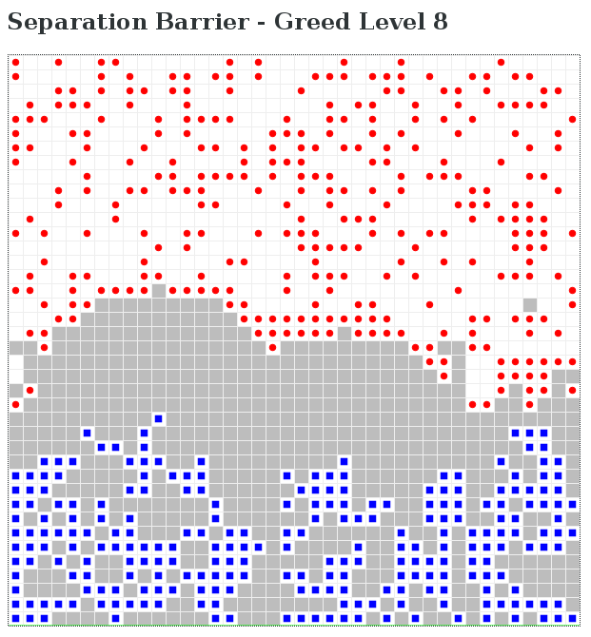
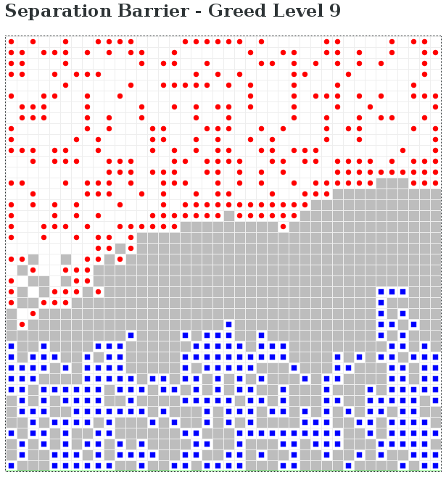
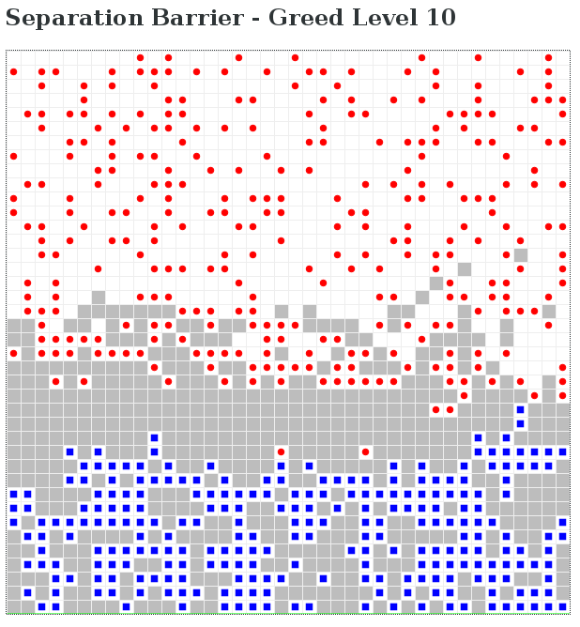

Slide 17
