Slide 1

The Art of Computer Simulations
Case Study: Dynamics of the Israeli-Palestinian Separation Barrier
Avner Peled

Slide 2
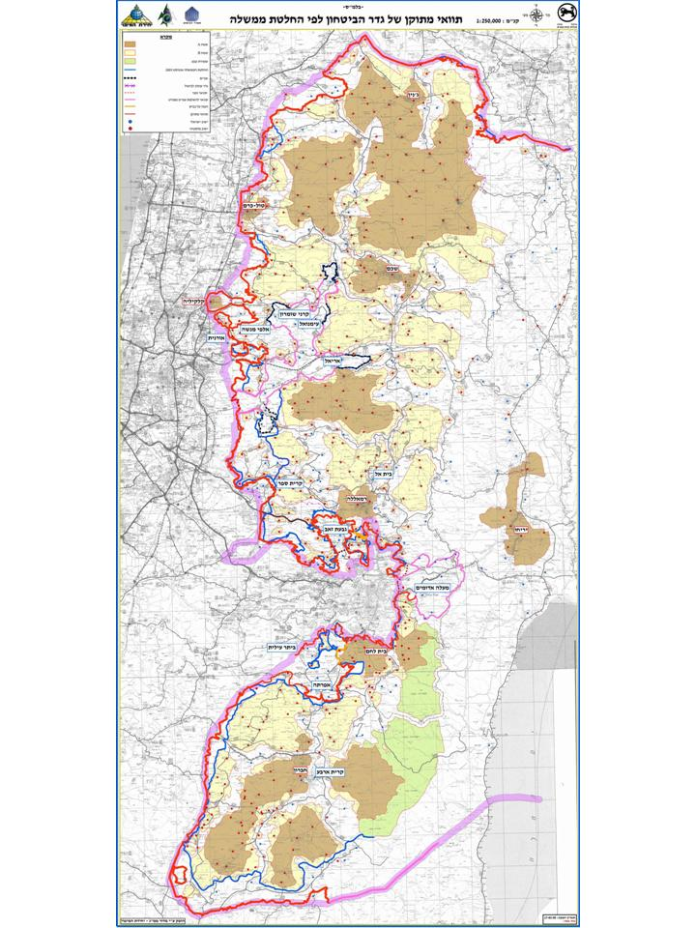
The Wall

Slide 3
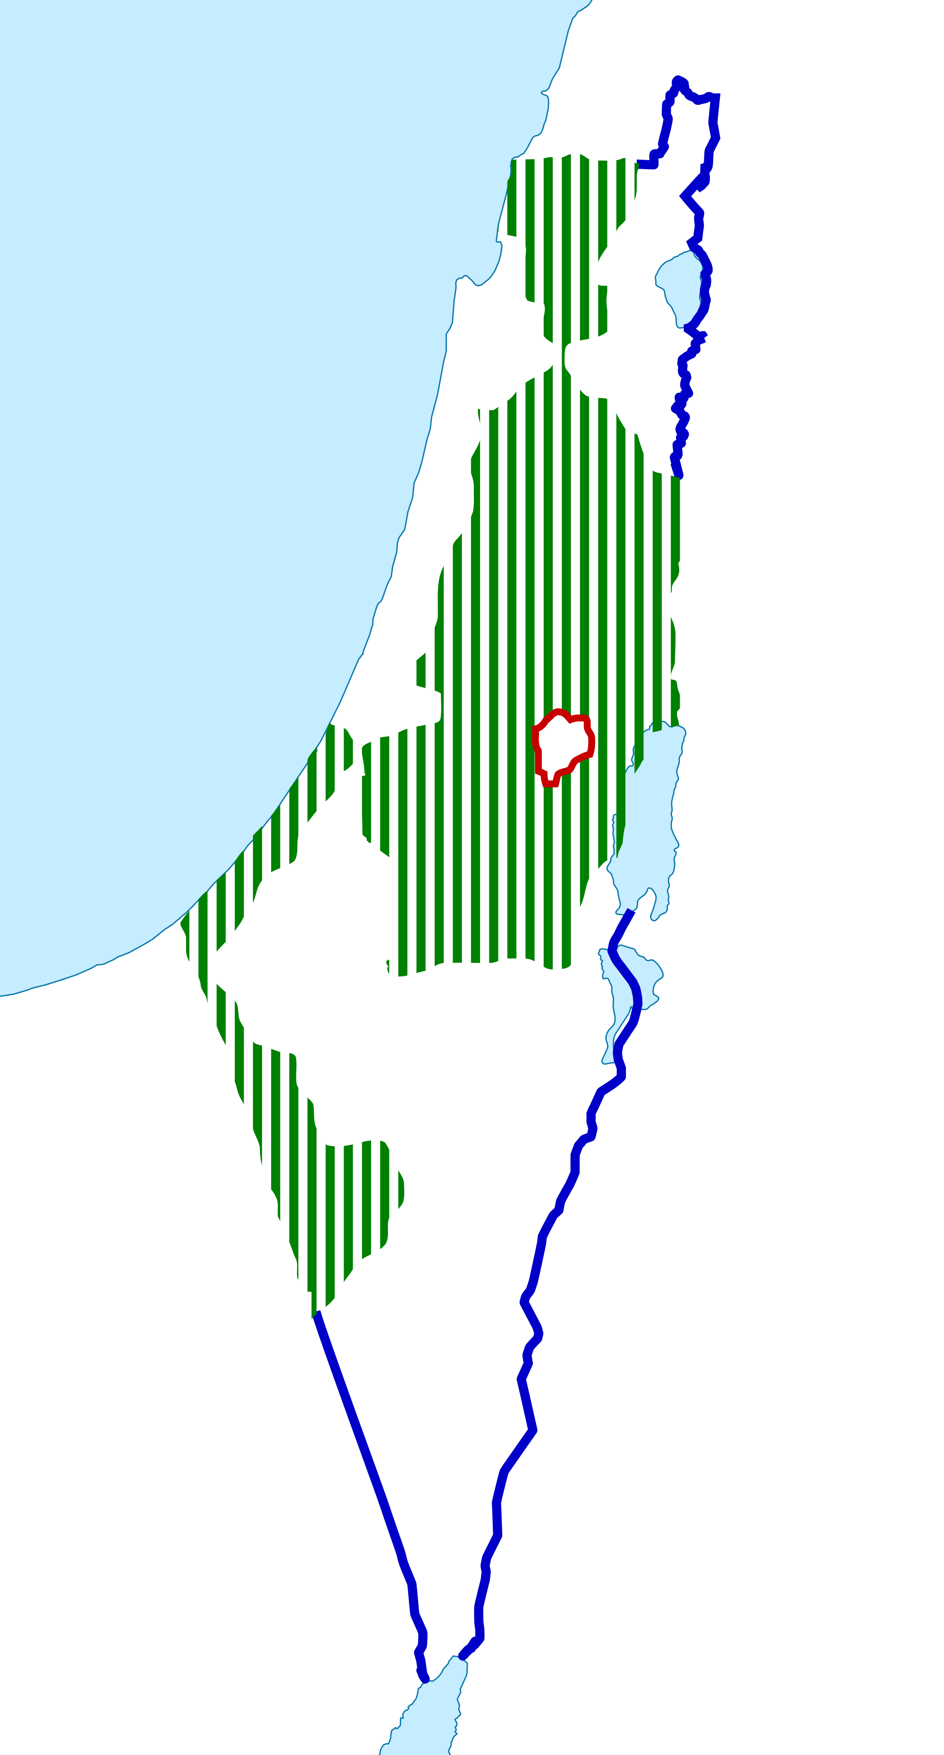
Security or Greed?

Slide 4
Agent Based
Modeling

Slide 5

Palestinian
Pv_{i,j}(t)=(1−exp[−k(1−π)(ψ)(1−λ)])
_{π - Level of Freedom : = 1−}∑ settler neighbors ,barrier neighbors
neighbors
Ψ – Anger
λ – Blockage

Slide 6

Settler
Vs – Violent rate
Es – Expansion rate

Slide 7

Wall
r = 1+Gr
Palestinian relocation

Slide 8
Demo

Slide 9
Results

Slide 10
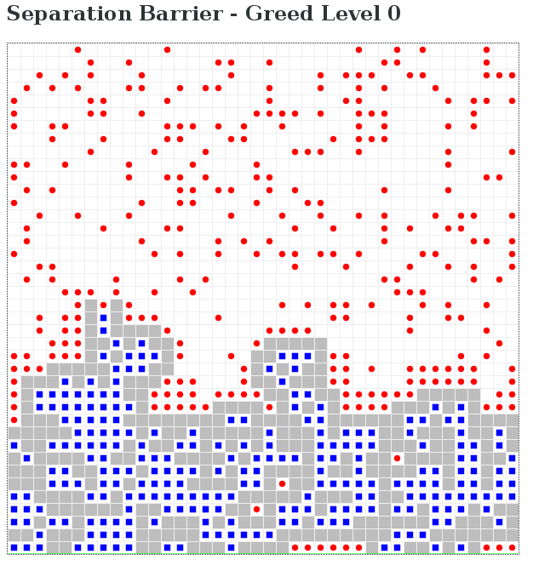
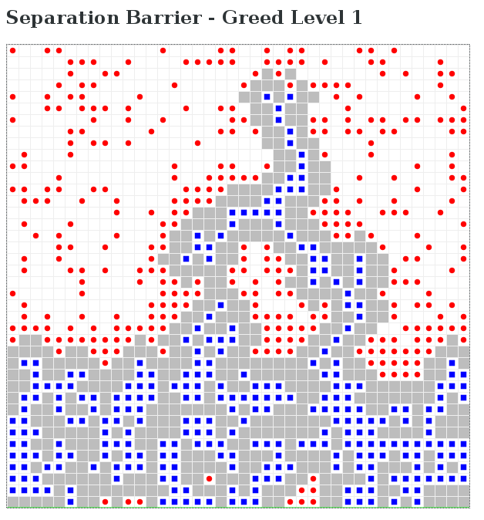
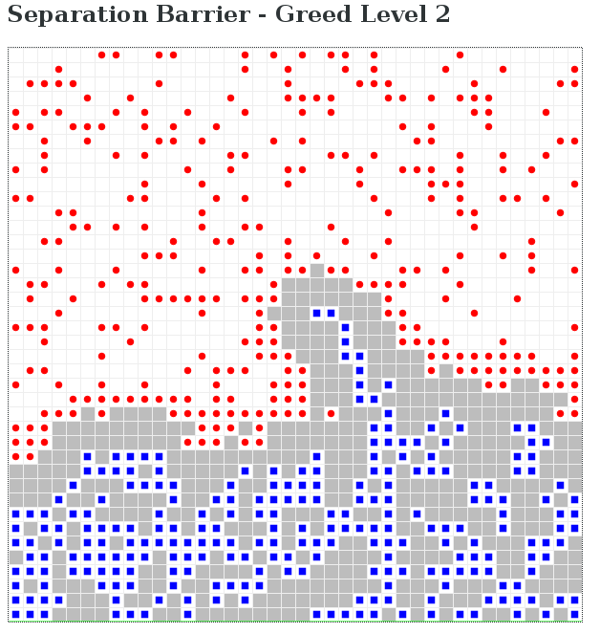
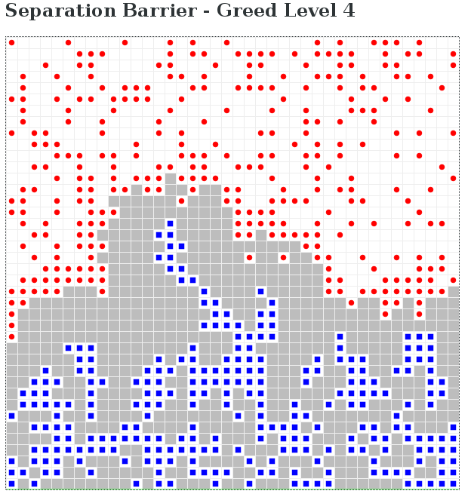
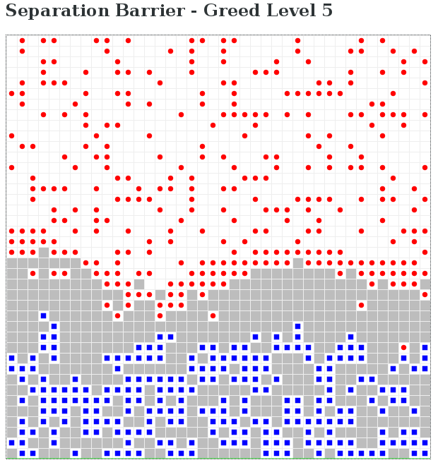
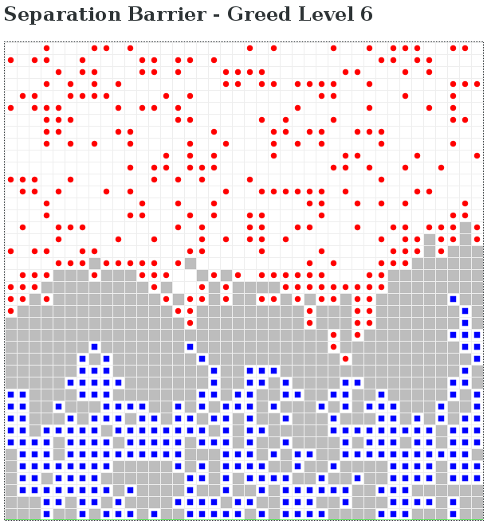

Slide 11
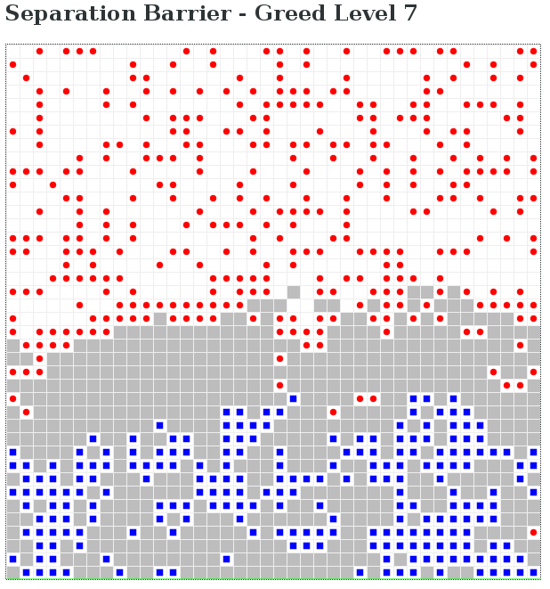
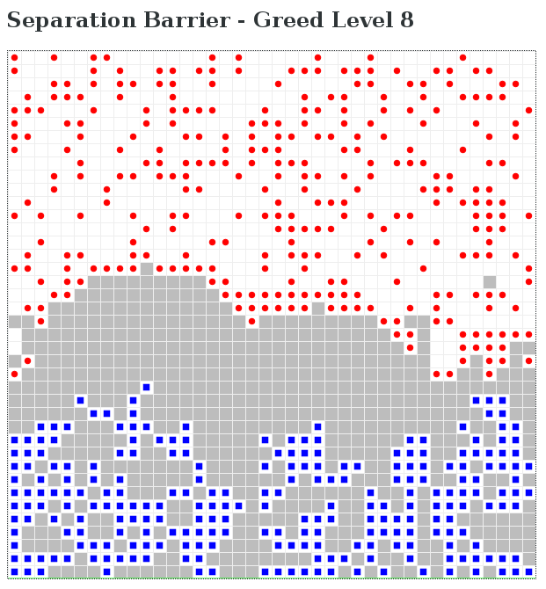
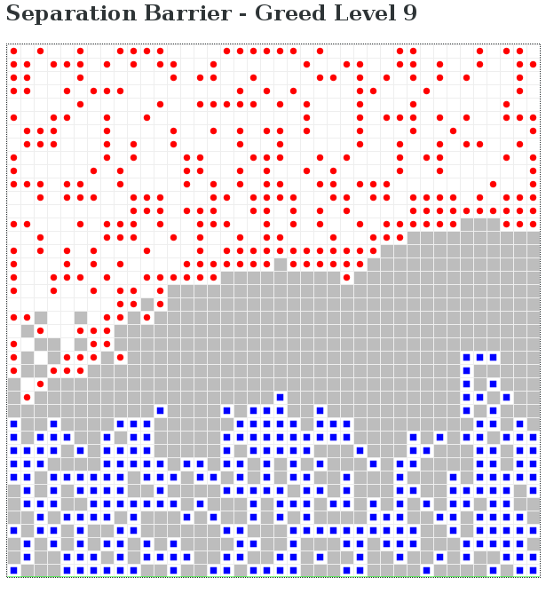
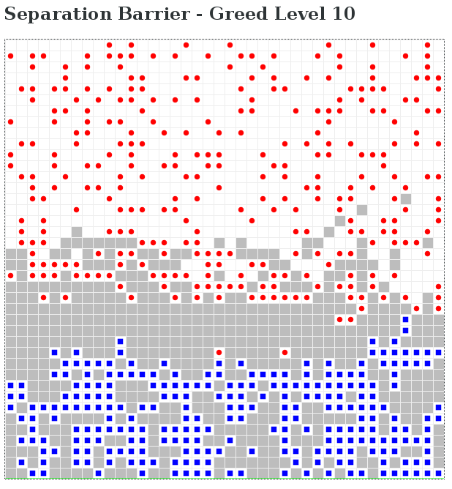

Slide 12
