Slide 1

VQA: Visual Question Answering
Presented by:
Avni Mehta
Trinadha Raji Muppala
Ref: VQA: Visual Question Answering {santol, aish, jiasenlu, dbatra, parikh}@vt.edu 2 {memitc, larryz} @microsoft.com
Notes:
1

Slide 2
Roadmap
Introduction
Related Work
Dataset Collection
Dataset Analysis
Baseline and Methods
Conclusion

Slide 3
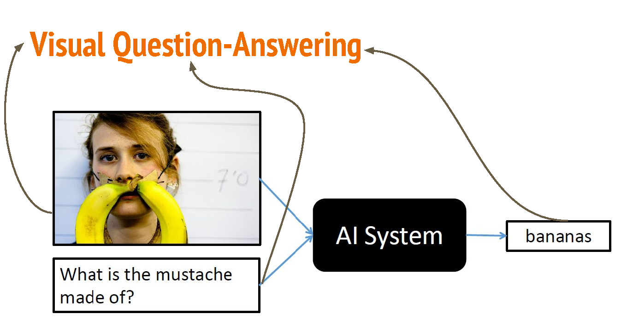
Introduction

Slide 4
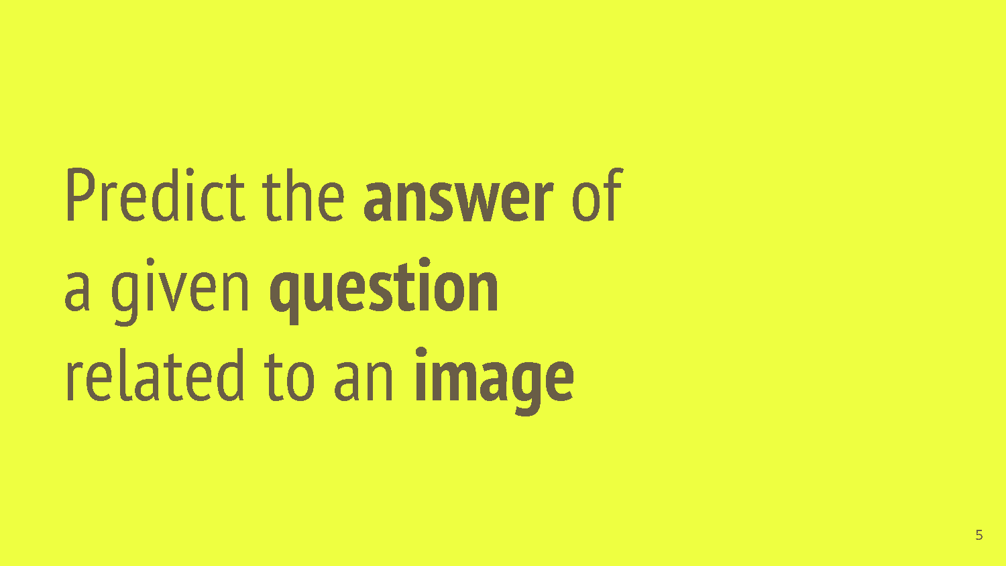
Introduction

Slide 5
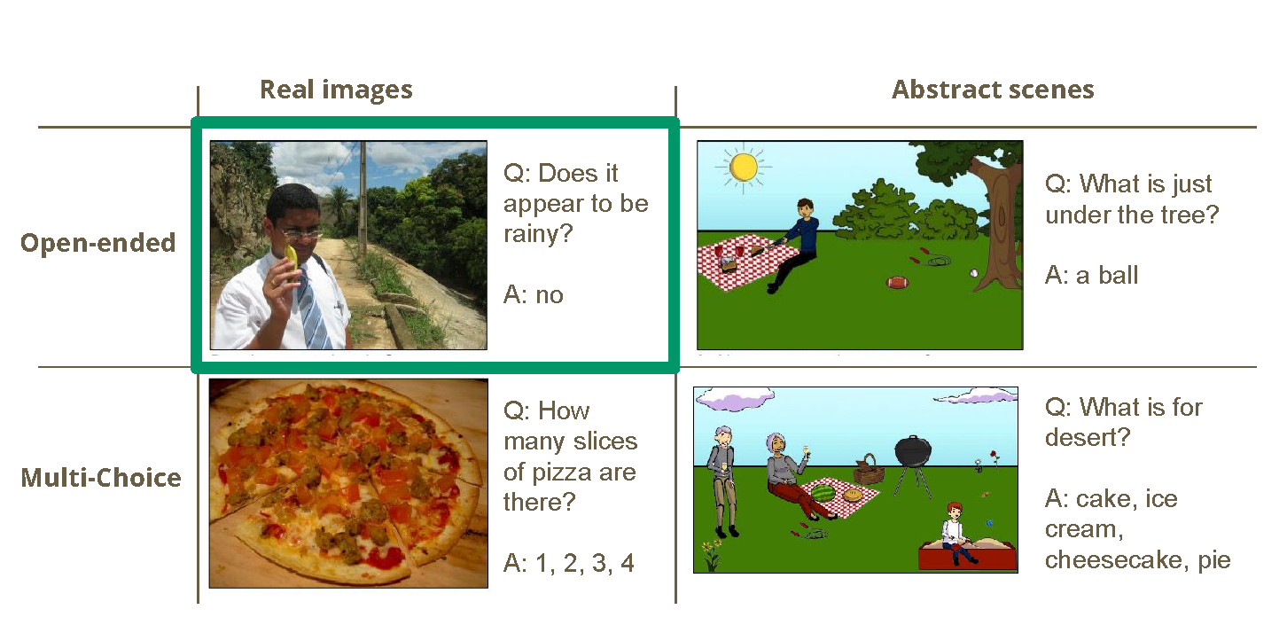
Visual Question-Answering Types

Slide 6
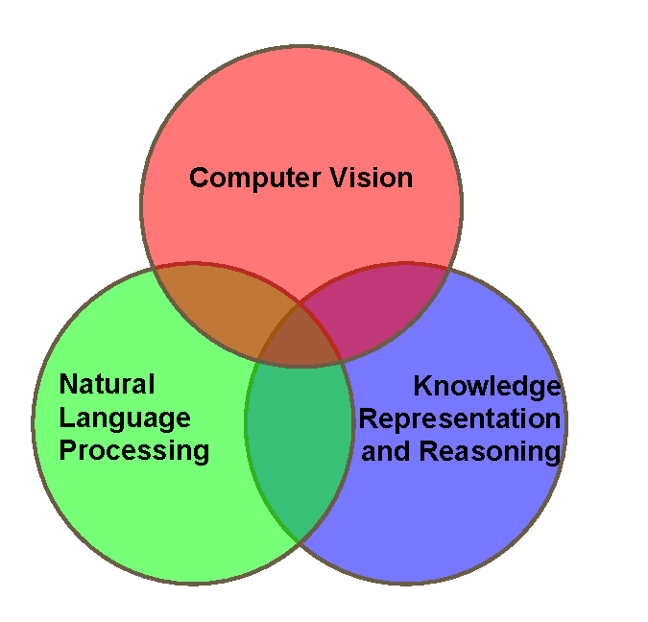
Motivation
Multi-disciplinary task
Models need to tackle different sub-tasks at once.

Slide 7
Roadmap
Introduction
Related Work
Dataset Collection
Dataset Analysis
Baseline and Methods
Conclusion

Slide 8
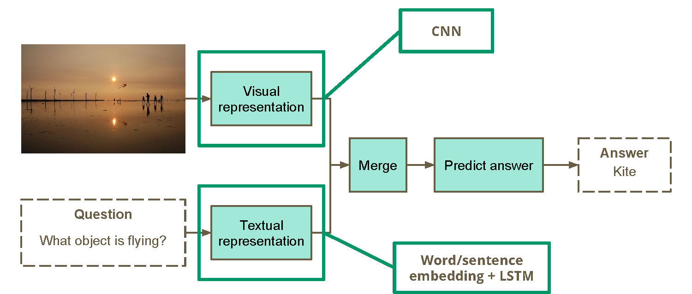
VQA Common Approach

Slide 9
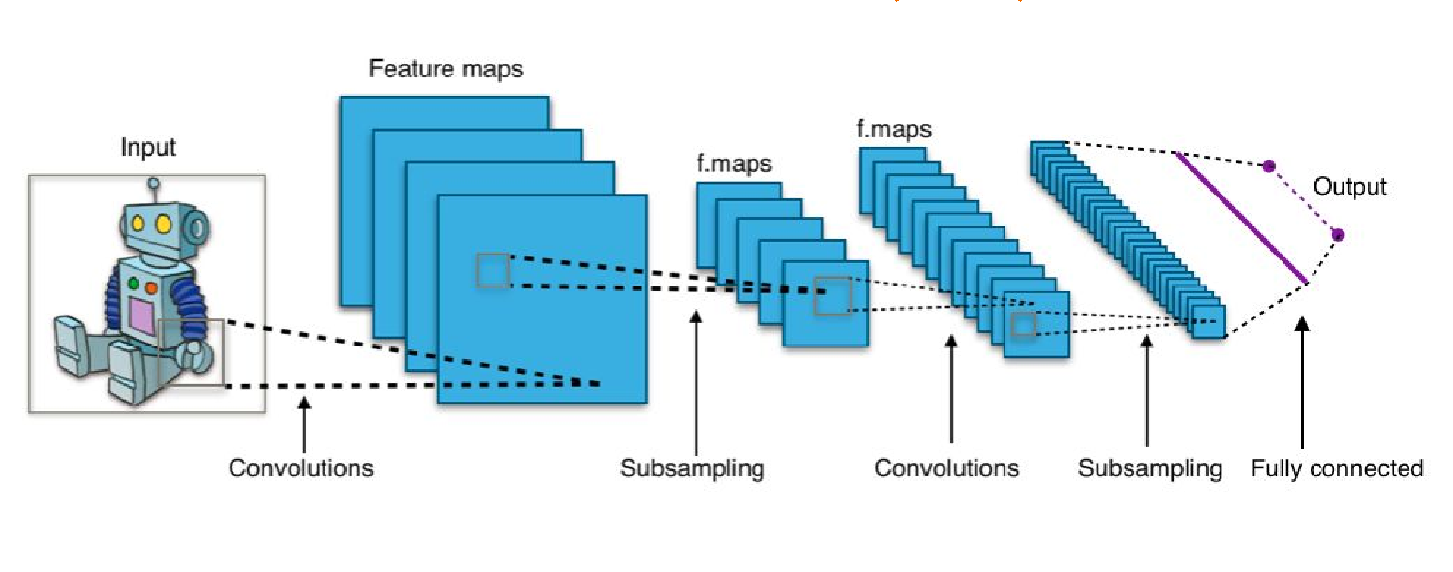
Tools: Convolutional Neural Networks

Slide 10
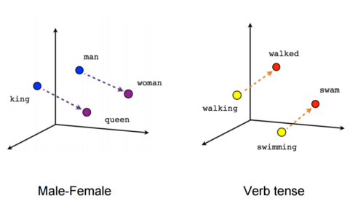
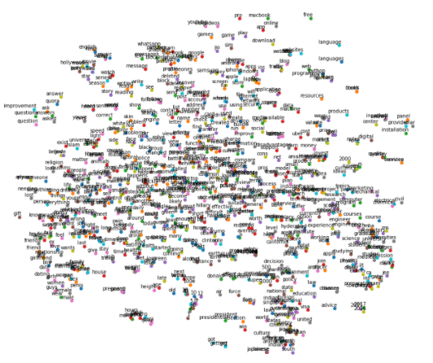
Tools: Word and Sentence Embedding
King – Man + Woman = Queen
Ref: https://www.quora.com/What-is-word-embedding-in-deep-learning
https://medium.com/data-science-group-iitr/word-embedding-2d05d270b285

Slide 11
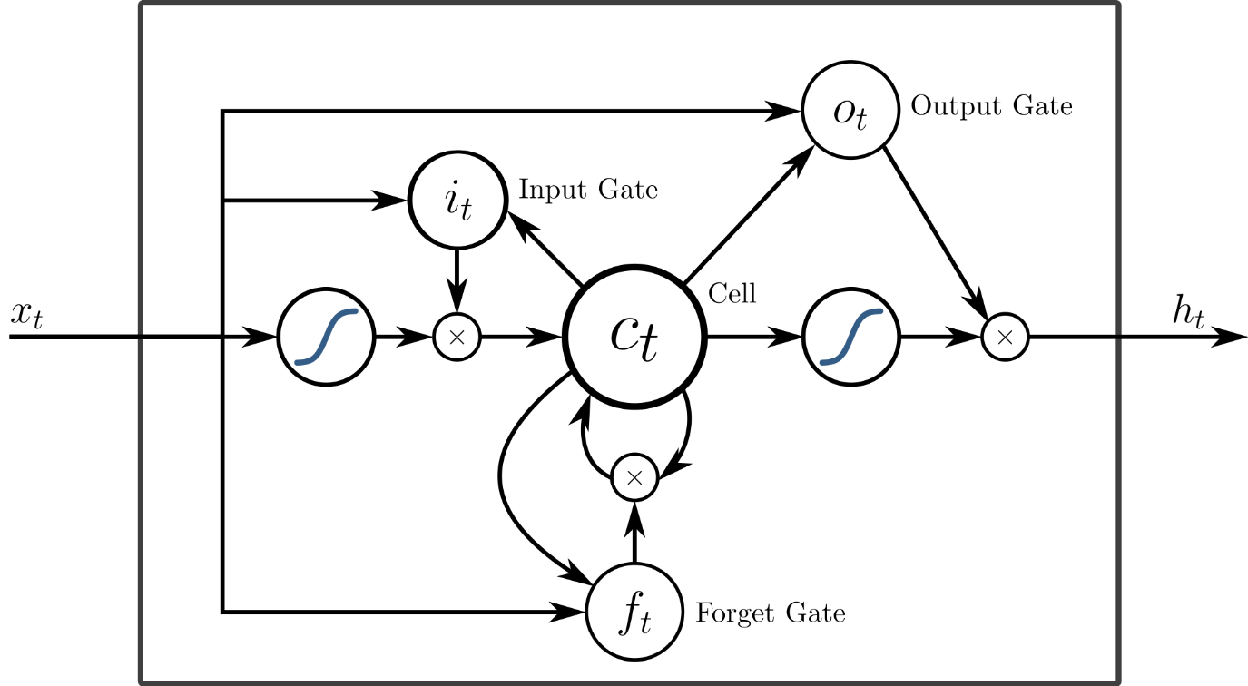
Tools: Long Short Term Memory
Ref: https://en.wikipedia.org/wiki/Long_short-term_memory

Slide 12
Roadmap
Introduction
Related Work
Dataset Collection
Dataset Analysis
Baseline and Methods
Conclusion

Slide 13
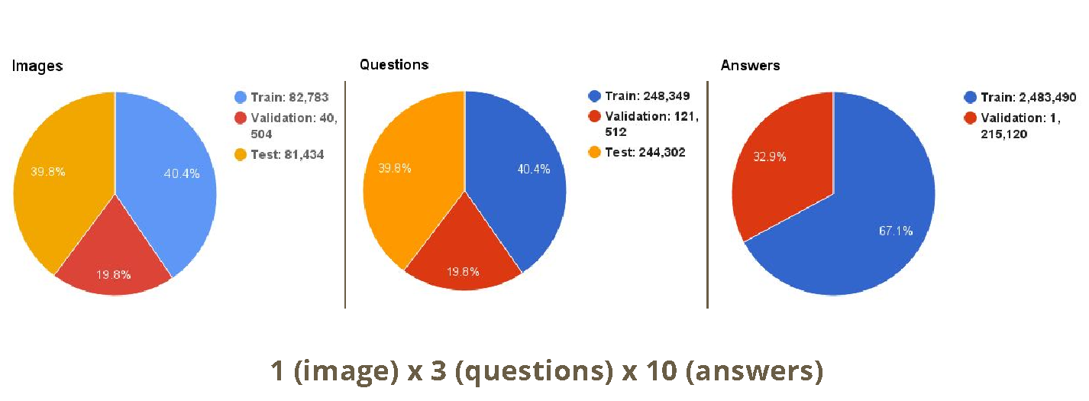
Dataset
MS COCO Dataset
~205K Images, ~615K Questions and ~3700K Answers

Slide 14
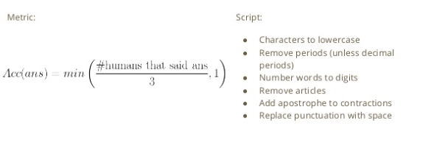
Dataset Continue
Questions
“smart robot” interface used to elicit the most interesting and diverse questions for both the real images and abstract scenes.
Testing evaluation answer

Slide 15
Dataset Continue
Questions
“smart robot” interface used to elicit the most interesting and diverse questions for both the real images and abstract scenes.
Answers Evaluation

Slide 16
Roadmap
Introduction
Related Work
Dataset Collection
Dataset Analysis
Baseline and Methods
Conclusion

Slide 17
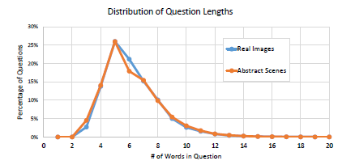
Dataset Analysis
Most questions range from four to ten words
Variety of question types, including “What is. . .”, “Is there. . .”, “How
many. . .”, and “Does the. . .”.

Slide 18
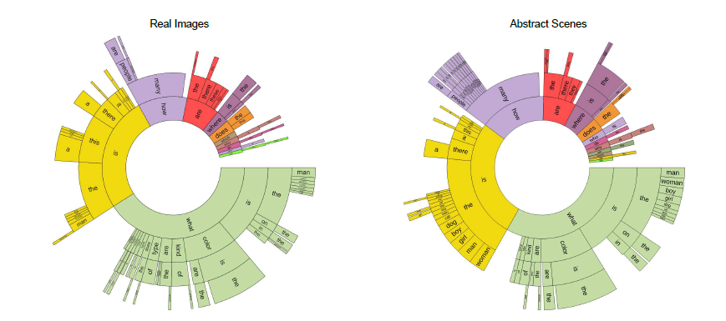
Dataset Analysis

Slide 19
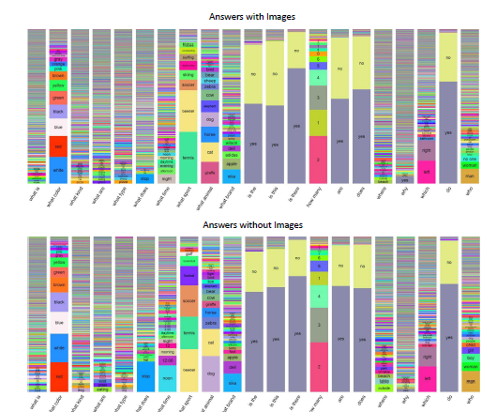
Dataset Analysis
“Is the ..”, “Are ..”, “Does .. “
“yes” and “no”
“What is. . . ” and “What type. . . ”
diversity of responses
“What color. . . ” or “Which. . . ”
more specialized responses
Most answers consist of a single word, with the distribution of answers containing one, two, or three words

Slide 20
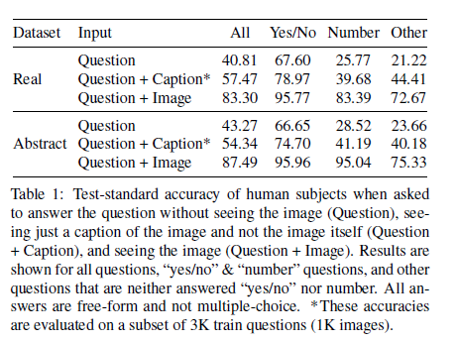
Dataset Analysis

Slide 21
Roadmap
Introduction
Related Work
Dataset Collection
Dataset Analysis
Baseline and Methods
Conclusion

Slide 22
Baseline and Methods
Experiment with 2 models
Multi-layer perceptron (MLP) neural network classifier with 2 hidden layers and 1000 hidden units (dropout 0.5) in each layer with tanh non-linearity
LSTM model followed by a softmax layer to generate the answer.

Slide 23
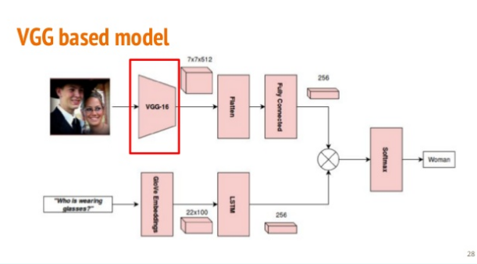
Baseline and Methods

Slide 24
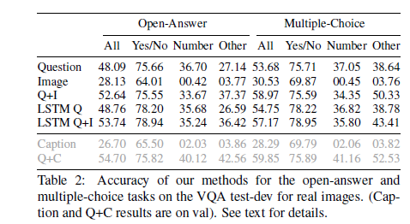
Baseline and Methods
The accuracy of VQA best model (LSTM Q+I, selected using
VQA test-dev accuracies) on VQA test-standard is 54.06%

Slide 25
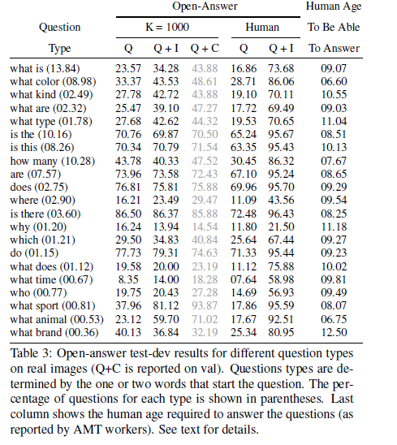
Baseline and Methods

Slide 26
Roadmap
Introduction
Related Work
Dataset Collection
Dataset Analysis
Baseline and Methods
Conclusion

Slide 27
Conclusion
Introduce the task of Visual Question Answering(VQA).
Given an image and an open-ended, natural language question about the image, the task is to provide an accurate natural language answer.
Dataset containing over 250K images, 760K questions, and around 10M answers.
Set up an evaluation server and organize an annual challenge and an associated workshop to facilitate systematic progress.
Demonstrate the wide variety of questions and answers in our dataset, as well as the diverse set of AI capabilities in computer vision, natural language processing, and commonsense reasoning required to answer these questions accurately.

Slide 28
References
https://www.slideshare.net/xavigiro/openended-visual-questionanswering
https://www.slideshare.net/xavigiro/visual-question-answering-20
https://arxiv.org/pdf/1702.01923.pdf

