Slide 1
Weapon Detection System
Paul Charles,
Trinadha Raji Muppala,
Avni Mehta,
Erich Thompson

Slide 2
Features
Login Page
Monitoring System
Displays live action footage from phone webcams
Shows four views, which include live and pre-recorded video
Threat notifying system
Sends a text message to admin when it identifies a threat
Statistics
Confusion matrix formatted statistics
Includes accuracy, precision, recall
Activity View
Shows recent activity obtained from a database
Machine Learning Modeling for Identification
Incorporated Inception model to classify the activity form the video frames

Slide 3
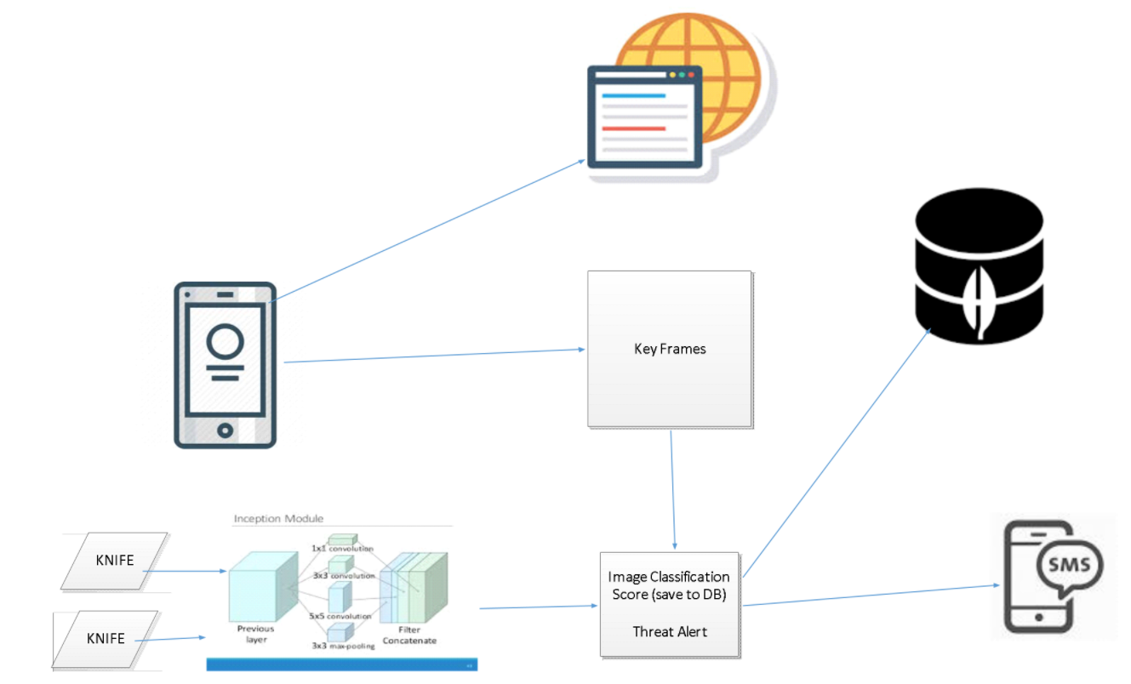
Architecture

Slide 4






Technologies
Component | Technology
Monitoring Video System | IP Web camera application, Wifi connection, Python, OpenCV
Threat notifying System | Twilio API, SMS, mobile phone
Web Pages | HTML, AngularJS, JavaScript, CSS, MongoDB
Machine Learning Identification Model | TensorFlow, NumPy

Slide 5
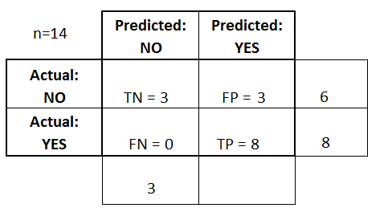
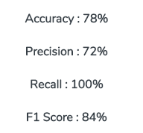
Statistics

