Slide 1
Task 3 – Walmart Sales Dashboard
By: Avni Singh

Slide 2
Objective & Dataset Overview
Objective:
Design an interactive dashboard for Walmart stakeholders to analyse weekly
sales performance.
Dataset:
Walmart Weekly Sales (CSV format)
Fields used:
Store, Date, Weekly Sales, Holiday Flag, Temperature, Fuel Price, CPI and
Unemplyoment
Tools Used:
Tableau Public, GitHub and PowerPoint

Slide 3
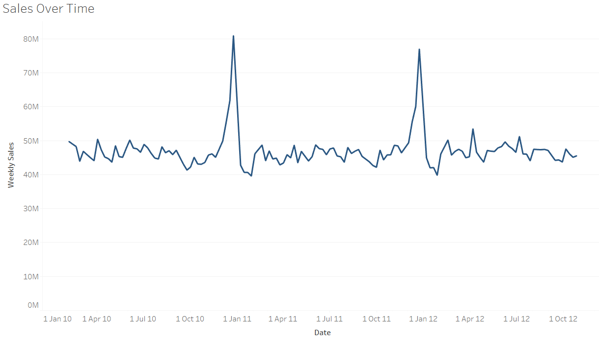
KPIs Followed & Visualizations Prepared
Line Chart – Weekly Sales Over Time

Slide 4
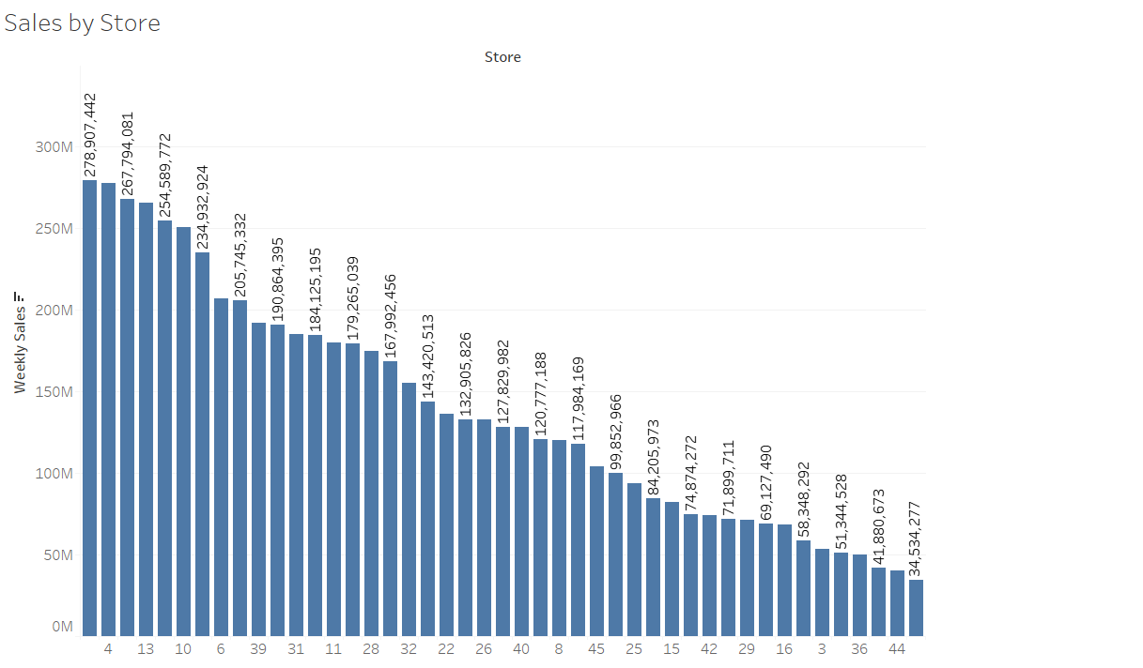
Bar Chart – Total Sales by Store

Slide 5
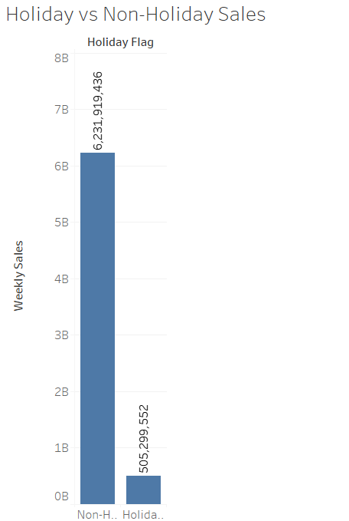
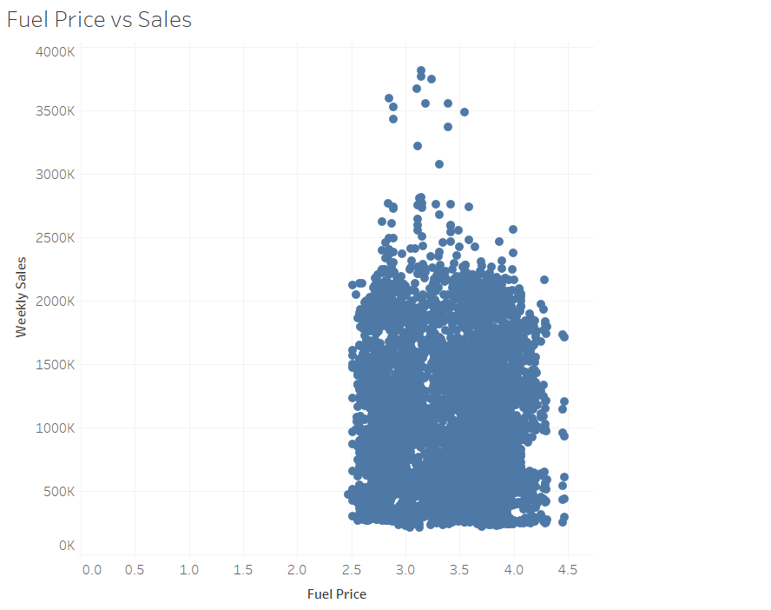
Bar Chart – Holiday vs Non-Holiday Sales
Scatter Plot – Fuel Price vs Weekly Sales

Slide 6
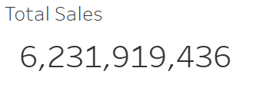
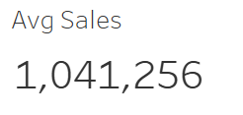
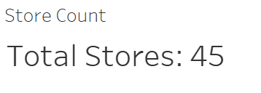
Critical KPIs:

Slide 7
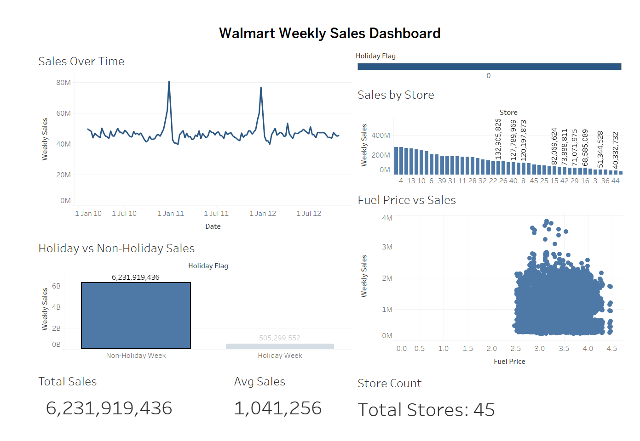
Final Dashboard View

Slide 8
The dashboard enables filtering by Holiday Flag and Store. It gives a precise picture of weekly performance, store comparison, and trend analysis.
View Online: https://public.tableau.com/app/profile/avni.singh7639/viz/Task3_17509420177800/Dashboard1?publish=yes

Slide 9
Insights & Learnings
Key Insights: - Store 20 had the highest total sales in the dataset. - Holiday weeks were slightly greater than non-holiday weeks in terms of sales. - No significant correlation between fuel price and sales. - Sales were greatest in and around the month of November.
Learnings: - How to effectively plot data using Tableau - How to create KPI cards and use filters/slicers - How to narrate a story through data using dashboards

