Slide 1
Higgs-Boson Classifier Web App
ML Deployment on AWS EC2
Avnish Dubey

Slide 2
Problem Statement
Predict Higgs-Boson particle outcomes from physics dataset
Automated ML pipeline for predictions
Save results automatically to output/prediction.csv

Slide 3
Dataset / Input
Features: 28+ numerical features per sample
Input format: CSV

Slide 4
Machine Learning Models
Models trained offline:
XGBoost Classifier → Best accuracy
Random Forest Classifier → Robust baseline
HistGB → Scaled performance
Logistic Regression → Simple baseline
Libraries: scikit-learn, xgboost, joblib, pandas, numpy

Slide 5
Model Prediction Function
Input: UserInputscreen
Output: Updated prediction.csv

Slide 6
Web App Architecture
[User JSON Input] → [Flask API] → [predict(input_json)] → [output/prediction.csv] → [User]
Flask handles requests
Absolute paths avoid file not found errors

Slide 7
AWS Deployment
EC2 Free Tier, Ubuntu 22.04
Python 3.11
Commands:
git clone <repo>
cd higgs-bosson
pip install -r requirements.txt
python3 app.py
Runs on port 5000, accessible via EC2 public IP

Slide 8
Key Features
Automatic prediction.csv update per run
Safe overwrite, error-free
Lightweight Flask API
User input → frontend integration

Slide 9
Challenges & Solutions
File path errors → Absolute path using os.path.join(BASE_DIR, ...)
Folder not present → os.makedirs(..., exist_ok=True)
Multiple models & prediction → predict(input_json) handles model loading & output
Dependencies mismatch → Fixed via requirements.txt

Slide 10
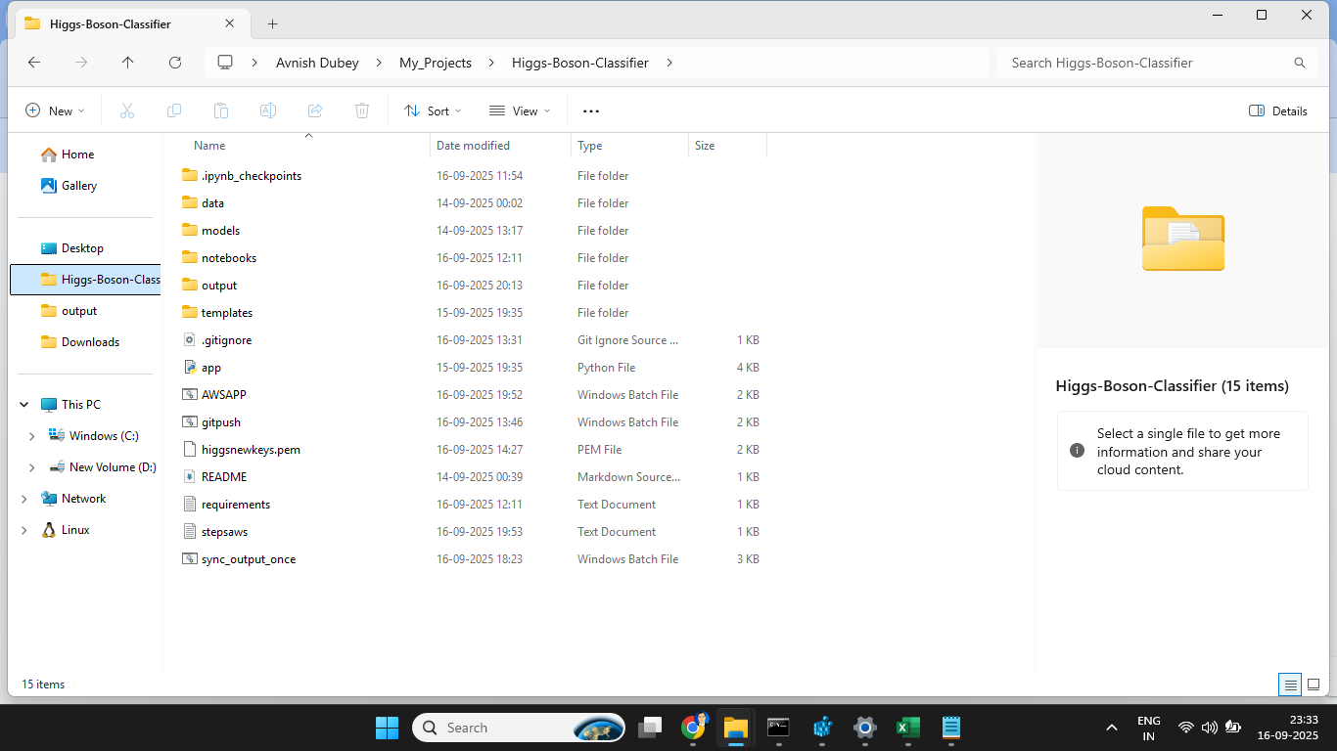
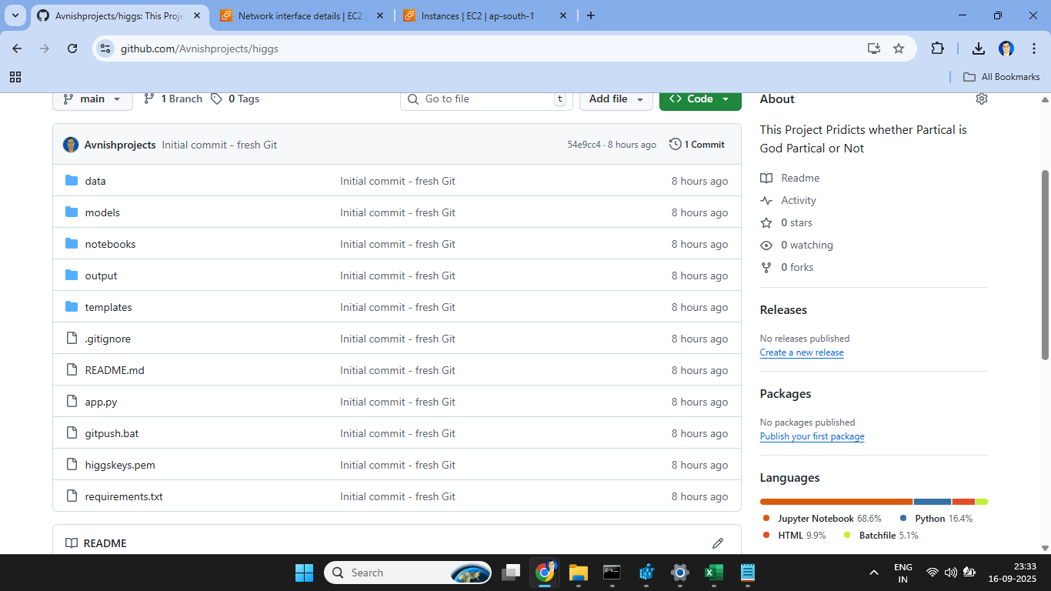
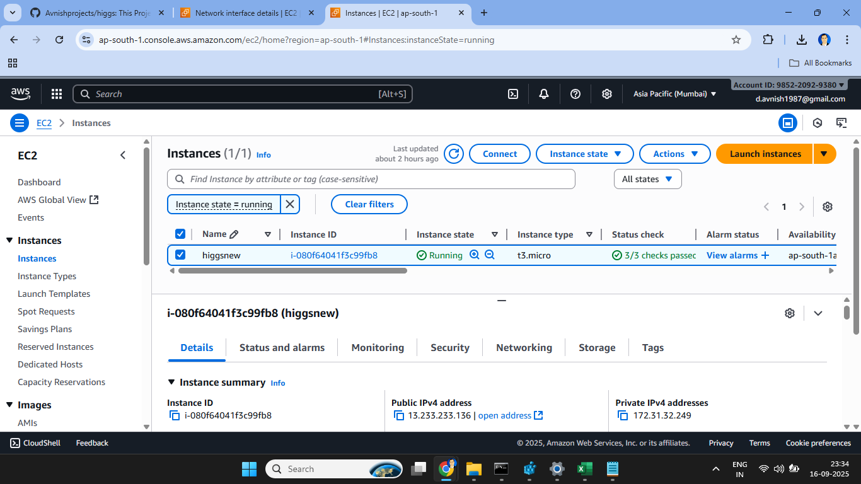
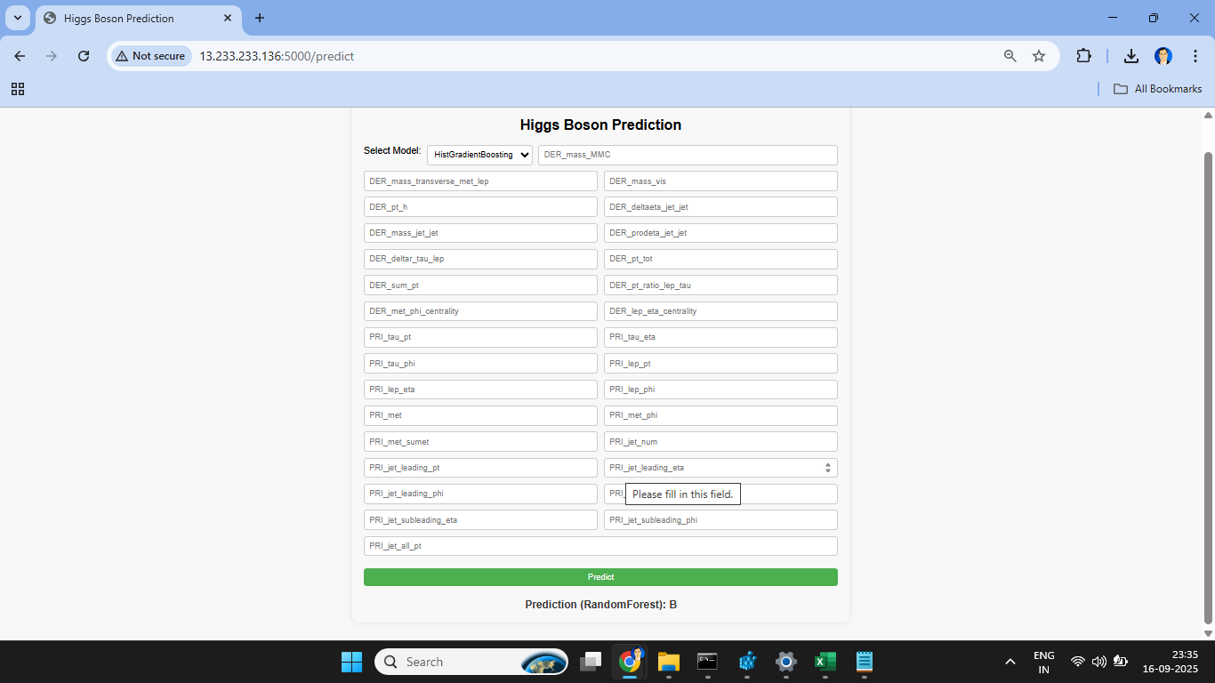
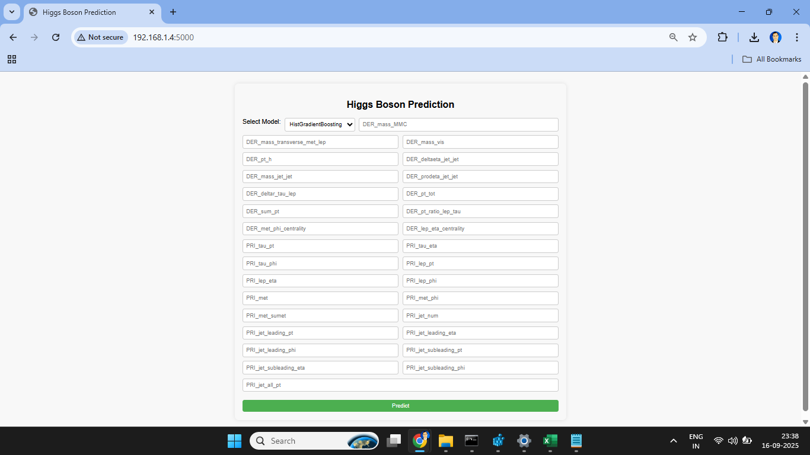
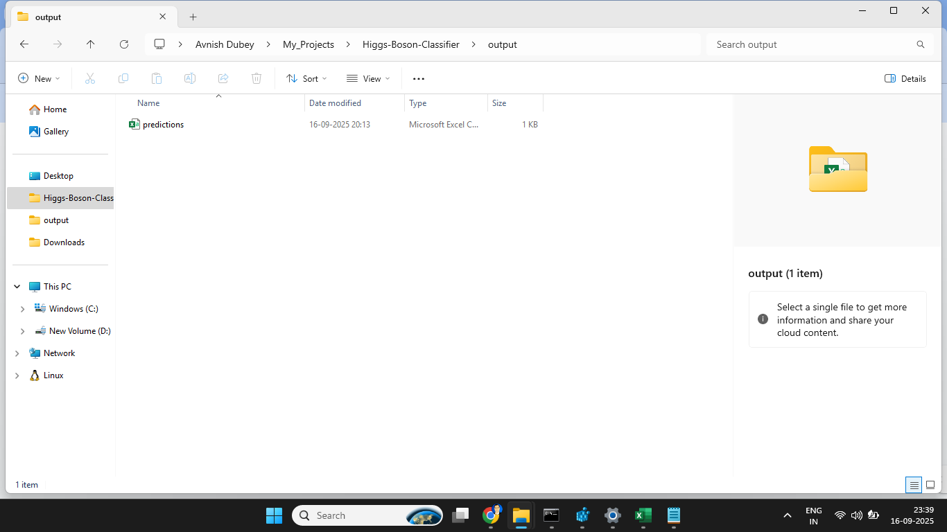
Screenshots

Slide 11
Conclusion
Automated Higgs-Boson predictions
All models can be used as primary model
Lightweight Flask app, deployable on AWS
Thank You

