Slide 1
Phase 1 - Defining a challenge/Good, Moderate and Bad

Slide 2
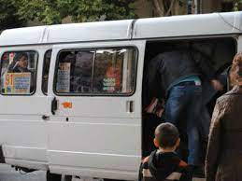
The BAD - Buses
Public buses in Yerevan can be very overcrowded, especially during rush hour. This can make it very uncomfortable for passengers and can also be dangerous.
There have been reports of people being pushed, shoved, and sexually harassed on public transport in Yerevan.
The city is often congested with traffic, and public transport vehicles can get stuck in traffic just like any other vehicle.
Sanitation: This is because the vehicles are not cleaned very often, and passengers can frequently track dirt and mud into the vehicles. This can be very unpleasant for passengers and can also be a health hazard.

Slide 3
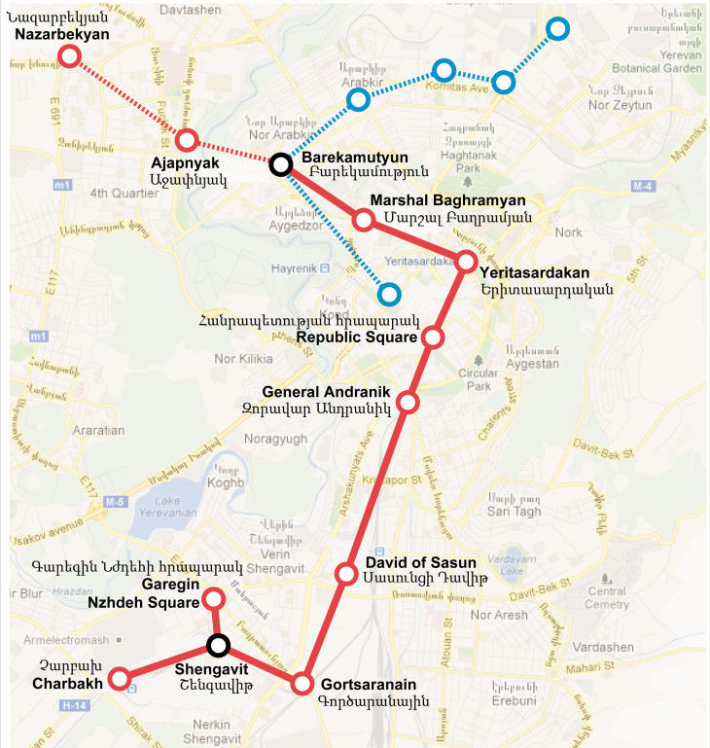
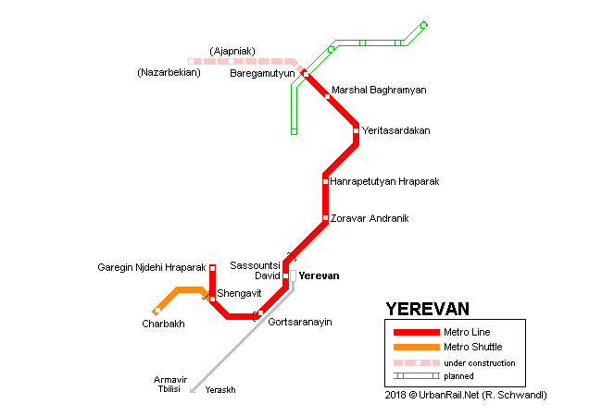
The Moderate - Metro
All stations have free wifi access and cell coverage. It's cool there during the hot summer months and warm in winter.
it is relatively fast, very cheap, a clean and safe way to travel, and an excellent way to avoid traffic congestion.
However, It has one huge disadvantage - the coverage is very inadequate for such a large city. A one-line metro system is not very comprehensive, as it does not manage to cover major parts of the town with its ten stations, resulting in difficulty trying to navigate to parts of the city.

Slide 4
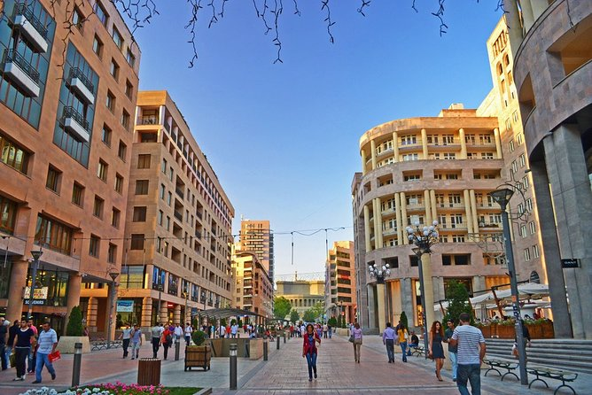
The Good - Walking!
The streets are generally well-paved and wide, making it easy to get around on foot. There are also plenty of sidewalks and pedestrian paths, so you can usually find a safe route to walk on. The city is also relatively flat, so you won't have to deal with too much uphill walking.

