Slide 1

GRITO LABS · IIT BOMBAY TECHFEST
Marketing Analytics & Attribution Framework
Multi-Channel Marketing Performance Analysis — evaluating Email, Social Media, Paid Search, and Display Ads using CTR, Conversion Rate, CPC, CAC, and ROAS to identify high-performing channels and optimize marketing budget allocation.

Slide 2
Objective & Dataset Overview
Objective
Dataset Overview
Analyze multi-channel marketing performance across Email, Social Media, Paid Search, and Display Ads using key marketing KPIs such as CTR, Conversion Rate, CPC, CAC, and ROAS.
The goal is to identify high-performing channels and provide data-driven recommendations for marketing budget optimization.
Marketing performance data includes:
Spend
Impressions
Clicks
Conversions
Revenue
Channels analyzed: Email, Social Media, Paid Search, Display Ads

Slide 3
Key Performance Summary
Overall marketing performance across all four channels demonstrates strong revenue generation with a healthy aggregate ROAS of 3.46x.
61,500
213,000
Total Spend
Total Revenue
Combined investment across all channels
Generated across all channels
1,720
3.46x
Total Conversions
Overall ROAS
Across all channels
Return on Ad Spend (approx)
KPIs Used
CTR (Click Through Rate)
Conversion Rate
CPC (Cost Per Click)
CAC (Customer Acquisition Cost)
ROAS (Return on Ad Spend)

Slide 4
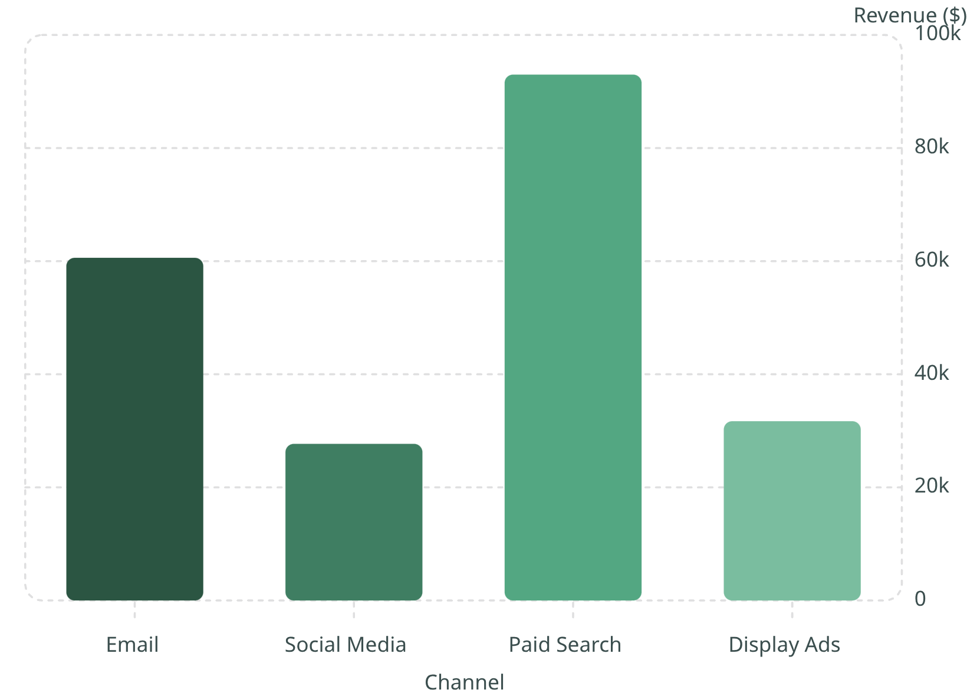
Revenue Analysis
Key Insights
Paid Search generates the highest revenue at 93,000, making it the strongest revenue-driving channel.
Email marketing follows with consistent high conversion-driven revenue.
Social Media and Display Ads contribute lower revenue comparatively, indicating optimization opportunities.

Slide 5
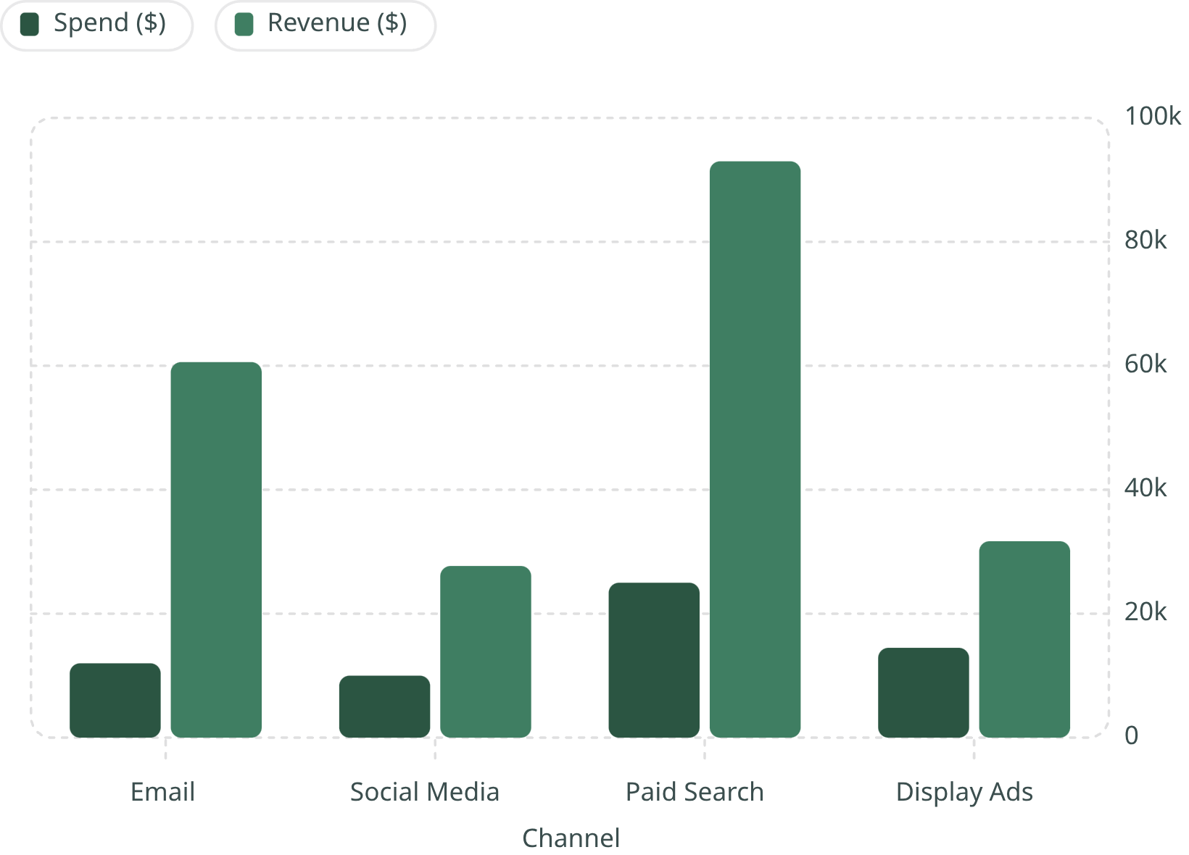
Spend vs. Revenue Comparison
Insights
Paid Search has the highest spend (25,000) but also delivers the highest revenue (93,000), indicating scale efficiency.
Email marketing shows strong revenue generation with relatively lower spend, making it highly cost-efficient.
Display Ads show low revenue relative to spend, indicating weak ROI.

Slide 6
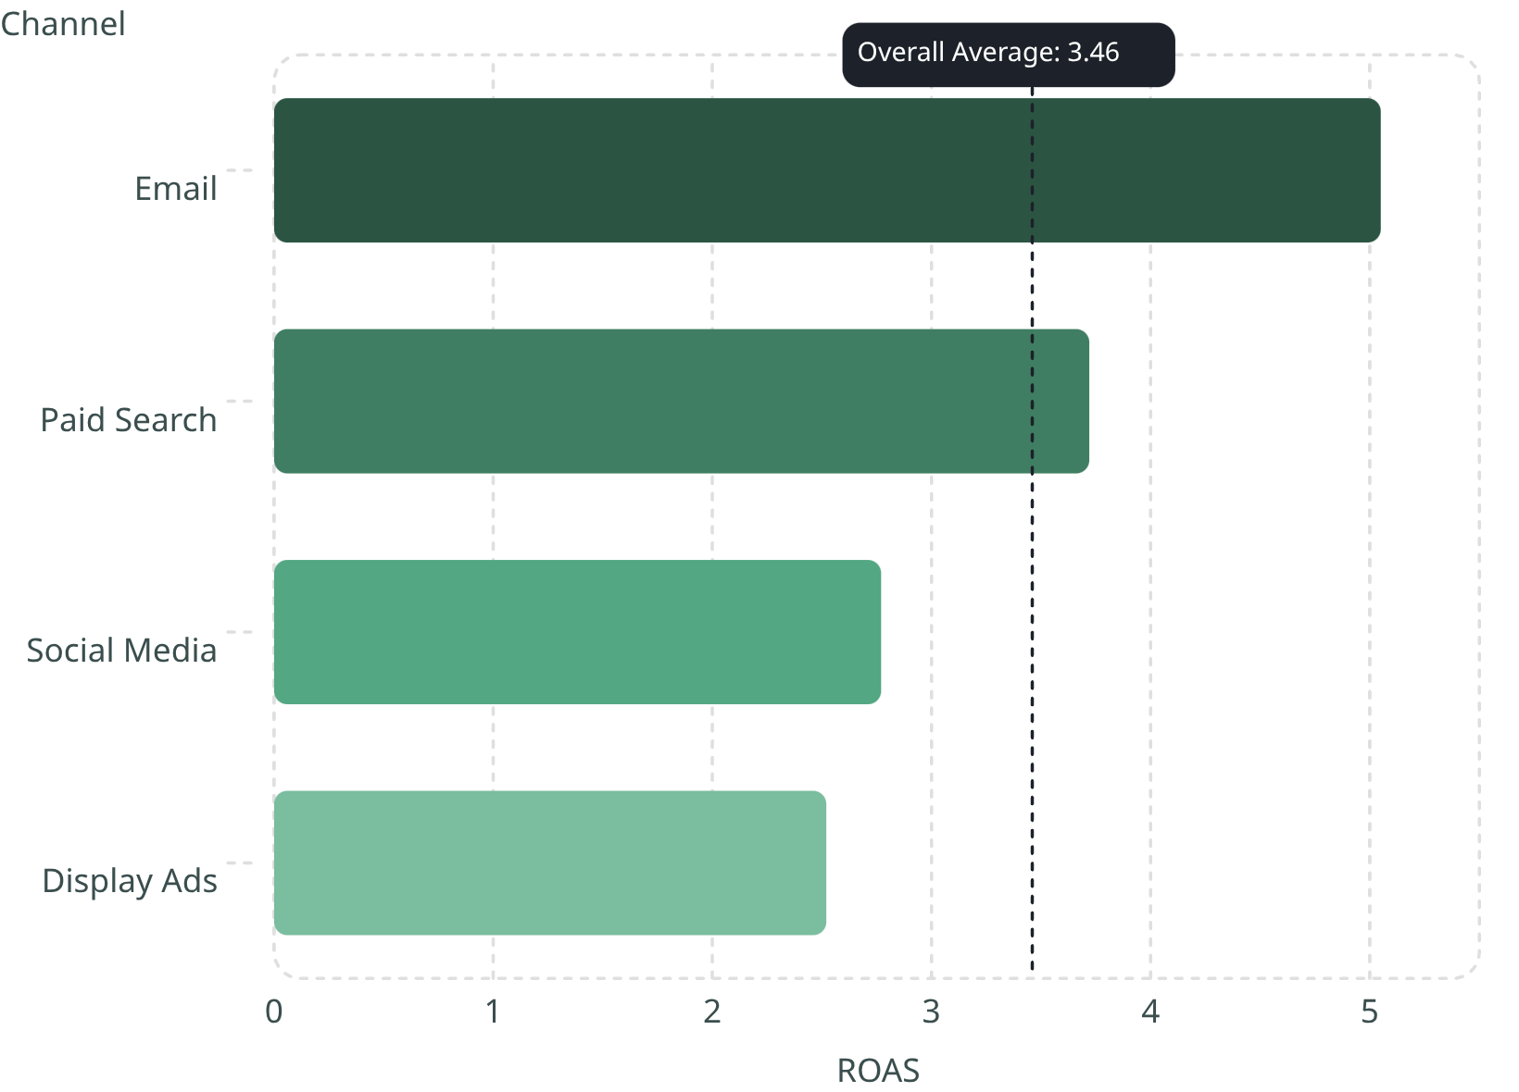
ROAS Analysis by Channel
ROAS Analysis
Email: 5.05 (Highest efficiency)
Paid Search: 3.72
Social Media: 2.77
Display Ads: 2.52 (Lowest efficiency)
Email marketing is the most efficient channel in terms of return on ad spend, while Display Ads require optimization or budget reduction.

Slide 7
Channel Insights
Each channel exhibits a distinct performance profile across efficiency, revenue contribution, and scale.
📧 Email
🔍 Paid Search
Most efficient marketing channel — highest ROAS at 5.05x with strong conversion-driven revenue.
Drives the highest revenue contribution at $93,000 with solid ROAS of 3.72x.
📱 Social Media
🖼️ Display Ads
Shows moderate performance across KPIs with room for targeting and conversion optimization.
Underperforms in terms of ROI and efficiency — lowest ROAS at 2.52x.

Slide 8


Recommendations
Based on the multi-channel performance analysis, the following strategic actions are recommended to optimize marketing budget allocation and improve overall ROI.
1
2
Increase Email Budget
Optimize Paid Search
Increase budget allocation for Email campaigns due to highest ROAS.
Optimize Paid Search campaigns for cost efficiency.
3
4
Reduce or Retarget Display Ads
Improve Social Media
Reduce or retarget Display Ads due to low ROI.
Improve Social Media targeting and conversion optimization.

Slide 9
Conclusion
This analysis demonstrates how marketing performance varies across channels. Data-driven insights enable better budget allocation, improved ROI, and more effective marketing strategy decisions.
Email and Paid Search emerge as the strongest performing channels in this analysis.
These findings underscore the importance of continuous performance monitoring and data-driven decision-making in multi-channel marketing strategy.

