Slide 1
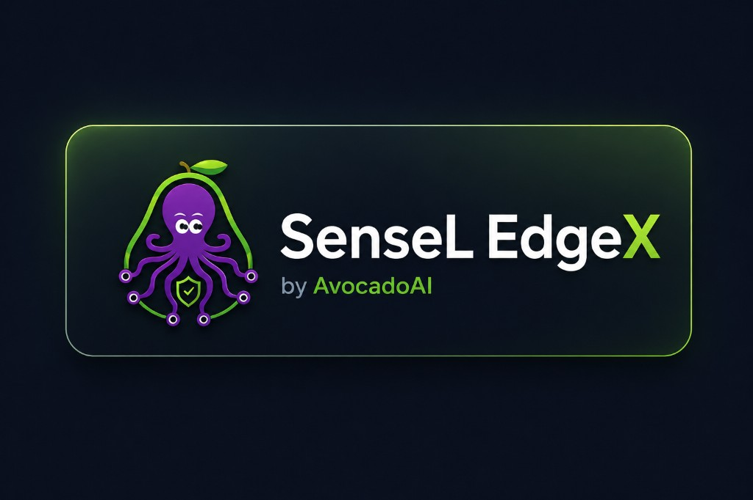
Avocado.ai
AI-native Security Validation
& OT Trust Platform
We turn threat intelligence, alerts and AI red-team automation into verified defense outcomes — across IT and OT.
Strategic Angel / Seed Pitch
2026
AI-native · IT + OT · Trust Layer
Bigger story: Detect → Validate → Prove → Improve
Avocado.ai | SenseL Investor Pitch

Slide 2
Problem
Security teams are overwhelmed — and OT is the blind spot
Enterprises don't need another dashboard. They need a validation loop that connects intelligence, alerts, evidence and improvement — including OT.
1
Fragmented signals
2
Non-actionable CTI
3
Unproven controls
4
OT trust gap
EDR, NDR, WAF, firewall and OT logs do not naturally explain each other.
IoCs, CVEs and supply-chain news rarely become testable defense actions.
Customers cannot easily prove whether controls detect, block and respond.
OT devices have no hardware identity, no quantum-safe channels, no zero-trust enforcement.
Core gap: “What happened?” is not enough. Customers need to know “Did our defense actually work?”
Avocado.ai | SenseL Investor Pitch
02

Slide 3
Why Now
AI, validation, and zero-trust OT are converging
1
AI changes attack speed
2
Buyers demand proof
3
OT + Zero-Trust + PQC
AI accelerates phishing, recon, malware variation and attack automation — defenders need AI agents for analysis and validation.
Budgets rise, but CISOs and boards ask whether EDR, NDR, WAF and OT controls actually work.
Factories and critical infrastructure face zero-trust mandates and post-quantum migration — with no enterprise SOC to lean on.
AI-assisted security operations
Continuous security validation
Future-proof OT trust layer
Security is shifting from manual monitoring to AI-driven validation. SenseL is built for that shift — IT and OT.
Avocado.ai | SenseL Investor Pitch
03

Slide 4
Solution
SenseL: AI-native Security Validation, extended to OT
SenseL connects threat intelligence, telemetry and AI red-team automation to continuously validate whether enterprise and OT defenses actually work.
1
Ingest
2
Reason
3
Validate
4
Deliver
EDR / NDR / WAF / OT telemetry / firewall / CTI / CVE / IoC / news
AI agents correlate alerts, generate hypotheses and map scenarios to MITRE ATT&CK
AI Red Team + BAS workflows test whether controls detect, block and respond
Evidence-linked reports, defense gaps, remediation playbooks and executive summaries
SenseL helps customers move from security monitoring to verified defense outcomes — now including OT trust.
Avocado.ai | SenseL Investor Pitch
04

Slide 5
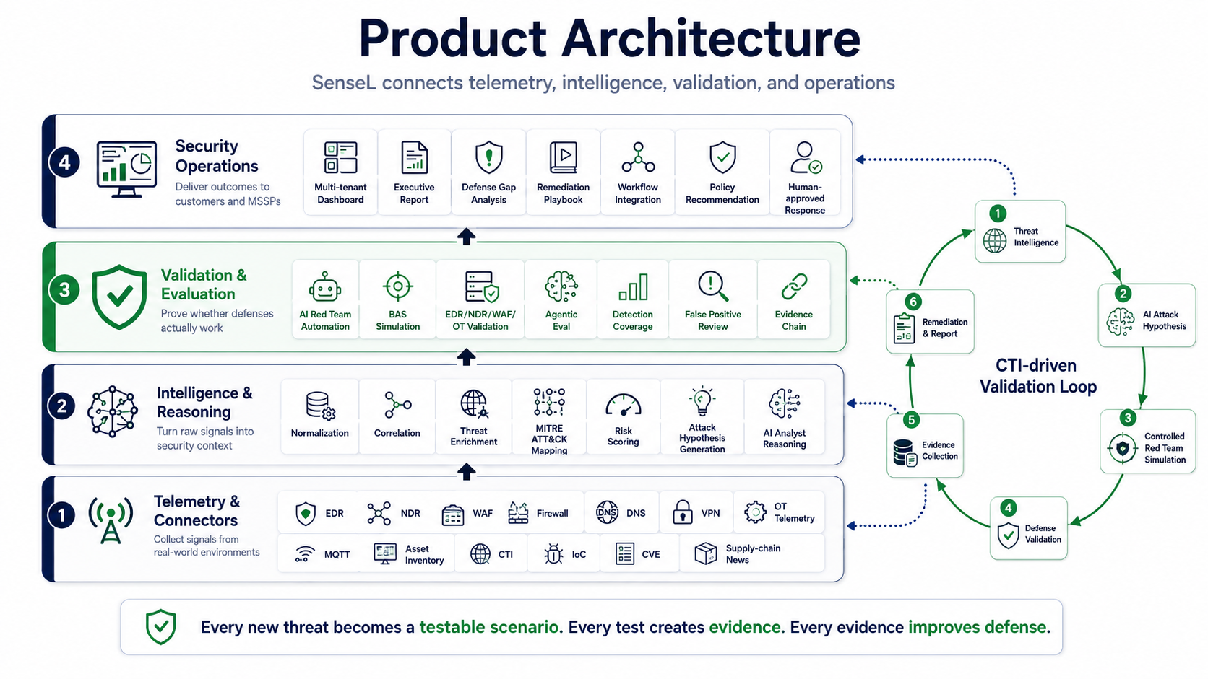
Product Architecture
Telemetry → Intelligence → Validation → Operations
One platform connects existing tools, CTI, AI red-team automation and customer-ready operations.
Avocado.ai | SenseL Investor Pitch
05

Slide 6
Commercial Wedge
Land with WAF, expand with XDR, scale into OT validation
1
WAF MSSP
2
XDR / AI SOC
3
OT Validation
Fastest revenue entry. Radware WAF integration + DNS onboarding for SMBs, schools and websites.
Core platform expansion. EDR, NDR, firewall, CTI and AI reporting for managed security operations.
Premium vertical. Energy & equipment telemetry becomes OT evidence, anomaly validation and trust assurance.
Low-friction onboarding · Recurring revenue
Monthly managed service · Exec reporting
Higher-value accounts · Strong differentiation
WAF gets us in. XDR expands the account. OT creates premium differentiation and a defensible trust moat.
Avocado.ai | SenseL Investor Pitch
06

Slide 7
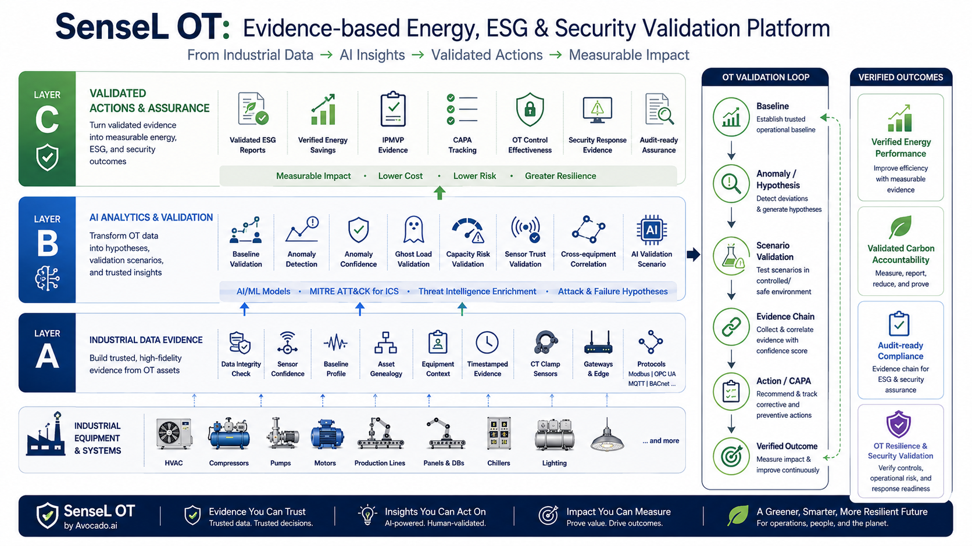
SenseL OT — Layer A / B / C
From industrial data → AI insights → validated, trusted actions
OT thesis: start with measurable energy / ESG value, then expand into evidence-based OT resilience and security validation.
Avocado.ai | SenseL Investor Pitch
07

Slide 8
OT Edge & Device Trust
Passive-first edge sensor — see everything, disrupt nothing
1
Device Management
2
Device-Side Defense
3
CTI & Rule Distribution
Three discovery tracks: sensor self-registration, EdgeX active devices (Modbus/OPC-UA/S7), and zero-risk passive mirror discovery.
OT-001~019 detection: network behavior, IEC 61850 (GOOSE/MMS) and CTI IoC matching — with evidence capture.
Cloud produces signed policy; edge subscribes over MQTT/HTTP and hot-reloads blacklists, rules and baselines.
Deployed on industrial gateways / Raspberry Pi. Passive by design — no process disruption, full visibility.
Edge runs offline-resilient with local buffering. Today the edge alerts and recommends; enforcement is the partner-enabled next step (ZTNA).
Avocado.ai | SenseL Investor Pitch
08

Slide 9
The Trust Engine
Explainable, behavior-based trust for every OT entity
Layer B computes a continuous, auditable trust score per entity — the core of our OT differentiation.
Healthy
Suspicious
Degraded
Critical
≥ 0.85
≥ 0.70
≥ 0.50
< 0.50
1
Penalty / Recovery
2
Risk Propagation
3
Trust Alerts
Trust drops on malicious episodes (severity · recurrence · sequence anomaly · confidence) and recovers slowly when clean.
A degraded/critical entity spreads risk along a trust graph (identity → workstation → PLC), fully audited.
Discrete alerts on critical drops, multi high-risk labels, and C2 + exfiltration combinations.
Not “LLM over logs.” A formula-driven, explainable trust engine that security and OT teams can audit.
Avocado.ai | SenseL Investor Pitch
09

Slide 10
OT Trust Layer & Strategic Partners
Identity + Channel + Access + Behavior = one Unified Trust Score
PUF
PQC
ZTNA
SenseL
Identity
Channel
Access
Behavior
Hardware root of identity — unclonable device ID, key wrapping, attestation.
Quantum-safe channels & signatures — mTLS and end-to-end signed policy.
Device posture, dynamic authorization, micro-segmentation and enforcement.
Existing behavioral trust engine — entity state, alerts, propagation.
Fused into one Unified Trust Score that drives real-time access and isolation decisions.
Partner play: PUF, PQC and ZTNA partners migrate into the SenseL Trust Layer — making OT validation defensible, future-proof and standards-aligned (NIST PQC).
Avocado.ai | SenseL Investor Pitch
10

Slide 11
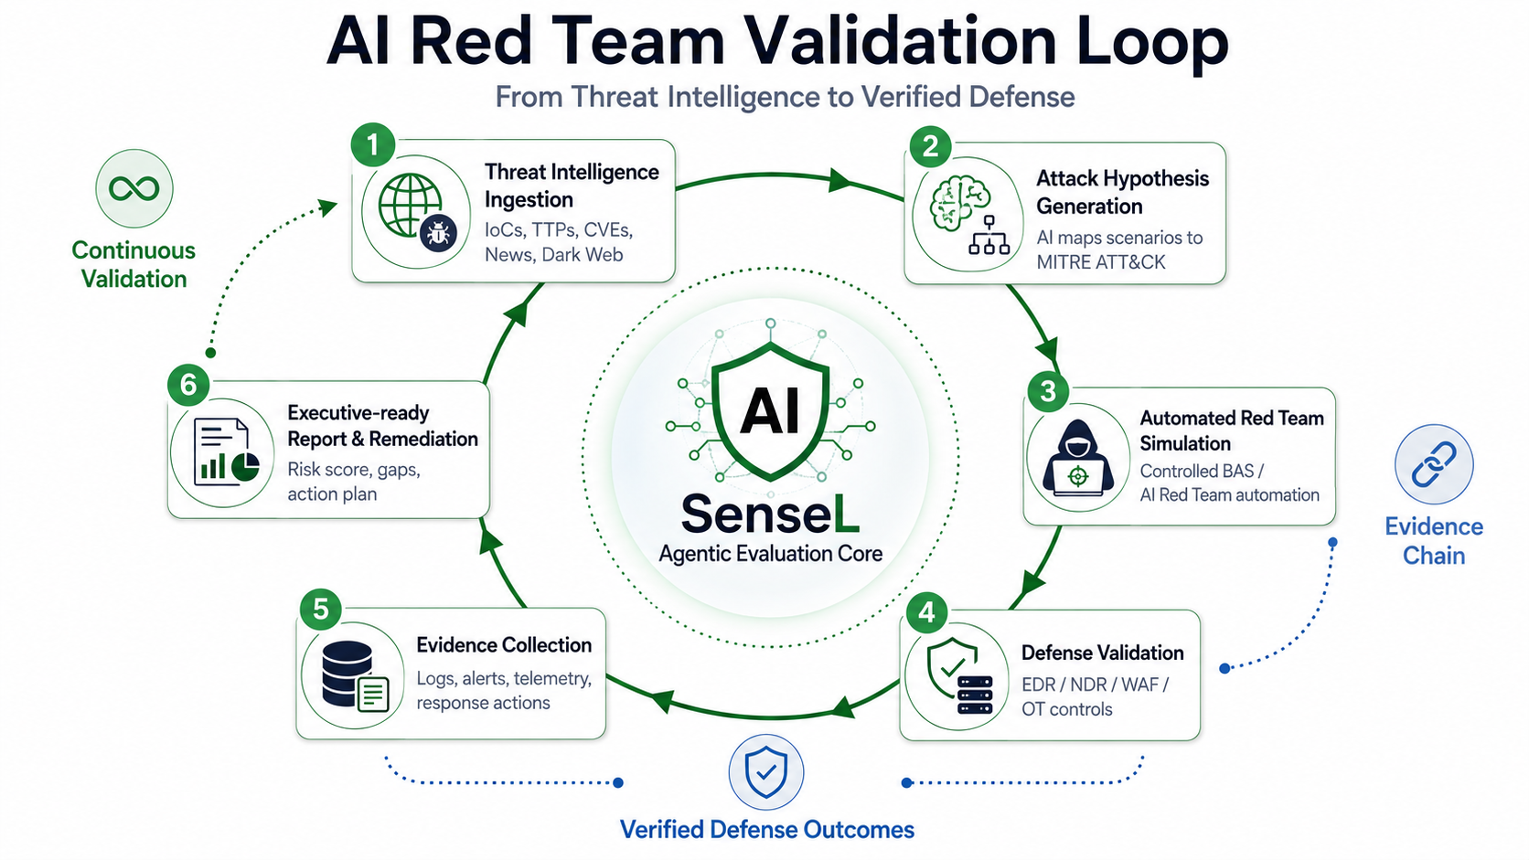
AI Red Team Validation Loop
From threat intelligence to verified defense
Every new threat becomes a testable scenario, and every test creates evidence — the engine that powers SenseL.
Avocado.ai | SenseL Investor Pitch
11

Slide 12
Technical Moat
Evidence Chain + Agentic Eval + OT Trust Layer
The moat is the evidence, evaluation and trust loop around the model — not the model itself.
1
Evidence Chain
2
Agentic Eval
3
OT Trust Layer
Every alert, IoC, hypothesis, scenario, telemetry record and action is linked into traceable evidence — prove what happened and what was tested.
AI agents, red-team workflows and defense outcomes are evaluated for accuracy, safety and reliability — reducing hallucination and unsafe automation.
Explainable trust scoring + PUF/PQC/ZTNA integration creates a defensible, standards-aligned OT moat competitors can't copy quickly.
Our moat is the evidence and evaluation loop — and an OT trust layer that gets stronger with every deployment.
Avocado.ai | SenseL Investor Pitch
12

Slide 13
Traction — WAF MSSP
Revenue-ready wedge with Radware / DNS onboarding
WAF is the fastest near-term entry: clear pain, light onboarding, recurring service.
Radware
DNS
MVP
3–10
WAF API integration path
CNAME / A record onboarding
Multi-tenant UI + mock API
Initial website targets
1
Current progress
2
Evidence to add
Radware WAF API / Postman reference reviewed; DNS onboarding and multi-tenant service workflow in implementation for MSSP operation.
Partner letter, first customer list, demo screenshots, onboarding time, WAF event examples, pricing sheet, conversion timeline.
Investor takeaway: WAF creates the first repeatable commercial package and validates partner-led go-to-market.
Avocado.ai | SenseL Investor Pitch
13

Slide 14
Traction — XDR / AI SOC
Core platform validation across EDR, NDR and AI reporting
Account / Partner
Technology
Status / Evidence
Commercial signal
Tung's Hospital
Wazuh EDR
June 2026 target: >500 endpoints
Healthcare XDR reference
鼎新 智管家
SentinelOne + FortiSIEM
XDR with enterprise software channel
Retail / ERP distribution
Qsec / Arista
NDR integration
NDR integrates with Arista telemetry
Network security validation
SenseL Reports
AI executive summary
EDR / NDR / CTI evidence into monthly report
AI SOC automation
XDR / AI SOC turns field deployments into repeatable managed operations, feeding EDR/NDR/CTI evidence into SenseL reports.
Avocado.ai | SenseL Investor Pitch
14

Slide 15
Traction — SenseL OT
Energy data is the entry; OT security validation is the expansion
1
Smart Meter PoC
2
OT Security Expansion
3
Edge + Trust Layer
Entered a semiconductor-line smart clamp meter ESG + OT analytics PoC. Q3 completion planned.
Q4 expansion from energy/ESG analytics toward OT cybersecurity validation and trust scoring.
RelayGuard edge sensor + Layer A/B/C trust engine + PUF/PQC/ZTNA partner roadmap.
OT vertical thesis: measurable energy / ESG value first, then evidence-based OT resilience and security validation.
Evidence to add: PoC scope, smart clamp meter architecture, Q3 acceptance criteria, Q4 OT security expansion plan, and partner LOIs for the trust layer.
Avocado.ai | SenseL Investor Pitch
15

Slide 16
Traction — 2026 Momentum
Concrete milestones turning vision into Taiwan market entry
1
Hsinchu Industry SIG
2
MoDA Cybersecurity Entry
3
OT Smart Meter PoC
4
MOEA SBIR Submission
Cooperate with Hsinchu Industrial Union on a cybersecurity SIG plan (Q3/Q4 2026); SenseL for supply-chain SMB adoption.
Applying for cybersecurity capability registration and self-developed R&D recognition for Taiwan market entry.
Semiconductor-line smart clamp meter ESG + OT analytics PoC; Q3 completion, Q4 OT cybersecurity expansion.
R&D proposal submitted to MOEA SBIR, targeting Q3 execution to support the SenseL validation engine.
Go-to-market access
Market qualification
Premium vertical proof
Non-dilutive leverage
Signal: early access to supply-chain SMBs, OT semiconductor use cases, Taiwan cybersecurity programs and SBIR R&D support.
Avocado.ai | SenseL Investor Pitch
16

Slide 17
Business Model
One platform, multiple recurring revenue streams
1
Platform Subscription
2
Managed Security Service
3
Validation-as-a-Service
4
Partner Revenue Share
Tenants, protected assets, endpoints, websites and OT data sources.
AI-assisted WAF MSSP, XDR monitoring, incident summary and monthly report.
AI Red Team validation, BAS scenarios, defense effectiveness and evidence reports.
SI, MSSP, WAF providers, OT and trust-layer partners (PUF/PQC/ZTNA).
Monthly / annual SaaS
Recurring service fee
Per assessment / package
Revenue share / reseller margin
Land through services, expand through subscriptions, scale through partners.
Avocado.ai | SenseL Investor Pitch
17

Slide 18
Go-to-Market
Partner-led, vertical-focused, validation-driven
When
Who
What
Why it matters
Q3 2026
SMB / school / website owners
WAF MSSP + SIG SMB package
Fast recurring revenue + SMB access
Q3–Q4 2026
Healthcare / retail / SMB
XDR + AI SOC + Red Team validation
Managed security + closed-loop validation
Q3–Q4 2026
Factory / semiconductor OT
SenseL OT smart meter PoC
Complete OT analytics, expand to OT security
12–18 mo
SI / MSSP / industry partners
Multi-tenant SenseL + Trust Layer
Channel scale and partner-led delivery
We land with urgent security needs, add AI Red Team validation, and scale through trusted partners.
Avocado.ai | SenseL Investor Pitch
18

Slide 19
Fundraising Ask
Strategic Angel Bridge → Seed-ready execution
Raise NT$3M–5M as a Strategic Angel Bridge, then NT$20M–30M Seed after commercial validation.
1
Bridge Round
2
Use of Funds
3
18-month Milestones
NT$3M–5M. Complete MVP, convert first commercial pilots, produce evidence assets, prepare seed data room.
Productization · MSSP onboarding · WAF/XDR/OT connectors · AI validation engine · OT Trust Layer · GTM.
10–20 paying customers/pilots · multi-tenant platform · WAF MSSP · XDR/AI SOC reports · OT validation + trust demo.
Goal: turn field PoCs into repeatable product modules, recurring revenue and Seed-ready traction.
Avocado.ai | SenseL Investor Pitch
19

Slide 20
Detect → Validate → Prove → Improve
Now extended with an OT Trust Layer: Identity (PUF) · Channel (PQC) · Access (ZTNA) · Behavior (SenseL)
Avocado.ai · SenseL EdgeX · Strategic Angel / Seed 2026

