Slide 1
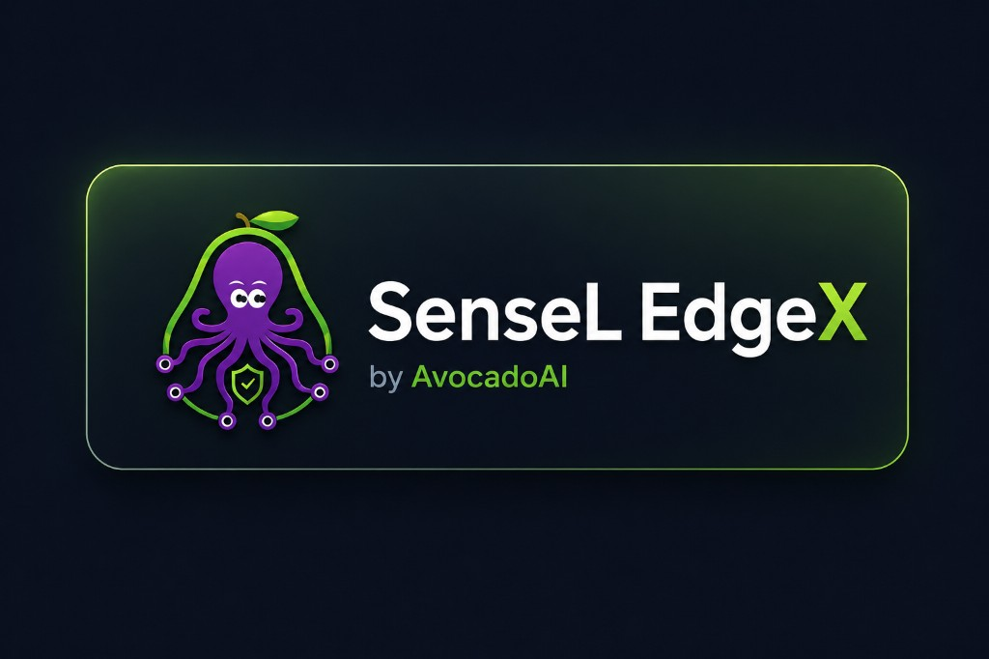
OT Security — Trust Layer Briefing
Partner Briefing for ZTNA · PUF · PQC Collaboration
Draft v0.1 · Confidential

Slide 2
EXECUTIVE SUMMARY
Four Trust Questions, Four Partners
SenseL runs a mature behavioral trust layer today. To reach a complete Zero-Trust posture for OT, three partners migrate their capabilities into one unified Trust Layer.
Partner
Provides
Answers the question
PUF
Hardware root of identity
Who is this device — really?
PQC
Quantum-resistant channels & signing
Can we trust how it was transmitted?
ZTNA
Access decisions & enforcement
What is this entity allowed to do?
SenseL (today)
Behavioral trust scoring
Is it behaving correctly?
The ask: combine these four signals into one Unified Trust Score that drives real-time access and isolation decisions.
SenseL EdgeX · by AvocadoAI · Confidential
2

Slide 3
WHO WE ARE
Three Building Blocks
CLOUD CONTROL PLANE
CTI hub · Policy production · Southbound rule distribution · Multi-agent workforce · Customer portal
INFERENCE PLANE (Layer A / B / C)
Normalization · ET-BERT inference · Episode aggregation · >> TRUST ENGINE << · Agentic investigation
EDGE SENSOR (industrial gateway / Raspberry Pi)
Passive traffic detection + active telemetry · Local alerting · Evidence capture · Policy sync
SenseL EdgeX · by AvocadoAI · Confidential
3

Slide 4
ARCHITECTURE
End-to-End Architecture (Purdue-Aligned)
FIELD ZONE (Purdue L1/L2)
PLC · RTU · IED · HMI
EDGE SENSOR
Passive detection (SPAN/TAP) + Active telemetry (EdgeX) → Edge Agent (register · health · policy)
INFERENCE PLANE (L3)
Layer A Normalization → Layer B Inference + Trust Engine → Layer C Agentic Investigation
CLOUD CONTROL PLANE (L4/L5)
CTI Hub → Policy Engine → Southbound Distribution (signed policy + IoC)
Design principles: passive-first (no process disruption) · explainable trust · clean north/south separation
SenseL EdgeX · by AvocadoAI · Confidential
4

Slide 5
CAPABILITY 1
Device Management
Track
How
Process risk
Sensor registration
Edge agent registers to cloud, bound to a tenant
—
Active devices
Guided wizard: Modbus / MQTT / OPC-UA / S7
Low (read-only)
Passive discovery
Mirror traffic reveals MAC/IP, mapped to devices
Zero (passive)
Plus optional read-only active probing (never writes to a device) and behavioral baseline learning.
GAP → PUF
Device identity relies today on a copyable API key. There is no hardware-bound, unclonable identity.
SenseL EdgeX · by AvocadoAI · Confidential
5

Slide 6
CAPABILITY 2
Device-Side Defense
Capability
What it does
Detection engine
OT network-behavior rules, IEC 61850 (GOOSE/MMS), CTI IoC hits
Threat-intel matching
Pulls/receives blacklists; hot-reloads local IoC cache
Policy enforcement
Applies cloud-pushed enabled rules + baselines
Evidence capture
In-memory ring buffer with evidence references
Offline resilience
Local buffering + exponential-backoff reconnect
Today: “Block / Quarantine” are recommended actions only — the edge does not block inline.
GAP → ZTNA
No “trust score → dynamic access control / micro-segmentation” enforcement.
SenseL EdgeX · by AvocadoAI · Confidential
6

Slide 7
CAPABILITY 3
Layer A / B / C Analytics · The Trust Engine
Layer A
Normalize
Layer B-1
ET-BERT Cascade
Layer B-2
Episodes
TRUST ENGINE
entity score
Layer C
Investigation
The Trust Engine — our existing software trust layer
• Formula: T_new = clamp( T_old − Penalty(event) + Recovery(time) )
• Penalty: weighs severity · recurrence · sequence anomaly · classifier confidence
• Recovery: slow, only when no new malicious activity occurs
• Levels: Healthy → Suspicious → Degraded → Critical
• Propagation: degraded/critical entity spreads risk along a trust graph (identity → workstation → PLC), fully audited
SenseL EdgeX · by AvocadoAI · Confidential
7

Slide 8
CAPABILITY 4 & 5
Cloud Service + Rule Distribution
CTI feeds
OpenCTI / Avocado
Scoring +
Policy Engine
Signed Policy Artifact
blacklist · STIX · IDS · TLS fp
Edge / NDR / FW
HTTP · MQTT · SSE
Two distribution pipelines:
Pipeline
Direction
Channel
Content
CTI / IoC blacklist
cloud → edge / NDR / FW
HTTP + MQTT + SSE
IP / domain / hash · IDS rules · TLS fingerprints
OT detection policy
cloud → edge
MQTT
enabled rules + baselines
GAP → PQC + PUF
Distribution relies on a copyable API key + optional TLS. Artifacts are not end-to-end signed; channels are not quantum-resistant.
SenseL EdgeX · by AvocadoAI · Confidential
8

Slide 9
THE PROBLEM
The Trust Gap — Current State vs. Need
Dimension
Today
Gap
Owner
Device identity
Copyable API key + invite
No hardware-bound identity
PUF
Behavioral trust
Mature scoring engine
Behavior-only; no identity/context
fuse
Channels
TLS (ECDHE/RSA)
Not quantum-safe
PQC
Policy integrity
API key, no signing
Tamper / replay possible
PQC
Access control
Portal RBAC only
No device-level zero trust
ZTNA
Enforcement
Recommendations only
No isolation on trust drop
ZTNA
Certificates
Static, manual
No HW root / rotation / PQC
PUF+PQC
We have behavioral trust. We need identity, channel, and access trust.
SenseL EdgeX · by AvocadoAI · Confidential
9

Slide 10
THE TARGET
The Unified Trust Layer
PUF — Identity Root
Behavioral Trust (today)
unclonable device identity · key wrapping · attestation
entity state · alerts
PQC — Crypto
quantum-safe KEM & signatures · mTLS · artifact signing
ZTNA — Access
device posture · dynamic authz · micro-segmentation
Identity (PUF) → Channel (PQC) → Access (ZTNA) → Behavior (existing) = ONE Unified Trust Score
SenseL EdgeX · by AvocadoAI · Confidential
10

Slide 11
HOW WE CONNECT
Partner Integration Points
#
Integration
Extension needed
Partner
1
Device registration
Add PUF attestation to enrollment
PUF
2
Health reporting
Carry attestation nonce / proof
PUF
3
Policy artifacts
Add signature + algo + key id; verify at edge
PQC
4
Channels
Hybrid PQC-TLS + mTLS north/south
PQC+PUF
5
Trust decision input
Consume entity-state / alert stream as input
ZTNA
6
Micro-segmentation
Map trust graph to ZTNA segments
ZTNA
7
Enforcement
Edge adapter ↔ ZTNA gateway / NAC
ZTNA
8
Unified score
Add identity + channel components
All
SenseL EdgeX · by AvocadoAI · Confidential
11

Slide 12
THE PLAN
Phased Roadmap
P0
Baseline (today)
Behavioral trust + CTI distribution + passive detection live
P1
Identity root
PUF device identity · attestation · anti-spoof enrollment
P2
Quantum-safe
Hybrid PQC-TLS · signed & verified policy artifacts
P3
Zero-trust access
Trust state → ZTNA decisions · micro-seg · enforcement
P4
Unified trust
One score fusing identity, channel, behavior, context
Incremental · backward-compatible · reversible (hybrid before cutover, audit before enforce)
SenseL EdgeX · by AvocadoAI · Confidential
12

Slide 13
DISCUSSION
Open Questions for Partners
Latency
Can PQC handshakes / signature checks meet OT control-loop timing on constrained edge hardware?
PUF carrier
Do target gateways have a PUF source (TPM / SE / SRAM-PUF), or is a secure element required?
Offline behavior
How to verify attestation / artifacts when the edge is disconnected (grace period? cached root)?
Safety
Fail-open vs. fail-secure for ZTNA isolation in a live OT environment?
Key governance
Rotation, revocation, and alignment with our tenant model.
Standards
PQC algorithm selection (ML-KEM / ML-DSA) and migration timeline vs. NIST guidance.
SenseL EdgeX · by AvocadoAI · Confidential
13

Slide 14
Let's build the OT Trust Layer together.
Identity (PUF) · Channel (PQC) · Access (ZTNA) · Behavior (SenseL)
SenseL EdgeX · by AvocadoAI

