Slide 1
Random Forest
Machine Learning Workshop
GLEON 19
November 27, 2017
TH Leach

Slide 2
What are RF’s?
Extension of classification and regression trees (CART)
Small changes to data can dramatically change tree
Accuracy not as high as other methods (e.g. SVM)
Use many weak trees to create a forest
Introduction of randomness when creating trees decreases bias
Averaging/Voting a lot of weak trees gives low variance

Slide 3
Why use a Random Forest?
Handle dataset with:
many potential predictor variables
multi-level categorical variables
Unbalanced
Do not need to a priori define nature of
Quantifies variable importance
Robust to overfitting
Insensitive to outliers
Handle missing data well
Fast, easily run in parallel
Well done, mature packages for doing RF’s
Notes:
Are a black box method - you need to know the data!
Not used for statistical hypothesis testing – no p-value!

Slide 4
How do RF’s work?
Draw n_{tree} boot strapped samples (K_{i})
2/3 is training data
1/3 is out-of-bag data (oob)
For each K_{i} grow an unpruned tree (tree_{i})
At each node of tree_{i}, split based on randomly selected subset of predictors (m_{try}; this decreases correlation between trees).
Predict oob with tree_{i} and calculate oob error rate
Aggregate oob error across all trees in forest
Notes:
Weak trees have low bias but high variance
Bagging is boot strap aggregation

Slide 5
For a single tree:
tree_{i}
At each node, choose best split among m_{try}
Full dataset
2/3
1/3
K_{i}
oob_{i}
Notes:
About 1/3 of the dataset is set aside as the oob

Slide 6
How do RF’s work?
Draw n_{tree} boot strapped samples (K_{i})
2/3 is training data
1/3 is out-of-bag data (oob)
For each K_{i} grow an unpruned tree (tree_{i})
At each node of tree_{i}, split based on randomly selected subset of predictors (m_{try}; this decreases correlation between trees).
Predict oob with tree_{i} and calculate oob error rate
Aggregate oob error across all trees in forest
Notes:
Weak trees have low bias but high variance
Bagging is boot strap aggregation

Slide 7
For a single tree:
tree_{i}
At each node, choose best split among m_{try}
Full dataset
2/3
1/3
K_{i}
oob_{i}
Notes:
About 1/3 of the dataset is set aside as the oob

Slide 8
How do RF’s work?
Draw n_{tree} boot strapped samples (K_{i})
2/3 is training data
1/3 is out-of-bag data (oob)
For each K_{i} grow an unpruned tree (tree_{i})
At each node of tree_{i}, split based on randomly selected subset of predictors (m_{try}; this decreases correlation between trees).
Predict oob with tree_{i} and calculate oob error rate
Aggregate oob error across all trees in forest
Notes:
Weak trees have low bias but high variance
Bagging is boot strap aggregation

Slide 9
For a single tree:
tree_{i}
Predict data in oob dataset.
Full dataset
2/3
1/3
K_{i}
oob_{i}
Notes:
About 1/3 of the dataset is set aside as the oob

Slide 10
How do RF’s work?
Draw n_{tree} boot strapped samples (K_{i})
2/3 is training data
1/3 is out-of-bag data (oob)
For each K_{i} grow an unpruned tree (tree_{i})
At each node of tree_{i}, split based on randomly selected subset of predictors (m_{try}; this decreases correlation between trees).
Predict oob with tree_{i} and calculate oob error rate
Aggregate oob error across all trees in forest
Notes:
Weak trees have low bias but high variance
Bagging is boot strap aggregation

Slide 11


Aggregate oob error rate across all trees.
“Mean of squared residuals”
% variance explained
Notes:
About 1/3 of the dataset is set aside as the oob

Slide 12
Inputs and Outputs
Inputs
Data = Flat file where rows = lake, col = variables
Number of trees
m_{try}
Outputs
Mean squared residual
% variance explained
Variable importance
Partial dependency plots

Slide 13
Aggregate oob error rate across all trees.
“Mean of squared residuals”
% variance explained
Notes:
About 1/3 of the dataset is set aside as the oob

Slide 14
Inputs and Outputs
Inputs
Data = Flat file where rows = lake, col = variables
Number of trees
m_{try}
Outputs
Mean squared residual
% variance explained
Variable importance
Partial dependency plots

Slide 15
Variable Importance
Quantifies variable importance
% increase in MSE (mean square error)
Increase in node purity
Estimated using the oob data
Compares oob to permuted oob data

Slide 16
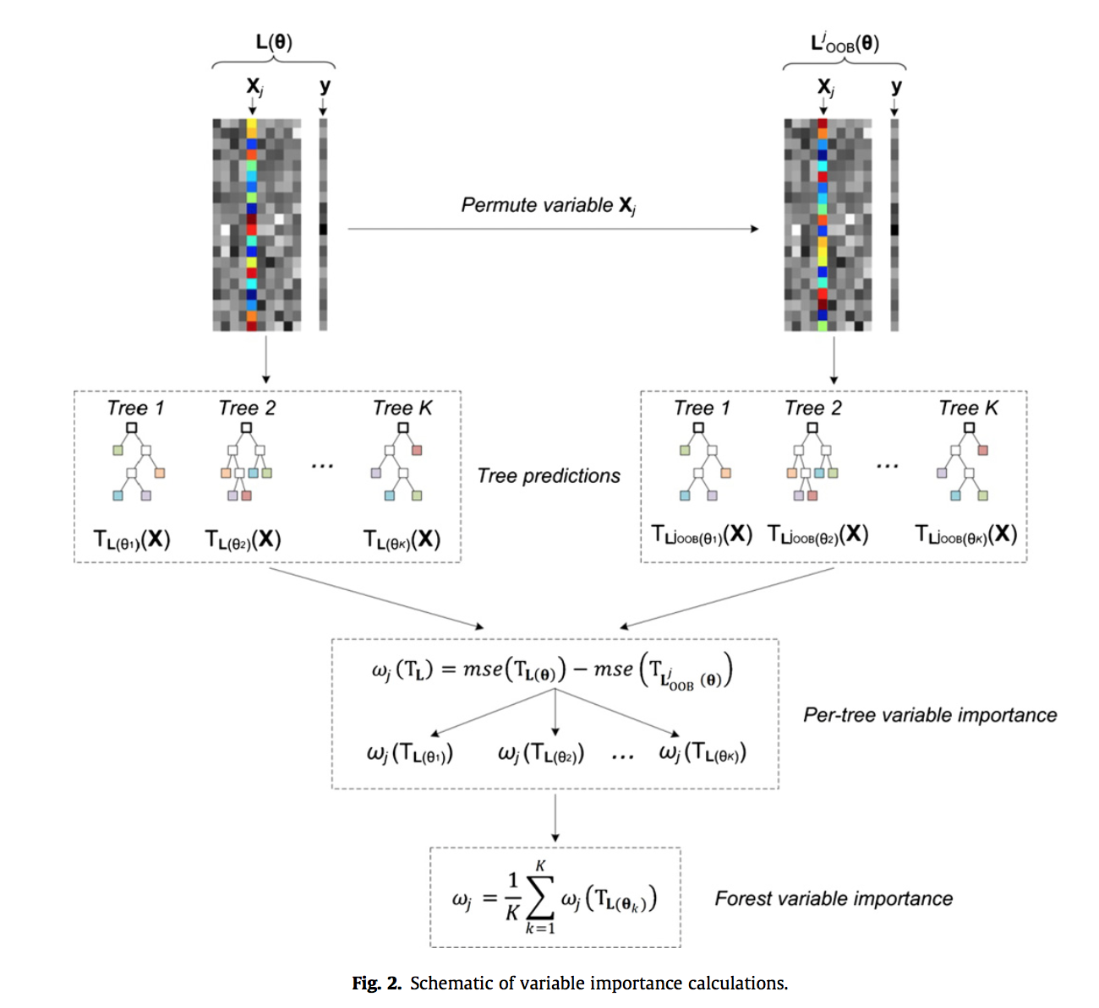
Auret and Aldrich 2012
Notes:
Example for independent variable X.
Randomly resample -
Permutation destroys the association of that variable with the response.

Slide 17
Inputs and Outputs
Inputs
Data = Flat file where rows = lake, col = variables
Number of trees
m_{try}
Outputs
Mean squared residual
% variance explained
Variable importance
Partial dependency plots

Slide 18
Partial dependency plots
Visualize relationship between a single variable and response, after accounting for the average effects or interactions of the other predictors.
Not unique to RF’s

Slide 19
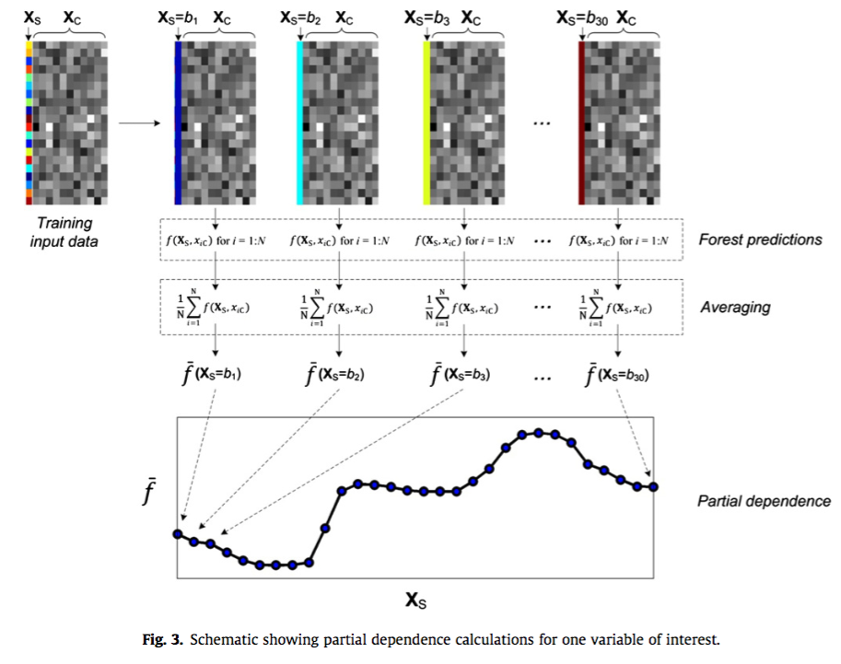
Auret and Aldrich 2012

Slide 20
Considerations: randomForest package
Handling NA’s
na.omit: if NA is present in available predictors, obs. is left out of tree, but not entire forest
na.roughfix: uses median/mode value of dataset to replace NA
m_{try} and n_{tree}
n_{tree} = 500 (something to play with during example)
m_{try} = 3/p for regression, nodesize = 5
m_{try} = p^{1/2} for classification, nodesize = 1
Defaults are pretty sensible
although Breiman suggests running small forest at default, ½x and 2x default and checking error.

Slide 21
Packages to do RF’s in R
randomForest (uses CART trees)
party (uses conditional inference trees)
use if you have continuous and categorical variables (Strobl et al. 2007, 2008)
if predictors are very highly correlated (Strobl et al. 2007, 2008)
cforest(... controls = cforest_unbiased)
need to use ‘edarf’ package to get PDP
randomForestSRC
Notes:
randomForest implementation may be biased towards continuous variables or those with many categories.

Slide 22
References & Resources
https://www.stat.berkeley.edu/~breiman/RandomForests/cc_home.htm
http://trevorstephens.com/kaggle-titanic-tutorial/r-part-5-random-forests/ (good example of party package)
‘party’ package - https://cran.r-project.org/web/packages/party/party.pdf
‘edarf’ package: contains functions to extract variable importance and pdp from RF objects (can be slow) - https://cran.r-project.org/web/packages/party/party.pdf
Example of proximity metrics and MDS from a RF - https://www.kaggle.com/aidangawronski/random-forest-proximity/code
Great explanation of differences between packages and approaches: https://www.statistik.uni-dortmund.de/useR-2008/slides/Strobl+Zeileis.pdf

Slide 23
References & Resources
Archer, K. J., and R. V. Kimes. 2008. Empirical characterization of random forest variable importance measures. Computational Statistics and Data Analysis 52:2249–2260.
Auret, L., and C. Aldrich. 2012. Interpretation of nonlinear relationships between process variables by use of random forests. Minerals Engineering 35:27–42.
Breiman, L. 2001. Random Forests. Machine Learning 45:5–32.
Carlisle, D. M., J. Falcone, and M. R. Meador. 2009. Predicting the biological condition of streams: use of geospatial indicators of natural and anthropogenic characteristics of watersheds. Environmental monitoring and assessment 151:143–60.
Cutler, D. R., T. T. C. Edwards, K. K. H. Beard, A. Cutler, K. K. T. Hess, J. Gibson, and J. J. J. Lawler. 2007. Random forests for classification in ecology. Ecology 88:2783–92.
Liaw, a, and M. Wiener. 2002. Classification and Regression by randomForest. R news 2:18–22.
Prasad, A. M., L. R. Iverson, A. Liaw, S. Ecosystems, and N. Mar. 2006. Newer Tree Classification and Techniques : Forests Random Prediction Bagging for Ecological Regression. Ecosystems 9:181–199.
Strobl, C., A.-L. Boulesteix, A. Zeileis, and T. Hothorn. 2007. Bias in random forest variable importance measures: illustrations, sources and a solution. BMC Bioinformatics 8:25.
Verikas, A., A. Gelzinis, and M. Bacauskiene. 2011. Mining data with random forests: A survey and results of new tests. Pattern Recognition 44:330–349.

