Slide 1
CS375
Design & Analysis of Algorithms
Spring 2016
Lecture 21-22
Lei Yu
Department of Computer Science
State University of New York at Binghamton
lyu@cs.binghamton.edu
www.cs.binghamton.edu/~lyu

Slide 2
Basic Graph Algorithms
Graph implementations
  Adjacency lists
  Adjacency matrix
Graph traversals
  Breadth First Search
  Depth First Search

Slide 3
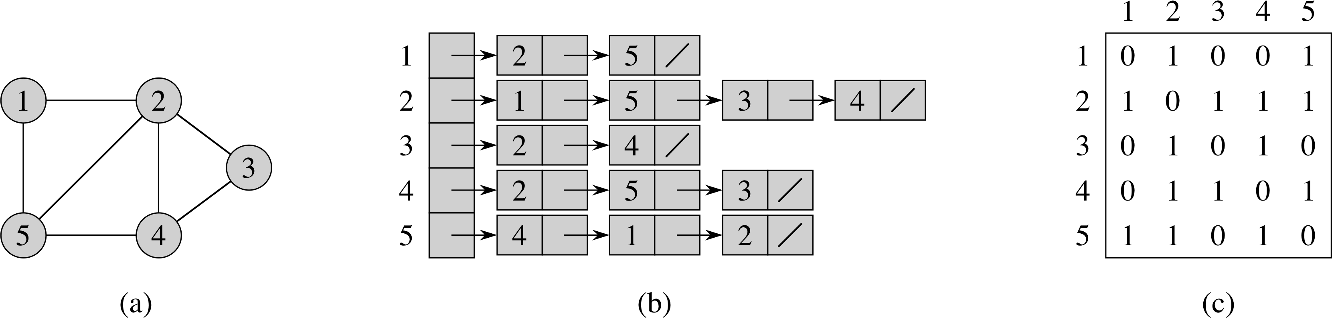
Graph Implementation: Adjacency-List Representation
Adjacency-list representation of a graph G = (V, E) consists of an array adj of |V | lists, one for each vertex in V. For each u ∈ V , adj[u] points to all its adjacent vertices.

Slide 4
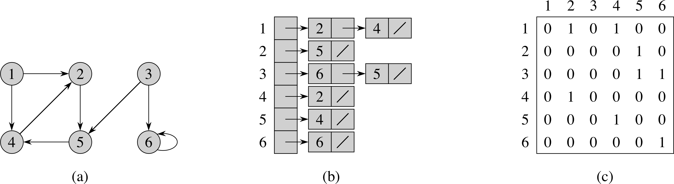
Adjacency-list Representation for Directed Graph
Adjacency-list representation of a directed graph G = (V, E) consists of an array adj of |V | lists, one for each vertex in V. For each u ∈ V , adj[u] points to all its adjacent vertices. In a digraph, v is adjacent to u if (u, v) ∈ E.
Variation: Can keep a second list of edges coming into a vertex.

Slide 5
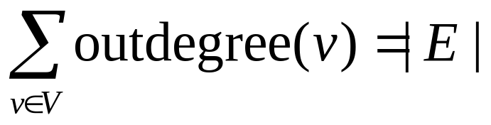
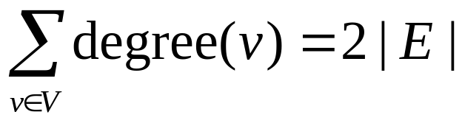
Adjacency List
Storage
  We need V pointers to linked lists.
  For a directed graph the number of nodes (or edges) contained (referenced) in all the linked lists is
  ➔ So we need Θ(|V | + | E |) storage space.
  For an undirected graph the number of nodes is
  ➔ Also Θ(|V | + | E |) for storage space.

Slide 6
Adjacency-matrix-representation of a graph G = (V, E) is a |V | × |V | matrix A such that a_{ij} = 1 if (i, j) ∈E and 0 otherwise.
Adjacency-Matrix-Representation (1)
For undirected graph:

Slide 7
Adjacency-matrix-representation of a graph G = (V, E) is a |V | × |V | matrix A such that a_{ij} = 1 if (i, j) ∈E and 0 otherwise.
Adjacency-Matrix-Representation (2)
For directed graph:

Slide 8
Pros and Cons of Adjacency List
Advantages:
  Saves space for sparse graphs. Most graphs are sparse.
  “Visit” edges that start at v
    Only need to traverse linked list of v
    Size of linked list of v is degree(v)
    Θ(degree(v)) time
Disadvantages:
  Check for existence of an edge (v, u)
    Must traverse linked list of v
    Size of linked list of v is degree(v)
    O(degree(v)) time

Slide 9
Pros and Cons of Adjacency Matrix
Advantage:
  Save space on pointers for dense graphs.
  Check for existence of an edge (i, j)
    Just check if A[i, j] = 1?
    So Θ(1).
Disadvantage:
  “Visit” all the edges that start at v
    Row v of the matrix must be traversed.
    So Θ(|V |).

Slide 10
Graph Traversals
Some applications involving graph G:
Is G connected?
Does G contain a cycle?
Is G a tree?
Is G bipartite?
Find connected components.
Topological sorting
Is directed G strongly connected?

Slide 11
Breadth First Search (BFS): Basic Idea
Given a graph G = (V, E) and a source vertex s, BFS systematically explores the edges of G to “discover” (visit) each node of G reachable from s.
Basic ideas: It discovers all vertices at distance k from s before discovering any vertices at distance k + 1 from s.
In the search process, it expands the frontier between already discovered and undiscovered vertices one step at a time.
Use a First-In-First-Out (FIFO) queue to implement the Frontier.
  Need O(1) time to update

Slide 12
Breadth First Search: Output
The algorithms also computes the shortest distance (dist) from s to any reachable node.
It also produces a breadth first tree with root s that contains all the reachable vertices from s.
To get O(|V| + |E|) running time, we use an adjacency list representation.
If we used an adjacency matrix, the running time would be O(|V|²).

Slide 13
BFS: Coloring the Nodes
To ease illustration, we use colors (white, gray and black) to denote the state of the node during the search.
A node is white if it has not been reached (discovered) yet.
Discovered nodes are gray or black.
  Gray nodes are at the frontier of the search.
  Black nodes are fully explored nodes.
    A node is considered fully explored if all of its adjacent nodes have been examined (discovered or fully explored).
All nodes change color in order: white → gray → black.

Slide 14
BFS: Algorithm Part 1 - Initialize
BFS(G, s) // start the search from node s in graph G
for each vertex u ∈ G.V – {s}
u.color = white
u.d = ∞ // u.d to hold the distance from s to u
 u.π = NIL // u.π denotes the predecessor of u in BS-tree
s.color = gray
s.d = 0 // distance to itself is 0
s.π = NIL
Q = φ // Q is an FIFO queue and it is initially empty
Enqueue(Q, s)

Slide 15
BFS: Algorithm Part 2 - Main
while ( Q ≠ φ )
u = Dequeue(Q)
for each v in adj[u]
if (v.color == white) // v has not been discovered
// from another path
v.color = gray
v.d = u.d +1
v.π = u // make u the predecessor or parent
// of v in the breadth first tree
Enqueue(Q, v)
u.color = black // u is now fully explored

Slide 16
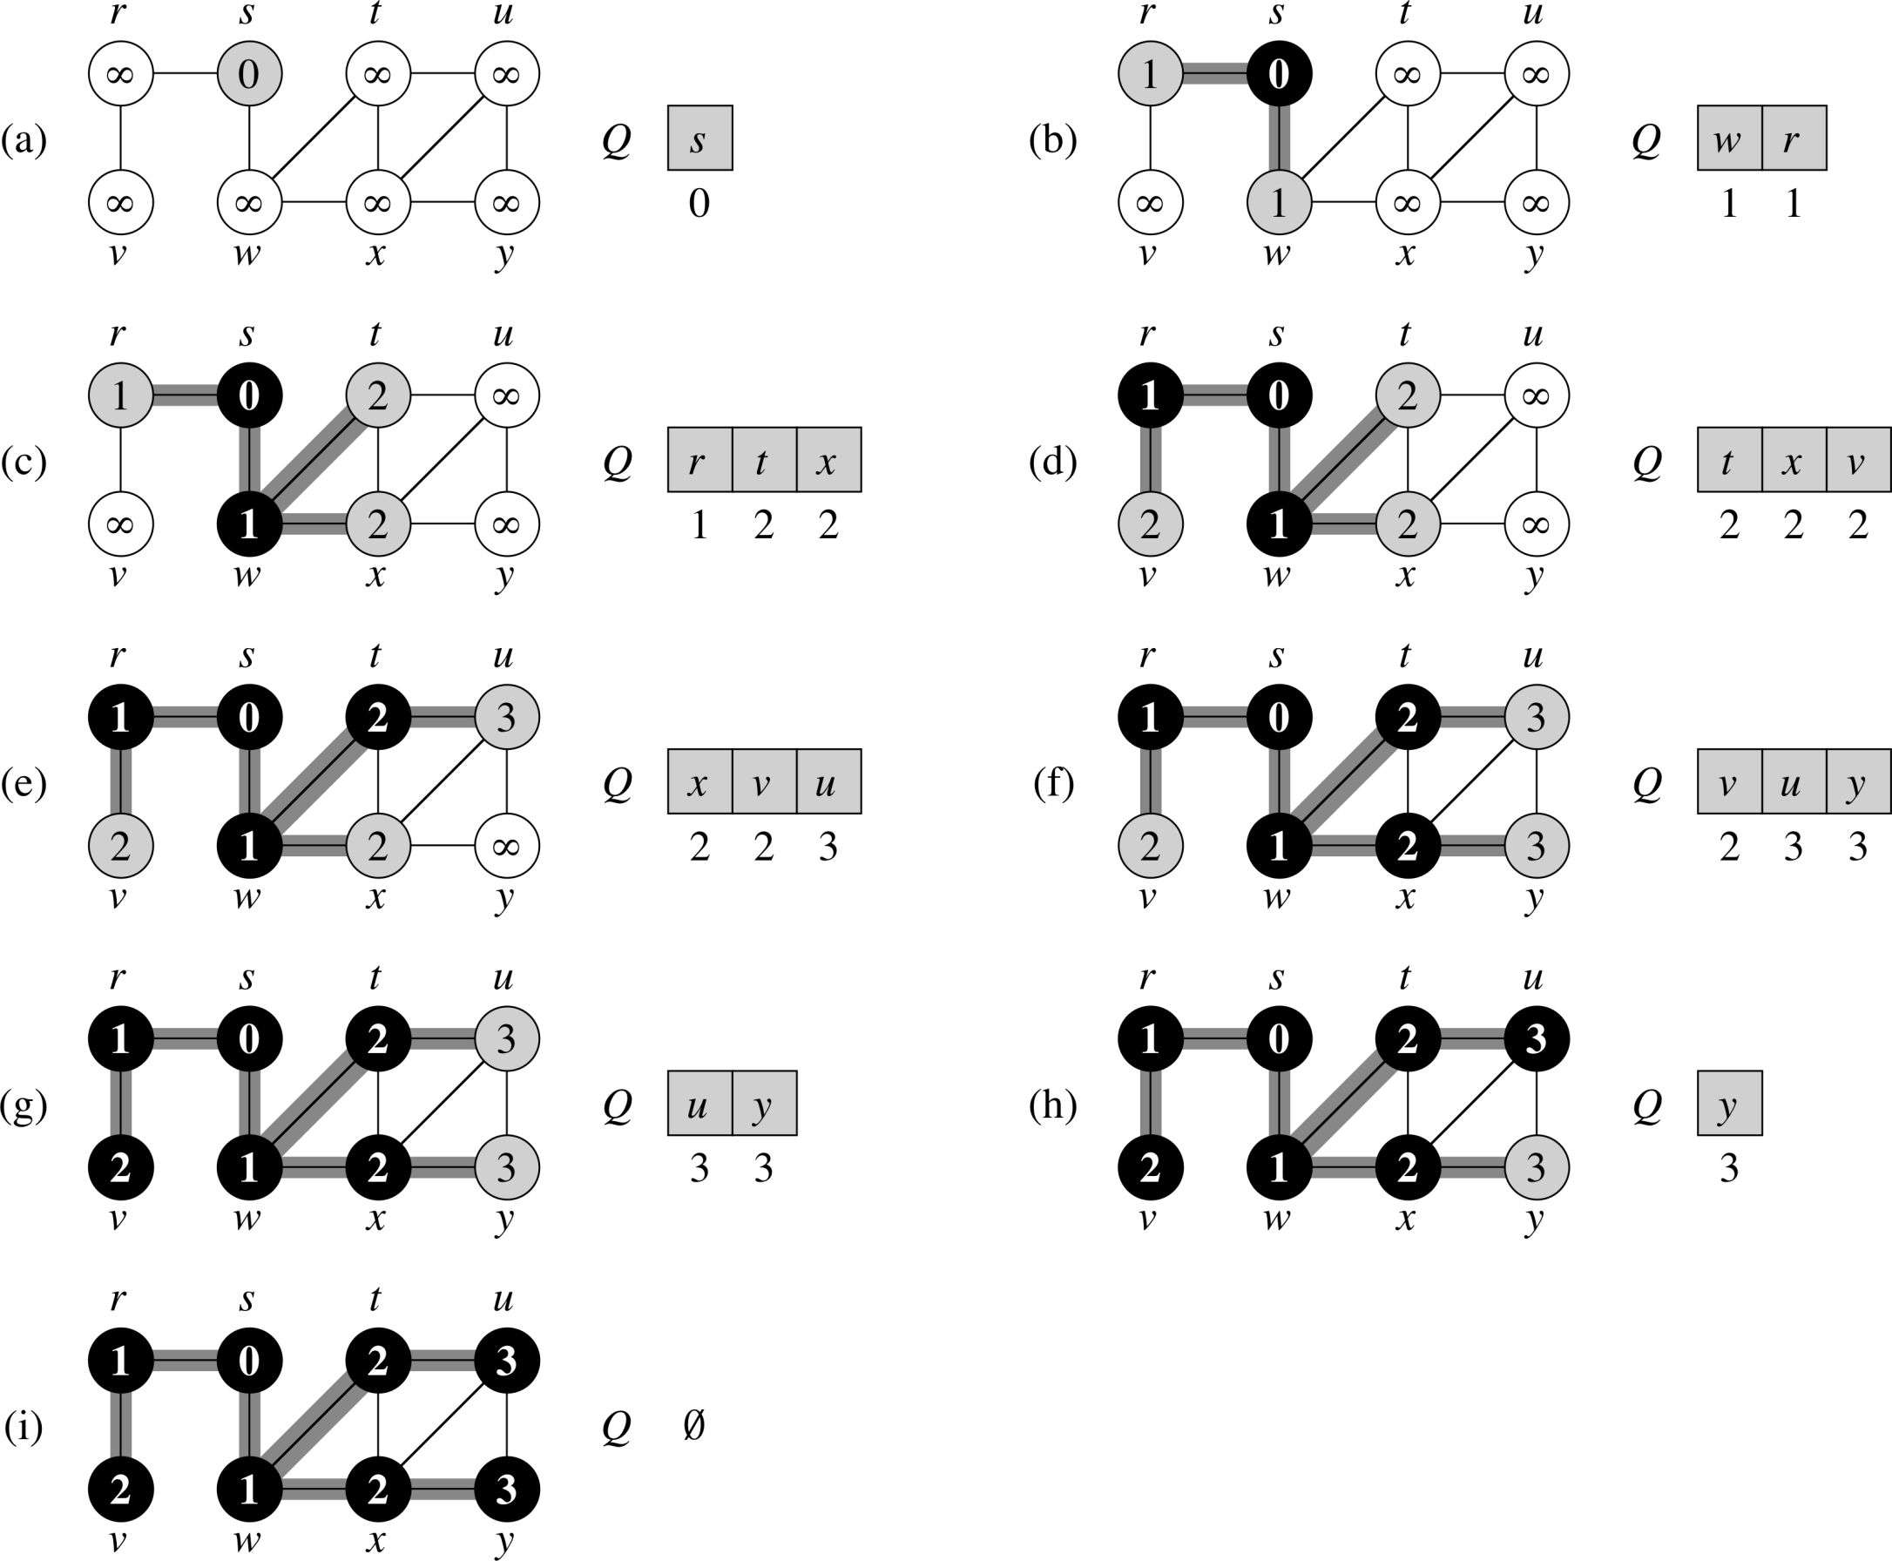
BFS: Example

Slide 17

BFS: Example (continued)
The shaded edges are edges of the breadth first tree.

Slide 18
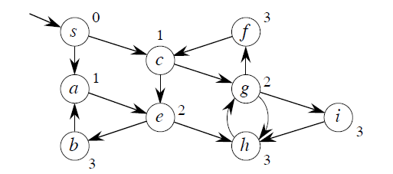
BFS: Another Example
The algorithm also works for directed graphs.

Slide 19
BFS: Analysis
Initialization is Θ(|V |) due to the for loop.
Each node can be added to the queue at most once (it needs to be white), and its adjacency list is searched only once.
If graph is undirected each edge is reached twice
  if u is in the adjacency list of v, then v is also in the adjacency list of u
  so the for loop in the main procedure executes ≤ 2|E | times.
If graph is directed each edge is reached exactly once. So the for loop is executed at most |E | times.
➔ Worst case time of BFS is O(|V |+| E |)
BFS may fail to reach all nodes for directed or unconnected graphs.

Slide 20
Depth First Search (DFS): Basic Idea
Goal: Explore every vertex and edge of G.
Basic idea: Go “deeper” whenever possible.

Slide 21
Depth First Search (DFS): Textbook Version
The DFS algorithm in the textbook does not require a pre-specified source node.
Idea: Until there are no more undiscovered nodes
  Pick an undiscovered node and start a depth first search from it.
  The search proceeds from the most recently discovered node to discover new nodes.
  When the last discovered node v is fully explored, backtrack to the node used to discover v. Eventually, the start node is fully explored.
The output varies depending on the order in which the nodes are considered.

Slide 22
DFS: Node Coloring Scheme
Same coloring method as the one used for BFS.
  white for un-discovered nodes
  gray for discovered but not fully explored nodes
  Black for fully explored nodes.
    A node is considered fully explored if all of its descendant nodes have been examined (discovered or fully explored).

Slide 23
Depth First Search: Some Features
The algorithm can discover all nodes regardless of whether the graph is directed, undirected, or even not connected.
The algorithm saves:
  A depth first forest composed of several depth first trees.
  Two timestamps for each node u
    u.d is its discovery time – the time when it is first discovered
    u.f is its finishing time – the time when it is fully explored.
Use adjacency list representation to get Θ(|V |+|E |) running time.
If we used an adjacency matrix, the running time would be Θ(|V |²).

Slide 24
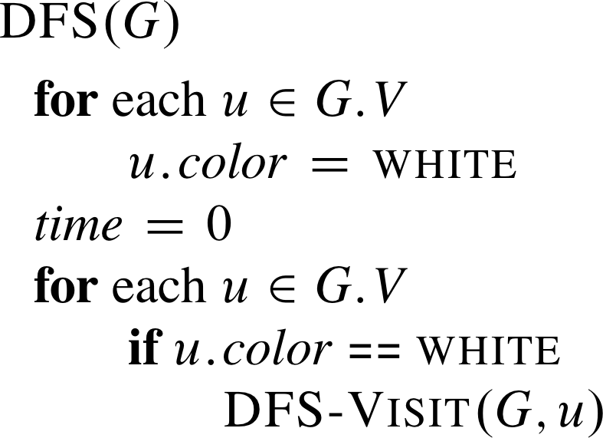
DFS: Algorithm
.π = NIL
// no parent or predecessor initially
Each time DFS-Visit(G, u) is called here, u becomes the
root of a new depth first tree in the depth first forest.

Slide 25
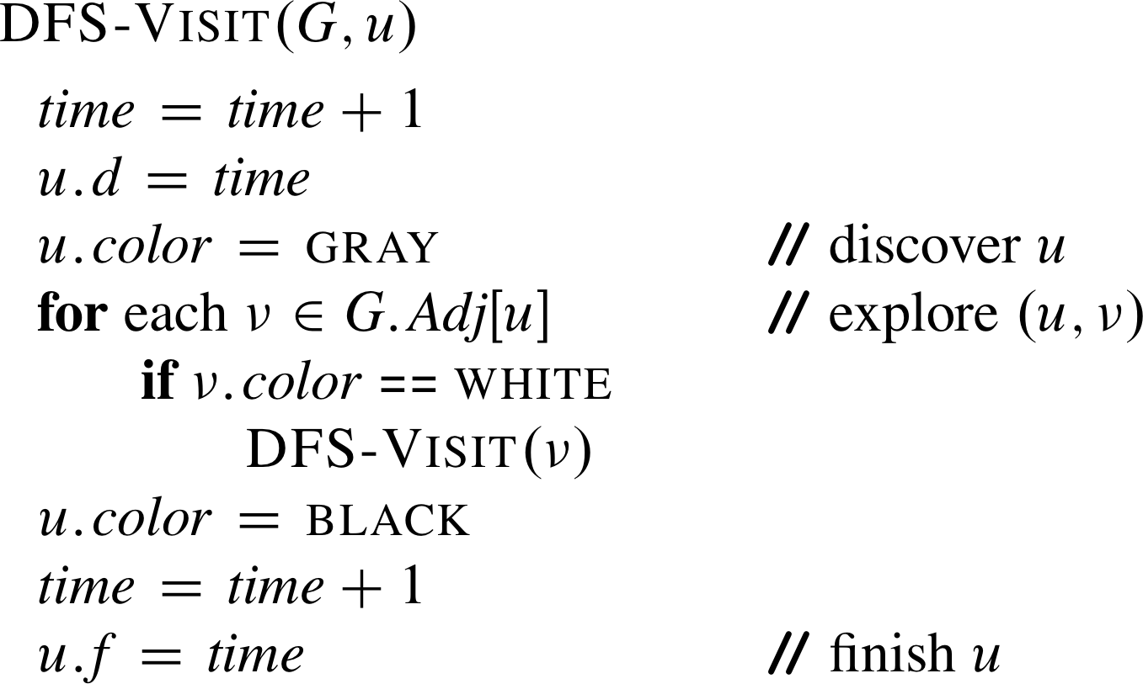
Procedure DFS-Visit(u)
π =
// create an edge for the current DF tree

Slide 26
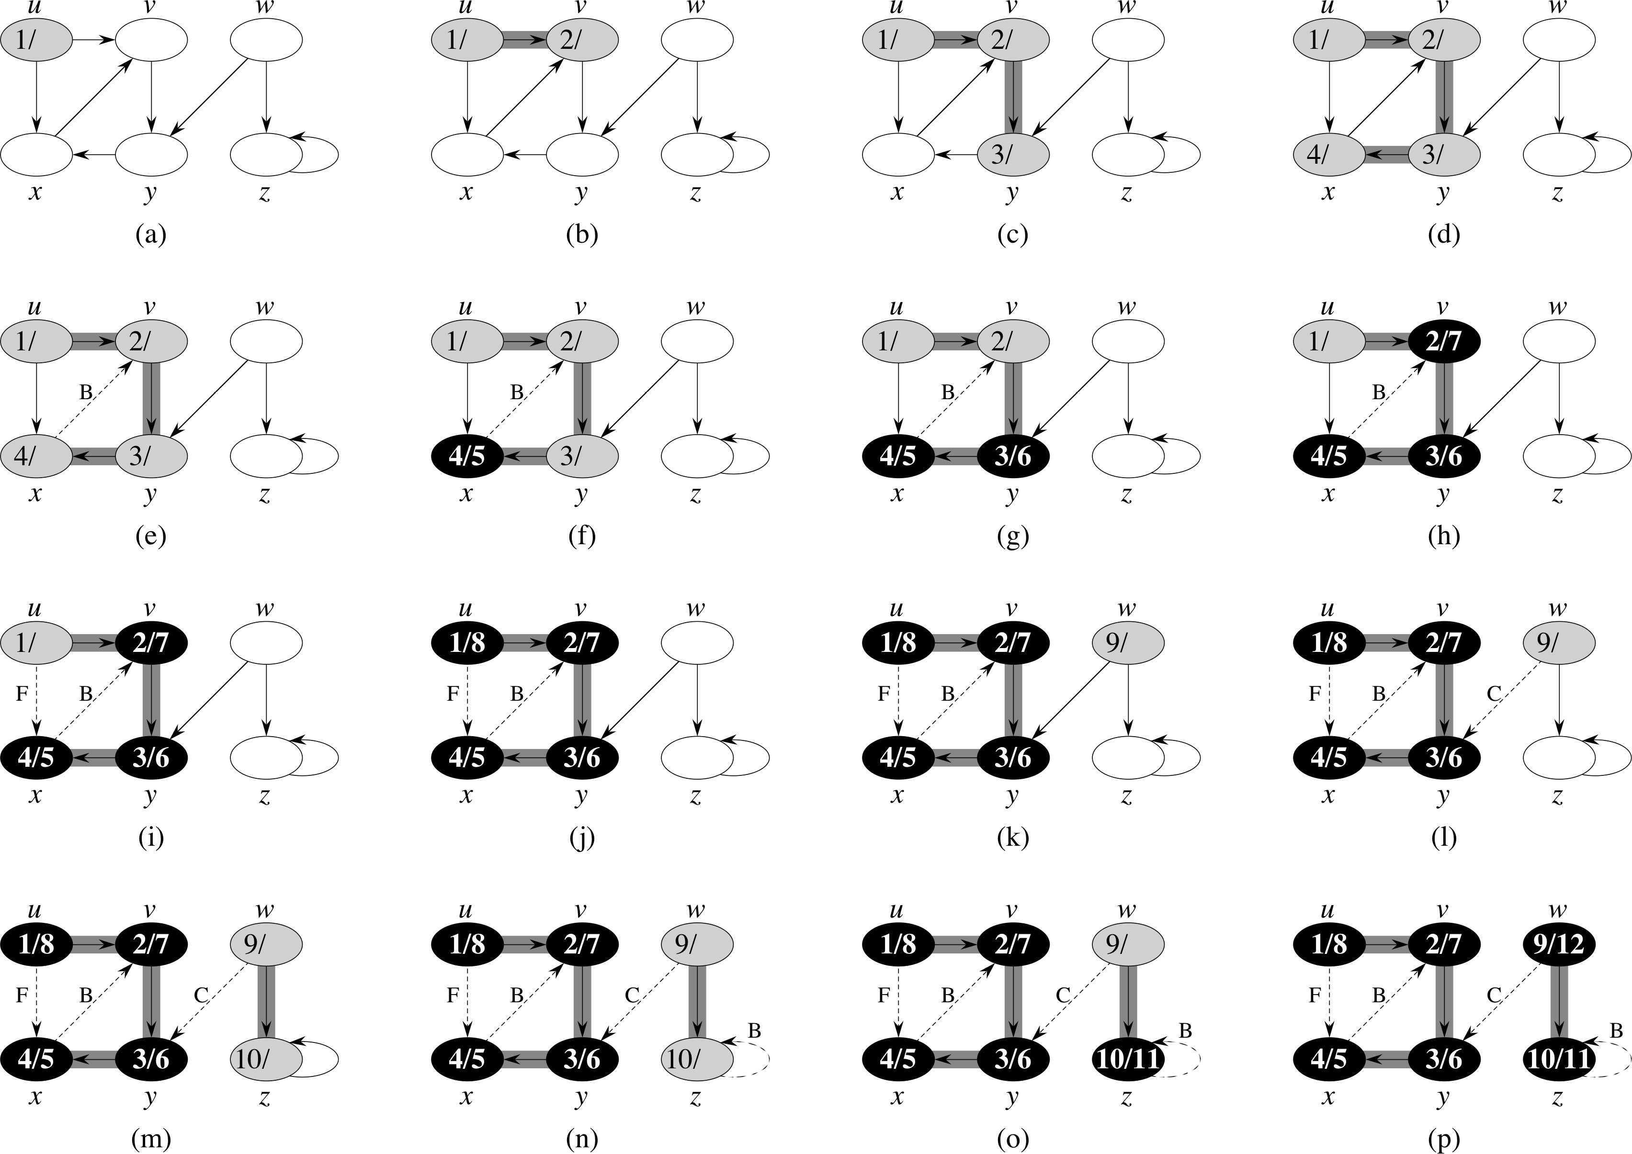
DFS: Example (1)

Slide 27
DFS: Example (2)

Slide 28
DFS: Example (3)

Slide 29
DFS: Example (4)

Slide 30
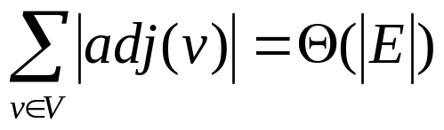
DFS: Analysis
DFS is Θ(|V |) (excluding the time
taken by the DFS-Visit).
DFS-Visit is called once for each
node v and its for loop is executed
|adj(v)| times. The DFS-Visit calls
for all the adjacent nodes take
time.
➔ Worst case running time is
Θ(|V |+| E |).
.π = NIL
π =

Slide 31
Depth-First Forest & Depth-First Trees
DFS produce a depth-first forest comprised of depth-first trees.
Each depth-first tree is made of edges (u, v) such that u is gray and v is white when (u, v) is explored.
  See the DFS example.

Slide 32
DFS: Classification of Edges (1)
Tree edges – edges belonging to the depth-first forest.
Back edges – non-tree edges from a node to an ancestor in a depth first tree.
  See the edges labeled B in the previous slide.
Forward edges – non-tree edges from a node to a descendant in a depth first tree.
  See the edge labeled F in the previous slide.
Cross edges – the rest of the edges
  See the edge labeled C in the previous slide.

Slide 33
DFS: Classification of Edges (2)
The type of some edges can be determined when the edges are encountered during DFS.
When edge (u, v) is first explored, the color of node v determines the type of (u, v):
  It’s a tree edge if v is white.
  It’s a back edge if v is gray.
  It’s a forward or cross edge if v is black.

Slide 34
DFS: Classification of Edges (3)
Note that for an undirected graph, edge (u, v) is the same as edge (v, u).
In this case, we classify the edge according to whichever of (u, v) or (v, u) is first encountered by DFS.
Theorem 1: When a graph is undirected, its edges are either tree edges or back edges.
Example: Treat the graph below as an undirected graph.
Edge (x, u) would be encountered
before (u, x), making the edge a
back edge.
Edge (y, w) would be encountered
before (w, y), making the edge a
tree edge.

Slide 35
DFS: Applications (1)
Is undirected graph G connected?
  Change DFS to call DFS-Visit(G, v) only once, and then to check if there are still white nodes. If no white nodes left, G is connected; otherwise, it is not connected.
  Running time: O(|V | + | E |)
Find connected components.
  Call DFS. The nodes discovered in each call to DFS-Visit(G, v) belong to a single connected component.
  Running time: Θ(|V | + | E |)

Slide 36
DFS: Applications (2)
Does a directed graph G contain a directed cycle?
  Do DFS. If there are back edges, then yes; otherwise, no.
  Running time: O(|V | + | E |).
Does an undirected graph G contain a cycle?
  Same as directed graph.
  If G is a tree or a forest, it can have at most |V | – 1 edges.
  Running time is O(|V |) since encounter at most |V | edges before cycle is found.
Is an undirected graph G a tree?
  DFS with one call to DFS-Visit(G, v). If all vertices are reached and no back edges, then G is a tree. If |V | edges are encountered, then G is not a tree.
  Running time: O(|V |).

