Slide 1
Overview of IPC Approaches
Interprocess Communication
Examples of IPC Systems
Communication in Client-Server Systems
Unix IPC
  First: overview with some code to provide the flavor and make concepts concrete
  Coming soon: labs and assignments using various Unix IPC facilities (pipes, shared memory, etc.)

Slide 2
Interprocess Communication
Processes within a system may be independent or cooperating
Cooperating process can affect or be affected by other processes, including sharing data
Reasons for cooperating processes:
  Information sharing
  Computation speedup
  Modularity
  Convenience
Cooperating processes need interprocess communication (IPC)
Two models of IPC
  Shared memory
  Message passing

Slide 3
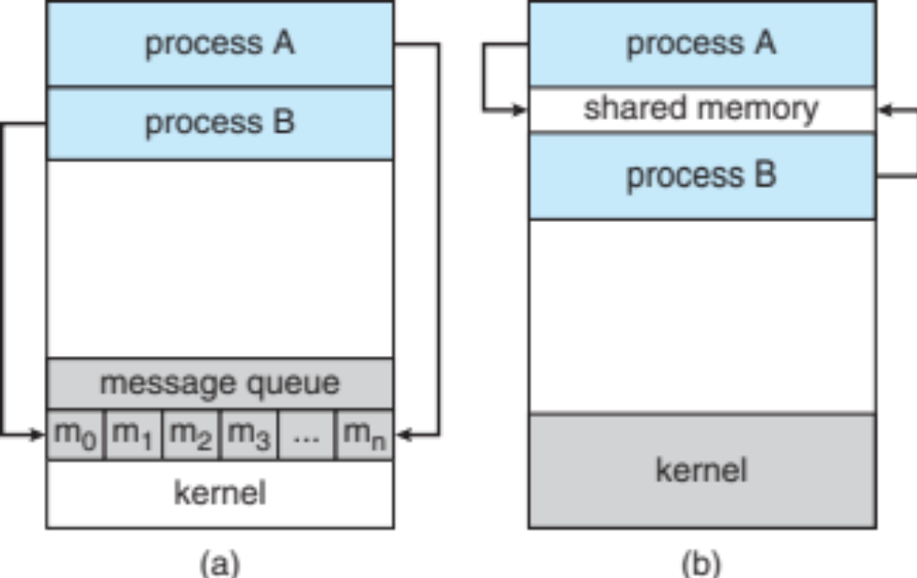
Communications Models

Slide 4
Cooperating Processes
Independent process cannot affect or be affected by the execution of another process
Cooperating process can affect or be affected by the execution of another process
Advantages of process cooperation
  Information sharing
  Computation speed-up
  Modularity
  Convenience

Slide 5
Producer-Consumer Problem
Paradigm for cooperating processes, producer process produces information that is consumed by a consumer process
  unbounded-buffer places no practical limit on the size of the buffer
  bounded-buffer assumes that there is a fixed buffer size

Slide 6
Bounded-Buffer – Shared-Memory Solution
Shared data
      #define BUFFER_SIZE 10
      typedef struct {
      . . .
      } item;
      item buffer[BUFFER_SIZE];
      int in = 0; // points to the next empty slot
      int out = 0; // points to next item to read out

Slide 7
Bounded-Buffer – Producer
item next_produced;
while (true) {
/* produce an item in next_produced */
while (((in + 1) % BUFFER SIZE) == out)
; /* do nothing */
buffer[in] = next_produced;
in = (in + 1) % BUFFER SIZE;
}

Slide 8
Bounded Buffer – Consumer
item next_consumed;
while (true) {
while (in == out)
; /* do nothing */
next_consumed = buffer[out];
out = (out + 1) % BUFFER SIZE;
/* consume the item in next consumed */
}

Slide 9
Message Passing
Mechanism for processes to communicate and to synchronize their actions
Message system
  processes communicate with each other without using shared variables
IPC facility provides two operations:
  send(message) – message size fixed or variable
  receive(message)

Slide 10
Message Passing
If P and Q wish to communicate, they need to:
  establish a communication link between them
  exchange messages via send/receive
Implementation of communication link
  physical (e.g., shared memory, hardware bus)
  logical (e.g., direct or indirect, synchronous or asynchronous, automatic or explicit buffering)

Slide 11
Implementation Questions
How are links established?
Can a link be associated with more than two processes?
How many links can there be between every pair of communicating processes?
What is the capacity of a link?
Is the size of a message that the link can accommodate fixed or variable?
Is a link unidirectional or bi-directional?

Slide 12
Direct Communication
Processes must name each other explicitly:
  send (P, message) – send a message to process P
  receive(Q, message) – receive a message from process Q
Properties of communication link
  Links are established automatically
  A link is associated with exactly one pair of communicating processes
  Between each pair there exists exactly one link
  The link may be unidirectional, but is usually bi-directional

Slide 13
Indirect Communication
Messages are directed to and received from mailboxes (also referred to as ports)
  Each mailbox has a unique id
  Processes can communicate only if they share a mailbox
Properties of communication link
  Link established only if processes share a common mailbox
  A link may be associated with many processes
  Each pair of processes may share several communication links
  Link may be unidirectional or bi-directional

Slide 14
Indirect Communication
Operations
  create a new mailbox
  send and receive messages through mailbox
  destroy a mailbox
Primitives are defined as:
send(A, message) – send a message to mailbox A
receive(A, message) – receive a message from mailbox A

Slide 15
Indirect Communication
Mailbox sharing
  P₁, P₂, and P₃ share mailbox A
  P₁, sends; P₂ and P₃ receive
  Who gets the message?
Solutions
  Allow a link to be associated with at most two processes
  Allow only one process at a time to execute a receive operation
  Allow the system to select arbitrarily the receiver. Sender is notified who the receiver was.

Slide 16
Synchronization
Message passing may be either blocking or non-blocking
Blocking is considered synchronous
  Blocking send has the sender block until the message is received
  Blocking receive has the receiver block until a message is available
Non-blocking is considered asynchronous
  Non-blocking send has the sender send the message and continue
  Non-blocking receive has the receiver receive a valid message or null

Slide 17
Synchronization (Cont.)
Different combinations possible
If both send and receive are blocking, we have a rendezvous
Producer-consumer becomes trivial
message next_produced;
while (true) {
/* produce an item in next_produced */
send(next_produced);
}
message next_consumed;
while (true) {
receive(next_consumed);
/* consume the item in next_consumed */
}

Slide 18
Buffering
Queue of messages attached to the link; implemented in one of three ways
  1. Zero capacity – 0 messages
  Sender must wait for receiver (rendezvous)
  2. Bounded capacity – finite length of n messages
  Sender must wait if link full
  3. Unbounded capacity – infinite length
  Sender never waits

Slide 19
Examples of IPC Systems - POSIX
POSIX Shared Memory
  Process first creates shared memory segment
  shm_fd = shm_open(name, O_CREAT | O_RDRW, 0666);
  Also used to open an existing segment to share it
  Set the size of the object
ftruncate(shm_fd, 4096);
  Memory map the shared memory object
  ptr = mmap(0, SIZE, PROT_WRITE, MAP_SHARED, shm_fd, 0);
  Now the process could write to the shared memory
  sprintf(ptr, ”String to be written into shared mem");

Slide 20
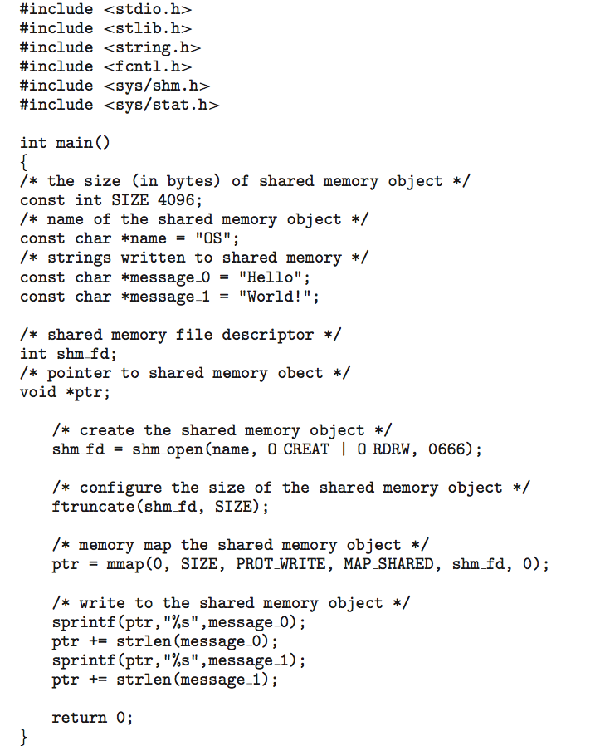
IPC POSIX Producer

Slide 21
IPC POSIX Producer

Slide 22
IPC POSIX Producer

Slide 23
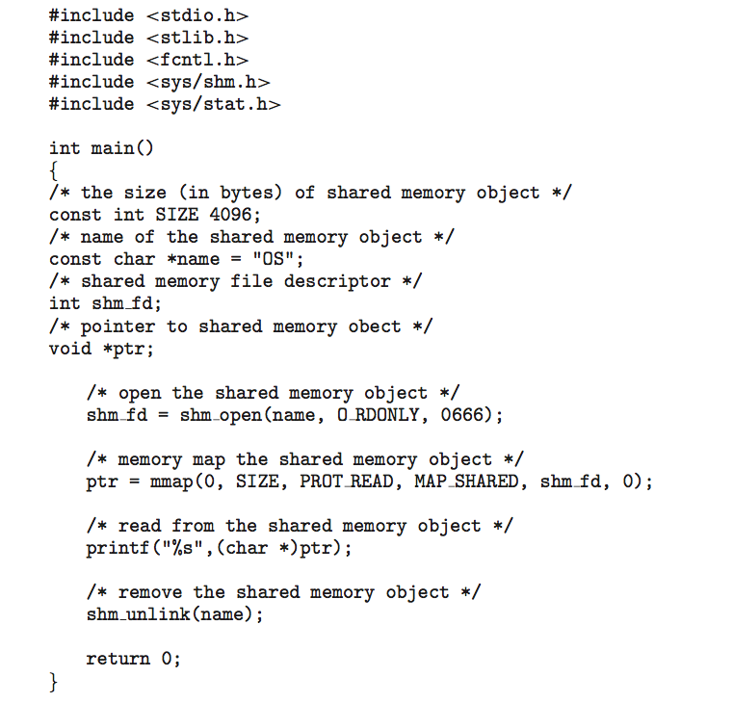
IPC POSIX Consumer

Slide 24
IPC POSIX Consumer

Slide 25
IPC POSIX Consumer

Slide 26
Communications in Client-Server Systems
Sockets
Remote Procedure Calls
Pipes

Slide 27
Sockets
A socket is defined as an endpoint for communication
Concatenation of IP address and port – a number included at start of message packet to differentiate network services on a host
The socket 161.25.19.8:1625 refers to port 1625 on host 161.25.19.8
Communication consists between a pair of sockets
All ports below 1024 are well known, used for standard services
Special IP address 127.0.0.1 (loopback) to refer to system on which process is running

Slide 28

Socket Communication

Slide 29

Sockets in Java
Three types of sockets
  Connection-oriented (TCP)
  Connectionless (UDP)
  MulticastSocket class– data can be sent to multiple recipients
Consider this “Date” server:

Slide 30
Remote Procedure Calls
Remote procedure call (RPC) abstracts procedure calls between processes on networked systems
  Again uses ports for service differentiation
Stubs – client-side proxy for the actual procedure on the server
The client-side stub locates the server and marshalls the parameters
The server-side stub receives this message, unpacks the marshalled parameters, and performs the procedure on the server
On Windows, stub code compile from specification written in Microsoft Interface Definition Language (MIDL)
Data representation handled via External Data Representation (XDL) format to account for different architectures
  Big-endian and little-endian
Remote communication has more failure scenarios than local
  Messages can be delivered exactly once rather than at most once
OS typically provides a rendezvous (or matchmaker) service to connect client and server

Slide 31

Execution of RPC

Slide 32
Pipes
Acts as a conduit allowing two processes to communicate
Issues
  Is communication unidirectional or bidirectional?
  In the case of two-way communication, is it half or full-duplex?
  Must there exist a relationship (i.e. parent-child) between the communicating processes?
  Can the pipes be used over a network?

Slide 33

Ordinary Pipes
Ordinary Pipes allow communication in standard producer-consumer style
Producer writes to one end (the write-end of the pipe)
Consumer reads from the other end (the read-end of the pipe)
Ordinary pipes are therefore unidirectional
Require parent-child relationship between communicating processes

Slide 34
Named Pipes
Named Pipes are more powerful than ordinary pipes
Communication is bidirectional
No parent-child relationship is necessary between the communicating processes
Several processes can use the named pipe for communication
Provided on both UNIX and Windows systems

