Slide 1
CS375
Design & Analysis of Algorithms
Spring 2016
Lecture 2
Lei Yu
Department of Computer Science
State University of New York at Binghamton
lyu@cs.binghamton.edu
www.cs.binghamton.edu/~lyu

Slide 2
Today’s Topics
Insertion sort
Loop invariant and algorithm correctness
Introduction to time complexity analysis

Slide 3
Insertion Sort (1)
The sorting problem
Input: A sequence of n numbers ⟨a₁, a₂, …, a_{n}⟩.
Output: A permutation (reordering) ⟨a'₁, a'₂, …, a'_{n}⟩ such that a'₁ ≤ a'₂ ≤ … ≤ a'_{n} .
Example:
Input: 5 2 4 6 1 3
Output: 1 2 3 4 5 6

Slide 4
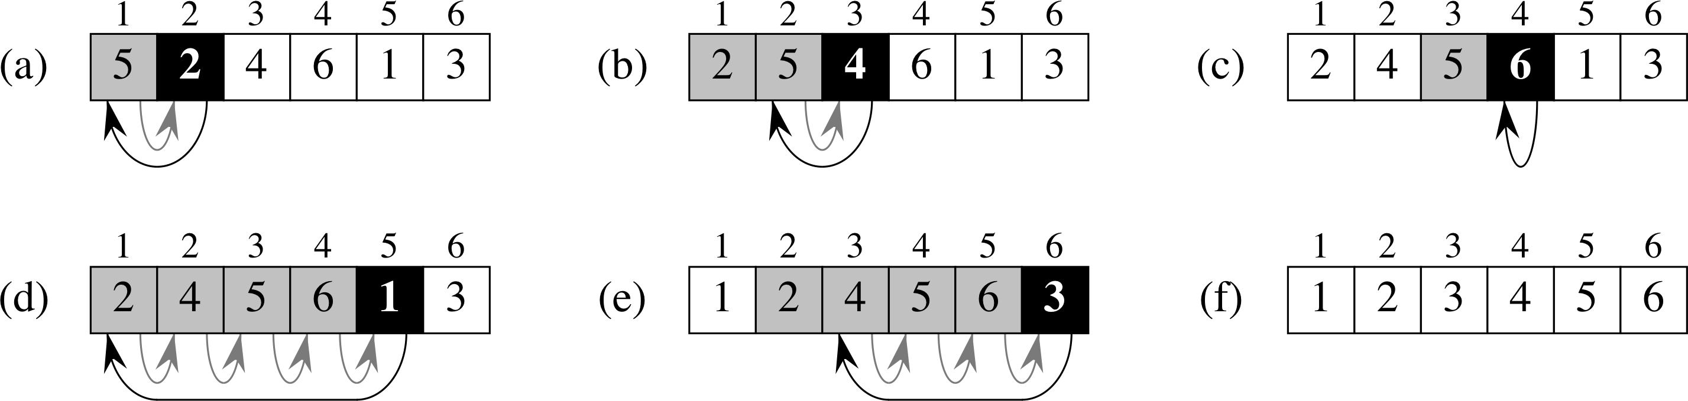
Insertion Sort (2)
Basic idea of the algorithm:
  Consider the input numbers one at a time.
  When the next number is considered, insert it into to the right position among all the numbers that have already been considered such that all processed numbers are sorted correctly.

Slide 5
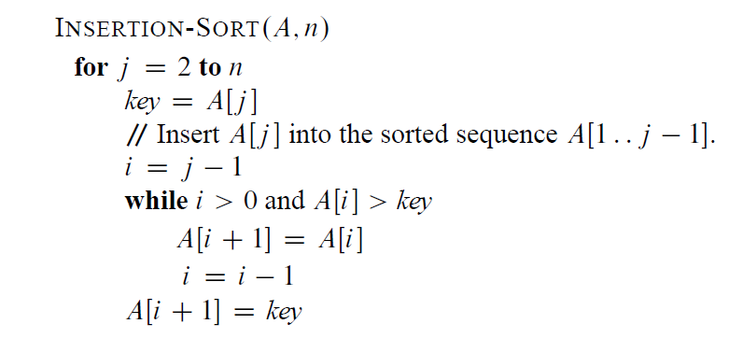
Insertion Sort (3)
Write the algorithm in pseudocode
We can also describe algorithms in English for easy understanding of the basic ideas.

Slide 6
Loop Invariant (1)
How to show that Insertion-Sort is correct?
For algorithm with loop, loop invariant is often the key for showing correctness.
For insertion-sort, the loop invariant is this property of A[1..j–1]: At the start of each iteration of the for loop, A[1..j–1] consists of elements originally in A[1..j–1], but sorted.
To use a loop invariant to prove correctness, we must show three things about it:
  Initialization: It is true prior to the first iteration of the loop.
  Maintenance: If it is true before an iteration of the loop, it remains true before the next iteration.
  Termination: When the loop terminates, the invariant gives us a useful property that helps show that the algorithm is correct.
Notes:
A loop variant is a property about the partial result obtained at each iteration.
Use factorial function as another example

Slide 7
Loop Invariant (2)
Using loop invariants is like mathematical induction:
To prove that a property holds, you prove a base case and an inductive step.
Showing that the invariant holds before the first iteration is like the base case.
Showing that the invariant holds from iteration to iteration is like the inductive step.
The termination part differs from the usual use of mathematical induction, in which the inductive step is used infinitely. We stop the “induction” when the loop terminates.

Slide 8
Loop Invariant (3)
For insertion sort
Initialization: Just before 1st iteration, j = 2. The subarray A[1..j–1] has a single element in A[1], which is trivially sorted.
Maintenance: To be precise, we would need to state and prove a loop invariant for the “inner” while loop. Rather than getting bogged down in another loop invariant, we instead note that the body of the inner while loop works by moving A[j–1], A[j–2], A[j–3], and so on, by one position to the right until the proper position for key (which has the value that started out in A[j]) is found. At that point, the value of key is placed into this position. Incrementing j preserves the loop invariant.
Termination: The outer for loop ends when j > n, which occurs when j = n + 1. Therefore, j – 1 = n. Plugging n in for j – 1 in the loop invariant, the subarray A[1..n] consists of the elements originally in A[1..n], but in sorted order. In other words, the entire array is sorted.

Slide 9
Analyzing Algorithms (1)
Analysis is performed based on some computational model.
We will adopt the uniprocessor Random-Access Machine (RAM) model:
No concurrent operations.
To simplify, we assume each of the following instructions takes a constant amount of time.
  Arithmetic: add, subtract, multiply, divide, remainder, floor, ceiling.
  Data movement: load, store, copy.
  Control: conditional/unconditional branch, subroutine call and return.

Slide 10
Analyzing Algorithms (2)
The running time of an algorithm heavily depends on the size of the input – it is the most important factor in our analysis.
Input size may be defined differently depending on the problem being studied.
  Usually, the number of items in the input. Like the size n of the array being sorted.
  But could be something else. If multiplying two integers, could be the total number of bits in the two integers.
  Could be described by more than one number. For example, graph algorithm running times are usually expressed in terms of the number of vertices and the number of edges in the input graph.
A given sorting algorithm may even take different amounts of time on two inputs of the same size.
  Example: Insertion sort takes less time to sort n elements when they are already sorted than when they are in reverse sorted order.

Slide 11
Analyzing Algorithms (3)
In our analysis, we define the running time or cost of an algorithm to be the number of primitive operations (steps) executed.
  Want to define steps to be machine-independent.
  Figure that each line of pseudocode requires a constant amount of time.
  One line may take a different amount of time than another, but each execution of line i takes the same amount of time c_{i} .
  This assumes that the line consists only of primitive operations.
    If the line is a subroutine call, then the actual call takes constant time, but the execution of the subroutine being called might not.
    If the line specifies operations other than primitive ones, then it might take more than constant time.
    Example: Sort the points by x-coordinate.

Slide 12
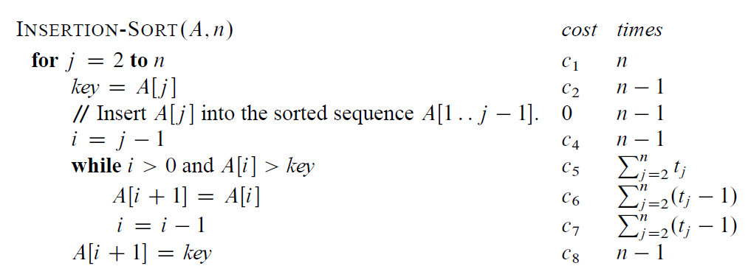
Analyzing Insertion-Sort (1)
Assume the i-th line takes time c_{i} , which is a constant.
For j = 2, 3, … n, let t_{j} be the number of times that the while loop test is executed for that value of j .
Note that when a for or while loop exits in the usual way—due to the test in the loop header—the test is executed one time more than the loop body.

Slide 13
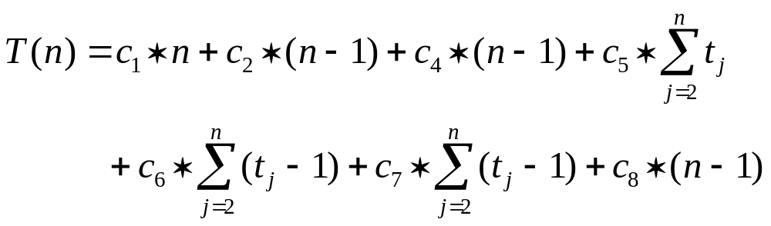
Analyzing Insertion-Sort (2)
The running time of the Insertion Sort algorithm is:
where Stmts is the set of statements of the algorithm.
Let T(n) = running time of Insertion-Sort with n elements.
  The running time depends on the values of t_{j} , which vary according to the input.
(F1)

Slide 14
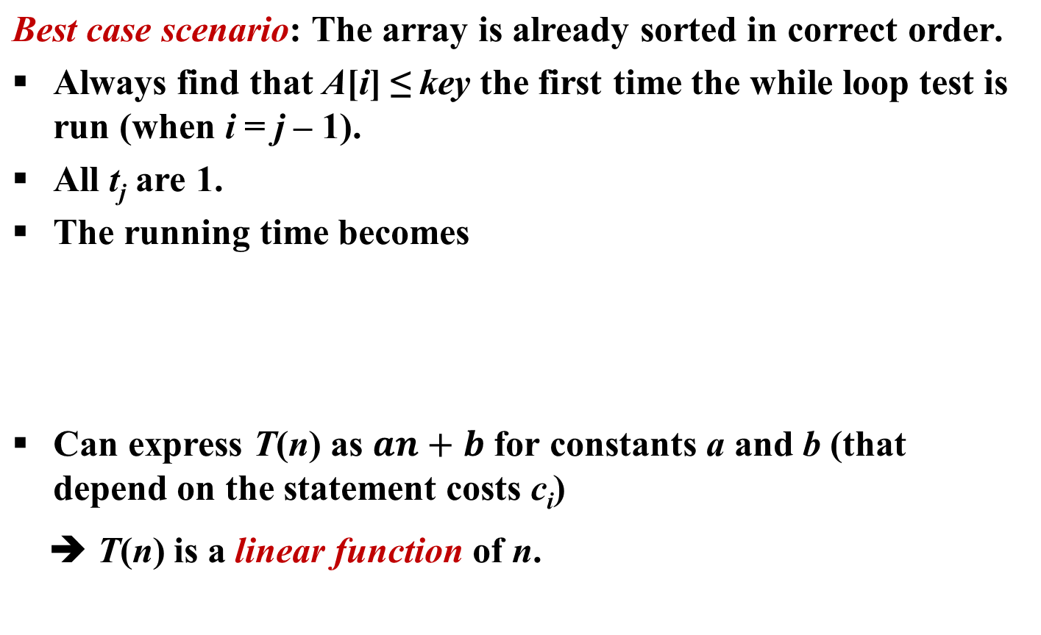
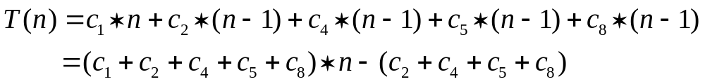
Analyzing Insertion-Sort (3)

Slide 15
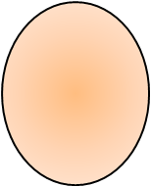
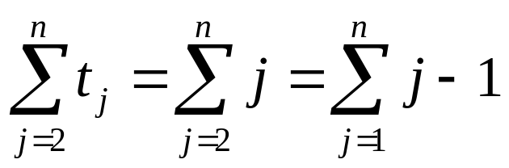
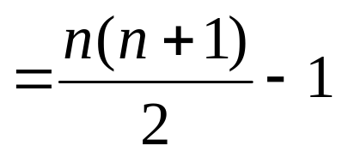
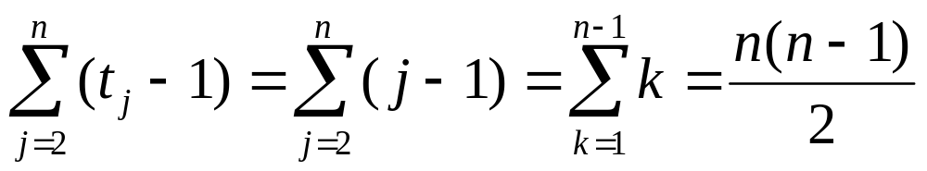
Analyzing Insertion-Sort (4)
Worst case scenario: The array is in reverse sorted order.
Always find that A[i] > key in while loop test.
Have to compare key with all elements to the left of the j-th position) ➔ compare with j – 1 elements.
Since the while loop exits because i reaches 0, there’s one additional test after the j – 1 tests) ➔ t_{j} = j .
Therefore
arithmetic series

Slide 16
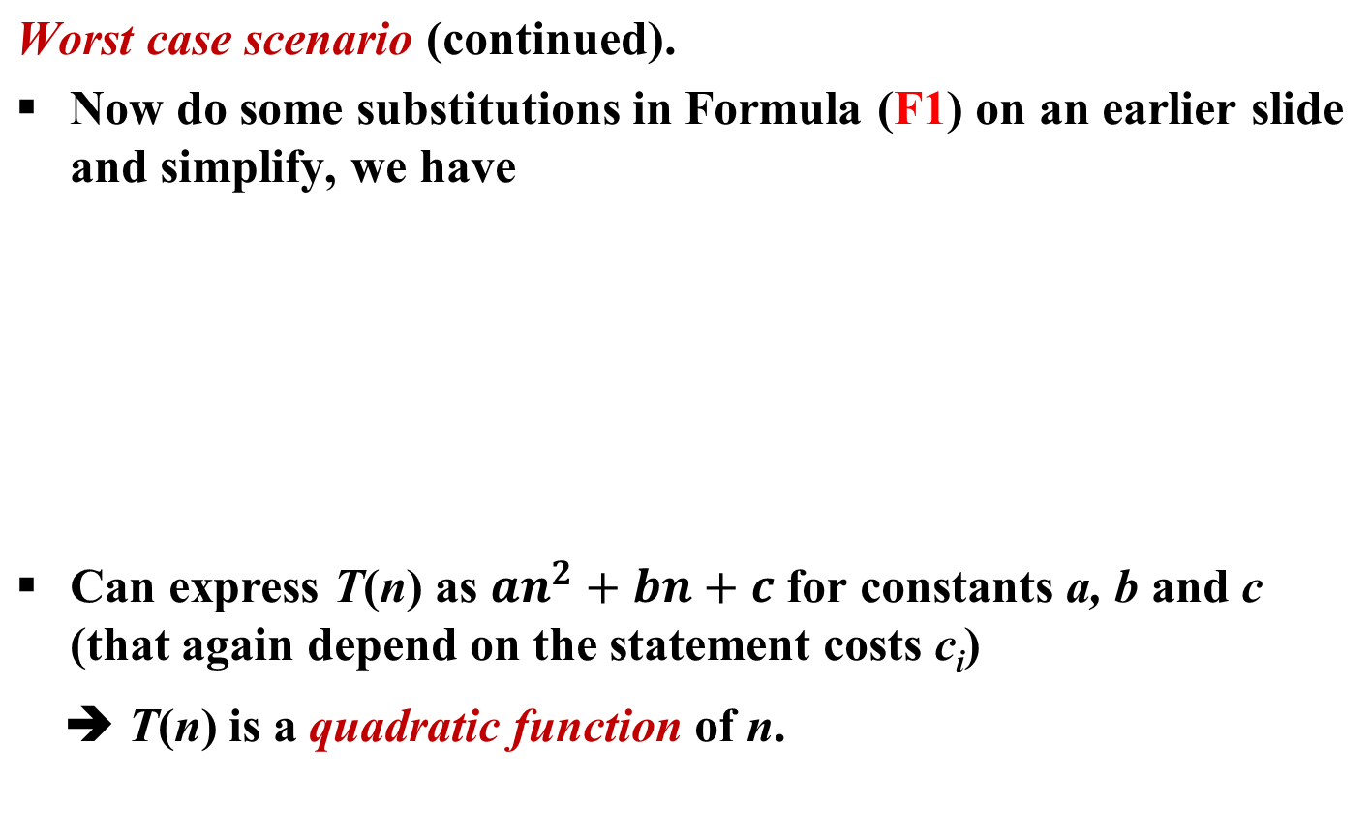
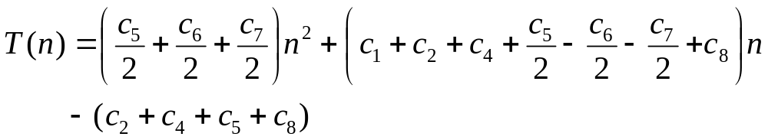
Analyzing Insertion-Sort (5)

Slide 17
Analyzing Insertion-Sort (6)
Worst-case analysis versus average-case analysis
We usually concentrate on finding the worst-case running time: the longest running time for any possible input of size n.
Why?
  The worst-case running time gives a guaranteed upper bound on the running time for any input instance.
  For some algorithms, the worst case occurs often. For example, when searching, the worst case often occurs when the item being searched for is not present.
  It is tricky to define an “average case”.
  The time complexity (in order of magnitude) of the average case is often the same as that of the worst case.
  Example: For Insertion-Sort, the running time for the average case scenario is still a quadratic function of n. Why?
Notes:
Use “search” as an example to explain “average case”.
Average case: One may assume that all possible input instances have the same probability to occur. But in practice, different instances often have different probabilities. For example, students’ GPA values do not have uniform distribution among the possible values in [0, 4].

Slide 18
Next Class
Growth function and asymptotic notations

