Slide 1
CS375
Design & Analysis of Algorithms
Spring 2016
Lecture 3
Lei Yu
Department of Computer Science
State University of New York at Binghamton
lyu@cs.binghamton.edu
www.cs.binghamton.edu/~lyu

Slide 2
Today’s Topics
Growth function
Asymptotic notations

Slide 3
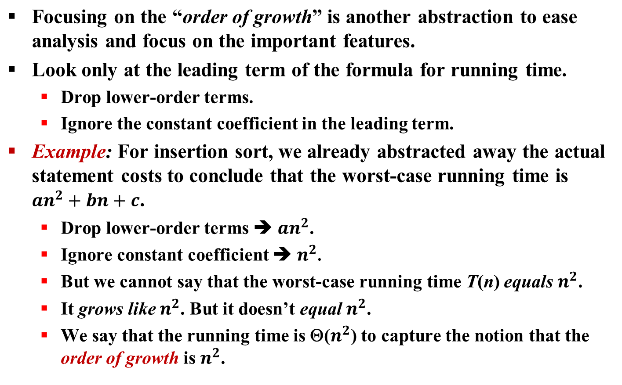
Order of Growth (1)

Slide 4
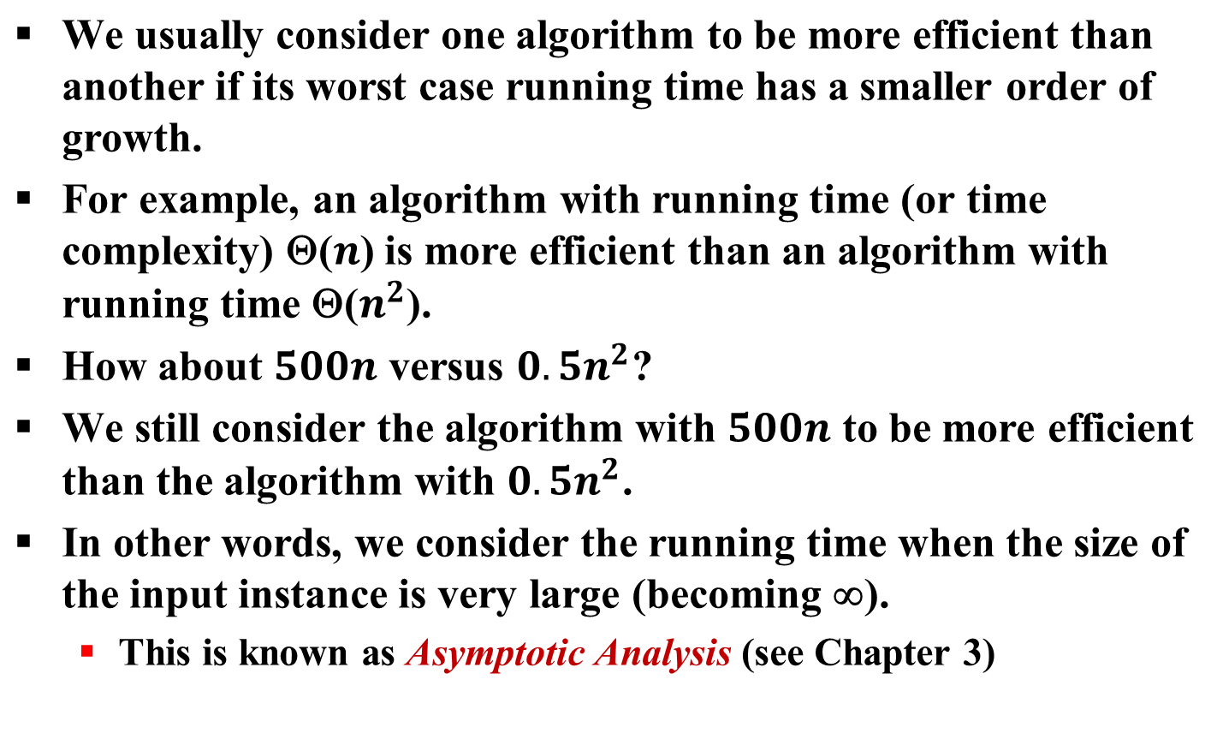
Order of Growth (2)
Not always based on worse case!
Notes:
Note: we usually compare algorithms by worst case, but worse case comparison also has limitations.
An algorithm could be superior in average than another, although the worst case time complexity is not superior. Example: Quick Sort than Insertion Sort
For some algorithms a worst case instance is very unlikely to occur in practice. Example: Quick Sort

Slide 5
Outline for Asymptotic Notations
Why do we need the different sets?
Definition of the sets O (Oh), Ω (Omega) and Θ (Theta), o (oh), ω (omega)
Classifying examples:
  Using the original definition
  Using limits
Properties of asymptotic notations

Slide 6
Why Asymptotic Notations?
Introduce a way to describe behavior of functions in the limit. We’re studying asymptotic efficiency.
Describe growth of functions.
Focus on what’s important by abstracting away low-order terms and constant factors.
Introduce asymptotic notations and use them to describe running times or complexities of algorithms and compare “sizes” of functions.

Slide 7
O-notation (big O) (1)
This notation is used to define a class of cost functions that can be asymptotically upper bounded by a given function.
The above statement can be more rigorously expressed below:
O(g(n)) = { f(n) : there exist positive constants c and n₀ such
that 0 ≤ f(n) ≤ cg(n) for all n ≥ n₀ }
  Example 1: 2n² ∈ O(n³), with c = 1 and n₀ = 2.
  Example 2: The following functions are all in O(n²):
  n², n² + n, n² + 1000n, 1000n² + 1000n, 5000n, 200n^{1.9}
For a given function g(n), O(g(n)) denotes a set of functions f(n)
such that after n becomes sufficiently large, f(n) is upper bounded
by g(n) subject to a constant factor.
Notes:
For example 1, another pair of c and n₀ is (2, 1). In general, qualified (c, n₀)’s are not unique. We just need to find one such pair, no need to find the “best” pair.
For 1000n² + 1000n, c = 2000 and n₀ = 1

Slide 8
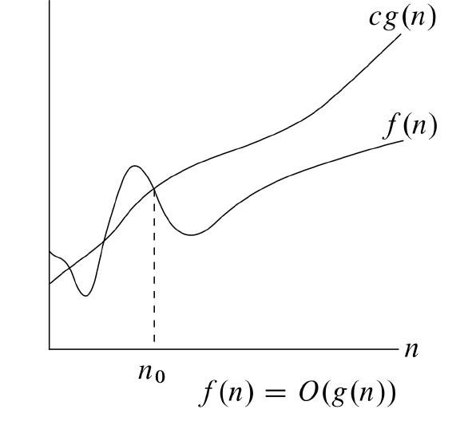
O-notation (big O) (2)
The relationship between g(n) and f(n), a function in O(g(n)), can be graphically illustrated by:
The big O notation is often used to find the cost function for the worst-case scenario.
Insertion sort is O(n²)
We sometimes just use f(n) = O(g(n)) to represent that f(n) ∈ O(g(n)).

Slide 9
O-notation (big O) (3)
How to determine the constants c and n₀?
In general, they can be found by solving inequalities.
  Inequalities often have multiple solutions.
  We just need to find “a” solution, not the “best” solution.
Example: We show that 2n² + 5n ∈ O(n²).
  To find c, we can create inequality 2n² + 5n ≤ cn², and then try to solve it for c and n ≥ 1.
  We can easily obtain: 2 + 5/n ≤ c
  There are many possible solutions: For n ≥ 1, the maximum of 2 + 5/n is 7. Thus c = 7 is sufficient. Of course, larger values of c would also work.
  Question: Would a smaller c work?
Notes:
c needs to be larger than 2. Any c larger than 2 works, just need a larger n₀. When c = 3, n₀ can be 5 or larger.

Slide 10
O-notation (big O) (4)
Show 5n+2 ∈O(n)
Proof: From the definition of big O, there must exist c>0 and integer n₀ >0 such that 0 ≤ 5n+2≤cn for all n≥ n₀ .
Dividing both sides of the inequality by n>0 we get:
0 ≤ 5+2/n≤c.
2/n ≤ 2, 2/n>0 becomes smaller when n increases
There are many choices here for c and n₀.
Notes:
c needs to be larger than 2. Any c larger than 2 works, just need a larger n₀. When c = 3, n₀ can be 5 or larger.

Slide 11
O-notation (big O) (5)
Show 5n+2 ∈O(n) (continued)
If we choose n₀ =1 then 5+2/n≤ 5+2/1= 7. So any c ≥ 7. Choose c = 7.
If we choose c=6, then 0 ≤ 5+2/n≤6. So any n₀ ≥ 2. Choose n₀ = 2.
In either case (we only need one!) we have c>0 and n₀ >0 such that 0 ≤ 5n+2≤cn for all n ≥ n₀ . So the definition is satisfied and
5n+2 ∈O(n)
Notes:
n^2<=cn for all n>=n0.
Let n0>0
Divide by n. We get n<c for all n>=n0, so also for n>c
We get a contradiction n<c and n>c
What do we call such a proof?

Slide 12
O-notation (big O) (6)
Example: Show that n³ – 1000n² is not in O(n²).
We want to show that we cannot find constants c and n₀ that can make n³ – 1000n² ≤ cn² hold for all n ≥ n₀.
We can use contradiction to draw the conclusion.
If n³ – 1000n² ≤ cn² is true, then c ≥ n – 1000 must be true.
Clearly, it is not possible to find a “constant” c that can keep c ≥ n – 1000 hold for all n no matter what n₀ is. In fact, no matter how large c is, if it is a constant, we can always find an n that is larger than c + 1000.
  ➔ n³ – 1000n² is not in O(n²)

Slide 13
O-notation (big O) (7)
Exercises: Is each of the following relationship true or false? Why or why not?
1000000n² ∈ O(n²)
(n – 1)n / 2 ∈ O(n²)
n / 2 ∈ O(n²)
n² ∈ O(n)
lg n² ∈ O(lg n)
lg²n ∈ O(lg n)
Notes:
Answer: true, true, true, false, true, false

Slide 14
Ω-notation (big Ω) (1)
This notation is used to define a class of cost functions that can be asymptotically lower bounded by a given function.
The above statement can be more rigorously expressed below:
Ω(g(n)) = { f(n) : there exist positive constants c and n₀ such
that 0 ≤ cg(n) ≤ f(n) for all n ≥ n₀ }
Example: The following functions are all in Ω(n²):
n², 1000n² + 1000n, 1000n² – 1000n, n³, 200n^{2.1}
For a given function g(n), Ω(g(n)) denotes a set of functions f(n)
such that after n becomes sufficiently large, f(n) is lower bounded
by g(n) subject to a constant factor.

Slide 15
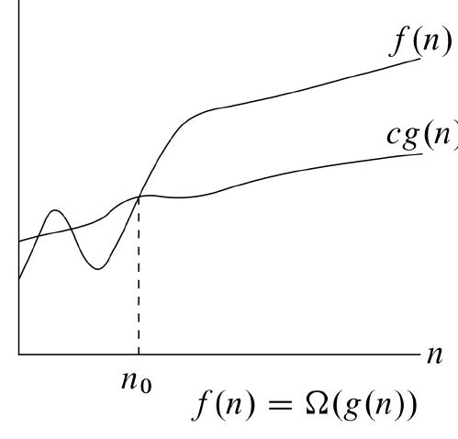
Ω-notation (big Ω) (2)
Ω -notation (continued)
The relationship between g(n) and f(n), a function in Ω(g(n)), can be graphically illustrated by:
Ω notation can be used to denote the best-case running time.
What is the running time of insertion-sort?
  It is both Ω(n) and O(n²).
)

Slide 16
Ω-notation (big Ω) (3)
Show 5n-20∈ Ω (n)
Proof: From the definition of big Ω, there must exist c>0 and integer n₀ >0 such that 0 ≤ cn ≤ 5n-20 for all n≥ n₀
Dividing the inequality by n>0 we get: 0 ≤ c ≤ 5-20/n for all n≥ n₀.
20/n ≤ 20, and 20/n becomes smaller as n grows.
There are many choices here for c and n₀.
Since c > 0, 5 – 20/n >0 and n₀ >4
  If we choose n₀ =5, then 1 ≤ 5-20/5 ≤ 5-20/n. So 0 < c ≤ 1. Choose c = ½.
  If we choose c=4, then 5 – 20/n ≥ 4 and n₀ ≥ 20. Choose n₀ = 20.
In either case (we only need one!) we have a c>o and n₀ >0 such that 0 ≤ cn ≤ 5n-20 for all n ≥ n₀. So the definition is satisfied and 5n-20 ∈ Ω (n)

Slide 17
Ω-notation (big Ω) (4)
Exercises: Is each of the following relationship true or false?
Why or why not?
1000000n² ∈ Ω(n²)
(n – 1)n / 2 ∈ Ω(n²)
n / 2 ∈ Ω(n²)
lg n² ∈ Ω(lg n)
lg²n ∈ Ω(lg n)
n² ∈ Ω(n)
Notes:
Answer: true. True, false, true, true, true

Slide 18
Next Class
Θ-notation (Theta)
o-notation (little o)
ω-notation (little ω)
Classifying examples using limits
Properties of asymptotic notations

