Slide 1
CS375
Design & Analysis of Algorithms
Spring 2016
Lecture 11
Lei Yu
Department of Computer Science
State University of New York at Binghamton
lyu@cs.binghamton.edu
www.cs.binghamton.edu/~lyu

Slide 2
Outline
Another divide and conquer approach for sorting
Quicksort algorithm
Quicksort time complexity analysis

Slide 3
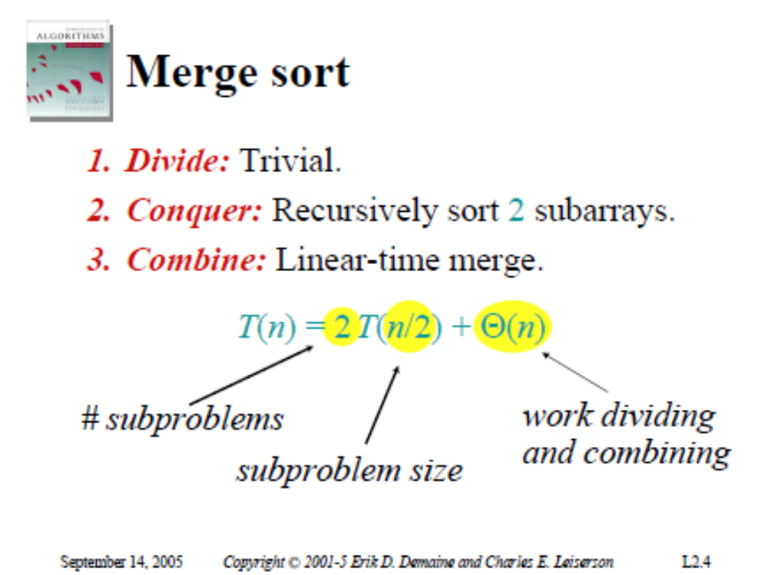
Notes:
Can we think of another design by divide and conquer?
Illustrating the logic of thoughts based on an example (use middle element as pivot and use an additional array to facilitate partition based on pivot
Analyze this basic approach

Slide 4
Quicksort: Main Idea
Quicksort is based on the divide-and-conquer approach.
To sort the subarray A[p .. r]:
  Divide: Partition A[p .. r] into two (possibly empty) subarrays A[p .. q – 1] and A[q + 1 .. r] such that each element in the first subarray A[p .. q – 1] is ≤ A[q] and A[q] is ≤ each element in the second subarray A[q + 1 .. r].
  Conquer: Sort the two subarrays by recursive calls to Quicksort.
  Combine: No work is needed to combine the subarrays, because they are sorted in place.
Perform the divide step by a procedure Partition, which returns the pivot index q that marks the position separating the subarrays.
Notes:
Same logic of thoughts as the previous illustration, just use the last element as pivot. The actual quicksort algorithm performs sorting in place in the partition procedure which makes the algorithm slightly more complicated to understand

Slide 5
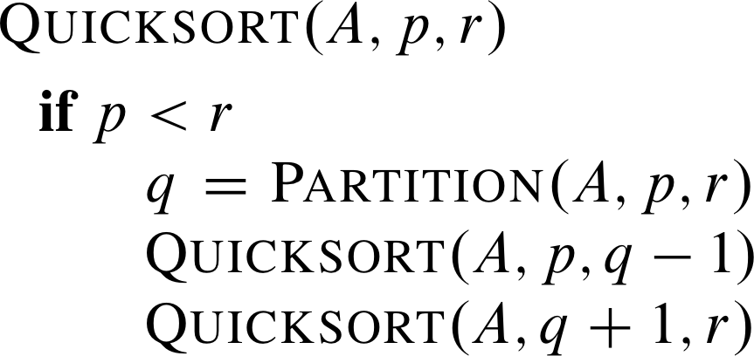
Quicksort: Pseudocode
The pseudocode of the main program
Initial call: Quicksort(A, 1, n).

Slide 6
Partition Procedure: Idea
Basic requirements:
  All elements to the left of pivot are ≤ pivot, and
  All elements to the right of pivot are ≥ pivot,
  pivot in correct place in sorted array.
Main idea for partition an array A[p .. r]:
  Select A[r] as the pivot element.
  Compare A[r] with A[j], j = p, p + 1, …, r – 1 in order.
    During the process, keep track of the left most element > A[r].
    If A[j] ≤ A[r] and no element on the left of A[j] is > A[r], keep A[j] where it is.
    If A[j] ≤ A[r] and there is an element e on the left of A[j] that is > A[r], exchange the positions of A[j] and e in the array.
  Exchange A[r] with the left most element that is > A[r].
Notes:
Illustrating a few cases to help understand the main idea
89765
67589
56897
89567

Slide 7
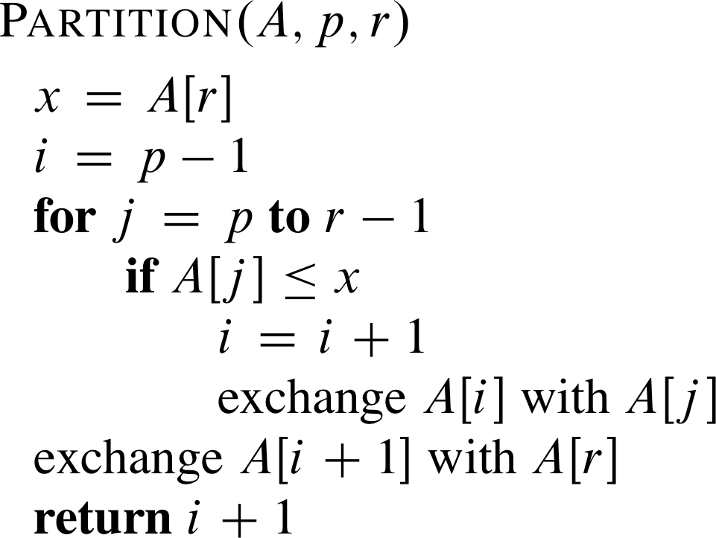
Partition Procedure: Algorithm
// A[p .. r] is an array
// index i is for tracking the potential left most element e > A[r].
// If e exists, it is located at A[i+1].
Running time for partitioning
an n-element subarray:
Θ(n).
// this is the pivot index
When “exchange A[i] with A[j]” happens, there are two cases:
  Case A: i = j. This keeps A[j] where it is. This happens when no element > A[r] is on the left of A[j].
  Case B: i < j. This happens when an element > A[r] is on the left of A[j]. The exchange moves A[i] to the right in the array.

Slide 8
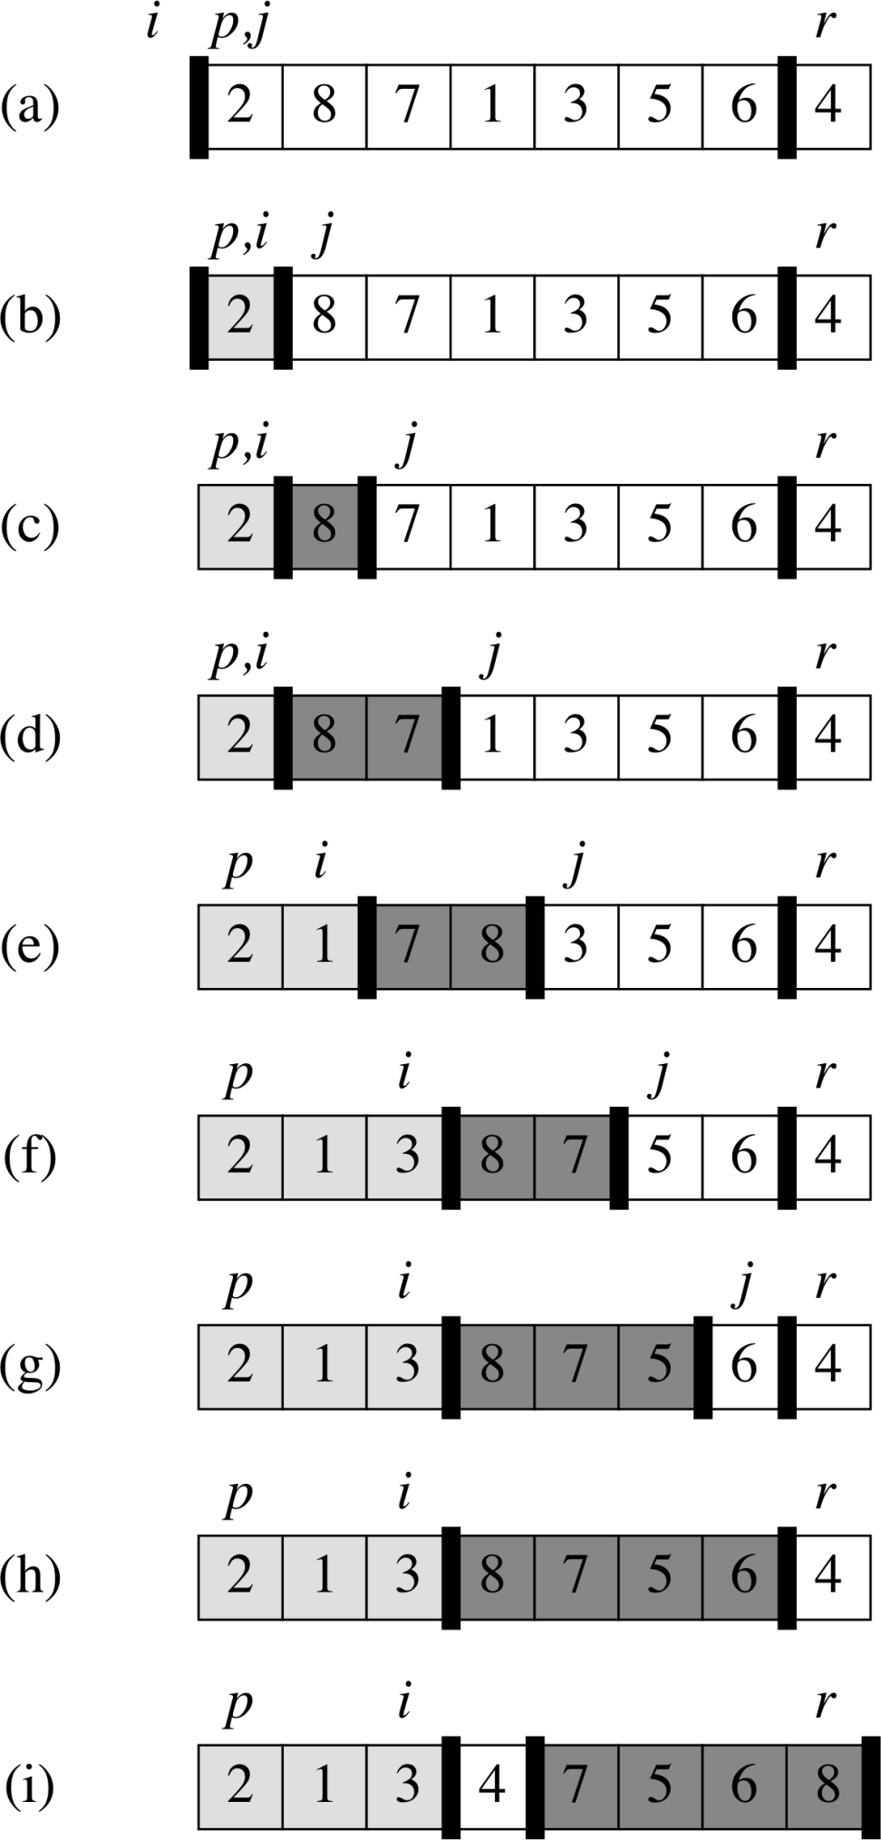
Partition Procedure: Example

Slide 9
Performance of Quicksort (1)
The running time of quicksort depends on the partitioning of the subarrays:
  If the subarrays are balanced (i.e., the pivot is the middle number in each partition), then Quicksort can run as fast as Merge-sort.
  If they are unbalanced, then Quicksort can run as slowly as Insertion-sort.
Best case:
  Occurs when the subarrays are completely balanced every time.
  Each subarray has ≤ n/2 elements.
  The recurrence: T(n) = 2T(n/2) + Θ(n) = Θ(n lg n).
Partition time

Slide 10
Performance of Quicksort (2)
WWorse case:
  Occurs when the subarrays are completely unbalanced.
  Have 0 elements in one subarray each time.
  What would be the recurrence look like?
  It is T(n) = T(n – 1) + T(0) + Θ(n).
    It can be solved using the iteration method.
  Same running time as Insertion-sort.
QQuestion: What input will lead to the worst case for Quicksort?
AAnswer: When the input array is already sorted!
  Note that when the input is correctly sorted, the Insertion-sort runs in O(n) time.
  T(n) = Θ(n²).

Slide 11
Performance of Quicksort (3)
BBalanced partitioning:
  Quicksort’s average running time is much closer to the best case than to the worst case.
  Imagine that Partition always produces a 9-to-1 split.
  In this case, the recurrence is
  T(n) = T(9n/10) + T(n/10) + Θ(n) = O(n lg n)
  Solution: See next slide.
  The “balance” requirement for “balanced partitioning” is very low.
    Even a 99-to-1 split will still produce a running time O(n lg n).

Slide 12
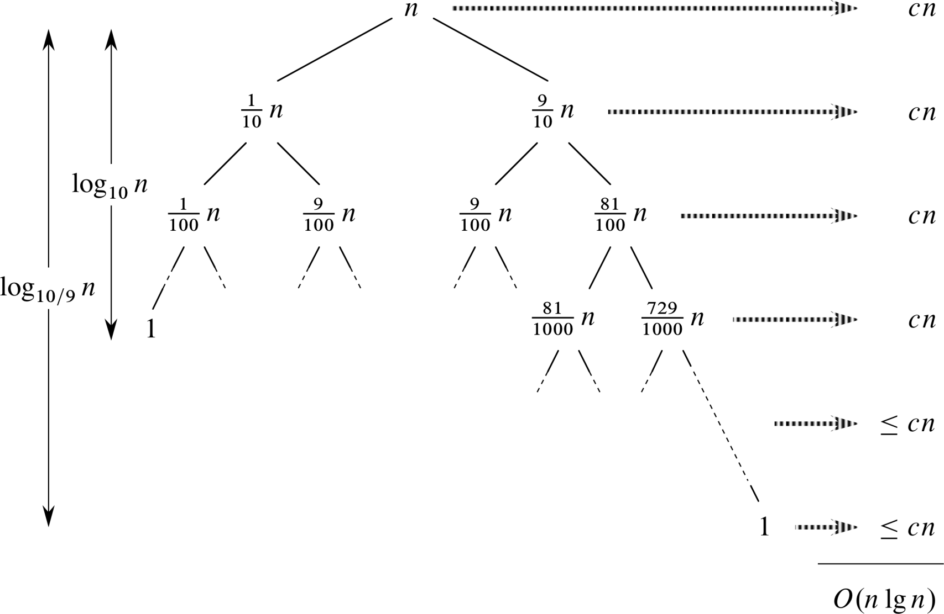
Performance of Quicksort (4)
  Solving T(n) = T(9n/10) + T(n/10) + cn = O(n lg n)
The shortest path terminates
when 10^{k} = n ➔ k = log₁₀n
The longest path terminates
when (10/9)^{k} = n ➔ k = log_{10/9}n

Slide 13
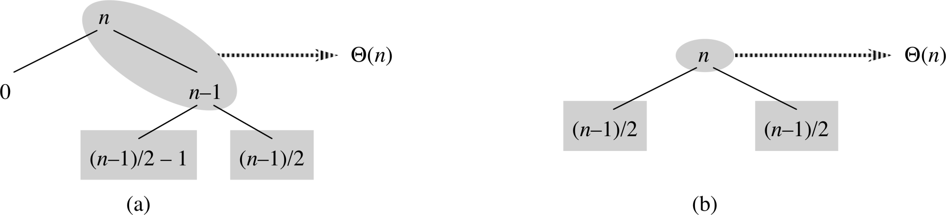
Performance of Quicksort (5)
AAverage case:
  Usually a mix of good and bad splits throughout the recursion tree.
  Consider the situation that levels alternate between best-case and worst-case splits.
  Two levels of splits of the mixed split case accomplish the same split result of one level of splits by the best-case.
  Still the same number of subarrays to sort, only twice as much work to get to that point ➔ a constant factor of difference, which can be absorbed by Θ ➔ both result in O(n lg n) time.
mixed case
best case

Slide 14
Summary of Quicksort Analysis
Worst-case running time: Θ(n²)
Expected and best-case running time: Θ(n lg n)
Constants hidden in Θ(n lg n) are small
Often faster than other Θ(n lg n) sorting algorithms in practice

Slide 15
Next Class
Additional discussion on Quicksort
Introduction to Dynamic Programming

