Slide 1
CS375
Design & Analysis of Algorithms
Spring 2016
Lecture 14
Lei Yu
Department of Computer Science
State University of New York at Binghamton
lyu@cs.binghamton.edu
www.cs.binghamton.edu/~lyu

Slide 2
Longest Common Subsequence Problem
Longest common subsequence (LCS) problem:
  Given two sequences X = < x₁, …, x_{m} > and Y = < y₁, …, y_{n} >, find the longest subsequence which occurs in both.
  Note that sequences here do not need to be consecutive.
  Example: For X = {A B C B D A B } and Y = {B D C A B A}
    Both {B C} and {A A} are subsequences of both X and Y.
    Question: What is the LCS?
    Answer: {B C A B}, {B C B A} and {B D A B}
    For example: X : {A B C B D A B }
    Y : { B D C A B A}
An important application of the LCS problem is matching DNA sequences in biology.

Slide 3
LCS: A Brute-force Solution
Brute-force algorithm: For every subsequence of X, check if it’s a subsequence of Y.
Question: How many subsequences are there in X?
Answer: 2^{m}
Question: What will be the running time of the brute-force algorithm?
Answer: Each check takes O(n) time, since we scan Y for first element, and then continue to scan for second element, etc.
➔ The worst case running time is: O(n2^{m}).

Slide 4
LCS: Dynamic Programming Solution
We now introduce a dynamic programming solution to the LSC problem.
We follow the 4-step methodology:
Step 1: Characterize the structure of an optimal solution.
Step 2: Define the recursive solution.
Step 3: Compute the values of an optimal solution.
Step 4: Construct an optimal solution from saved information.

Slide 5
Step 1: Characterize the Structure of LCS
The LCS problem has an optimal substructure property.
  The LCS of two sequences X and Y must have the LCS of any pair of prefixes of X and Y.
  Subproblems: Finding the LCS of pairs of prefixes of X and Y.
Given a sequence X = < x₁, …, x_{m} >, let X_{i} = <x₁, …, x_{i} > denote the ith prefix of X; X₀ is the empty sequence.
Theorem 1: Let Z = < z₁, …, z_{k} > be any LCS of X and Y.
If x_{m} = y_{n} , then z_{k} = x_{m} = y_{n} and Z_{k-1} is an LCS of X_{m-1} and Y_{n-1}.
If x_{m} ≠ y_{n} , then z_{k} ≠ x_{m} implies that Z is an LCS of X_{m-1} and Y.
If x_{m} ≠ y_{n} , then z_{k} ≠ y_{n} implies that Z is an LCS of X and Y_{n-1}.

Slide 6
Step 2: Define a Recursive Solution (1)
We first note the overlapping subproblems property in the LCS problem.
  To find an LCS of X and Y, we may need to find the LCSs of X and Y_{n-1} and of X_{m-1} and Y. Each of these subproblems has the subsubproblem of finding an LCS of X_{m-1} and Y_{n-1}.
The recursive solution needs to establish a recurrence for the value of an optimal solution.
The value for the LCS problem is the length of the LCS as the optimization problem is to find the longest CS.
  Later we will discuss how to utilize the solution to this problem to solve the LCS problem.
Let c[i, j] be the length of the LCS of X_{i} and Y_{j} .
  The length of the LCS of X and Y is c[m, n].

Slide 7
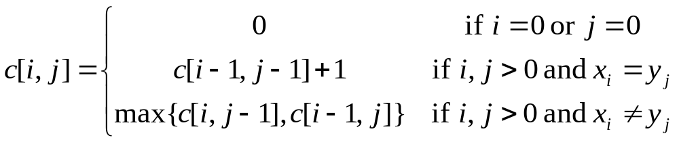
Step 2: Define a Recursive Solution (2)
Based on the optimal substructure established in Theorem 1, we can form the following recurrence equation for computing c[i, j]:
Notice how a new entry is computed from other entries: It determines in which order the table will be computed.
If x_{i} = y_{j}
If x_{i} ≠ y_{j}
c[i –1, j –1] | c[i – 1, j]
c[i , j – 1] | c[i , j] = c[i –1, j –1] + 1
c[i –1, j –1] | c[i – 1, j]
c[i , j – 1] | c[i , j] = max{c[i , j –1], c[i – 1, j]}

Slide 8
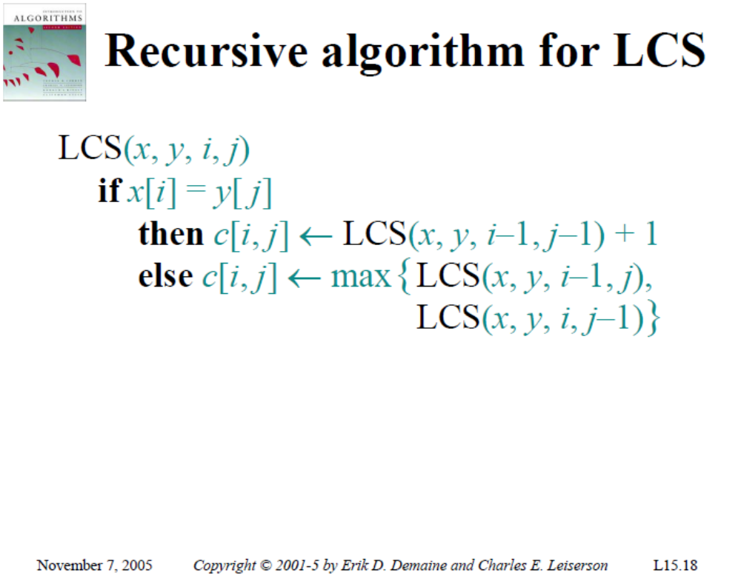
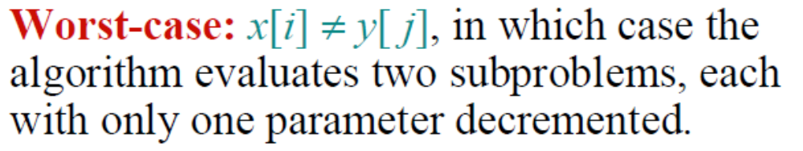

Slide 9
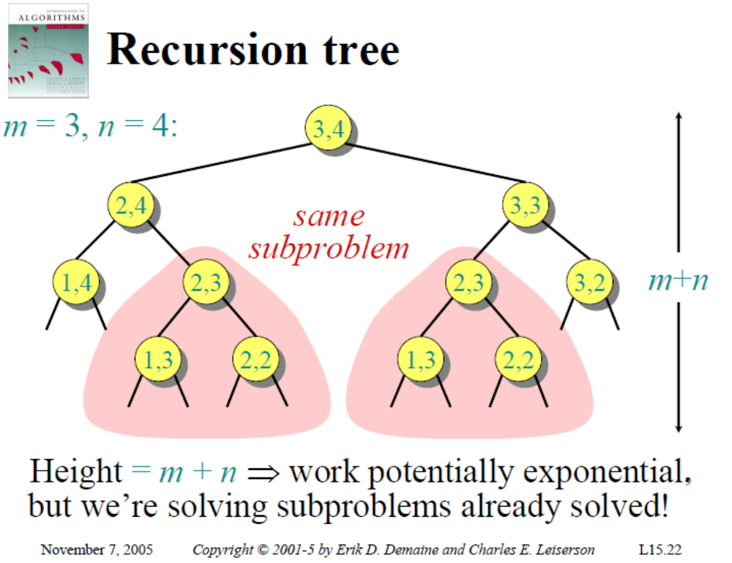

Slide 10
Step 3: Compute the Length of an LCS (1)
Having the recurrence equation by itself does not mean we automatically have a polynomial time solution.
A top-down recursive algorithm would incur exponential running time.
However, the number of distinct subproblems is only Θ(mn), i.e., there are only Θ(mn) different c[i, j]’s, 0 ≤ i ≤ m, 0 ≤ j ≤ n.
To take advantage of the small (polynomial) number of distinct subproblems, we use dynamic programming to compute the solutions bottom-up.
  Bottom-up means solving smaller problems first, not filling up the table bottom-up.

Slide 11
Step 3: Compute the Length of an LCS (2)
The dynamic programming solution stores the c[i, j] values in a table c[0 .. m, 0 .. n].
  It computes the entries and fills up the table one row at a time, from left to right (the order is determined by the recurrence).
  When the algorithm finishes, entry c[m, n] contains the length of an LCS of X and Y.
It also maintains another table b[1 .. m, 1 .. n] to help construct an optimal solution.
  b[i, j] points to the entry corresponding to the optimal subproblem solution chosen when computing c[i, j].

Slide 12
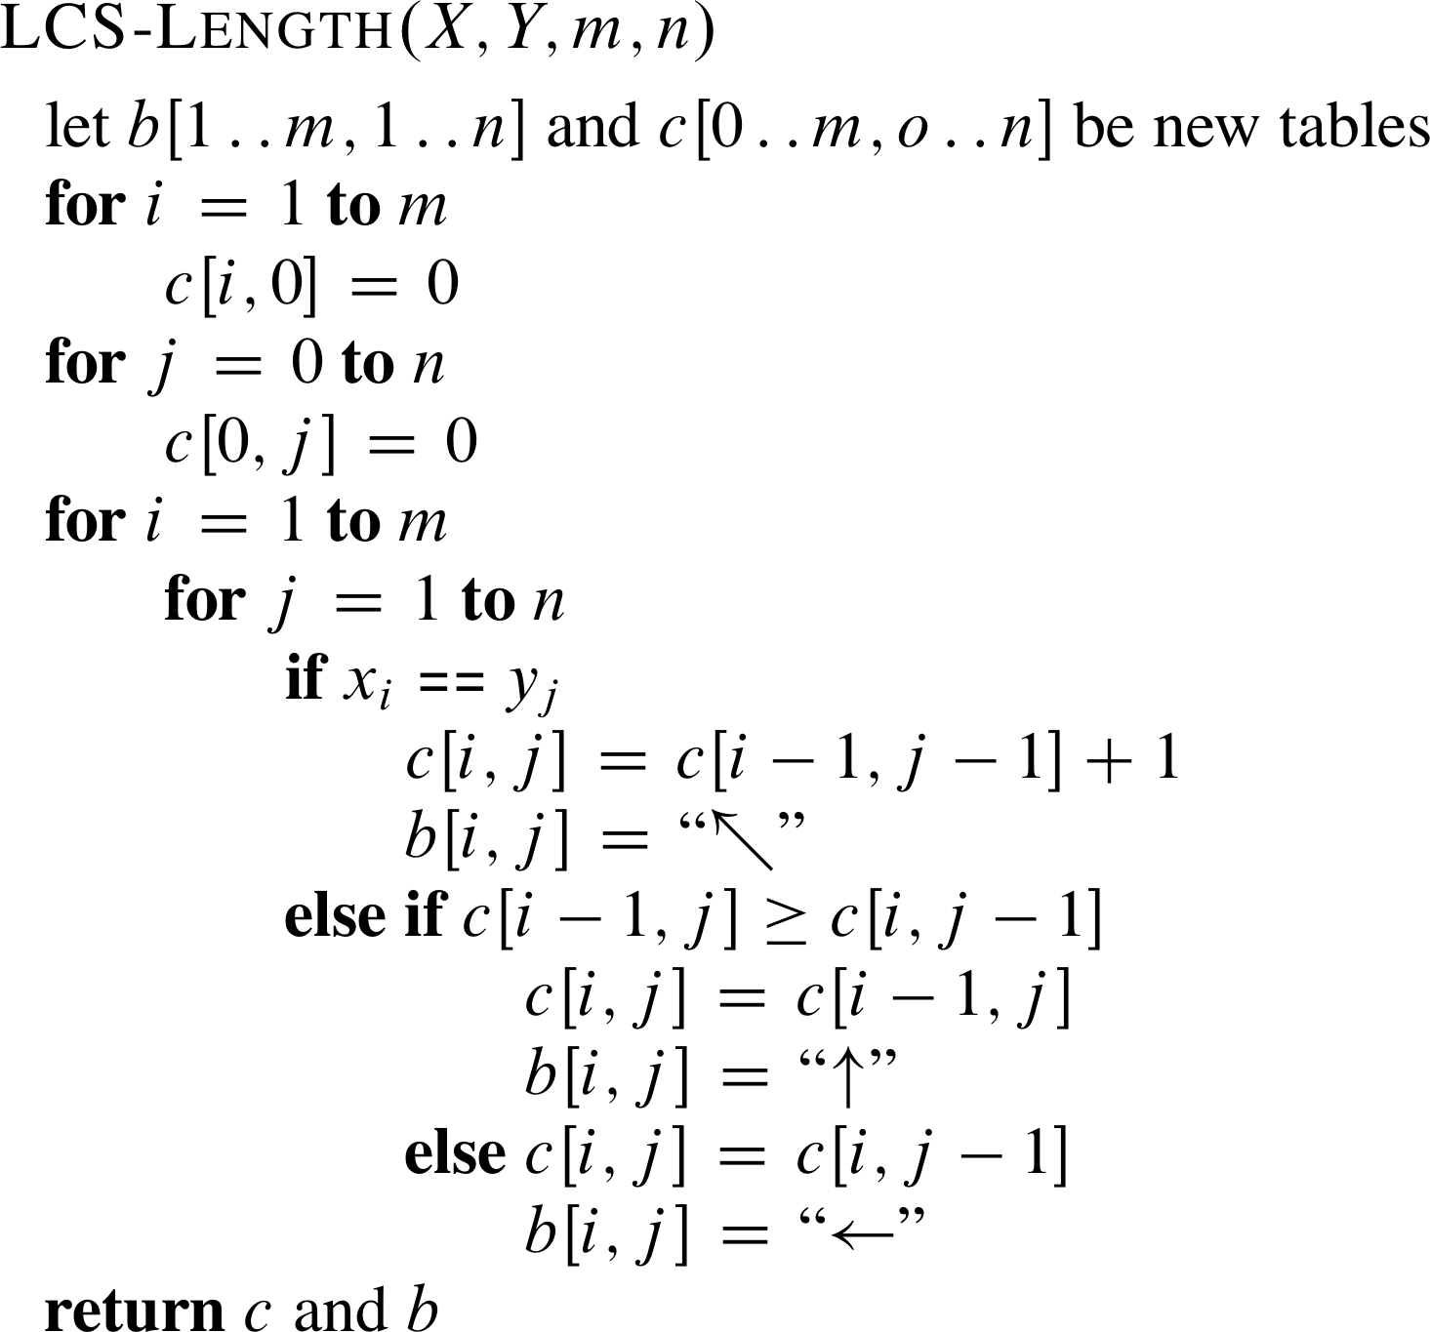
Step 3: Compute the Length of an LCS (3)
The running time of this procedure
is Θ(m×n) as each table entry takes
Θ(1) time to compute.
// indicating x_{i} = y_{j} is an element of LCS
// move to the row above
// move to the column on the left

Slide 13
LCS: Example 1 (1)
X = A B C B; m = |X| = 4. Y = B D C A B; n = |Y| = 5.
This is a combined c table and b table.
j 0 1 2 3 4 5
i
y_{j}
B
D
C
A
B
0
x_{i}
1
A
2
B
3
C
4
B

Slide 14
LCS: Example 1 (2)
Initialization: Make all c[i, 0] = c[0, j] = 0.
Entries in the c table are numbers.
j 0 1 2 3 4 5
i
y_{j}
B
D
C
A
B
0
x_{i}
0
0
0
0
0
0
1
A
0
2
B
0
3
C
0
4
B
0

Slide 15
LCS: Example 1 (3)
if ( x_{i} == y_{j} )
c[i, j] = c[i-1, j-1] + 1
else c[i, j] = max{ c[i-1, j], c[i, j-1] }
Computation process: start at c[1, 1], row by row from left to right
j 0 1 2 3 4 5
i
y_{j}
B
D
C
A
B
0
x_{i}
0
0
0
0
0
0
1
A
0
0
Black arrows indicate the solutions of which subproblems are used.
Red arrows are entries in b table.
2
B
0
3
C
0
4
B
0

Slide 16
LCS: Example 1 (4)
if ( x_{i} == y_{j} )
c[i, j] = c[i-1, j-1] + 1
else c[i, j] = max{ c[i-1, j], c[i, j-1] }
j 0 1 2 3 4 5
i
y_{j}
B
D
C
A
B
0
x_{i}
0
0
0
0
0
0
1
A
0
0
0
2
B
0
3
C
0
4
B
0

Slide 17
LCS: Example 1 (5)
if ( x_{i} == y_{j} )
c[i, j] = c[i-1, j-1] + 1
else c[i, j] = max{ c[i-1, j], c[i, j-1] }
j 0 1 2 3 4 5
i
y_{j}
B
D
C
A
B
0
x_{i}
0
0
0
0
0
0
1
A
0
0
0
0
2
B
0
3
C
0
4
B
0

Slide 18
LCS: Example 1 (6)
if ( x_{i} == y_{j} )
c[i, j] = c[i-1, j-1] + 1
else c[i, j] = max{ c[i-1, j], c[i, j-1] }
j 0 1 2 3 4 5
i
y_{j}
B
D
C
A
B
0
x_{i}
0
0
0
0
0
0
1
A
0
0
0
0
1
2
B
0
3
C
0
4
B
0

Slide 19
LCS: Example 1 (7)
if ( x_{i} == y_{j} )
c[i, j] = c[i-1, j-1] + 1
else c[i, j] = max{ c[i-1, j], c[i, j-1] }
j 0 1 2 3 4 5
i
y_{j}
B
D
C
A
B
0
x_{i}
0
0
0
0
0
0
1
A
0
0
0
0
1
1
2
B
0
3
C
0
4
B
0

Slide 20
LCS: Example 1 (8)
if ( x_{i} == y_{j} )
c[i, j] = c[i-1, j-1] + 1
else c[i, j] = max{ c[i-1, j], c[i, j-1] }
j 0 1 2 3 4 5
i
y_{j}
B
D
C
A
B
0
x_{i}
0
0
0
0
0
0
1
A
0
0
0
0
1
1
2
B
0
1
3
C
0
4
B
0

Slide 21
LCS: Example 1 (9)
if ( x_{i} == y_{j} )
c[i, j] = c[i-1, j-1] + 1
else c[i, j] = max{ c[i-1, j], c[i, j-1] }
j 0 1 2 3 4 5
i
y_{j}
B
D
C
A
B
0
x_{i}
0
0
0
0
0
0
1
A
0
0
0
0
1
1
2
B
0
1
1
1
1
3
C
0
4
B
0

Slide 22
LCS: Example 1 (10)
if ( x_{i} == y_{j} )
c[i, j] = c[i-1, j-1] + 1
else c[i, j] = max{ c[i-1, j], c[i, j-1] }
j 0 1 2 3 4 5
i
y_{j}
B
D
C
A
B
0
x_{i}
0
0
0
0
0
0
1
A
0
0
0
0
1
1
2
B
0
1
1
1
1
2
3
C
0
4
B
0

Slide 23
LCS: Example 1 (11)
if ( x_{i} == y_{j} )
c[i, j] = c[i-1, j-1] + 1
else c[i, j] = max{ c[i-1, j], c[i, j-1] }
j 0 1 2 3 4 5
i
y_{j}
B
D
C
A
B
0
x_{i}
0
0
0
0
0
0
1
A
The length of the LCS of X and Y is 3.
X: A B C B
Y: B D C A B
0
0
0
0
1
1
2
B
0
1
1
1
1
2
3
C
0
1
1
2
2
2
4
B
0
1
1
2
2
3

