Slide 1
CS375
Design & Analysis of Algorithms
Spring 2016
Lecture 16
Lei Yu
Department of Computer Science
State University of New York at Binghamton
lyu@cs.binghamton.edu
www.cs.binghamton.edu/~lyu

Slide 2
Fibonacci's Series
Recursive definition
  F(0) = 0,
  F(1) = 1,
  F(n) = F(n-1) + F(n-2) n>1
  0, 1, 1, 2, 3, 5, 8, 13, 21, …
Recursive code
  fib (n)
  1. if n < 2
  2. return n
  3. else return (fib (n -1) + fib(n -2))
Recursive time complexity function
  T(n)=T(n-1)+T(n-2)+ Θ(1) for n>1
  T(1)=T(0)= Θ(1)
How to solve this recurrence?

Slide 3
Recursion Tree
Fib(5)
+
  Exponential complexity, why?
        T(n) ∈O(2^{n}), T(n) ∈Ω(2^{n/2})
Fib(4)
+
Fib(3)
+
Fib(3)
+
Fib(2)
+
Fib(2)
+
Fib(1)
Fib(2)
+
Fib(1)
Fib(1)
Fib(0)
Fib(1)
Fib(0)
Fib(1)
Fib(0)
Notes:
T(n) ∈O(2^{n}), T(n) ∈Ω(2^{n/2})
T(n) ∈O(2^{n}), T(n) ∈Ω(2^{n/2})

Slide 4
Dynamic Programming Solution
Build a table with the first n Fibonacci numbers.
fib(n)
1. A[0] =0
2. A[1] = 1
3. for i ← 2 to n
4. do A[ i ] = A [i -1] + A[i -2 ]
5. return A
How many additions are needed?
What is the space requirements?
If we only need the nth number can we save space?

Slide 5
Memoization – Main Idea
Memoization is an alternative (top-down) approach to traditional (bottom-up) dynamic programming. It is used for recursive code that solves subproblems more than once.
The idea is to modify the recursive code, and use a table to store the solution for every subproblem that was already solved. So, the need to solve the same subproblem multiple times is avoided.
Logically equivalent to recursive calls, but recursive calls are replaced with table look-ups for more efficiency.

Slide 6
Memoization - Method
In this method, the recursive code is modified as follows:
  Step 1: An initialization function is added.
    It initializes a table with “impossible values” and then invokes the recursive function.
    This is the table where solution values will be stored.
  Step 2: The modified recursive function checks the table entry for the value of the solution needed by the subproblem for the call:
    If the table entry contains the “impossible value” the recursive code is used to solve problem and the modified code stores the value of the solution in the table.
    If the table entry contains a solution, the modified code returns the value of the solution without solving it again.

Slide 7
Fibonacci Example
Memoized version of recursive Fibonacci
MemoizedFib(n)
for (i=0; i<=n; i++)
A[i]=-1 //initialize the array
return LookupFib(n)
LookupFib(n) //compute fn if not yet done
if A[n]== -1 //initial value
if n<=1 //base case
A[n] = n //store solution
//solve and store a general case
else A[n] = (LookupFib(n-1)+LookupFib(n-2))
return A[n] //return f_{n} = A[n]
If A[n] <> -1, simply return
A[n] making no more
recursive calls!!!

Slide 8
Memoization vs. Dynamic Programming
Algorithms based on memorization and dynamic programming for the same problem usually have the same time complexity.
Dynamic programming outperforms memoization if every subproblem needs to be solved at least once as it avoids the usual overhead associated with recursion and it reduces the overhead of maintaining and accessing the table. (See LCS problem)
Memoization may perform better when the solution does not require every subproblem to be solved. It solves only subproblems that need to be solved. (See Knapsack problem)

Slide 9
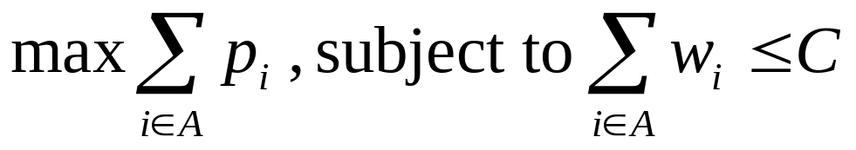
0/1 Knapsack Problem
Given
  a knapsack with integer weight capacity C > 0, and
  a set of n items with integer weights w_{i} > 0 and profits p_{i} > 0 for i = 1, …, n,
Find a subset of the items which does not exceed the weight capacity C of the knapsack and maximizes the profits
- to determine a subset A of { 1, 2, …, n } that satisfies the following:

Slide 10
Variations of Knapsack Problem
Fractions are allowed. This applies to items such as:
  bread, for which taking half a loaf makes sense
Integer values (no fractions)
  0/1 (1 green shirt…)
  0/any allows putting many items of same type in knapsack (5 pairs of socks, 10 gold bricks…)
  More than one knapsack, etc.
First 0/1 integer knapsack problem will be covered then fraction knapsack problem

Slide 11
0-1 Knapsack problem: Different Solutions
Brute-force solution (this class)
Dynamic programming solution (this and next classes)
Greedy solution (Friday’s class)
Backtracking and brand and bound solutions (later)

Slide 12
0/1 Knapsack Problem – Brute Force
Generate all 2^{n} subsets
Discard all subsets whose sum of the weights exceed C (not feasible)
Select maximum total profit of the remaining (feasible) subsets
What is the time complexity?
  O(n 2^{n}), Ω(2^{n})
Lets try the dynamic programming approach

Slide 13
Defining a Subproblem (1)
One possible way to define the subproblem is as follows:
If items are labeled 1 .. n, then a subproblem would be to find an optimal solution for S_{i} = {items labeled 1 .. i}.
This is a valid subproblem definition.
But can we describe the final solution ( S_{n} ) in terms of subproblems (S_{i})?
Unfortunately, we can’t do this as explained next.

Slide 14
Defining a Subproblem (2)
Suppose capacity C = 20.
Weight
Profit
The optimal solution for S₄ is:
Item #
w_{i}
p_{i}
w₁ =2
p₁ =3
w₂ =3
p₂ =4
w₃ =4
p₃ =5
w₄ =5
p₄ =8
1
2
3
2
3
4
S₄
Total weight: 14; total profit: 20
S₅
3
4
5
The optimal solution for S₅ is:
4
5
8
w₁ =2
p₁ =3
w₃ =4
p₃ =5
w₄ =5
p₄ =8
w₅ =9
p₅ =10
5
9
10
Solution for S₄ is not part of the solution for S₅!
Total weight: 20; total profit: 26
What if consider different choices of S₄ ?

Slide 15
Dynamic Programming Solution
We now introduce a dynamic programming solution to the 0/1 knapsack problem.
We again follow the 4-step methodology:
Step 1: Characterize the structure of an optimal solution.
Step 2: Define the recursive solution.
Step 3: Compute the value of an optimal solution.
Step 4: Construct an optimal solution.

Slide 16
Step 1: Structure of Optimal Solution
Assume S_{i} denote the subproblem in which only items labeled in {1, …, i } are considered, where i ≤ n, and the knapsack capacity available is c, where 0 ≤ c ≤ C.
  Let P[i, c] denote the maximum profit achieved for S_{i} when the capacity is c.
  Our goal is to compute the maximum profit for S_{n} when the capacity is C, i.e., we need to find out P[n, C] and the corresponding set of items included in the knapsack.

Slide 17
Optimal Substructure
Two cases for item_{n} when computing P[n, C]:
  1. w_{n} > C : In this case, an optimal solution for S_{n} with capacity C is the same as an optimal solution for a subproblem S_{n-1} with capacity C, and P[n, C] = P[n – 1, C].
  2. w_{n} ≤ C : In this case, an optimal solution for S_{n} with capacity C may or may not include item_{n}:
  if item_{n} is included, then the optimal solution for S_{n} with capacity C requires an optimal solution for a subproblem S_{n-1} with capacity C – w_{n} , and P[n, C] = P[n – 1, C – w_{n}] + p_{n} .
  if item_{n} is not included, then the optimal solution for S_{n} with capacity C is the same as an optimal solution for a subproblem S_{n-1} with capacity C, and P[n, C] = P[n – 1, C].
Overlapping subproblems: It is easy to see this, e.g., the subproblem S_{n-1} with capacity C is seen twice.

Slide 18
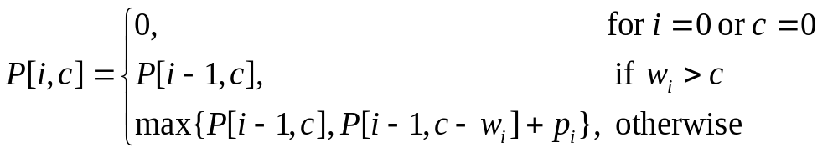
Step 2: Recursive Solution
Three cases when considering S_{i} with capacity c :
  1. There are no items (when i = 0) or the capacity c = 0: P[i, c] = 0.
  2. The weight of item_{i} exceeds the capacity c : item_{i} cannot be included in the knapsack: P[i, c] = P[i – 1, c].
  3. Otherwise, P[i, c] may be achieved by either not including item_{i} ( i.e., P[i, c] = P[i – 1, c]) or by including item_{i} (i.e., P[i, c] = P[i – 1, c – w_{i}] + p_{i} ).
Thus, the recurrence is:

